Slide 1
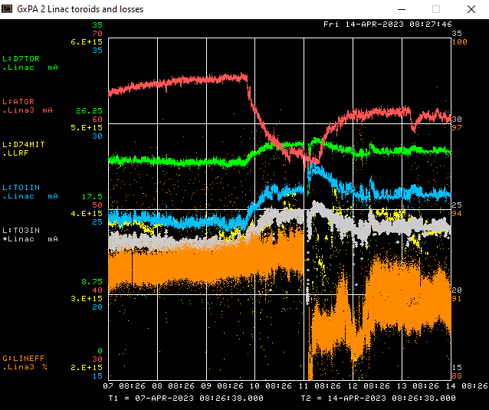
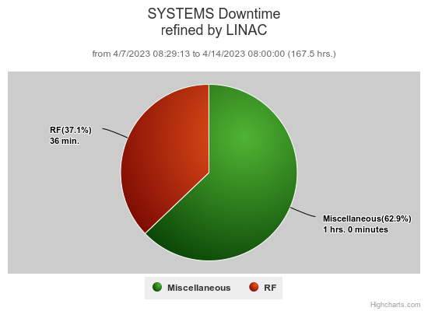
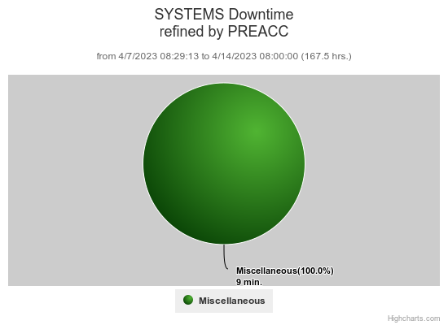
Preacc/Linac Weekly Performance
Tuesday: Scheduled Maintenance Period

Slide 2
Current Conditions/Plans
Source A – 60.7 mA
Linac input – 26 mA
Linac output – 23.3 mA

