Slide 1
RR/MI status
Marty Murphy
0900 Operations Scheduling Meeting
14 April 2023

Slide 2
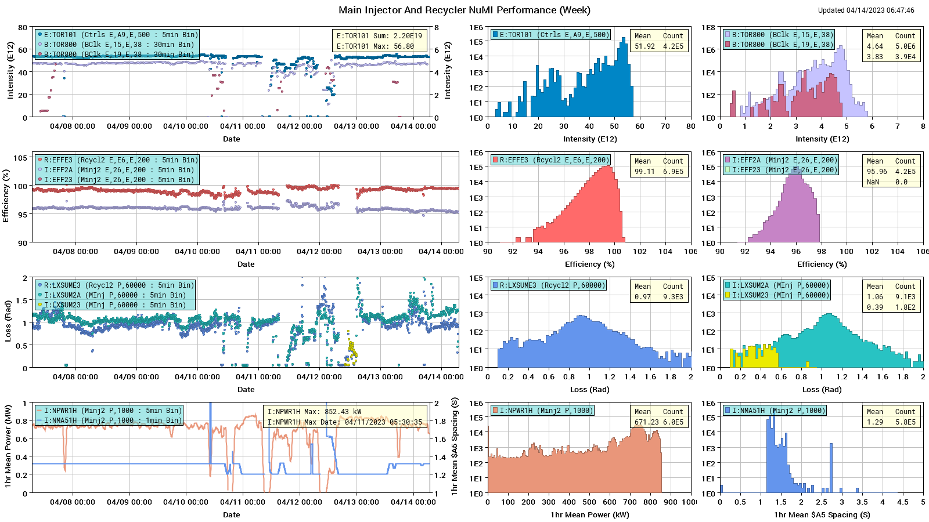
NuMI performance

Slide 3
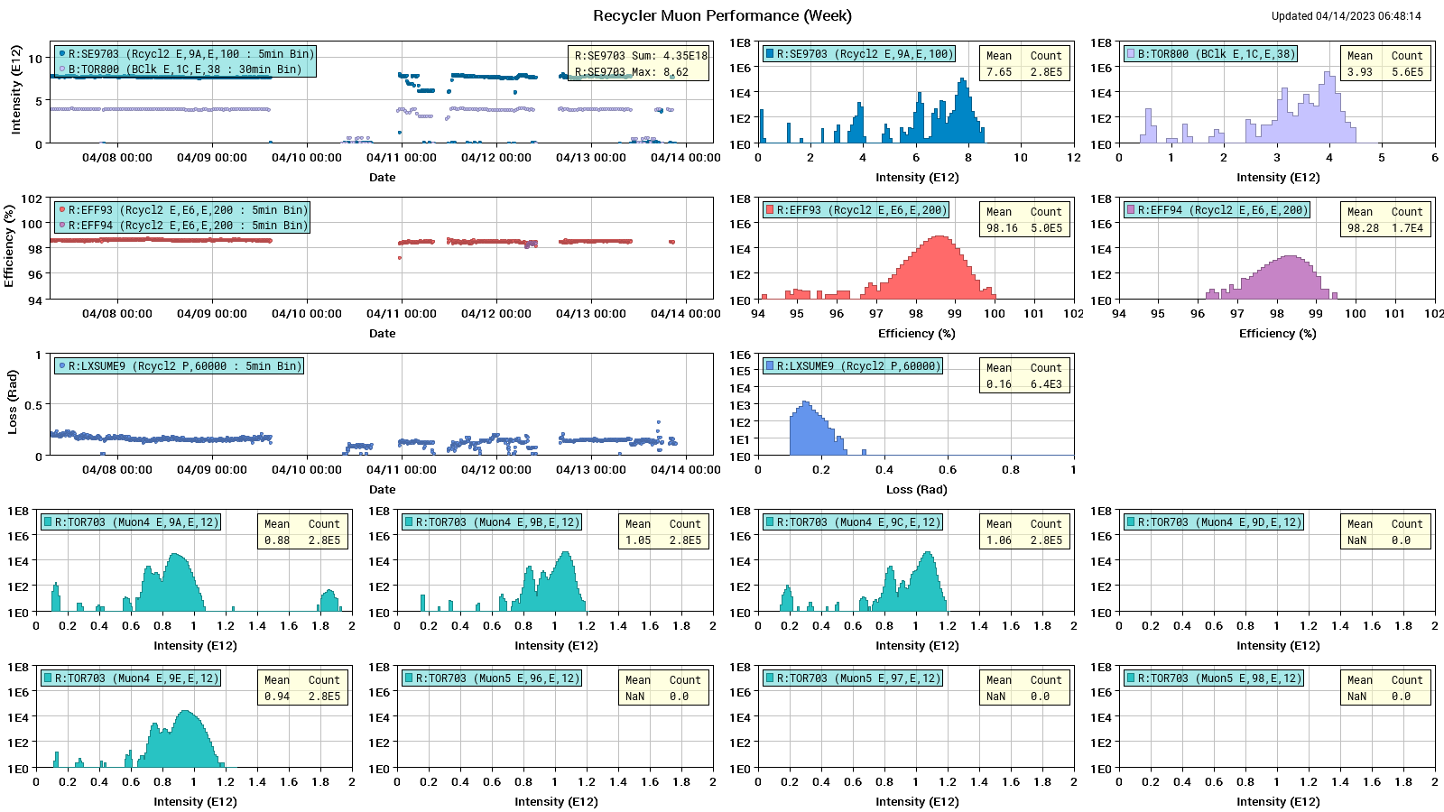
Muon Performance

Slide 4
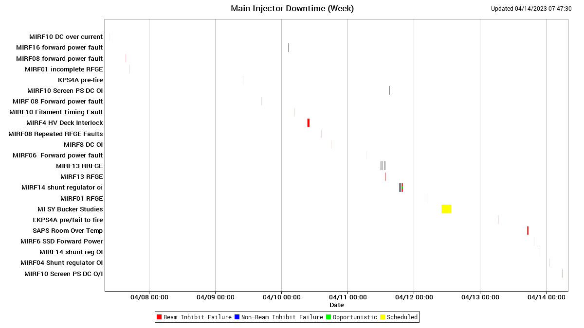
Main Injector Downtime

Slide 5
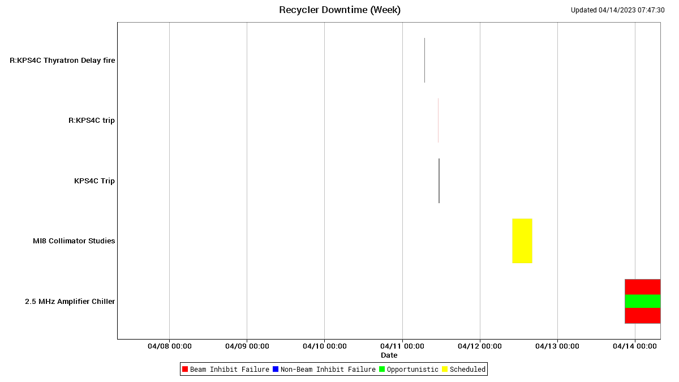
Recycler Downtime

Slide 6
Weekly Summary
Mostly stable beam to users when beam was available.
Notable Downtime Causes:
RR 2.5 MHz RF went down Thursday evening. The amplifiers turned off (automatically) when cooling water got too hot. MSD techs were called in and found the problem is most likely in the chilled water condenser outside MI31 (between building and road). DM and DE were called, but could not keep the unit operating. ISD informs me they will be looking at it first thing today.
Problems with various MI RF stations; currently running with 19/20 stations. MIRF13 HV cable needs to be high potted (two hours no beam in MI or RR).

Slide 7
Wednesday Dedicated Studies Results
MI8 collimator measurements and RR-1st turn abort wire measurements.
MI8 collimators are indeed keeping ring & collimator losses in RR down.
RR Ion Profile Monitor (IPM) measurements:
POSTPONED due to beam scattering by RR injection multiwire measurements.
SY Slow Spill Bucker Measurements:
Successful insofar as new arrangement looks promising, but needs modification. Much was learned and Peter & Co are working on next steps. Stay tuned.
Motivation: to improve spill quality of 6-batch beam for SpinQuest.

Slide 8
Today + Next week
NuMI
Continue providing beam as requested; tuning for increased intensity and reduced losses.
Muon
Fix RF amplifier cooling system and restore beam ASAP.
Support g-2 operation and m2e beam studies as they happen.
SY
Provide beam to users as requested
Studies
Parasitic RR studies using $E0 or $E1 under the SY $20
Possible: 2-4 hours. 120-GeV halo scraping on MI collimators to verify cause of NuMI target baffle heating. Dedicated, destructive NuMI study; other users unaffected.

