Slide 1
Muon Campus Operation Report
Dean Still
Friday 09:00 Operation Meeting
Week of April 10, 2023

Slide 2
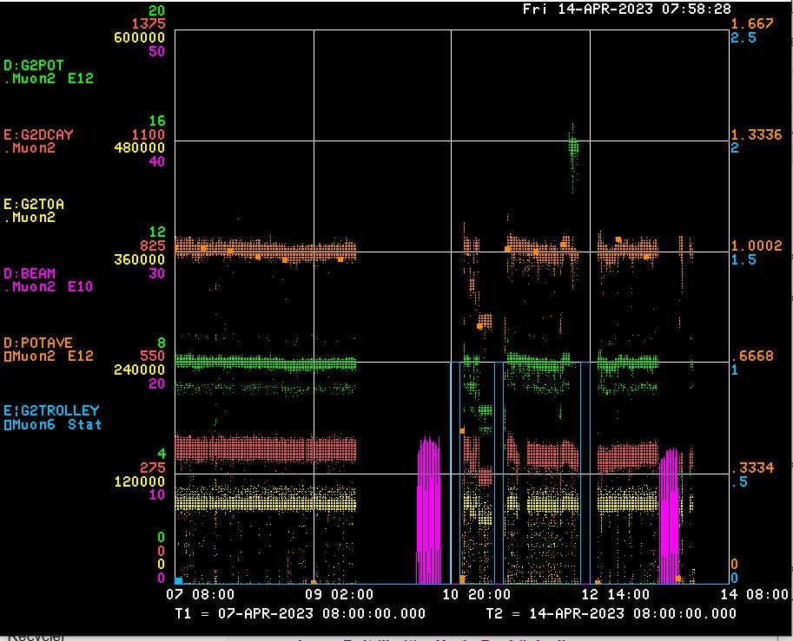
Performance for the Past Week
Protons On Target
Avg Protons on Target
Particles to Entrance of G-2 Ring
Decay Positrons in G-2 Ring
G-2 Trolley Run
8Gev Delivery Ring beam
← 300 Mev Study for g-2
← 300 Mev Study for g-2
← MI/RR Studies – MC no beam
← BPM Studies
← Booster maintenance -RF
← BPM & Tune tracker Studies
← RR RF Amp Chiller down
<- g-2 down->
repairing
cryo issues
<-------Weekend ------→
<------------Week Days -------------------→

Slide 3
Activities for the Past Week
G-2 Status:
Delivered beam to g-2
Work completed:
PRAC 40 required to be recovered.
Target blower maintenance.
MSD brought CUB column II on line to help clean up remnant LCW resistivity.
MSD worked on AP50 RF cooling system to improve resistivity.
Repaired ESS2 power supply with noisy output.
AP0 water cage RAW samples and water make up.
RR RF Amp chiller compressor won’t stay on – currently no beam to g-2
8Gev Studies: (2days)
BPM 8Gev beam studies. New code to the digitizers & period to retime BPMs. (Patel +)
Worked on getting tune tracker data through the QX ramp.
Low Momentum 300 Mev Study for g-2. (Morgan)

Slide 4
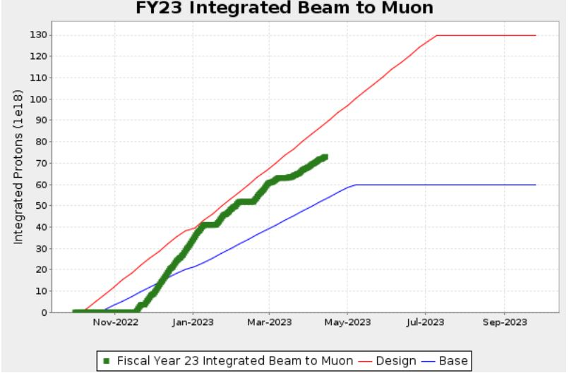
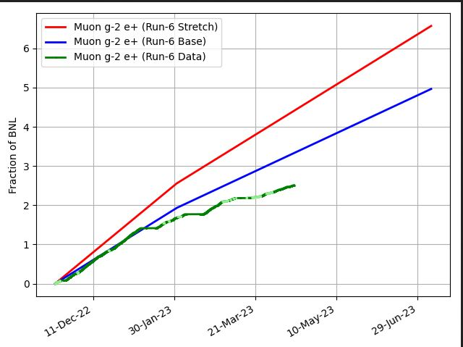
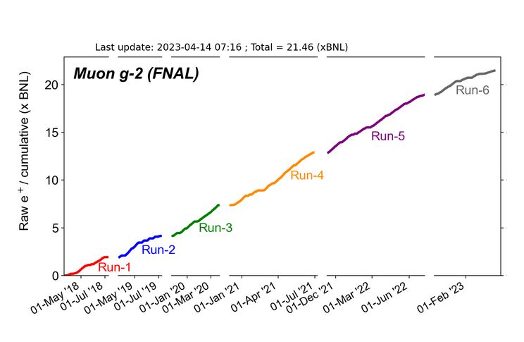
G-2 Performance – Integrated for Run 6
G-2 Experiment POT Run Goal
~4.2E20 POT
Run 6 period is Nov 2022 – June 2023
Run 6: Goal of ~x 6 BNL
Total Run: goal of x 21 BNL
Currently running 6.6 Hz
Run 6 # POT Delivered ~ 7.2E20
Run 6 Integrated ~ x 2.51 BNL
0.09 for the week
Total Integrated ~ x 21.46 BNL
Start of
Summer
Shutdown
2023
Plots as of 4/14/2023

Slide 5
Plan for Next Week
g-2 operation:
Deliver Beam to g-2
Muon Campus Study Plans :
Monday April 17 starts AP0 AC installation work.
Trend is probably going to be do AC work during day shift & delivery beam to g-2 Evening & Owls.
To work in AP0 water cage area requires 1.5 hour cool down.
Waiting on an operation note to allow to run Mu2e studies during the AC installation.
Friday – 1000 – 1430 -- BPM Studies
Saturday – Deliver beam to g-2
Sunday – Deliver beam to g-2
Monday - 0630 -1600 - No Beam to g-2 – start of AP0 AC work
Tuesday - AP0 AC work - No Beam to g-2
Wednesday - Booster Study Day – No beam to muon campus
Thursday – AP0 AC work - No Beam to g-2
Friday – AP0 AC work - No Beam to g-2
Future Planning :
G-2 line
Mu2e M4
line

