Slide 1
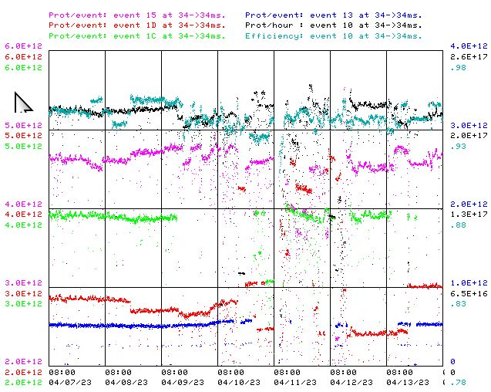
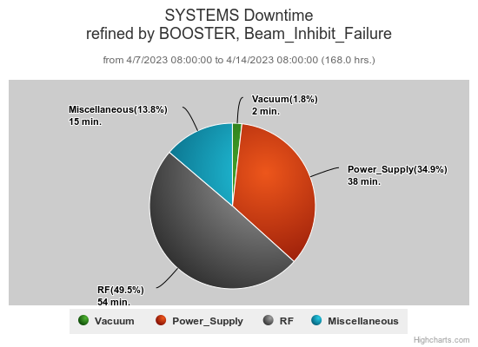
Booster Operations 04/7/23 – 04/14/23
Downtime this week: ~1.8 hrs
BRF10 Modulator issues, other RF trips ~54min
HL14 Corrector amp replaced ~40min
Beam instability early in cycle ~15min
Also this week:
This week:
Beam to NuMI currently ~4.7 E12 per pulse.
This week to BNB ~2.5.-4.6 E12 per pulse, up to 5Hz , ~ 3-7E16 pph.
Beam to Muon this week, ~ 4E12 per pulse, ~ 1E12 pot.
Beam to SY as requested 2T, ~ 5E11 per pulse.
During Tuesday’s planned repair period, RF worked BRF10 but station needs more work. Supported MI/RR studies on Wednesday.
General tuning to work on higher beam output stability and loss reductions.
Kicker/notch timing adjustments needed due to bucket slip, cause unknown.
Scheduled PS studies date TBD.
20Hz Magnet Test effort at E4R progressing.
Thanks to Ops for maintaining good Booster performance over week.

