Slide 1
9 O’Clock Meeting
Keymonty Bullock
MCR Crew Chief
Friday, April 14, 2023

Slide 2
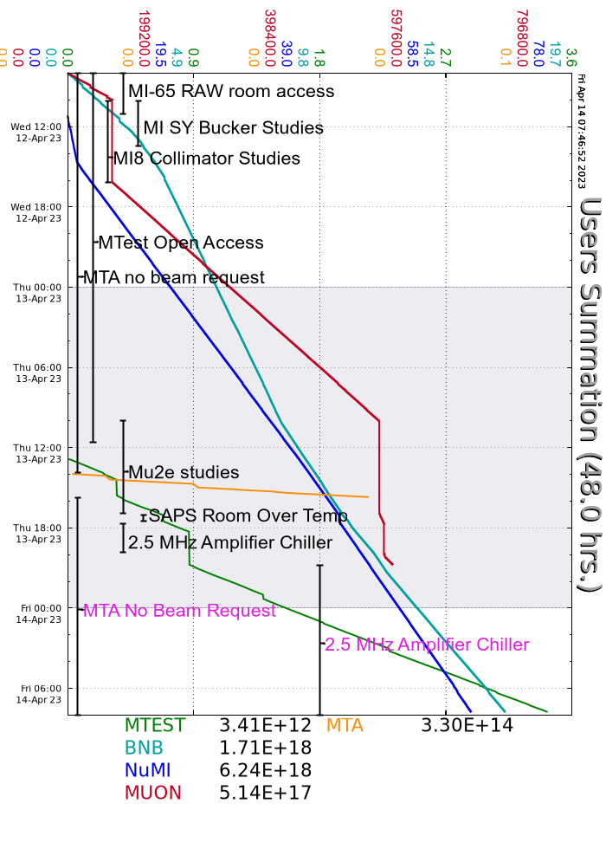
Since Wednesday…
MI/RR Studies Day
NuMI Horn 1 RAW Skid temperature issues resolved
Mu2e studies
Recycler 2.5Mhz amplifier chiller issues
Walkthroughs on off-shifts
Beam to FAST when requested
Beam to NuMI, MTest and BNB

