Slide 1
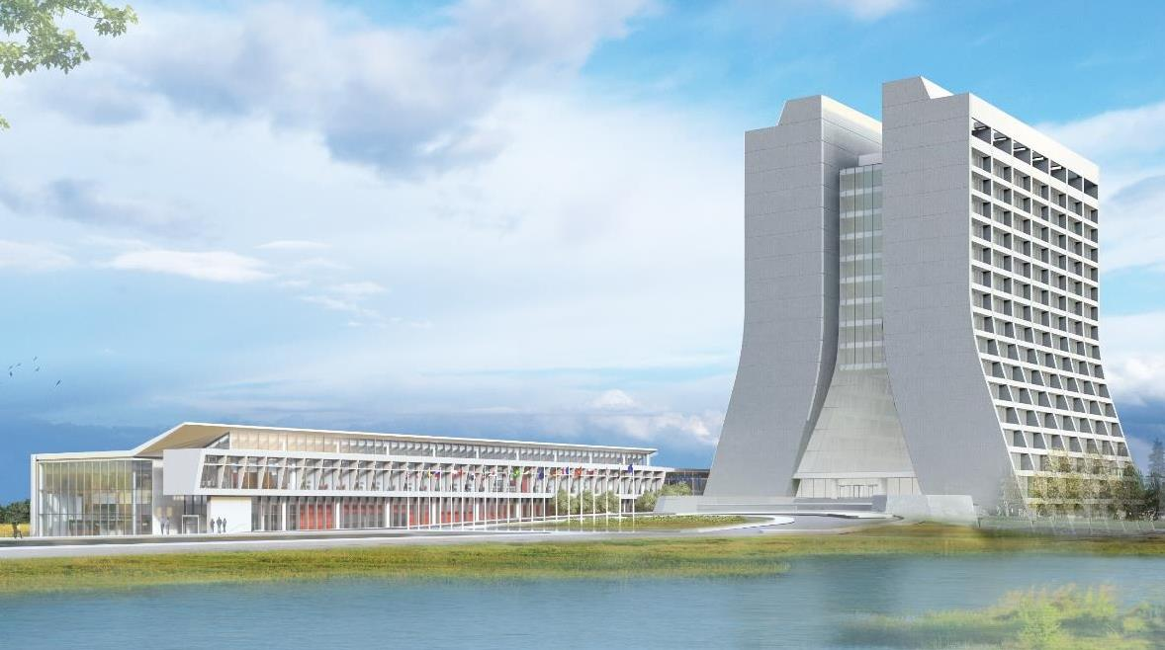
Infrastructure Services Division Updates
Pressing Issues
Worked on WO’s for CO Assembly Bldg (Doors, lighting, E-lights, dehumidifier)
Overhead door issues (RSB0, MI8, Linac)
Roof Leaks work (NS-4, MI-8, MI30)
Items of note
Working on EOL equipment plan
eLights Preventative Maintenance/cataloging
Planning the roofing work for the summer
Exterior lighting moving forward
Cooling changeover in progress
Generator PM’s this month

Slide 2
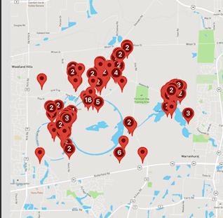
Items of Note
Visual
Notable Mentions
We are trialing a PM schedule that would work towards working down the backlog of work orders.
We are sitting at 397 open tickets. Varying in topics and requests.
5 office painting/carpet projects with procurement, 1 under review and several related requisitions in various stages of development

Slide 3
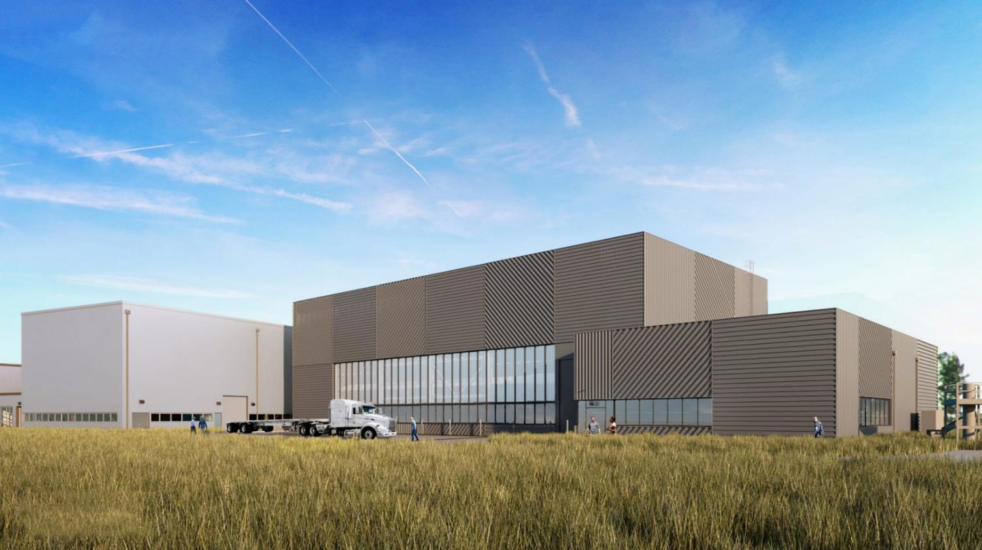
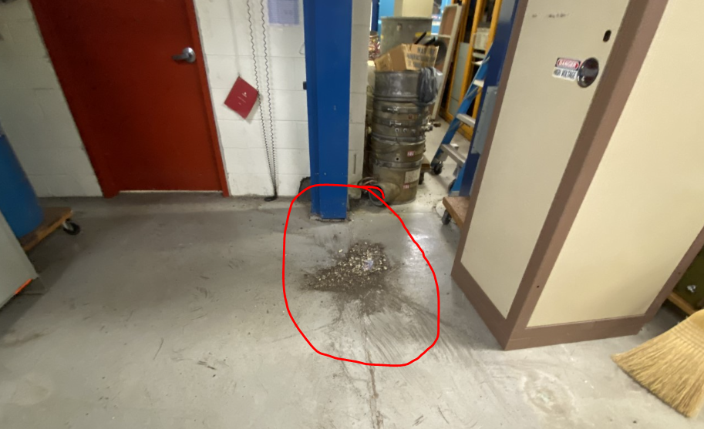
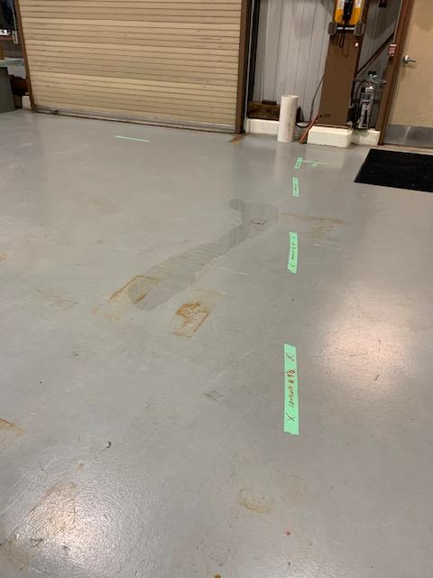
Special Topic: Leaks
Water leaks due to weather has been an ongoing challenge.
We are tracking roof leaks and roof EOL information so we can make sure AD roof systems are on the roof replacement schedule
Not all leaks are roof related. We do try to mitigate problems from utilities with a “take care of the utility before it takes care of us” approach.
MI-8 is an example of an ongoing water infiltration problem we are working on.
If you see areas like this
take a picture with the location
Send to your AFM

Slide 4
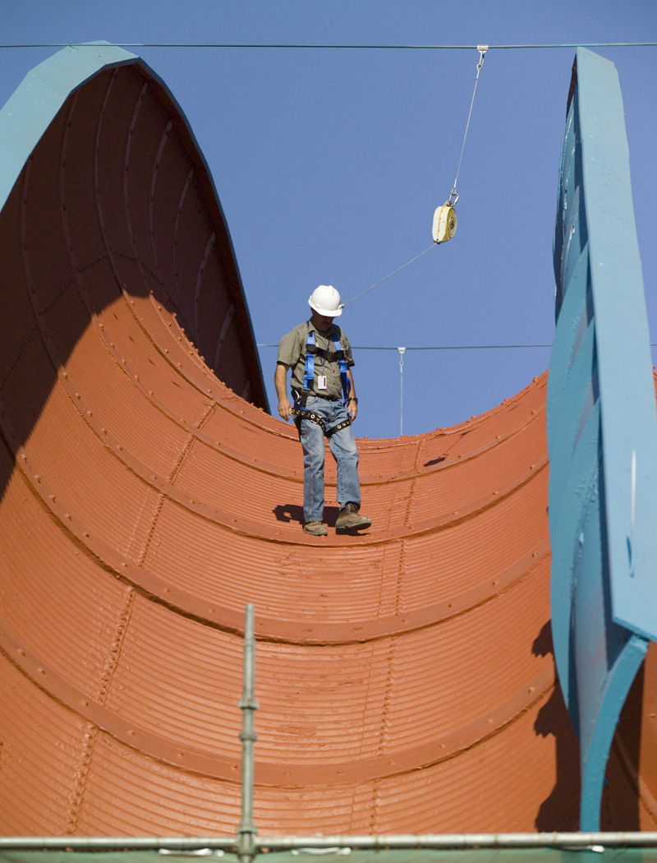
Projected Roof Projects
From Fy21
324, G2SB
500, Proton Pagoda
508, PS-1
510 PS-2
251 F0
623 NSB7
602 Neutrino Lab B
From Fy22
CUB_214- NORTH
LAB B_LAB F
NWA-614
HAB 323
MINOS 785
VAG_164_F38FSC_929

Slide 5
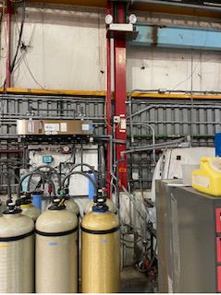
Emergency Lights
Currently performing our PM’s on e-Lights – Monthly inspection. We have around a few hundred e-Light inspections done to date.
There are currently in the AD buildings 756 lights and exit signs.
Piloting a standardized PM program in FAMIS for e-Lights
Occasionally we find access to an emergency light obstructed. Please be mindful, where possible, of the need to access these lights for inspection and maintenance purposes.

Slide 6
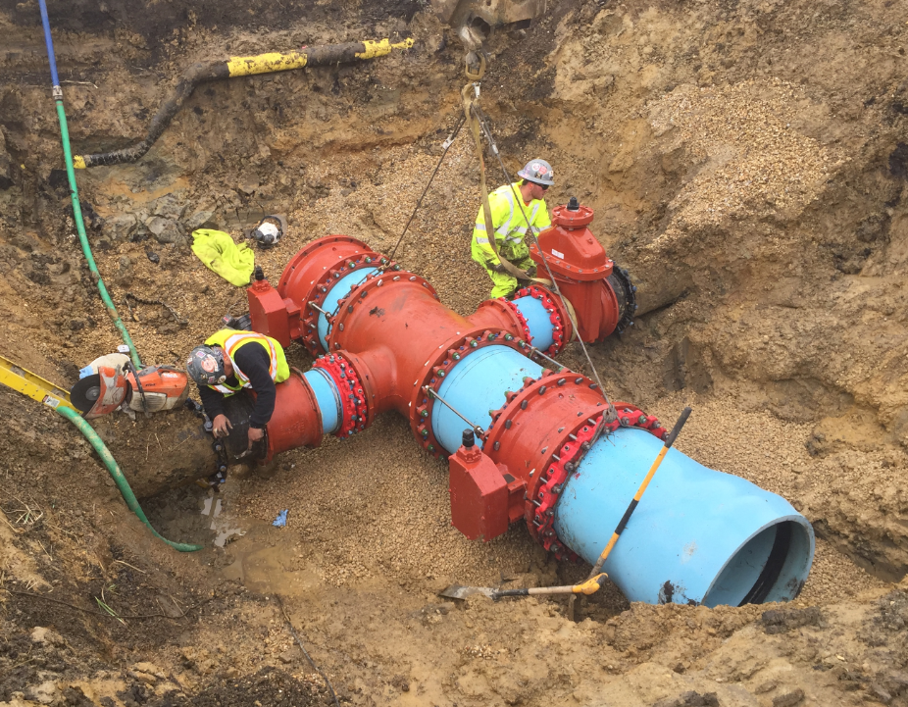
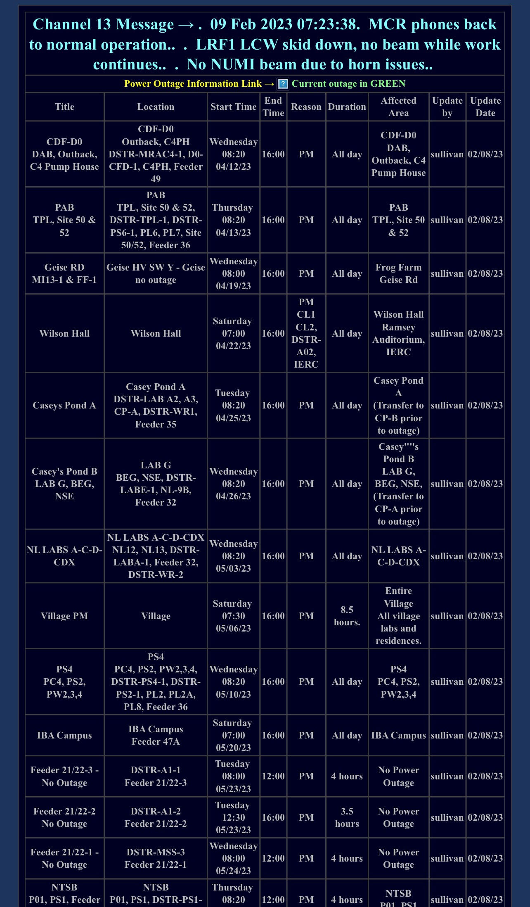
Utility Outages

Slide 7
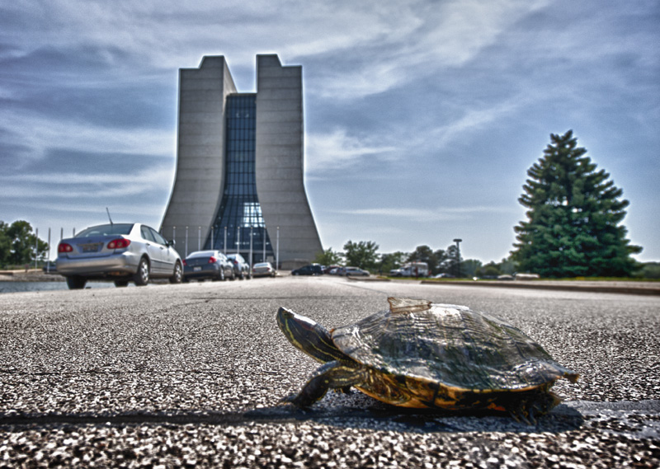
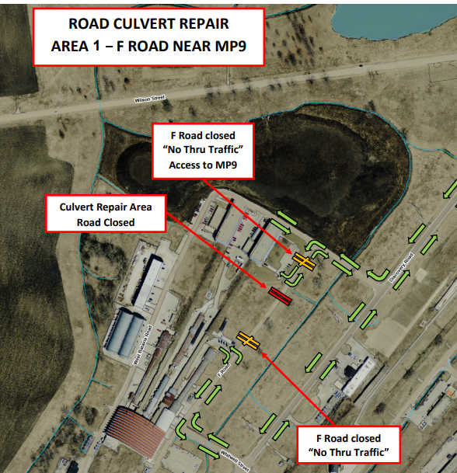
Road Closures
Fermilab Road Culvert Replacement Project Closures
Starts April 24, 2023
Closure 1: 4/24/23 – 5/2/23 – F Road near MP9
Next Closure (2): 5/3/23 – 5/11/23 – Discovery Road near NS1

Slide 8
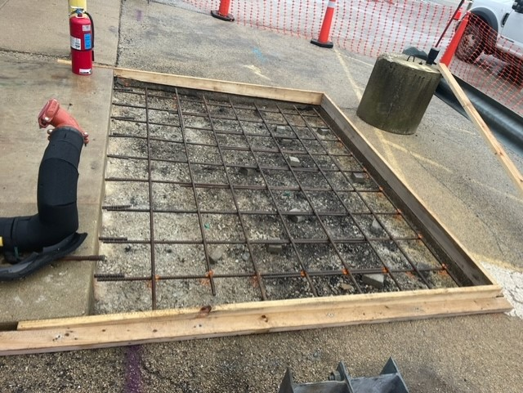
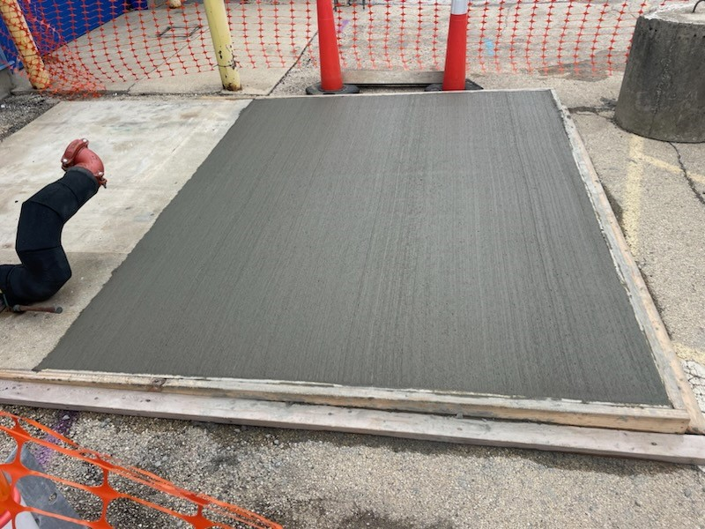
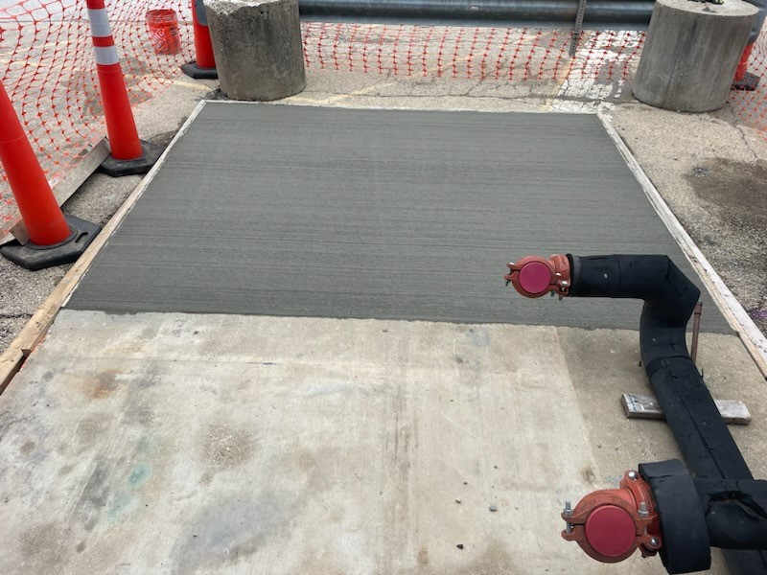
Progress Shots
AO Chiller Pad

Slide 9
Contractors on Site (As of 4/13/23)
Midwest Mechanical: OFF
ECS: WH North 2nd Floor conference rooms, Concrete sidewalk Lab A, Scale house interior patch/paint.
MM Peters: Lab A concrete work.
Water Well Solutions: Training (next week Well 4)
Seivert (crane): Annual Inspections PPD, PAB, PB7, Lab6
Leyden Electric: Lab 8, WH 2nd Floor NW (Zoom Room Black Hole)
MidAmerican Elevator: Elevators

Slide 10
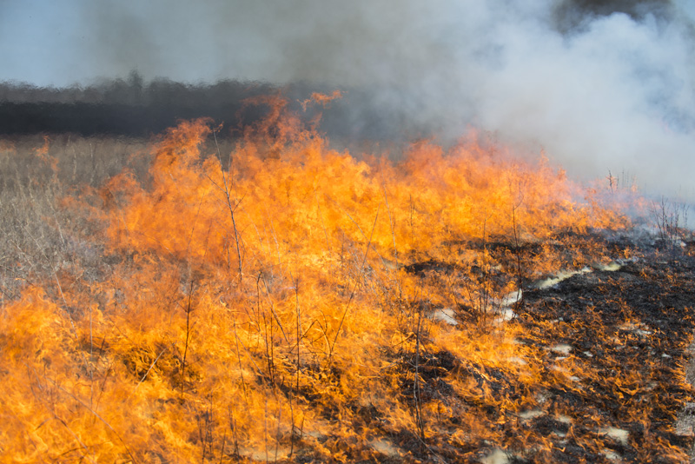
Prairie Burns
None Scheduled

