Slide 1
Electrical Design 1 David Christian April 18, 2023

Slide 2
Outline
SiPM hybrid (parallel/series) passive ganging
Signal processing for cathode-mounted modules (including one complication)
Signal processing for membrane-mounted modules
Unexpected problems

Slide 3
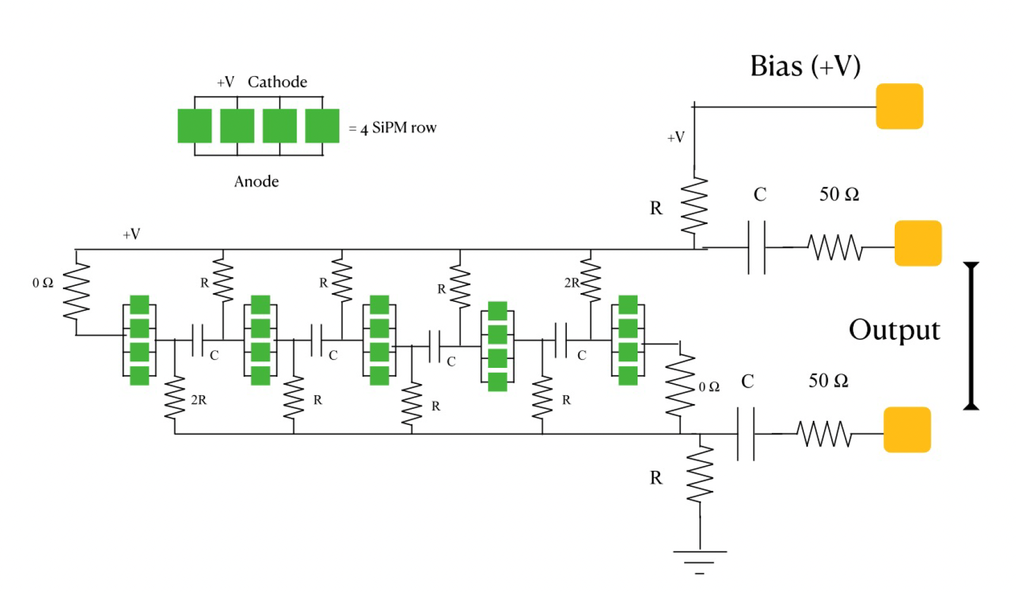
Hybrid Passive Ganging of SiPMs
R=10k; C=.01uF
Picture from D. Tonani & G. Cancelo 11/17/21; inspiration from K. Ieki (XeSAT 2017)

Slide 4
Bias voltage is delivered in parallel to all 20 SiPMs (No high voltage required)

Slide 5
Readout path is through 5 groups of 4 SiPMs in series; Signal is shorter than if all 20 were in parallel (capacitance adds in parallel)
Hybrid ganging yields good S/N with a larger number of SiPMs than is possible with parallel ganging while using the same bias voltage.

Slide 6
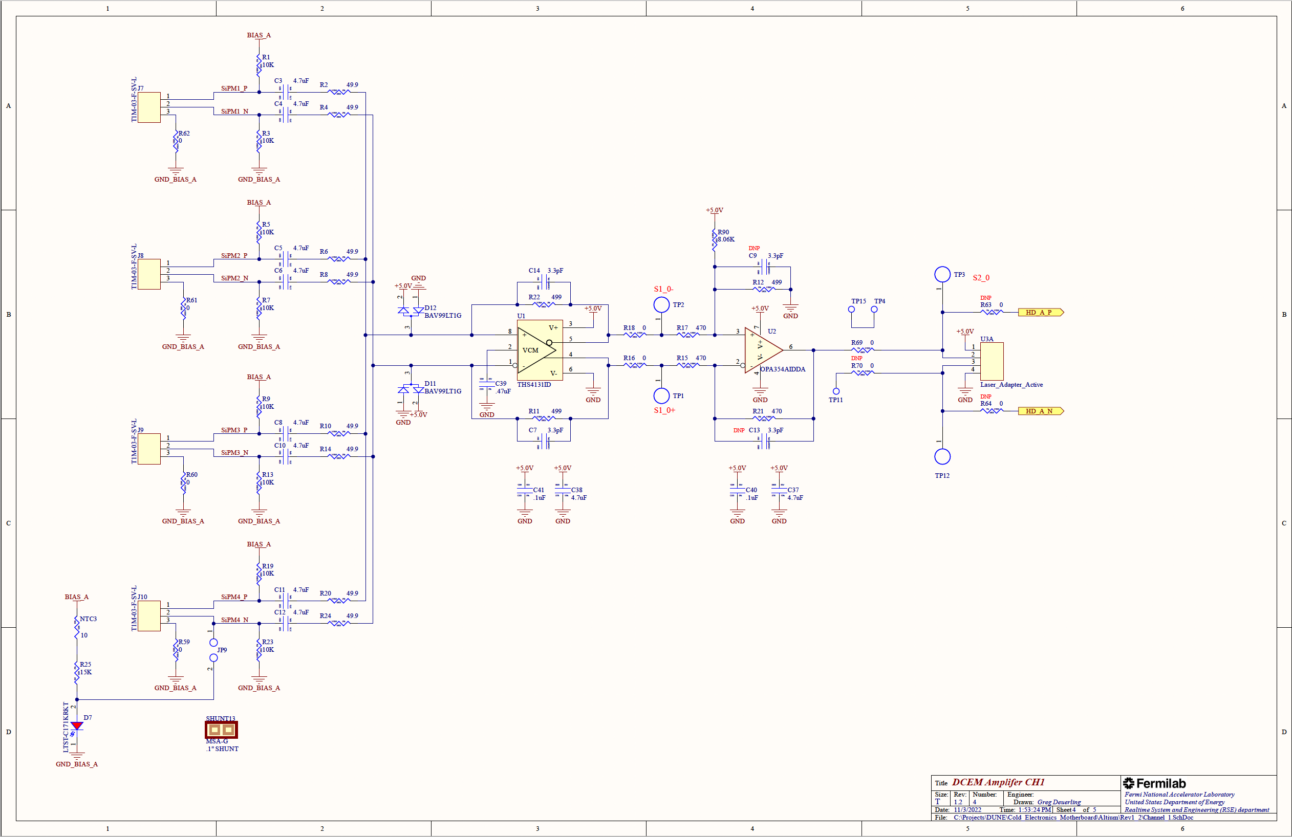
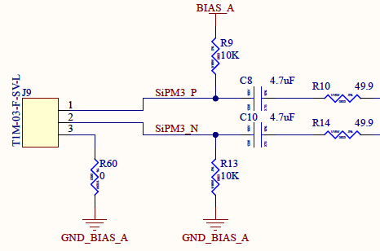
Cathode Mounted Modules – Signal Processing
Structured as a motherboard with daughter cards to facilitate parallel development of key components
Active ganging 1st stage: op-amp with ~10x voltage gain
2nd stage establishes DC offset for laser diode (SE output)
3rd stage (laser driver) on daughter card.
Design led by APC group.
Decoupling capacitors are on the “DCEM” to minimize the number of components on the SiPM flexible circuits.
DCEM has 2 identical channels; each corresponding to 80 of the 160 SiPMs in an XArapuca module.

Slide 7
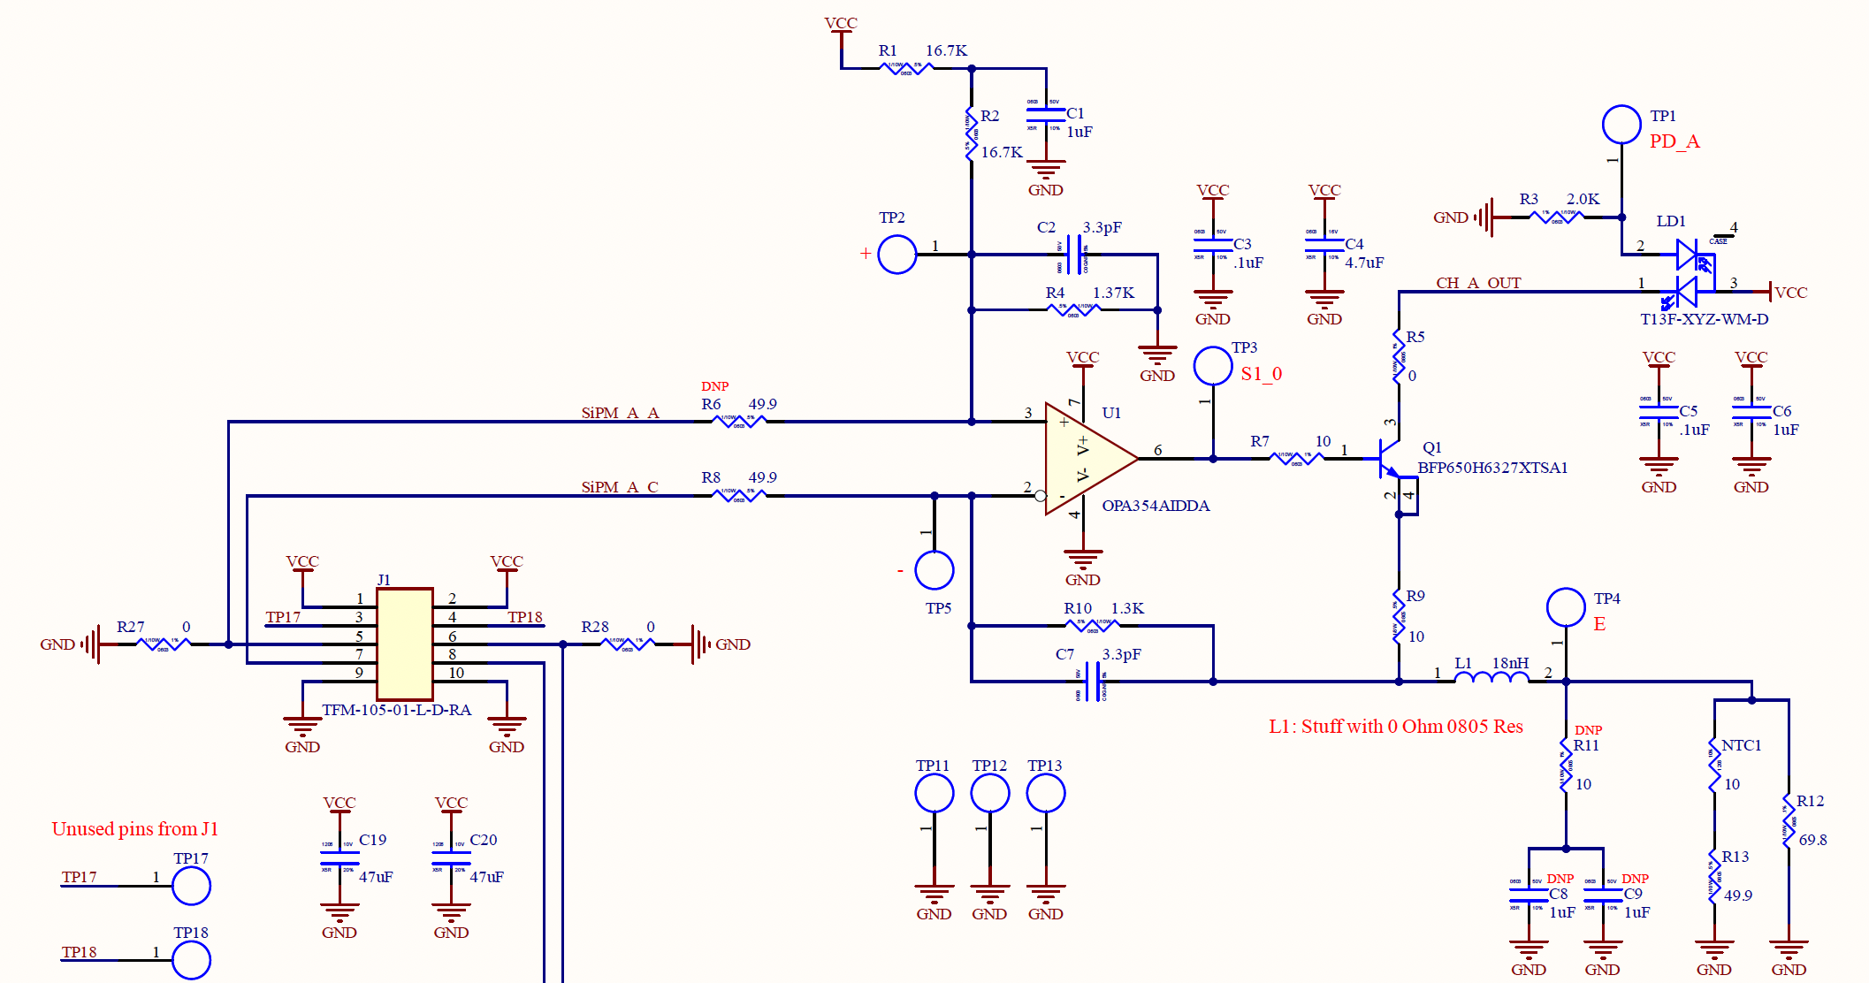
Cathode Mounted Modules – Laser Diode Characteristic
The plot on the right shows the light output (measured after a length of 62.5 micron diameter multimode optical fiber at room temperature) as a function of diode current.
Since the SiPM signal is mostly unipolar, we would choose to bias the laser driver circuit so that the laser current with no signal is ~ 12.5 mA and arrange the circuit so that signals are positive going.

Slide 8
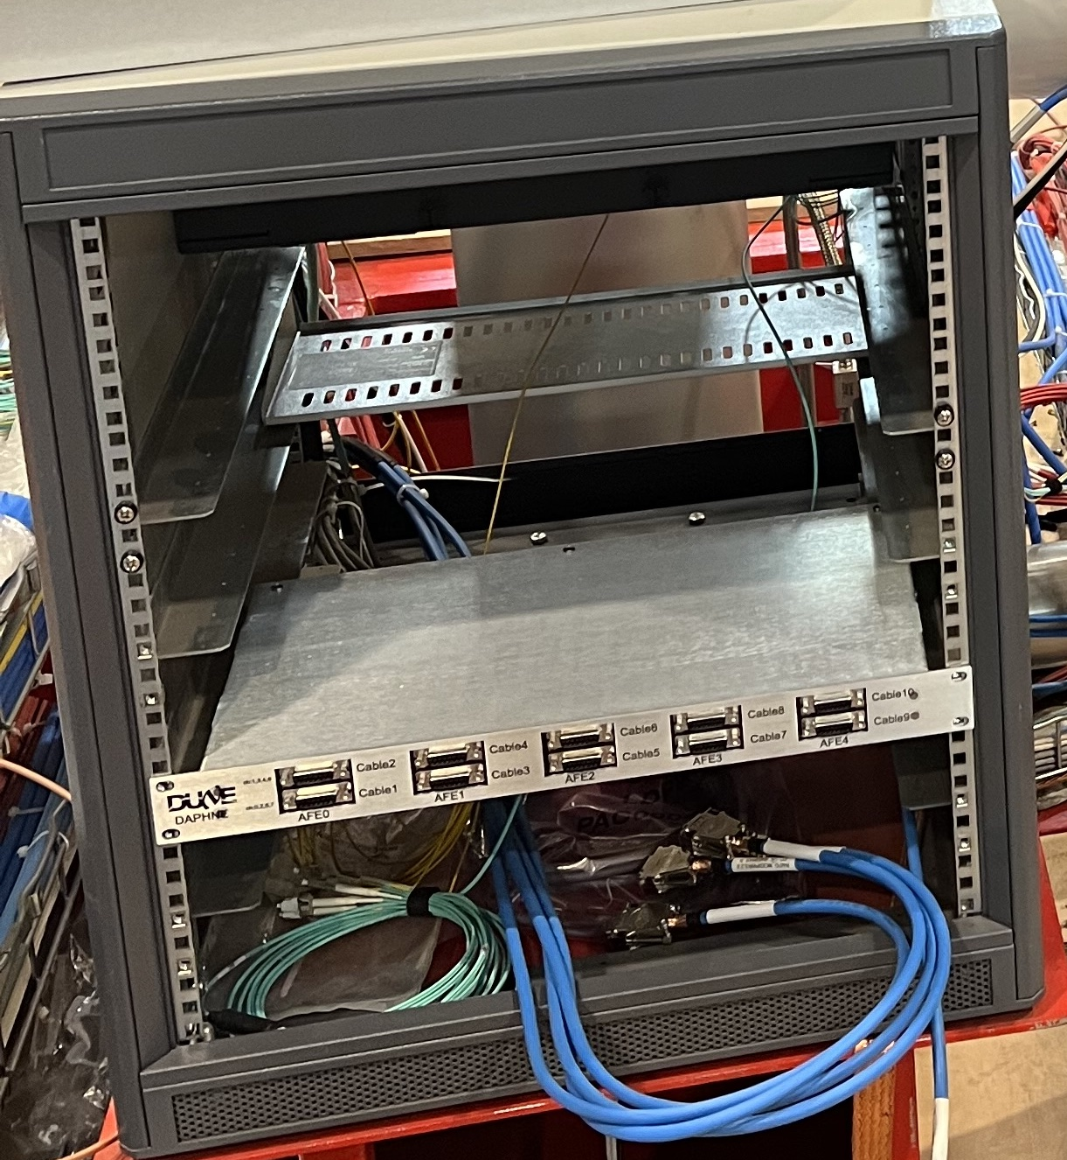
Cathode Mounted Modules – Outside of Cryostat
Optical signals are converted to electrical using a photodiode (board sold by Koheron includes also a transimpedance amplifier).
DAPHNE will digitize the signals and interface with the DAQ system.
We plan to design a version of DAPHNE in which the optical to electrical conversion replaces the differential to single ended conversion at the input of DAPHNE.
Alternatively, we could continue to use a separate module, which might even consist of Koheron cards.

Slide 9
Cathode Mounted Modules – SiPM and circuit bias
Early versions of the optical readout used 3 “Optical Power Converters” in series (with a Zener diode circuit to set the output voltage) to bias the SiPMs.
DCEM provides for up to 4 OPCs with jumper options to allow flexibility in how many are used for SiPM bias and how many are used for circuit bias.
Typically, 1 OPC (with a voltage regulator to set the output voltage) is used as input to a DC/DC step-up converter which generates the SiPM bias voltage.
Typically, 1-2 OPCs (with a voltage regulator to set the output voltage) is used to bias the readout electronics.

Slide 10
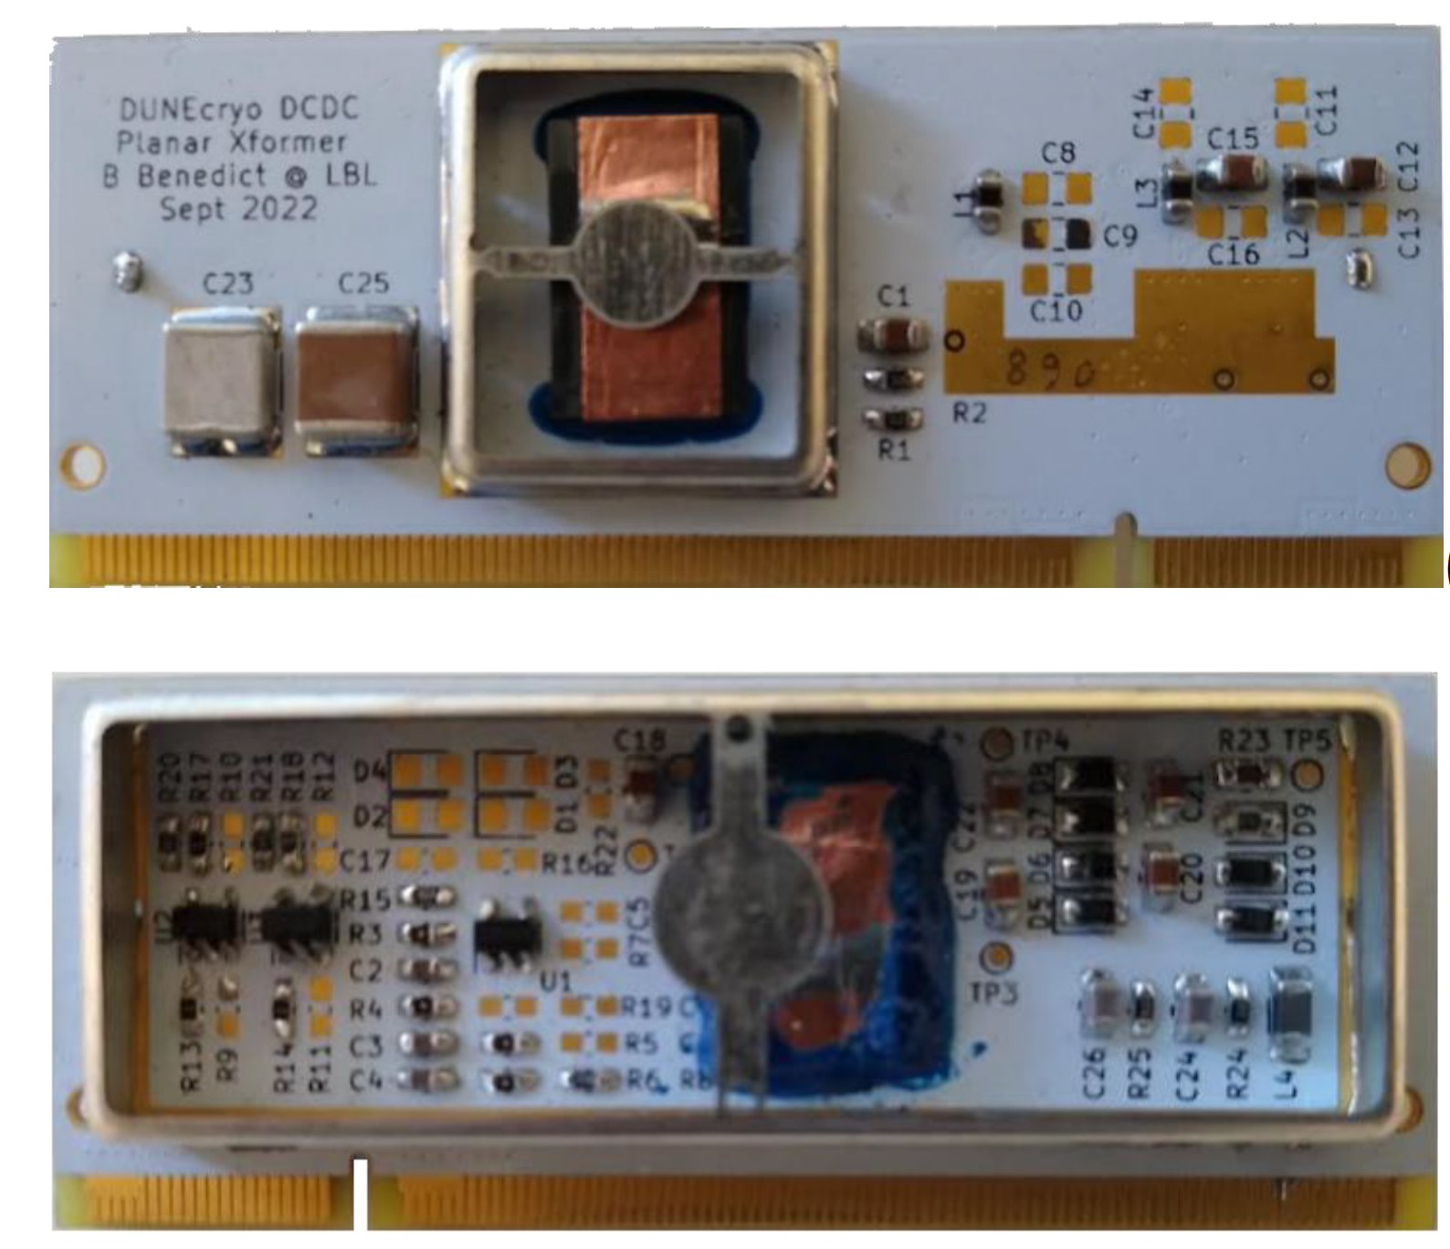
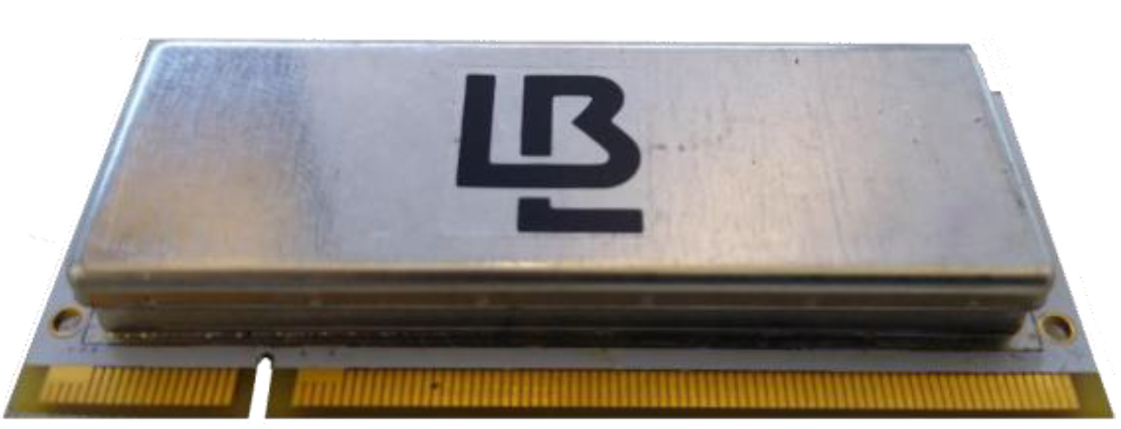
Cathode Mounted Modules – DC/DC Step-up Converter
Multiple DC/DC converter development paths have been pursued simultaneously.
One cryo-compatible commercial option was identified (Pico).
Successful circuits have been designed and implemented by a group at LBL and also by a group at INFN Milano.
LBL version shown at right (top view, bottom view, & with RF shield).
ProtoDUNE-II (Vertical Drift) will include both LBL and INFN versions.

Slide 11
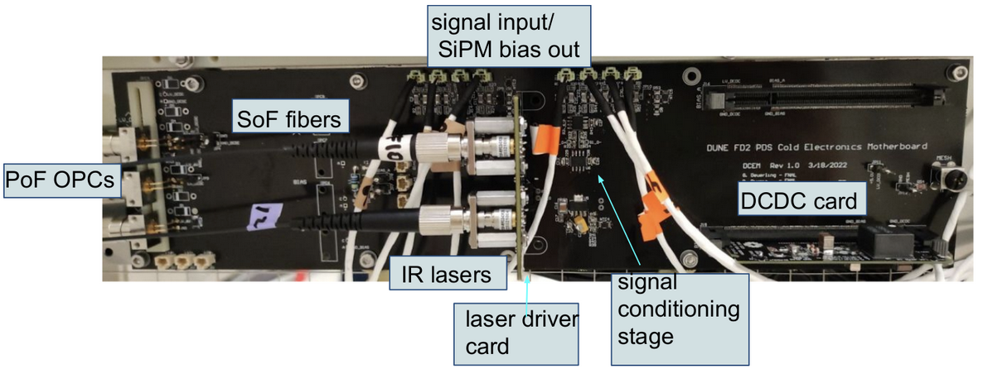
Signal Processing – DCEM for Cathode Mounted Modules

Slide 12
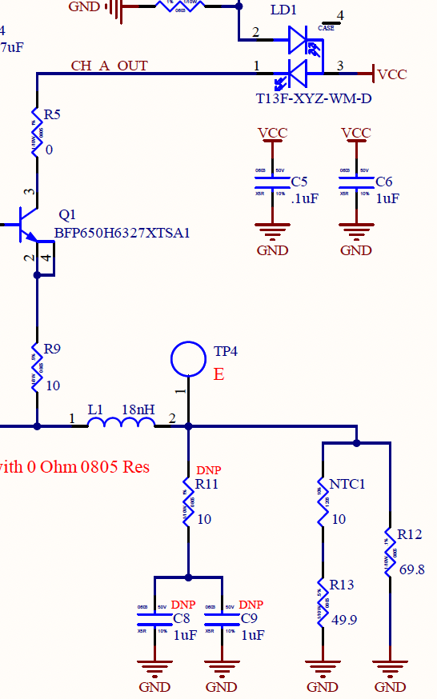
Complication & Solution
Need to verify that XA module and readout are operational after installation and before the cryostat is sealed, but…
SiPM breakdown voltage is lower cold than at room temperature.
Laser diode threshold current is lower cold than at RT.
Solution: Use resistors with large negative temperature coefficient (NTC) to allow electronics to passively switch between cold & RT configurations. NTC resistors are essentially open switches at cryogenic temperature.
NTC1 is 10 Ohms at RT; very large in LAr
(A. Kish)

Slide 13
Signal Processing for Membrane Mounted Modules
Horizontal-drift style (default option):
Modified version of DCEM distributes input signals from 2 XAs to 4 HD cold amplifiers (same daughter cards as used in the HD XAs, but with slightly modified feedback).
1 Readout board will be located between 2 membrane-mounted XAs
Outputs/bias circuits are routed on the DCEM to a single 15-pin D connector.
SiPM Bias and CE power is provided by DAPHNE.
The I/O cable is compatible with DAPHNE.
Board on the right has 3 of 4 HD-CE amplifiers mounted.

Slide 14
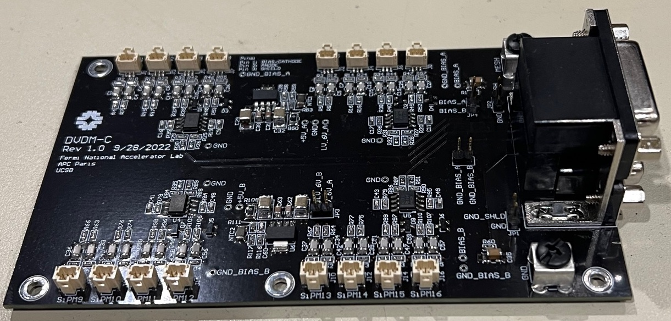
Signal Processing for Membrane Mounted Modules
Vertical-drift style readout of membrane-mounted XAs will also be deployed in PD-II.
Modified DCEM with differential output directly from the 1st ganging stage.
I/O is compatible with DAPHNE if very minor modifications are made to the DAPHNE input stage (to separate signals from SiPM bias).
SiPM and CE bias provided by DAPHNE
Two twisted-pair cables are required for a 4-channel readout board, which is located between 2 membrane-mounted XAs.
Can also be read out using a warm board that is similar to the 2nd stage of the DCEM (will be used in cold box tests with CAEN digitizer)

Slide 15
Unexpected Problem - Laser Diodes
Air; index of refraction ~1
The first FC LDs that we got from Lasermate produced much less light in the NP02 cold box run in Dec 2021 than in our tests with (shallow) LN2.
The next batch of LDs from Lasermate produced essentially no light in a subsequent cold box run.
We eventually understood that the problem was that the LD package became flooded with liquid argon.
This changed the optics such that much less light was captured in the (very fine) single mode fiber used in the package.
In response to a question, Lasermate said that they had changed the lens type between orders.
LAr; index of refraction ~1.23 @1220 nm

Slide 16
Flooded Laser Diode Problem
We tried sealing the LD package using cryogenic compatible epoxy.
This worked for a while… but eventually failed.
Lasermate agreed to produce sealed LDs for us… but they also used glue and their FC and pigtailed diodes all eventually failed. We did some tests in a pressurized dewar and failure occurred sooner than in relatively shallow liquid argon.
Lasermate would not share the size or divergence of the Fabry-Perot laser diodes and would not share the lens shape or any other details of their package… but they did agree to produce samples in which a hole was made in the wall of the package to facilitate liquid argon infiltration and the fiber was moved away from its nominal position by 1mm and 1.5mm.
We measured both types and found that the 1.5mm defocused LDs produced more light at the end of an optical fiber in deep liquid argon than in air.
We then purchased a series of LDs with defocus distance between 1mm and 2.5mm (the maximum that Lasermate was willing to produce).
The 2.5mm defocused LDs are best in LAr and produce enough light in air that the function of the module can be verified at room temperature.

Slide 17
Flooded Laser Diode Solution
This LD is made with a 2mW class diode → the light yield is ~50% of what it would be with optimal optics.

Slide 18
Unexpected Problem – Capacitor Failures
We selected capacitors based on a list of components proven to be suitable for cryogenic use.
Nonetheless, we have had a number of capacitor failures.
This issue is now top on our list of problems to solve.
The problems have been associated with 4.7 uF X7S surface mount capacitors.
All of the DCEMs used recently have been assembled by hand.
The problem may be related to CTE induced stress associated with use in liquid argon, exacerbated by stress on the capacitor related to heating it with a soldering iron while the PCB as a whole is not heated.
We have recently had two DCEMs assembled at U. Iowa using the wave soldering machine in their surface mount lab.
We are confident that we will fully understand this problem soon and that it will be easy to solve.

