Slide 1
FD2 Photon Detector System: Final Design Review Mechanical Design Overview
David Warner for the Photon Detector Consortium
4/18/23

Slide 2
Outline
PD mounting in detector
Cathode mounting
Membrane mounting
Cable trays, routing, monitoring system mounting
PD module description
Module dimensions, general design outline
SiPM spring loading
Electronics housing
HV protection
Filter plate mounting
Assembly and shipping plan
Monitoring system mechanics
Engineering analysis/Compliance office status
Conclusion

Slide 3
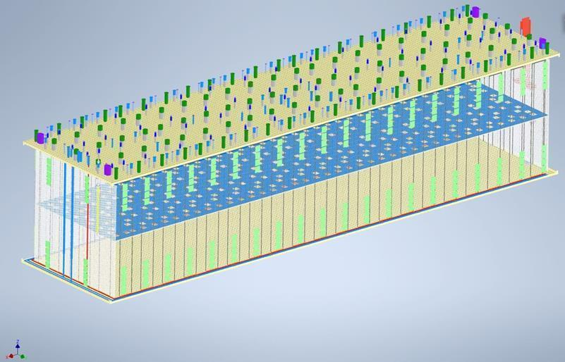
PD module arrangement on TPC
Flange crossing tube rows
(20/side)
Membrane mount modules
(20 strings of 8 modules
Per side, 320 total)
Cathode modules
(80 cathodes, 4 modules
Per cathode, 320 total)
End wall modules (16 per
End, 32 total

Slide 4
PD system layout (by the numbers)
320 Cathode modules
73.4 X 65.3 X 3cm³
8.8 kg (dry) 2.7kg (submerged)
160 SiPMs (51,200 total)
2 readout channels
32 WLS plates (144 X 144mm²)
2-sided readout
1 WLS plate
352 Membrane modules
74.6 X 65.3 X 2.6cm³
8.8 kg (dry) 2.7kg (submerged)
44 readout columns (8 modules each)
160 SiPMs (51,200 total)
2 readout channels
16 WLS plates (144 X 144mm²)
2-sided readout
1 WLS plate
44 Membrane mount module support assemblies
40 flange assemblies
88 monitoring system kits
44 top, 44 bottom kits
176 light diffusers (mounted to field cage supports, one per membrane mount column)
176 flasher channels
All inner module surfaces lined with Vikuiti reflective foil to increase light collection

Slide 5
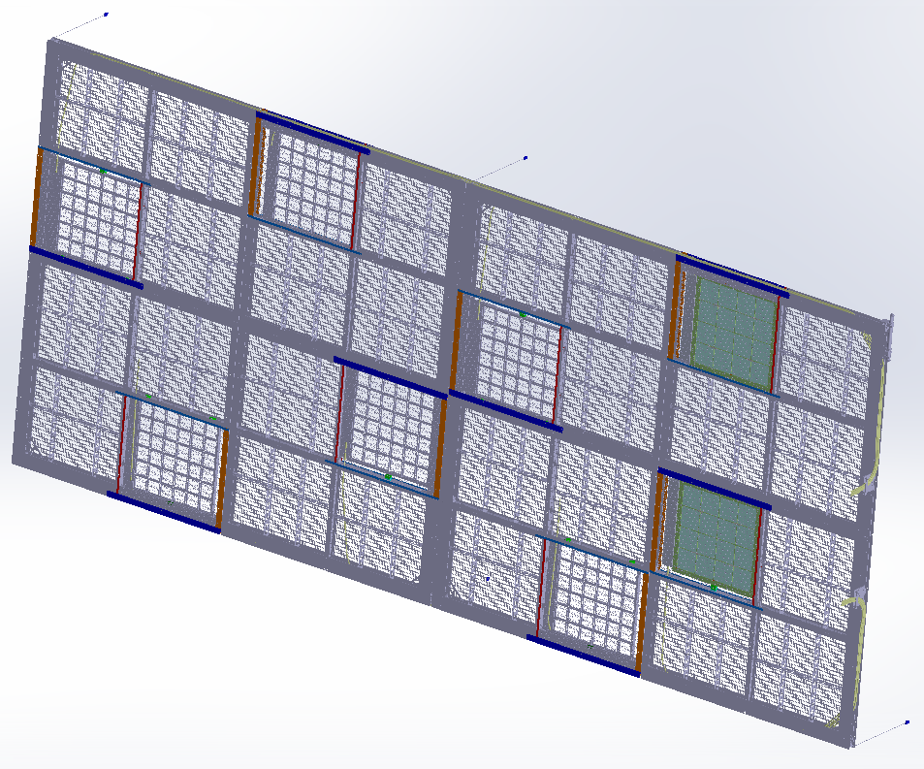
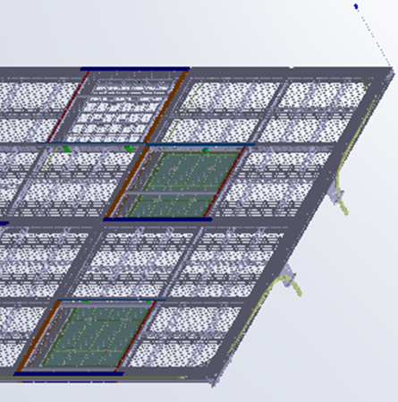
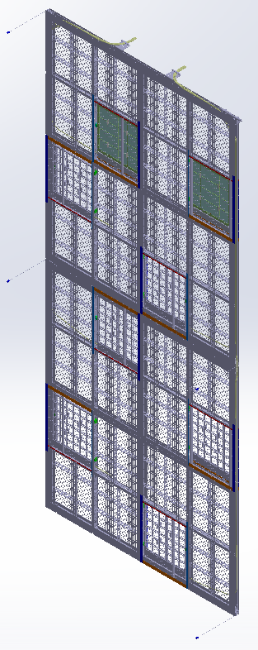
Cathode mounted modules
Note modules are offset from
cathode edge to HV protection
Fiber routing path
Fiber exit points
Note: field cage side
Modules stepped back
From edge (HV protection)
Field
Cage
Side

Slide 6
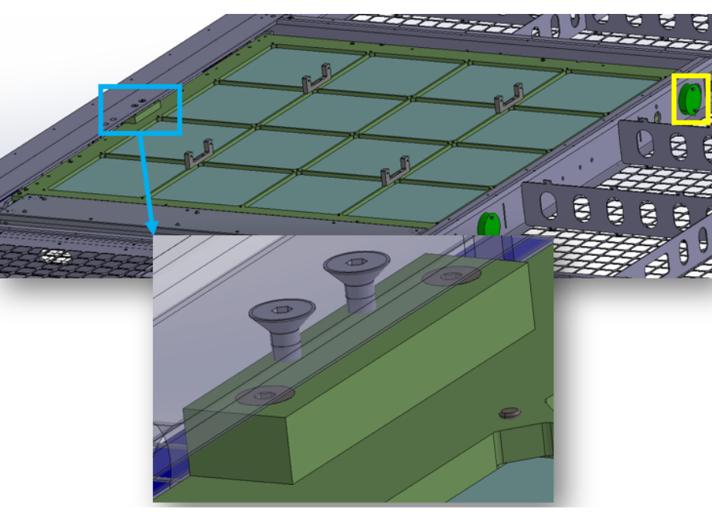
Cathode mounting points
PD modules mounted in cathode with 3-point suspension
Two configurations: Perimeter and interior mounting
Perimeter
Interior

Slide 7
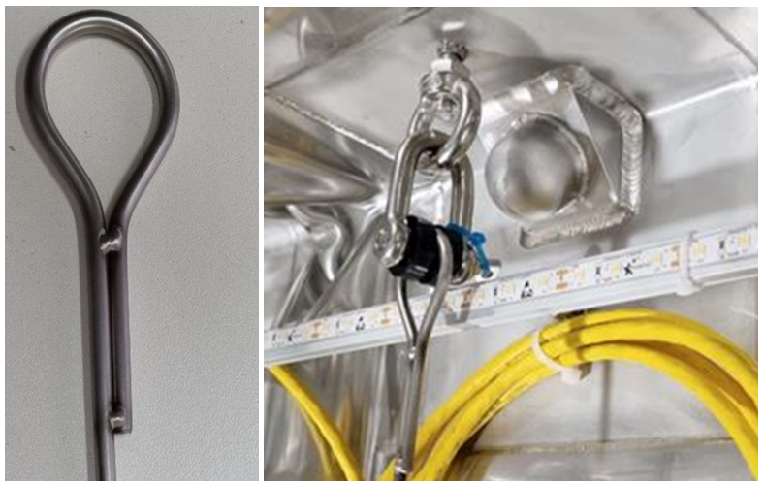
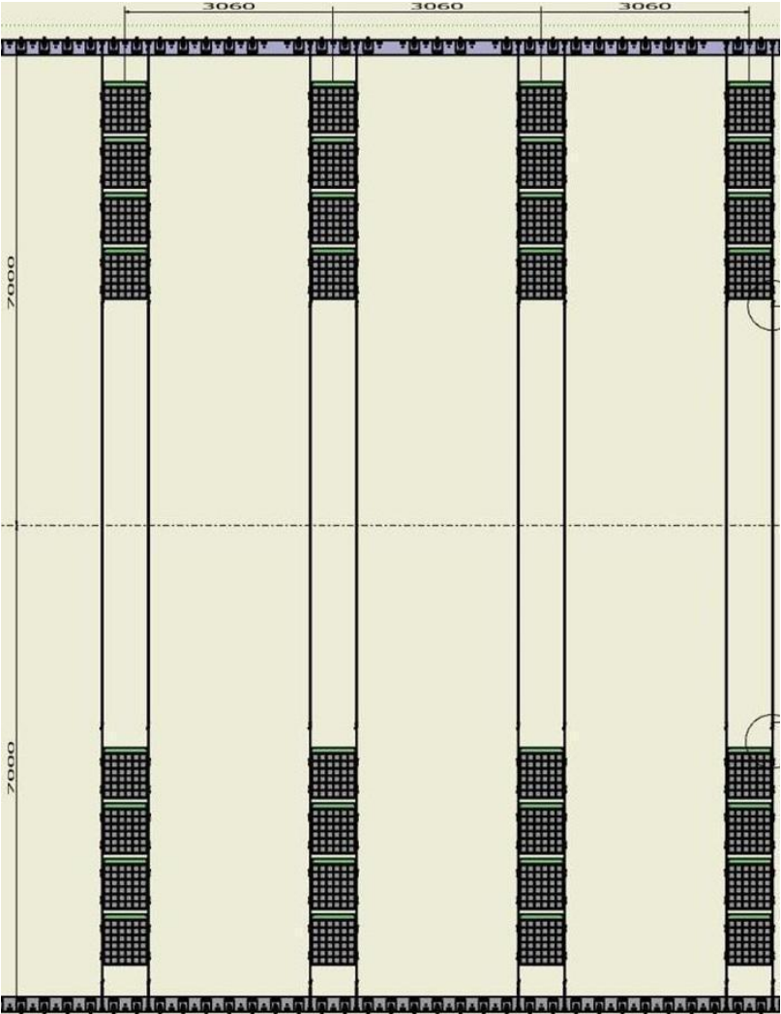
Membrane mount
PD modules mounted in cathode with 3-point suspension
Two configurations: Perimeter and interior mounting
HV
Protection
Mesh

Slide 8
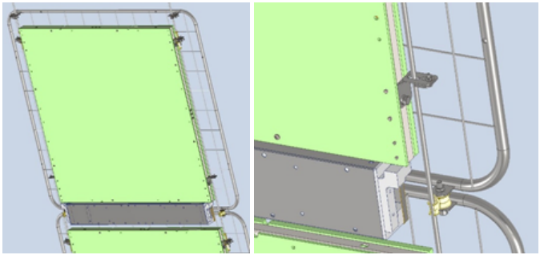
Module mounts to suspension lines
Modules attach to suspension lines at 4 points using a single M5 screw for each support
Mounting system designed to address thermal expansion of module relative to suspension lines:
Upper supports carry weight, restricts motion in plane perpendicular to cable
Lower supports allow motion along suspension line, restrict motion in plane perpendicular to cable
HV shielding meshes attach with similar supports
Upper constraint.
Lower Constraint

Slide 9
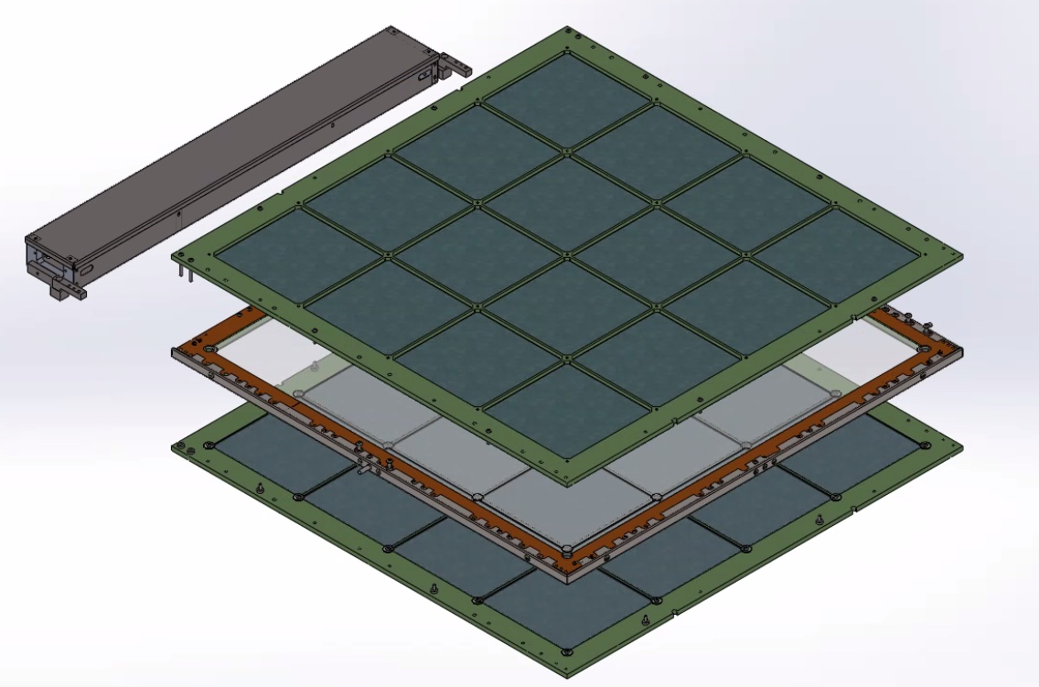
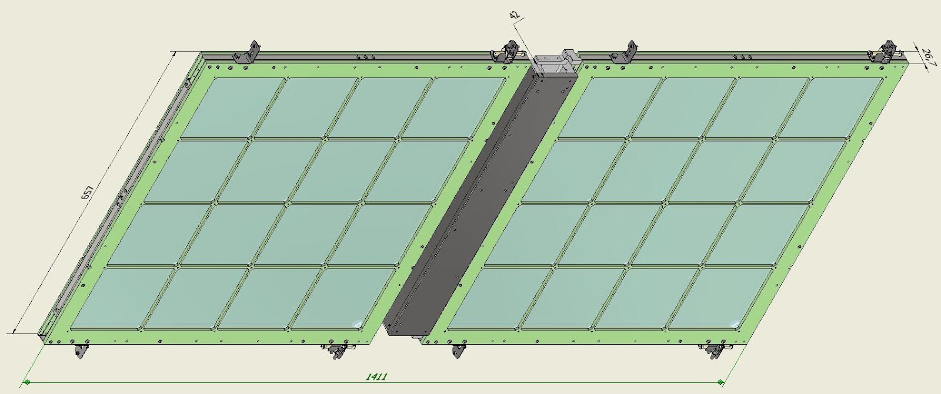
Module dimensions
Cathode Module
Membrane Module
Membrane modules sharing electronics box

Slide 10
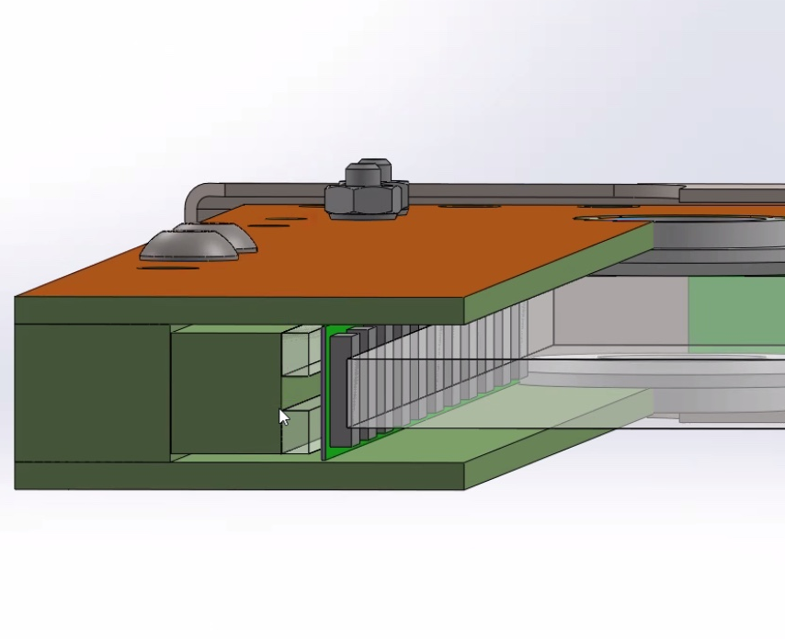
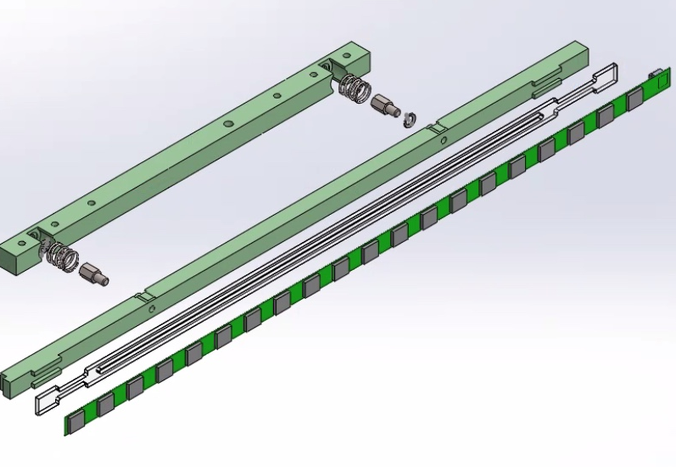
Spring-loaded SiPM mounting
2 springs push SiPMs against WLS plate
Designed to accommodate full relative WLS plat motion during cooldown (~6mm)
Acrylic shoe behind flexi PCB to manage contraction of PCB

Slide 11
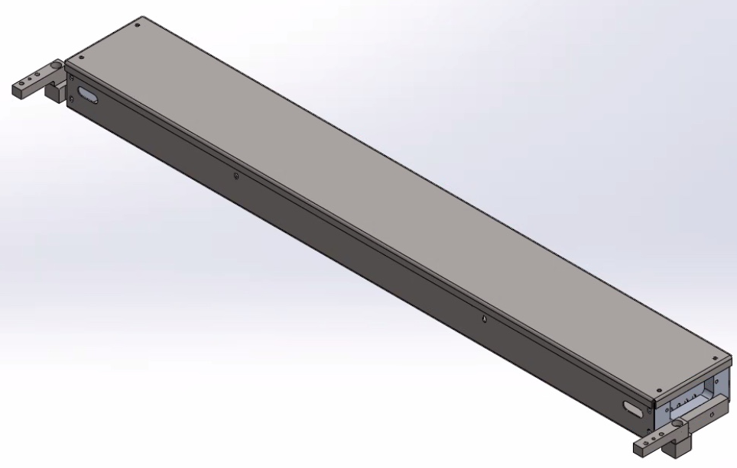
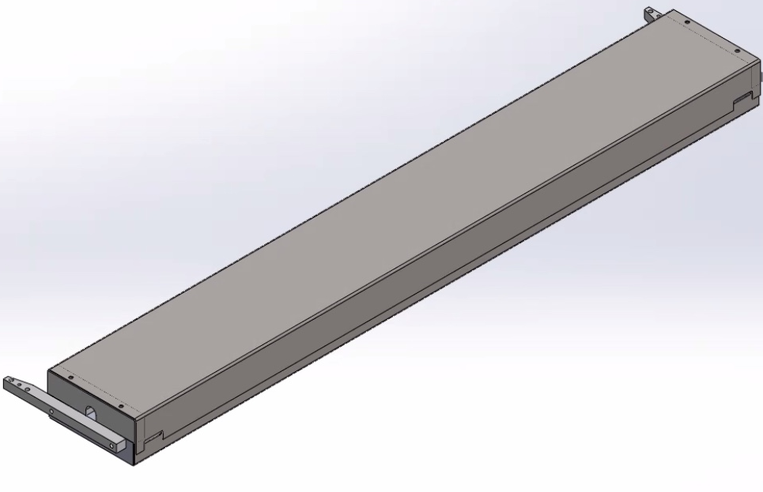
Electronics enclosures
Folded stainless-steel sheet metal box.
Top cover can be removed after assembly to allow electronics hookup following installation in cryostat.
Extends module Faraday cage around electronics.
Provides light shield around POF and SOF to protect module
Cathode electronics box
“Fork lift” mounting arms
Membrane electronics box
(note openings in back)
Membrane module shared electronics box

Slide 12
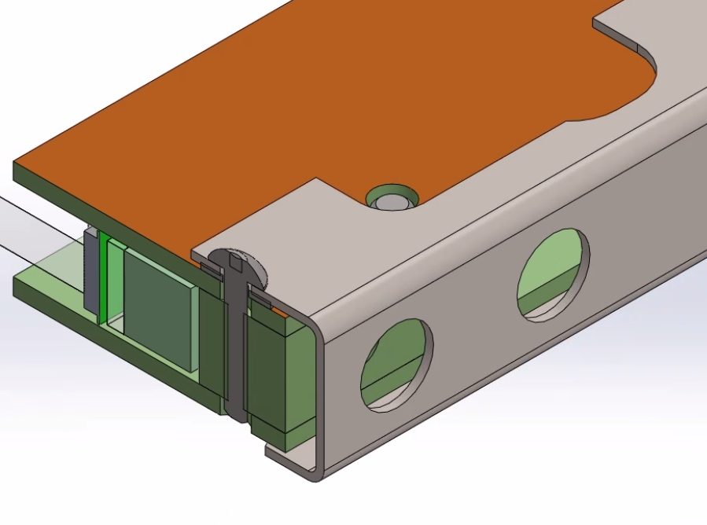
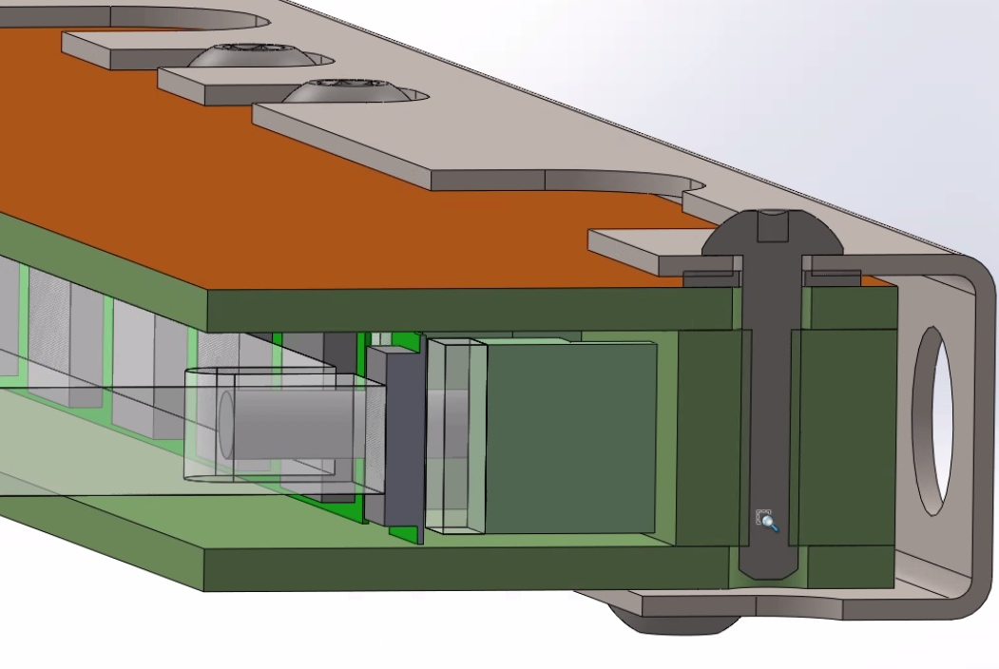
Cathode HV breakdown protection
3-sided Faraday cage (single-sided copper-clad FR4, stainless steel backing channel) provides protection for SiPMs and cables.
Connected to electronics box ground.
Enclosure designed to protect SiPMs after thermal contraction of WLS plate.
Validated by simulations at FNAL, BNL.

Slide 13
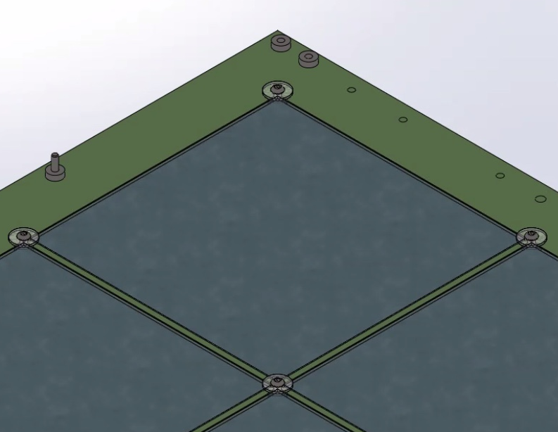
Filter Frame Assembly
Dichroic filters are supported in pockets in FR-4 G-10 frames.
Held in place by polycarbonate washers with M3 screws.
Assembly time is approximately 30 minutes per frame
Frame ribs covered with Vikuiti to increase light collection
Polycarbonate
Washers

Slide 14
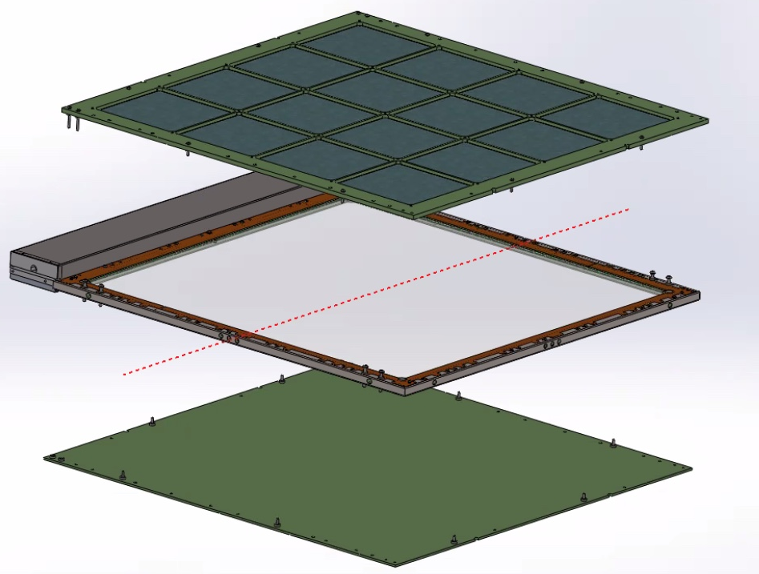
Shipping/ underground assembly plan
PD modules were designed to be shipped in 3 pieces:
Core assembly (including SiPMs, WLS, electronics box, Faraday cage) pre-assembled at assembly sites
Filter frame assemblies (or filter frame and backing plate for membrane module
Dichroic filter plates
Assembly at SURF will consist of
Loading filters into frame (~ 30 minutes per frame
Screwing frames to module core (~10 minutes per frame)

Slide 15
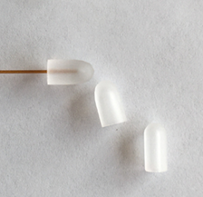
Monitoring system mechanicals
Possible fiber
end diffusers

Slide 16
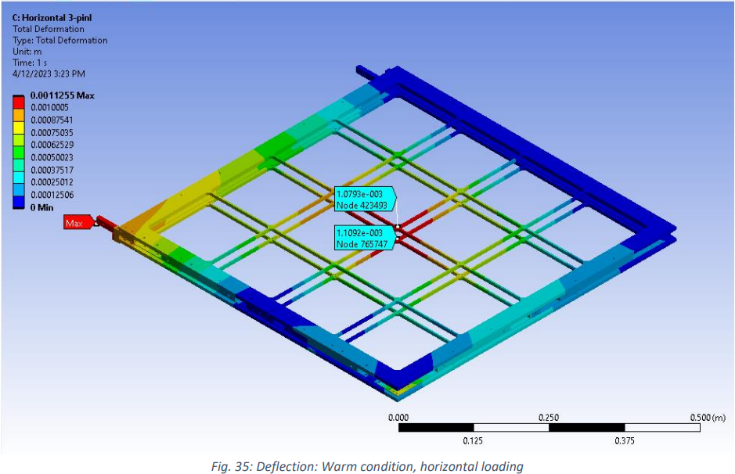
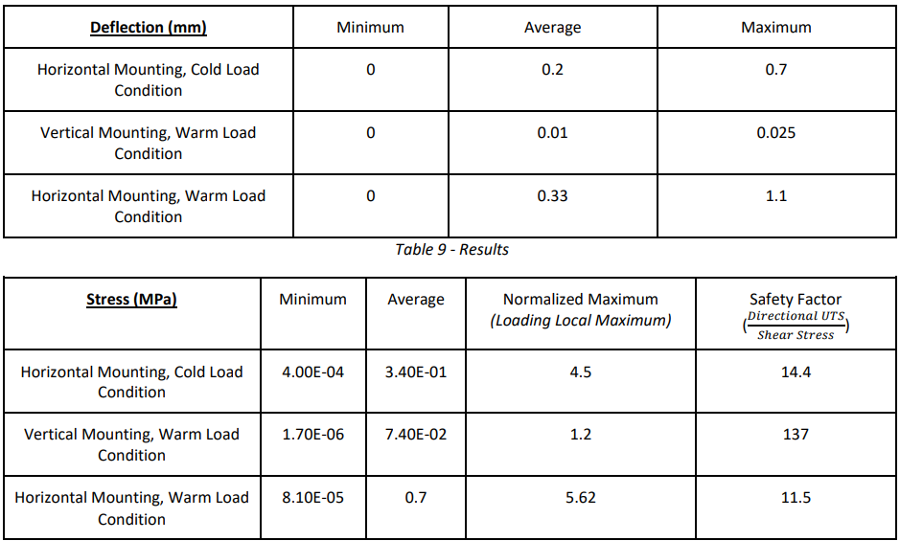
Compliance Office Analysis Documents
Analysis results for membrane mount supports
Analysis plan submitted to compliance office. https://edms.cern.ch/document/2883231/1
Analysis report submitted to compliance office. https://edms.cern.ch/document/2883232/1
All loads and deflections within reasonable safety factors
Awaiting reply from compliance office
Analysis results for module deflections in cathode support

Slide 17
Conclusions
Extensive testing in the NP02 cold box and Module 0 have resulted in a well-proven mechanical system.
Multiple phases of design evolution and internal reviews have led to an easy to assemble, reliable module design.
Engineering analysis show that the support systems are reliable and meet required safety factors.
Manufacturing and QC plans are well advanced and reasonable.
The PD mechanical system is well advanced and ready to prepare for the Production Readiness Review.

Slide 18
Backups

Slide 19
Many selected drawings from drawing packages here…

