Slide 1
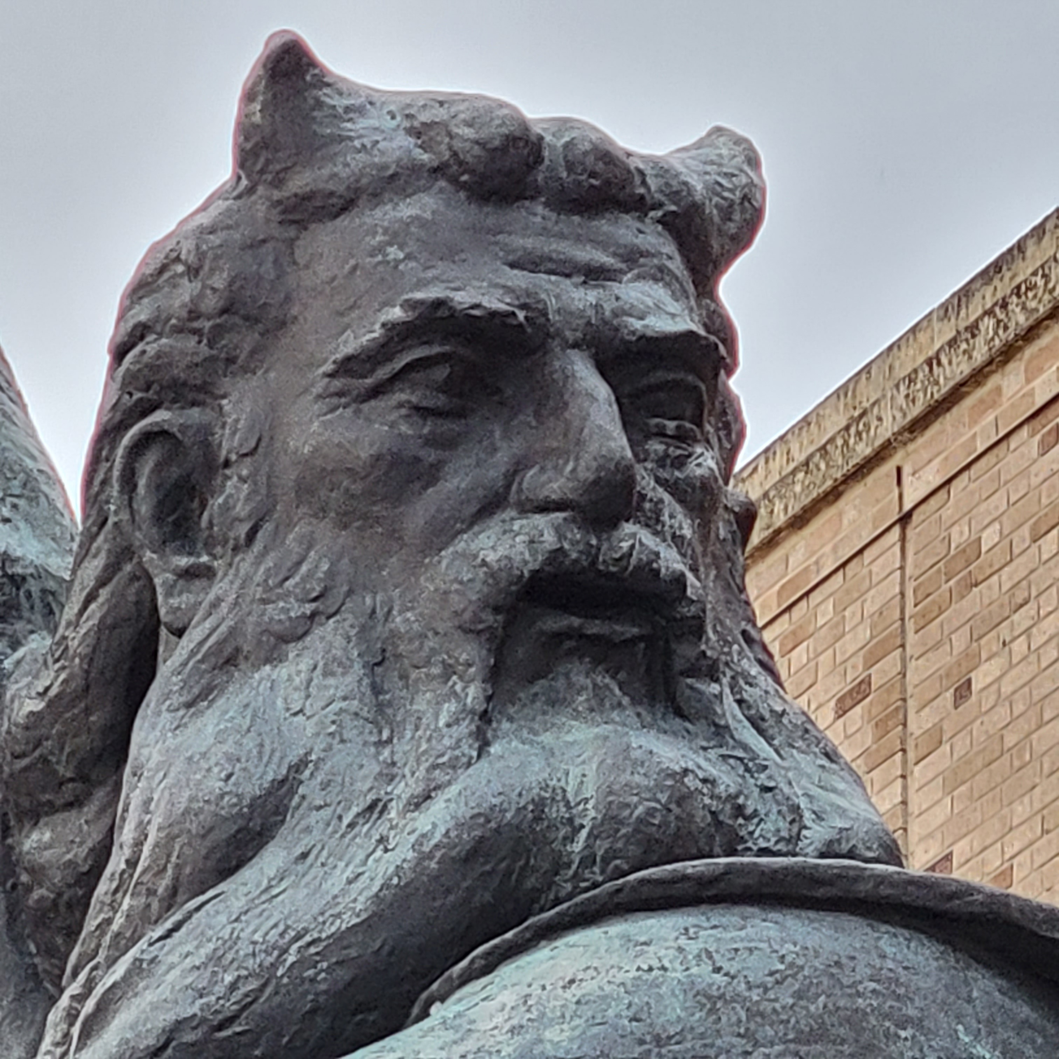
Test beam at Notre Dame Radiation Lab
Dan Levin, Yuxiang Guo
for UM Calvision team

Slide 2
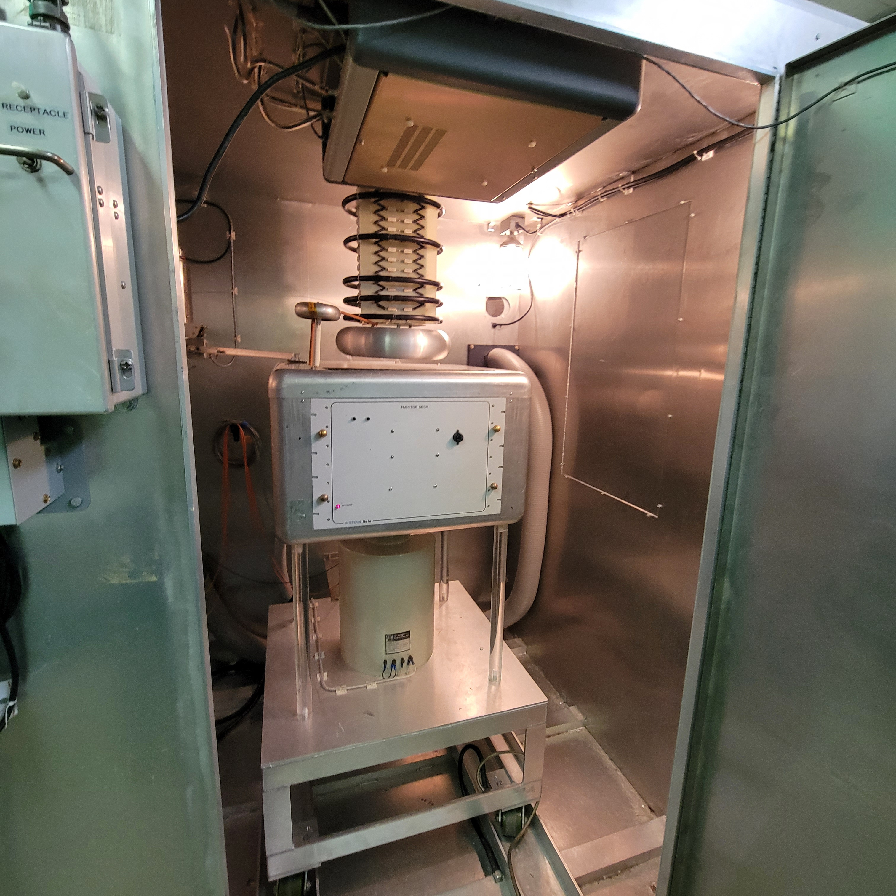
Beam line
electron source - injector

Slide 3
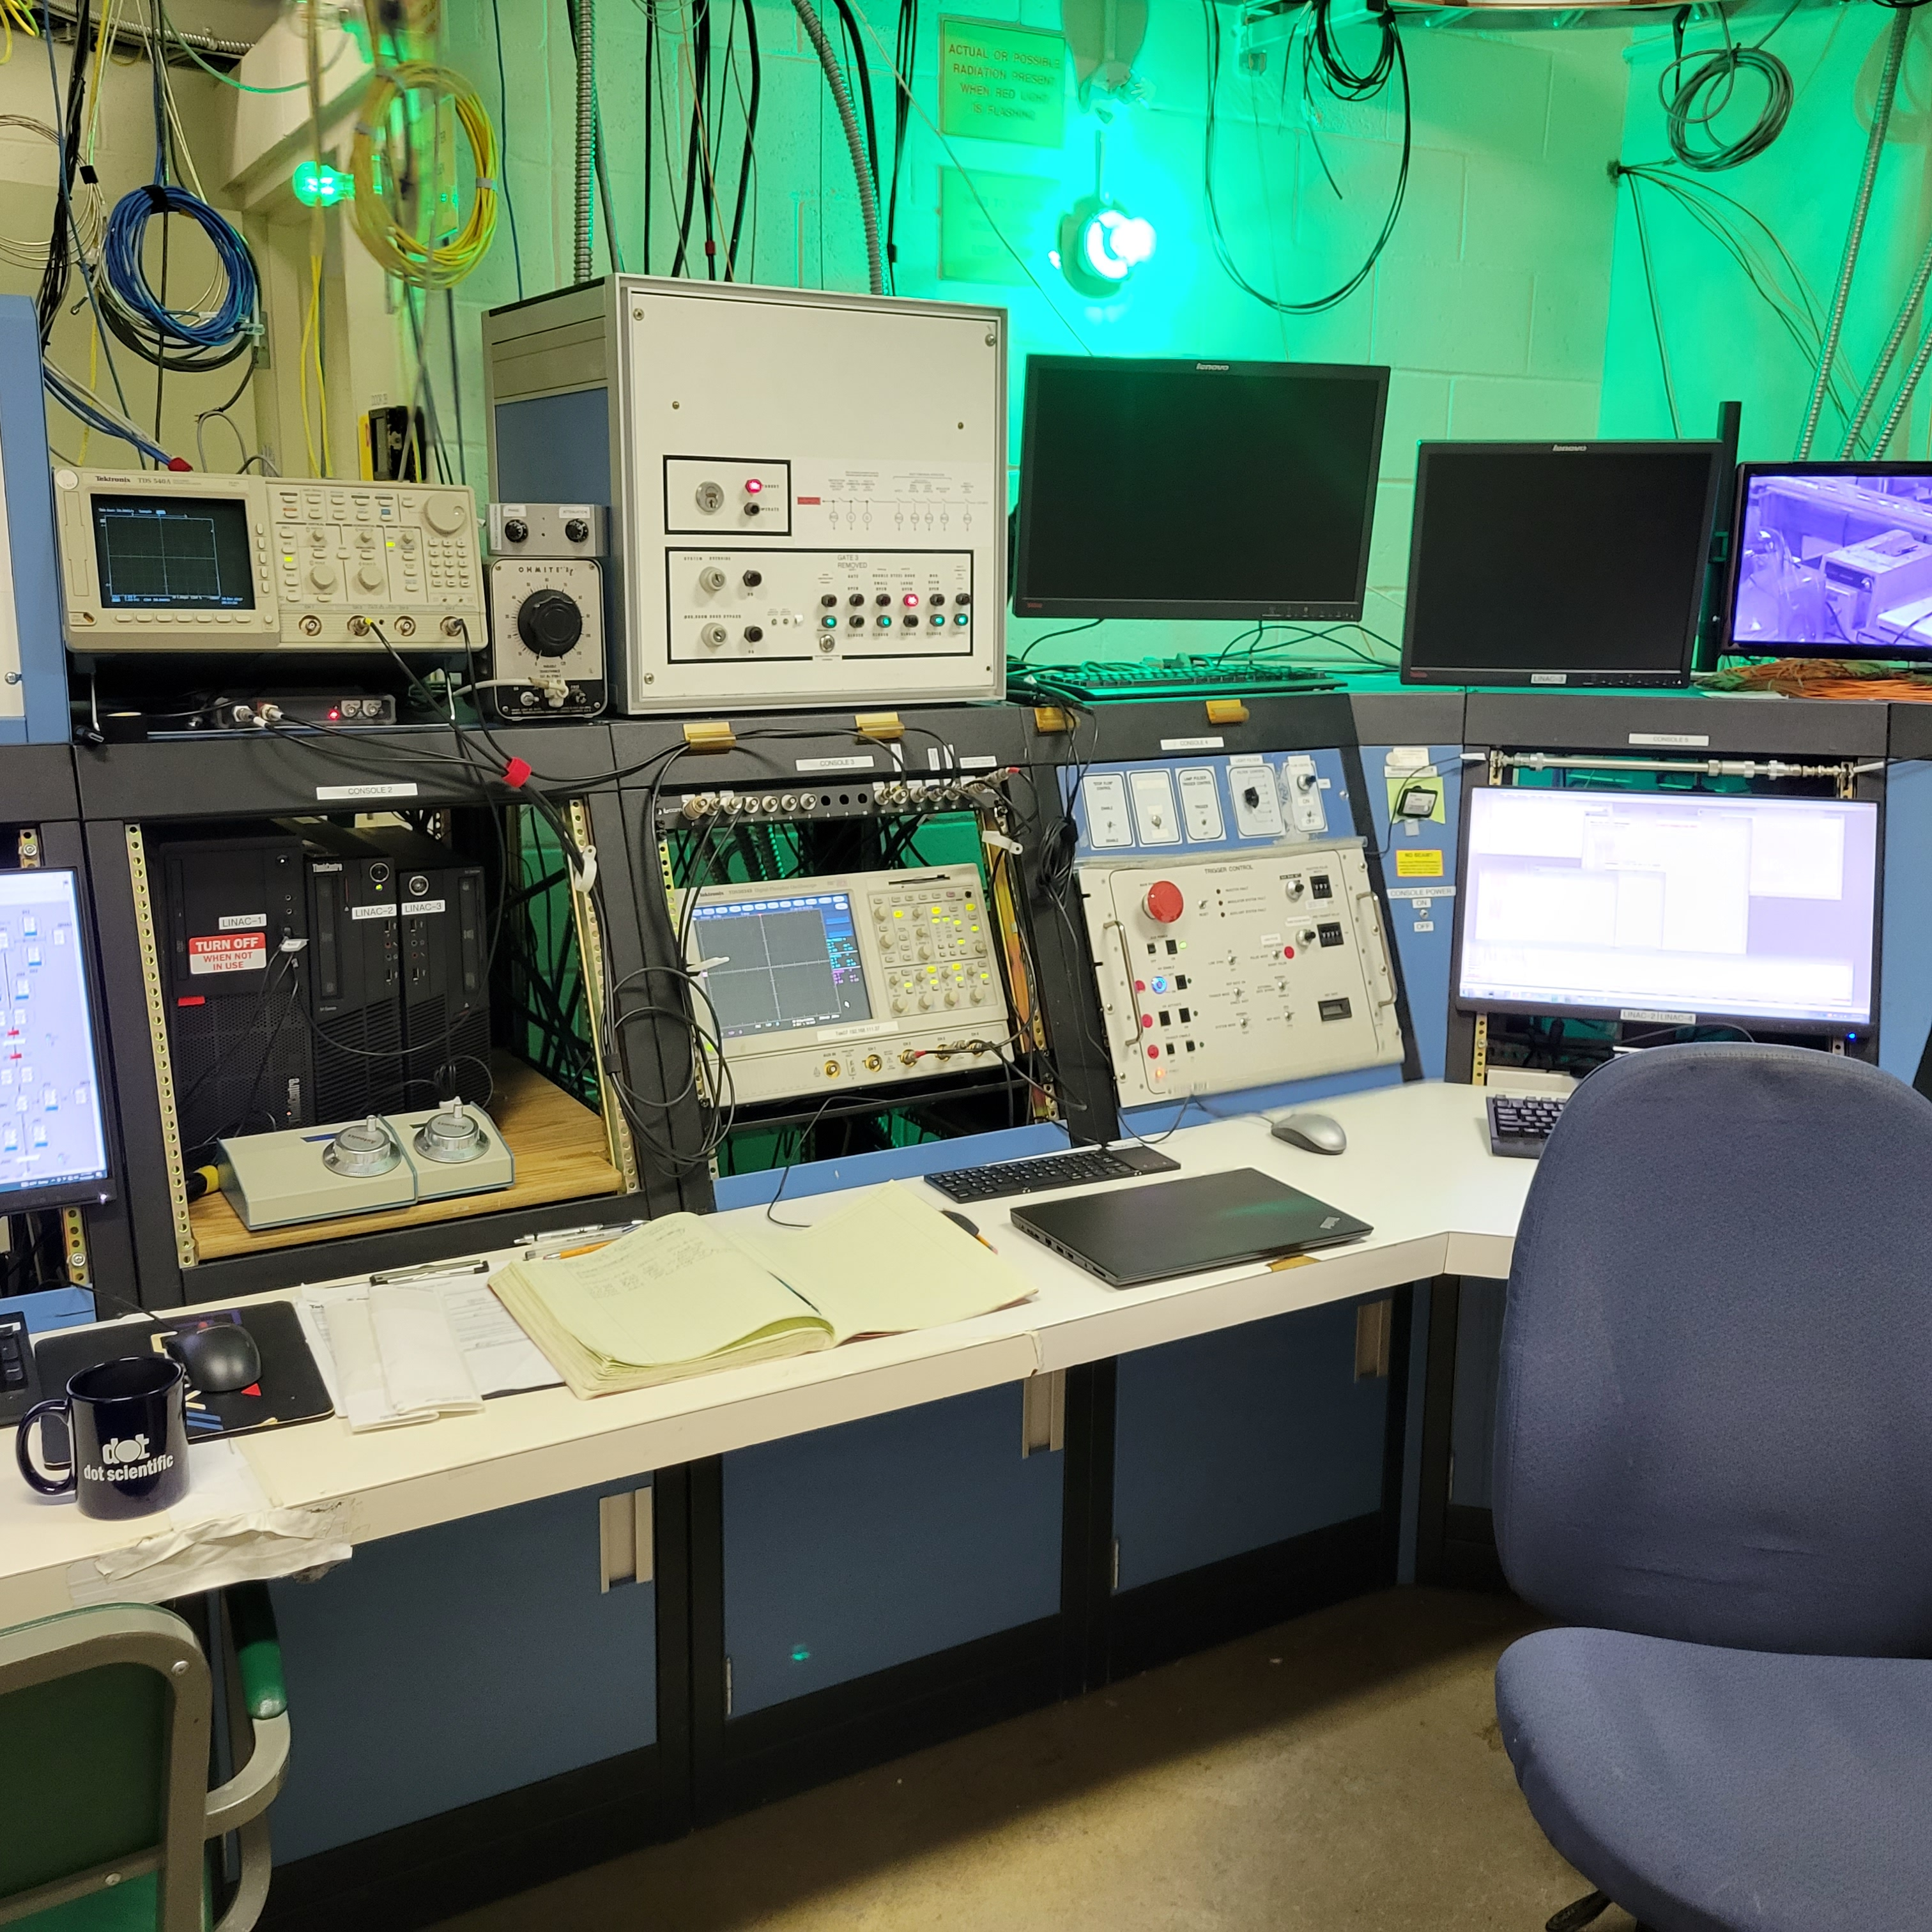
Control room
pulse measurement

Slide 4
What kind of pulse ?
Generates 8 MeV electrons
pulsed beam with injector: width = 1 ns to 1.6 us
Pulsed beam with injector : repetition rate. Was 30 Hz (normally can be 60 Hz)
We ramped down to very short ~ 1 ns (FWHM) pulse of many particles.
max current > 1 amp. We lowered the current to lowest measurable using beam transformer and Faraday Cup/
minimum measurable charge per pulse
➔ 0.09 nC using in-line inductive pickup
defocus to achieve arbitrarily low rates.
Cannot directly measure with in-house instrumentation !
Gauge pulse intensity using the known average pulse height from CR muons in PWO
rep rate = 30 Hz
1 ns

Slide 5
We provided our own beam collimator: ¾ inch thick steel with 4.9 mm aperture
5 mm bore
low particle count per pulse
rep rate = 30 Hz
1 –1600 ns

Slide 6
Estimate the charge /pulse using PWO– normalized to CR muons as follows:
Average pulse amplitude = 100 mV from CR muon
Average energy loss in PWO for 8 MeV electrons dE/dX = 2.1 MeV cm²/g (from estar NIST database)
PWO density = 8.28 , approx. pathlength (avg =2.5 cm)
==> total muon energy loss = 44 MeV ==> this is equal to about 5 electrons
During beam set up we defocused to get abut 400 mV signal
➔ about 50 electrons/pulse.

Slide 7
Rotatable platform
Use worm-gear drive, remote control stepper motor
collimator
beam pipe
SiPM readout
board
SiPM readout
board
Test crystal
cradle

Slide 8
SiPM placement
e11
e12
25 mm
s12
s11
e21
e22
s22
s21
60 mm

Slide 9
Signals available: total 9 channels (8 SiPMs, + 1 PMT)
DAQ channels = 4
All readout conducted with S11, S12 and E11, E12. (two side and two end rows)
4 SiPMs
area of each = 6mm x6 mm
PMT
4 SiPMs
area of each = 6mm x6 mm
𝜃
Beam angles: -60 < 𝜃 < 30
Beam max radius ~ 1 cm

Slide 10
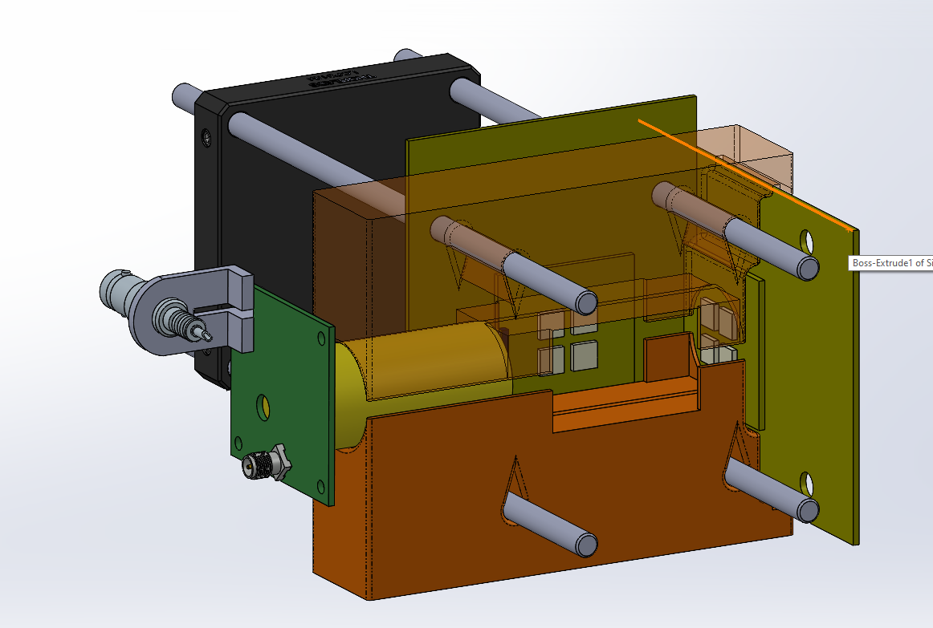

Slide 11
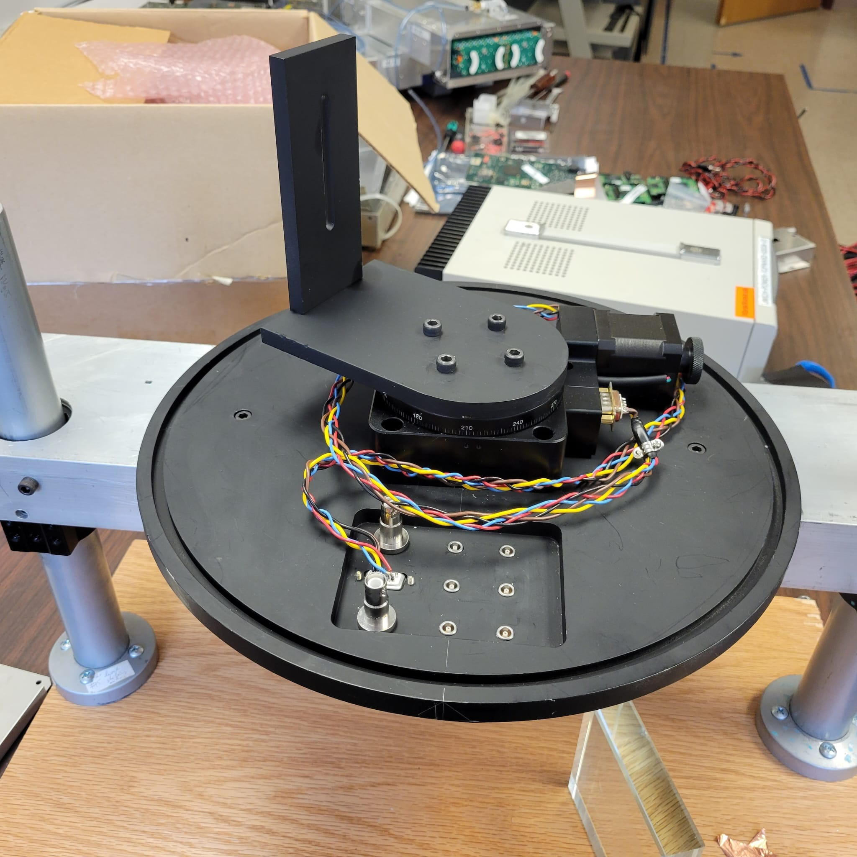

Slide 12
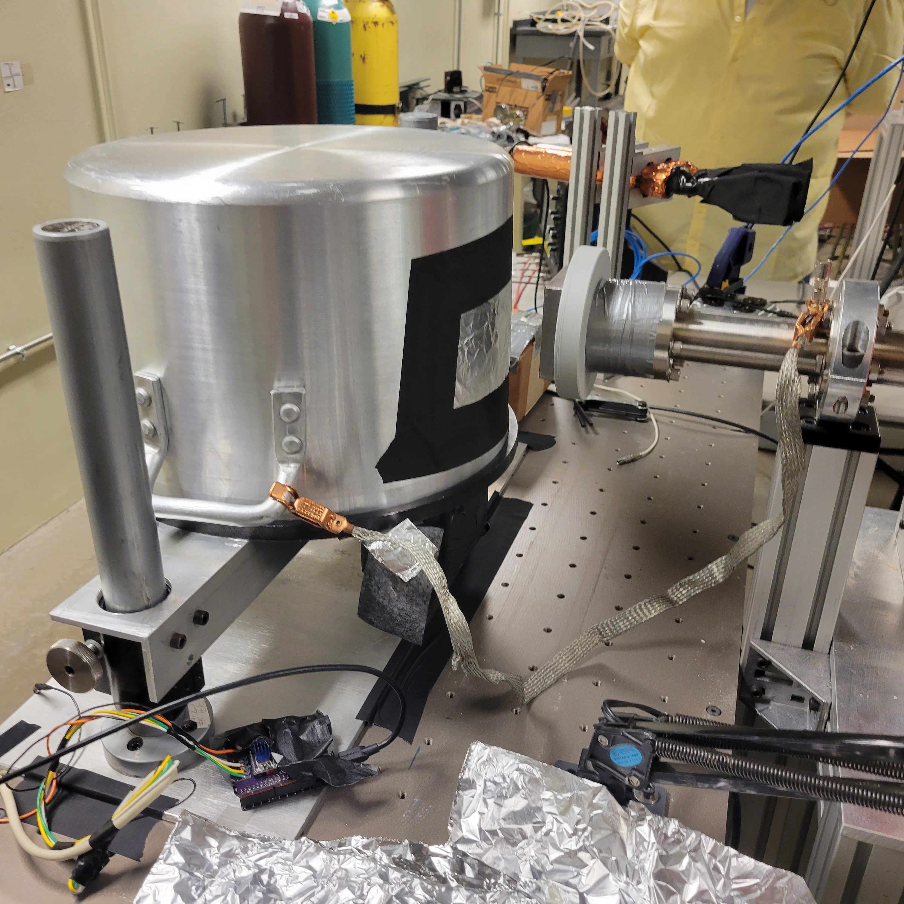
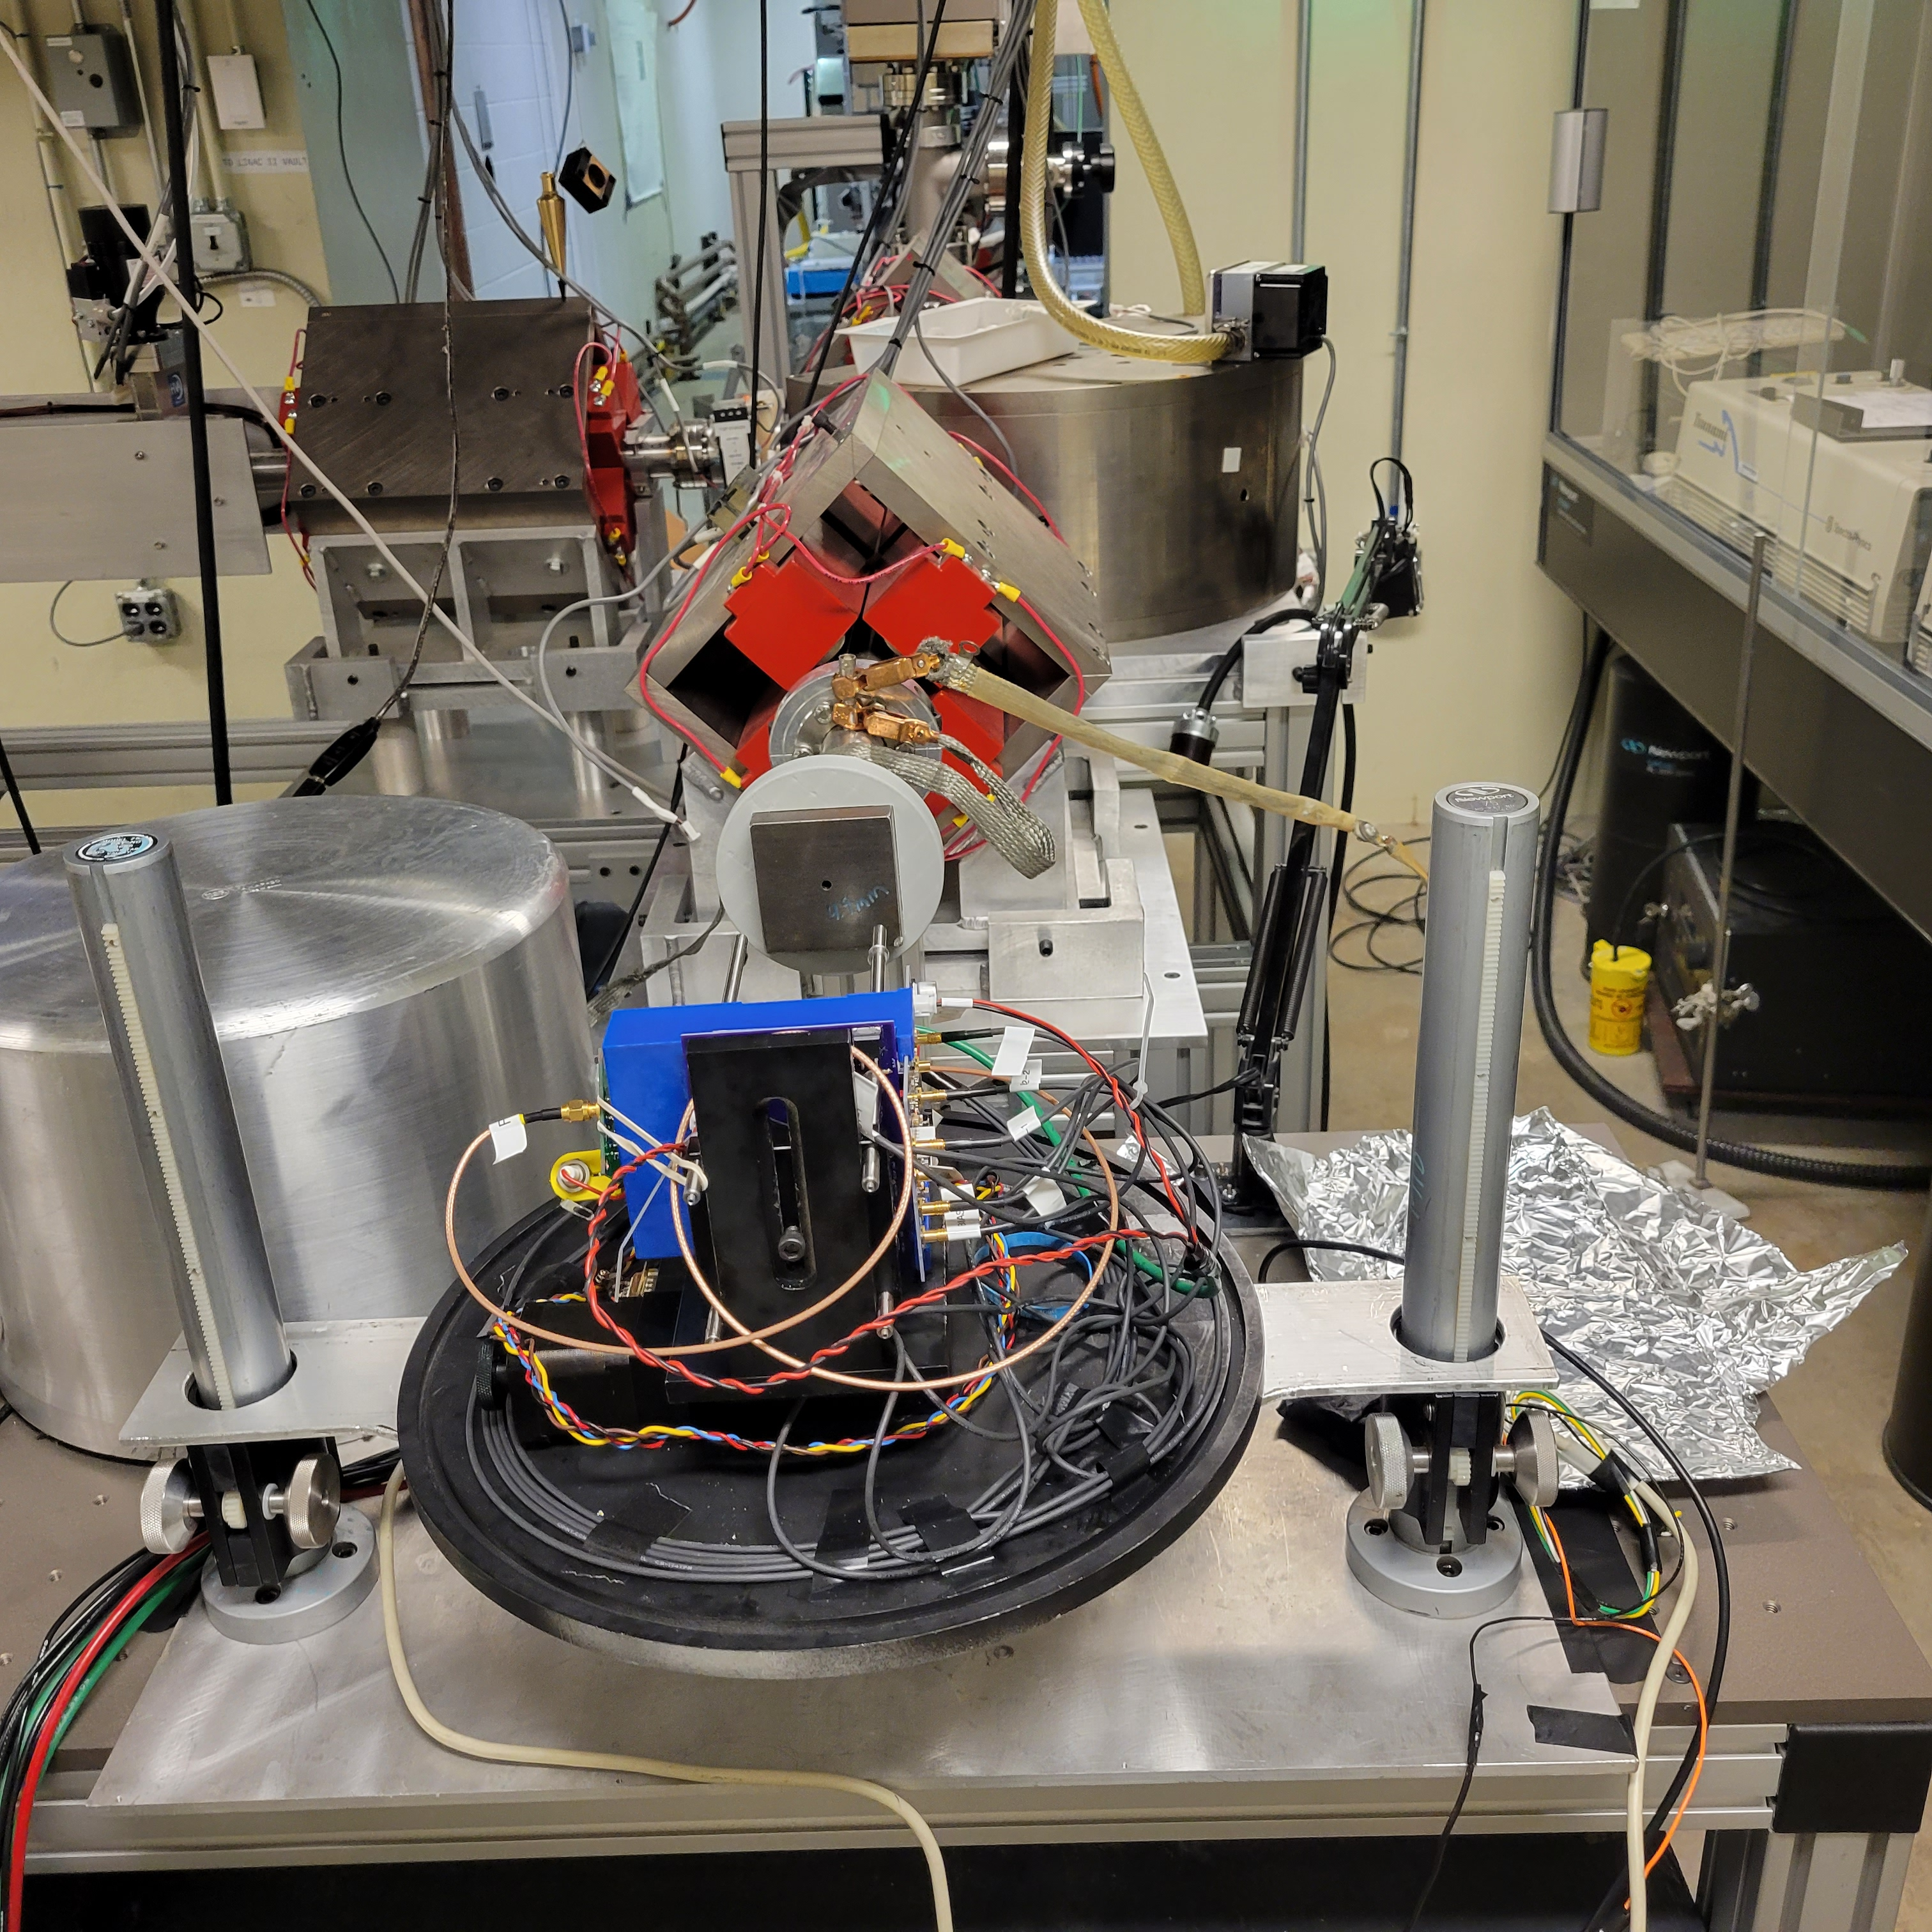

Slide 13
Test samples:
Chemical | Density g/cm³ | Index refraction | dE/dX 8 MeV ele. (range cm) | Cerenkov |  | Scintillation
 |  |  |  | Threshold [MeV] | Yield ph/MeV | Peak 𝜆 | Yield ph/MeV | Decay time [ns]
PbWO₄ (PWO) | 8.28 | 2.16 | 2.1 (0.3 ) | 0.066 | tbd | 420 | 200 | 6-20
Bi₄Ge₃O₁₂ (BGO) | 7.13 | 2.15 | 2.03 (.72) | 0.066 | 20 | 480 | 8K-10K | 300
PBF₂ | 7.8 | 1.8 |  | 0.103 |  |  | ~500
Optical glass Silica (59%) + PbO ? unknown | 2.2 | 1.5 | 2.05 (2.3) | 0.190 | tbd | N/A | N/A | N/A

Slide 14
Experimental considerations:
Look for Cerenkov signal features:
in optical glass block as reference without scintillation
evaluate with SiPMs
with/without the U330 notch filter
With/without long wavelength pass filter
Evaluate for BGO, PWO, Optical glass
Evaluate usefulness of NDRL for future experiments

Slide 15
DAQ/readout
Photodetectors are the 4 channel SiPM board.
Use the fast Tektronix (1 GHz BW) digital scope
Readout rate capability = 45 hz, four channels at 2000 points/scan

Slide 16
Program
Dataset: 1 minute runs at 45 Hz: ~2K events/run
2 samples: BGO, PWO, Optical Glass)
each sample: data at. 60, 40, 20, 0 , -20 degrees
each sample with and without filters on end SiPMs only.
Trigger:
Option 1: two side SiPms in coincidence No filter.
Readout :
two side SiPMs and two End SiPMs (same row).
Many other possible combinations using linear analogue fan in- but we did not pursue this.

Slide 17
Preliminary results
Total of 49 data runs
Evaluated PWO, BGO, Glass
Tested with and without long pass PWO and B˝O and notch filter on BGO only
Most runs were ~ 1 minute, about 500 events each
Conducted one long run of 15 minutes to check beam stability.
Data consists of full waveform in the DSO readout window
Beam diameter measured using a beam monitor imager.

Slide 18
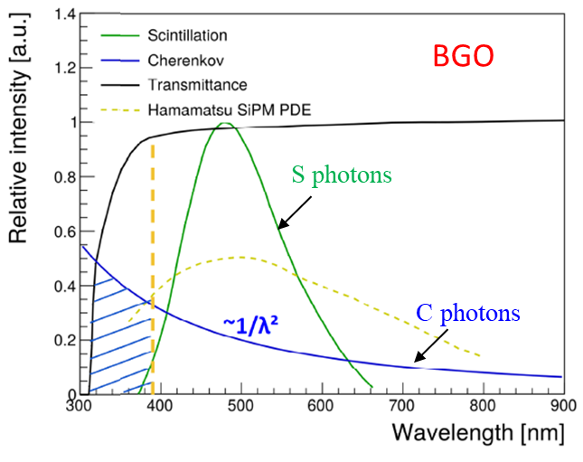
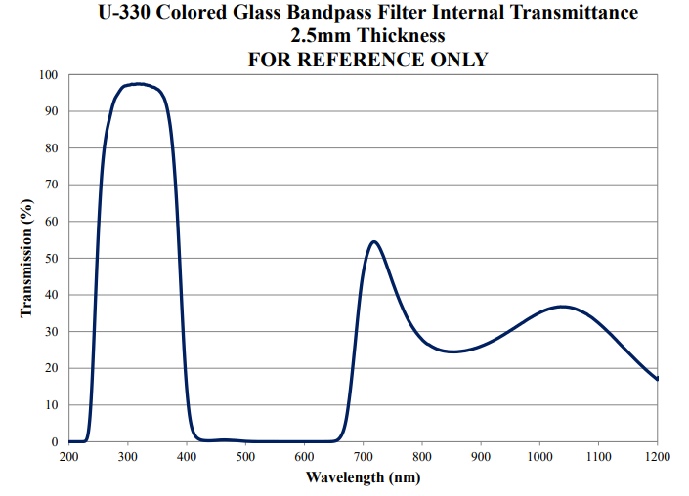
U330 notch filter
18
U330

Slide 19
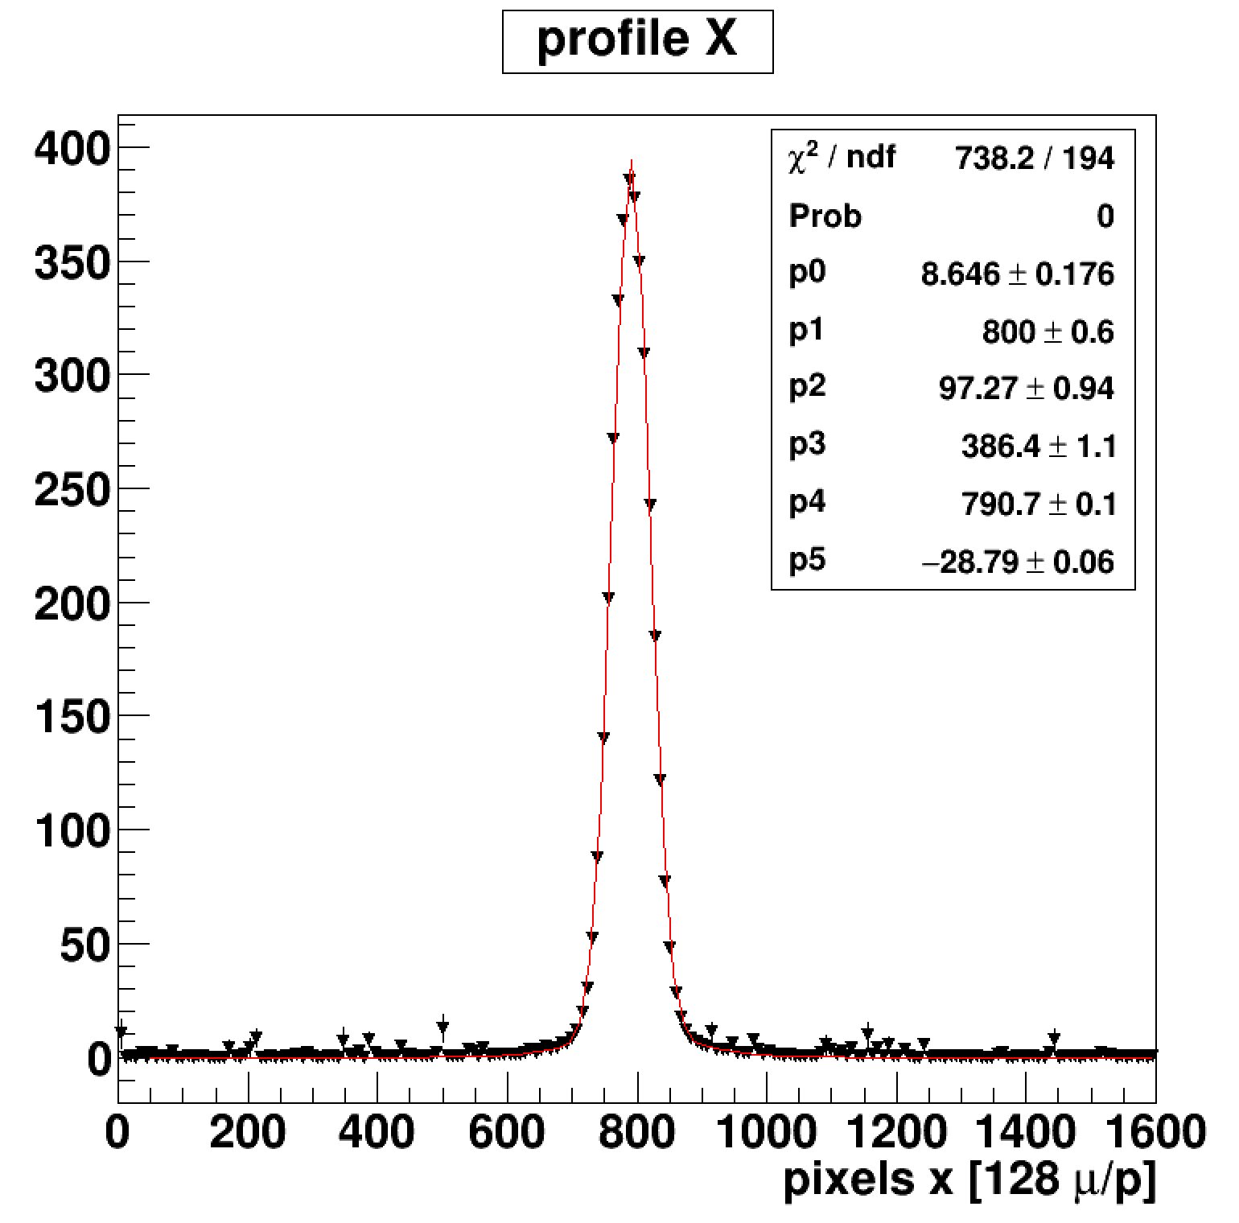
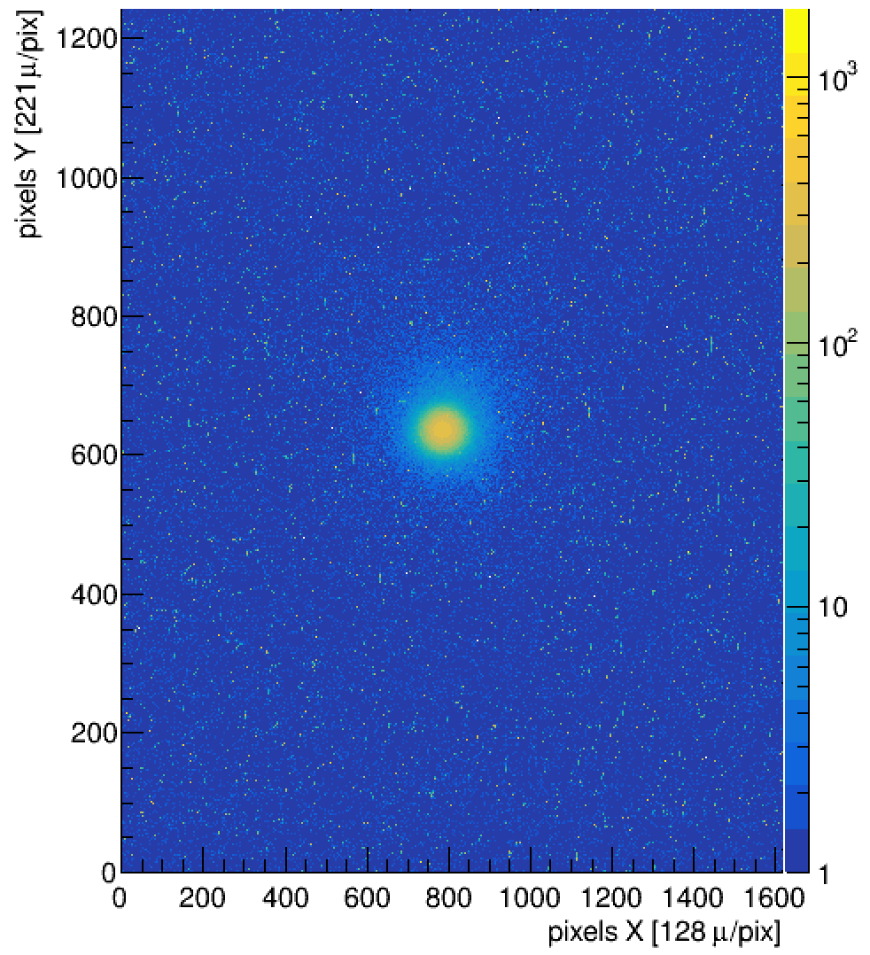
Image from the prototype Fast Scintillator Beam Monitor
3.2 nC/pulse
FWHM = 8.7 mm
Image plane is at 9 cm from 5 mm aperture
Crystal surface is 20 cm from aperture
FWHM at crystal surface ~ 1.4 cm
beam used for crystal test ~0.3 nC/pulse

Slide 20
H
h
r = 2.5 mm
5 mm dia
x = 9 cm
X = 20 cm
FWHM @ 9 cm = 2(h+r) =9 mm ➔ h= 2mm
H=h(X/x) = 4.4 mm
FWHM @ 20 cm = 2*(H+r) ~ 1.4 cm

Slide 21
Data prep:
49 runs in hdf5 binary Digital Sampling Oscilloscope format
readout into temporary text files using python
all data files from all runs merged into a single root tree (with thanks to Claudio )
File is NDRL.root 12 GB
Analysis conducted on the root tree
Analysis considerations:
Due to:
Variations in beam over time
Beam intensity changes due to incidence angle
Large diameter of beam at crystal surface also introduces systematic change WRT angle
➔ develop a metric that is insensitive to these factors

Slide 22
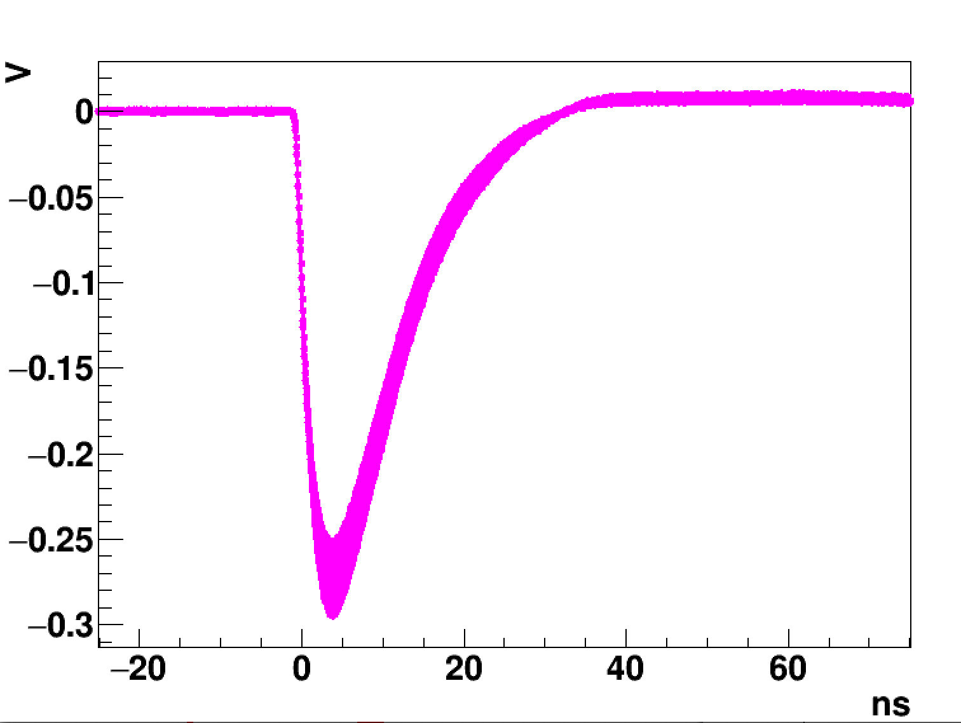
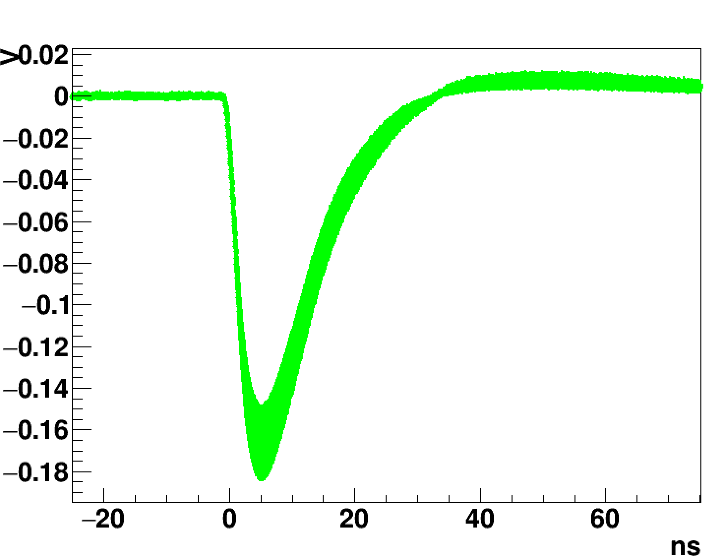
Average of 500 waveforms:
no filter
0 degree incidence angle
PWO
side
PWO
end

Slide 23
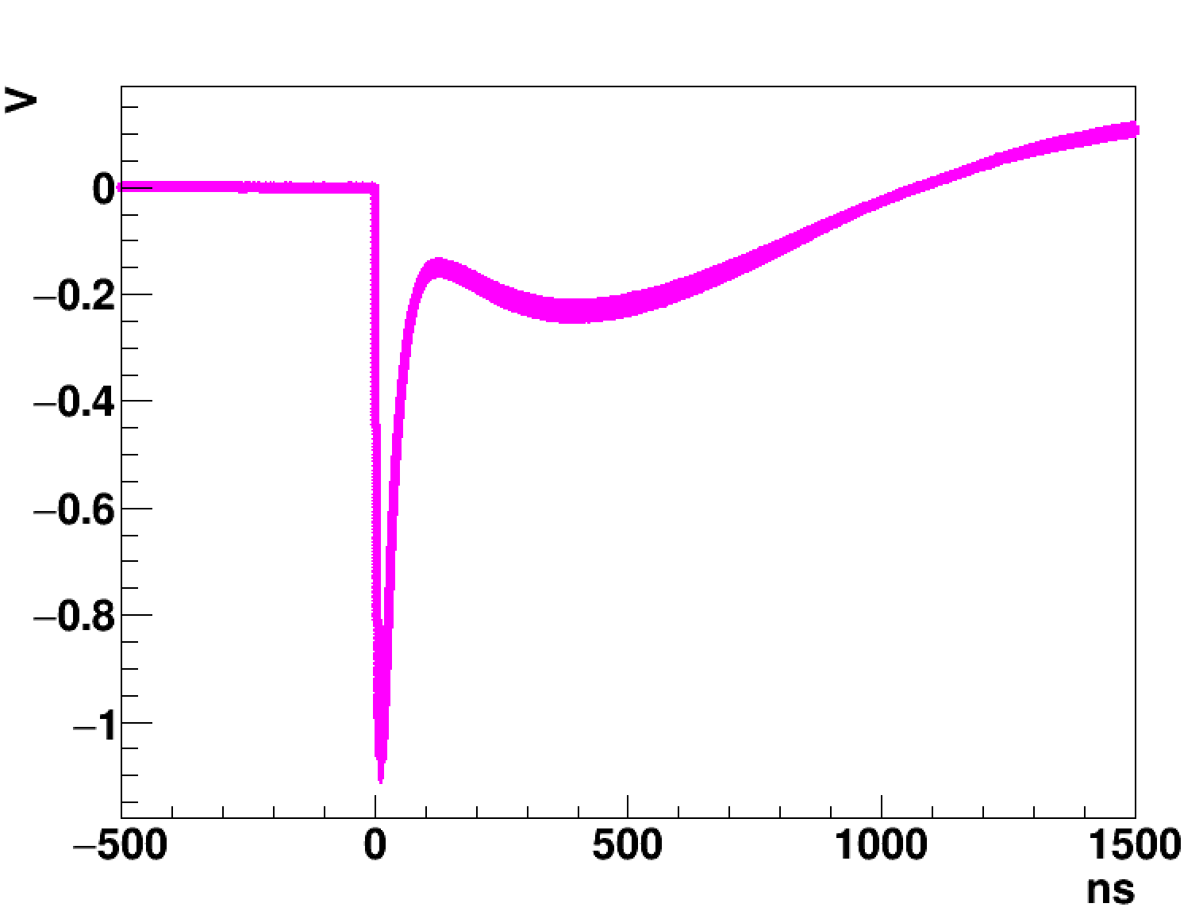
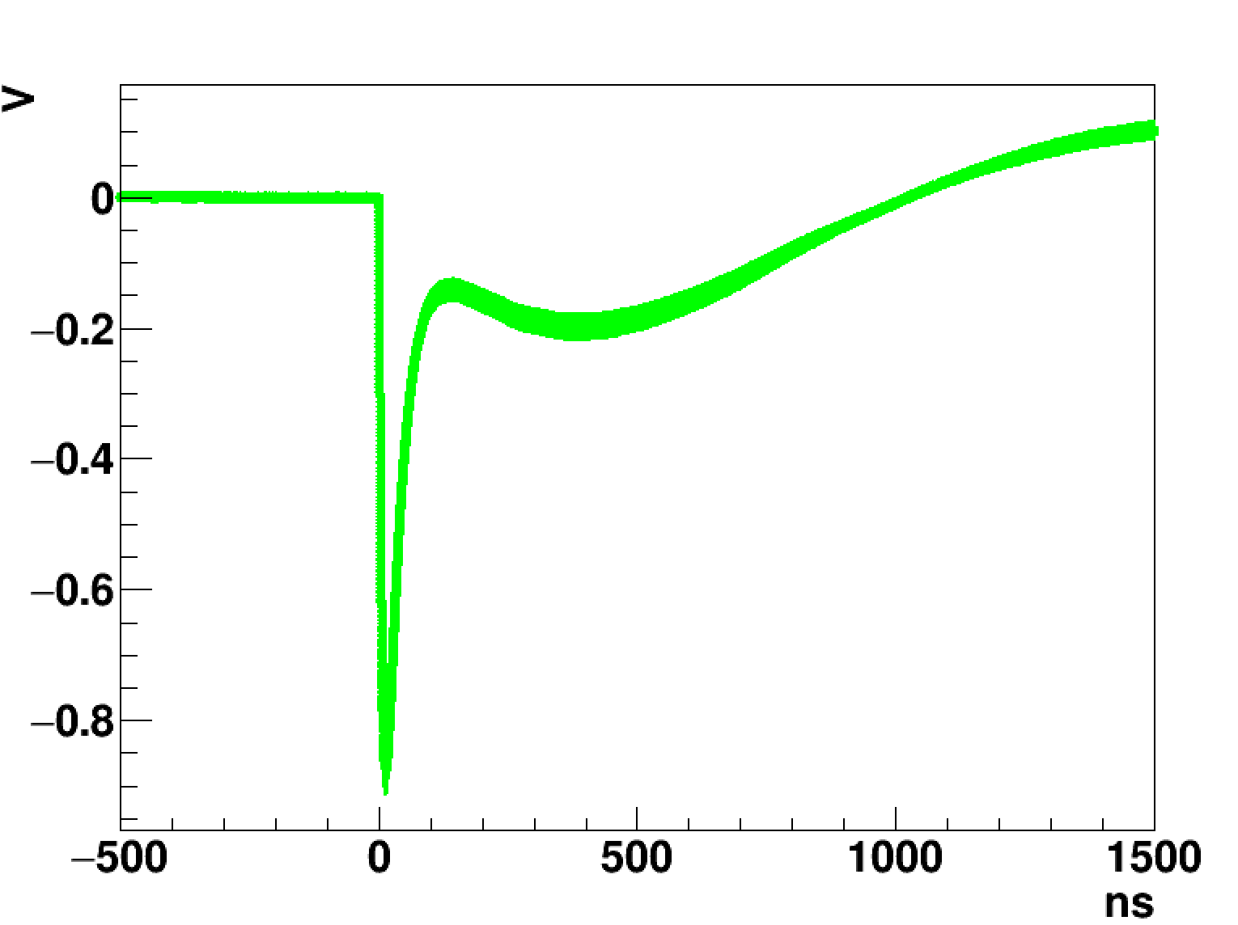
Average of 500 waveforms:
no filter
0 degree incidence angle
BGO
side
BGO
end

Slide 24
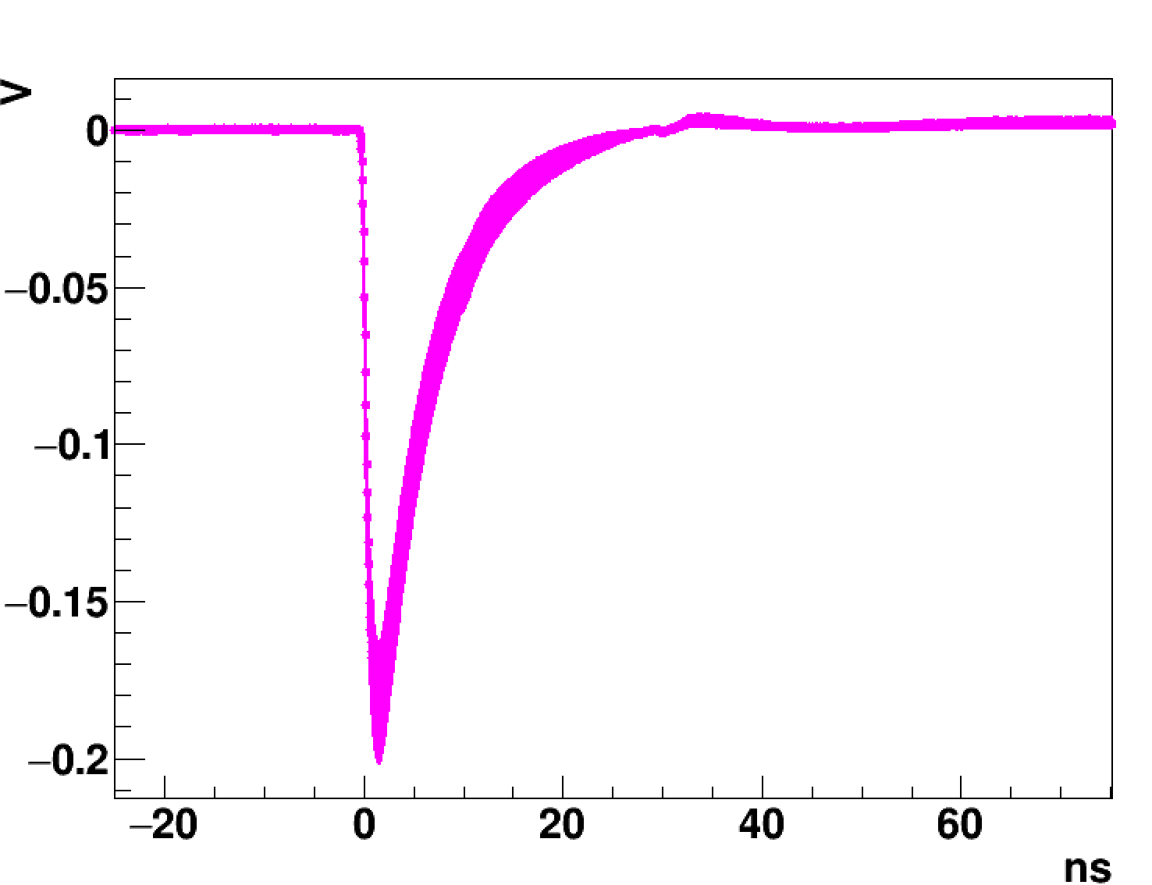
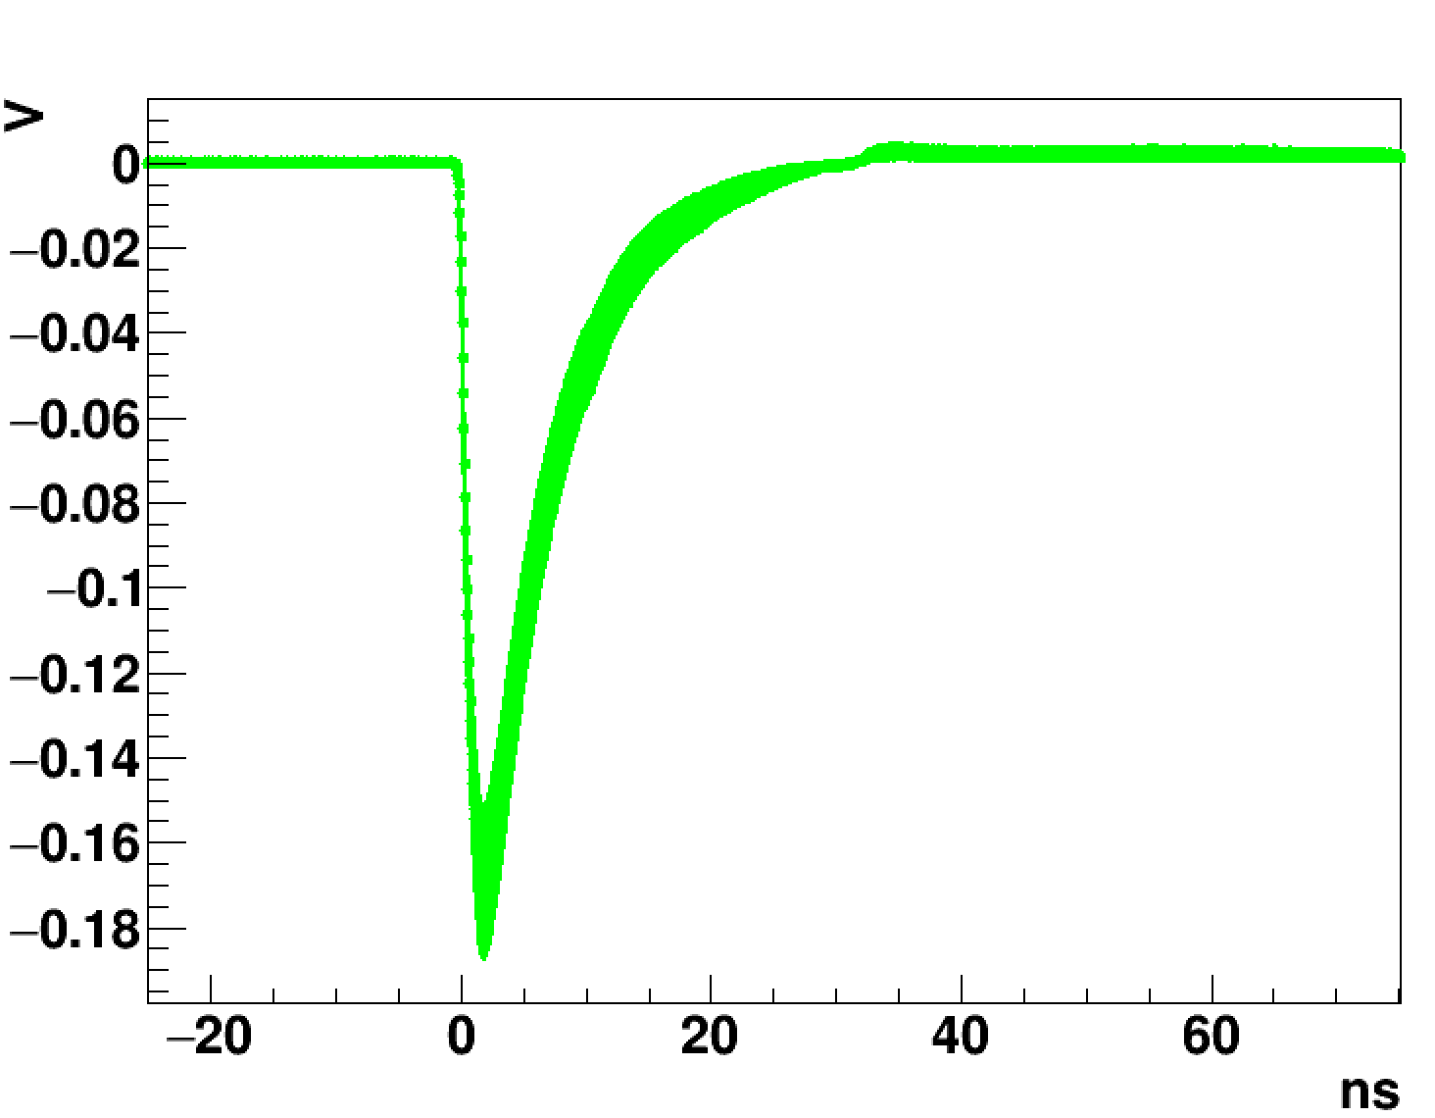
Average of 500 waveforms:
no filter
0 degree incidence angle
Use glass sample for Cerenkov only signal
Side vs End readout channels similar
- same FWHM = 7 ns
Cerenkov signal is delta function:
- FWHM and decay is feature of the SiPMs.
glass
side
glass
end

Slide 25
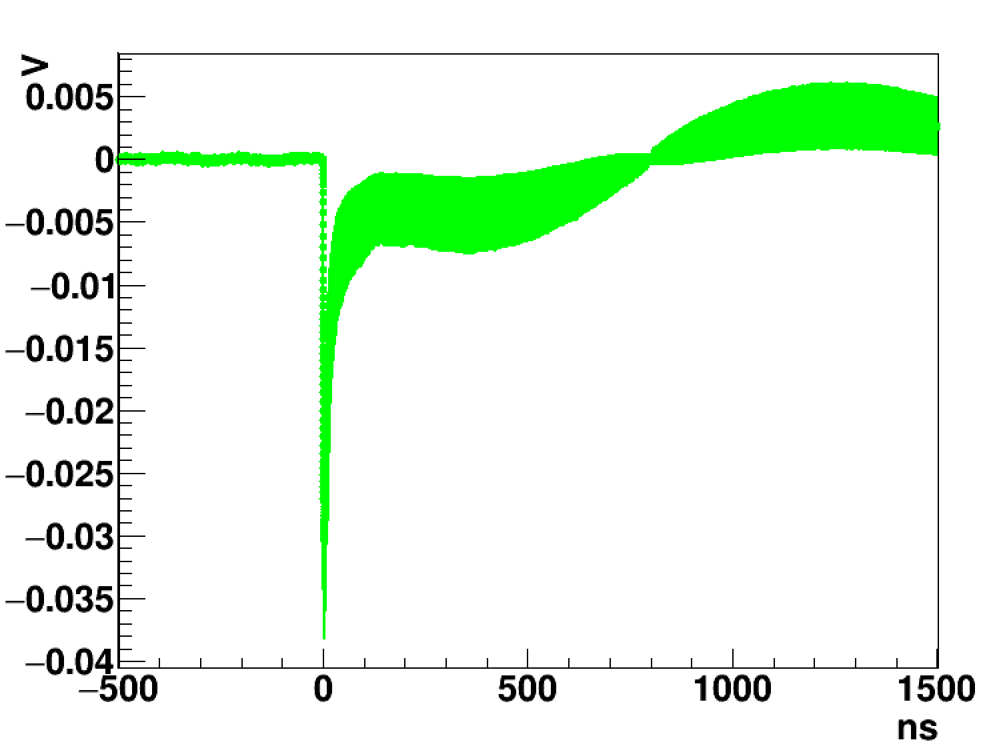
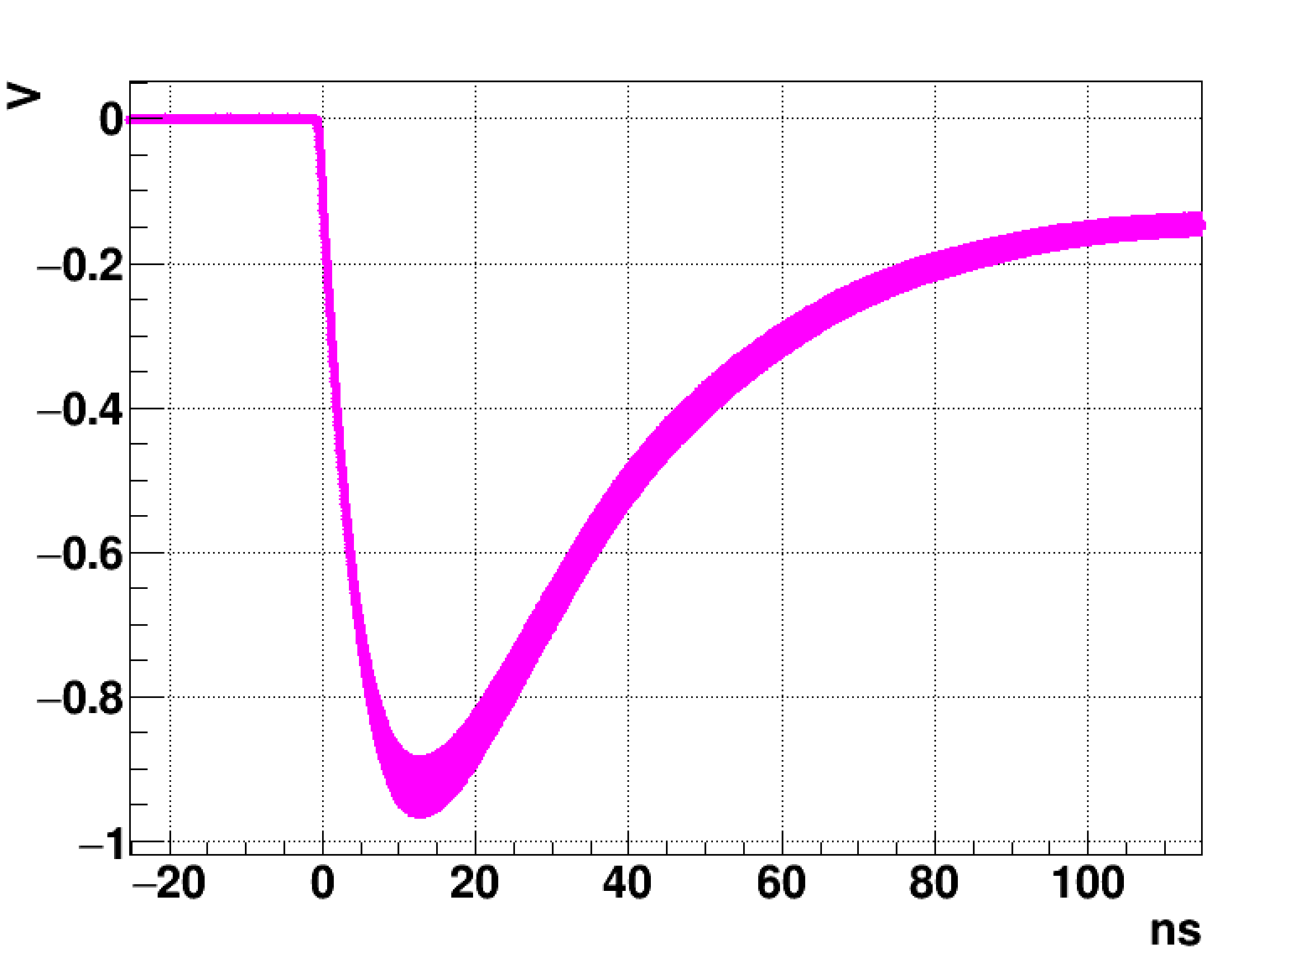
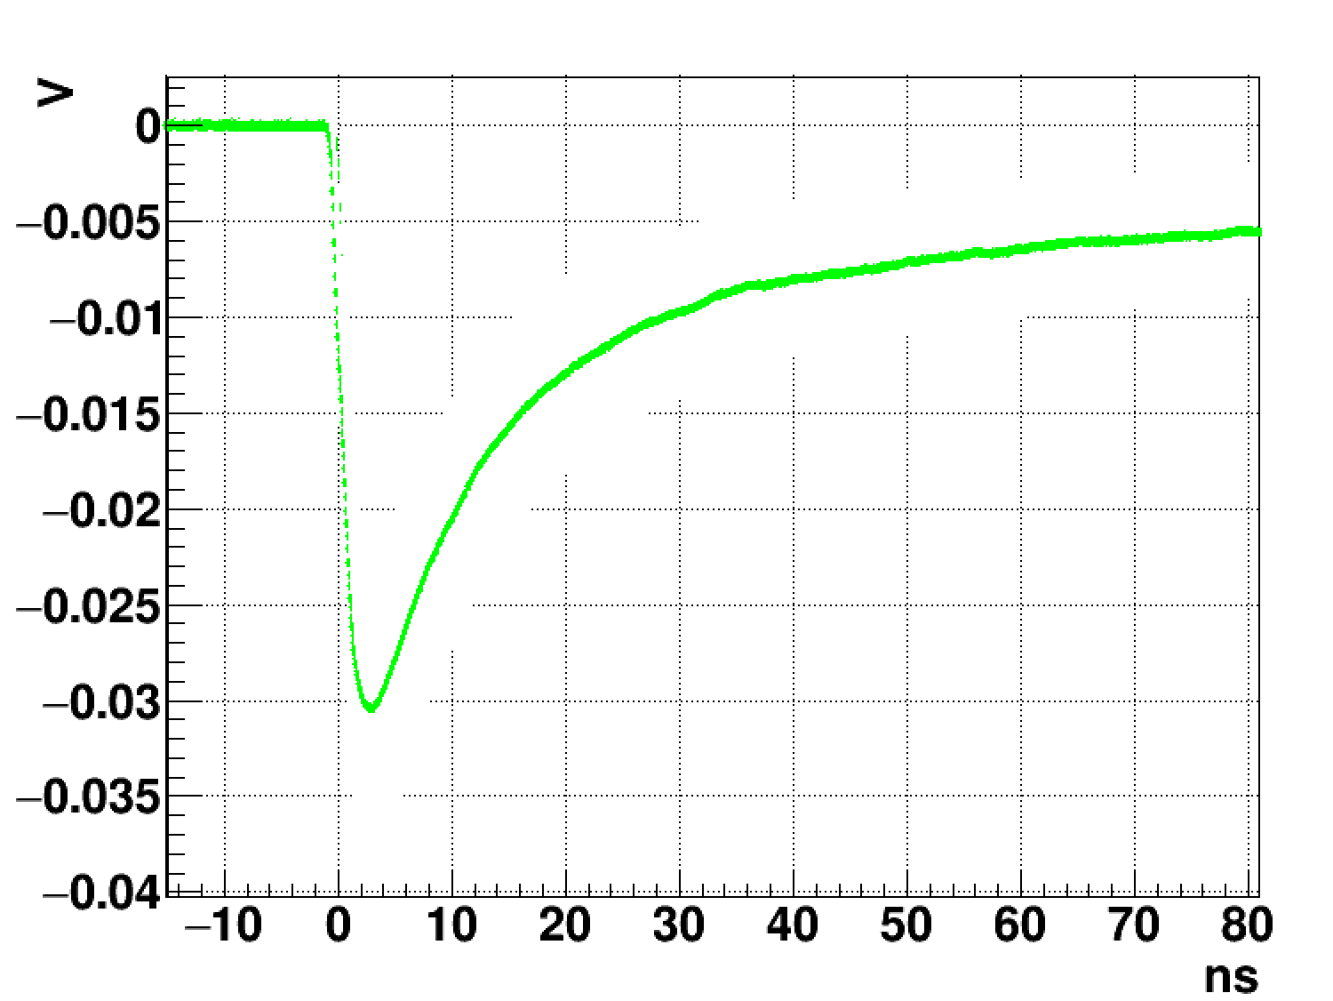
BGO
Side
UV330
400-600 nm notch filter
Removes most scintillation
BGO
Side
No filter
Reduced signal
FWHM= 15 ns
FWHM= 40 ns

Slide 26
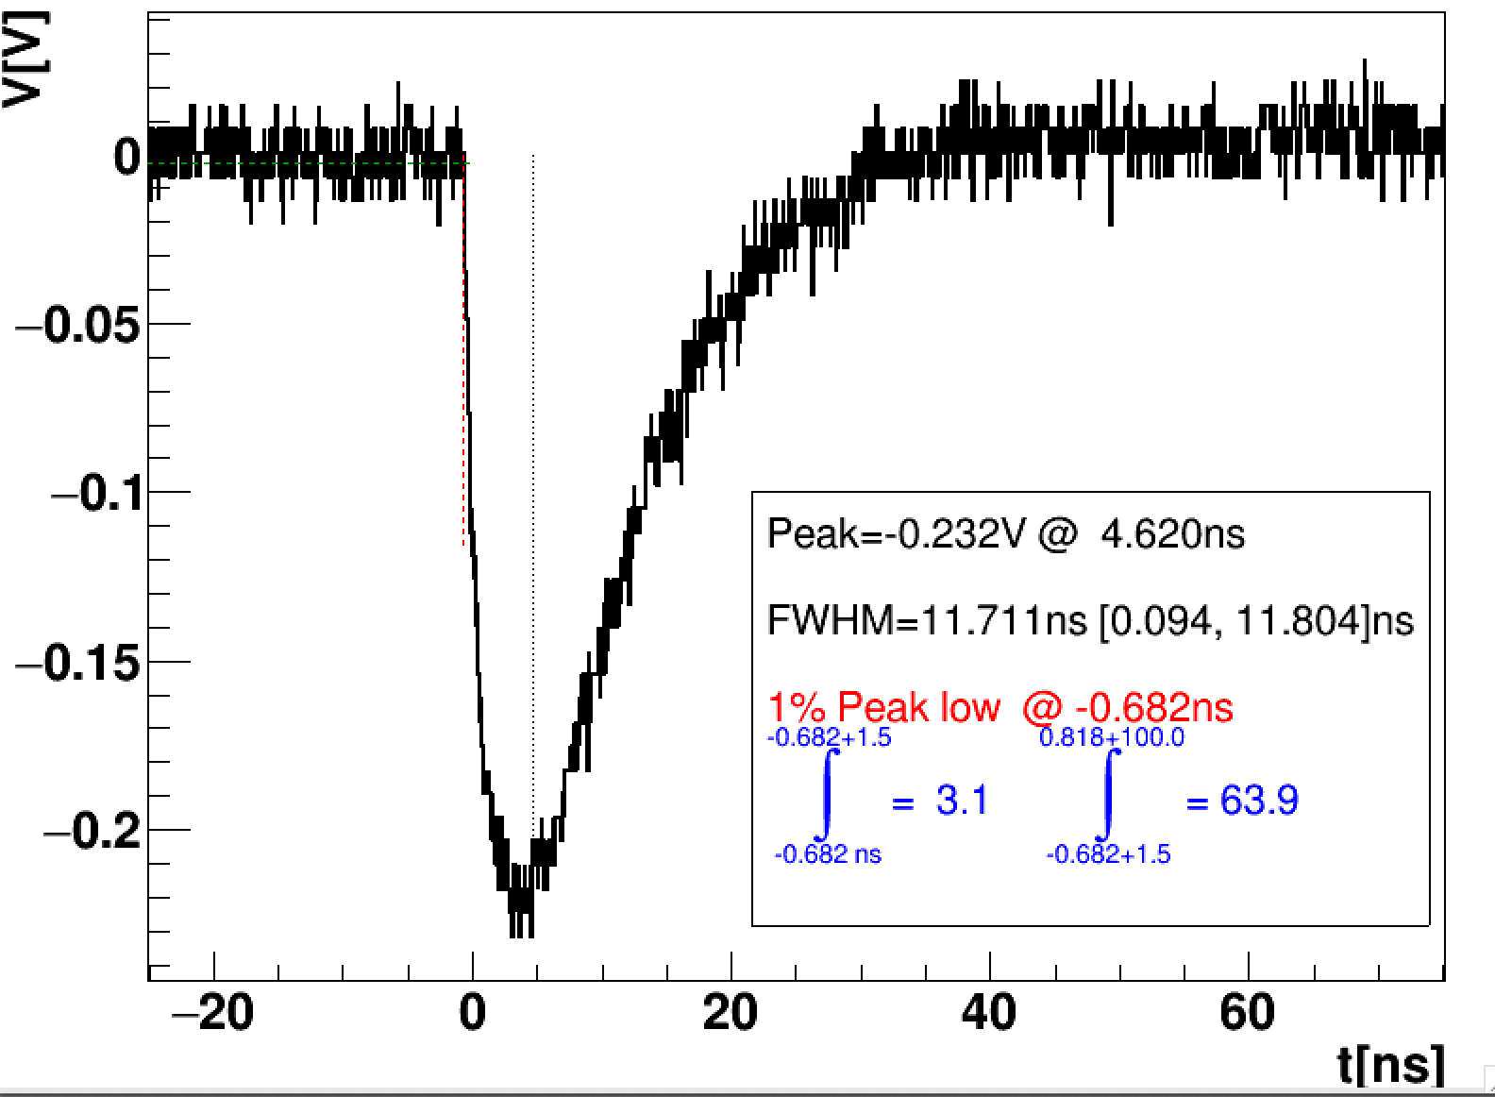
Example: I_{low} = 1% above baseline to 1.5 ns
I_{high} = 1.5 ns to 100 ns
Analysis method:
Define a metric that is insensitive to beam conditions:
Take ratio of the presumed
Cerenkov to scintillation components of the waveform:
i.e the ratio of leading integral to the trailing integral
Use a fixed limit of integration set by the glass sample

Slide 27
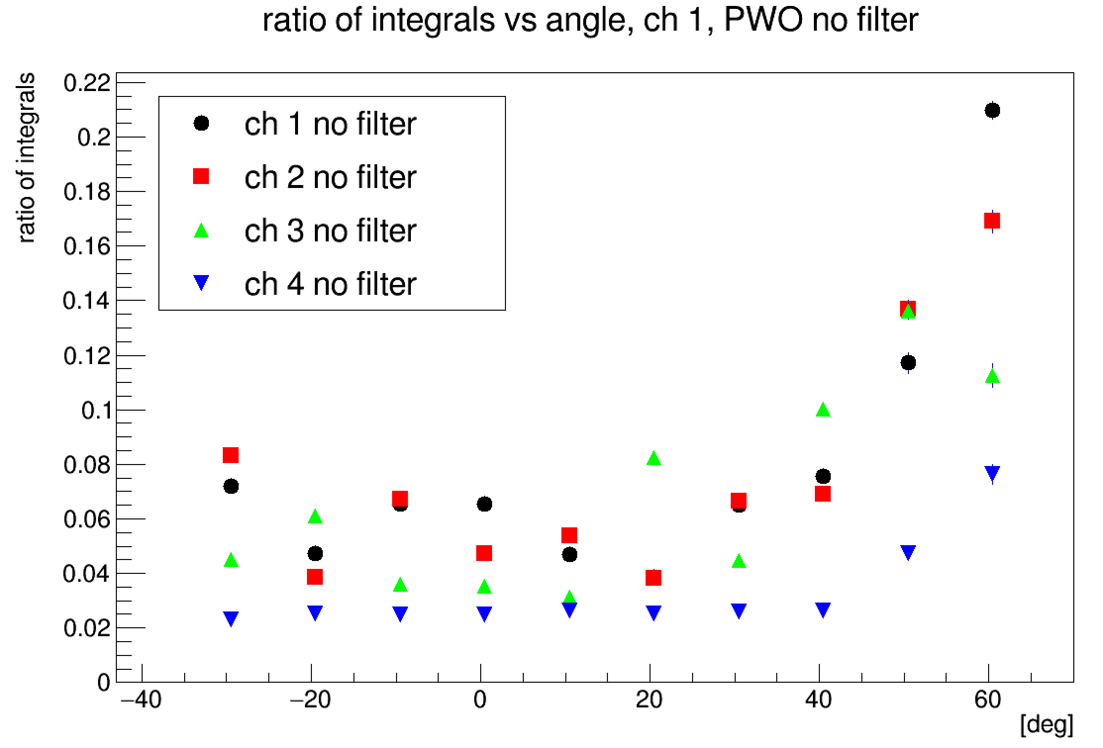
Towards SiPM end of crystal →
PWO no filter

Slide 28
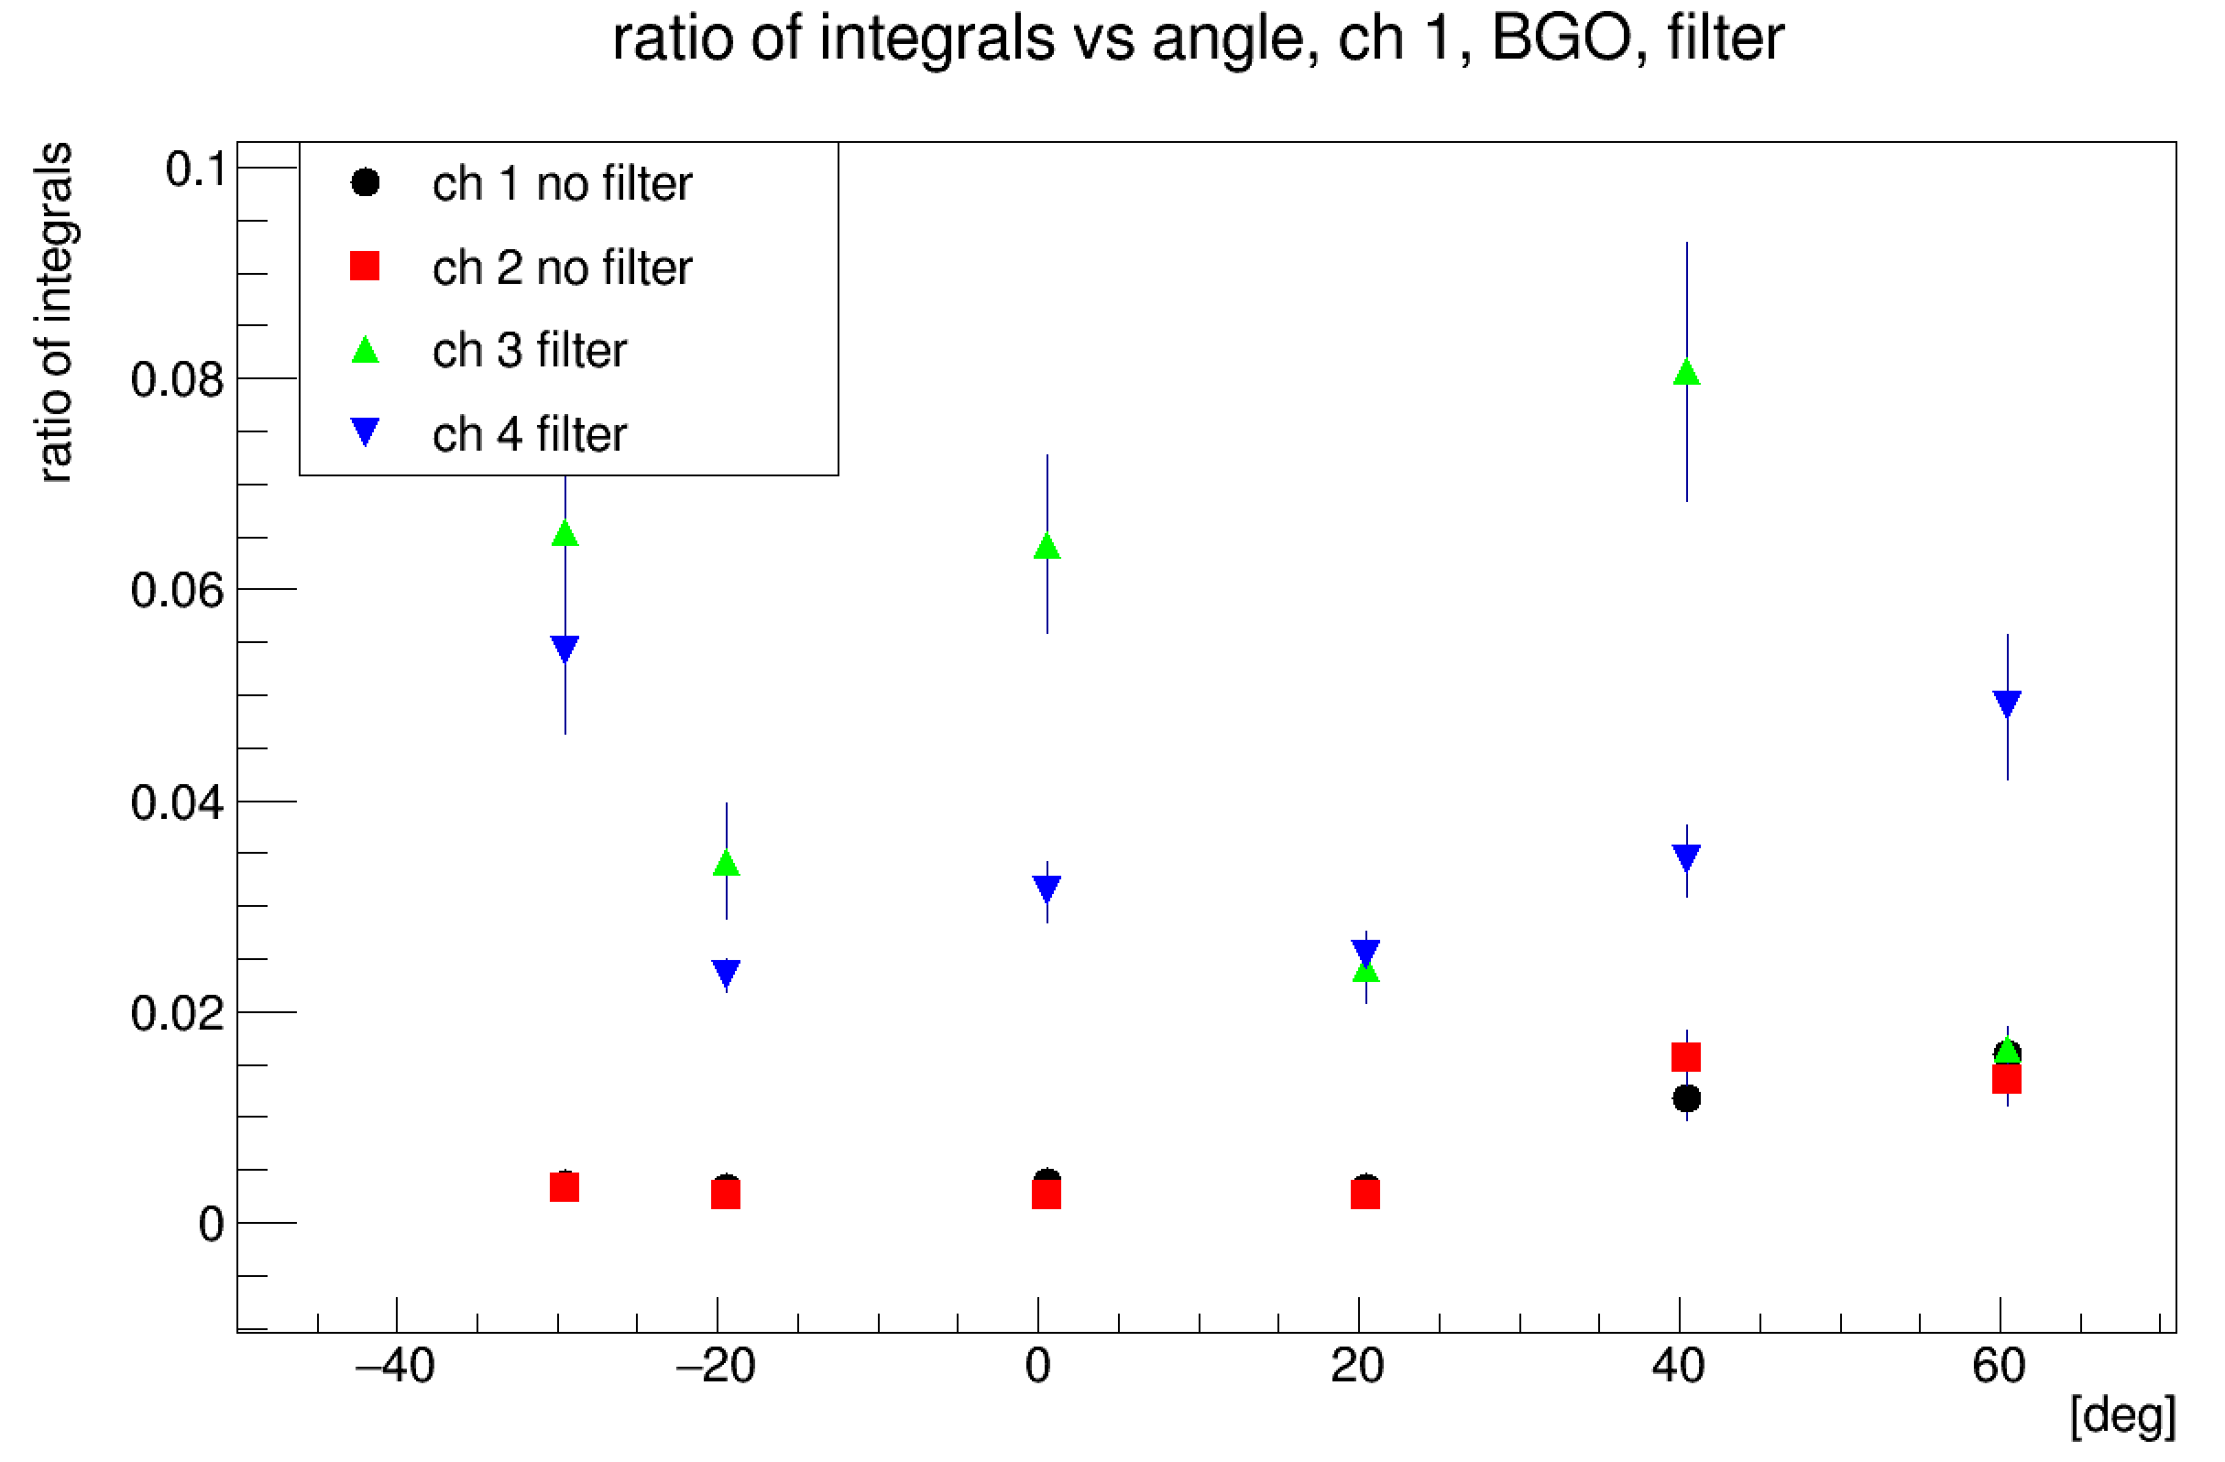

Slide 29
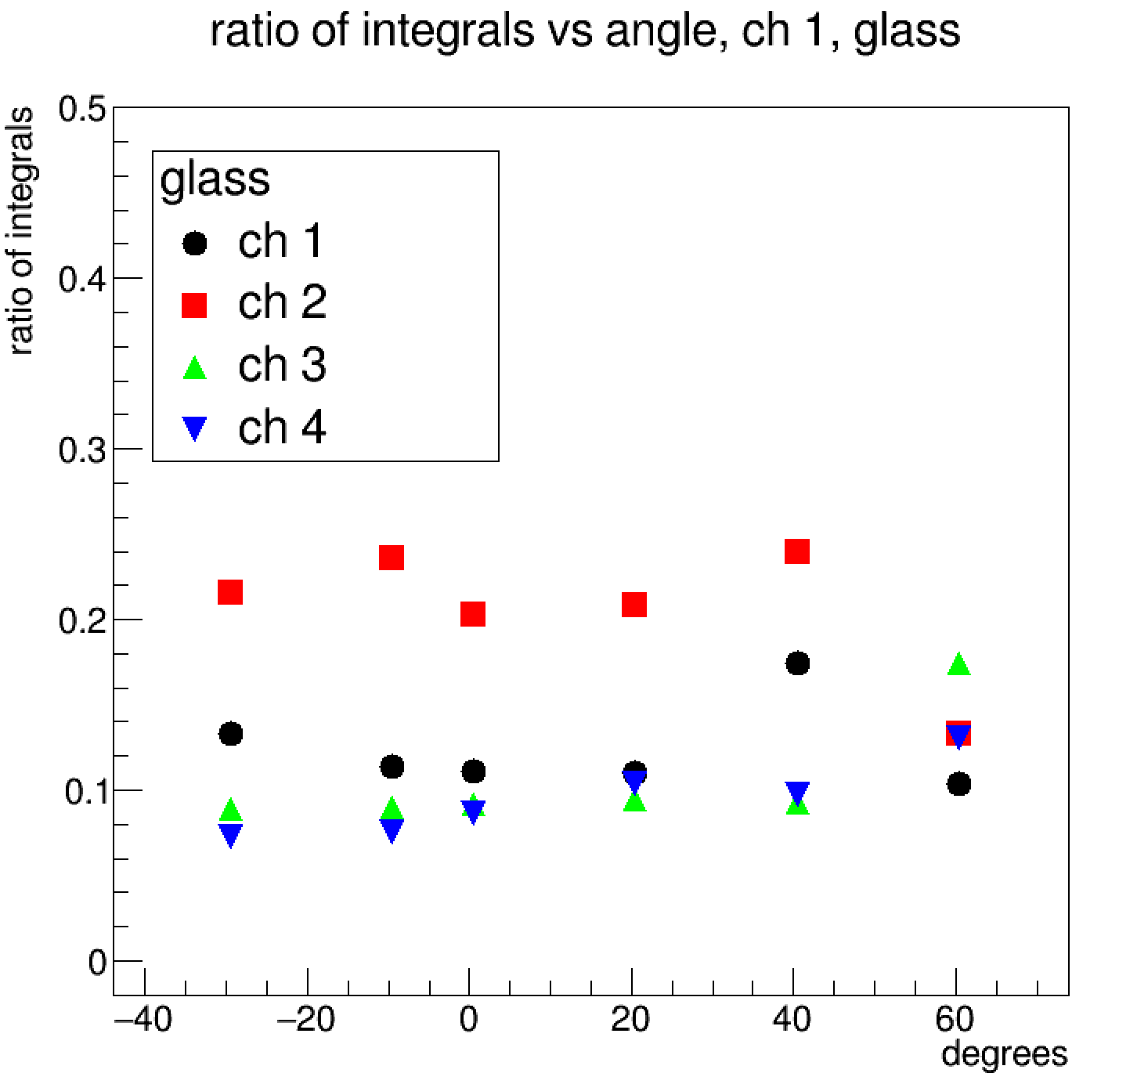

Slide 30
Preliminary Conclusions
Conducted first beam test with at NDRL
There samples tested – glass, PWO, BGO
Developing a beam current insensitive metric to gauge Cerenkov vs scintillation components
Hints of angular effect from Cerenkov signal in scintillator, none in glass
UV filter affect pulse width – removes most scintillation light.
UV filter also removes most of the signal. (slide 20)

