Slide 1
9 O’Clock Meeting
Nathan Ruffatti
MCR Crew Chief
Monday, April 17th, 2023

Slide 2
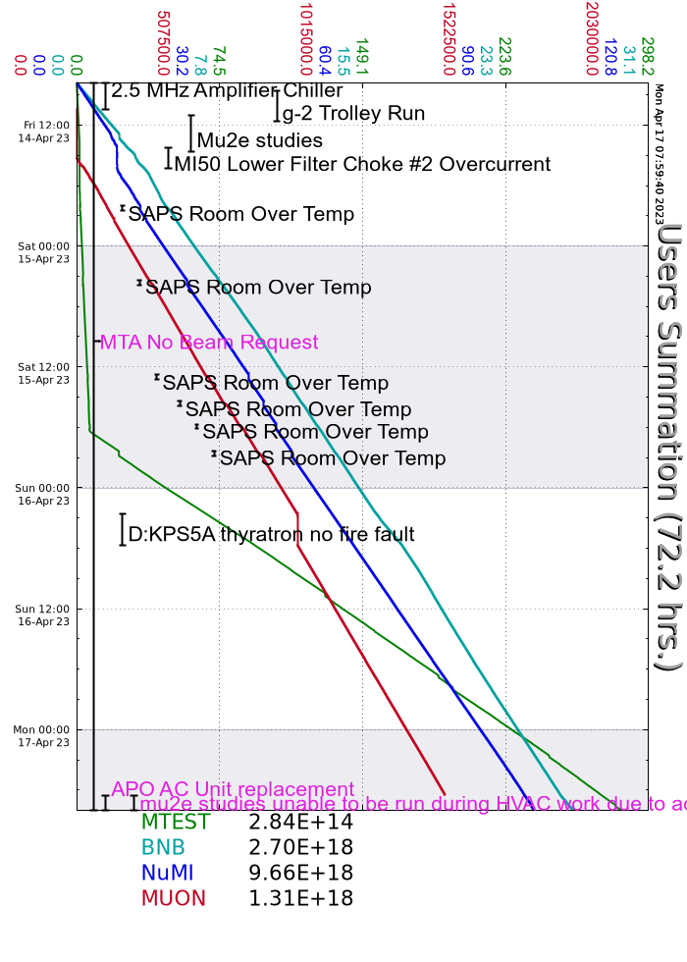
Since Friday…
Friday
2.5Mhz RF chiller resolved by cleaning debris off system
MI-50 Lower Bend bus Filter Choke #2 OI
Gate firing card for Voltage regulator chassis replaced
Started getting MIRF SAPS trips on DC Room Over Temp, continued into Saturday.
Saturday
Column II starting to crash
D:KPS5A tripped off, Thyratron no fires
PFL cable sparking, experts swapped the bad PFL
Monday
MIRF11 modulator found leaking water, disconnected from the anode and bypassed the station
AP0 HVAC work starting today, beam disabled to muon at 0630

