Slide 1
Geometry Updates
Zach Hulcher, Alejandro Diaz
zhulcher@slac.Stanford.edu, diaza@caltech.edu

Slide 2
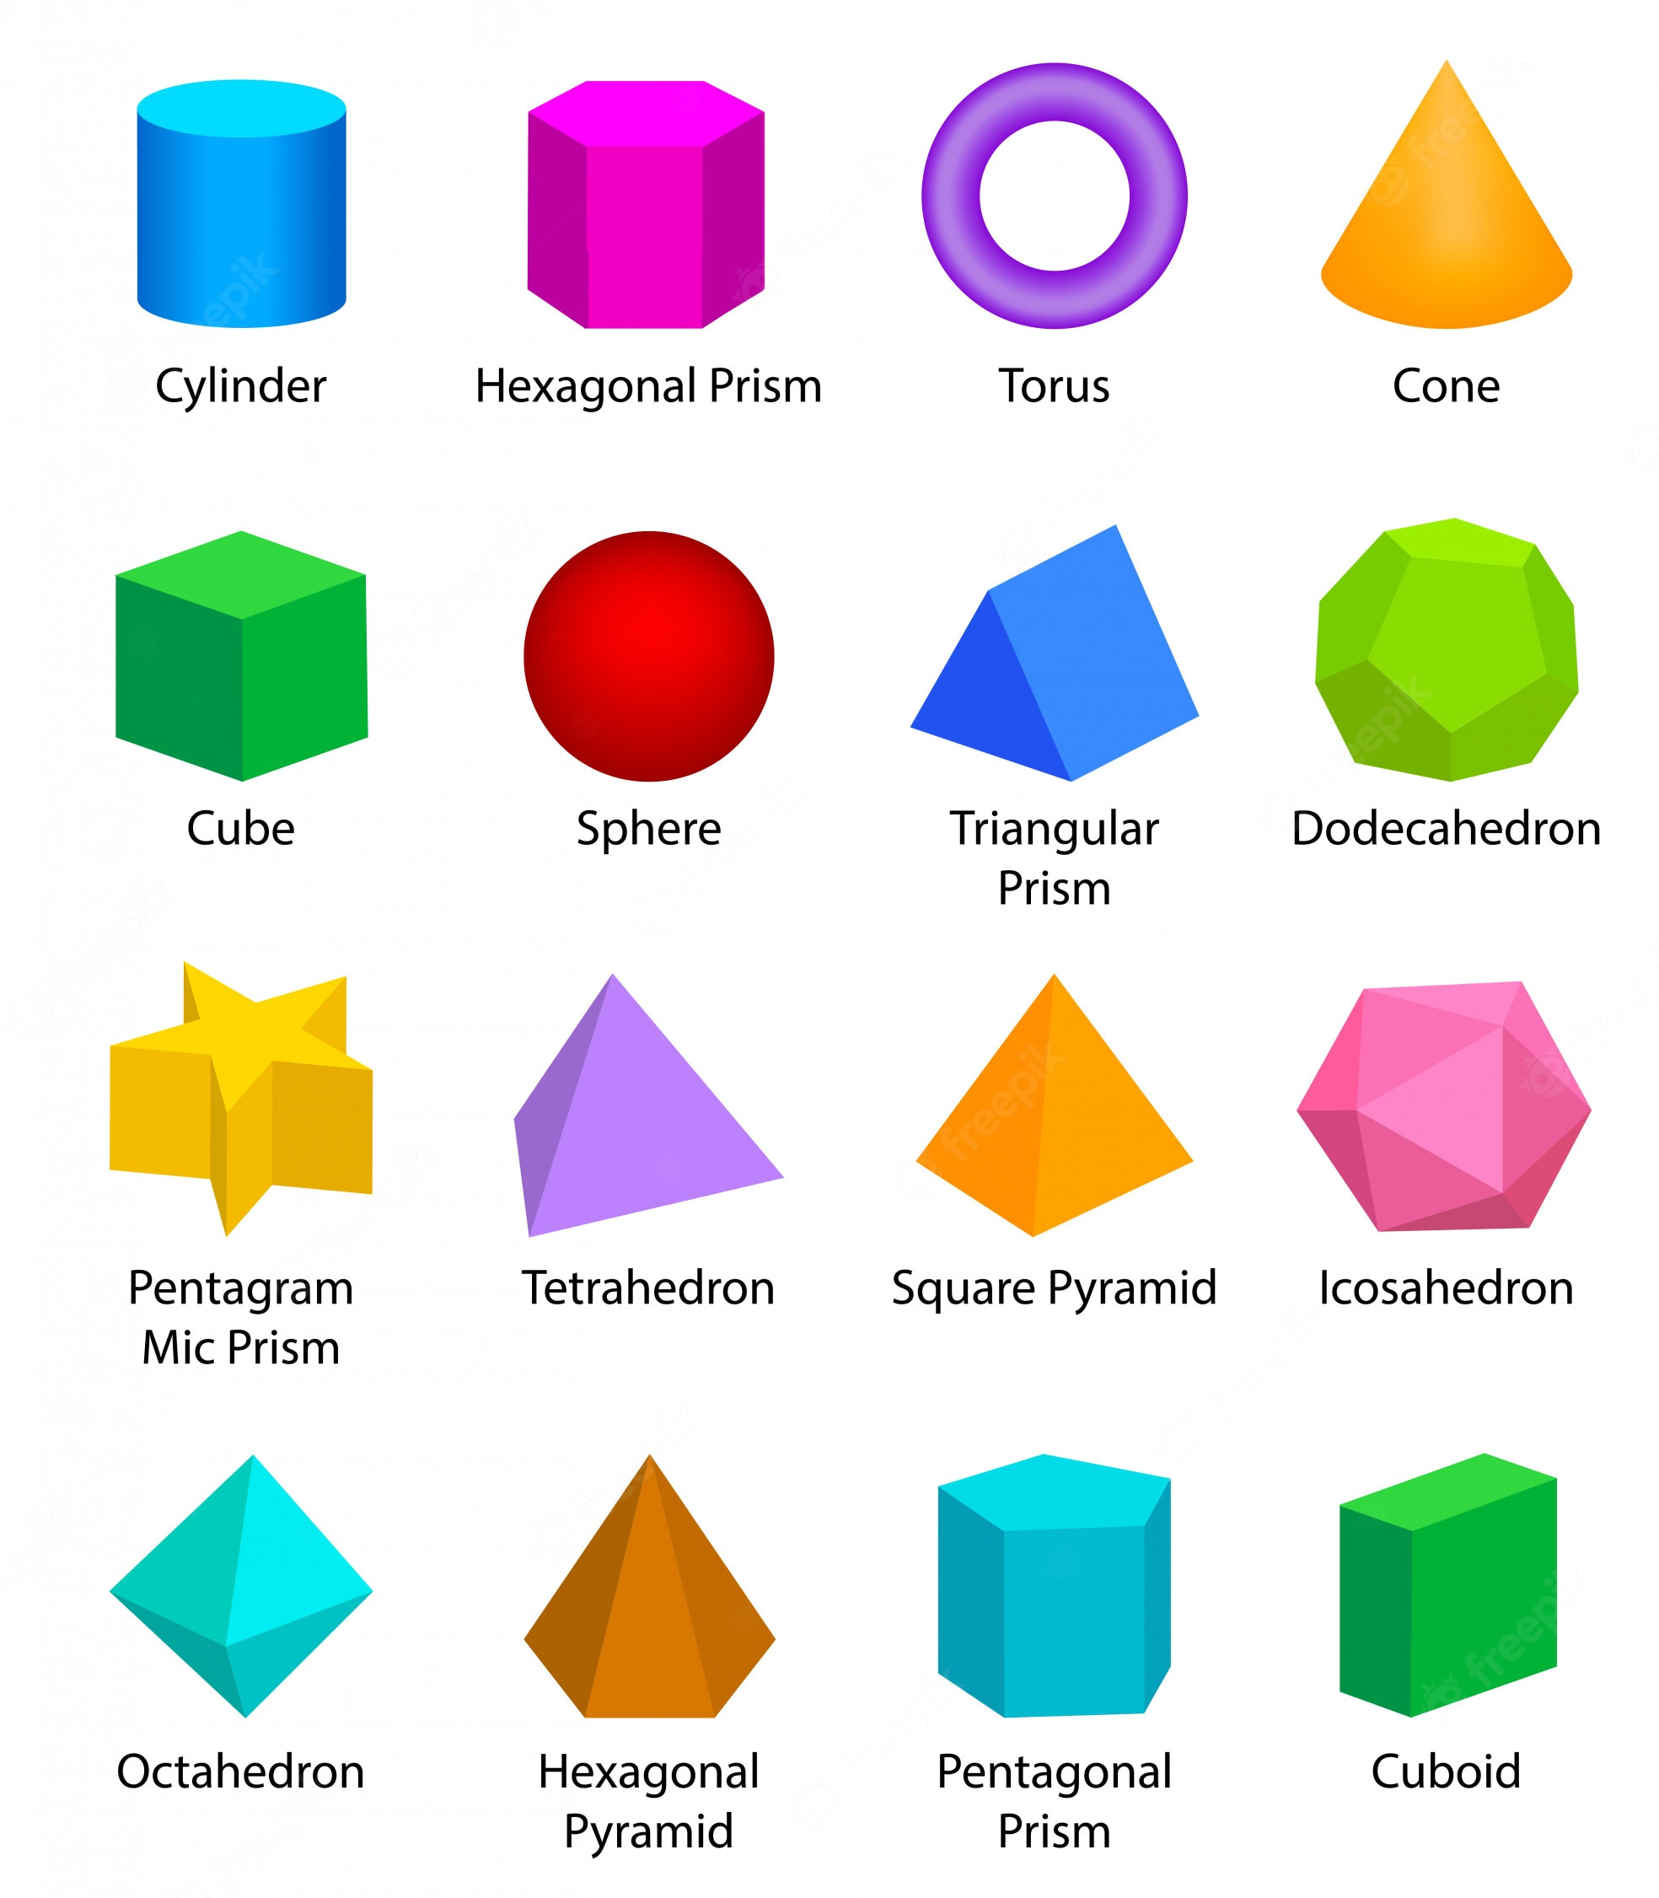
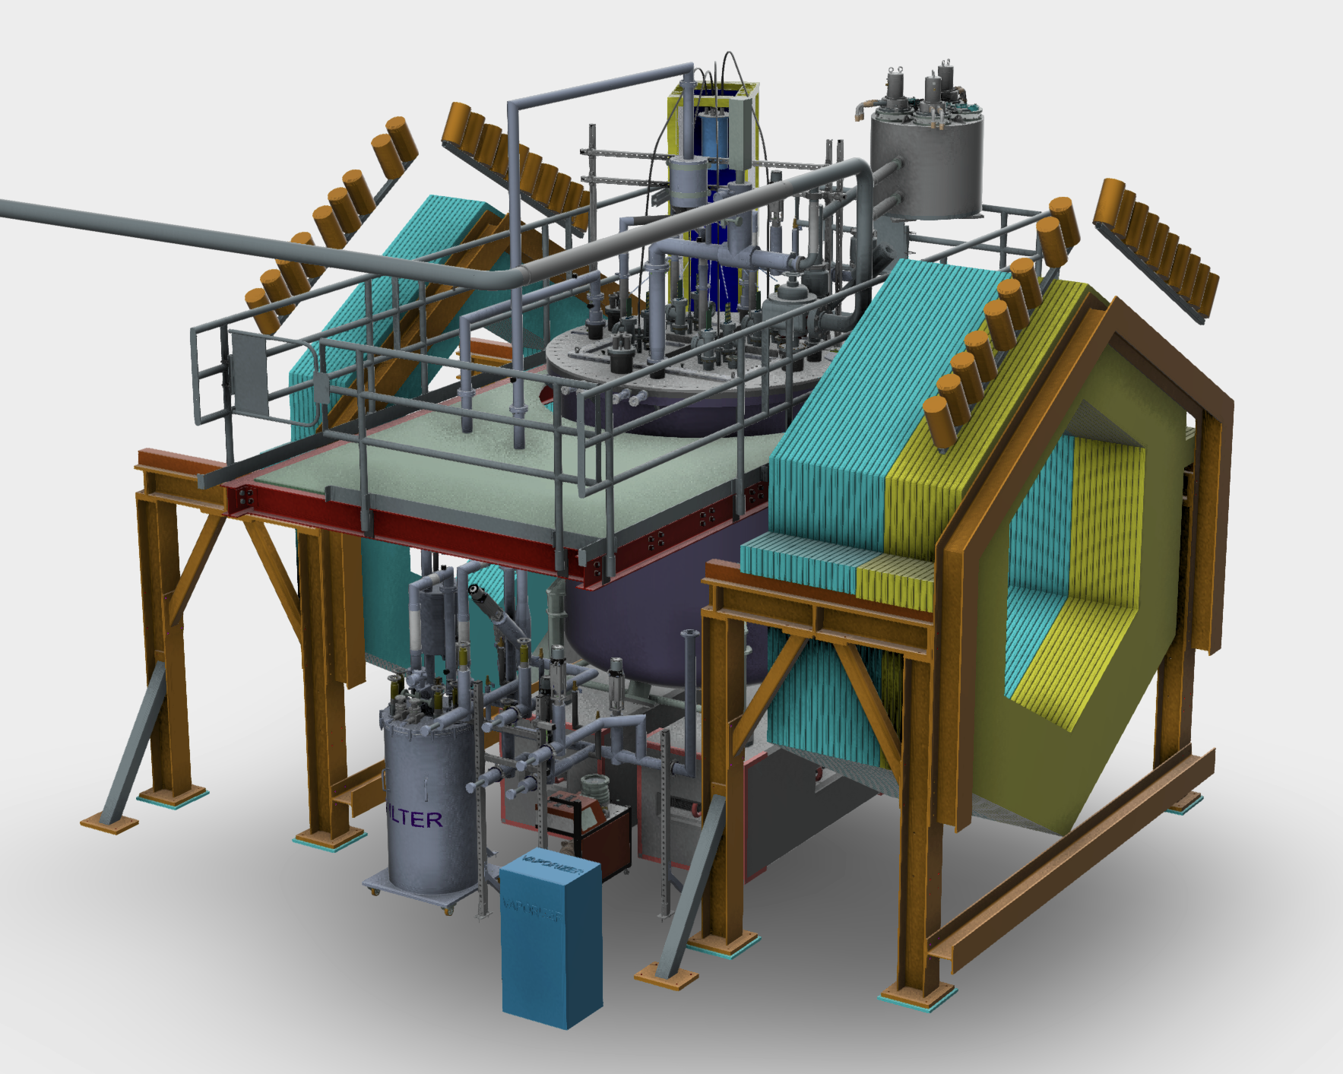
Overarching Goal
Convert 2x2 geometry from CAD/ drawings to GDML (Geometry Description Markup Language)
https://gemc.jlab.org/gemc/html/documentation/gdmlCadFactories.html
Not representative of all GDML shapes

Slide 3
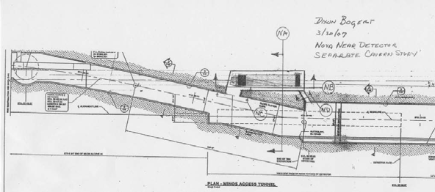
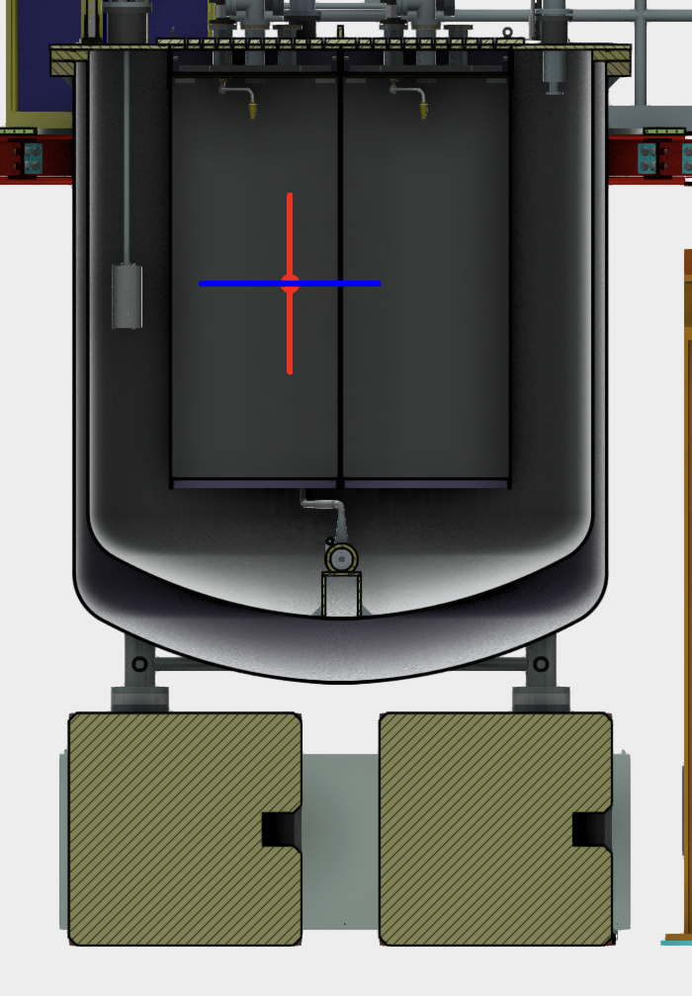
Goals
Hall Geometry
2x2 and Friends
Cryostat Geometry

Slide 4
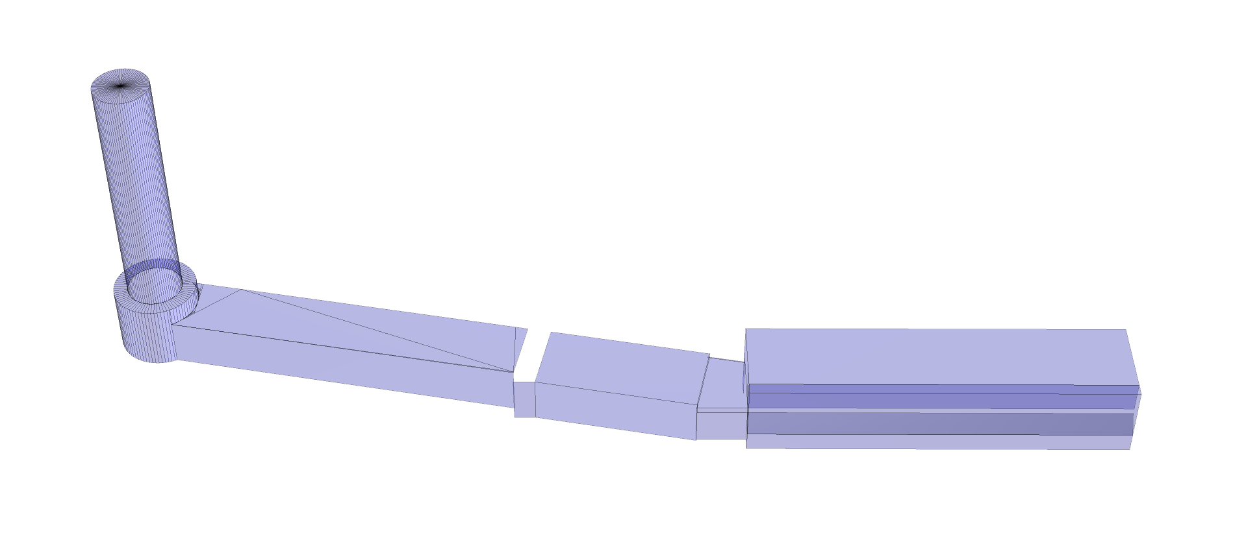
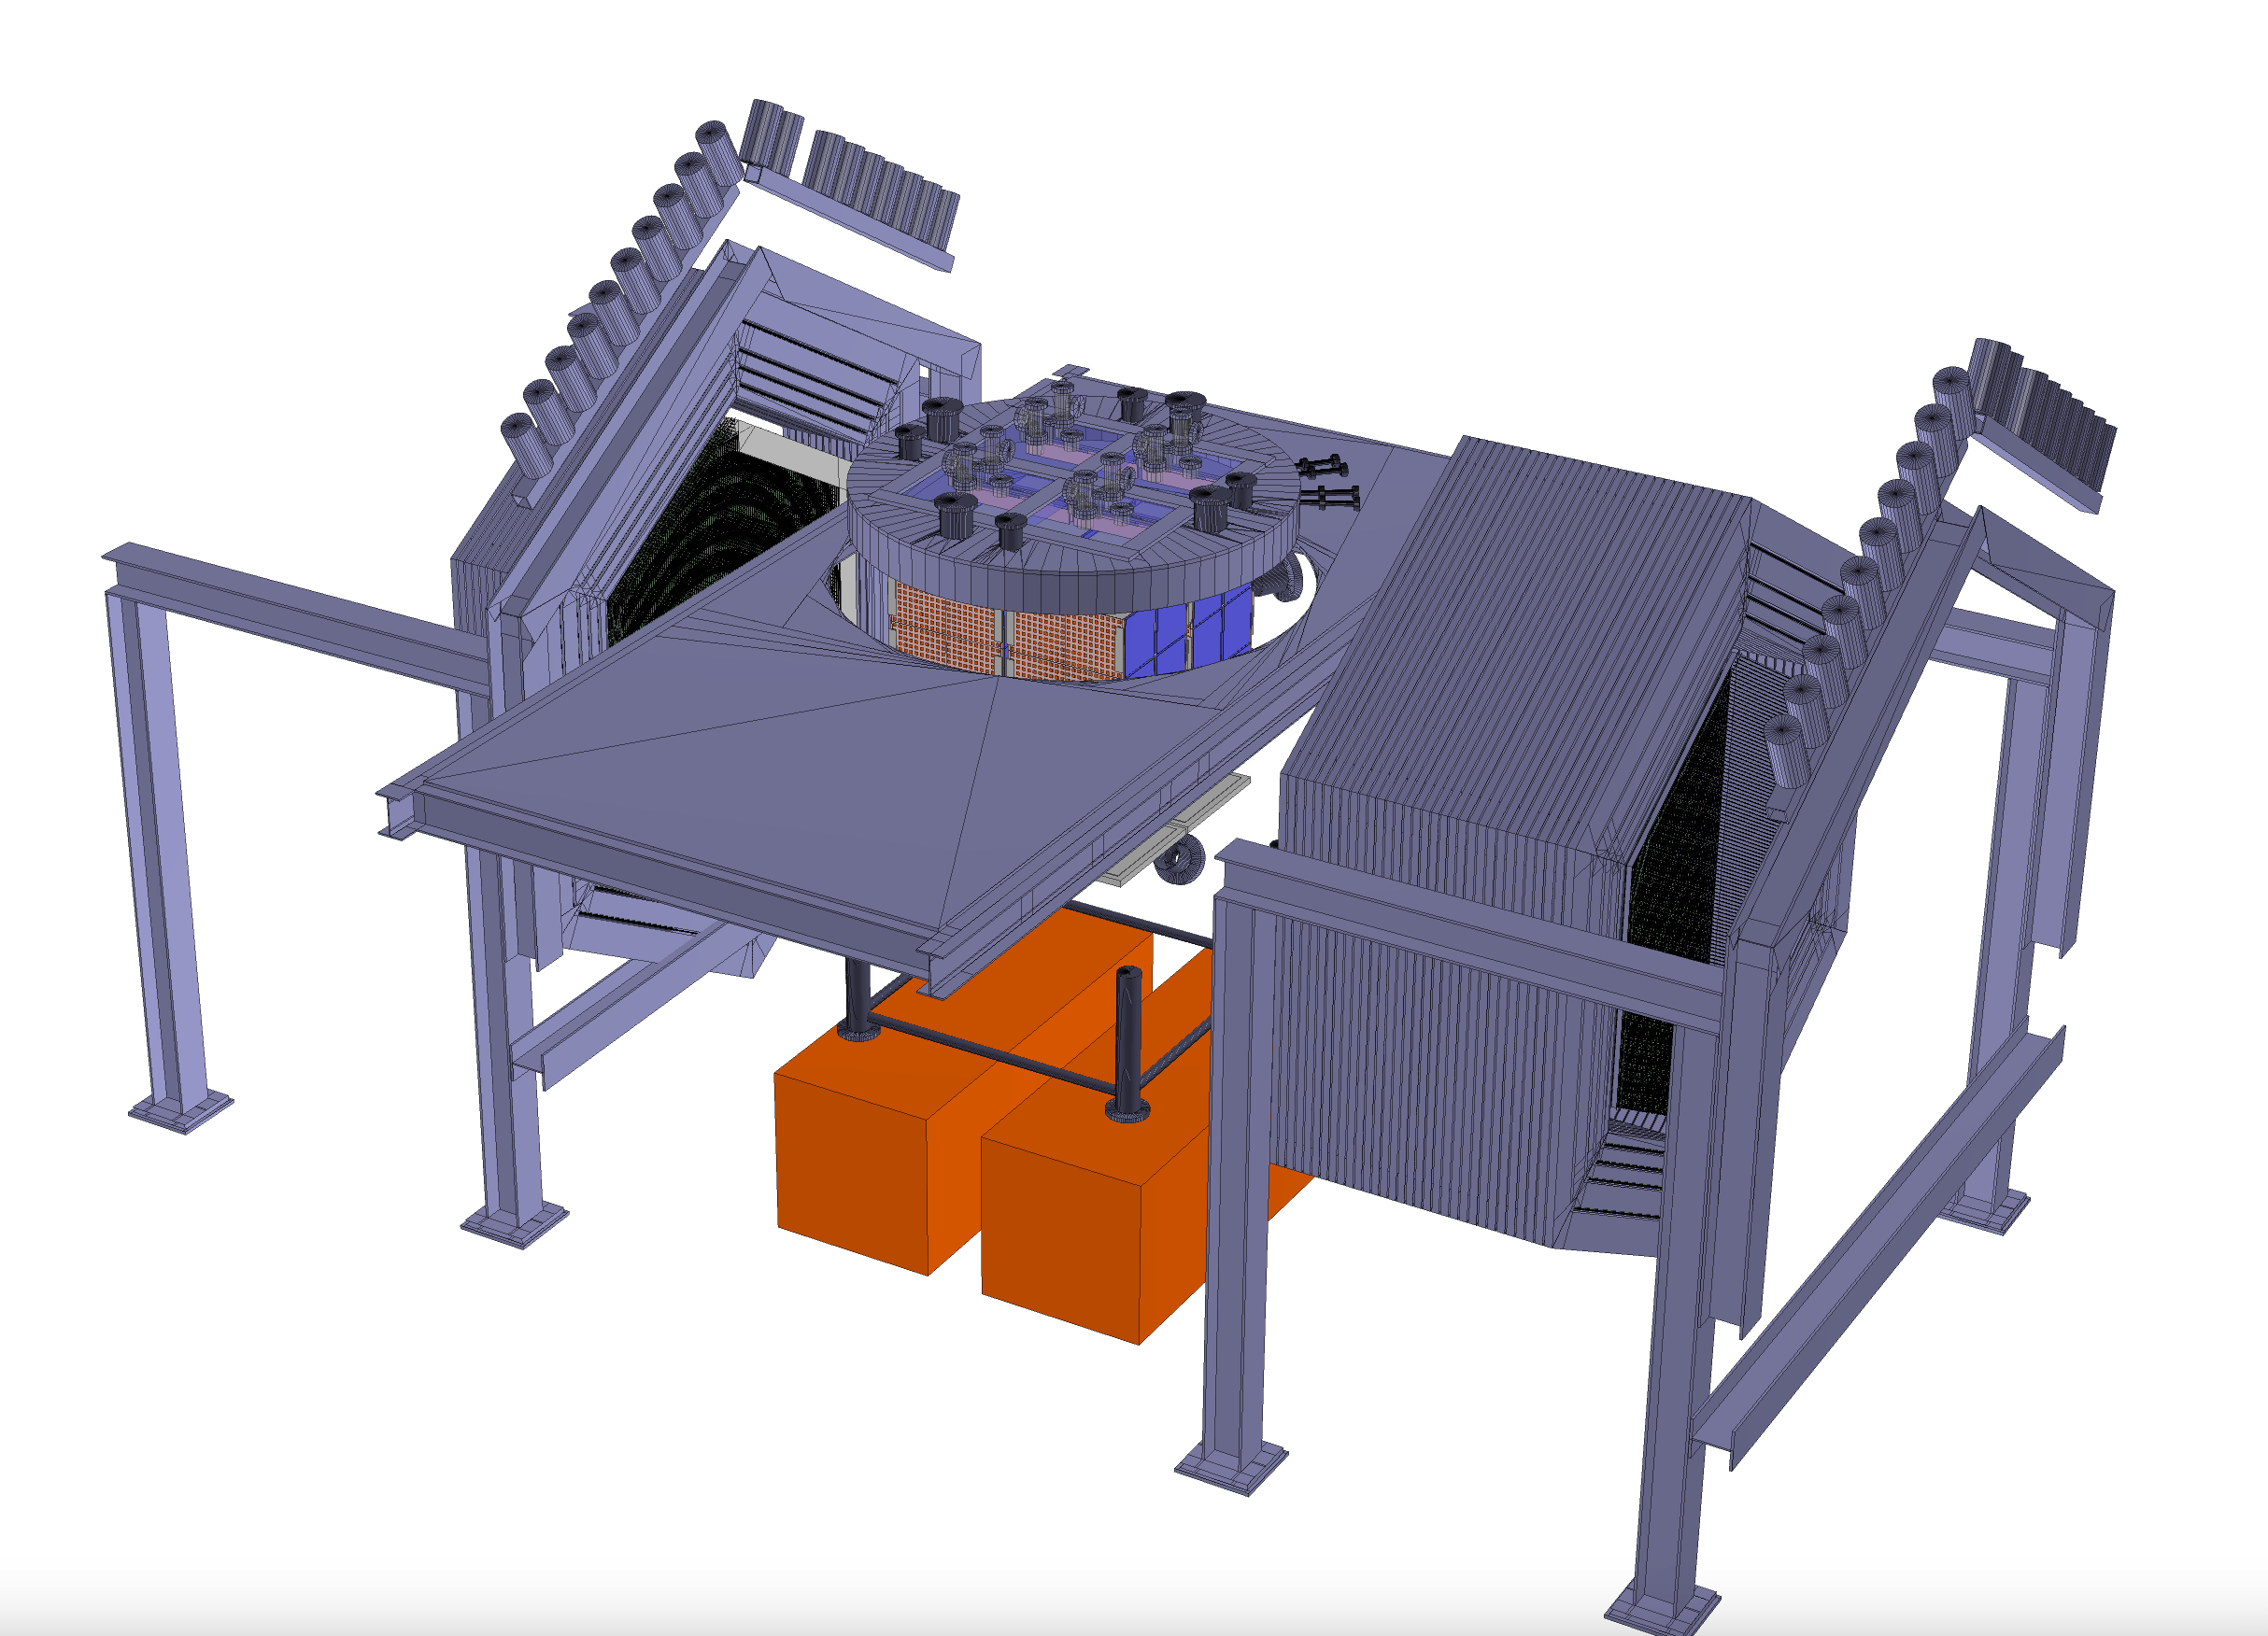
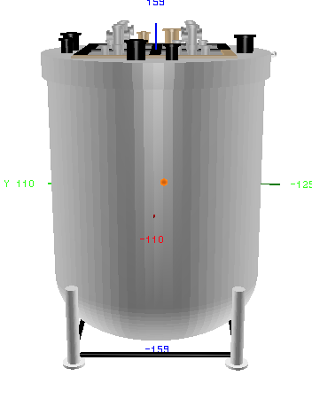
Work in Progress
Hall Geometry
2x2 and Friends
Cryostat
Cryostat Geometry

Slide 5
2x2 GDML TODO
Get CAD and hall 2d drawings
Provided by Min Jeong and Fermilab engineers, Thank you!
MINERvA
Provided by Tammy and Minerva group.
Directly import that into rest of 2x2 GDML (Thanks Callum)
Upper platform
2x2 Base
Rock Hall (but more structure added anyways)
MINERvA Support Structure
Redo of Cryostat flange and bottom (Partial Completion) (Alex will talk about this ☺)
Putting it all together + remove overlaps + relative placements of MINERvA+2x2, etc
Large Mass Additions
Ensure correct materials (Missing in my Parasolid viewer ☹)

Slide 6
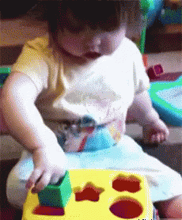
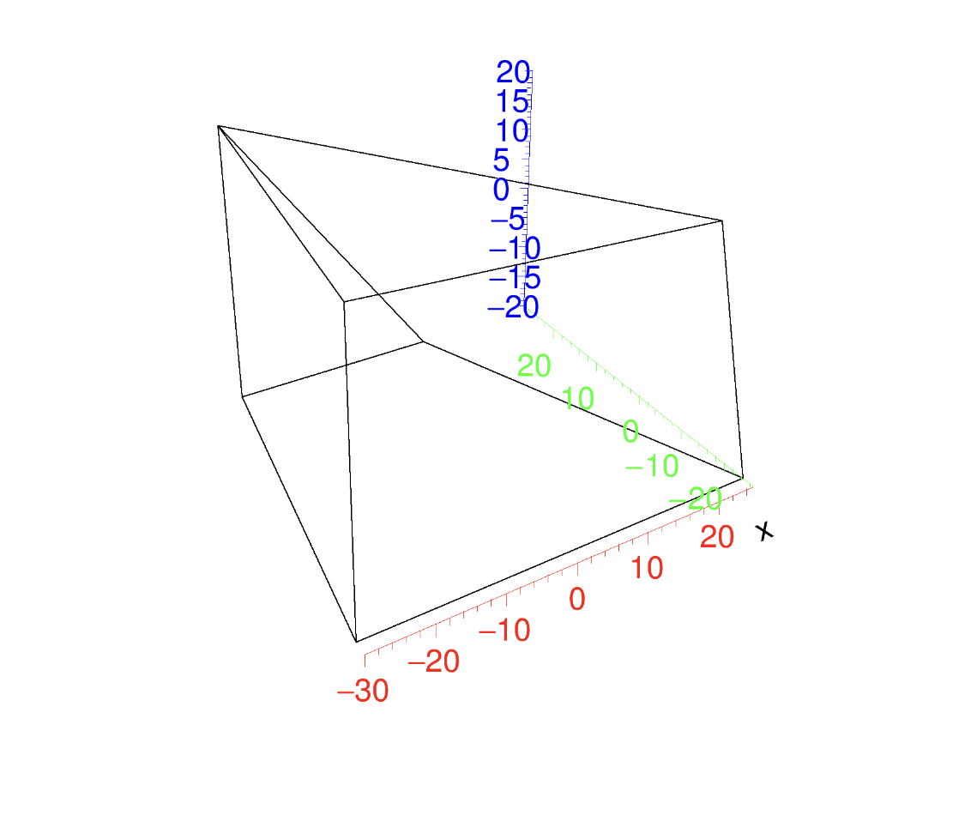
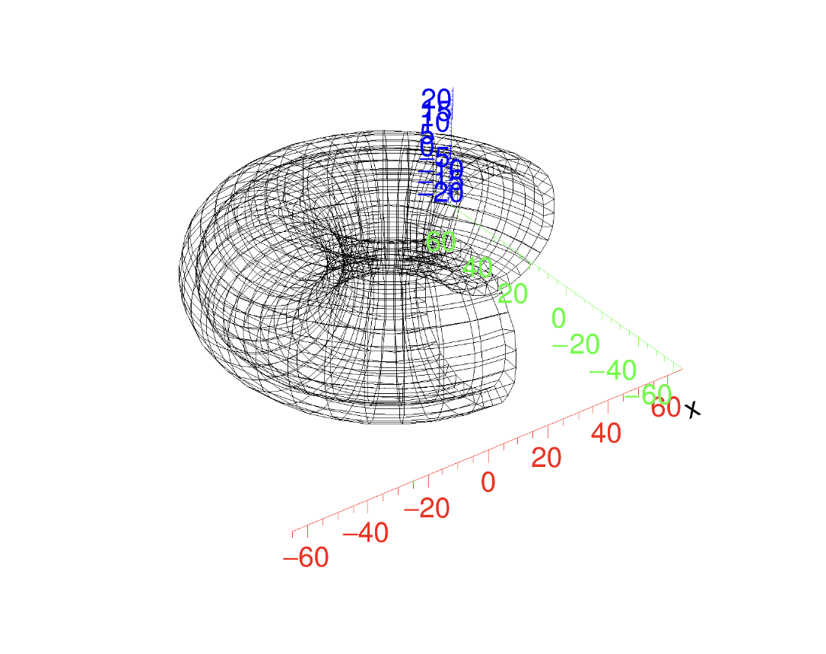
New Shapes for gegede + Edep-Sim
Required before-unimplemented shapes
Arb8 (arbitrary trapezoidal prism)
Toruses
Both shapes will need to be added to edep-sim for simulation to run!
Pull requests done for all.
Required Shapes (so far) | gegede implemented | Edep-sim implemented
Torus | ✅ | ❌
Arb8 | ✅ | ❌

Slide 7
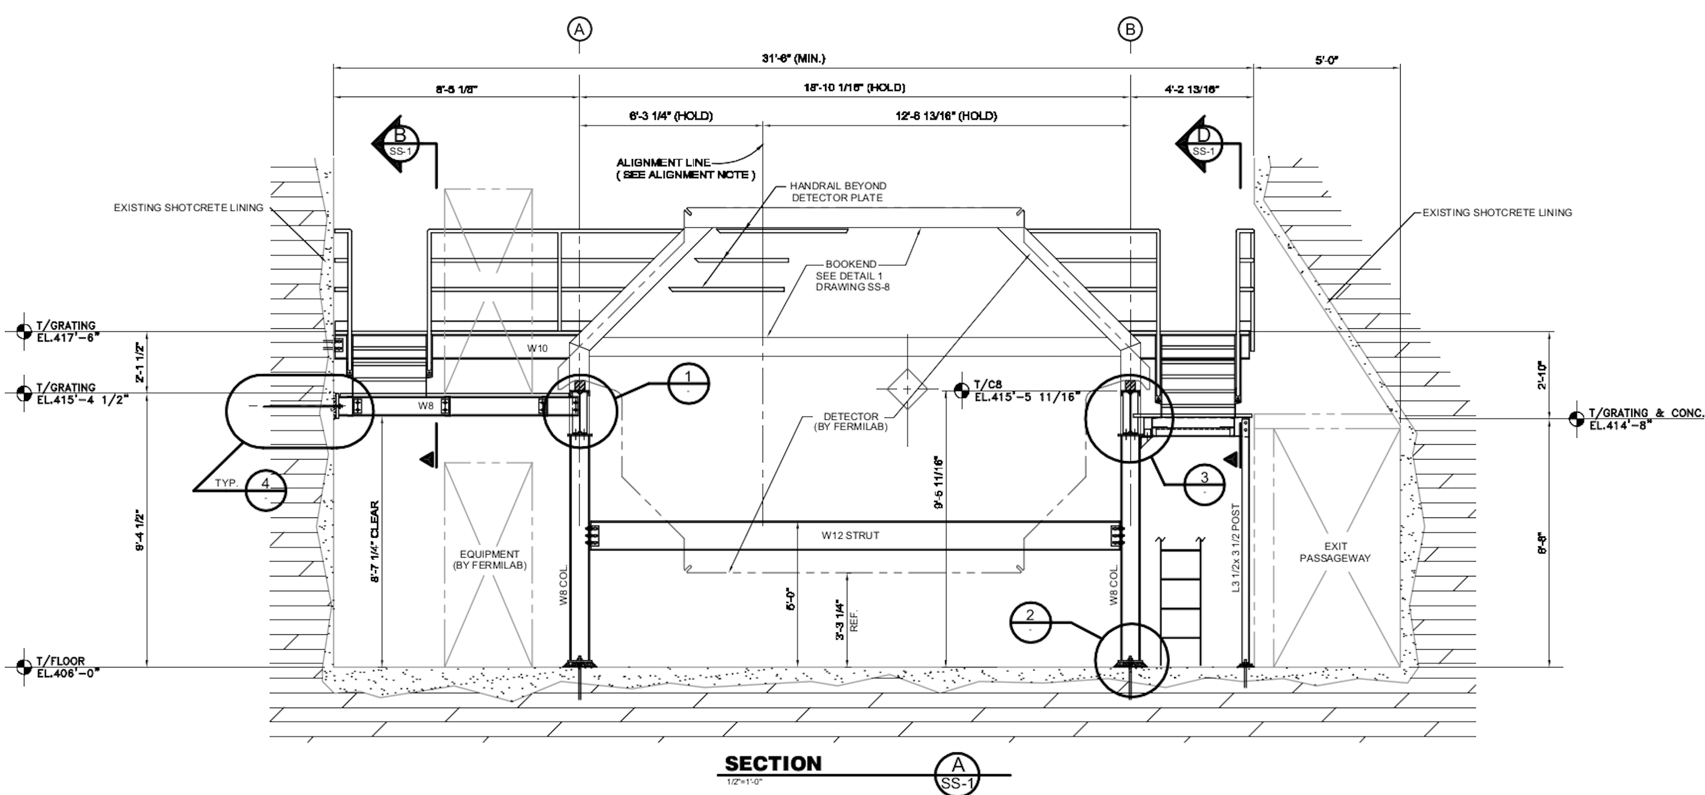
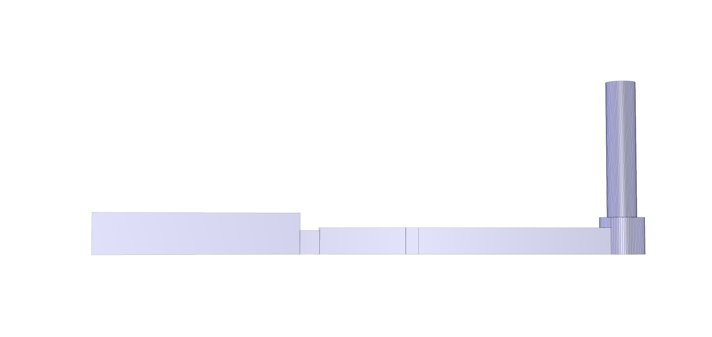
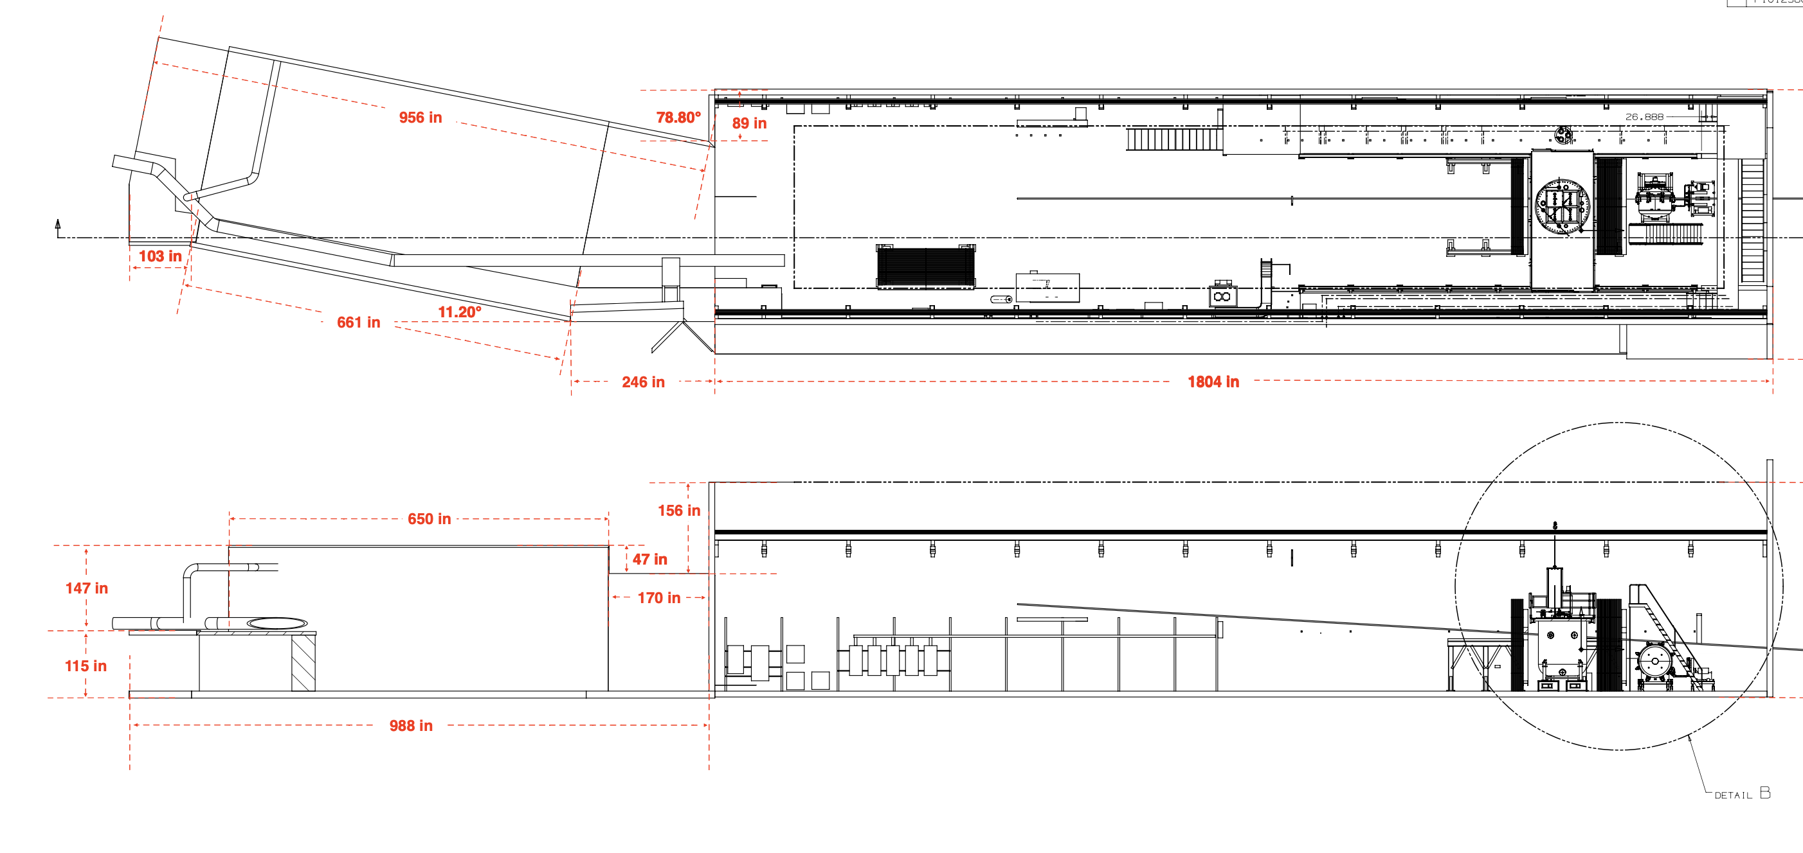
Rock Hall
Rock hall completed for rock muon simulation.
10m downstream rock, ~30m upstream rock (from safety hazard shaft)
~30m rock above/below hall

Slide 8
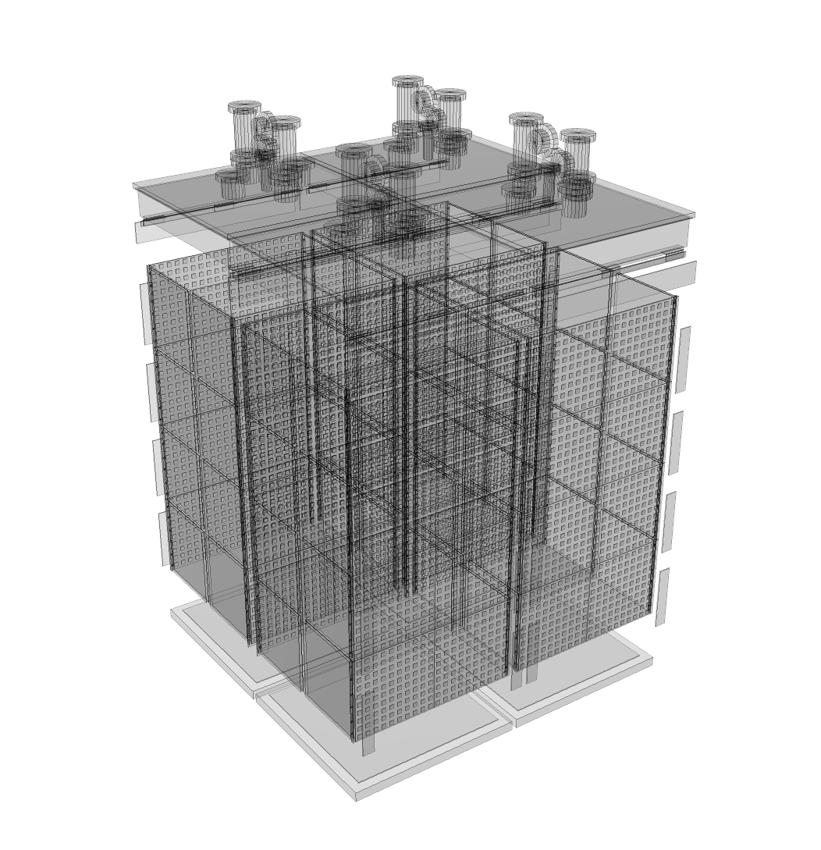
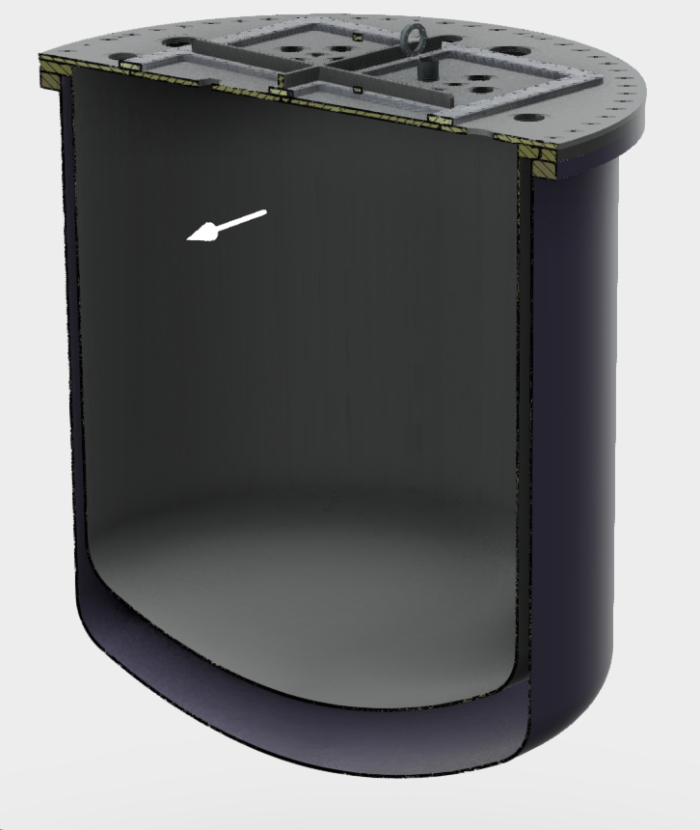
Integrate the updated 2x2 module geometry into the cryostat.
Make rough improvements to cryostat shape.

Slide 9
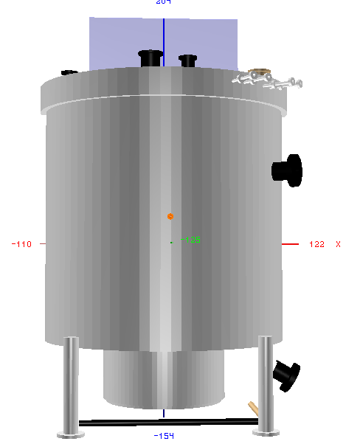
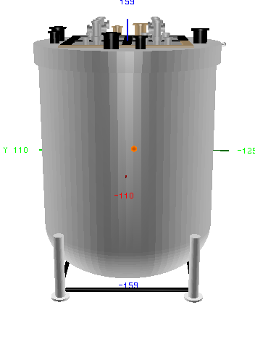
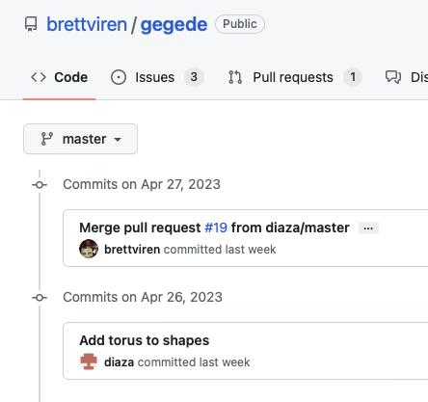
Turns out gegede, can’t couldn’t make toruses.
It was already half implemented, so I made a pull request and gegede can now make toruses.

Slide 10
Next up: Cryostat Shape

Slide 11
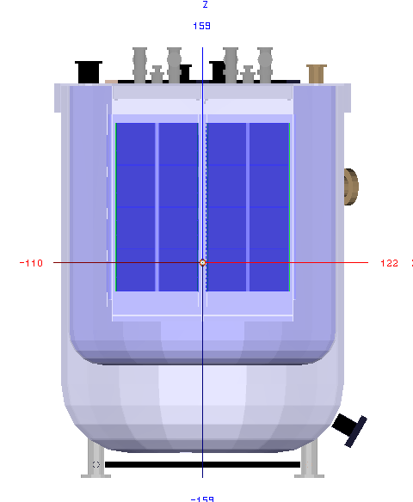
Next up: Cryostat Shape

Slide 12
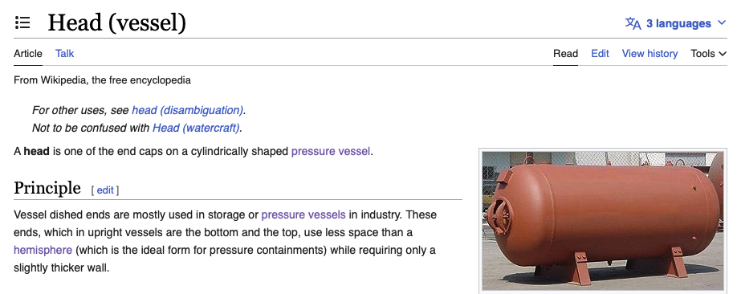
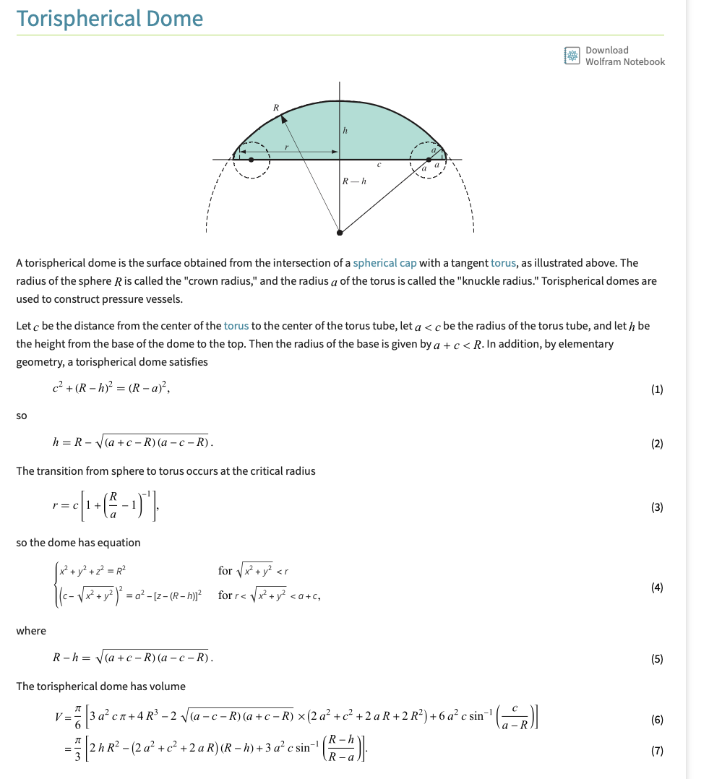
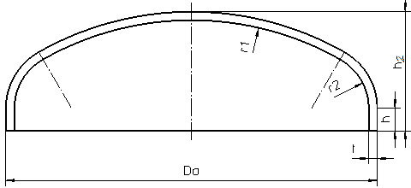

Slide 15
With new bottom,

Slide 16
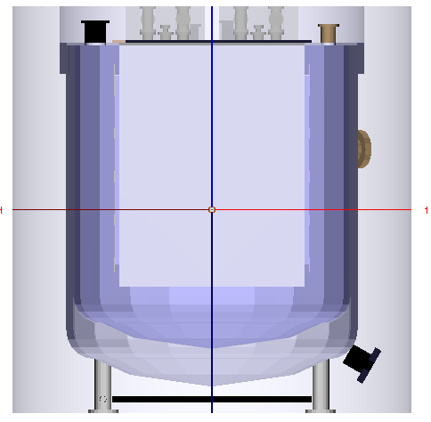

Slide 17
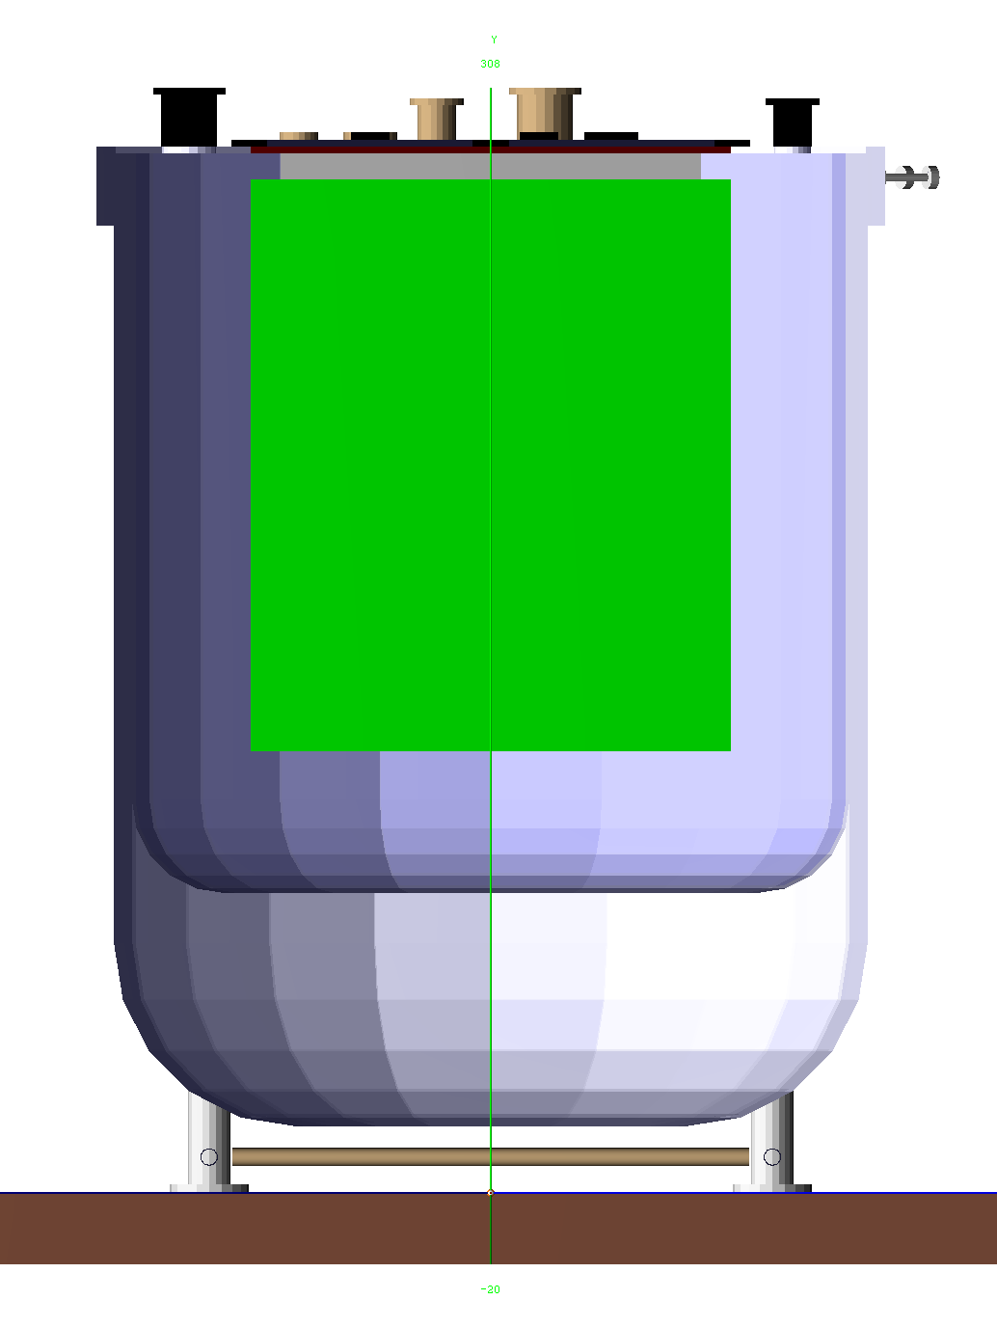

Slide 19
Questions:
I’m using Autocad to view the Parasolid CAD file. Is it possible to get the underlying parameters to construct the CAD geometries with Parasolid? If so, does someone here have Parasolid?
Besides the CAD file, do there exist more blueprints?
Maybe the details of the cryostat model don’t matter too much in principle. But, in the current implementation, the height of the module depend on the cryostat.

Slide 20
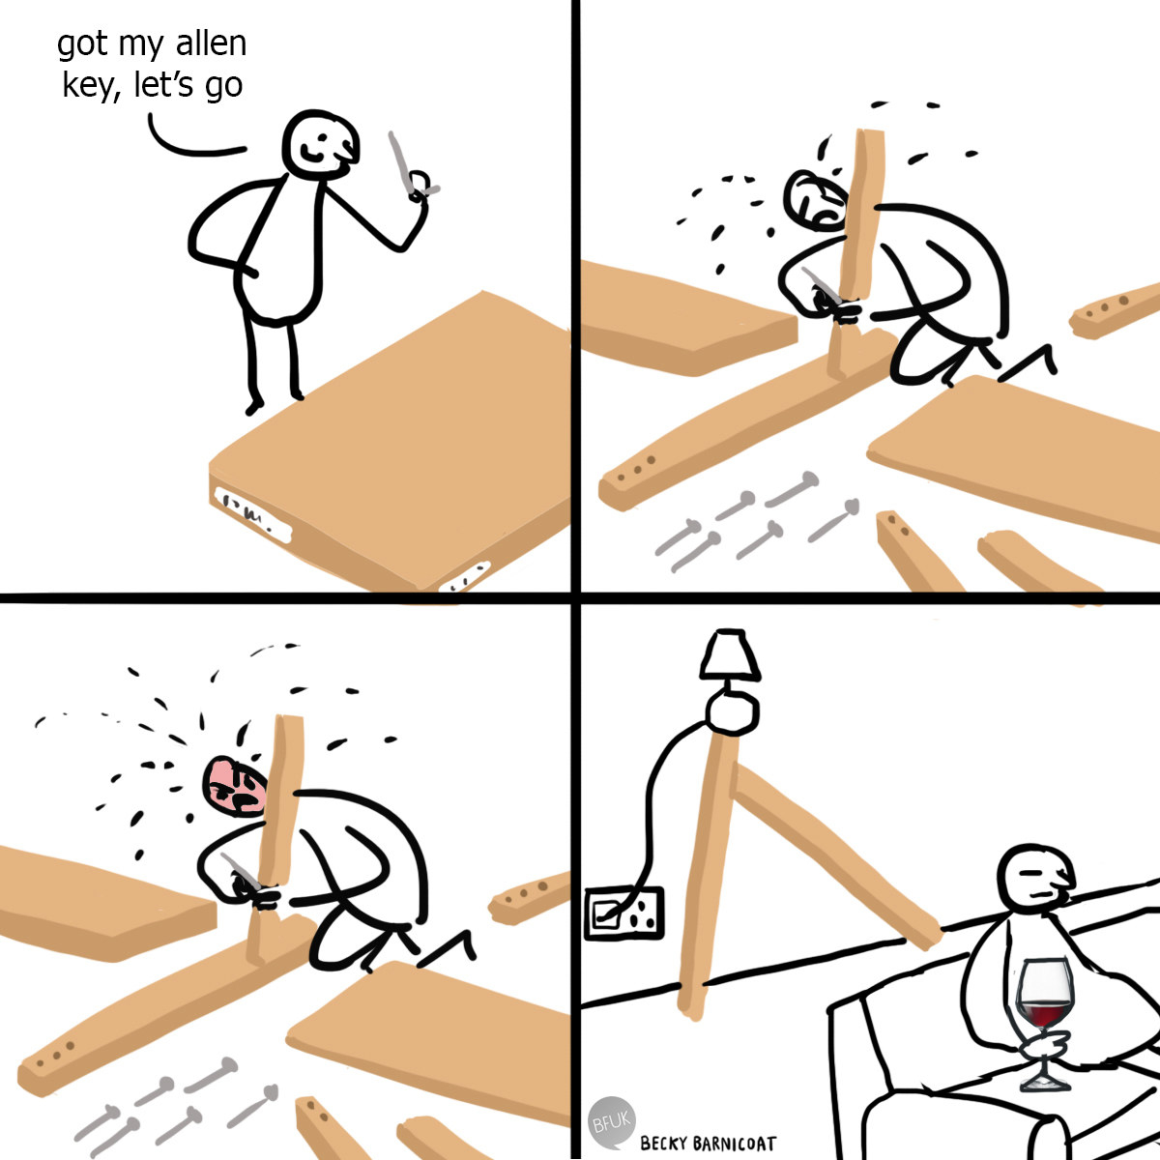
More to Do
Some dimensions need fixing
Some overlaps need squashing
Some masses need adding
Some detectors need aligning
Some materials need defining

Slide 21
Going Forward
Possible that Dune git repo of edep-sim should be maintained as official version
New shapes necessary, and DUNE specific changes needed in real time.
Current workflow
Look at CAD geometry, note important details, ignore screw holes, etc.
Guess shape and hope it’s available (or add it in yourself)
measure relevant sizes, angles from CAD (geom.shapes)
record materials
Record position/ relative positions/ orientation (geom.structure.Position/Rotation)
Combine shapes (geom.shapes.Boolean, etc)
Place objects with correct orientation (geom.structure.Placement)
Add to relevant volume
Realize you’ve just created 100 overlaps that need to be sorted individually
Go back to step 2,4,5 as needed
Combine objects/volumes hierarchically into existing volumes
Give appropriate volume sizes and place appropriately relative to local geometry
Don’t over-define objects
Repeat for every object in CAD/ Drawings
Automatic file converter w/o tessellation?
Convert from arbitrary 3-d CAD shapes to “best” possible combination of smaller number of shapes, Best$≈$low number of shapes/operations and $\frac{GDML⋂CAD}{GDML⋃CAD}\sim 1$

