Slide 1
Precision Ionization Calibrations of Silicon Skipper CCDs for Dark Matter Detection
New Perspectives 2023
Rachana Yajur,
for the DAMIC-M collaboration
June 27
rachanayajur@uchicago.edu

Slide 2
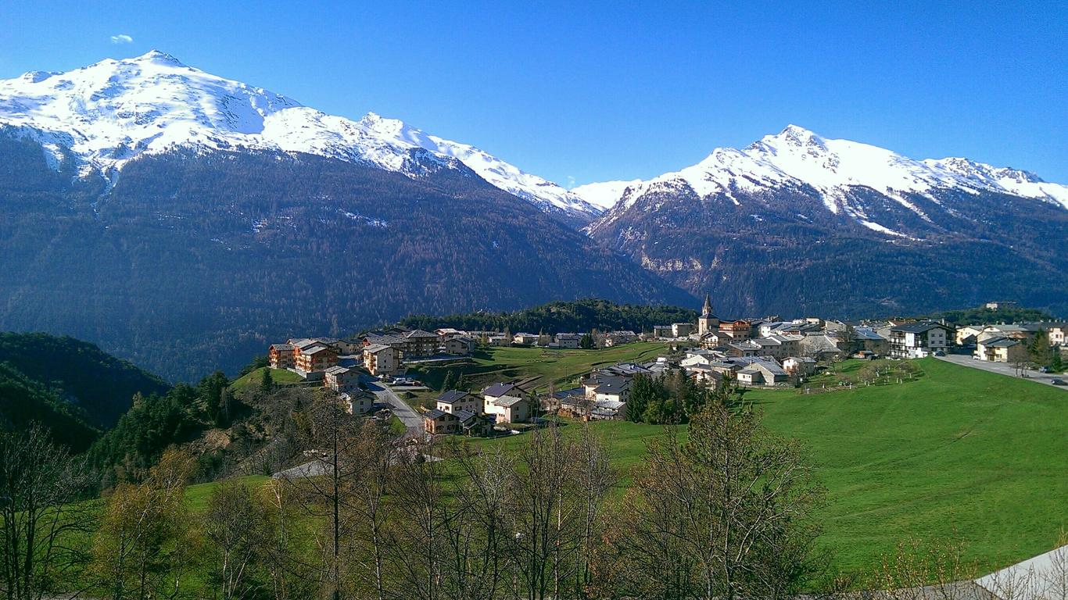
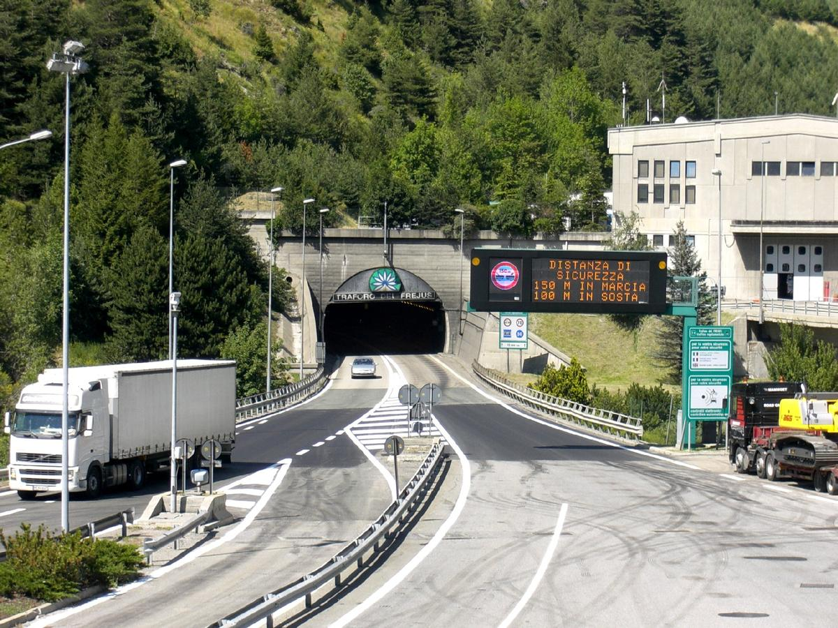
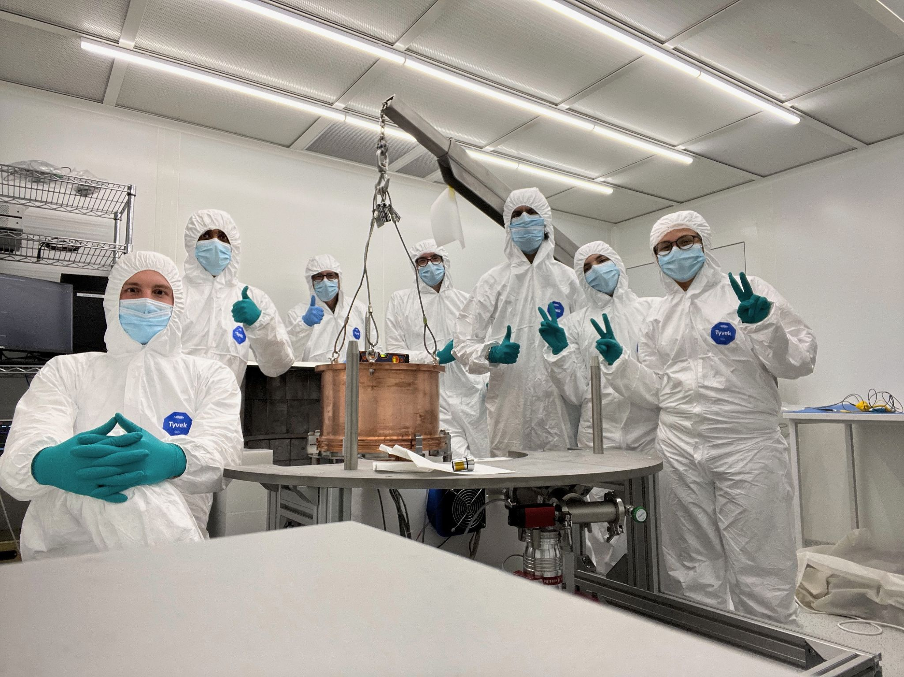
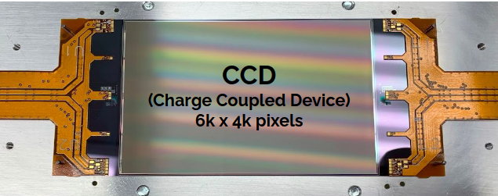
Dark matter detection with silicon CCDs
Modane, France
Frejus Tunnel
LSM, cleanroom

Slide 3
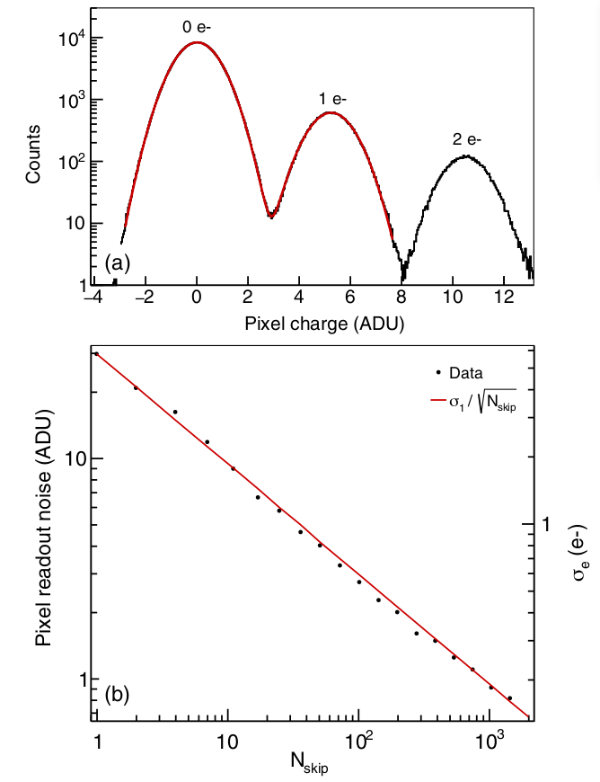
Skipper CCDs
Measures charge multiple times when compared to conventional CCDs
Can achieve single electron resolution
Per each Non Destructive Charge Measurement [NDCM] the readout noise reduces by 1/√N_{skips}
PRD 106, 092001(2022)
Courtesy: J.Cuevas-Zepeda

Slide 4
Detection
DM
Dark matter interaction in the CCDs can occur in 2 ways:
Electron recoil: Resulting in the excitation of electrons from the silicon atomic and band structure. The recoil energy is directly proportional to the number of electron hole pairs generated
Nuclear recoil: When a DM particle interacts with the silicon nucleus, part of the nuclear recoil energy gets transferred to ionisation of electrons. A quenching factor quantifies the relationship between the nuclear recoil energy and the ionization electrons.
DM
DM
DM

Slide 5
Compton scattering
Signals from background gamma rays can mimic DM electron recoil signals.
Hence it is important to understand the detector response to gammas low energies
γ
e⁻
θ

Slide 6
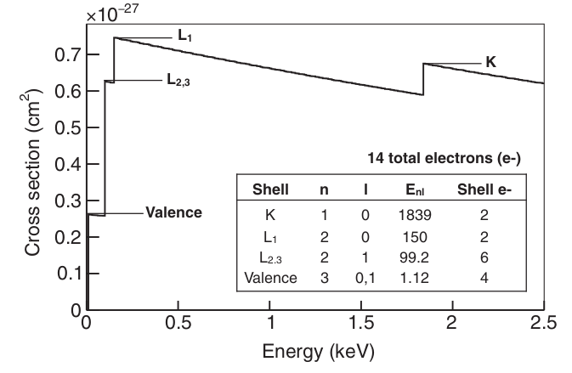
Compton scattering in Silicon
γ
L₁
K
L_{2,3}
²⁸Si
PRD 106, 092001(2022)
Valence
Relativistic Impulse Approximation [RIA] model

Slide 7
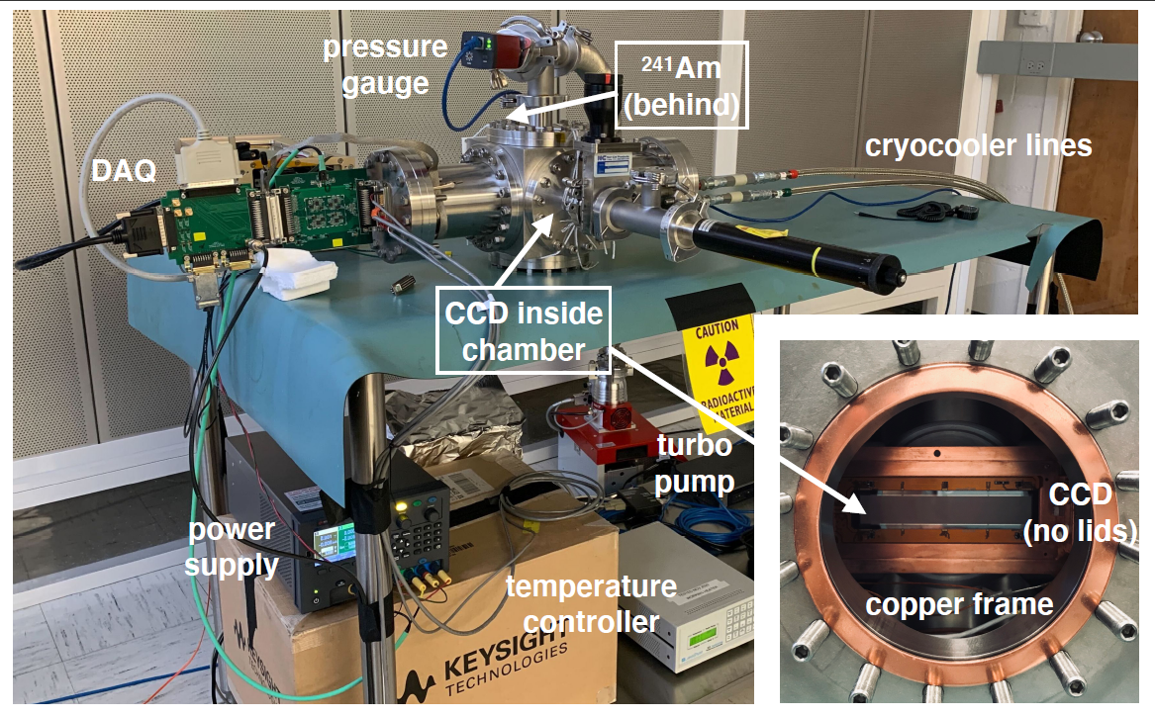
Experimental Setup and Data collection
Skipper CCD with 1024 x 6176 pixels is used as the silicon target detector
²⁴¹Am was used as the gamma ray source, emitting 59.54 keV γ rays was mounted to illuminate the backside of the CCD
The CCD was cooled to 126 K and under pressure of 10⁻⁷ mbar
Images with N_{skip} = 64 were taken with a total exposure of 105.5 days
Background images with no source and serial register images with source but clocking the CCD in the opposite direction were taken

Slide 8
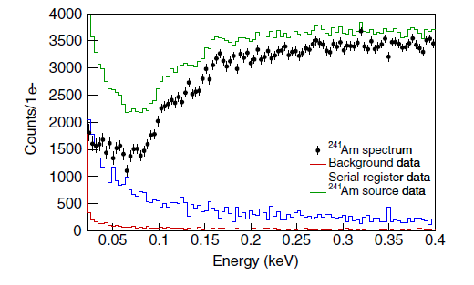
Analysis
Images were processed so as to reconstruct clusters of pixels associated with each event to obtain their full energy.
Events occurring at the serial register present as horizontal clusters throughout the image posing as significant background.
Exposure normalized background and serial register data were subtracted from the source data to obtain the final spectrum.
PRD 106, 092001(2022)

Slide 9
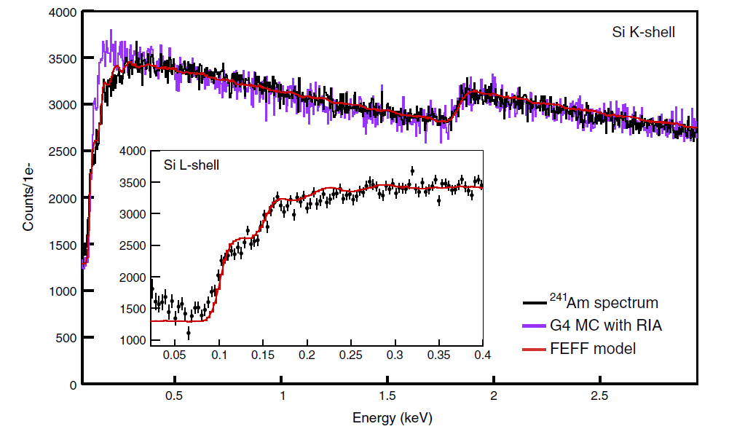
Results
The final spectrum was compared with GEANT4 simulations.
While the K-step showed perfect agreement with GEANT4, discrepancies arose at lower energies near the L₁ and L_{2,3} steps.
An ab initio calculation framework called FEFF was used to model the spectrum, which showed agreements with our measured spectrum.
Hence we have successfully measured the compton scattering spectrum in Silicon down to 23 eV.
This result will be used to model the uncertainties in the gamma backgrounds for DAMIC-M DM searches.
PRD 106, 092001(2022)

Slide 10
Neutron scattering in silicon
e⁻
Si lattice
n
n

Slide 11
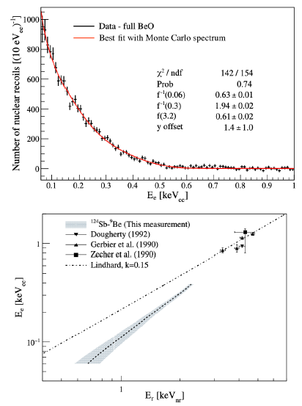
Silicon nuclear recoil measurement
Measurement of nuclear recoil in silicon produced by low energy neutrons (<22.6 keV)
¹²⁴Sb-⁹Be photoneutron source was used to produce the necessary neutrons
Measurement with conventional CCDs found deviations from the lindhard model
Phys. Rev. D 94, 082007 (2016)

Slide 12
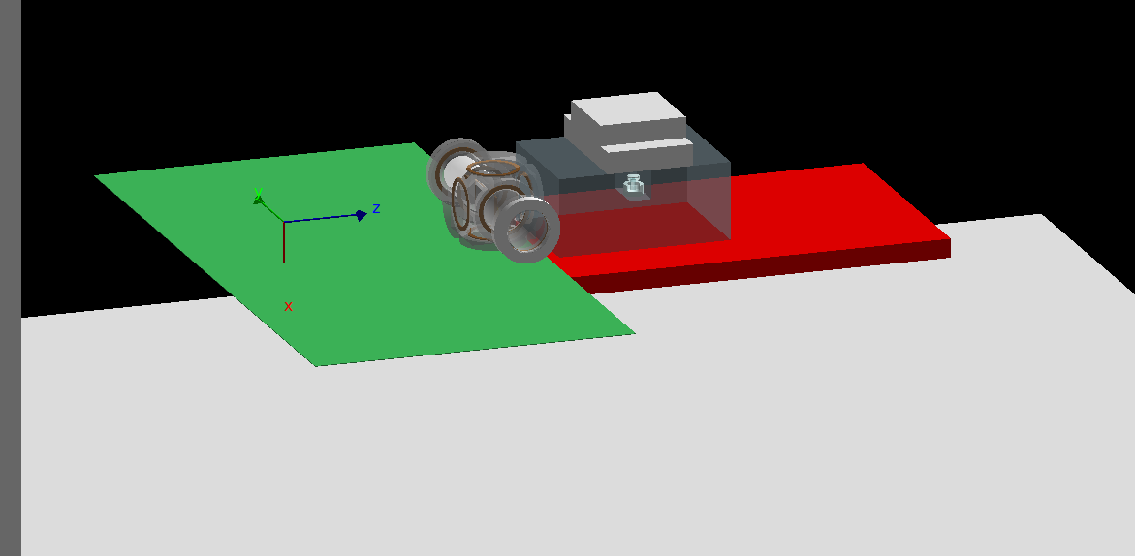
Nuclear recoil measurement setup
Similar setup to that of Compton measurement was used.
A lead castle was built to house the photoneutron source to shield the CCD from high energy gammas.
The source setup was alternated between SbBe and SbAl to account for background due to gammas.
GEANT4 geometry

Slide 13
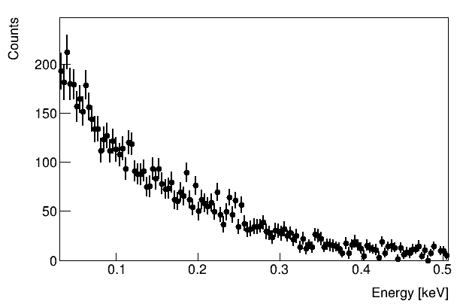
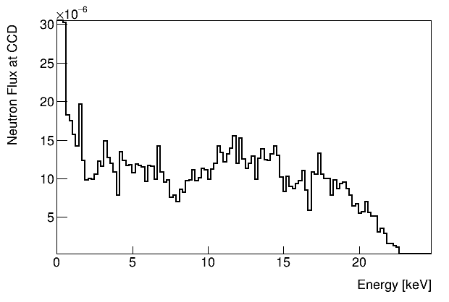
Preliminary results
Preliminary
Background subtracted nuclear recoil ionization spectrum
Flux of neutrons seen at the CCD as simulated by GEANT4
Obtaining the quenching factor is work in progress

Slide 14
Conclusions
We have measured Compton scattering down to 23 eV
Obtaining the nuclear recoil quenching factor at energies < 20 eV is in progress.
These precision ionization measurements at low energies aid in calibrating the detector behaviour to backgrounds and improve limits in DM detections.

