Slide 1
Domain Adaptation in Gravitational Lens Analysis
Paxson Swierc
Yifan (Megan) Zhao
Department of Astronomy and Astrophysics, University of Chicago
pswierc@uchicago.edu
yifanzyf@uchicago.edu
Brian Nord ¹ ² ³ ⁴
Aleksandra Ciprijanovic ¹ ²
¹ Fermi National Accelerator Laboratory
² Department of Astronomy and Astrophysics, University of Chicago
³ Kavli Institute for Cosmological Physics, University of Chicago
⁴ Laboratory for Nuclear Science, MIT
FERMILAB-SLIDES-23-131-CSAID
New Perspectives 2023 June, 2023

Slide 2
Talk Outline
Introduction
Project motivation
What is domain adaptation
Our dataset
Technique #1: Maximum Mean Discrepancy (MMD)
What is MMD
Results
Technique #2: Domain Adversarial Neural Network (DANN)
What is DANN
Results
Discussion & Conclusion
Limitation of our work
Summary of our work
1
1 New Perspectives | June 2023

Slide 3
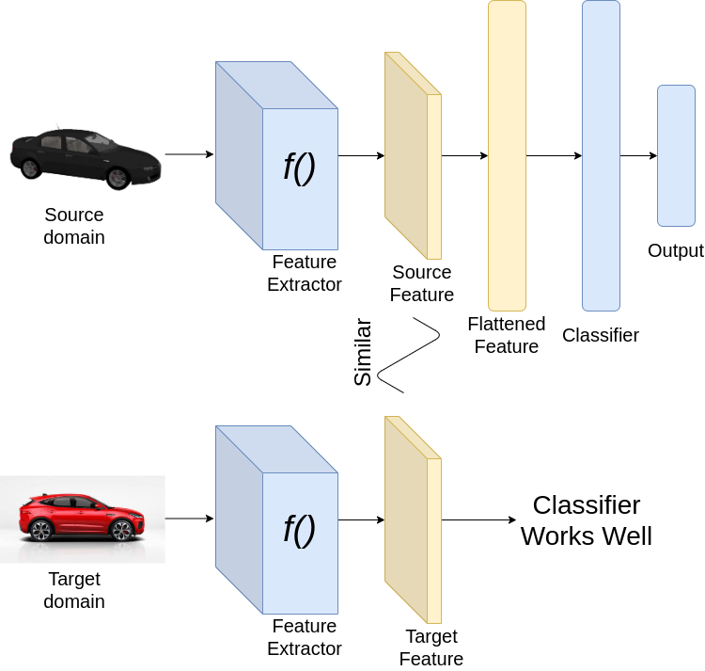
Introduction
Motivation:
Large number of gravitational lens data in upcoming surveys makes machine learning necessary
Lack sufficient real lensing data for training machine learning algorithm, must use simulated data
Algorithms trained on simulated data perform poorly on real data
Question:
How can we bridge the gap between simulated data and real data, when we have large amounts of labeled simulated data and few labeled real samples
Solution:
Domain Adaptation: apply algorithm trained on “source domain” to a different “target domain”, without access to target domain labels
Maheshwari, Harsh. “Understanding Domain Adaptation.” Medium, 10 Sept. 2021, towardsdatascience.com/understanding-domain-adaptation-5baa723ac71f.
1
2 New Perspectives | June 2023

Slide 4
This work
Source: simulated galaxy-galaxy strong lens using deeplenstronomy
Convolutional Neural Network (CNN)
Estimated Einstein Radius
+label
Testing on target:
Estimate Einstein radius
Low R2 score
+label
CNN + Domain adaptation
Estimated Einstein Radius
Target: simulated galaxy-galaxy strong lens with real survey like conditions
(no label)
Testing on target:
Estimate Einstein radius
High R2 score
3 New Perspectives | June 2023

Slide 5
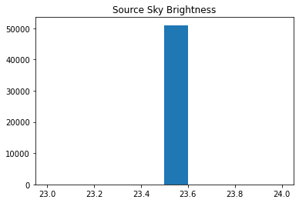
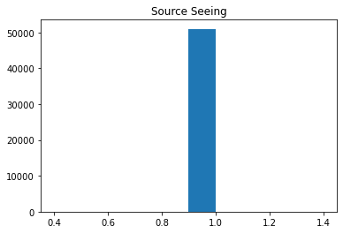
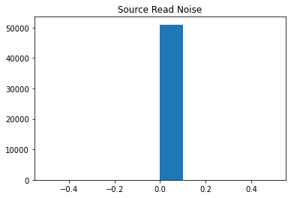
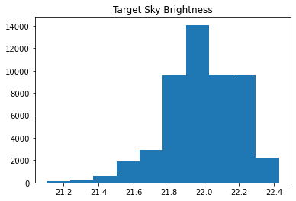
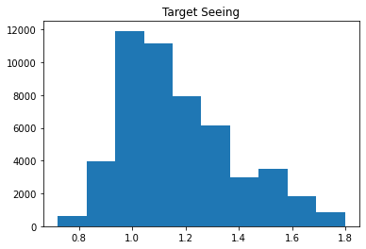
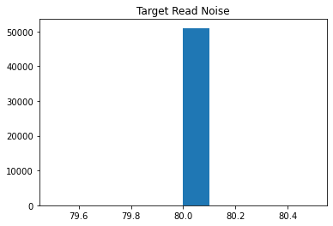
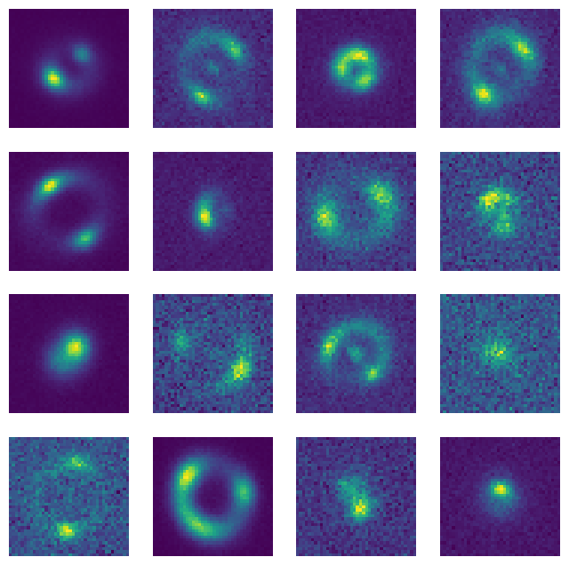
The Dataset
Source domain (has labels)
Target domain (unlabeled for training)
Simulated data
bridge
Real data
Source domain: No real-survey like conditions
Target domain: Dark Energy Survey like conditions
1
4 New Perspectives | June 2023

Slide 6
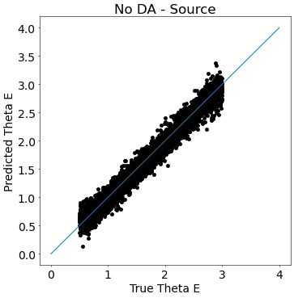
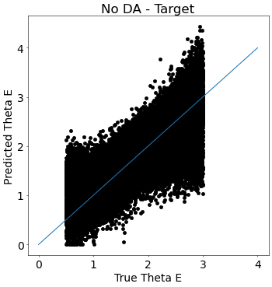
Performance Without Domain Adaptation
When trained only on source domain, CNN performs poorly on target domain
 | Source domain | Target domain
No DA | 0.98 | -0.7
R2 score
1
5 New Perspectives | June 2023

Slide 7
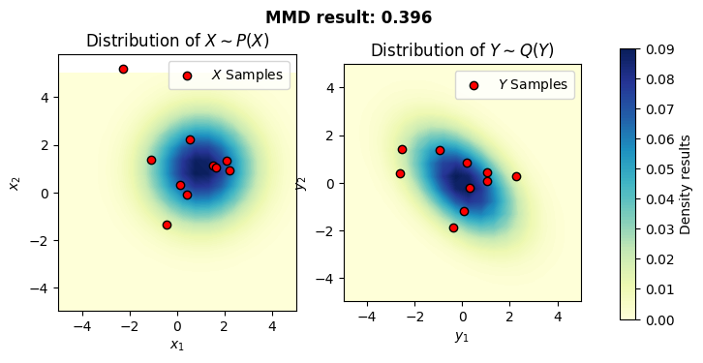
Maximum Mean Discrepancy (MMD)
What is MMD:
Minimize distance between means of source and target domain distributions
Kernel method: minimize distance = maximize kernel that describe similarities in distributions => domain invariant features
Total loss:
Mean squared error (MSE) used in regular training
MMD loss weighted by constant
Comparison of two distributions with different means
1
Maximum Mean Discrepancy (MMD) in Machine Learning, 8 Mar. 2019, www.onurtunali.com/ml/2019/03/08/maximum-mean-discrepancy-in-machine-learning.html.
6 New Perspectives | June 2023

Slide 8
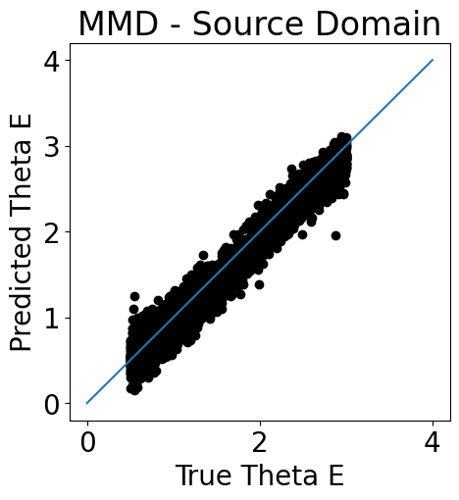
MMD results
Training with MMD significantly improves CNN performance on the target domain (-0.7 to 0.95)
 | Source domain | Target domain
No DA | 0.98 | -0.7
MMD | 0.96 | 0.95
R2 score
1
7 New Perspectives | June 2023

Slide 9
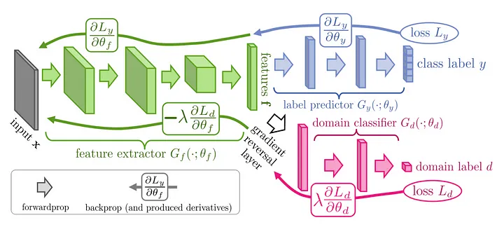
Domain Adversarial Neural Network (DANN)
What is DANN:
Approach to find domain invariant features, using an added domain classifier head
The Architecture:
Features found by convolutional layers are fed into two heads, the losses of which are summed
In training, labeled source data is given to the label predictor, which handles the main task
Unlabeled source and target data is given to the domain classifier, which tells the difference
Gradient reversal layer is used to teach the convolutional layers to confuse the domain classifier
1
Ganin, Yaroslav, et al. “Domain-adversarial training of neural networks.” The journal of machine learning research 17.1 (2016)
8 New Perspectives | June 2023

Slide 10
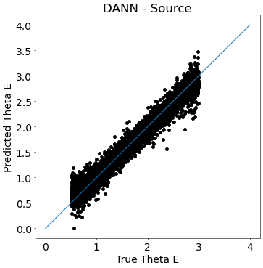
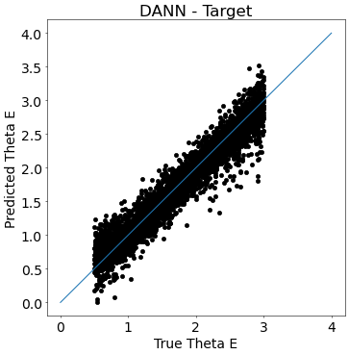
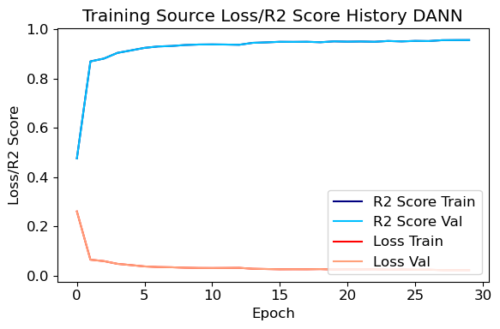
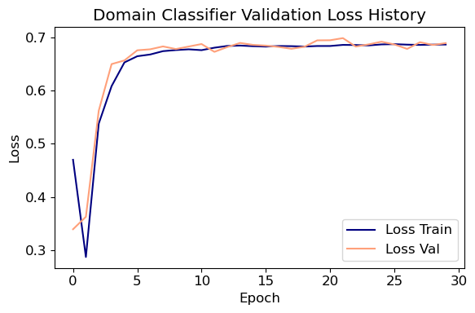
DANN Results
Training with DANN significantly improves CNN performance on the target domain (-0.7 to 0.93)
 | Source domain | Target domain
No DA | 0.98 | -0.7
DANN | 0.96 | 0.93
R2 score
1
9 New Perspectives | June 2023

Slide 11
Discussion - the limit of feature based DA
Thinking About the Domain Shift
Both these techniques teach the network to find invariant features
So the network learns to ignore whatever difference characterizes the two domains
This is amazing when the difference is noise, but what if the domain shift contains informative information?
Example in our context - if the domain shift is two different distributions of Einstein Radius values, both MMD and DANN may be a detriment to performance.
Since the DA methods will teach the networks to ignore differences between domains, but in this context the domain difference is the same value that we want to estimate.
1
10 New Perspectives | June 2023

Slide 12
Conclusion
We show that both DA technique improves target domain R2 score
DANN got better results on target data, but did worse on source data
MMD did worse on target data, but maintained better performance on source data
Although we are using simulated data, DA has potential for real survey data application
Further research in other DA methods needed
New Perspectives 2023 June, 2023

