Slide 1
Exploring the Dark Sector in MicroBooNE Through e⁺e⁻ Final States
FERMILAB-SLIDES-23-119-V
LA-UR-23-26783
Leon Niu Tong, on behalf of the MicroBooNE Collaboration
New Perspectives 2023
June 26, 2023
This document was prepared by MicroBooNE using the resources of the Fermi National Accelerator Laboratory (Fermilab), a U.S. Department of Energy, Office of Science, HEP User Facility. Fermilab is managed by Fermi Research Alliance, LLC (FRA), acting under Contract No. DE-AC02-07CH11359.
Notes:
Alright. Hello. My name is Leon Tong. I’m a post-bachelor intern at Los Alamos National Laboratory and will be presenting to you today on behalf of the MicroBooNE Collaboration about exploring the dark sector in MicroBooNE through e+e- final states.

Slide 2
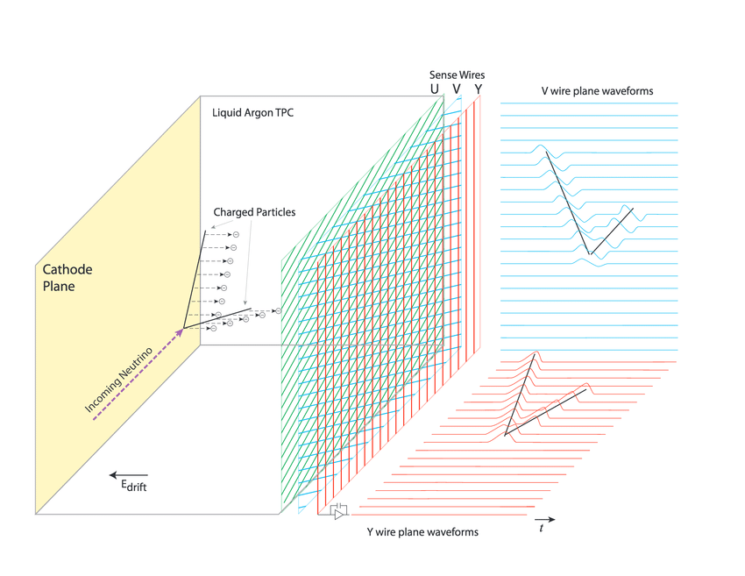
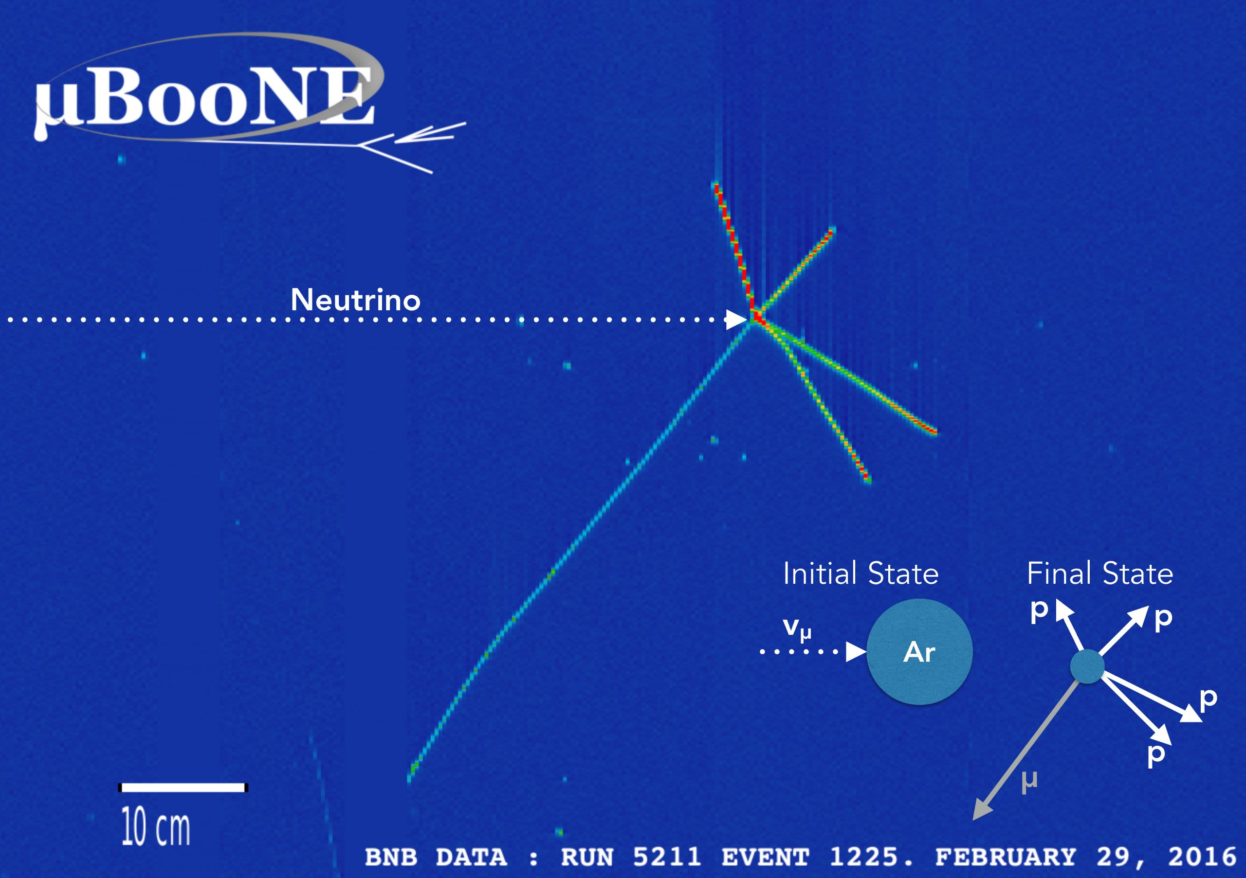
MicroBooNE
A liquid Argon time projection chamber that detects charged particles produced in neutrino events
Spatially resolves the trail of electrons produced by a charged particle through ionization
Fermilab/MicroBooNE
Notes:
As Natsumi mentioned, MicroBooNE is a liquid argon time projection chamber here at Fermilab. It tracks the path of charged particles produced by neutrino interactions within the detector.
For each event, it spatially resolves the trail of electrons produced by each charged particle. Here, for example, we have a neutrino interaction that produces 4 protons and a muon, and each particle type has distinct signatures.

Slide 3
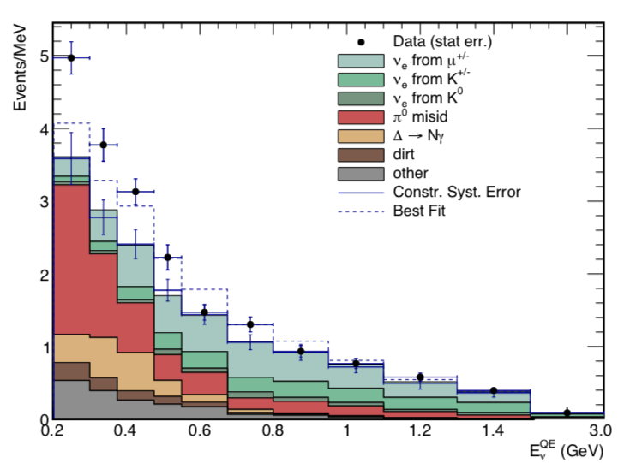
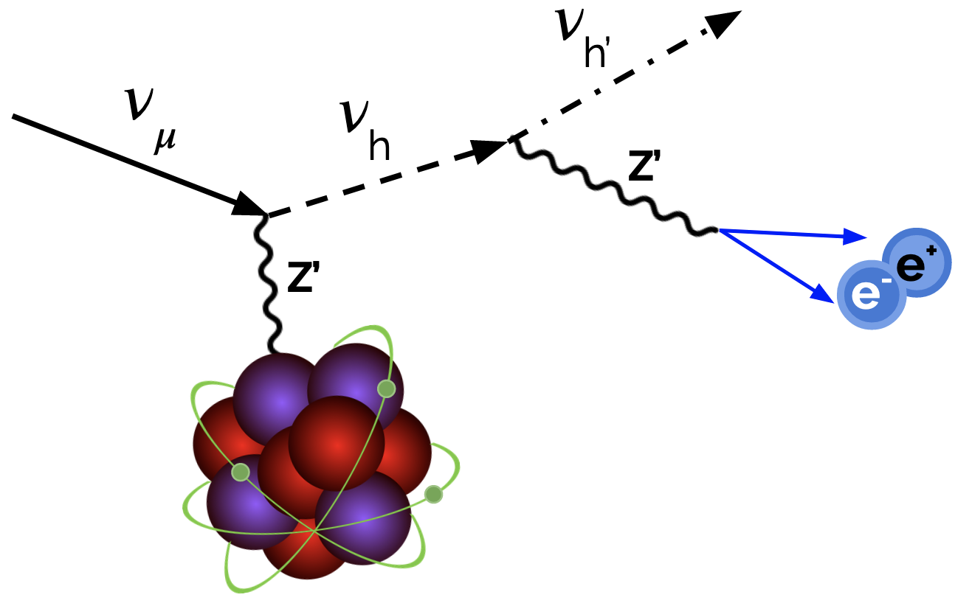
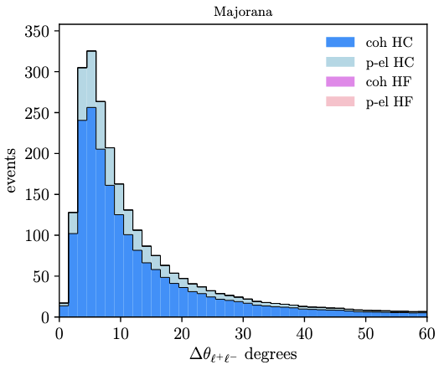
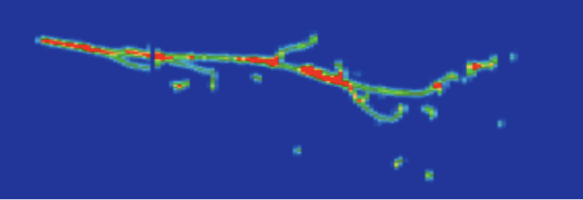
Motivation
MiniBooNE observed excess electrons/photons.^{[1]}
Dark sector models predict e⁺e⁻ pairs with small opening angles.^{[2][3]}
Could MiniBooNE excess have been e⁺e⁻ pairs?
How can we tell low-opening angle e⁺e⁻ pairs from true photons?
Extra electrons!
True photon (𝛳_{sep} ~ 0º)
True e⁺e⁻ (𝛳_{sep} ~ 4º)
Hypothetical dark sector e⁺e⁻ production pathway
Mark Ross-Lonergan
Possible distribution of e+/e- opening angles
Abdullahi et al.^{[4]}
Simulation
MiniBooNE Collaboration
Notes:
MicroBooNE was designed to explore an anomaly detected by its predecessor MiniBooNE, which observed a low-energy excess of electron or photon events that it couldn’t tell apart.
Certain dark sector models predict the production of electron positron pairs with low opening angles. Here, an incoming neutrino interacts with an Argon atom and becomes a dark sector heavy neutrino, which decays after a short time into an e+e- pair. I have here the opening angle distribution predicted by one such model. As you can see, it has a mode of roughly 5 degrees, although it stretches out further.
Could such events be mistaken for single photons or electrons and explain the MiniBooNE excess?
With spatial resolution of MicroBooNE, we can see the paths taken by the electron and positron. On the left here is a simulated photon event, which pair produces an e+e- with a 0 degree opening angle. On the right is an e+e- pair with a roughly 4 degree opening angle, as might be produced by a dark sector neutrino. The question is, can we distinguish between these two types of events?

Slide 4
Outline
Goal: Given a pair of e⁺e⁻ showers, calculate the angle between them.
Line-fitting Method
Steps
Difficulties
Results
PointNet++
What is it?
How does it work?
Results
Notes:
The goal of our work is, given a pair of e+e- showers, to calculate the opening angle between those showers, and we developed two methods of doing so. The first is a conventional line-fitting algorithm. I will describe the steps to our algorithm, show a few examples of the difficulties it faces, and finally the results it produces on simulated events. The second method uses PointNet++, which is a pioneering point cloud neural network. I will describe to you what that is, how it works, and the results from this second method.

Slide 5
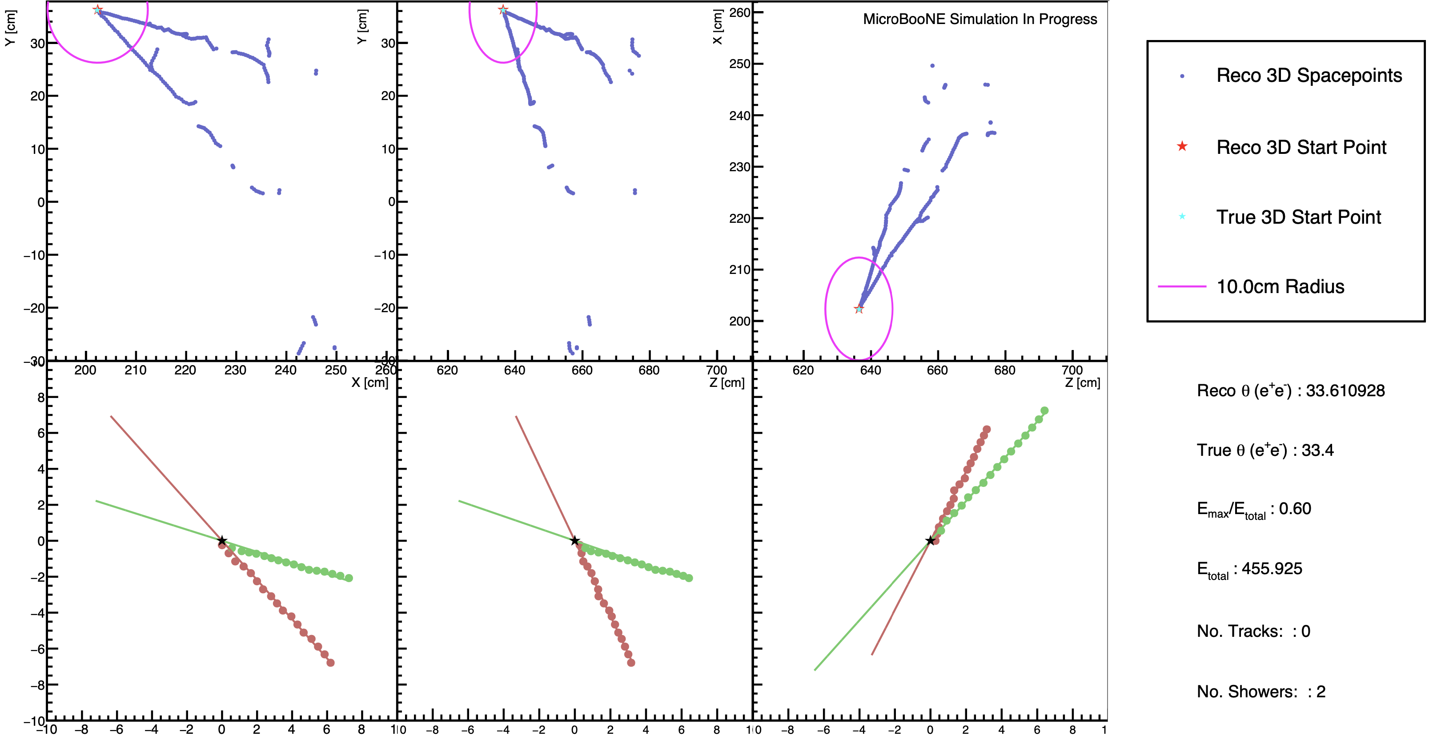
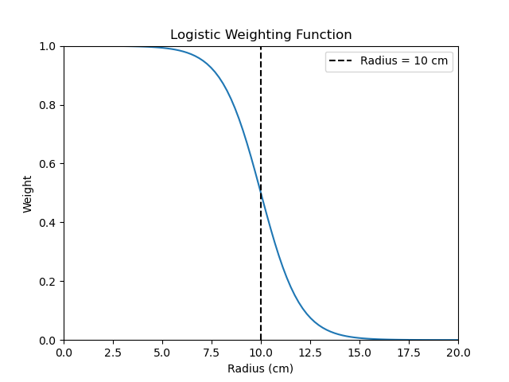
Line-fitting Method
Steps:
Retrieve reconstructed 3D space points and vertex.
Weight space points according to their distance from the vertex.
Fit line to space points through the vertex.
Fit plane through line to divide space points into two showers.
Fit line through each shower and calculate the angle between the lines.
Notes:
First, let’s go over the line-fitting method.
Here are the basic steps we take to calculate the opening angle for a single event.
First, we retrieve the reconstructed 3D spacepoints, which are represented by the blue dots, and the reconstructed vertex, which is represented by a red star. These are reconstructed by complex reconstruction frameworks upstream from our program.
Next, we weight the space points according to their distance from the reconstructed vertex using a logistic function. You can see a pink circle here with a 10 cm radius that corresponds to the midpoint of the logistic function, which I call the fitting radius.
Once we’ve chosen the spacepoints to use, we fit a line to those spacepoints through the vertex
and then fit a plane to the spacepoints through the line. All the points on one side of the plane are grouped into one shower, and all the points on the other side are grouped into the other shower.
And here are the results of that division. This bottom row of plots shows only the points within the fitting radius and splits them by color into the two showers using the methodology above.
Once we have those, we fit a line to each shower and calculate the angle between them.
Here’s the final result of the calculation. We reconstruct an opening angle of 33.6 degrees, compared to true angle of 33.4 degrees, which is pretty good. We also have some extra information like energy asymmetry, total energy in MeV, and the number of reconstructed tracks and showers.

Slide 6
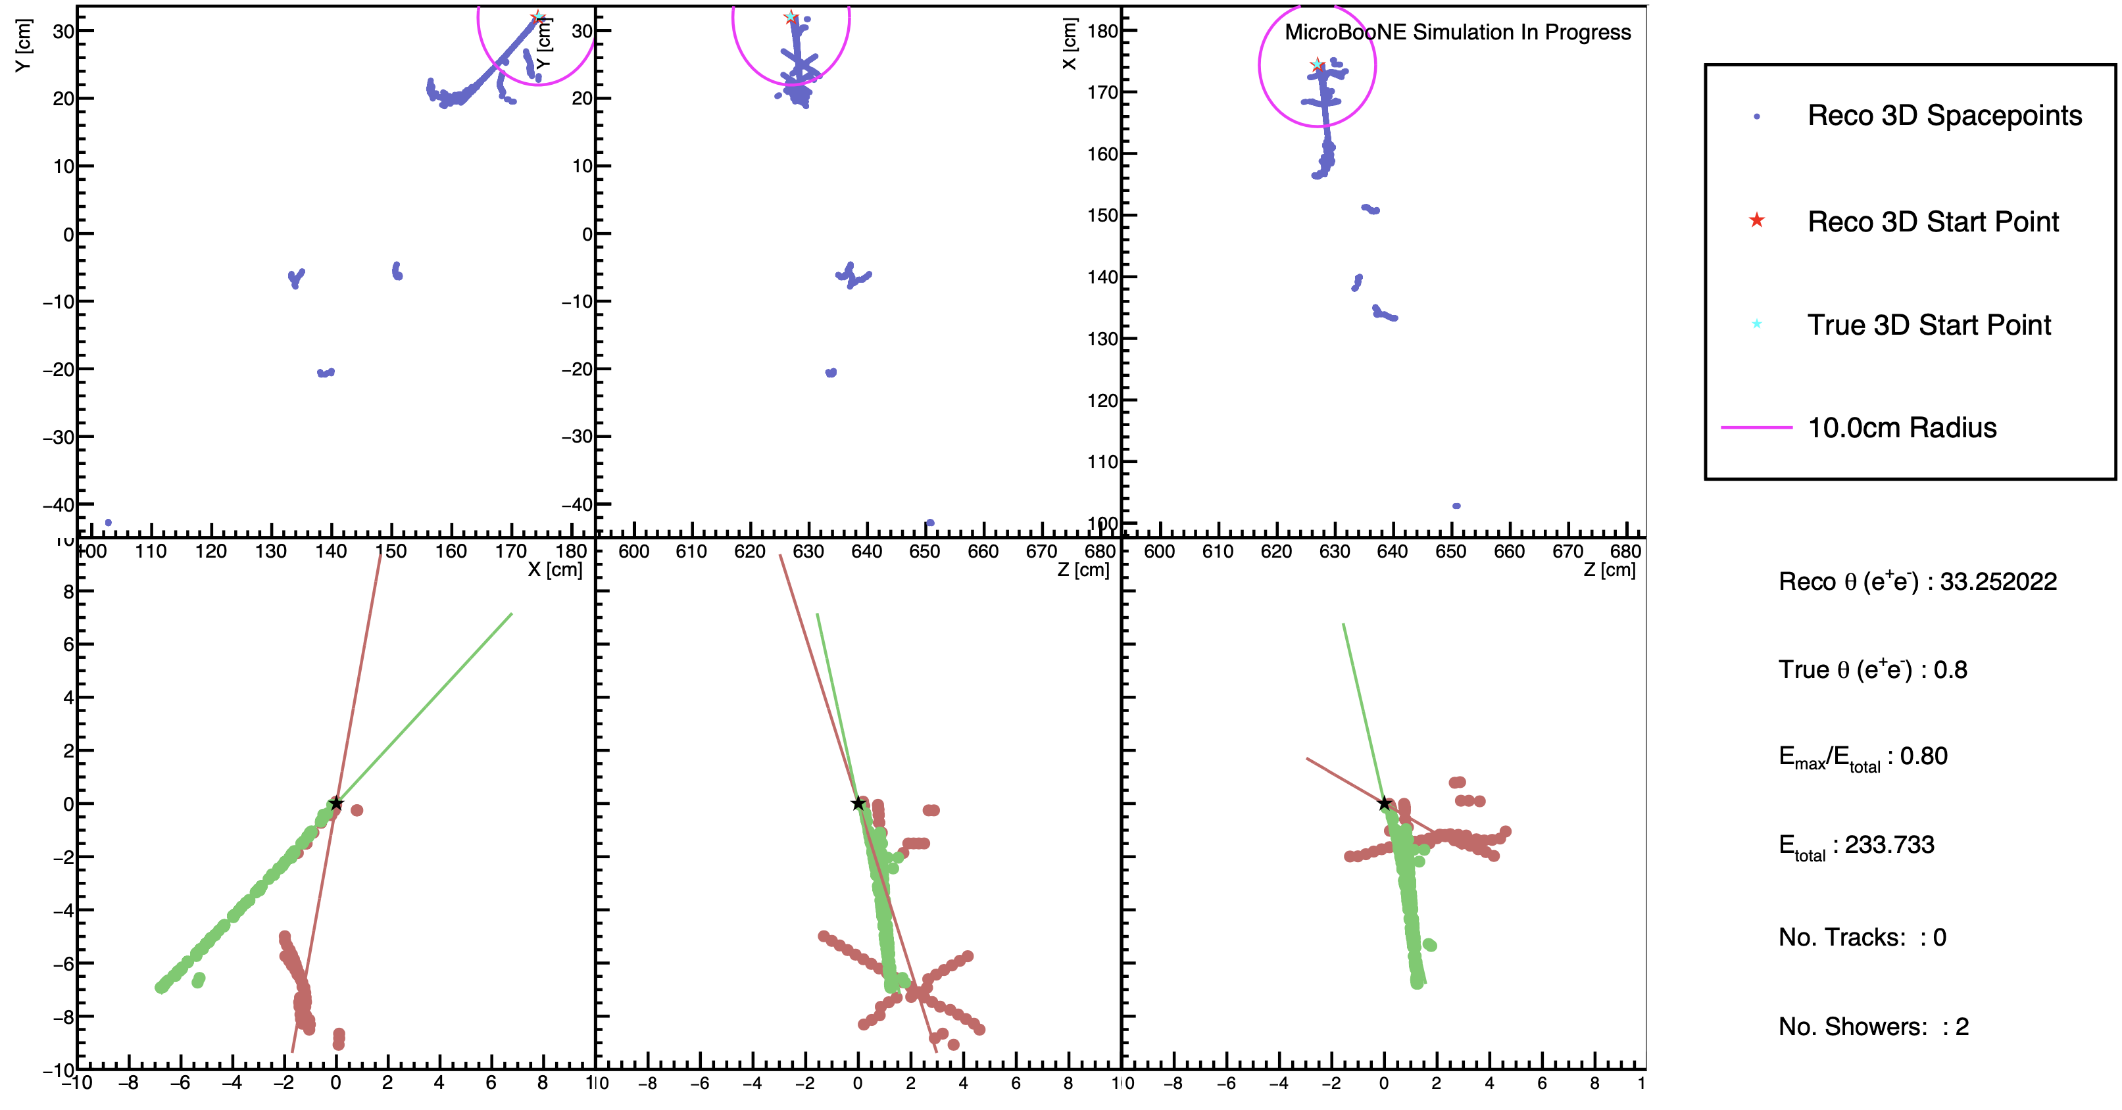
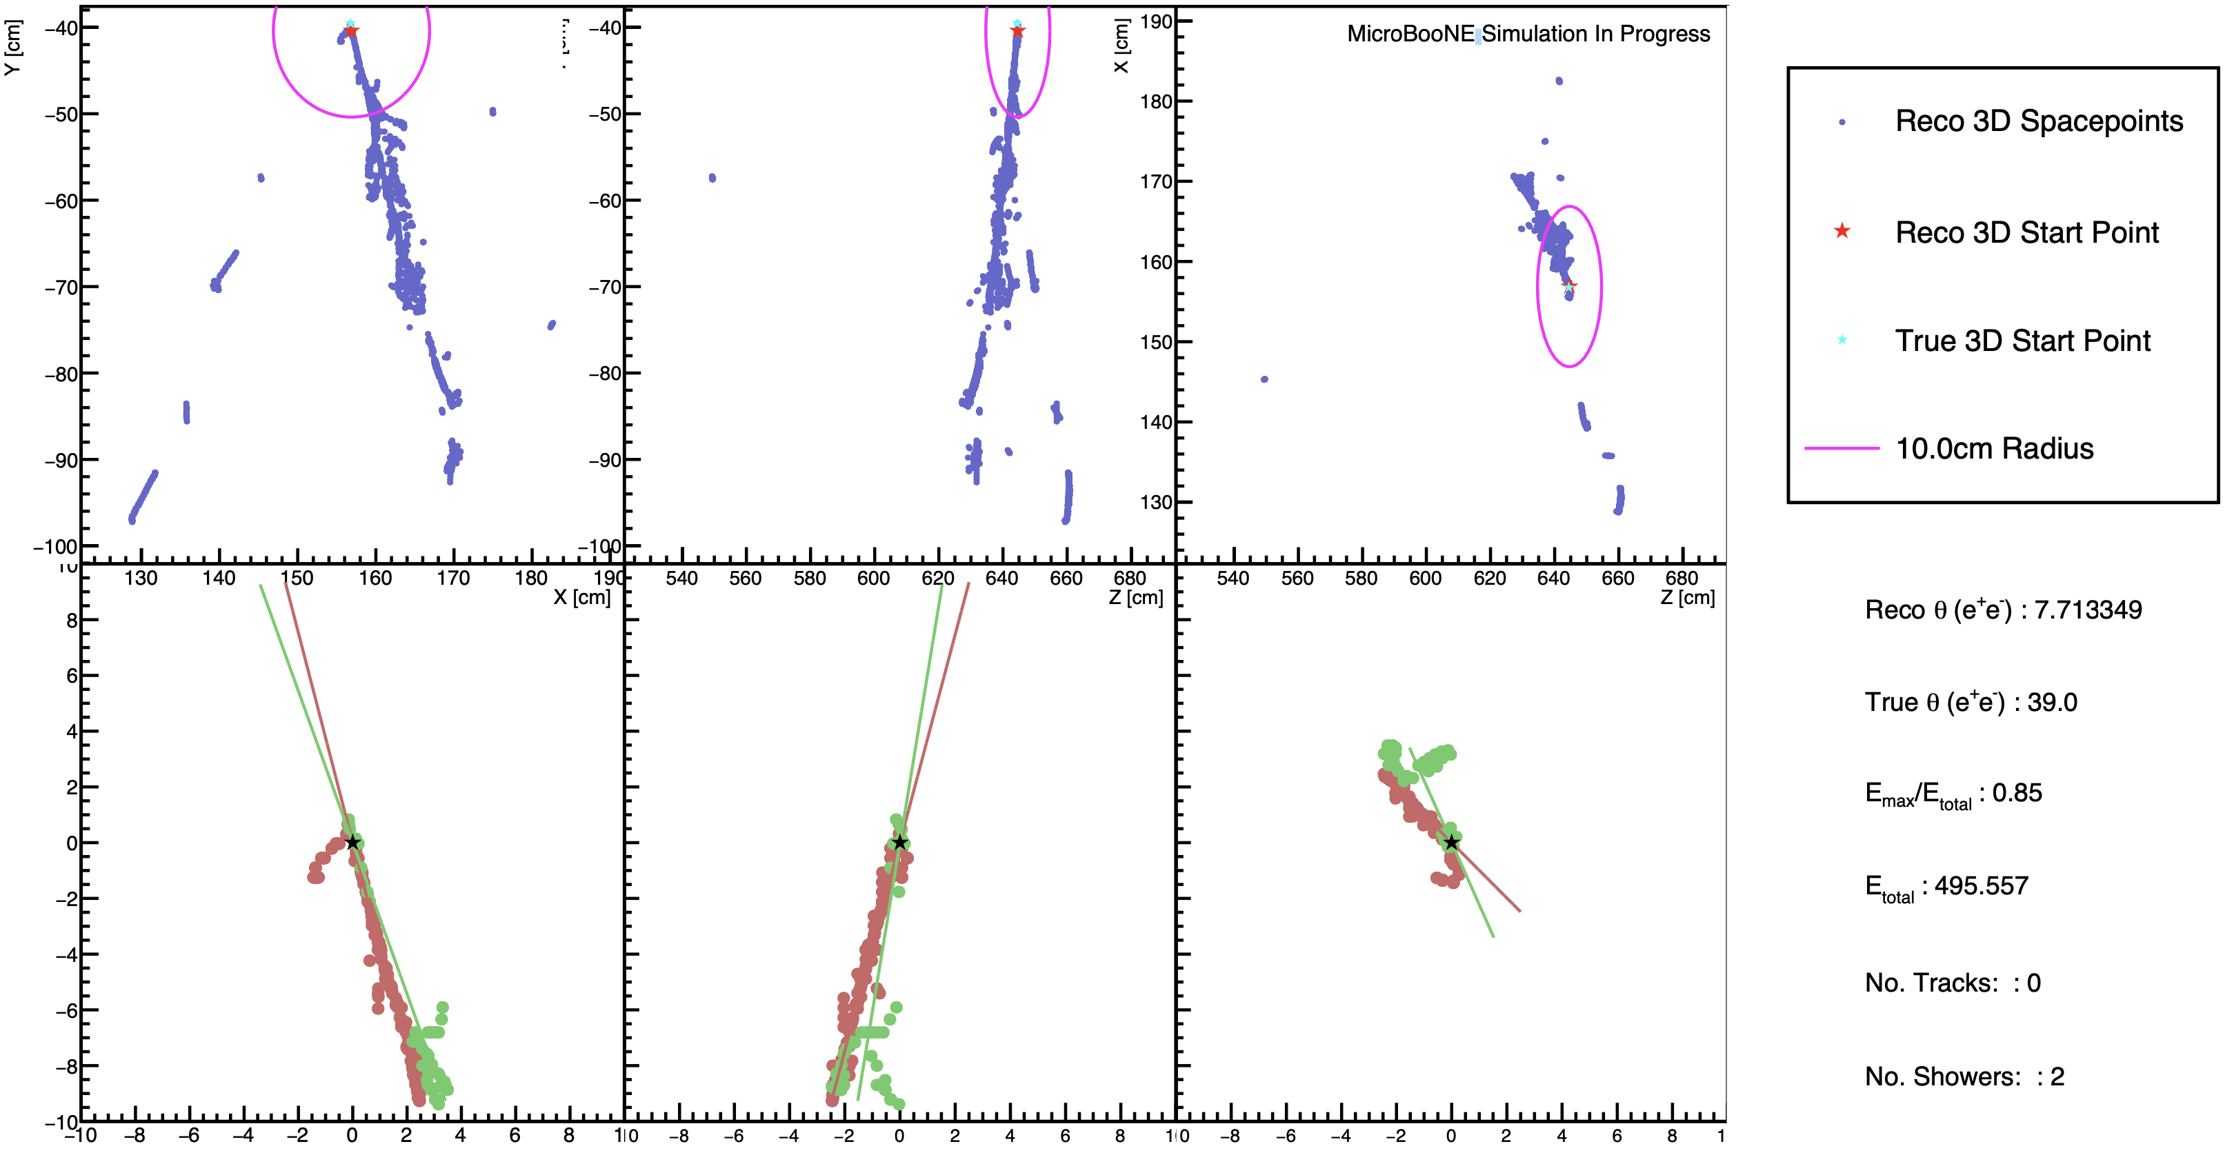
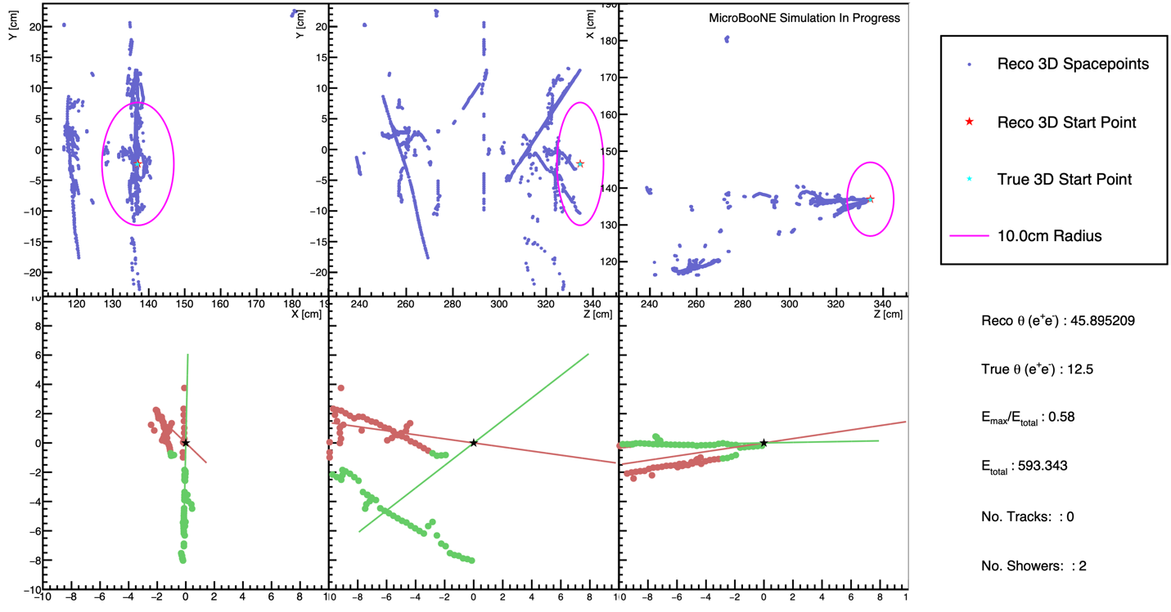
Difficulties
Partially/ completely missing shower
Early showering
???
Notes:
Not all events are so clean and easy to fit. Here are some of the situations in which our program fails.
Sometimes, the reconstruction misses part or all of a shower.
In this case, it misses the portion of the right shower that is within our fitting radius, so it fits only to the left shower, and you can see the consequence on the reconstructed angle.
If the electron or positron starts showering too early on,
it can also influence the fit in unpredictable ways.
There are also poorly reconstructed events where you just have no idea what is going on.

Slide 7
Accuracy depends on…
Fitting radius
Which 3D space points: Pandora^{[5]}, Wirecell^{[6]}?
Which vertex: Pandora, Wirecell?
Notes:
So what determines how accurate our model is?
The fitting radius, which, as a reminder, is just the midpoint of our logistic weighting curve, is a major factor.
We also have 2 sets of reconstruction frameworks to take our space points and vertices from: Pandora and Wire-Cell. As mentioned, these are complex reconstruction toolkits that were independently developed to convert raw detector hits to a 3D event.

Slide 8
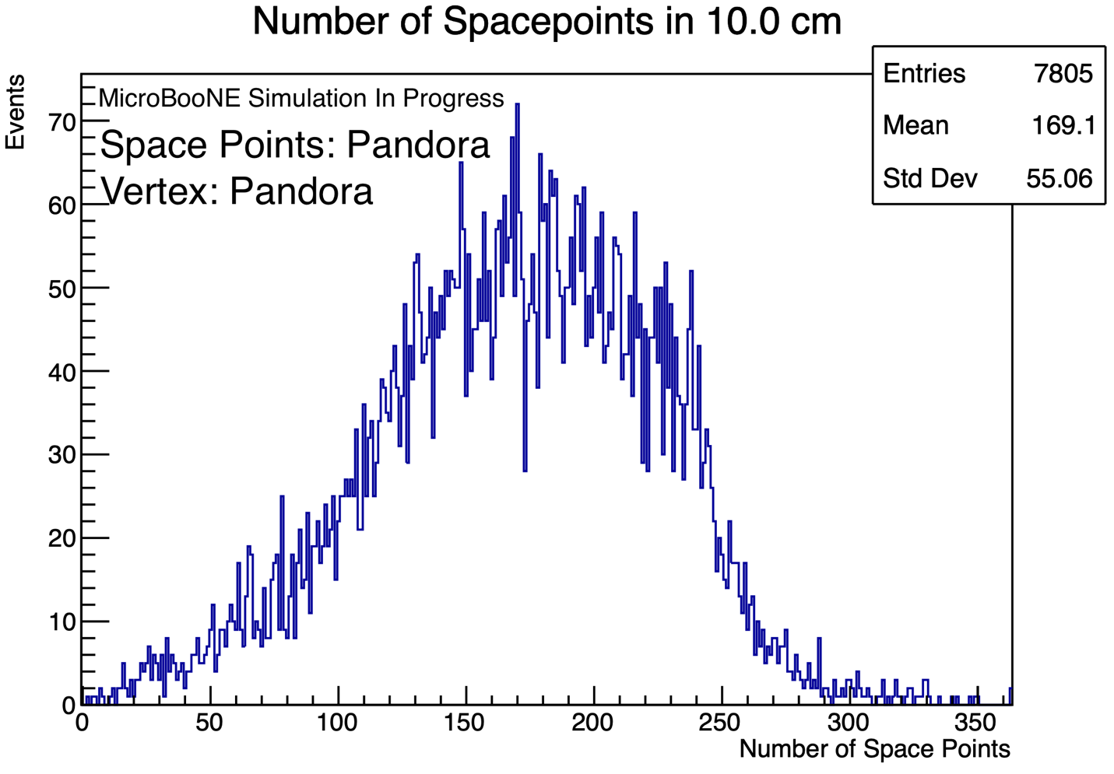
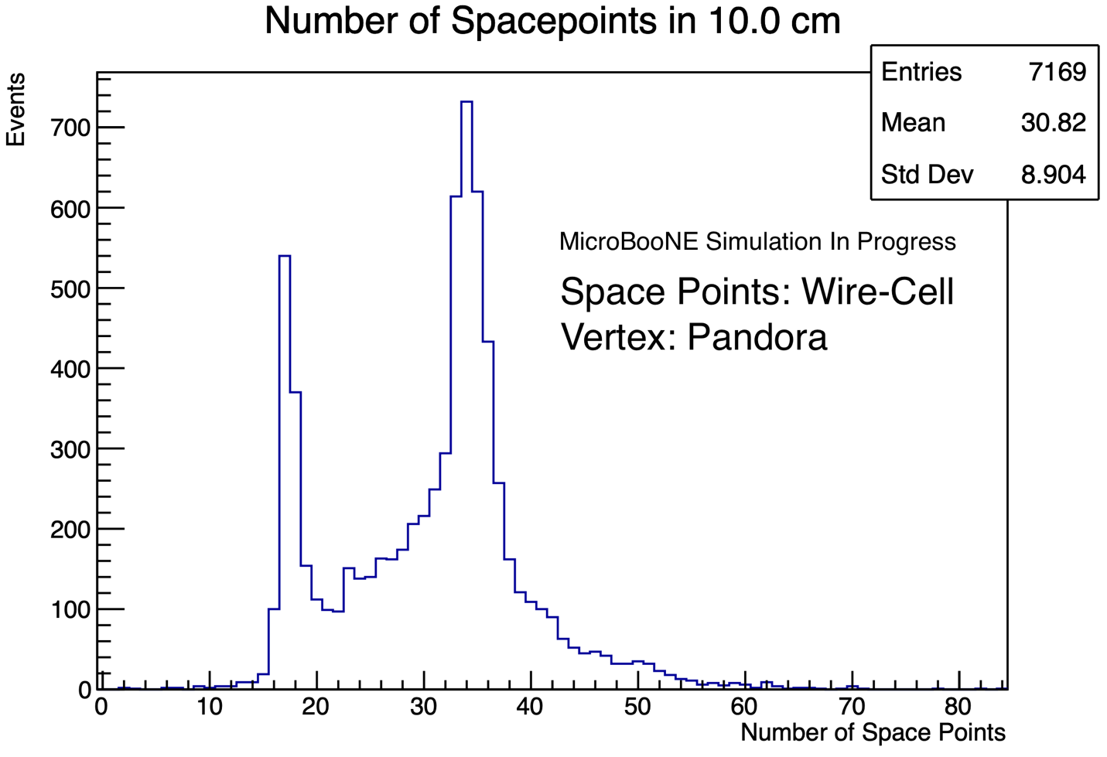
Combined Space Points
Best results were obtained by combining both sets of space points. Poorly reconstructed regions from one set could be augmented by points from the other set.
Must reduce the weight of Pandora space points due to their greater quantity.
Notes:
Well, we actually found that we got best overall results by combining Pandora and Wire-Cell space points for fitting. The idea is that poorly reconstructed regions such as a missing shower in one reconstruction can be augmented by points from the other set.
I should note that Pandora space points were given a greatly reduced weight to compensate for the fact that it produces several times more points on average that Wire-Cell. 169 compared to 31.

Slide 9
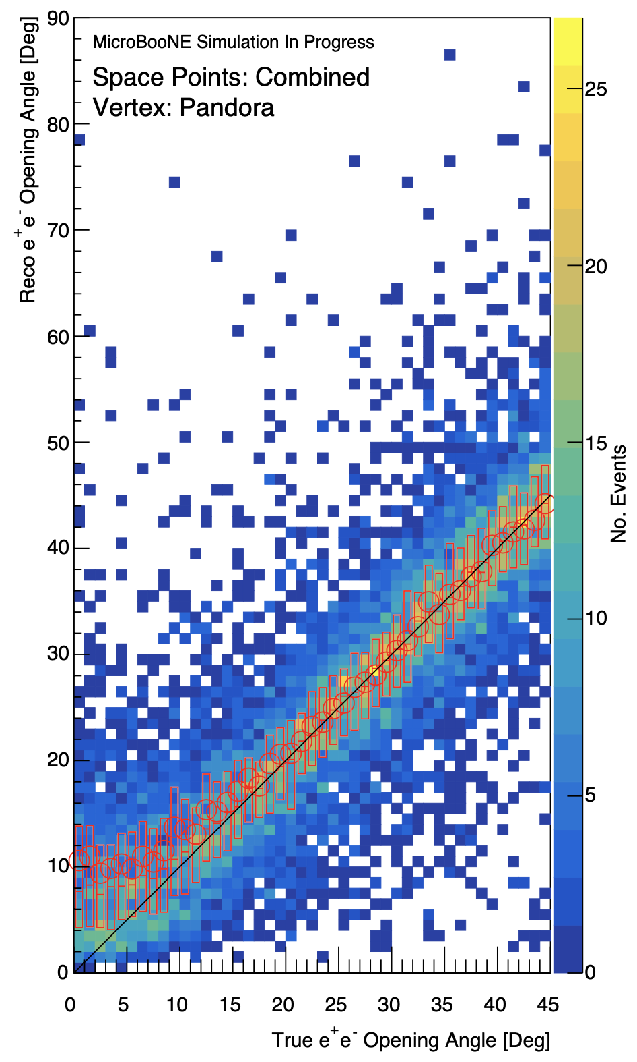
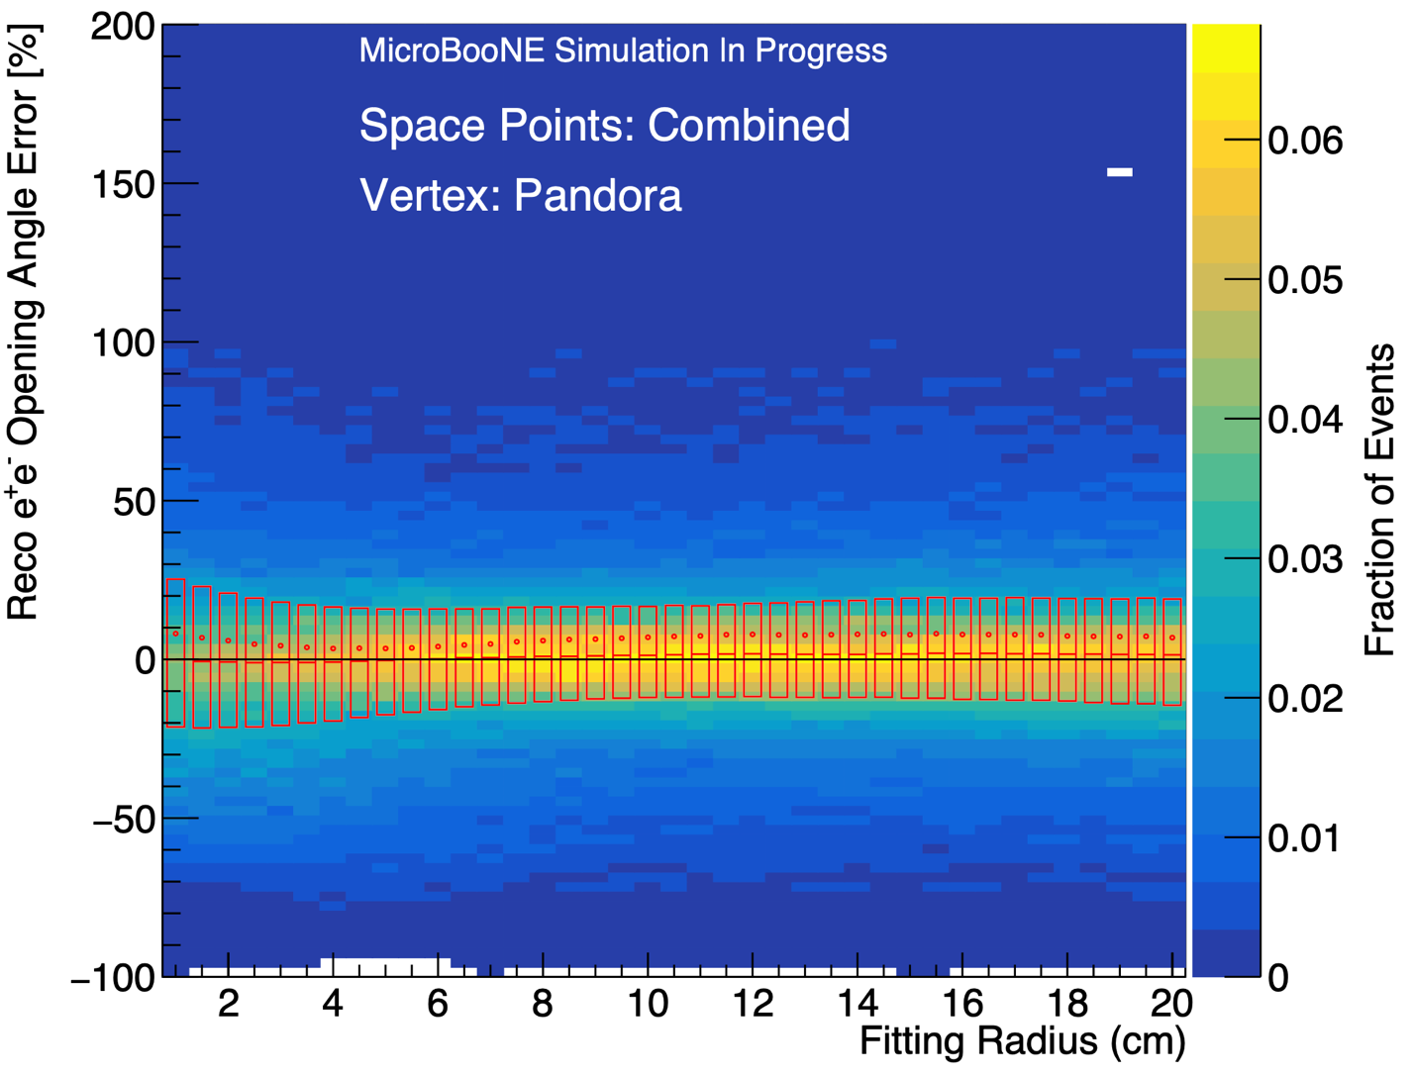
Results
Optimal radius ~10 cm.
Symmetric errors above ~20°.
Plateaus at low angles.
σ_{err} = 8.34°
Notes:
With the combined space points and Pandora vertices, which performed better than Wire-Cell vertices, we first determine an optimal fitting radius. On the y axis of this histogram is the percent error in the reconstructed opening angle. On the x axis is the fitting radius. The red bars are candle plots showing the interquartile range, meaning they contain 50% of the events for a given radius. As you can see, we get an optimal fitting radius of about 10 cm.
If we zoom in on the 10 cm radius, we can look at the actual distribution of reconstructed angle to true angle rather than just the error. Here, we have our reconstructed angle on the y axis and the true angle on the x axis. Once again, the candle bars display the interquartile range. I’ve also drawn a 45 degree line, which would be where the reconstructed angle matches the true angle. There is a fairly symmetric distribution above roughly 20 degrees, where the error is evenly about the 45 degree line.
However, it does pull away from that line at the lower end, and below 9 or 10 degrees, the reconstructed angle plateaus.
I also use a metric here, the standard deviation in the degree error, to assess the overall performance of our algorithm. We’ll see how this value of 8.34 degrees compares to our PointNet++ predictions.

Slide 10
Line-fitting Method Conclusions
Accurate reconstruction above 20° but overestimates low angles
Unable to exploit fine structures or recognize signs of poor reconstruction
Further tweaks may have improved the algorithm but would likely result in diminishing returns.
Notes:
So here’s the takeaway conclusions from our traditional line-fitting algorithm.
It’s able to reconstruct angles above 20 degrees somewhat accurately, even if the spread is a bit wide for our liking, but it systematically overestimates low opening angles, which are the ones we care about most for distinguishing dark sector e+e- pairs from true photons.
Our simple algorithm is unable to make use of fine structures that might signal important points for reconstruction, nor is it able to throw away poorly reconstructed points.
Further tweaks might have led to incremental improvements, but these would likely give diminishing returns, so we moved on instead to our next method.

Slide 11
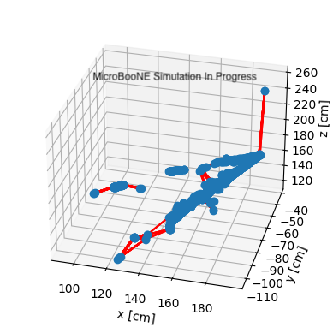
PointNet++
A graph neural network that runs directly on 3D space points!
Notes:
PointNet++.
PointNet++ is a graph neural network that that runs directly on our 3D space points. Now, what is a graph neural network?

Slide 12
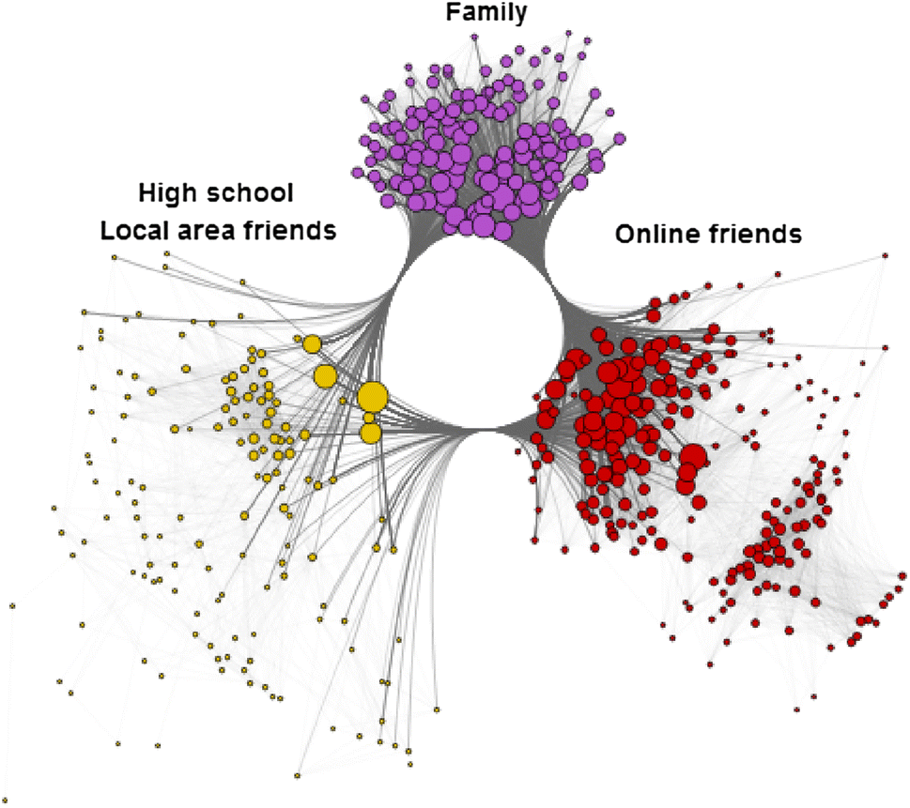
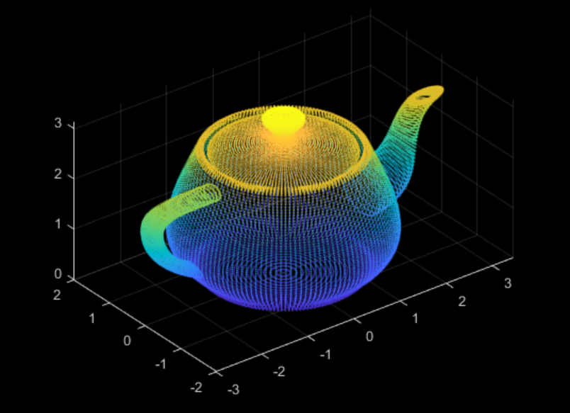
Graph Neural Network
Processes unordered data sets
Operates on graphs, made up of nodes and edge connections.
Point cloud neural networks are a subset that operate on point clouds, unordered points in 3D space with no intrinsic connections.
Revopoint 3D
Stanford
Mittal et al.
Notes:
A graph neural network is a type of neural network that processes unordered data sets as opposed, for example, to language learning models, which operate on linear, one dimensional text and convolutional neural networks, which operate on grid-based, pixel-based images.
Graph neural networks operate on graphs, which consist of nodes and edge connections. They’re particularly suited for learning the relations between nodes, for instance relationships within a social network.
PointNet++ is, in particular, a point cloud neural network, among the first of its kind. It operates directly on point clouds, which are unordered points in 3D space with no intrinsic relations between one another. These are usually generated by things like 3D scanners, but our e+e- space points can be considered point clouds as well.

Slide 13
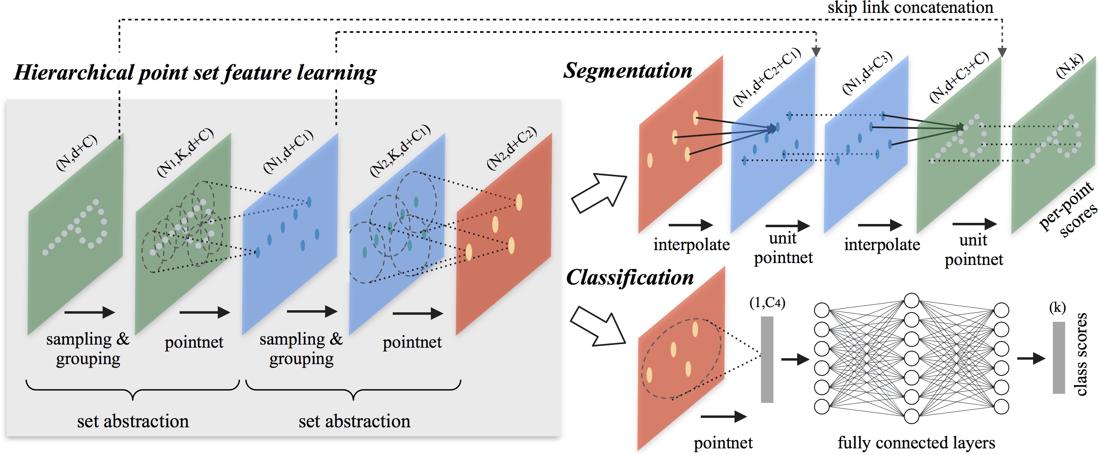
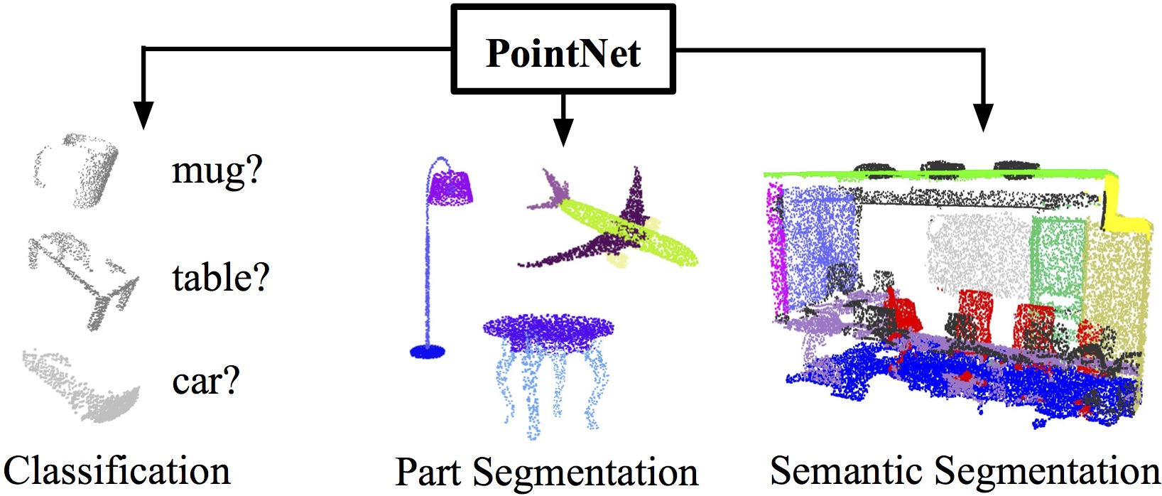
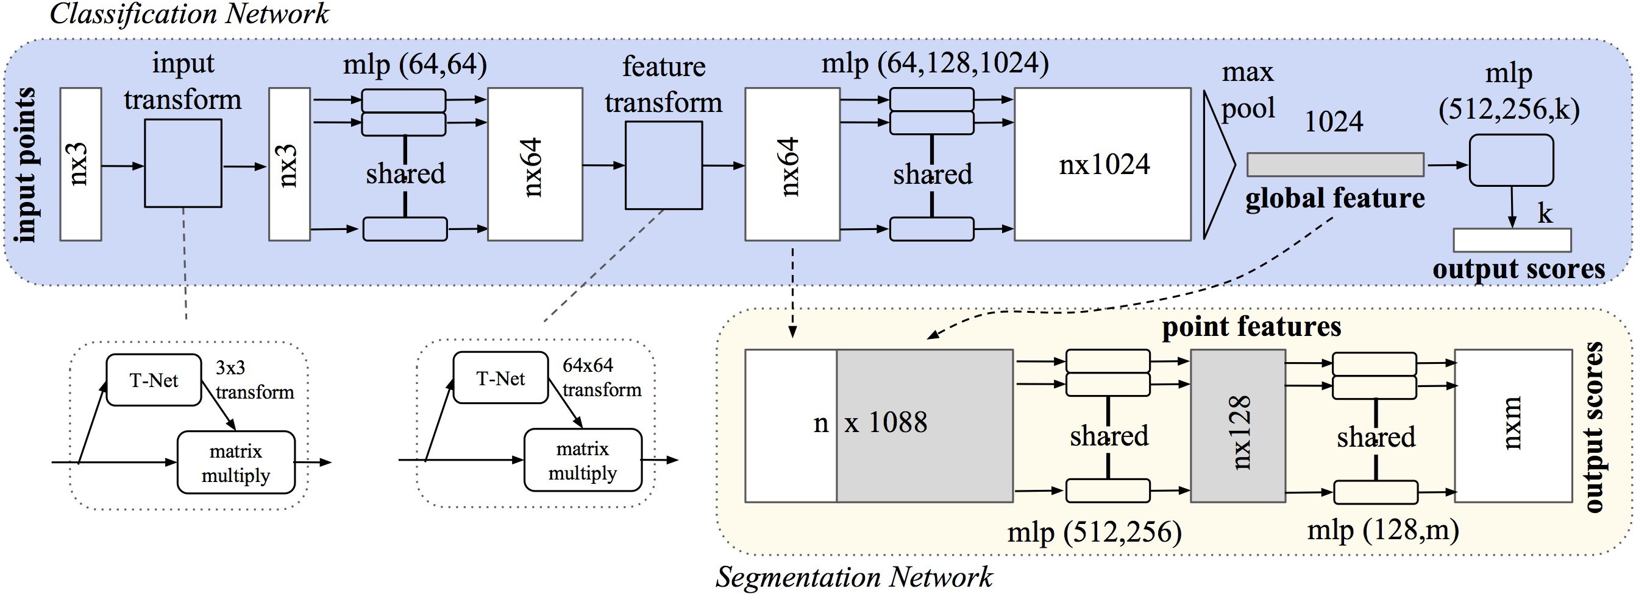
PointNet++
PointNet++^{[7]}
A graph neural network that runs directly on 3D space points!
Samples and groups points into neighborhoods and extracts features from each one using PointNet.
Repeats the above to learn from features at a hierarchy of scales.
Traditionally used for classification and segmentation rather than numerical regression.
PointNet^{[8]}
Qi et al.
Notes:
PointNet++ samples and groups input point clouds into neighorhoods of points and extracts features from each one using a network called PointNet.
It then repeats this process at larger scales to ultimately learn from features at a hierarchy of scales.
PointNet++ was developed for classification and segmentation, such as identifying the different parts of a 3D object. In our case, we had to modify the network for regression, making it output a numerical angle.

Slide 14
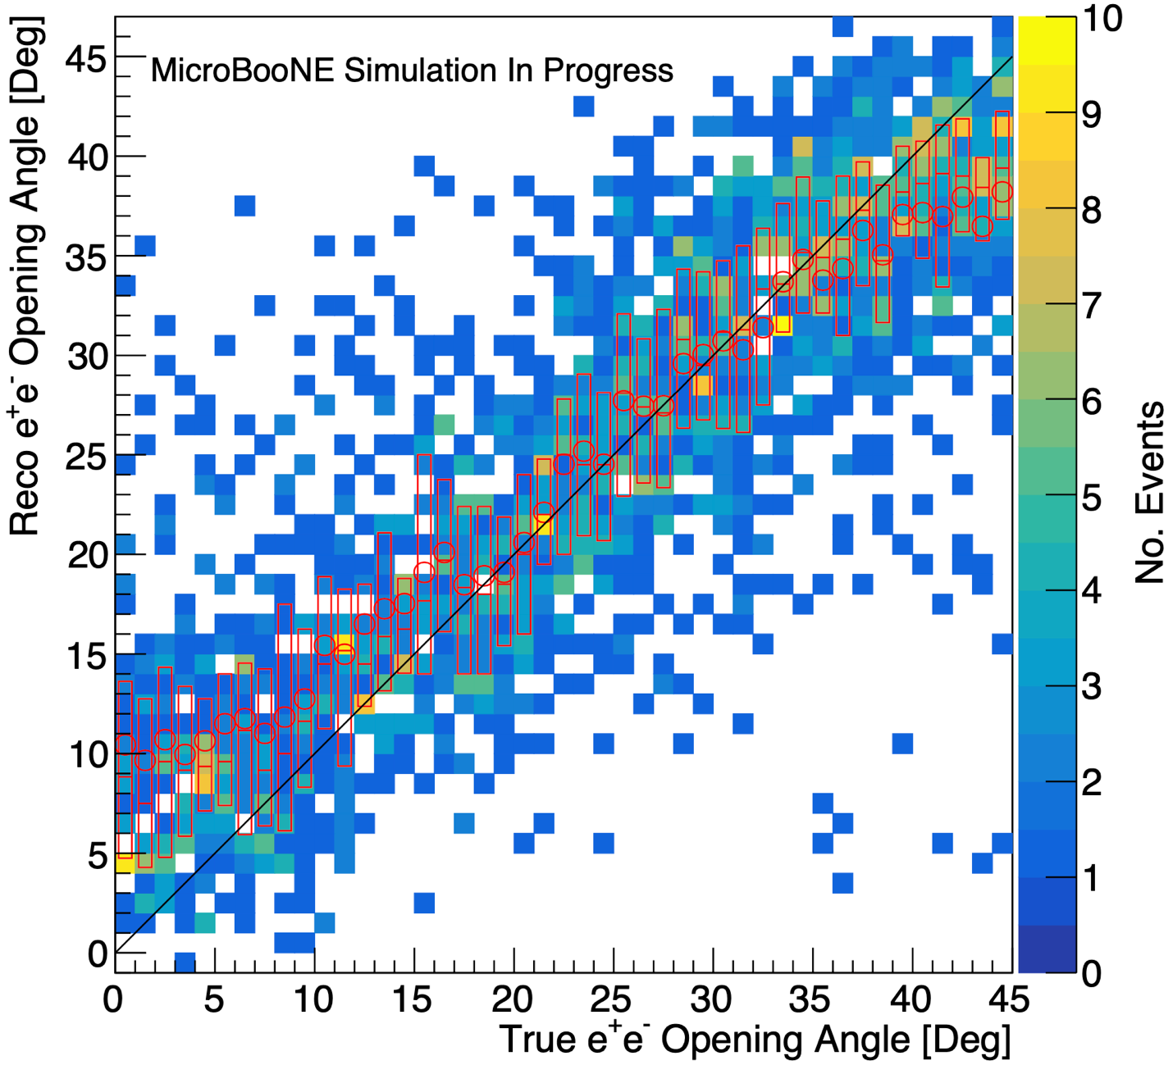
Results
Early results are better than those from combined line-fitting (σ_{err} = 7.30° vs. 8.34°)
Plateaus at upper and lower ends
Normalizing the scale of inputs improves performance despite transformation invariance
Does best when limiting input to space points within radius
Notes:
Our network is still in its early stages, but already it obtains a better overall result than line-fitting with combined space points. It is difficult to compare visually due to the sparser data since we take 75% of events for training, leaving only 25% for validation. However, the neural network achieves a standard deviation in the degree error of 7.3 compared to 8.34 from before.
However, the reconstructed angle distribution plateaus at high and low angles, presumably due to edge issues in training at least for the upper plateau.
Normalizing the scale of inputs before training improves the network’s performance despite the fact that PointNet++ is supposed to be transformation invariant.
Finally, limiting the input to points within a radius, in my current implementation 10 cm, also improves performance, presumably also because of more consistent scaling.

Slide 15
Future Work
Refine and improve current neural network
Produce more events
Add point features
Improve visualization of results
Explore other point cloud architectures
Test on true photons
Search for dark sector candidates in real events
Notes:
In the future,
we have much work to do refining and improving our current neural network.
More events would improve training and reduce over-fitting to our current set of 8,000 events.
We also want to add features to points other than their coordinates, for instance the energy of the spacepoint or its distance to a reconstructed vertex.
Additionally, we want to improve the visualization of our results, breaking them down by event attributes and adding statistical information.
We also plan to look at other point cloud architectures such as PointNeXT, PointTransformer, etc.
We need to generate true photon events and test our network on them, using both regression, where hopefully the angle should be close to 0, and classification, which would identify an event as a photon event or not.
Finally, when our algorithm is at a mature stage, we will use it to look for dark sector candidates in real events.

Slide 16
Acknowledgments
I would like to thank Dr. Sowjanya Gollapinni for mentoring me in this internship. This project would not have been possible without the help of Dr. Mark Ross-Lonergan, who worked closely with me on all aspects of it. I am grateful to Lee Hagaman and Erin Yandel for obtaining the Wire-Cell 3D space points and combining them with Pandora data for ease of comparison. Finally, I thank the MicroBooNE Collaboration for their input on my research and this presentation.
Notes:
And I thank everyone who was involved in this project for their help and support. Thank you.

Slide 17
References
[1] A. Aguilar-Arevalo et al., “Significant excess of electronlike events in the MiniBooNE short-baseline neutrino experiment,” Physical Review Letters 121 (2018), 10.1103/physrevlett.121.221801.
[2] E. Bertuzzo, S. Jana, P. A. Machado, and R. Z. Funchal, “Dark neutrino portal to explain MiniBooNE excess,” Physical Review Letters 121 (2018), 10.1103/physrevlett.121.241801.
[3] P. Ballett, S. Pascoli, and M. Ross-Lonergan, “U(1)’ mediated decays of heavy sterile neutrinos in MiniBooNE,” Phys. Rev. D 99, 071701 (2019), arXiv:1808.02915 [hep-ph].
[4] A. M. Abdullahi, J. H. Zink, M. Hostert, D. Massaro, and S. Pascoli, “Dark-news: a python-based event generator for heavy neutral lepton production in neutrino-nucleus scattering,” (2022), arXiv:2207.04137 [hep-ph].
[5] MicroBooNE collaboration et al., “The pandora multi-algorithm approach to automated pattern recognition of cosmic-ray muon and neutrino events in the microboone detector,” (2017), arXiv:1708.03135 [hep-ex].
[6] P. Abratenko et al., “Wire-cell 3d pattern recognition techniques for neutrino event reconstruction in large LArTPCs: algorithm description and quantitative evaluation with MicroBooNE simulation,” Journal of Instrumentation 17, P01037 (2022).
[7] C. R. Qi, L. Yi, H. Su, and L. J. Guibas, “Pointnet++: Deep hierarchical feature learning on point sets in a metric space,” (2017), arXiv:1706.02413 [cs.CV].
[8] C. R. Qi, H. Su, K. Mo, and L. J. Guibas, “Pointnet: Deep learning on point sets for 3d classification and segmentation,” (2017), arXiv:1612.00593 [cs.CV].

Slide 18
Backup Slides

Slide 19
Event Sampling Range
True 𝛳: 0° – 45°
E_{assymetry}: 0.50 – 0.90
E_{tot}: 100 – 800 MeV
Events with reconstructed vertices greater than 1 cm from the true vertex were also removed from analysis since an accurate vertex is crucial for an accurate fit, but the vertex is reconstructed upstream from our program and out of our control.
Notes:
Here’s the range of parameters we used in generating our events. The true angles are between 0 and 45 degrees. The energy asymmetry is between 0.5 and 0.9. That’s the percent of total energy contained in the more energetic shower. The total energy of the events is between 100 and 800 MeV. Additionally, we filter out events where the reconstructed vertex is greater than 1 cm from the true vertex.

Slide 20
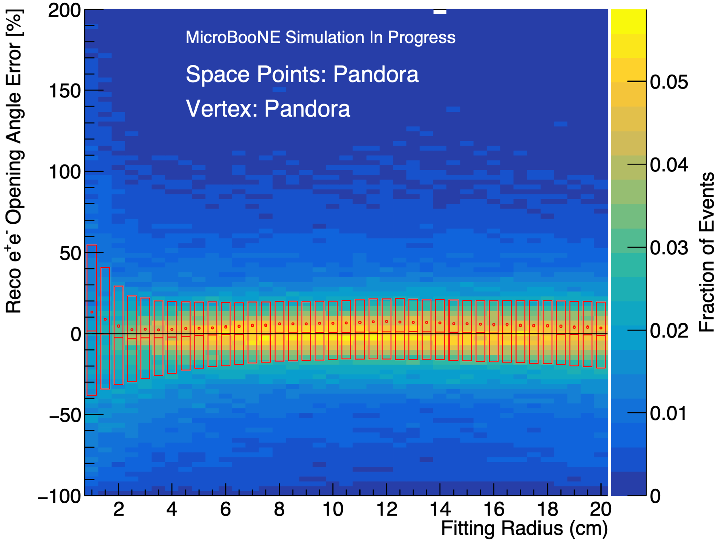
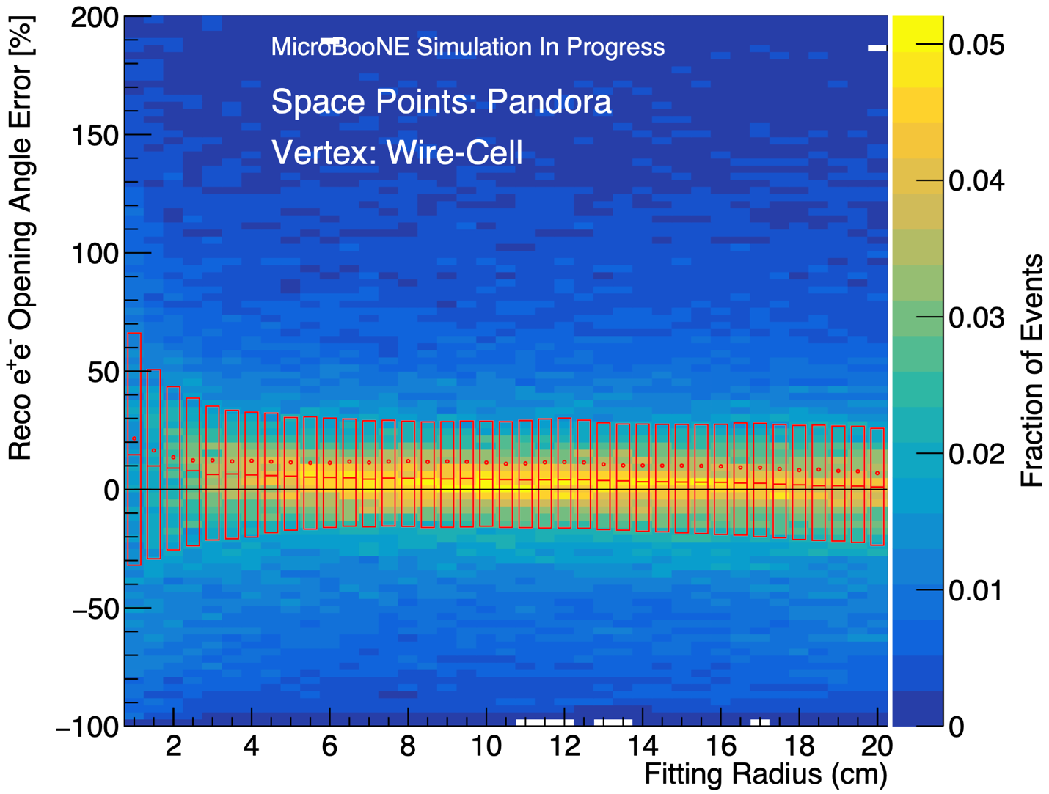
Pandora Space Points
Pandora Vertex
Wirecell Vertex
Notes:
So the first step in our analysis is to determine an optimal fitting radius.
Here, we have a histogram distribution for Pandora spacepoints with Pandora vertices. On the y axis is the percent error in the reconstructed opening angle. If the value is negative, it means our algorithm underestimates the opening angle, and the opposite is true if the y value is positive. On the x axis is the fitting radius. The color represents the density of events in a given bin. And finally, the red bars are candle plots showing the interquartile range, meaning they contain 50% of the events for a given radius. The red line near the middle is the median error for a radius, and the red dot is the mean. So, having said all that, let’s look at the dependence of the percent error on radius.
Here is the same plot using Pandora space points with Wire-Cell vertices.

Slide 21
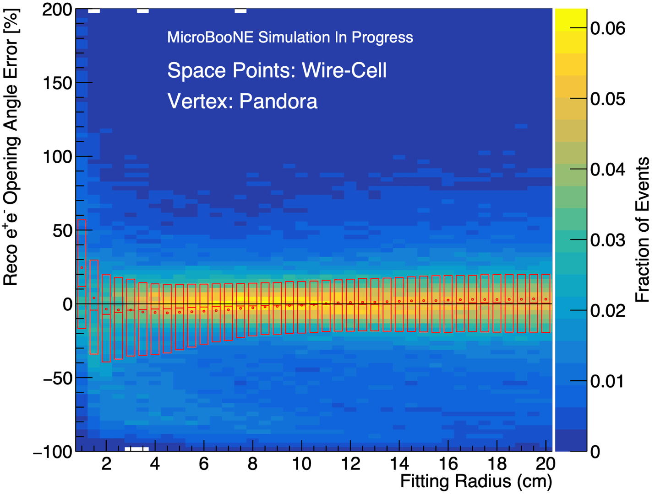
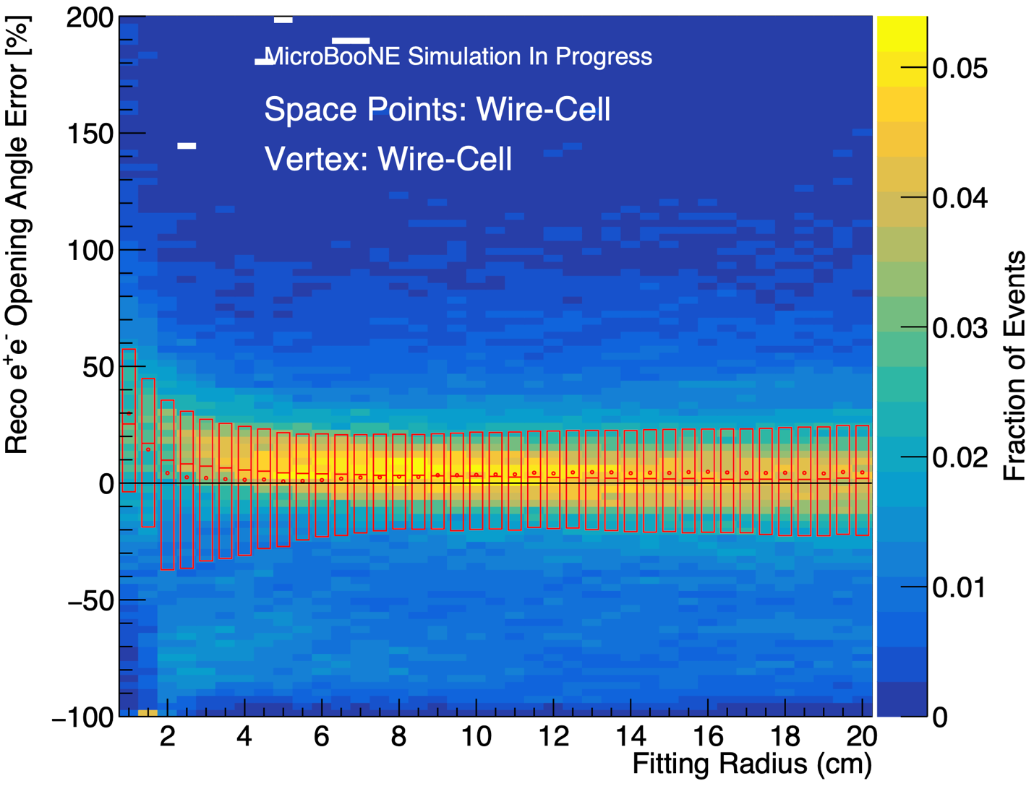
Wirecell Space Points
Pandora Vertex
Wirecell Vertex
Notes:
Next, we’ll look at the distribution with Wirecell spacepoints.
Here’s Wirecell spacepoints with Pandora vertices.
One thing that you’ll notice is the sort of tongue of very negative errors, especially at low radius. You’ll see it again in other plots. It probably corresponds to a large number of events where the Wirecell reconstruction misses part or all of one shower.
Here’s wirecell spacepoints with Wirecell vertices.
Once again, you see the concentration of negative errors. In all cases, you see an optimal range of about 8-12 cm, which is why we use 10 cm as the default.

Slide 22
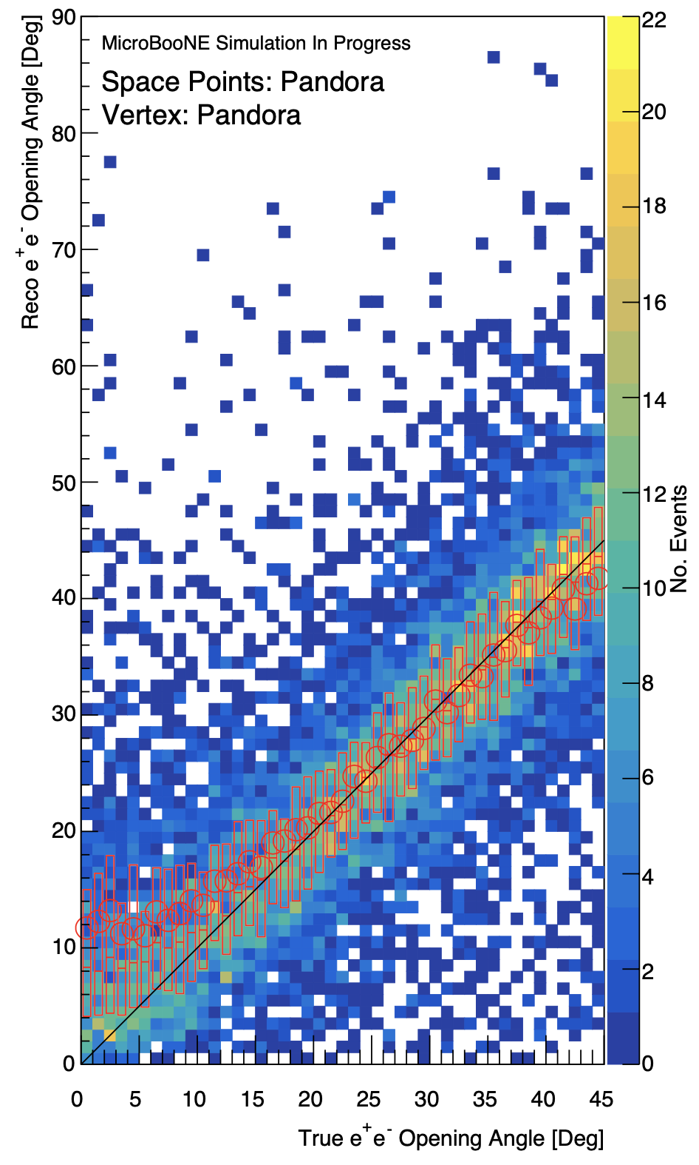
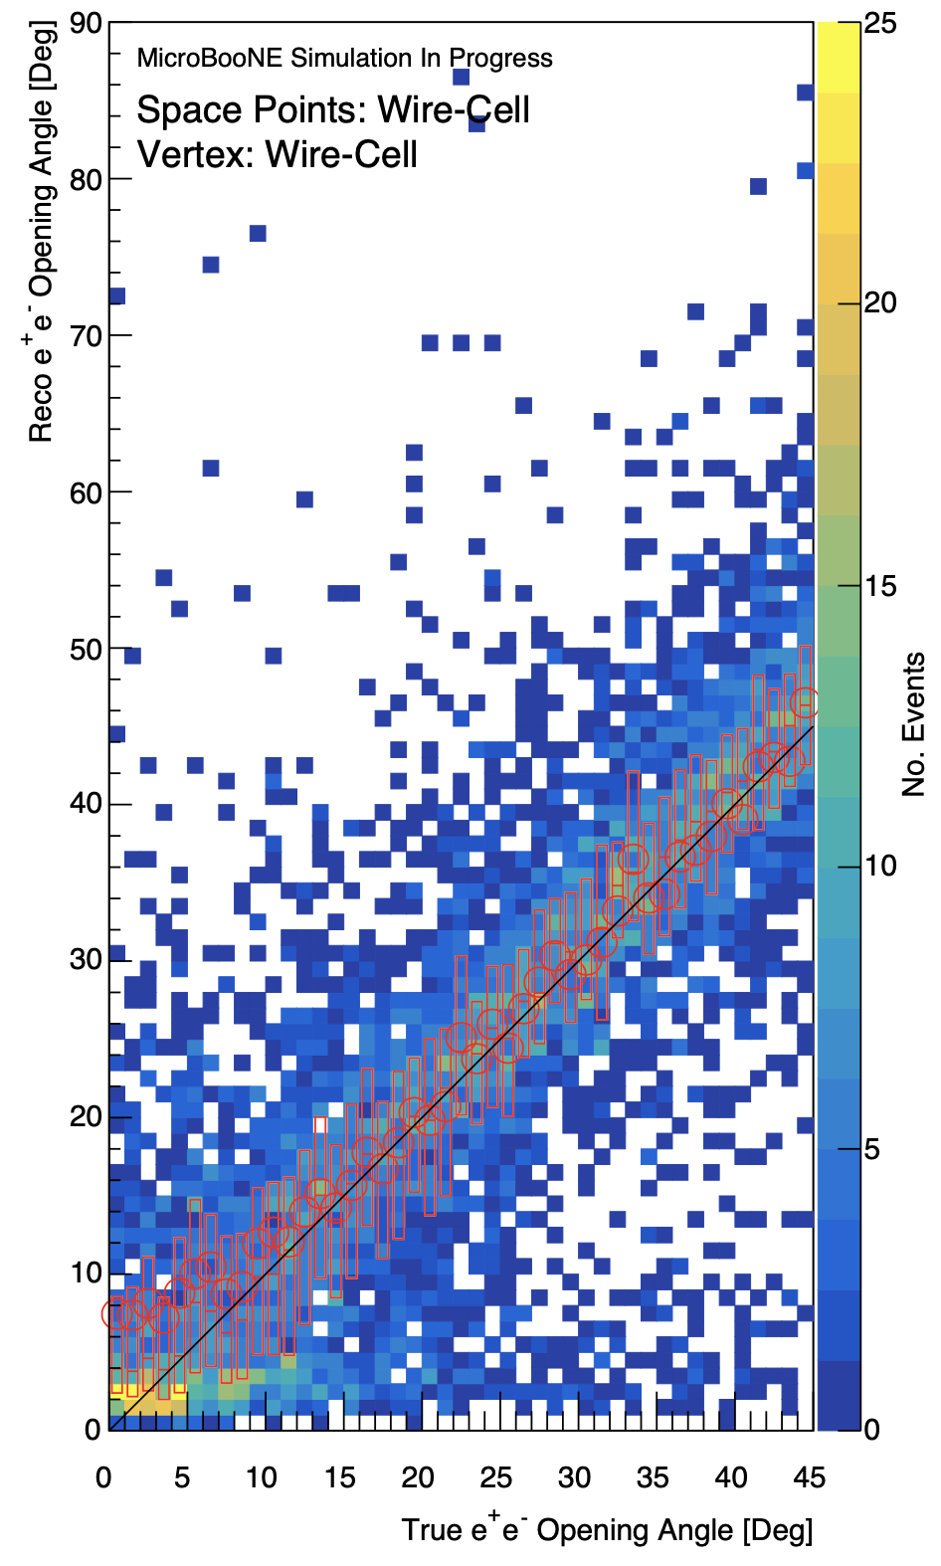
Reconstructed Angle vs. True Angle Distribution (10 cm)
Pandora (σ_{err} = 10.41°)
Wirecell (σ_{err} = 9.95°)
Combined (σ_{err} = 8.34°)
Notes:
If we zoom in on the 10 cm radius,
we can look at the actual distribution of reconstructed angle to true angle rather than just the error. Here, we have our reconstructed angle on the y axis and the true angle on the x axis. Once again, the candle bars display the interquartile range, the circle represents the mean, and the line in the middle, which is sort of difficult to see, shows the median. I’ve also drawn a 45 degree line, which would be where the reconstructed angle matches the true angle. Pandora spacepoints result in a fairly symmetric distribution, where the error is evenly about the 45 degree line. However, it does pull away from that line at the lower end, around the 20 degree mark, and below 9 or 10 degrees, the distribution becomes almost flat, making it impossible to differentiate between any angles lower than that. I use a metric here, the standard deviation in the degree error, to assess the overall performance of our algorithm.
Wirecell spacepoints present a narrower central distribution that is also roughly symmetric, except for the tongue of events mentioned earlier near 0 degrees. Note that the color bar is not consistent across the plots, so Wirecell appears to have a dimmer yellow in the center despite a narrower distribution. Wirecell also pulls away from 45 degrees at the lower end later than Pandora does and to a lesser extent. However, it still becomes impossible to distinguish between angles in the very lowest region, below around 9 degrees.

Slide 23
Pandora Vertex
Pandora Space Points
Wirecell Space Points
Combined Space Points
Notes:
Well, we confirm that the combined distribution still has an optimal value of around 10 cm, and we use the Pandora vertex because it gives slightly better results with the combined space points.

Slide 24
PointNet
PointNet++^{[7]}
Trainable T-Net layer independently transforms each point coordinate, making PointNet transformation invariant.
Each point is processed by a shared MLP, and the output layers are pooled with a symmetric function to obtain overall features for the processed points.
Global features are processed by an MLP, outputting a final result (the angle)
PointNet^{[8]}
Notes:
So how does PointNet produce features from a collection of points? Well, for each point, we start with just its Cartesian coordinates and its identity as a Pandora or Wire-Cell point as its features. Its coordinates are fed into a trainable T-Net layer, which produces a unique 3x3 transformation matrix for each point and applies it to the point. This makes PointNet transformation invariant.
Each point is then independently processed by a shared MLP to produce new features for each point. The new point features are then pooled using a symmetric function to get neighborhood features or global features. For example, if we had 16 points with 1,024 output features, a max pool takes the maximum value of each feature in any of the 16 points, and that becomes the value for the corresponding neighborhood or global feature. This structure allows for an arbitrary number of points and is also invariant to the order of the points, which is convenient for our use case.
Neighborhood features get passed on as point features for the next iteration of sampling and grouping, while the final layer groups all remaining points together and produces a set of global features, which get passed through a final MLP that outputs the final results, in our case an opening angle.

