Slide 1
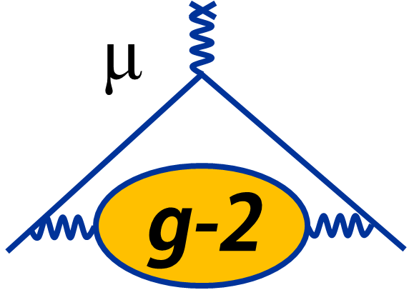
Dark Matter Search in the Muon $g−2$ experiment at Fermilab
Byungchul Yu, University of Mississippi
On behalf of Muon g-2 collaboration
June 27, 2023 (New Perspectives Conference, Fermilab)
DOE Report Number: FERMILAB-SLIDES-23-132-V

Slide 2
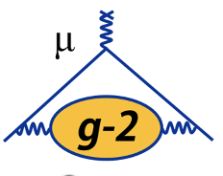
Outline
Muon $g−2$ experiment at Fermilab
Aim to measure the magnetic anomaly of the muon, $a_{μ}$ at 140 ppb precision ($ω_{a}=a_{μ}\frac{e}{m_{μ}}B$).
Measurement of $ω_{a}$in the effort to track the time evolution of muon spin subject to magnetic field.
Measurement of $B$ with by nuclear magnetic resonance (NMR) technique with a shielded water sample.
For more details: refer to Paolo’s talk: https://indico.fnal.gov/event/59506/contributions/269947
My talk: “Overview of the Muon g-2 experiment at Fermilab” at Users Meeting on June 29, 4:00 pm
(https://indico.fnal.gov/event/59656/contributions/269384)
Dark Matter search in the Muon $g−2$ experiment at Fermilab
Why do we search for Dark Matter in the Muon $g−2$ experiment at Fermilab?
How can we observe the DM signals from the Muon $g−2$ data?
Data analysis for Dark Matter search.
Byungchul Yu (byu1@go.olemiss.edu) | University of Mississippi | New Perspectives Conference (06. 27. 2023)

Slide 3
Why do we search for Dark Matter in Muon $g−2$ experiment?
Byungchul Yu (byu1@go.olemiss.edu) | University of Mississippi | New Perspectives Conference (06. 27. 2023)

Slide 4
Motivation
1. Dark Matter is one of the biggest mysteries in physics
-> Since we don’t know their identity, we need to scan for all possible DM mass in all sectors
2. Muon $g−2$ experiment has strong hint for New Physics with high precision (4.2$σ$)
-> If DM is responsible for our discrepancy between SM prediction and experimental result, we can tell you if there is New Physics.
-> Have never done before. It might be one of the most important places to look because we have strong hint for New Physics.
I would like to emphasize that our Muon $g−2$ experiment represents a direct DM search, so we can contribute to the DM investigation from the muon sector.
This would be the first-ever direct DM search with muons in a storage ring
Byungchul Yu (byu1@go.olemiss.edu) | University of Mississippi | New Perspectives Conference (06. 27. 2023)

Slide 5
How can we observe the DM signals from the Muon $g−2$ data?
Byungchul Yu (byu1@go.olemiss.edu) | University of Mississippi | New Perspectives Conference (06. 27. 2023)

Slide 6
Connection Muon $g−2$ to DM search
In the Muon $g−2$ experiment, we measure the anomalous precession frequency of the muon from the effort to track the time evolution of muon spins subject to an external magnetic field
$$ω_{a}=−a_{μ}\frac{q}{m}B(1+C_{sys})$$
Byungchul Yu (byu1@go.olemiss.edu) | University of Mississippi | New Perspectives Conference (06. 27. 2023)

Slide 7
Connection Muon $g−2$ to DM search
In the Muon $g−2$ experiment, we measure the anomalous precession frequency of the muon from the effort to track the time evolution of muon spins subject to an external magnetic field
$ω_{a}\left(t\right)=−a_{μ}\frac{q}{m}B(1+C_{sys})+ δω_{a}^{DM}(t)+δω_{a}^{CPTLV}(t)+⋯$
Dark matter may alter the precession by applying a spin torque and this results in a characteristic DM precession signal which is observable in this experiment
BSM signal
$$δω_{a}^{DM}\left(t\right)= A_{DM}\cos\left(m_{DM} t\right)$$
Byungchul Yu (byu1@go.olemiss.edu) | University of Mississippi | New Perspectives Conference (06. 27. 2023)

Slide 8
Dark Matter mass sensitivity
Dark Matter mass range with its corresponding frequency range
Q: What are the lower and upper limit of DM mass that we can target?
A: We have to look into what is the maximum and minimum time scale that we can resolve
Byungchul Yu (byu1@go.olemiss.edu) | University of Mississippi | New Perspectives Conference (06. 27. 2023)

Slide 9
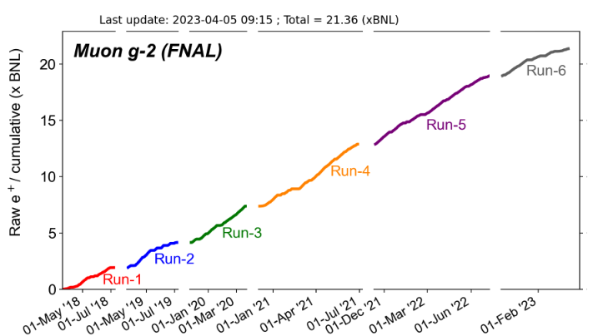
Estimation of DM mass sensitivity from experimental time scale
Q: What are the lower limit of DM and upper limit of DM mass that we do target?
Maximum time scale
Whole experiment lifetime (5years)
DM Mass
$${10}^{−23}eV$$
$${10}^{−13}eV$$
DM Freq
$${10}^{−8}Hz$$
${10}^{2}$ $Hz$
Targeted Dark Matter mass range with its corresponding frequency
Byungchul Yu (byu1@go.olemiss.edu) | University of Mississippi | New Perspectives Conference (06. 27. 2023)

Slide 10
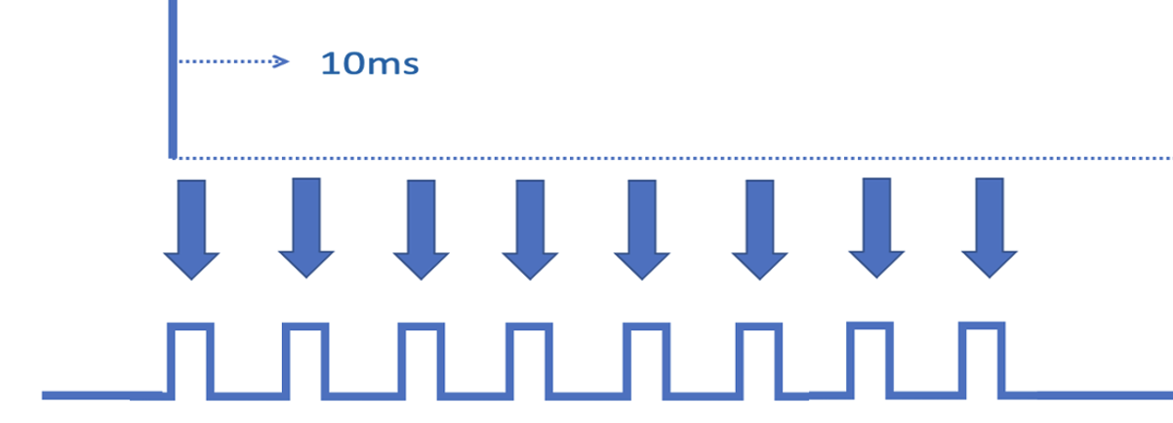
Estimation of DM mass sensitivity from experimental time scale
Q: What are the lower limit of DM and upper limit of DM mass that we do target?
Maximum time scale
Minimum time scale
Whole experiment lifetime (5years)
Bunch separation (10ms)
DM Mass
$${10}^{−23}eV$$
$$m_{DM}$$
$${10}^{−13}eV$$
DM Freq
$${10}^{−8}Hz$$
${10}^{2}$ $Hz$
Targeted Dark Matter mass range with its corresponding frequency
Byungchul Yu (byu1@go.olemiss.edu) | University of Mississippi | New Perspectives Conference (06. 27. 2023)

Slide 11
Data analysis strategy
Low mass DM $≈{10}^{−23}eV$
High mass DM $≈{10}^{−13}eV$
Wiggle Plot (A-method)
High
Statistics
Five-Parameter-Fit
(${ ω}_{a}$ time series)
UBML Technique
(${ ω}_{a}$ time series)
Low Statistics
$$R=\frac{ω_{a}}{{\tilde{ω}}_{p }}$$
-> Anomalous spin precession frequency
Plot $R$vs Time
-> Proton larmor frequency (${ℏ\tilde{ω}}_{p }=2μ_{P}B$)
Data Extraction part
Data Analysis part
MC
DATA
MC
DATA
Folding&Stacking by modulos
Periodogram & Hypothesis testing
Multi-Parameter-Fit &
Hypothesis testing
Systematics
Set upper limits of exclusion area in DM dependent sensitivity plots

Slide 12
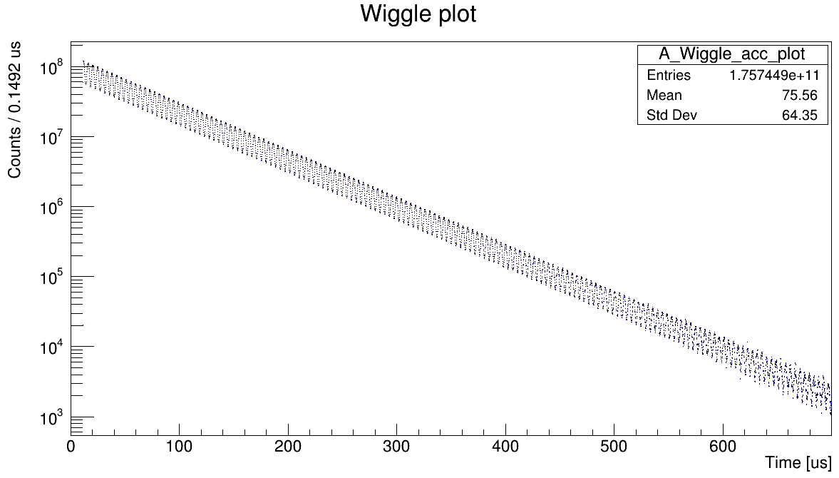
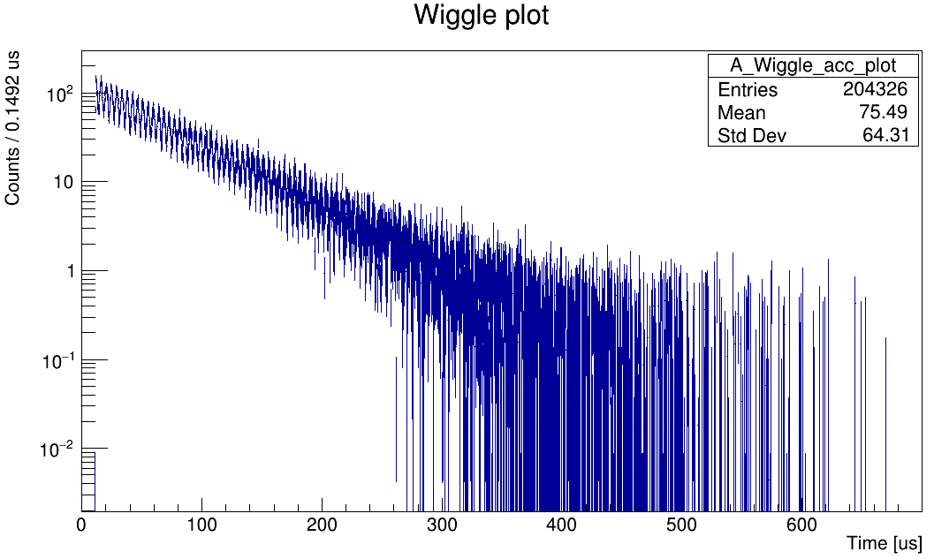
Generation of wiggle plots
LOW MASS DM Analysis
(5 years)
HIGH MASS DM Analysis
( 10 ms)
One dataset (Run 2B)
One subrun in Run 2B
( about $O (1)$ seconds)
Approximately 80 wiggle plots (Run1 - Run6)
Approximately millions wiggle plots (Run1 - Run6)
Total # of positrons 1.8 e+9 in the dataset 2B
(Super high statistics)
Total # of positrons 205287 in this subrun
(Very low statistics)
Byungchul Yu (byu1@go.olemiss.edu) | University of Mississippi | New Perspectives Conference (06. 27. 2023)

Slide 13
Extraction of $ω_{a}$ from wiggle plots
One dataset (Run 2B)
One subrun in Run 2B
LOW MASS DM
HIGH MASS DM
Five Parameter Fit method
$N_{0}$(Normalization constant)
$τ$ (Lifetime of the muon)
A (Asymmetry value)
r ($\frac{δω_{a}}{ω_{a}}$) due to the blinding of $ω_{a}$
$φ$($g$-2 phase)
$N\left(t\right)= N_{0}e^{−\frac{t}{γτ}}\left[1+Acos\left(ω_{a} \left(1+r\right)t+φ\right)\right]$
Unbinned Maximum Likelihood method: Optimization of the methodology and framework are under development
Byungchul Yu (byu1@go.olemiss.edu) | University of Mississippi | New Perspectives Conference (06. 27. 2023)

Slide 14
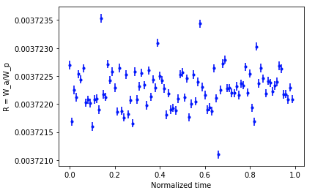
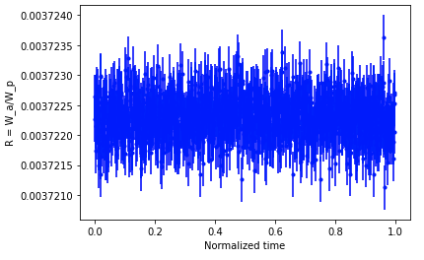
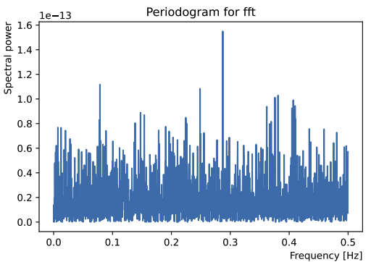
Time resolved $ω_{a}$analysis (Periodogram)
$$R=\frac{ω_{a}}{{\tilde{ω}}_{p }}$$
LOW MASS DM Analysis
$R vs T$ plot
HIGH MASS DM Analysis
Simulation
Simulation
$${Slow DM frequency ≈ 10}^{−8}Hz$$
$${Fast DM frequency ≈ 10}^{2}Hz$$
Check for $R$value oscillation, its frequency is exactly the DM mass!!
Simulation
Currently working on periodogram analysis with MC simulation data
DM oscillation amplitude -> Spectral power -> Set upper limit of the spectral power with 95 % confidence level (Hypothesis testing)
Byungchul Yu (byu1@go.olemiss.edu) | University of Mississippi | New Perspectives Conference (06. 27. 2023)

Slide 15
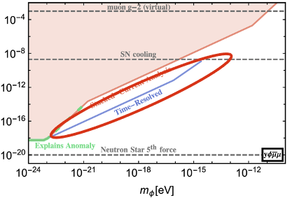
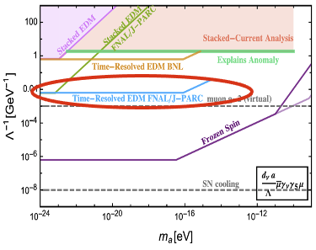
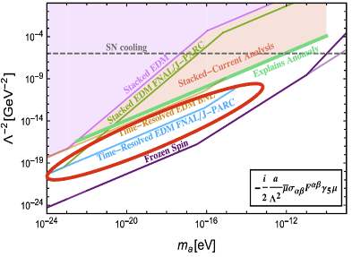
Dark Matter model dependent sensitivity
$m_{μ}=m_{μ}^{SM}+y\sqrt{\frac{2ρ_{φ}}{m_{φ}}}\cos\left(m_{φ}t\right)$, ${\vec{ω}}_{μ}={\vec{ω}}_{SM}\frac{y}{m_{μ}}\sqrt{\frac{2ρ_{φ}}{m_{φ}}}\cos\left(m_{φ}t\right)$
Scalar DM (Yukawa)
Axion-like DM (gradient)
Axion-like DM (EDM)
Ryan Janish, Harikrishnan Ramani PRD 102, 115018 (2020)
Projected sensitivity of “direct” DM search using the Muon $g−2$ data is beyond the astronomical bounds.
Byungchul Yu (byu1@go.olemiss.edu) | University of Mississippi | New Perspectives Conference (06. 27. 2023)

Slide 16
Thank you for your attention!
Byungchul Yu (byu1@go.olemiss.edu) | University of Mississippi | New Perspectives Conference (06. 27. 2023)

Slide 17
Back up
Byungchul Yu (byu1@go.olemiss.edu) | University of Mississippi | New Perspectives Conference (06. 27. 2023)

Slide 18
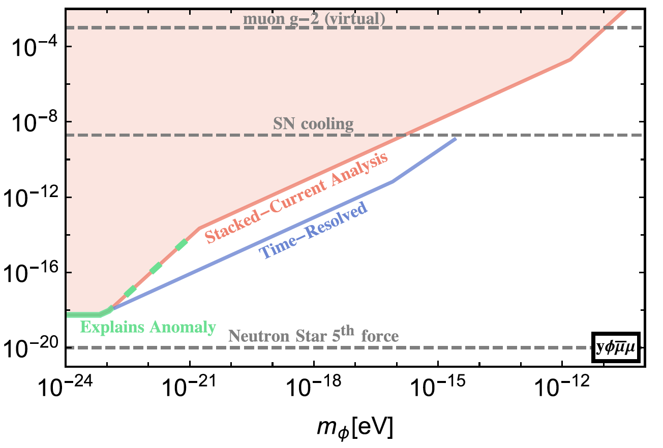
Scalar Dark Matter model (Parallel perturbation)
Scalar DM affects muon’s mass: $ω_{a}\left(t\right)=−a\frac{q}{m}B(1+C_{sys})+ δω_{a}^{Scalar DM}(t)$
(Muon’s mass oscillating -> the magnitude of $ω_{a}$ oscillating)
Scalar DM (Yukawa)
$$ω_{a}\left(t\right)=−a\frac{q}{m(t)}B=−a\frac{q}{m_{0}\left(A_{DM}^{′}cos{m_{DM}t}\right)}B$$
$=a\frac{q}{m_{0}}B\left(1+A_{DM}^{′}cos{m_{DM}t}\right)$
$$∴δω_{a}^{DM}\left(t\right)= A_{dm}\cos\left(m_{dm} t\right)$$
Byungchul Yu (byu1@go.olemiss.edu) | University of Mississippi | New Perspectives Conference (06. 27. 2023)

Slide 19
Pseudoscalar Dark Matter model (Perpendicular perturbation)
Pseudoscalar DM affects muon’s spin axis: $ω_{a}\left(t\right)=−a\frac{q}{m}B(1+C_{sys})+ δω_{a}^{PS−DM}(t)$
(Muon’s spin axis oscillating -> decay positron is preferentially emitted to the spin direction -> investigate the vertical distribution of the decay positron)
Byungchul Yu (byu1@go.olemiss.edu) | University of Mississippi | New Perspectives Conference (06. 27. 2023)

Slide 20
Unit conversion
For example, we are looking at low mass DM, ${10}^{−23}eV$
$f=\frac{E}{h}=\frac{{10}^{−23}eV}{6.63×{10}^{−34}jouls/s}=\frac{1.6×{10}^{−42}jouls}{6.63×{10}^{−34}jouls∗s}≈2.41×{10}^{−9}$Hz
$$t= \frac{1}{f}≈\frac{1}{2.41×{10}^{−9}s}≈4.14×{10}^{8}s$$
Since 1 year $≈$ $3.1×{10}^{7}$, ${10}^{−23}eV$ correspond to approximately 10 years
Byungchul Yu (byu1@go.olemiss.edu) | University of Mississippi | New Perspectives Conference (06. 27. 2023)

Slide 21
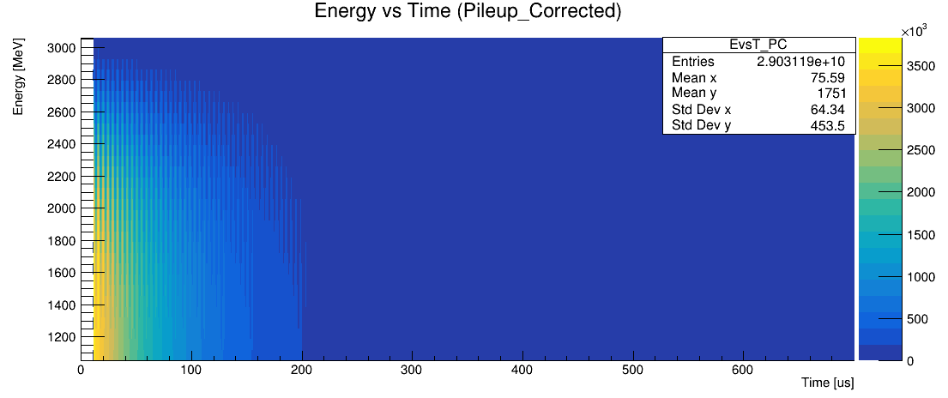
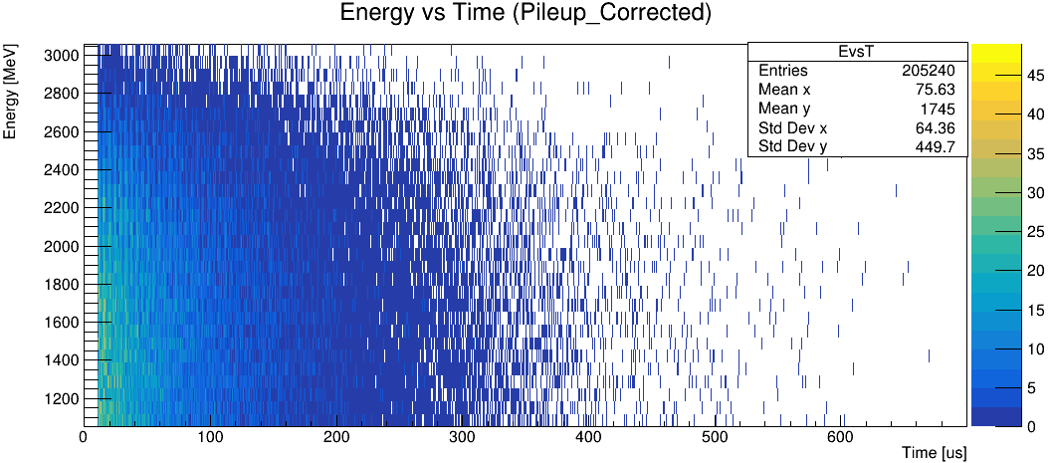
Generating Wiggle plots with Asymmetry weighted method
Asymmetry weighted method
Asymmetry is defined as how much decay positron is correlated to muon spin
Set the threshold energy from 1 GeV to 3 GeV
Count the total number of positrons by multiplying by the corresponding asymmetry values
LOW MASS
Entire Run 2
HIGH MASS
Subrun 83th in Run24576 in Run2
Byungchul Yu (byu1@go.olemiss.edu) | University of Mississippi | New Perspectives Conference (06. 27. 2023)

Slide 22
Subrun level mass sensitivity
Whole experiment lifetime (5years)
Subrun level (second)
DM Mass
$${10}^{−23}eV$$
$${10}^{−15}eV$$
DM Freq
$${10}^{−8}Hz$$
1 $Hz$
Byungchul Yu (byu1@go.olemiss.edu) | University of Mississippi | New Perspectives Conference (06. 27. 2023)

Slide 23
Total positron number
Dataset #
RUN2B
RUN2C
RUN2D
RUN2E
RUN2F
RUN2G
RUN2H
RUN3B
RUN3C
RUN3D
RUN3E
RUN3F
RUN3G
RUN3I
RUN3J
RUN3K
RUN3L
RUN3M
RUN3N
RUN3O
⋮
# of Subrun
13715
69303
60658
25178
23336
4929
6729
43207
12767
73347
29392
14764
33485
32619
24184
15656
11262
38681
67307
50292
⋮
# of Fills
1437874
6593870
5284733
2098556
2130004
445103
609113
4693030
1275319
7185302
2900754
1467861
3326052
3220143
2397365
1563390
1120450
3911125
6615499
4932960
⋮
# of Positrons
1.7659759e+9
5.0409016e+9
2.0068400e+9 1.9072812e+9
3.8651030e+8
4.9208241e+8
2.6608932e+9
1.4849000e+9
6.6528021e+9
2.2461135e+9
1.5678460e+9
2.8847235e+9
2.7504486e+9
2.1838608e+9
1.6779035e+9
9.1342620e+8
2.8761200e+9
5.4615424e+9
4.0099532e+9
⋮
We can estimate how much the number of positrons would approximately be in a subrun/in a bunch:
In a subrun, ~ e5 positrons
In a bunch, ~ e3 positrons
Byungchul Yu (byu1@go.olemiss.edu) | University of Mississippi | New Perspectives Conference (06. 27. 2023)

