Slide 1
Dopant R&D in LArTPCs
Report No: FERMILAB-SLIDES-23-111-ND
Raisa Tasnim Raofa
Neutrino Division, Fermilab
Advisors: Joseph Zennamo & Fernanda Psihas (Fermilab)

Slide 2
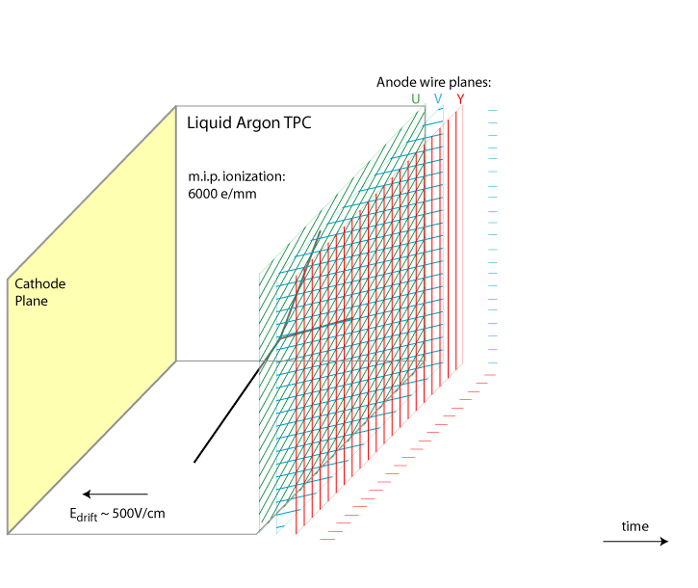
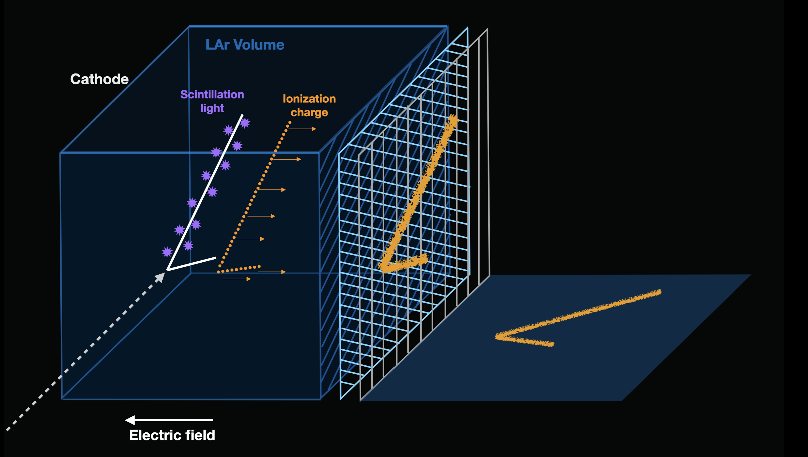
LArTPC (Liquid Argon Time Projection Chamber)
An incoming charged particle ionizes Ar producing Ar ions & ionization electrons
Trajectory is measured by ionization charge and time is measured through scintillation light
Fernanda Psihas
Created by: Fernanda Psihas
Notes:
If we have to calculate only based on charge, ½ the info is lost
So light is an important aspect and need to collect more light info
Sufficient ratio for physics in GeV scale
Unable to do physics in MeV scale
Liquid Argon – noble gas
Add the black diagram Fernanda sent in case animation does not work
Your talk going well is about practicing, but it is also about discipline. Stick to what I practiced.
Wordings:
Allow people time to think
Try to say in few words as possible.
You have TPC filled with liquid argon.

Slide 3
Event Display in LArTPC
Joseph Zennamo
Event display shows collected ionization charges
Energy reconstruction relies on collected charge
Very small signals for low energy events
Time [2 ms]
Color scale: Number of charge collected
Number of Wires
Fig: Simulation of 10 GeV electron neutrino
Notes:
If we have to calculate only based on charge, ½ the info is lost
So light is an important aspect and need to collect more light info
Sufficient ratio for physics in GeV scale
Unable to do physics in MeV scale
Change the
Overall trajectory and topology depends on the charge
Instead use Joseph’s Pure one 10 GeV -> Find any of the smaller dots and say what MeV events will look like.
Event Display
Gets trajectory information -> by collecting number of charges collected on large number of channels (each wire is a channel). More trajectory info -> better energy information. Longer path -> estimate the energy based on the trajectory.
Small energies only falls on a handful of channels. Only depends on the charge not the trajectory.
Event Display:
Relies on the charge collected

Slide 4
Charge & Light Collection in LArTPCs
In LArTPC, ratio of charge and light is 50:50
Sum of charge and light is constant
Charge + Light = Constant
~50% of information lost for low light collection efficiency
Notes:
Apart from the charge, we also have light
If we have to calculate only based on charge, ½ the info is lost
So light is an important aspect and need to collect more light info
Sufficient ratio for physics in GeV scale
Unable to do physics in MeV scale

Slide 5
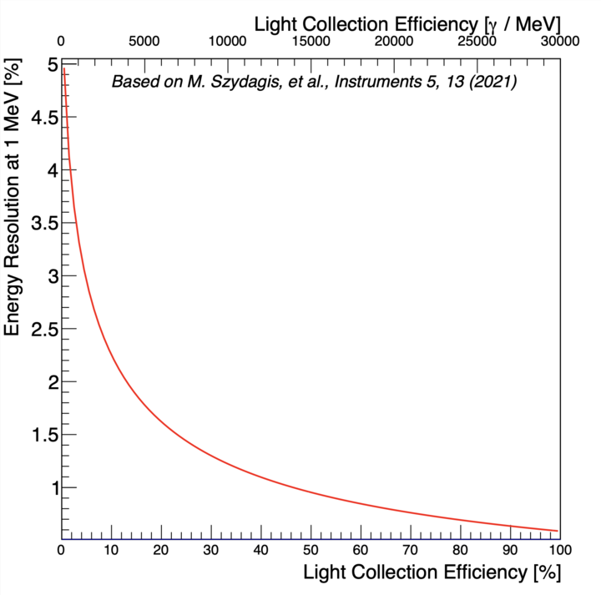
Light Collection for Energy Measurements
Using light and charge information can yield more accurate energy information
1% energy resolution requires collection of ~15000 photons/MeV
LArTPCs currently collects ~160 photons/MeV
Notes:
If we have to calculate only based on charge, ½ the info is lost
So light is an important aspect and need to collect more light info
Sufficient ratio for physics in GeV scale
Talk about the plot
Unable to do physics in MeV scale
No light for small points-> we can do 5% Energy Resolution at 1 MeV.
If we want to measure 1% -> need better light collection efficiency -> requires 15000 photons. But we cannot collect that many.

Slide 6
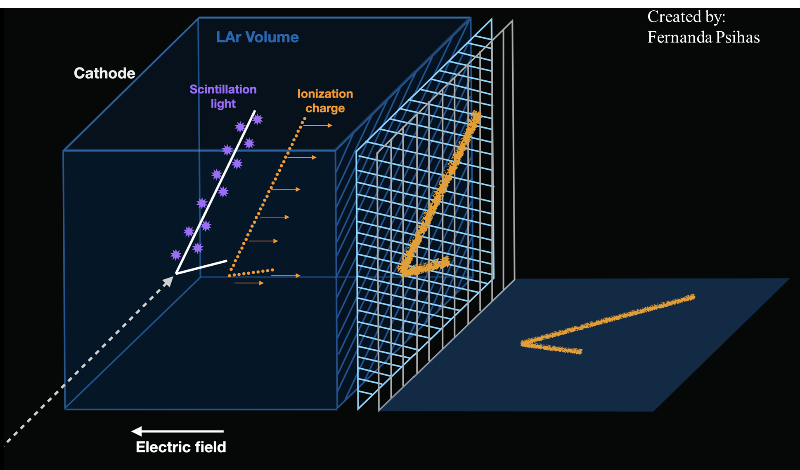
Now what?
Photosensitive dopants saves the day!
Convert light to charge
Notes:
If we have to calculate only based on charge, ½ the info is lost
So light is an important aspect and need to collect more light info
Sufficient ratio for physics in GeV scale
Talk about the plot
Unable to do physics in MeV scale

Slide 7
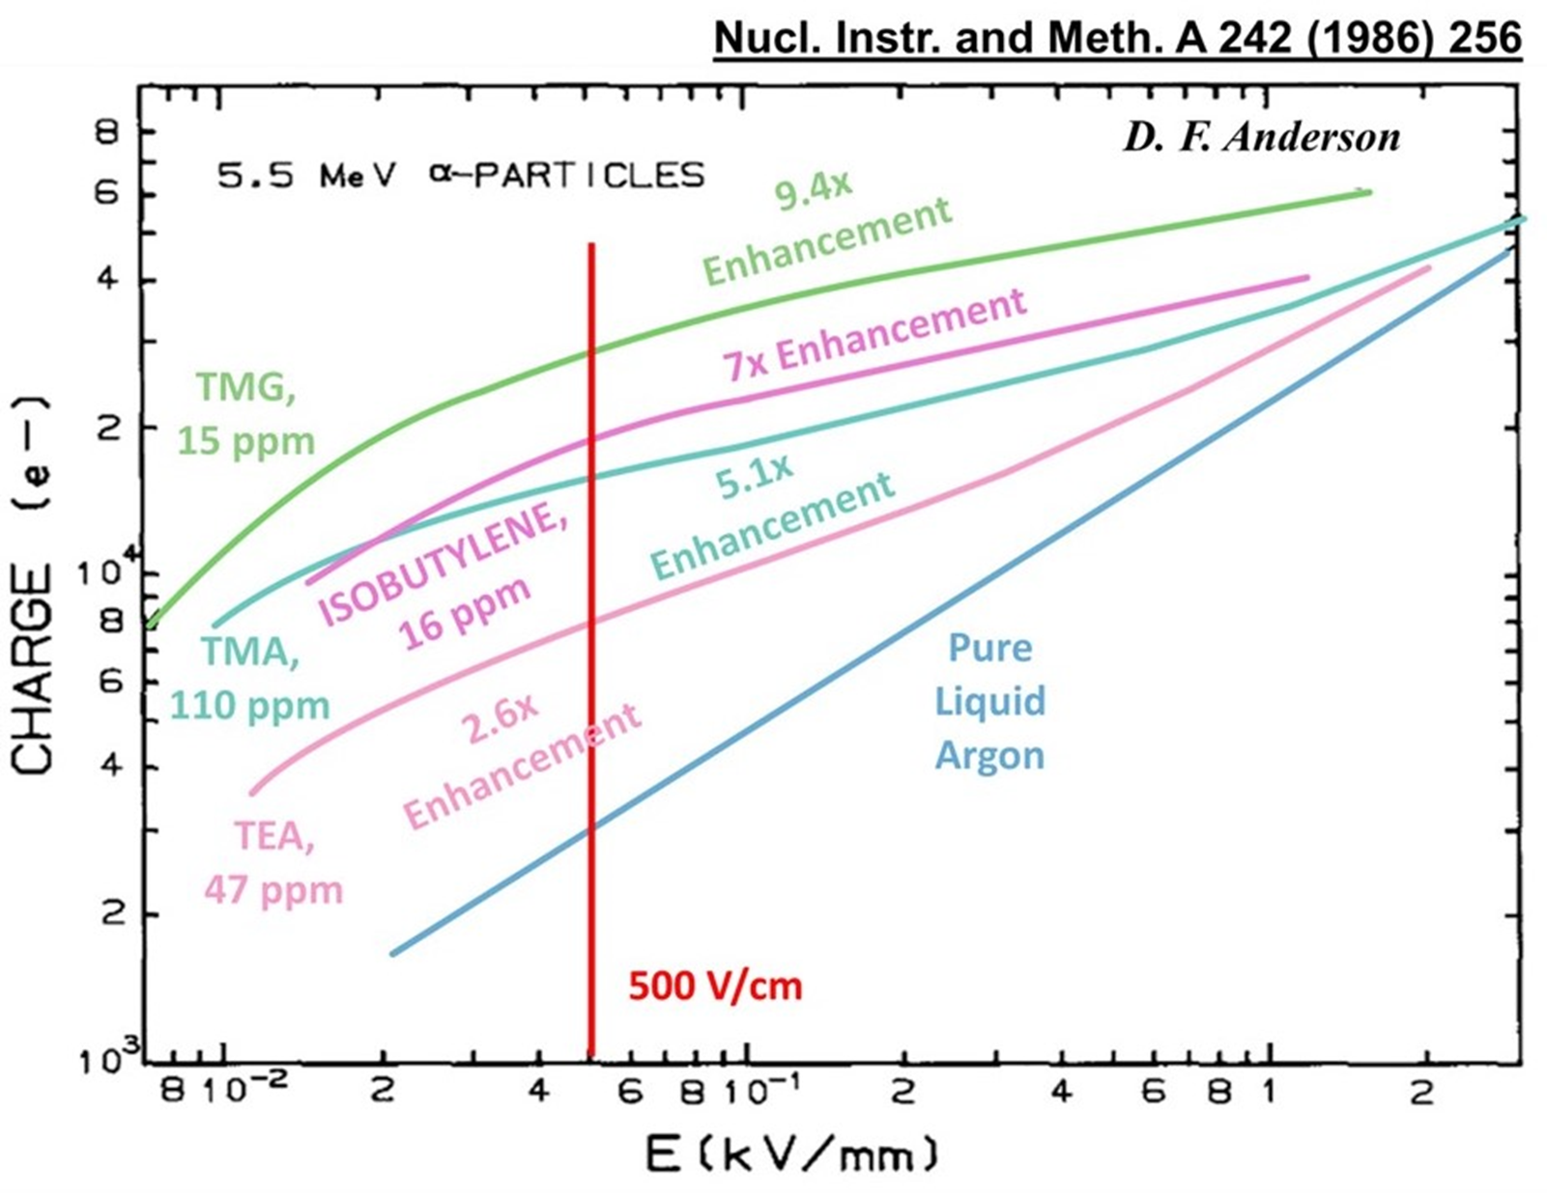
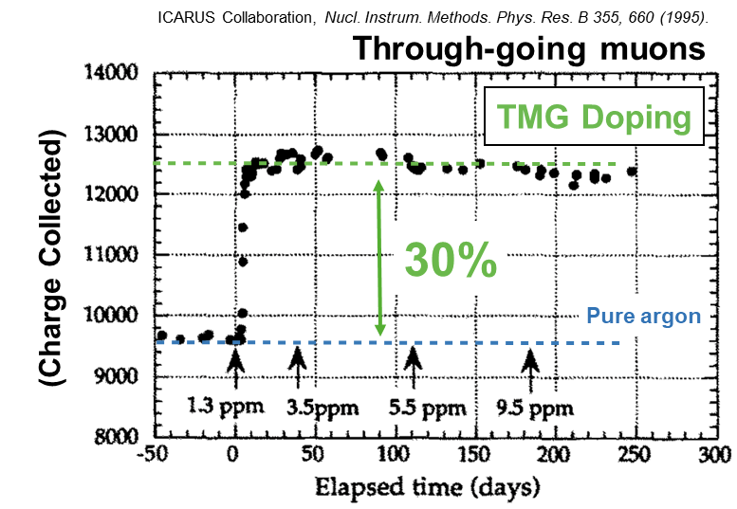
Past Photosensitive Dopant Test Stand
ICARUS used Tetramethylgermane (TMG)
30% increase in muon charge signals
Small test stands
Explored different chemicals
Found an increase in charge collection for highly scintillating particles
We will use Isobutylene
Expect all dopants to convert more than 50% of the light to charge
Notes:
Change the order of the pictures.
Small test stands explored different chemicals and found an increase in charge for highly scintillating particles
These plots are from test stand data
Studies done in 90s
The dopants we will use should give us a 7 time increase in charge
Muon -> closer to gamma, makes less light so makes less charge from doping
Bottom one is for alpha, alphas make more light so makes more charge from doping
We should see about 30% increase from our source
Stable operation for 250 days
Found a more linear detector response for highly ionizing particles

Slide 8
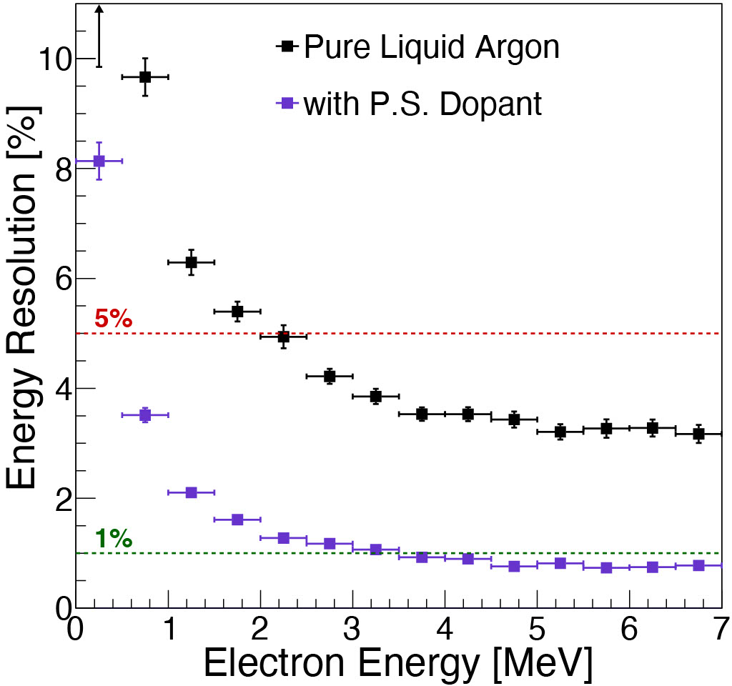
Photosensitive Dopant Simulations
Number of Wires
J. Zennamo
Joseph Zennamo
Converting light to charge
Lowers 1.1 MeV threshold to 10 keV
Improves charge only energy resolution
Dopants
Time [2 ms]
Joseph Zennamo
Created by: Fernanda Psihas
Notes:
Do the event display first and then talk about the plots.
Just use the Pure event display(10 GeV) instead of the microBooNE
Could drop the injection one
In Joseph’s simulation’s we can show how qualitative representation of we can see some points showing up.
The graph is quantitively simulation.
The simulations are full detector simulation.
We are interested in 2MeV electron energy region.
Highlight these are simulations

Slide 9
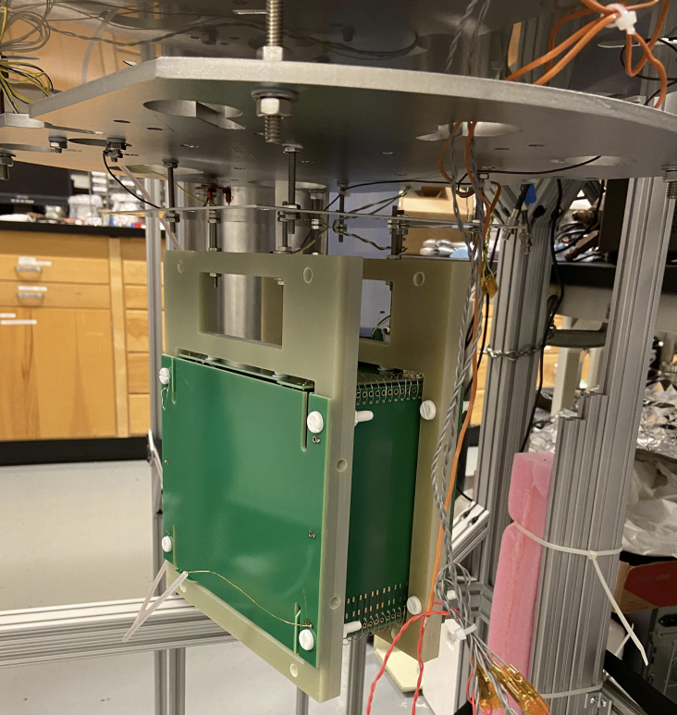
Dopant R&D @ Fermilab
Stage 1: Run TPC with the pixel readout LArPix V2 in the cryostat Blanche
Stage 2: Introduce radioactive sources to measure LArPix V2 performance at low energy
Stage 3: Add photosensitive dopants to demonstrate charge enhancements in LArTPC
Stage 4: Explore optimal doping strategies for low energy events
Fig: LArTPC Ready to be Deployed (From LArPix Documentation)
Notes:
Put the logo of Rutgers and LBNL

Slide 10
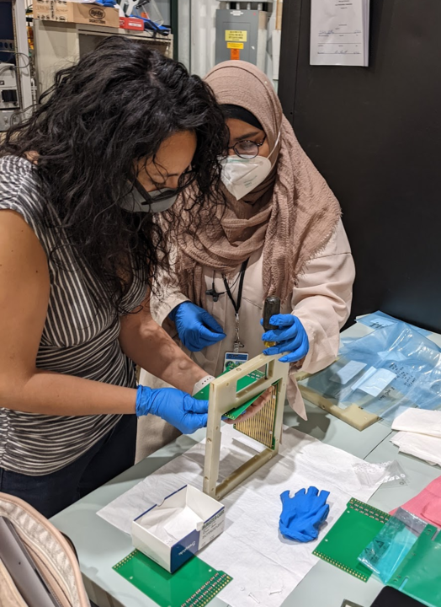
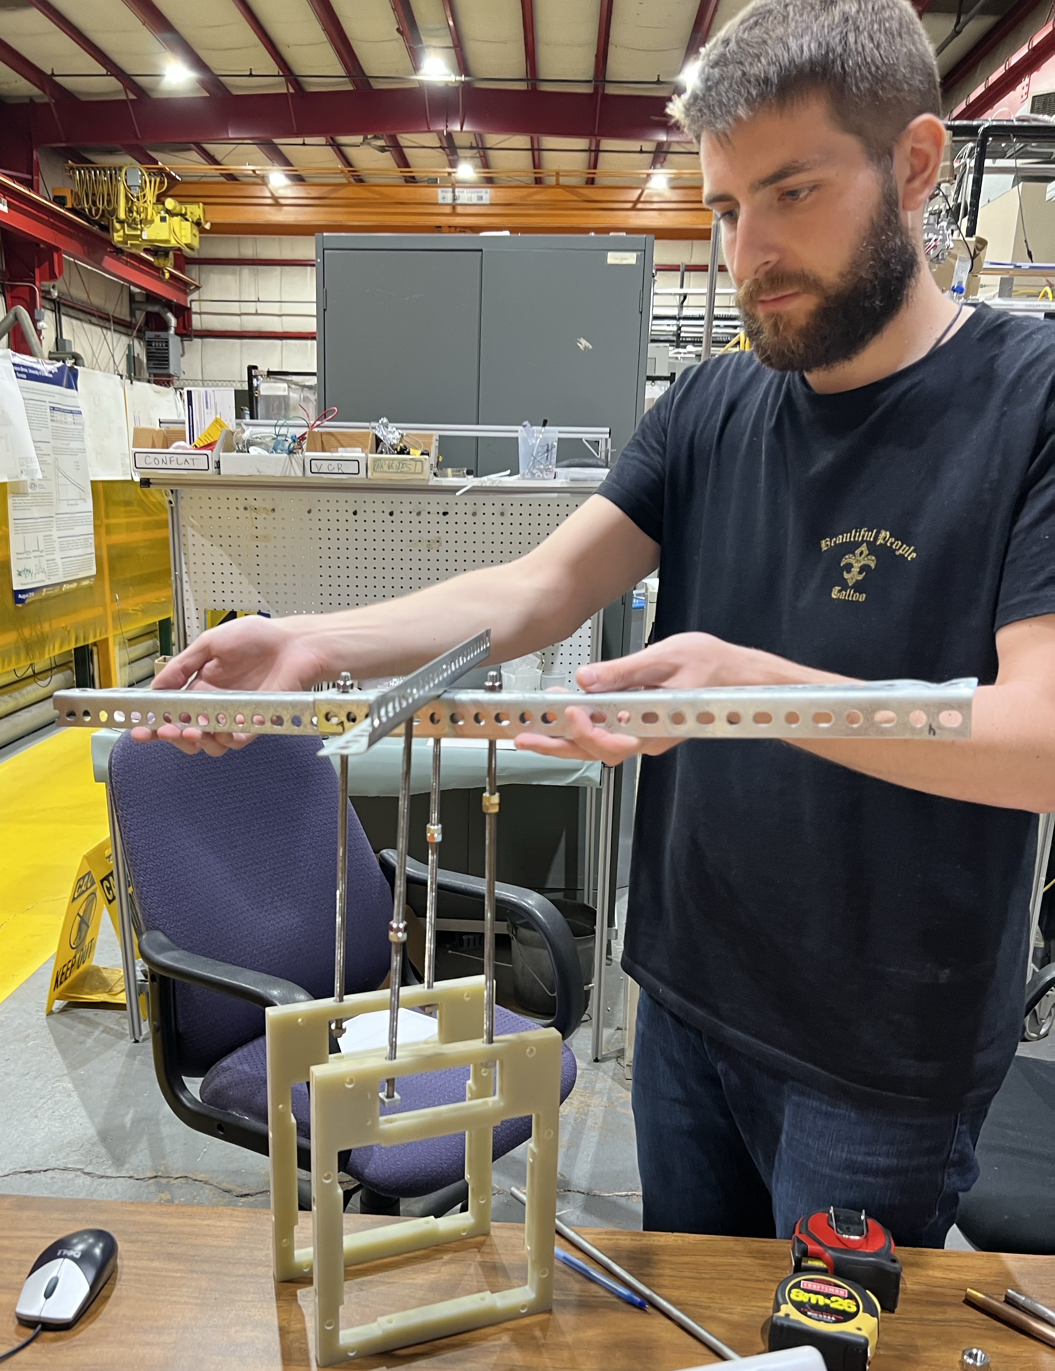
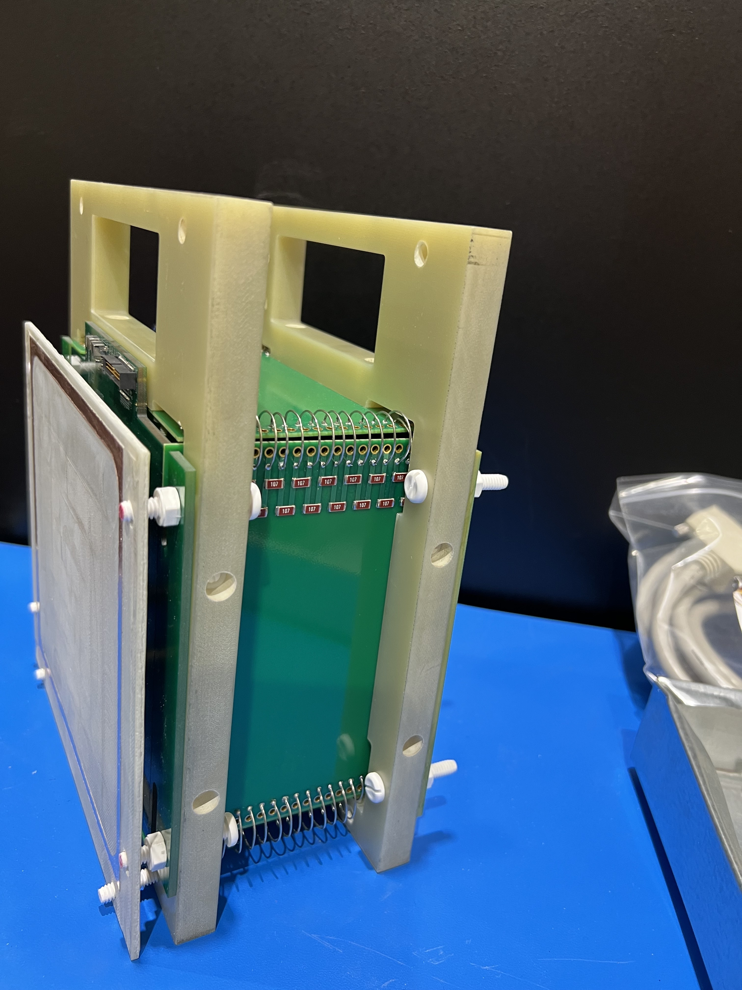
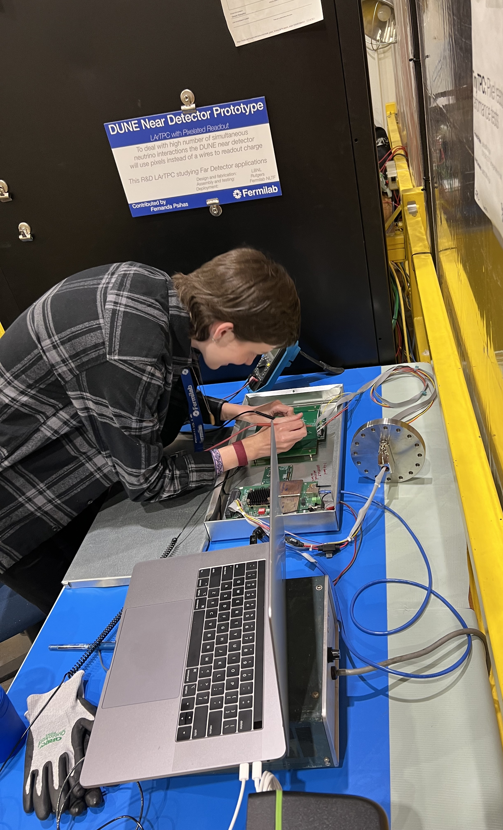
Progress
Raisa T. Raofa &
Fernanda Psihas
Panos Englezos
Rutgers U.
TinyTPC
@ PAB
Hannah Lemoine
UMN Duluth
TPC in the making
Testing Mechanical Design
Completed TPC
Bench test of TPC
Ready to be deployed!
Notes:
Put in pictures of people working in this slide and say: TPC is assembled, mechanical design is done, will be deployed in the coming weeks
Put this and the next 2 slides in the backup, have people and their institutions.

Slide 11
Thank You! Question?
Special thanks to everyone in PAB for all their input and help. ☺
Notes:
-Thank you to people at PAB who have helped in this slide. Thanks to Rutgers, LBNL -> put their logos

Slide 12
Back Up Slides
Notes:
-Thank you to people at PAB who have helped in this slide. Thanks to Rutgers, LBNL -> put their logos

Slide 13
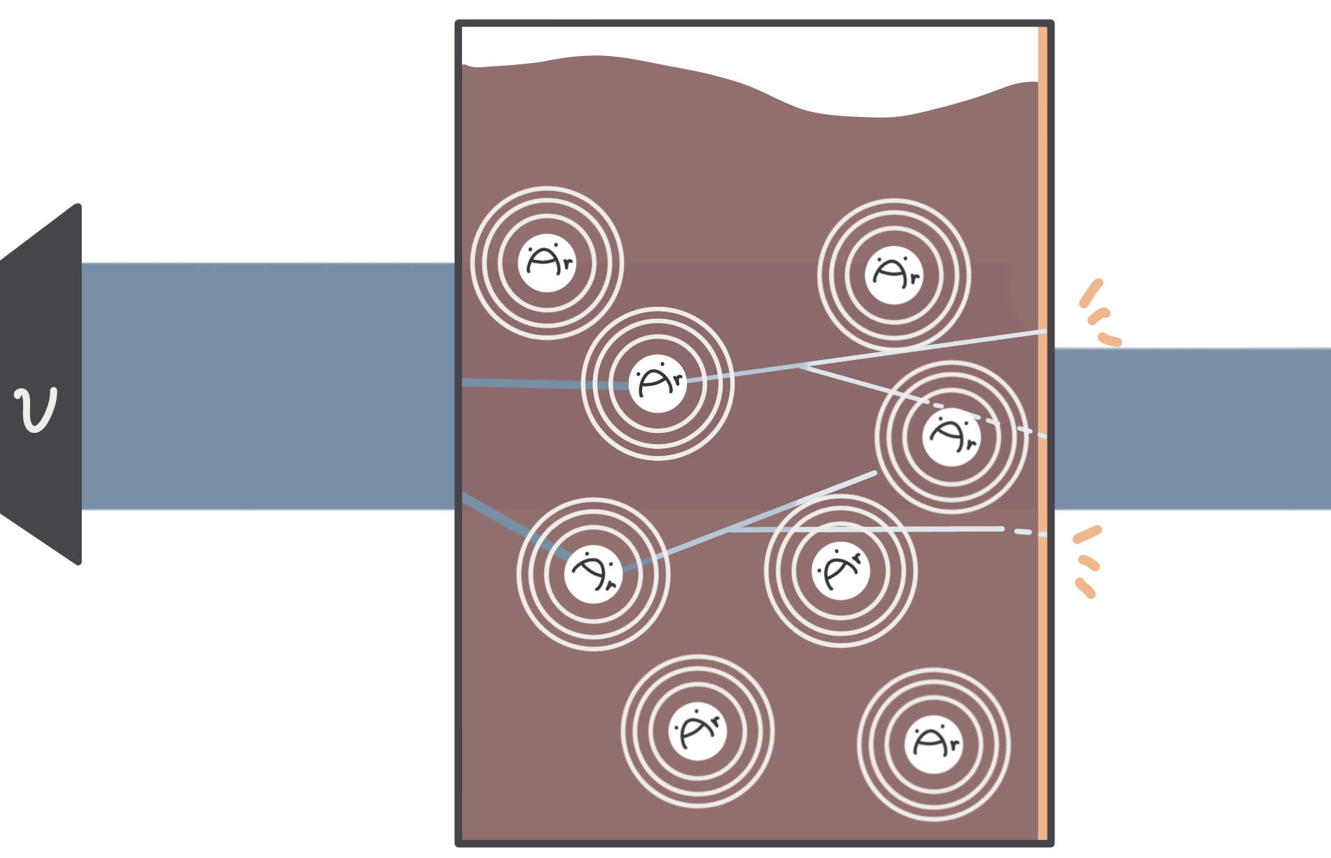
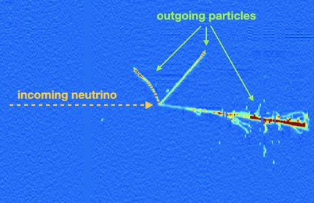
LArTPC Functionality
some of them will collide with Ar atom
Charged particles!
→ knock electrons along the way
→ create trails
→ drift through liquid Ar to detector
→ record the particle tracks
Liquid Argon
Intense neutrino beam
Most of them just pass through :(
Liquid Argon in cryostats: very cold, dense =
high chance of interaction
Created by: I-see Jaidee

Slide 14
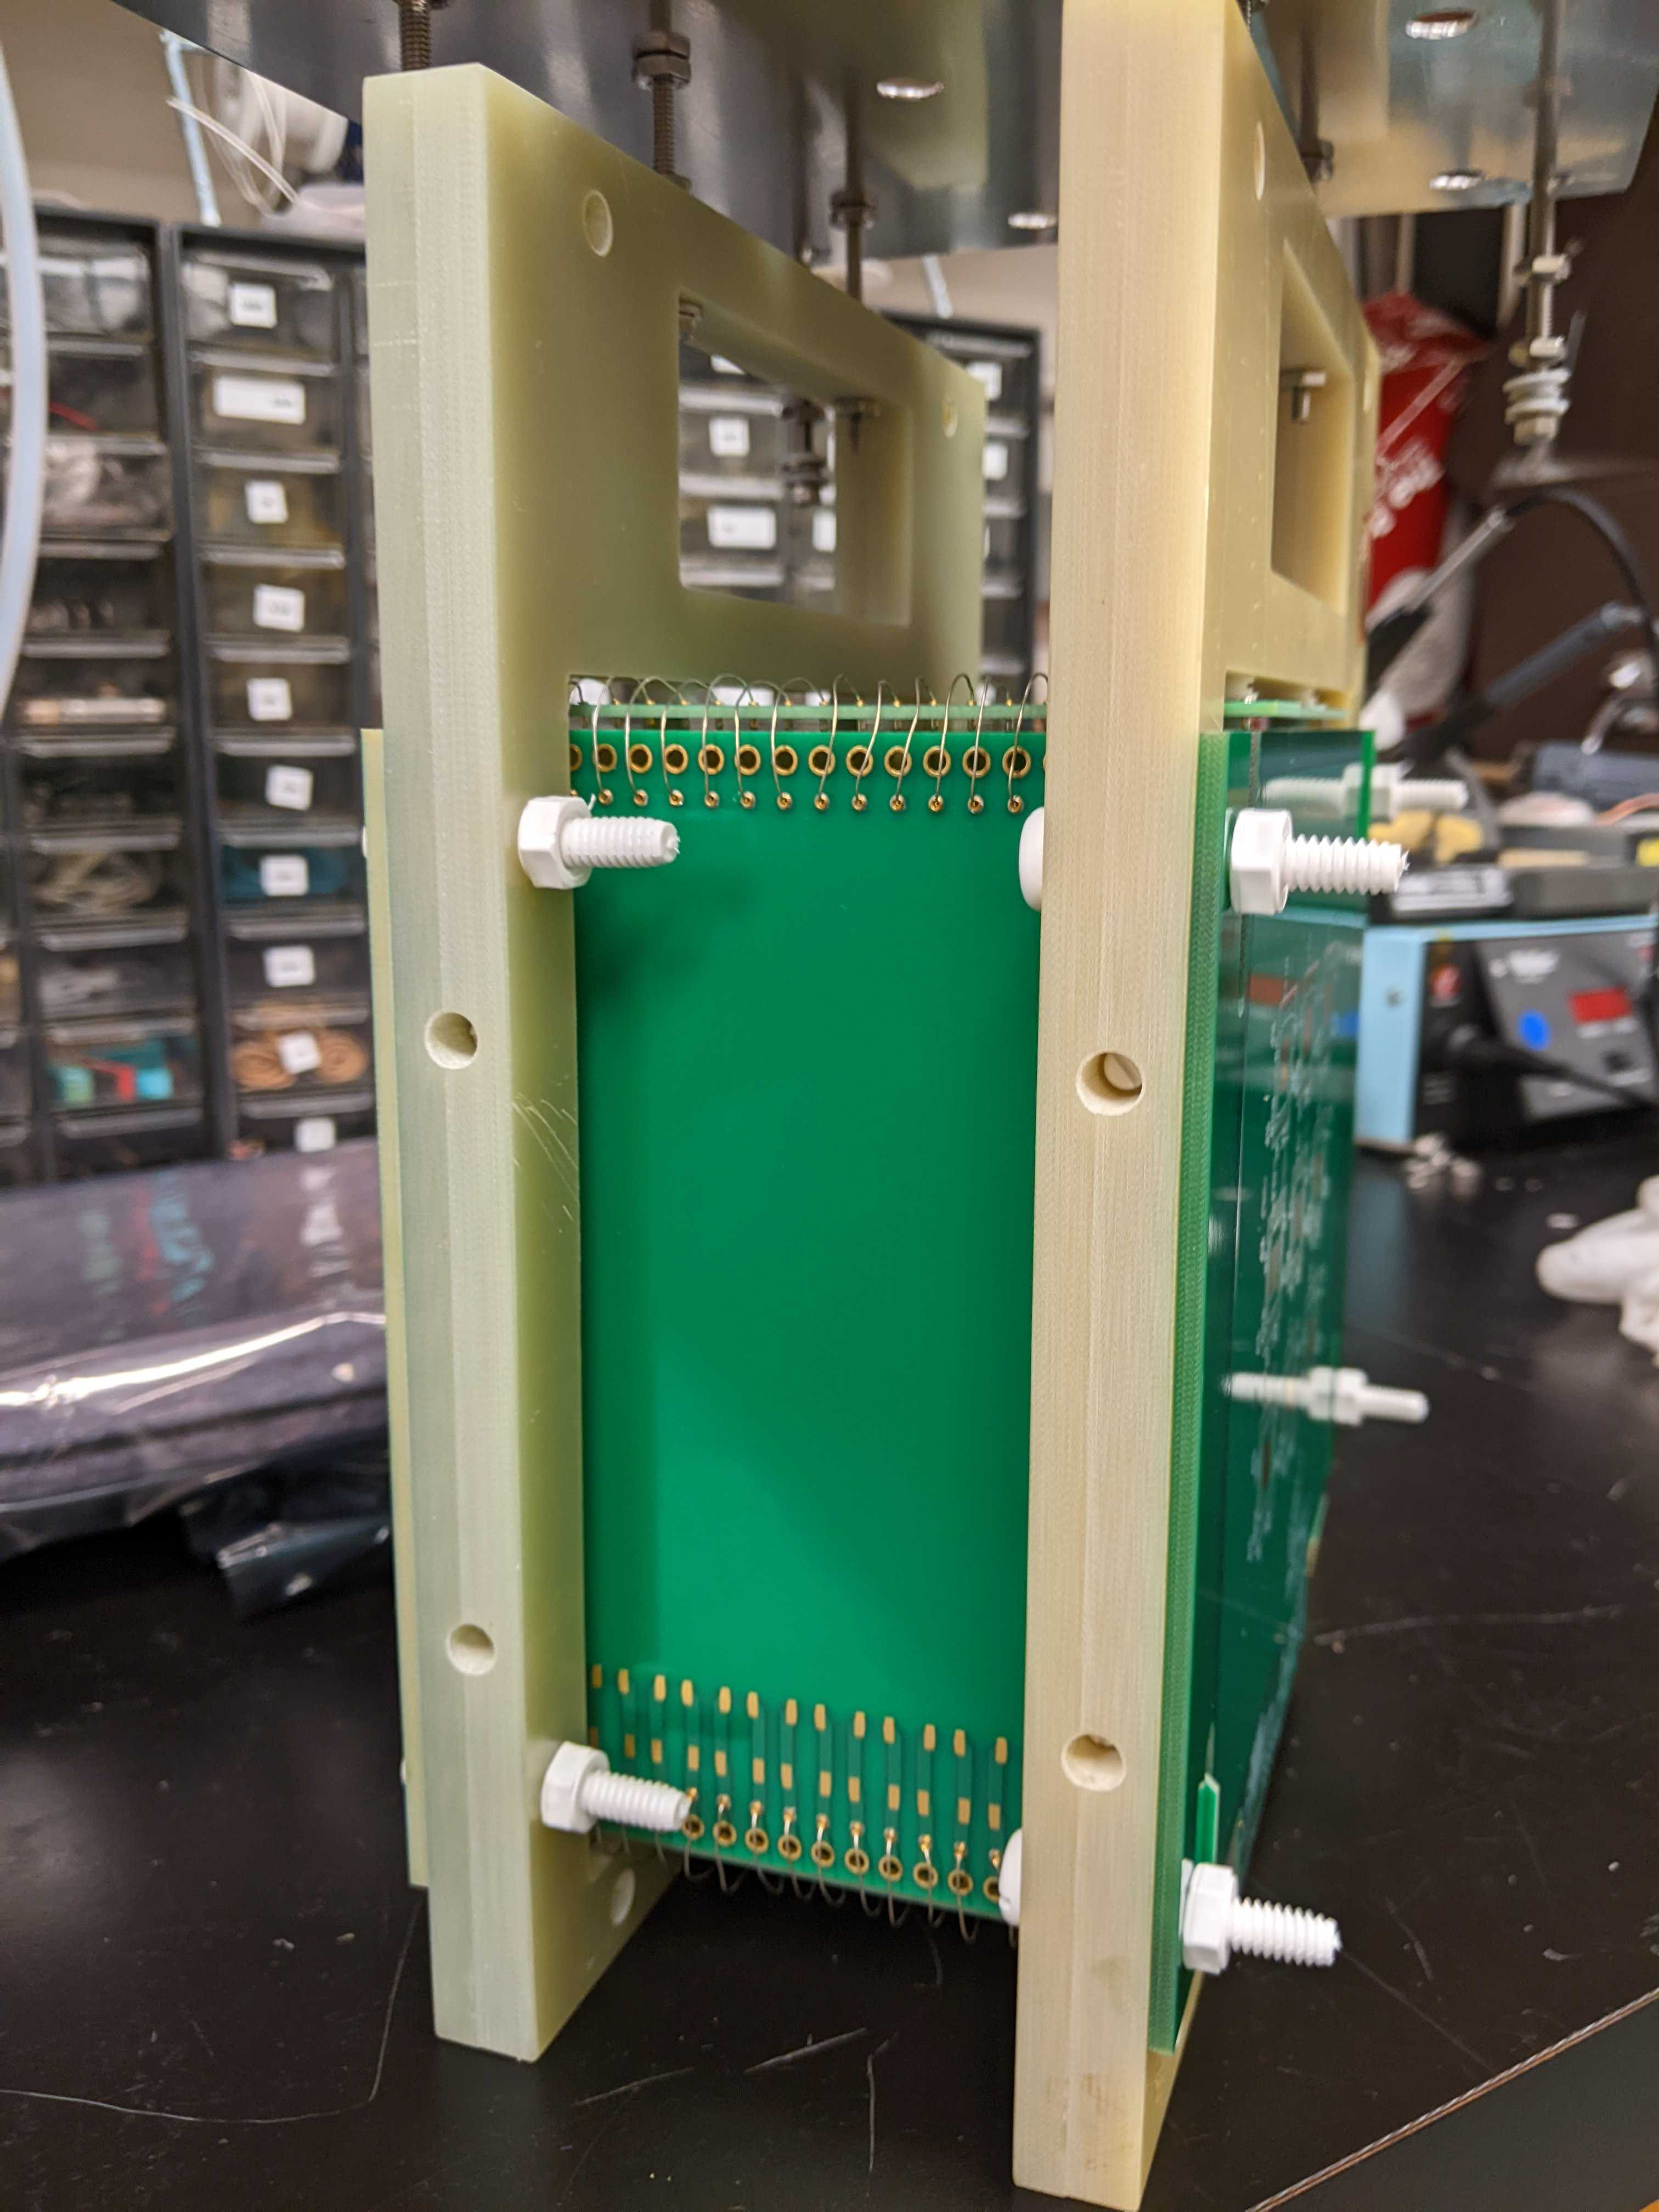
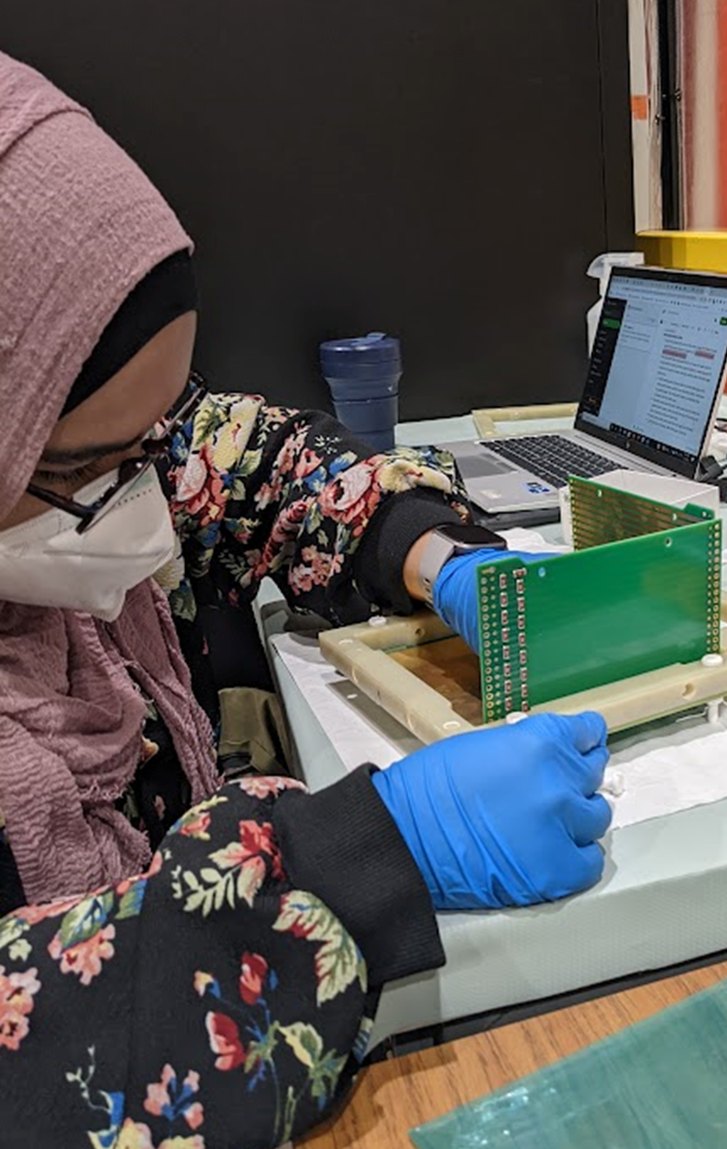
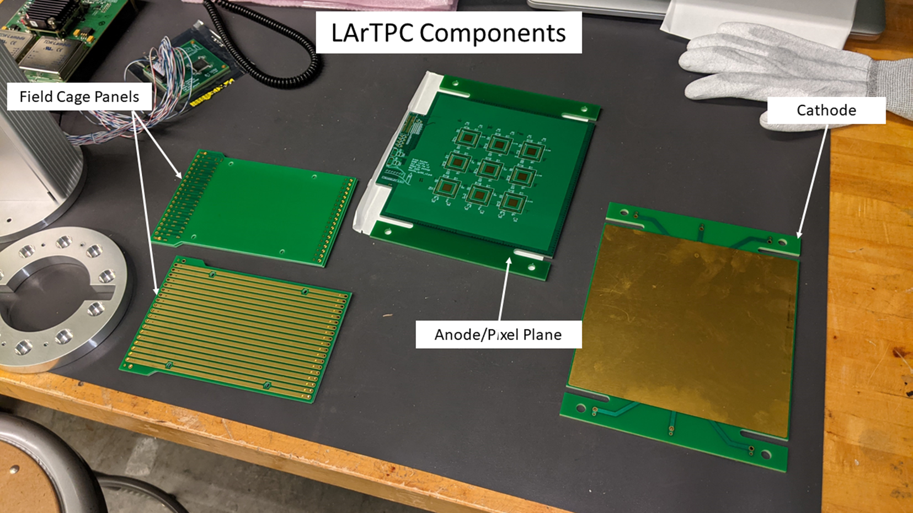
Steps to Dope LArTPC
Step 2:
Charge Drift Path
Step 1:
Completed Tiny LARTPC (Source: LArPix documentation)
Step 3:
Components Tiny LARTPC (Source: LArPix documentation)
TPC in the making
Blanche Cryostat (Source)
Notes:
Just have one slide which has -> TPC is assembled, mechanical design is done, will be deployed in the coming weeks

Slide 15
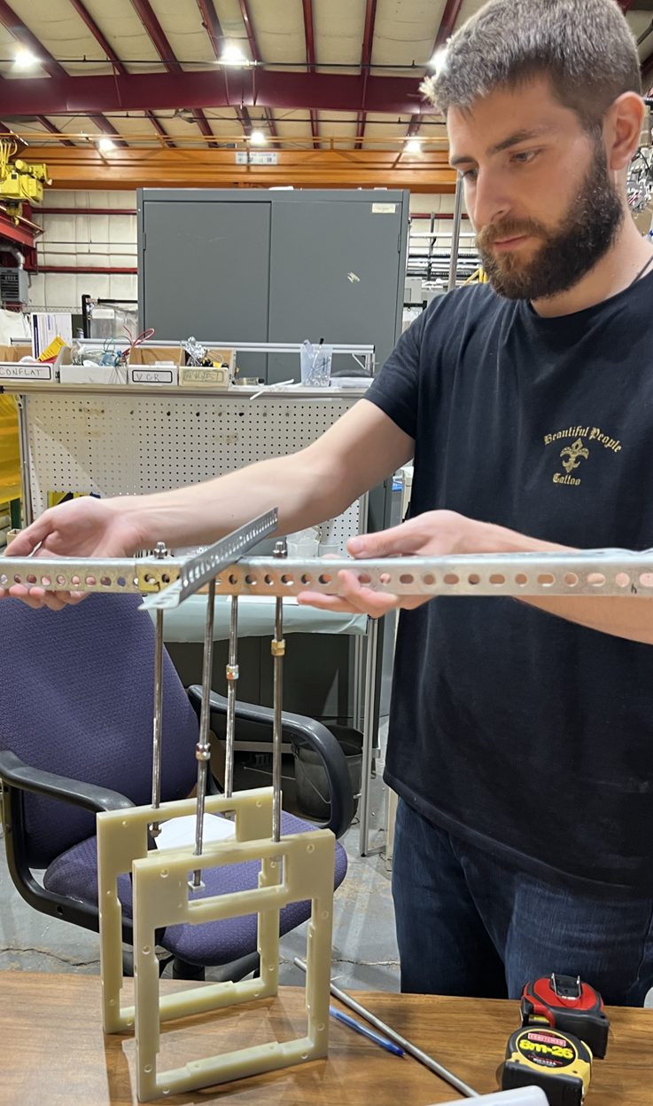
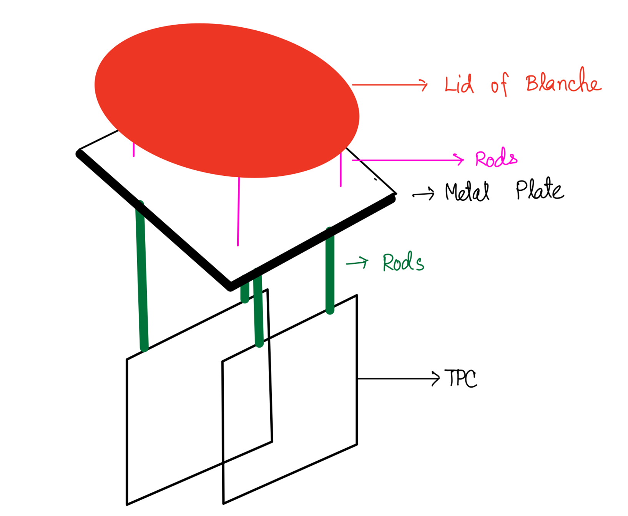
R&D in the Lab: Mechanical Design
Diagram of TPC when Deployed in Blanche
Testing Mechanical Design
(Source: LArPix documentation)

Slide 16
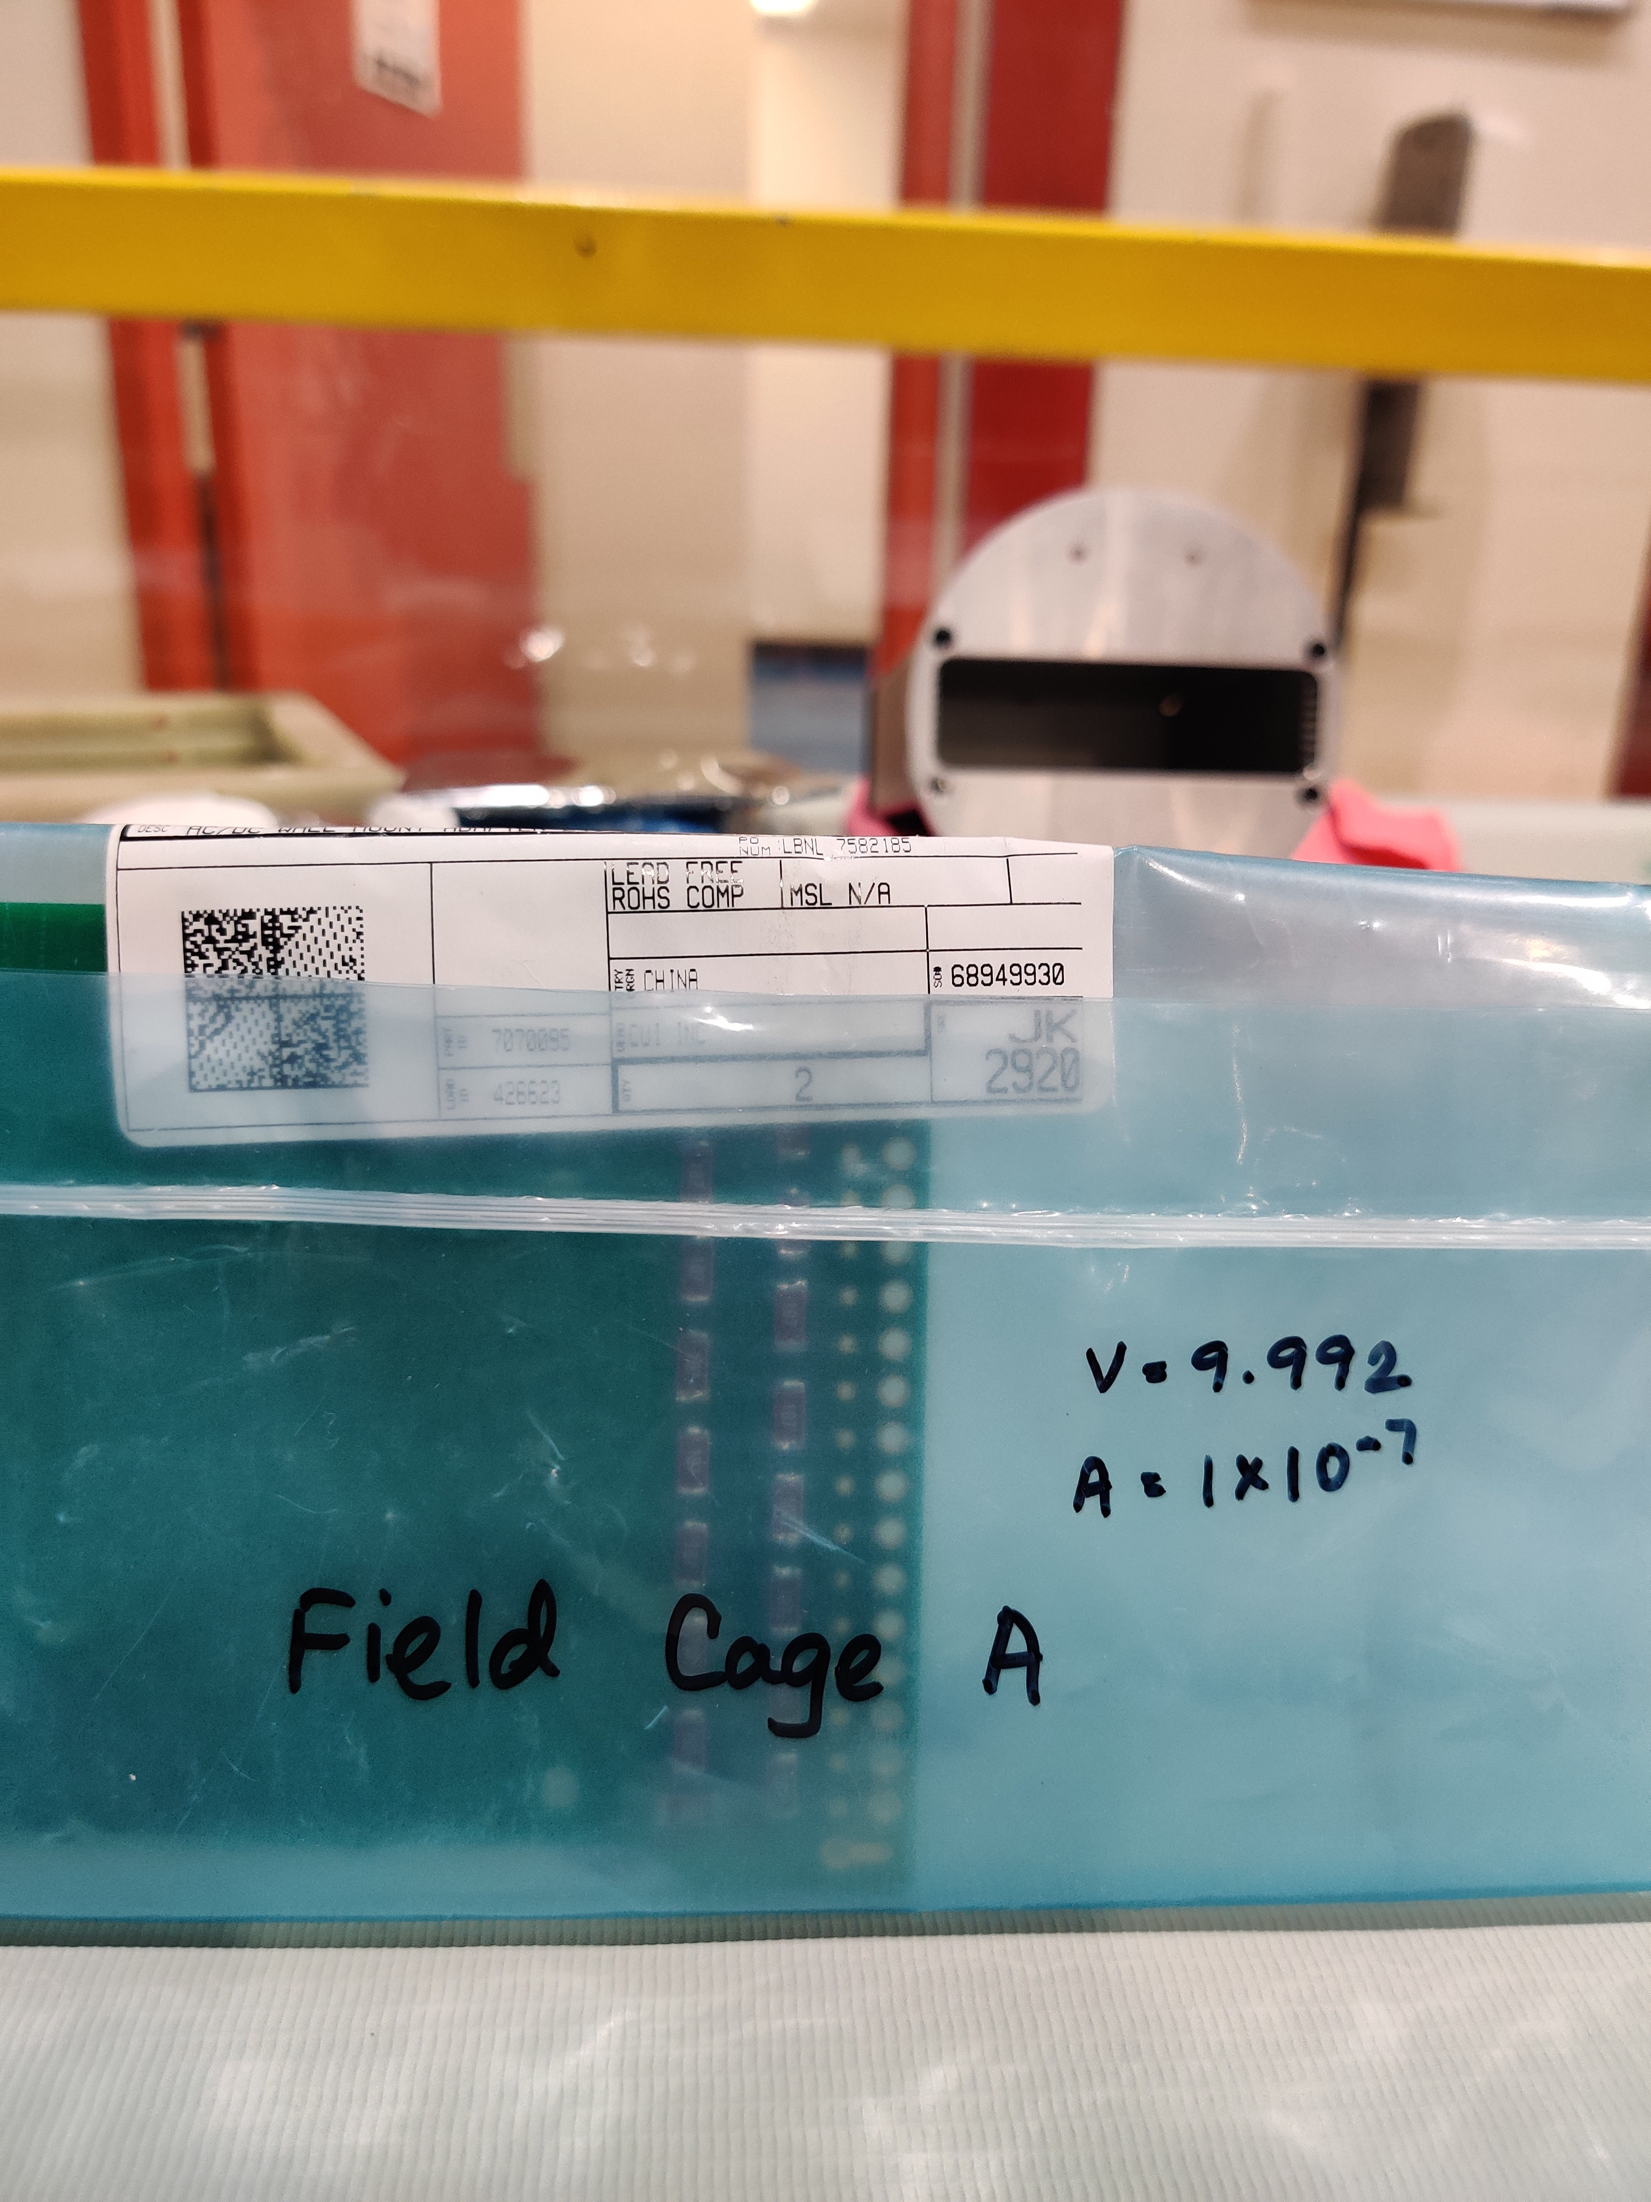
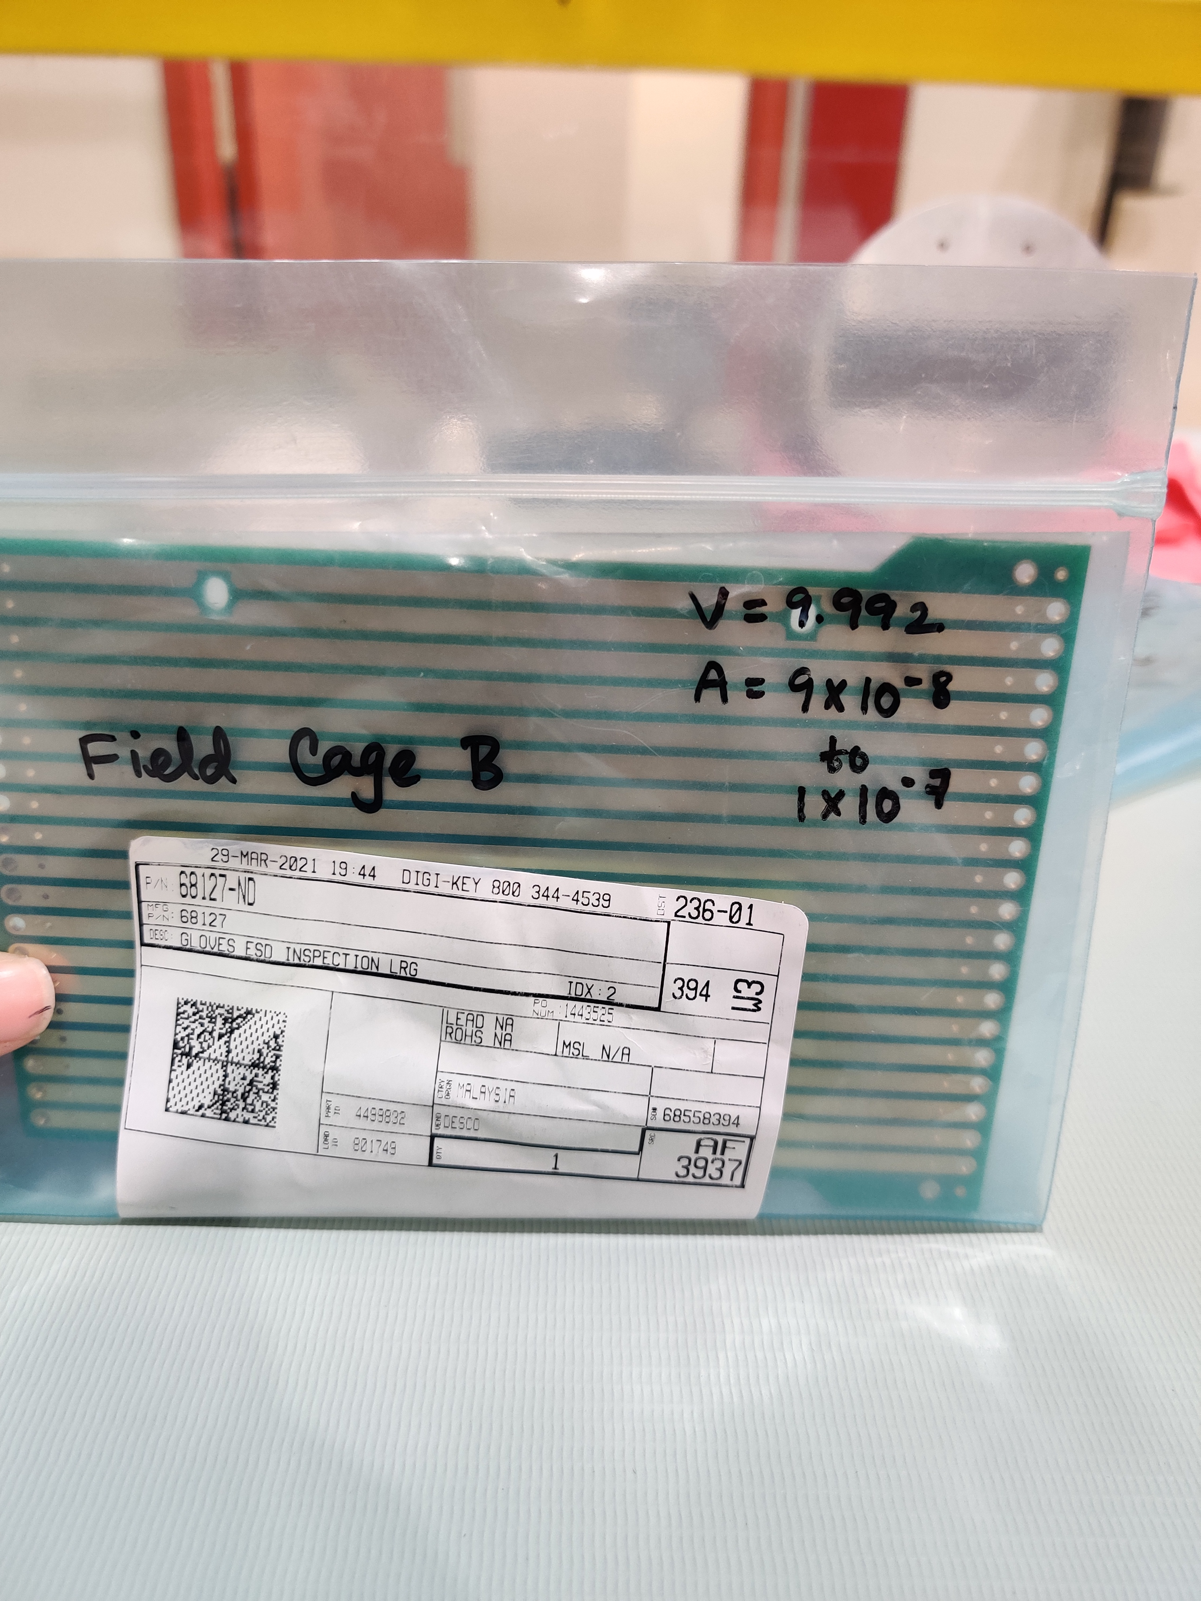
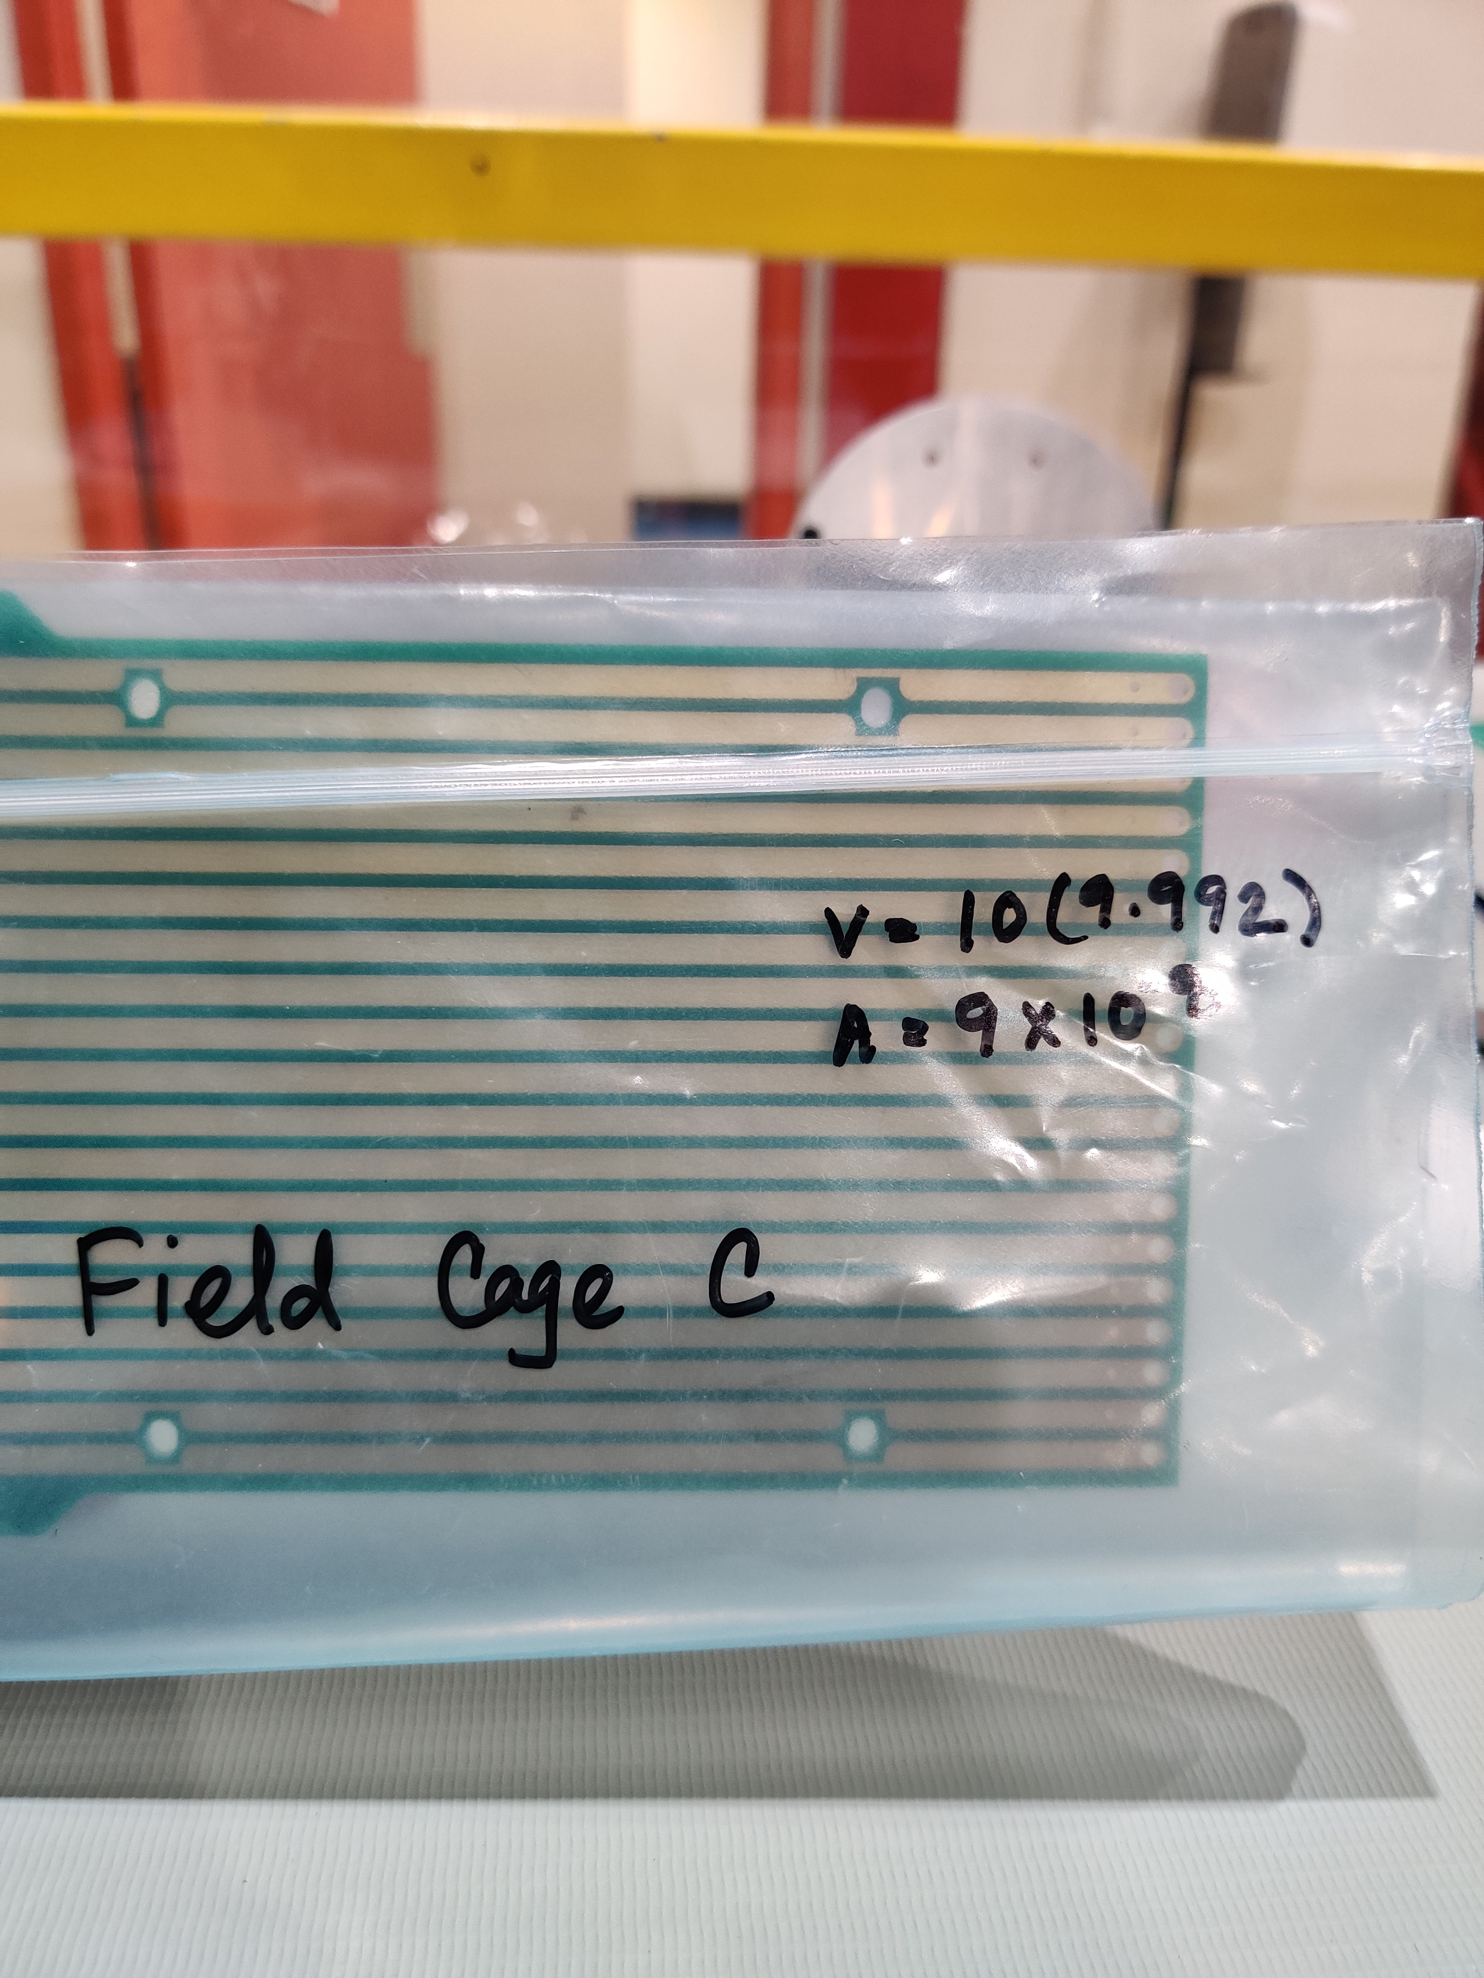
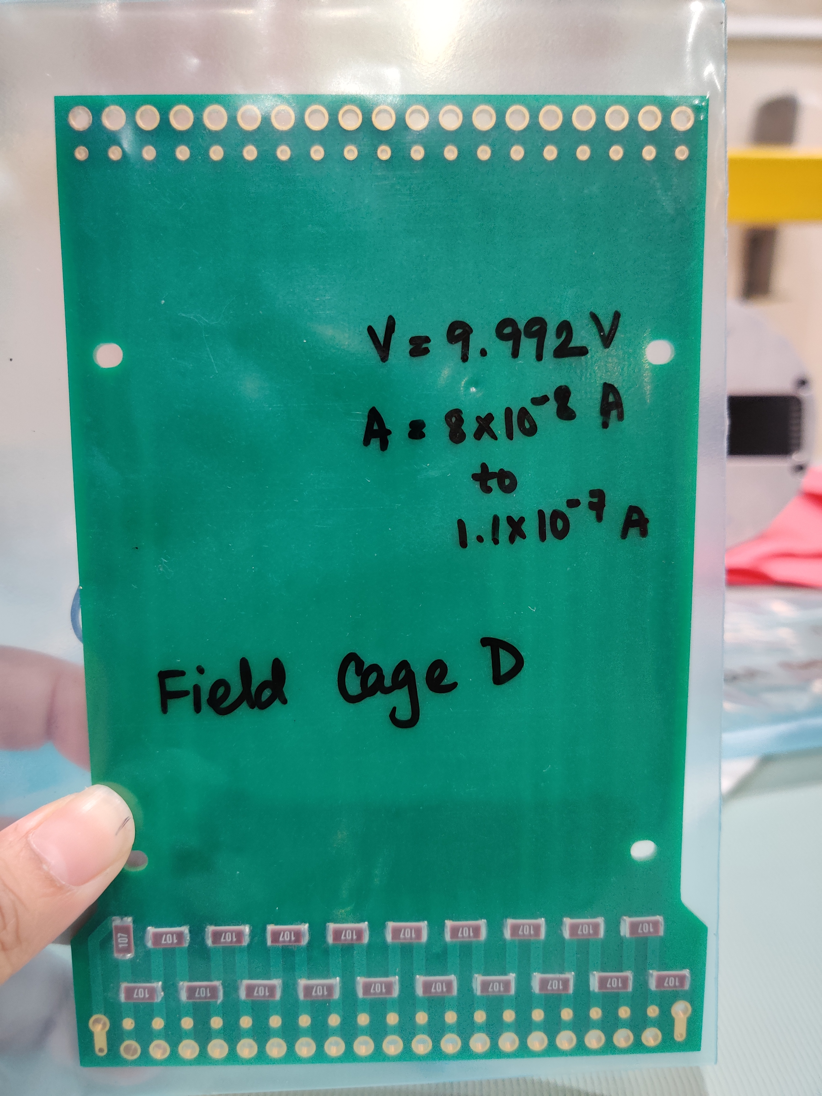
R&D in the Lab: Test Electronics
Picoammeter
Voltage
Source
Resistors on the
Field
Cage Panels
Notes:
Main goal : Checking none of the resistance is shorted

Slide 17
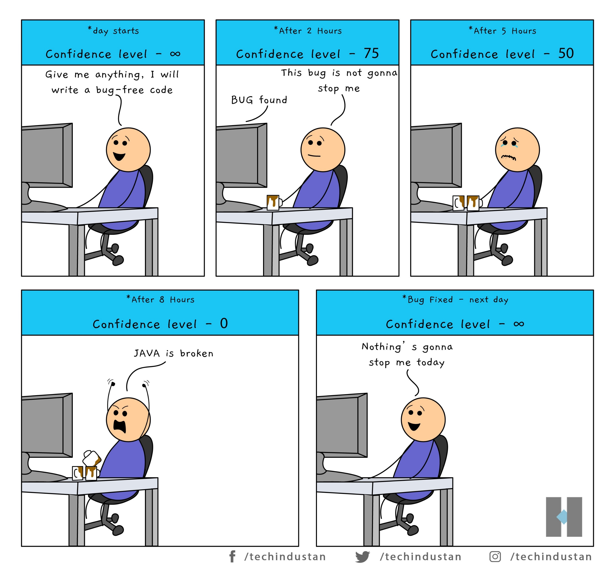
Future Steps
Conducting bench tests of the TPC once it is assembled
Completing Python scripts to collect and analyze data (aka Questioning One’s Existence)
Deploying the TPC in the Cryostat
Completing Safety Protocol
Collecting and analyzing data
Python

Slide 18
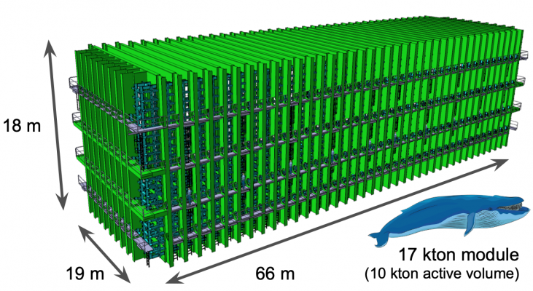
DUNE (Deep Underground Neutrino Experiment)
The detectors are in
Fermi National Accelerator Laboratory, Batavia, Illinois
Sanford Underground Research Facility, Lead, South Dakota
Objective
Accelerator neutrino
Neutrino oscillations
Supernova neutrino
Operational Diagram of DUNE (Source)
One of Four DUNE Far Detector Modules (Source)
Source:
Figure:https://www.dunescience.org/
Notes:
Fermilab has one detector. This one is finalized.
Sanford has multiple detectors and the R&D questions focused in our project is more directly related to these detectors.

Slide 19
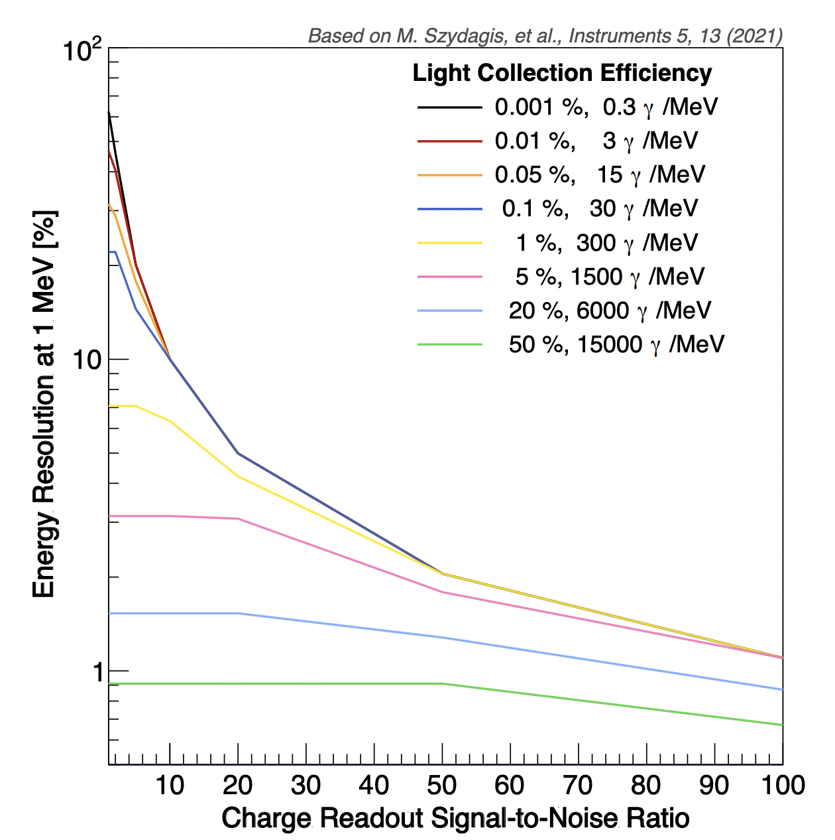
Energy Resolution at Low Energy
Using both light and charge information can yield a more accurate energy information
According to NEST, the (%) energy resolution requires collection of at least 6000 photons per MeV
The best LArTPC collects 160 photons/MeV
Better Energy Measurement
ProtoDUNE-SP
JINST 15 (2020) P12004
Less noise in charge readout
Notes:
- This image shows what happens if we can collect sufficient amount of light
But light collection is hard.

Slide 20
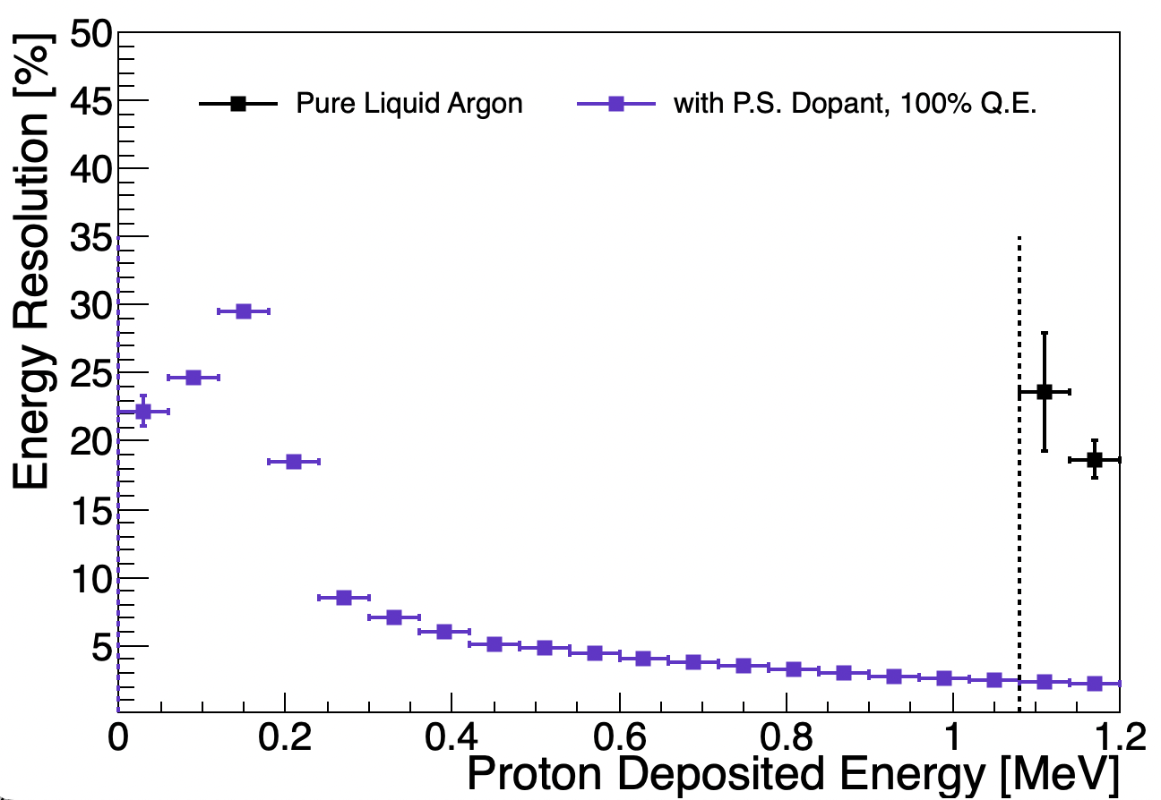
Photosensitive Dopant Concept
Using photosensitive dopants will convert light to charge
Converting light to charge
Lowers 1.1 MeV threshold to 10 keV
Improves charge only energy resolution
J. Zennamo

Slide 21
Photosensitive Dopant Concept
Benefits of MeV Reco In LArTPCs
Phys. Rev. D 102, 092010
Using photosensitive dopants will convert light to charge
Converting light to charge
Lowers 1.1 MeV threshold to 10 keV
Improves charge only energy resolution
J. Zennamo
Created by: Fernanda Psihas
Notes:
- Do the event display first and then talk about the plots.

Slide 22
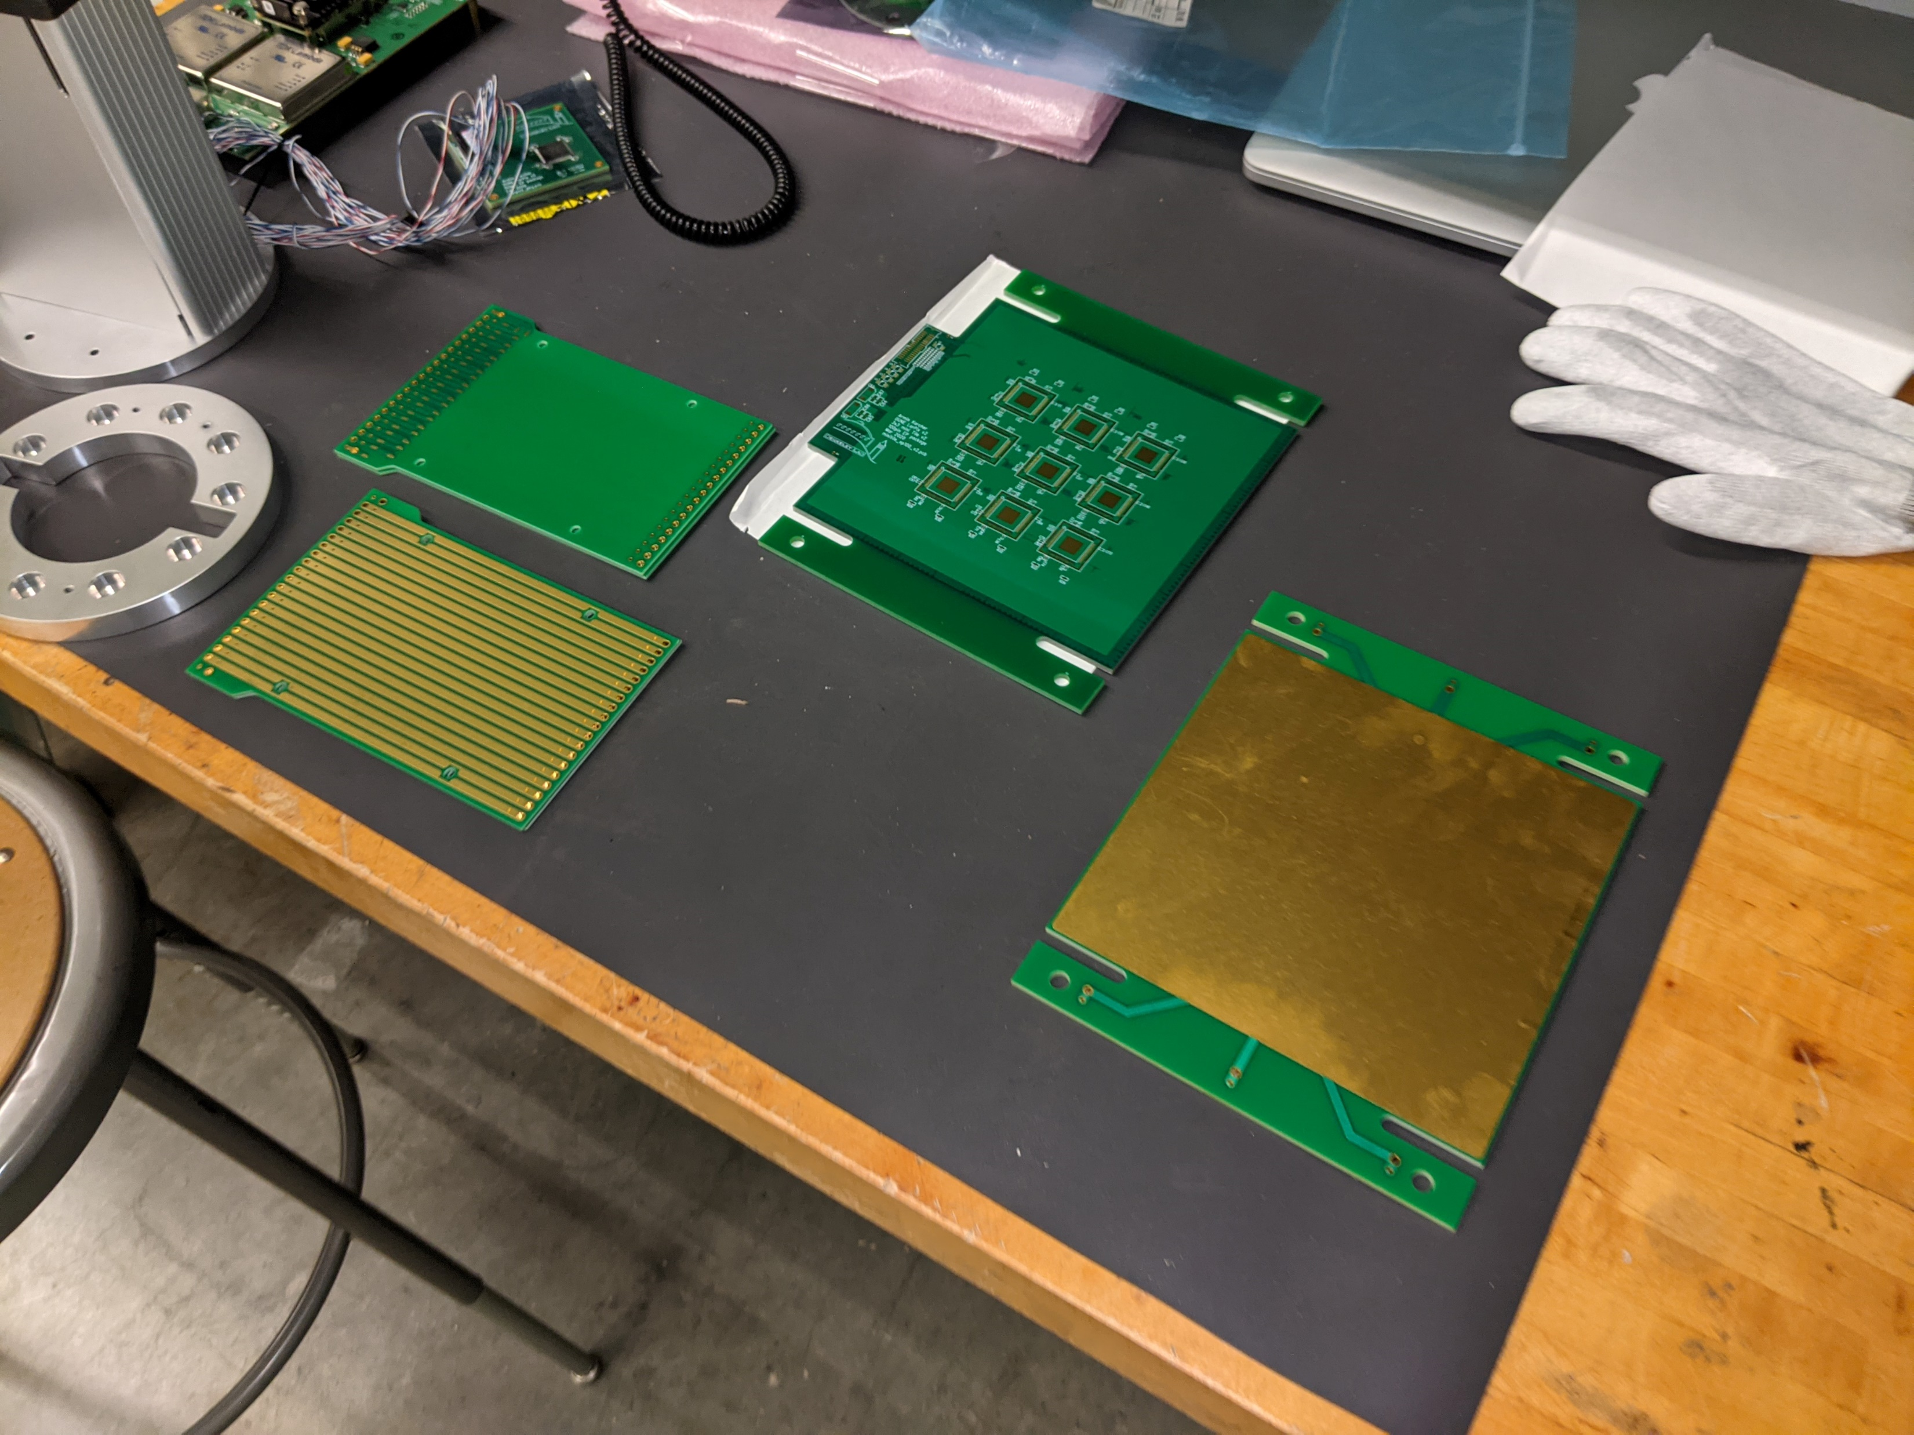
Objective : LArPix V2
Measure the energy of low energy events in LArTPCs
Background/cosmic data
Radioactive source
Photosensitive dopants
Analyze the data
Charge Drift Path
Completed Tiny LARTPC (Source: LArPix documentation)
Anode or readout plane: the pixel is in the back
Field cages
Components Tiny LARTPC (Source: LArPix documentation)
Fig 5 : Blanche Cryostat (Source)
Notes:
Construct a tiny LArTPC prototype
Focus on R&D
Lower the threshold
Improve the precision
TPC is deployed in Balance in PAB
The picture is from the one made in LBNL

Slide 23
Steps to Build a LArTPC
Completing paperwork
TSW = Technical Scope of Work
ORC = Operational Readiness Clearance
Preparing work area
Mechanical Designs
TPC in the Cryostat
Test Electronic Equipment
Test Assemble the TPC
Soldering

Slide 24
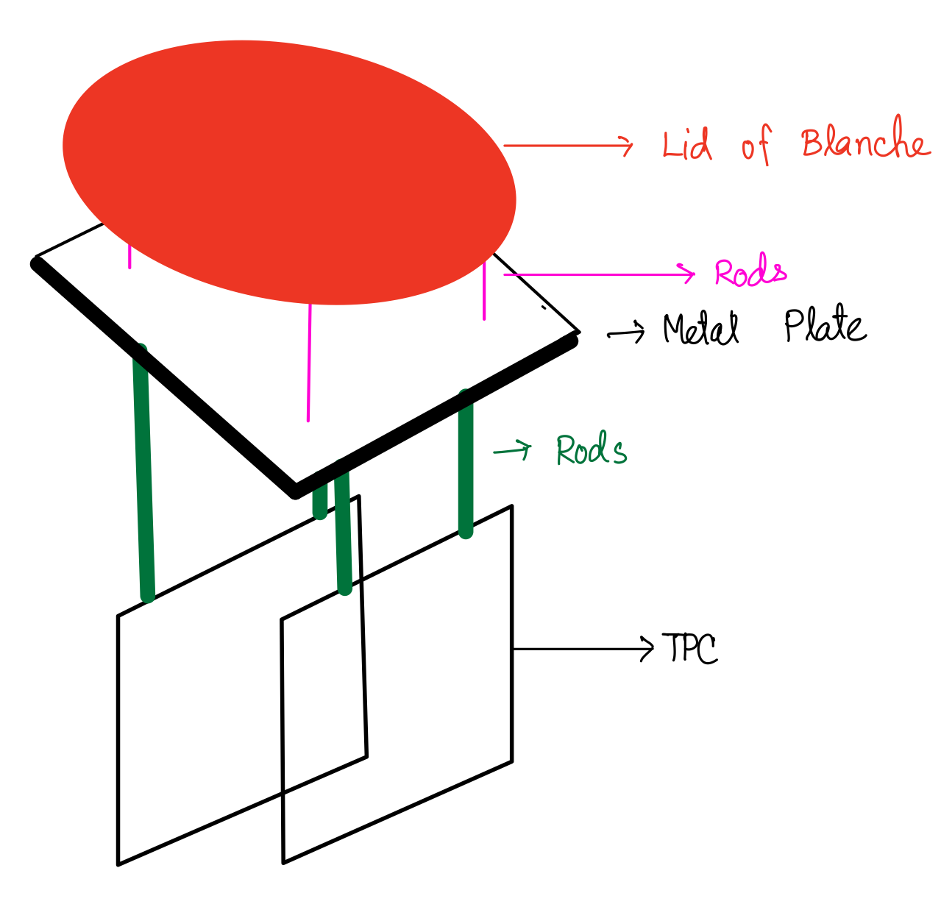
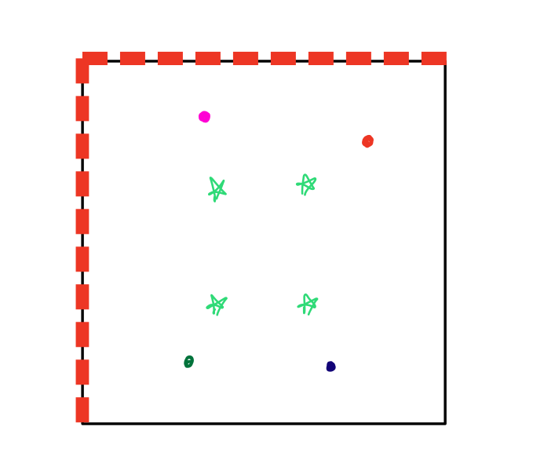
Mechanical Design (Theory vs Application)
Blanche Lid (Source)
Mechanical Design of Metal Plate
Diagram of TPC when Deployed in Blanche
TPC Top Details
Detailed Design of Metal Plate and the Corresponding Locations on Blanche Lid and TPC

Slide 25
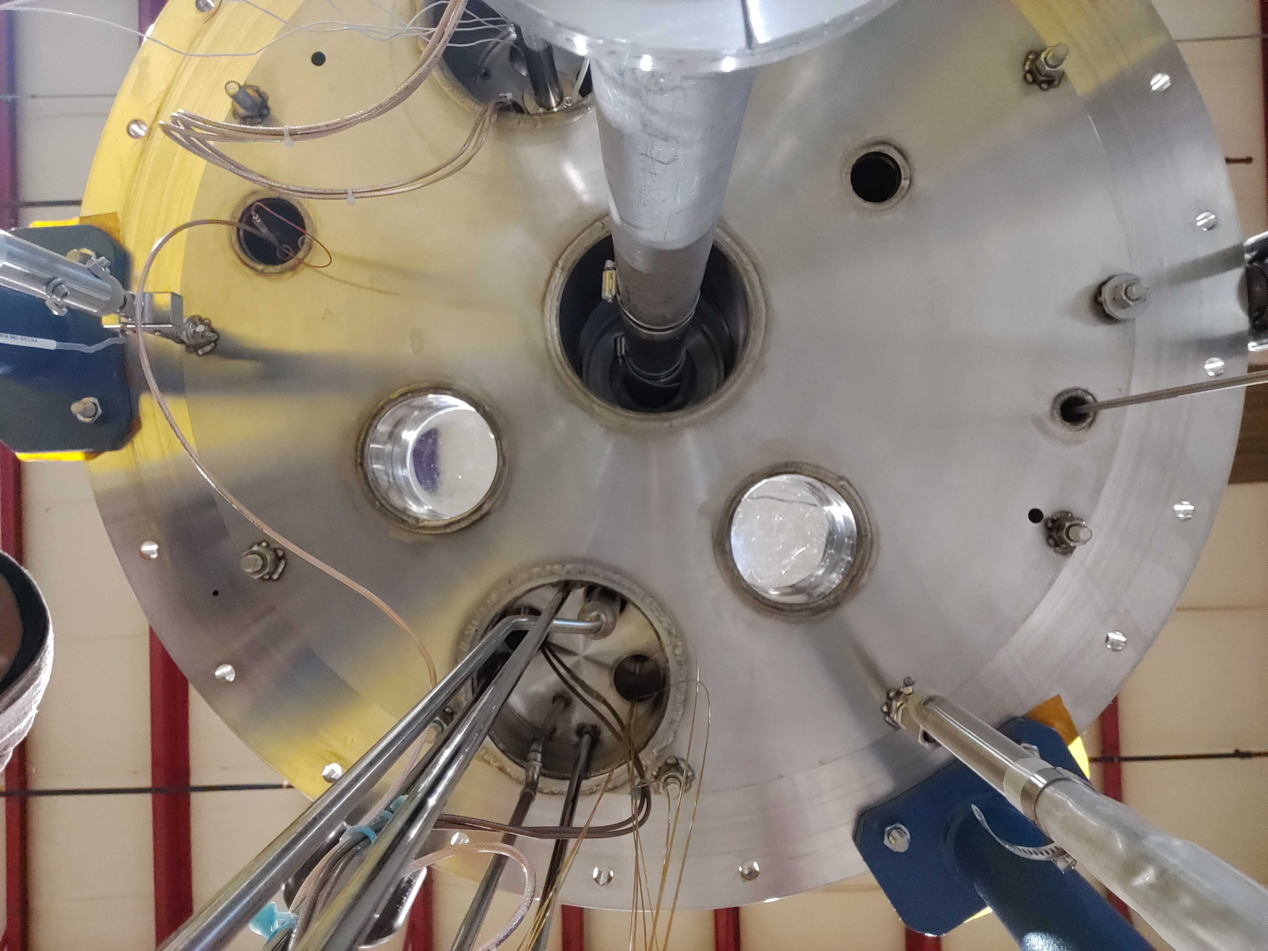
Mechanical Design (Theory vs Application)
Solution = Use metal strips instead of a metal plate
Engineering Design of Blanche Lid (Source)
Proposed Idea to Stabilize TPC
Inside of Blanche Lid

Slide 26
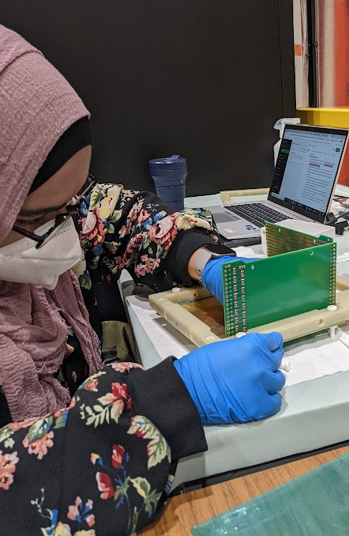
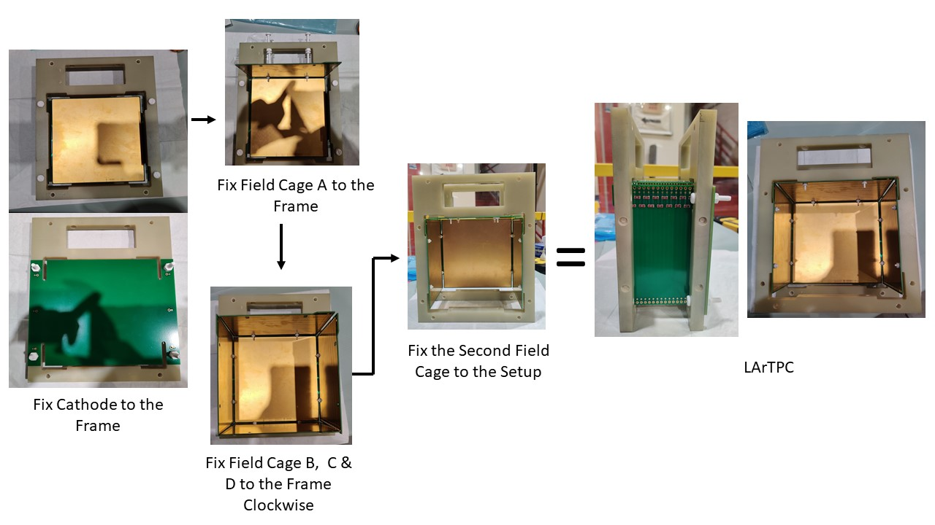
Test Assemble
Goal:
Ensure proper functionality of all elements
Test existing assembly procedure
TPC in the making
Diagram of the TPC Assemble Procedure
Notes:
Waiting on Anode plane.

Slide 27
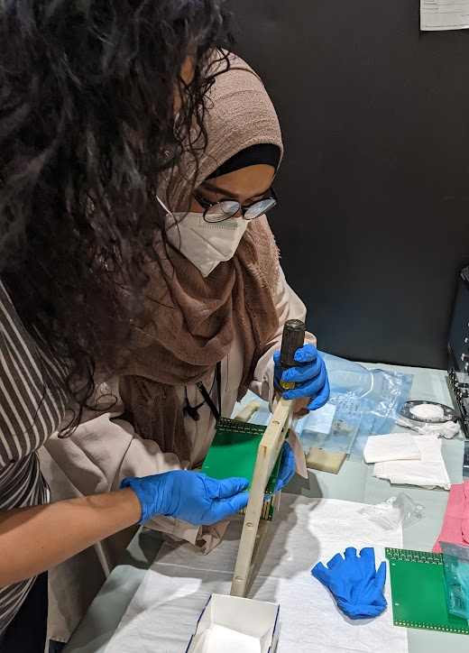
Soldering
Checklist
Electronic schematics
Description of procedure
Schematics of the Electronics
Drawings for Soldering
Expected Outcome
(Source)

Slide 28
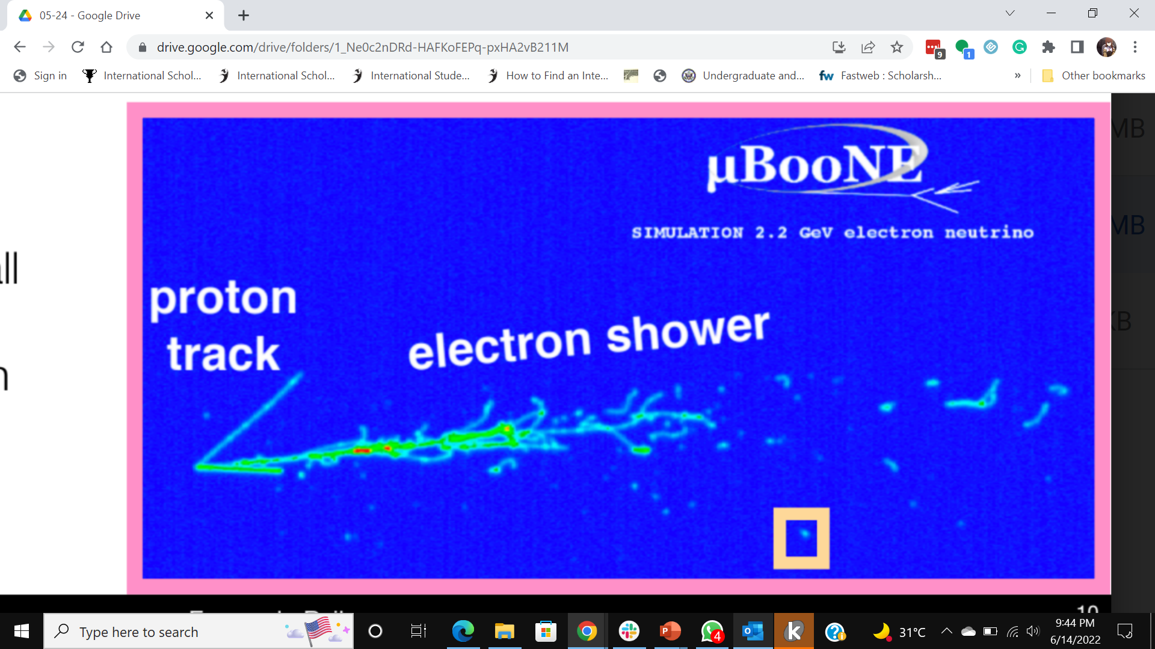
Low Energy Signals in LArTPCs
Signals are very small in low energy events
Not much information to reconstruct the events
Fig: MicroBooNE Simulation of 2.2 GeV electron neutrino
Notes:
If we have to calculate only based on charge, ½ the info is lost
So light is an important aspect and need to collect more light info
Sufficient ratio for physics in GeV scale
Unable to do physics in MeV scale

Slide 29
Neutrino Detector Event Display
Energy measurements require charge and light measurements
Light is collected with low efficiency
Fig: MicroBooNE Simulation of 2.2 GeV electron neutrino
Notes:
If we have to calculate only based on charge, ½ the info is lost
So light is an important aspect and need to collect more light info
Sufficient ratio for physics in GeV scale
Unable to do physics in MeV scale

