Slide 1
Telescopes Drive Themselves: Optimizing Cosmic Survey Scheduling with Reinforcement Learning
Franco Terranova¹², Maggie Voetberg², Brian Nord²³⁴⁵, Eric Neilsen²
New Perspectives 2023
June 2023
1. University of Pisa, Department of Information Engineering, Pisa, IT 2.Fermi National Accelerator Laboratory, Scientific Computing Division, Batavia, IL 3. Department of Astronomy and Astrophysics, University of Chicago, Chicago, IL 4. Kavli Institute for Cosmological Physics, University of Chicago, Chicago, IL 5. Laboratory for Nuclear Science, MIT, Cambridge, MA
FERMILAB-SLIDES-23-143-CSAID

Slide 2
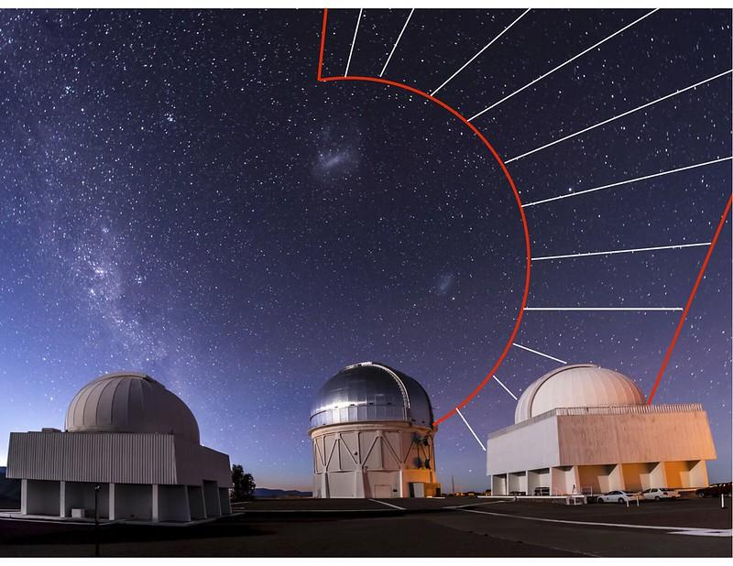
Clockwork Science Design
Use modern Machine Learning techniques to optimize what we investigate and how we do it
Let the telescope decide what is interesting
Investigate that in non-human scheduled downtime
Respond to unexpected events without intervention
Find novel questions to ask
Dark Energy Survey, via Yuanyuan Zhang
2
06/27/2023
Maggie Voetberg | Telescopes Drive Themselves: Optimizing Cosmic Survey Scheduling with Reinforcement Learning
FERMILAB-SLIDES-23-143-CSAID

Slide 3
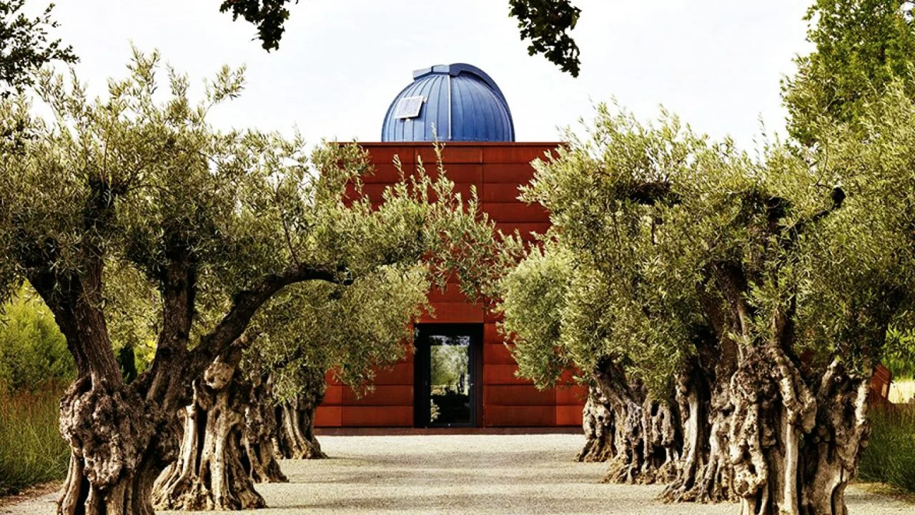
The first step – Learning to schedule
Start with a program that optimizes a sequential schedule based on a single parameter maximization
Give the model a set of parameters, receive the best possible next step in the schedule
Working with Stone Edge Observatory in California for a proof-of-concept volume survey
Stone Edge Observatory
3
06/27/2023
Maggie Voetberg | Telescopes Drive Themselves: Optimizing Cosmic Survey Scheduling with Reinforcement Learning
FERMILAB-SLIDES-23-143-CSAID

Slide 4
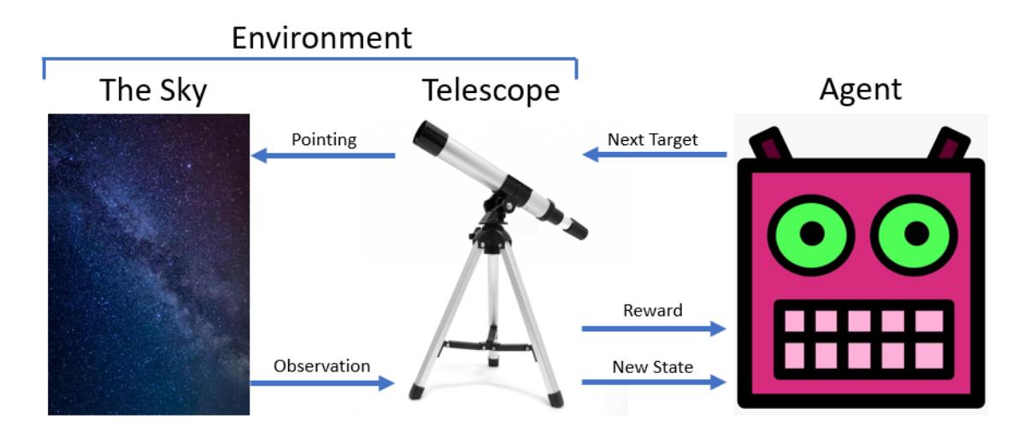
Learning to Learn – Reinforcement Learning
Attempts to replicate how a human learns
Conceptualize as a model trying to learn how to play a game
The agent interacts with an environment, via an ‘action’, and gains ‘reward’ through the interaction
4
06/27/2023
Maggie Voetberg | Telescopes Drive Themselves: Optimizing Cosmic Survey Scheduling with Reinforcement Learning
FERMILAB-SLIDES-23-143-CSAID

Slide 5
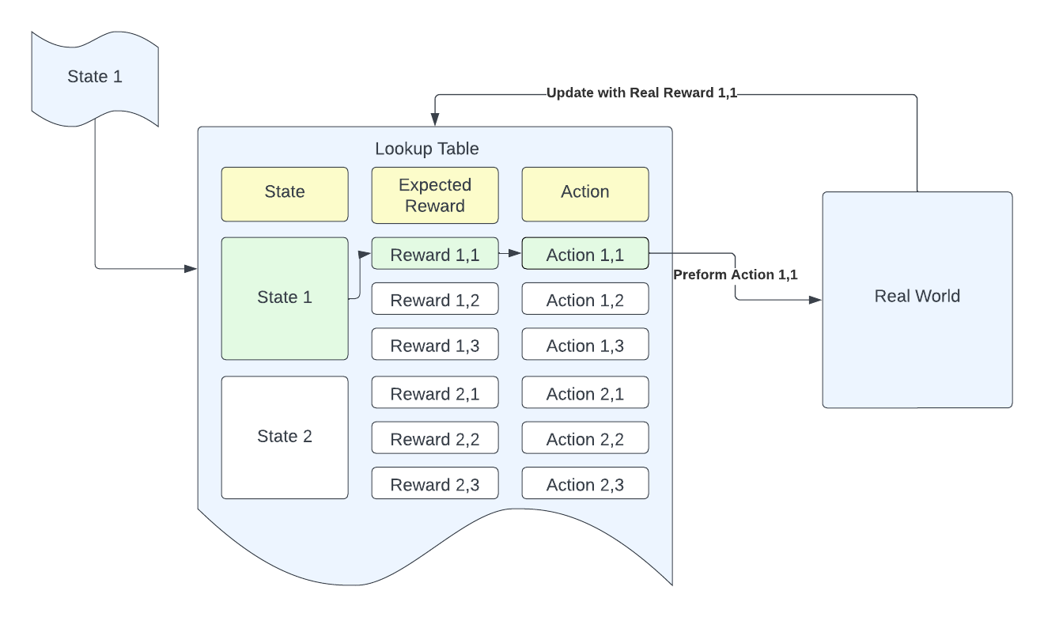
Using Value-Based Methods
Imagine a look-up table of values that correspond to every state-action pairing, with the probability of the optimal reward
Gets complicated very quickly for large problems – intractable for continuous problems
5
06/27/2023
Maggie Voetberg | Telescopes Drive Themselves: Optimizing Cosmic Survey Scheduling with Reinforcement Learning
FERMILAB-SLIDES-23-143-CSAID

Slide 6
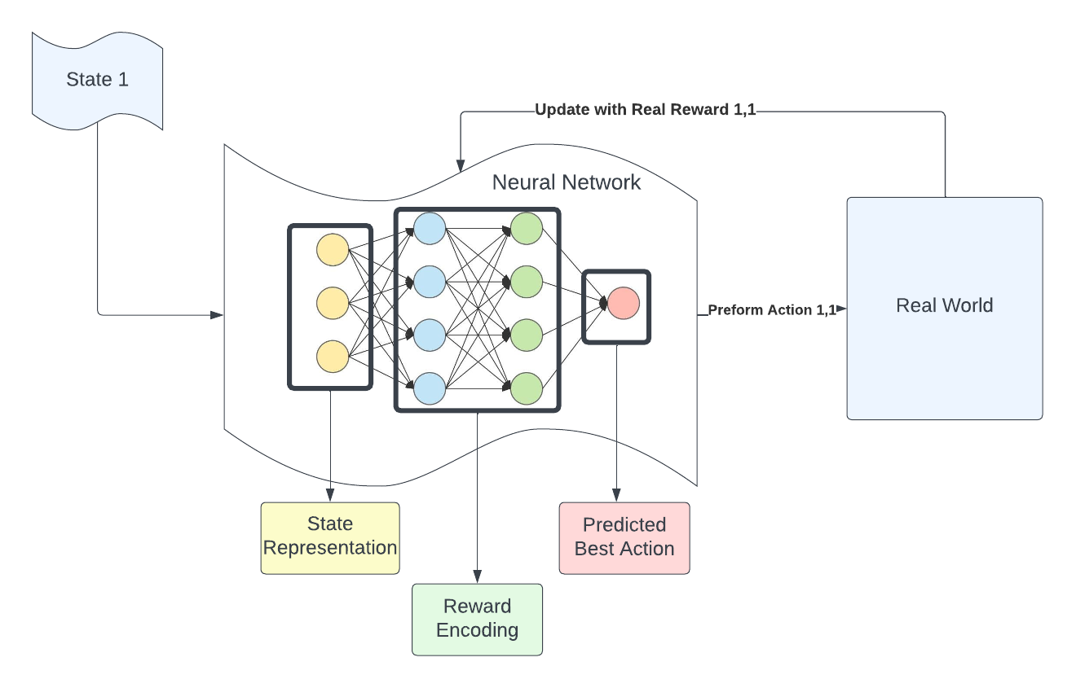
Enhance Value Methods with Offline Deep Learning
6
06/27/2023
Maggie Voetberg | Telescopes Drive Themselves: Optimizing Cosmic Survey Scheduling with Reinforcement Learning
FERMILAB-SLIDES-23-143-CSAID

Slide 7
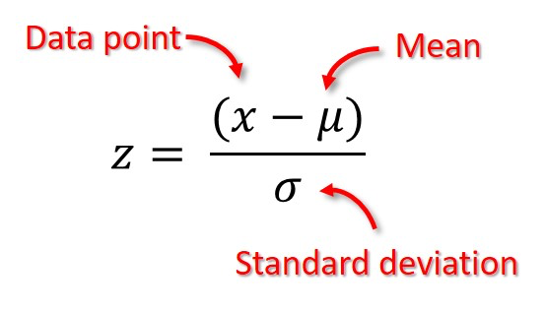
Data Preprocessing
ID | az | alt | …. | sun_ ra | sun_ decl | …. | moon_ airmass | moon_ angle | sky_ mag
ID_1 | 10.01 | 31.03 | …. | 64.77 | 21.41 | …. | 5.89 | 112.2 | 18.91
ID_2 | 10.01 | 31.03 | …. | 64.77 | 21.41 | …. | 5.89 | 112.2 | 18.91
…. | …. | …. | …. | …. | …. | …. | …. | …. | ….
Right Ascension | Declination
79.0 | 324.0
24.0 | 221.0
…. | ….
T-Effective
38
29
….
New State
ID_29
ID_46
….
Observation space
Action space
Reward
Next state
Normalization of the dataset involves adjusting the value of the data to a standardized range.
This operation will ensure that the data is in a format easier for the RL algorithm to work with.
Z-score normalization of the reward values intra-state
Z-score normalization of the observation space columns
06/27/2023
Franco Terranova | Telescopes Drive Themselves: Optimizing Cosmic Survey Scheduling with Reinforcement Learning
FERMILAB-SLIDES-23-143-CSAID

Slide 8
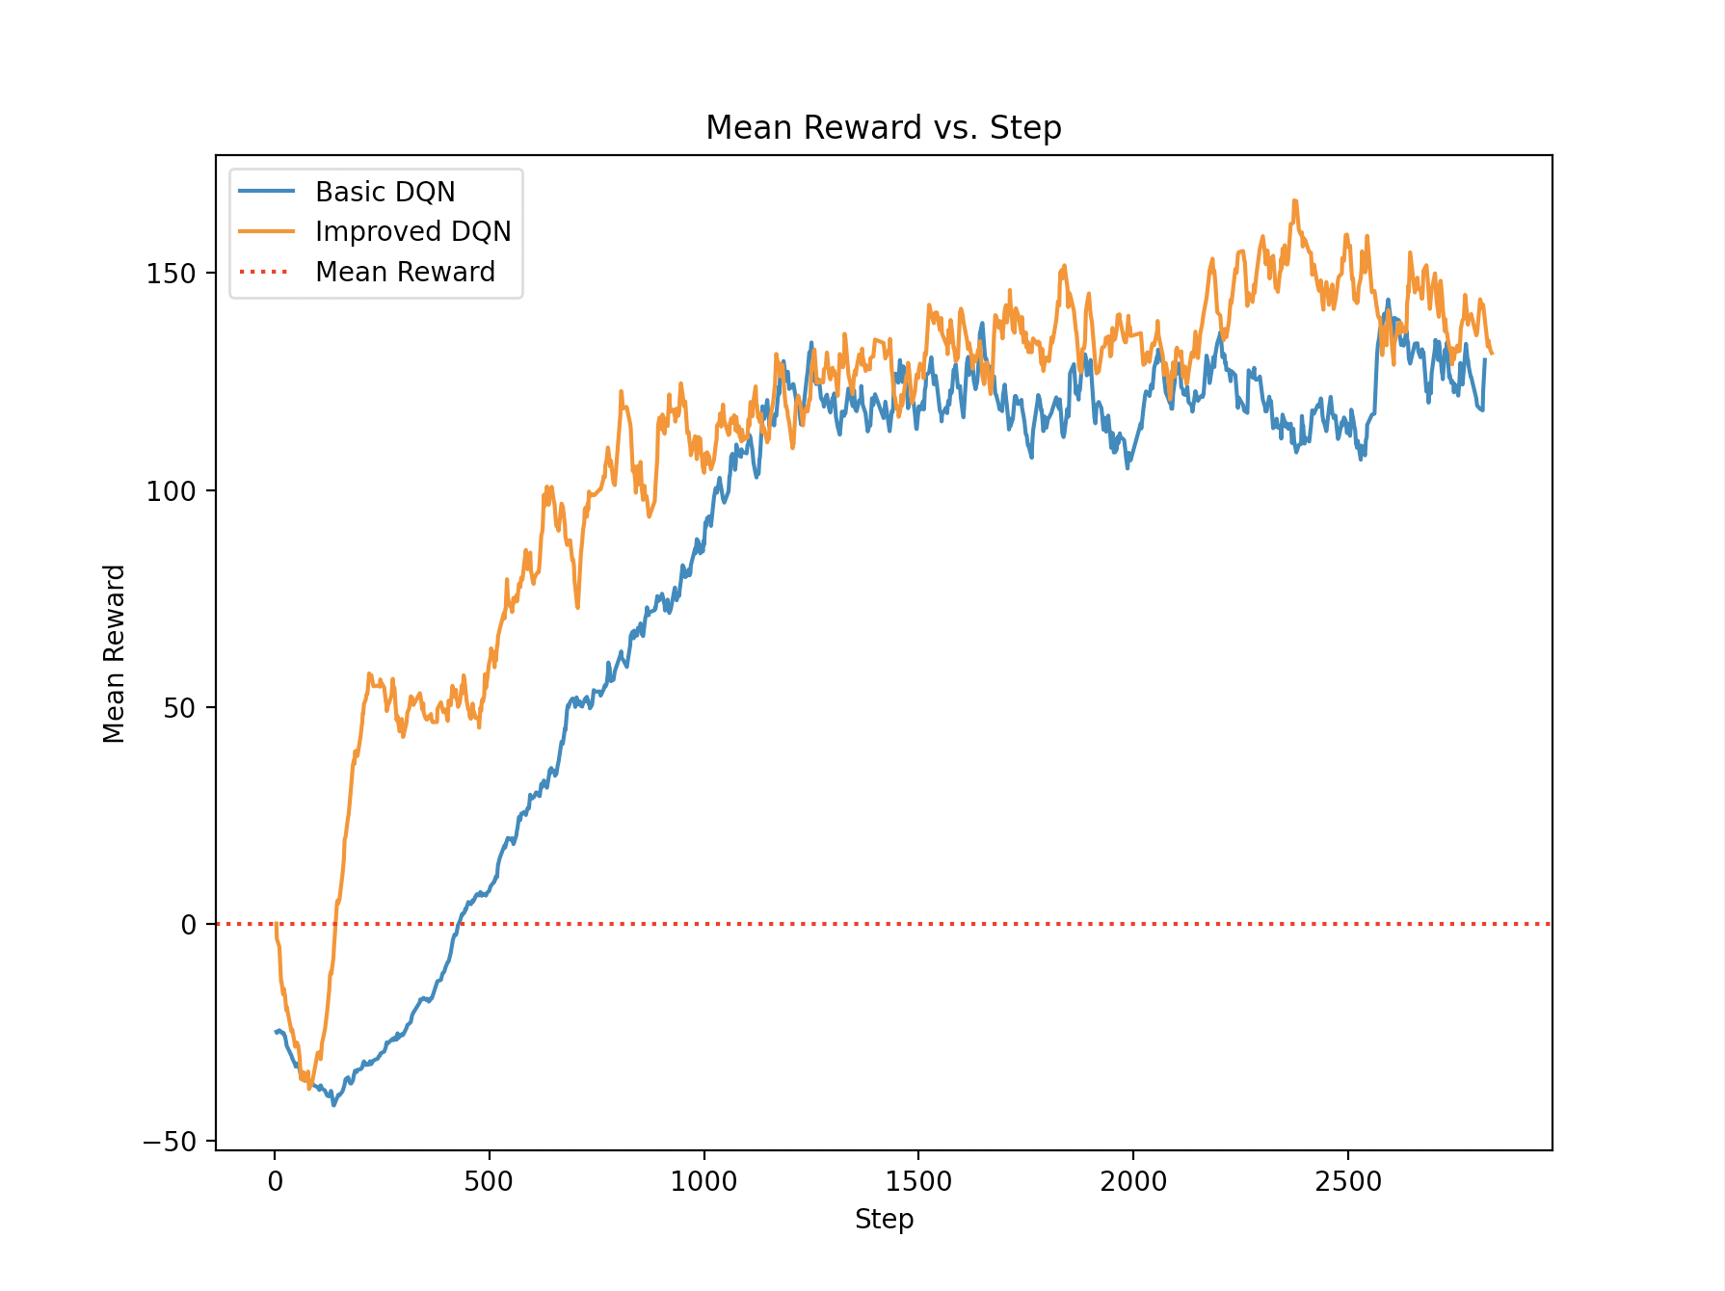
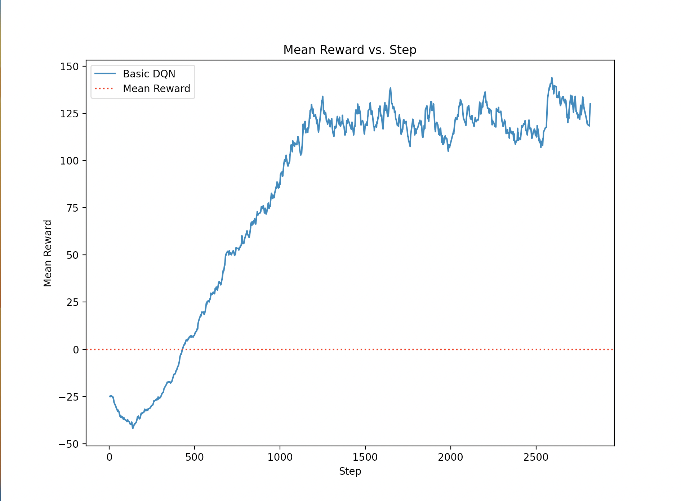
Training
Improvements:
Normalization of the observation space
N-steps Bellman Unrolling (N=3)
Dueling DQN
Noisy Linear Layers
06/27/2023
Franco Terranova | Telescopes Drive Themselves: Optimizing Cosmic Survey Scheduling with Reinforcement Learning
FERMILAB-SLIDES-23-143-CSAID

Slide 9
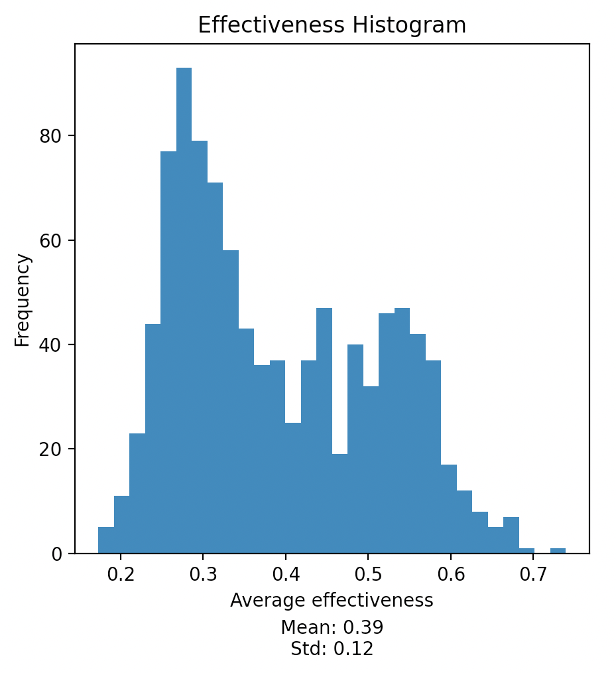
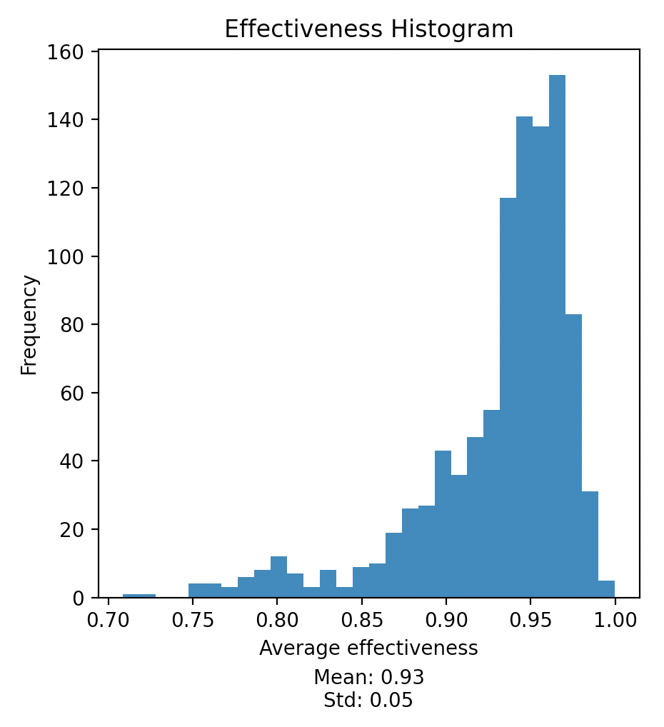
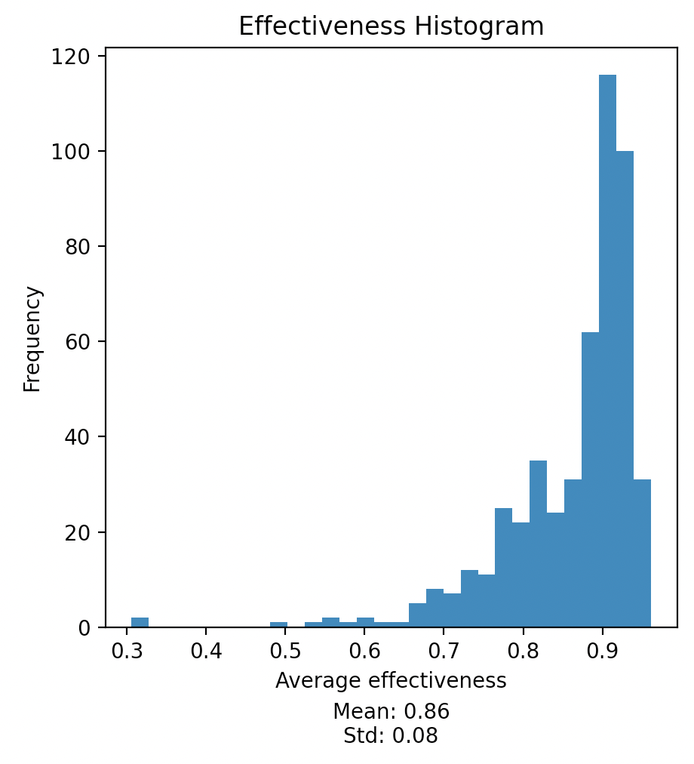
Effectiveness & Generalization - Comparison with a Random Agent
Our Agent
Random Agent
Full environment
Test set
06/27/2023
Franco Terranova | Telescopes Drive Themselves: Optimizing Cosmic Survey Scheduling with Reinforcement Learning
FERMILAB-SLIDES-23-143-CSAID

Slide 10
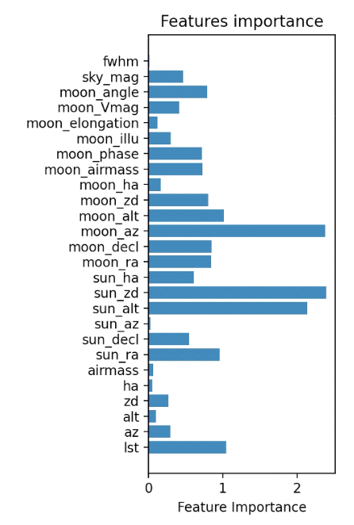
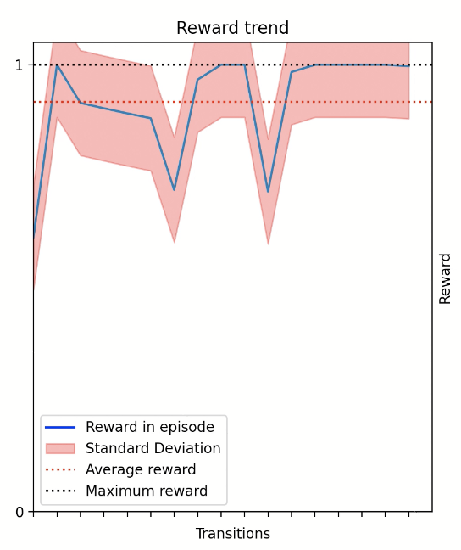
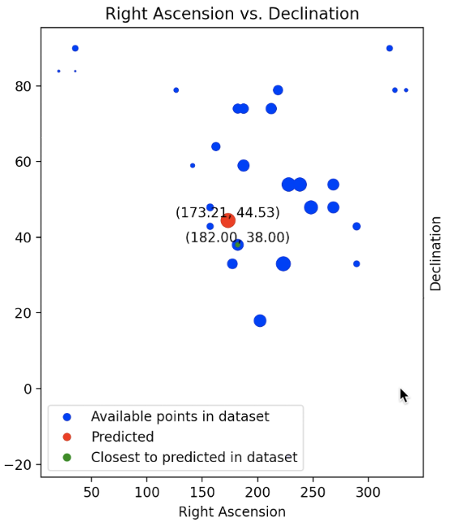
Live execution - Current best Agent
06/27/2023
Franco Terranova | Telescopes Drive Themselves: Optimizing Cosmic Survey Scheduling with Reinforcement Learning
FERMILAB-SLIDES-23-143-CSAID

Slide 11
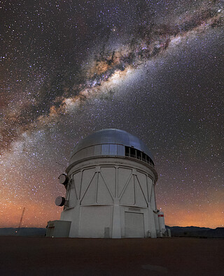
Conclusions
Trained an agent able to optimize telescope observations
Future deployment at the Stone Edge Observatory
“What if an autonomous self-driving telescope could find the solutions we’ve been missing?”
The Victor M. Blanco 4-meter Telescope at Cerro Totolo Inter-American Observatory
11
06/27/2023
Franco Terranova | Telescopes Drive Themselves: Optimizing Cosmic Survey Scheduling with Reinforcement Learning
FERMILAB-SLIDES-23-143-CSAID

