Slide 1
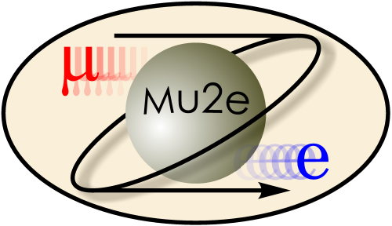
Mu2e in 10 Minutes: an Overview of the Mu2e Experiment
Rose Powers on behalf of the Mu2e Collaboration
New Perspectives
27 June 2023
FERMILAB-SLIDES-23-137-PPD

Slide 2
Contents
Introduction to Mu2e
Beyond the Standard Model: Physics of Mu2e
Signal and Backgrounds
Layout and Detectors
Outlook

Slide 3
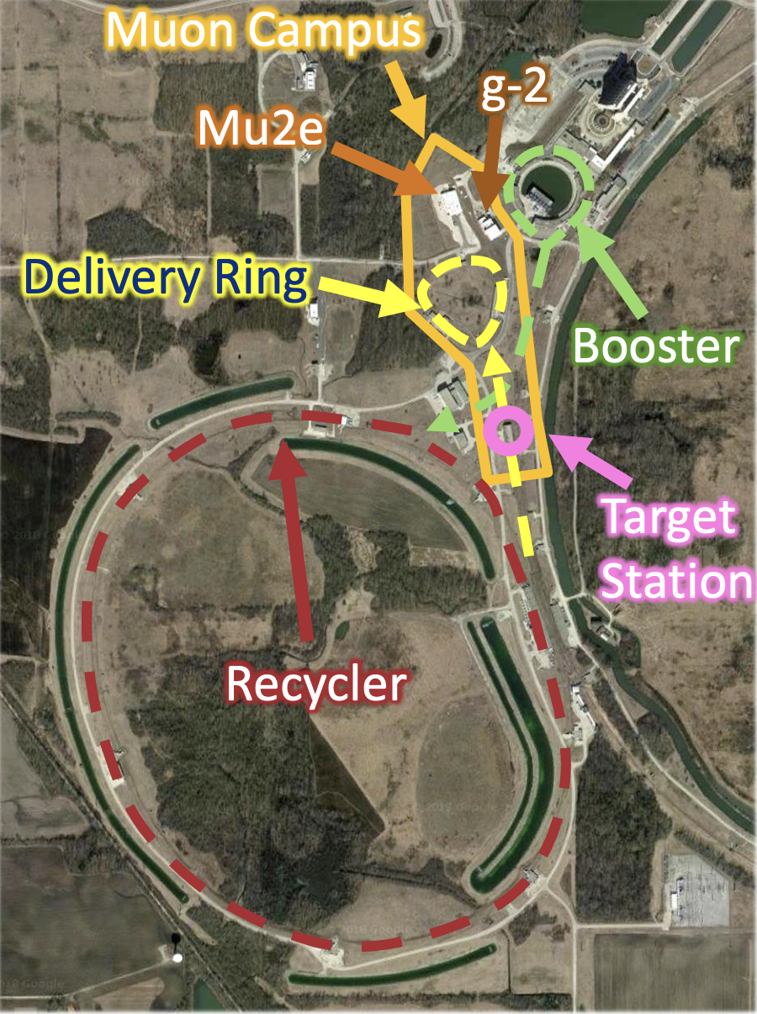
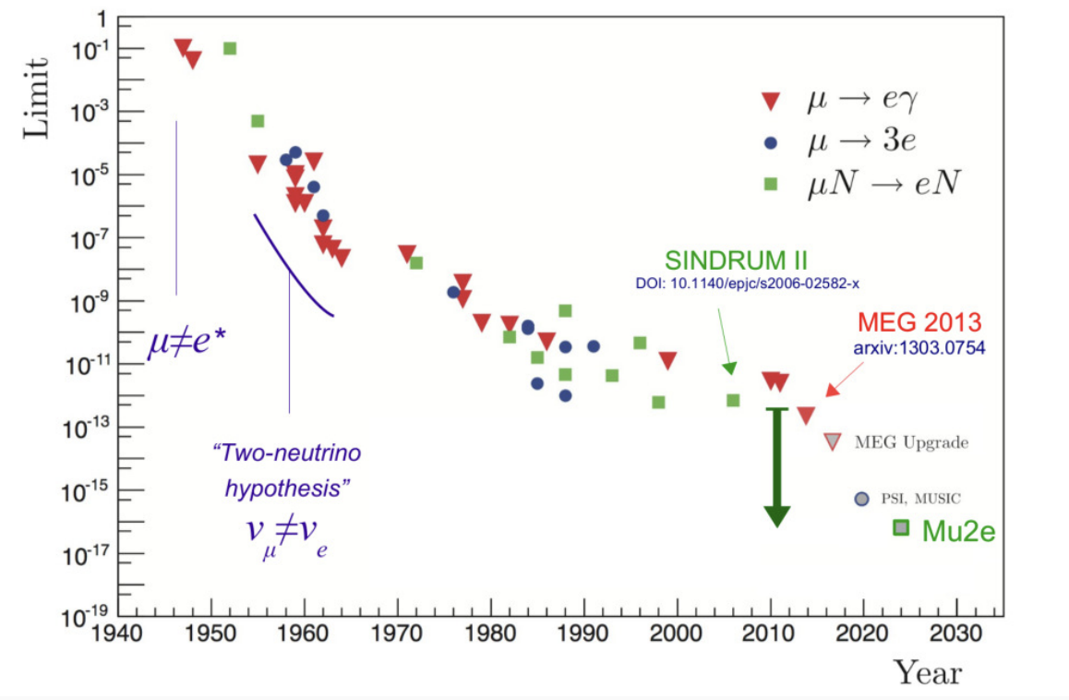
Introduction to Mu2e
Search for neutrinoless muon-to-electron conversion in the field of an Al nucleus
Monochromatic signal ~105 MeV (rest mass of muon)
Testing the Standard Model
Probing several unobserved physics processes
Run-I set to begin taking data in 2025
Sensitivity limit set by various $μ→e$ searches by year (left); the Fermilab muon campus, where Mu2e will run (right)
From Bonventre (2023). Status of the Mu2e Experiment at Fermilab, SLAC FPD Seminar

Slide 4
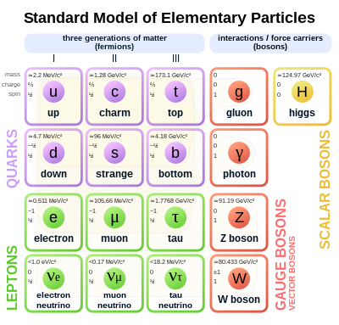
Beyond the Standard Model: Physics of Mu2e
Standard Model: fundamental particles and their interactions
Lepton number, lepton flavor are conserved quantities
Neutrino flavor oscillation observed
Charged lepton flavor violation?

Slide 5
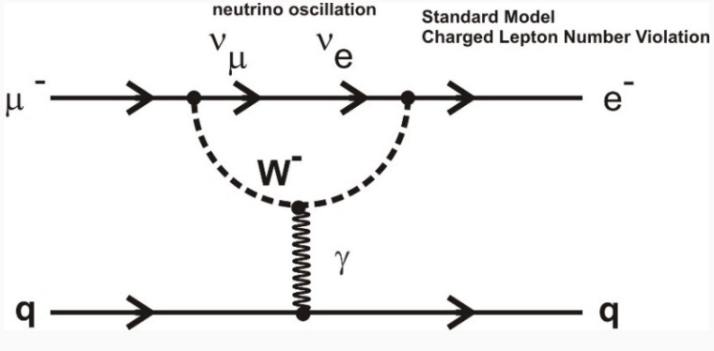
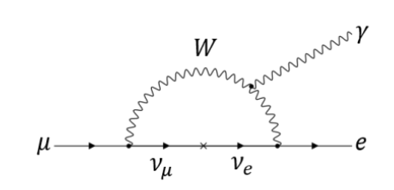
Beyond the Standard Model: Physics of Mu2e
With neutrino mass extension, SM predicts CLFV ~10⁻⁵²
From Bonventre (2023). Status of the Mu2e Experiment at Fermilab, SLAC FPD Seminar
From Devilbiss 2023, unpublished.
Mu2e sensitivity: 10⁻¹⁷
If we detect conversion, NOT due to SM processes
What else could cause neutrinoless muon-to-electron conversion?

Slide 6
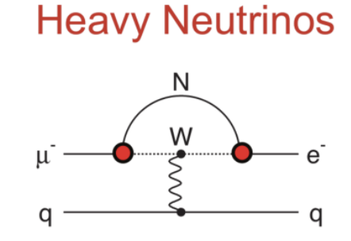
Beyond the Standard Model: Physics of Mu2e
Feynman diagrams illustrating three possible BSM $μN→eN$ conversion scenarios
Bottom Line: One rare signal → A whole new era of particle physics
Feynman diagrams from Bonventre (2023)

Slide 7
Signal and Background
Momentum spectrum of signal and background (Edmonds 2023)
(Edmonds 2023)
Signal:
105 MeV negative conversion electron
Background:
Cosmic rays
Decays in orbit
Antiproton annihilation
Radiative pion capture (RPC)
Radiative muon capture (RMC)
Decays in flight

Slide 8
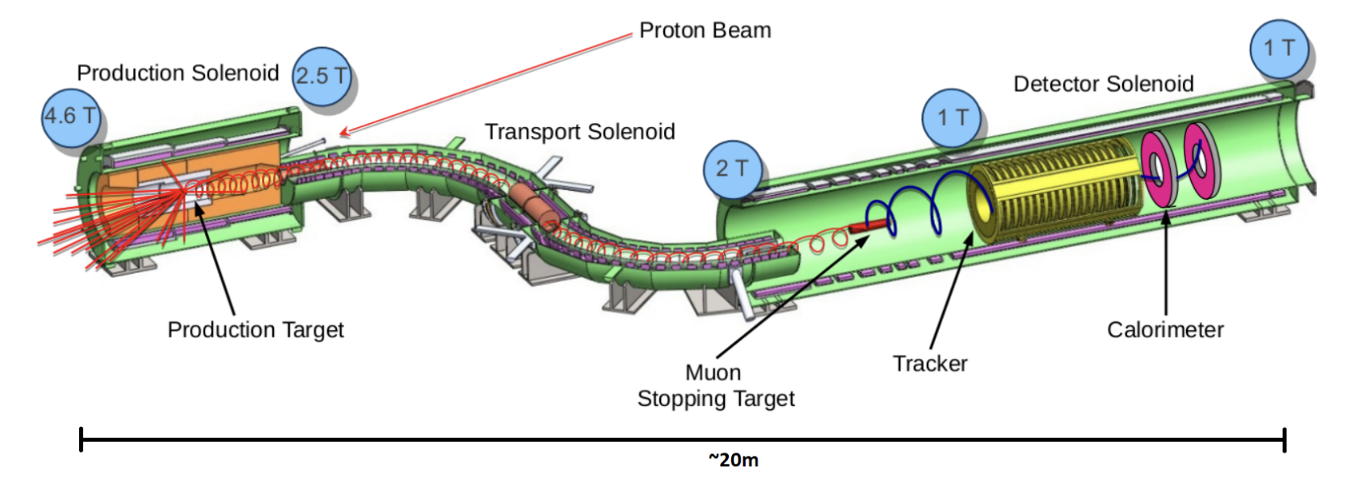
Layout and Detectors
Edmonds (2023)

Slide 9
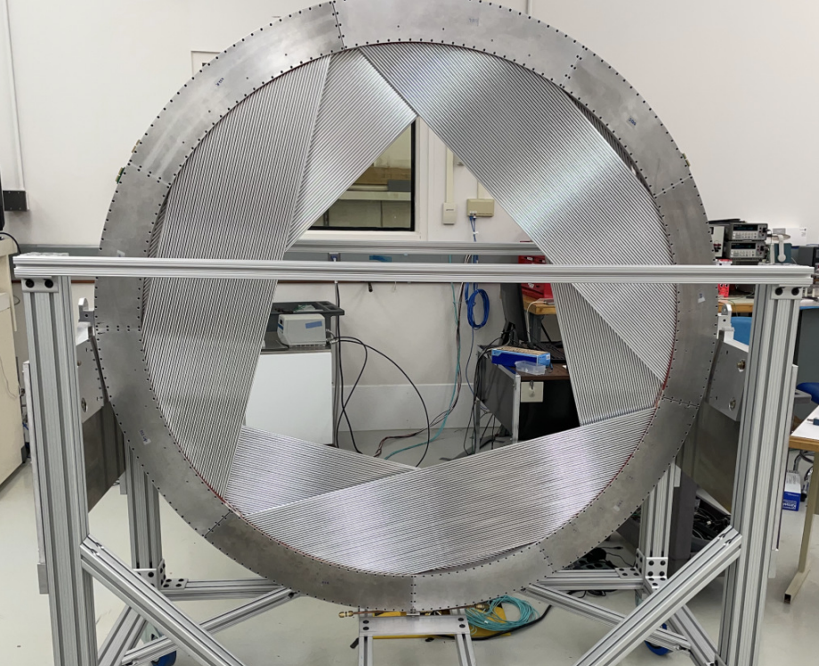
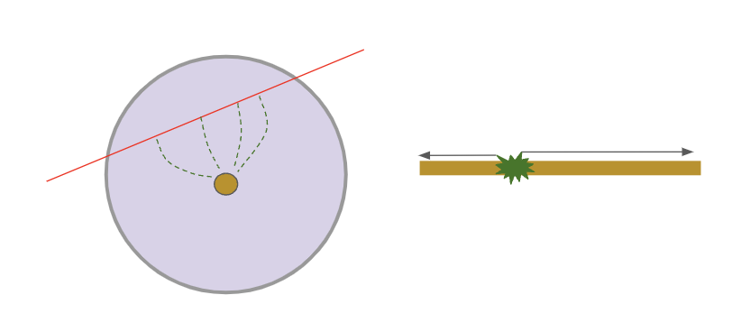
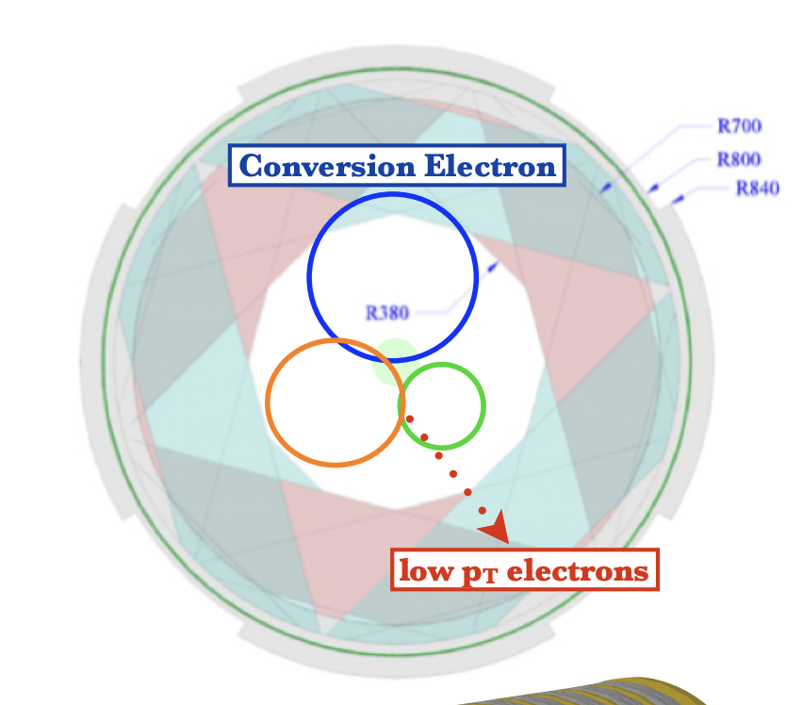
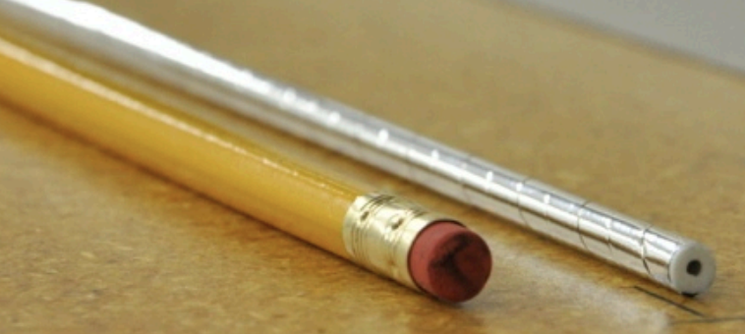
Layout and Detectors
The Tracker
>20k straw tubes filled with Ar/CO₂ mixture
Voltage ~1.5kV
Au sense wire
36 planes, 6 panels per plane
Central gap to optimize signal acceptance, suppress bkg
A single tracker plane composed of six panels
For electrons ~E_{CE}, intrinsic momentum resolution expected to be:
Assembled tracker planes (bottom left); single straw tube with a pencil for scale (top left); acceptance of tracker (right).
Pictures from Bonventre (2023), Pezzullo (2018)
The Mu2e Collaboration, Universe 9(1):54 (2023)

Slide 10
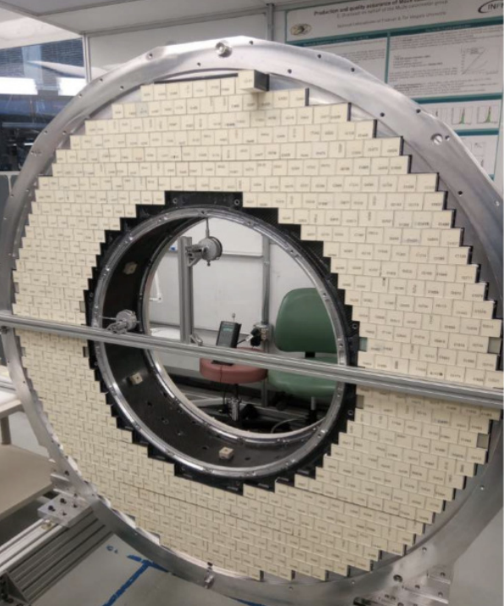
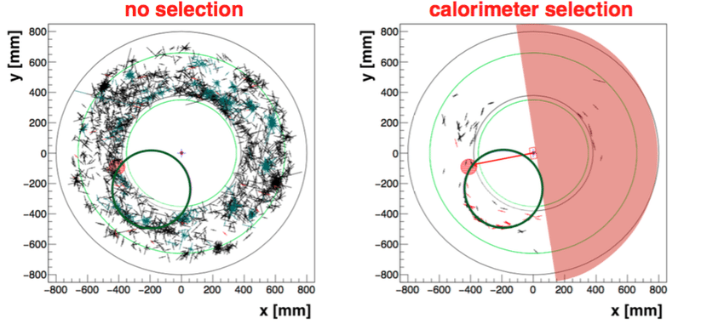
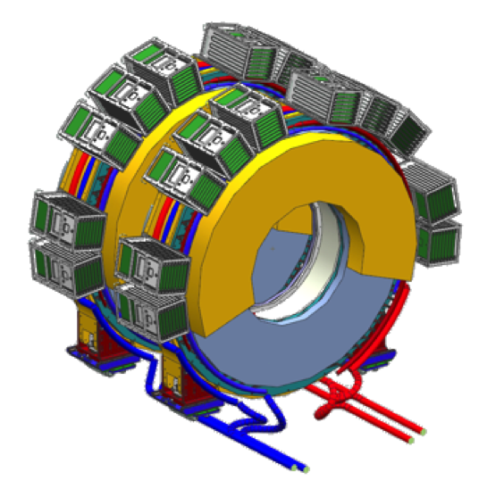
Layout and Detectors
The Calorimeter
~1300 CsI crystals, each with 2 SiPM readouts
20 x 3.4 x 3.4 cm³ in volume
Fast energy measurement, track pre-selection
Energy + momentum → particle identification
Event displays showing background mitigation achieved by calorimeter track selection.
The Mu2e Collaboration, Universe 9(1):54 (2023); Pezzullo 2018
Difference in E/p for conversion and muon backgrounds at signal energy.

Slide 11
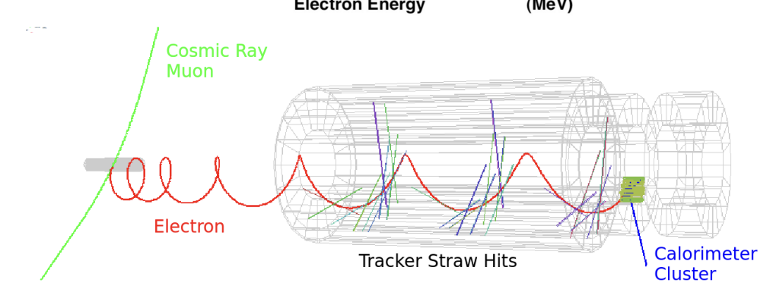
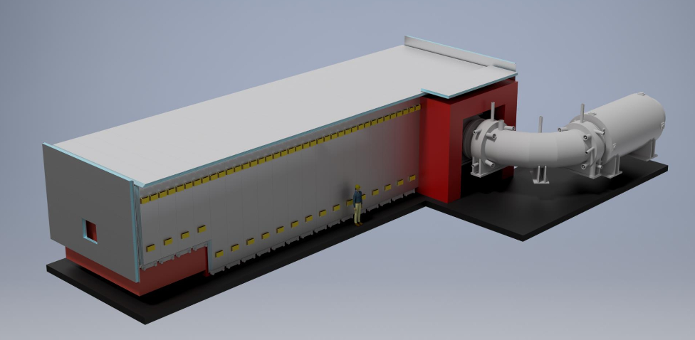
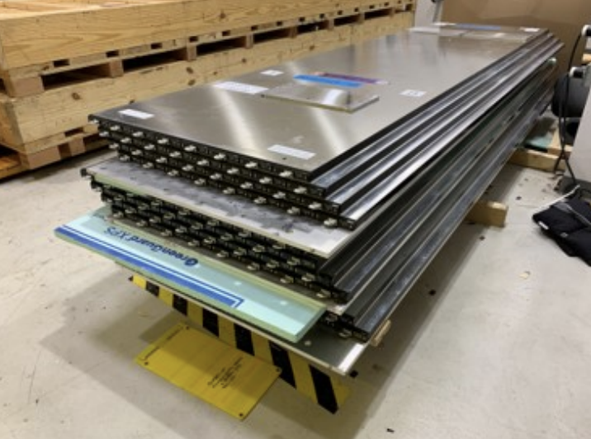
Layout and Detectors
The Cosmic Ray Veto (CRV)
Encompasses detector solenoid, part of TS
Extruded scintillator and SiPM readouts
IDs cosmic track candidates for offline veto
Cosmic backgrounds must be lifetime <1
Event display of cosmic background (Edmonds 2023)
Outside view of the CRV with human figure to scale (left); CRV modules (below)

Slide 12
Outlook
Mu2e recently re-baselined
As of May 2023:
Transport solenoids almost complete
Other solenoids arriving early fall
More than half of tracker planes assembled, frame complete
Both calorimeter disks will be assembled by end of summer
More than 80% of CRV completed
On schedule to begin taking data in 2025
Run-I to be completed before PIP-II shutdown

Slide 13
The Mu2e Collaboration

Slide 14
Backup Slides
Mu2e fast facts
Beam timing
BSM

Slide 15
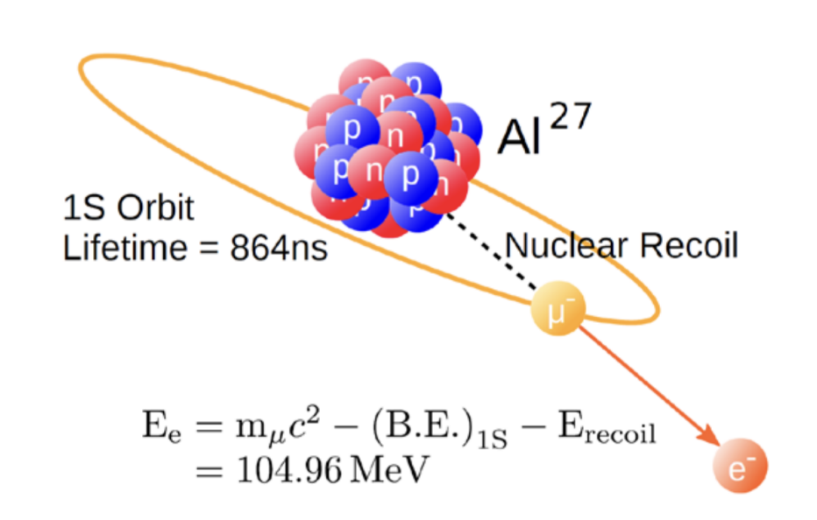
Mu2e Fast Facts
Run-I: 2025-2027, 2 years at reduced intensity
Sensitivity → 10⁻¹⁶
Run-II: 2029-2032, 3 years at full intensity
Sensitivity → 10⁻¹⁷
Will stop O(10¹⁸) muons
Will discover CLFV at 5$σ$ if $R_{μ→e}\sim {10}^{−16}$

Slide 16
Beam Timing
From S. Di Falco (2022)

Slide 17
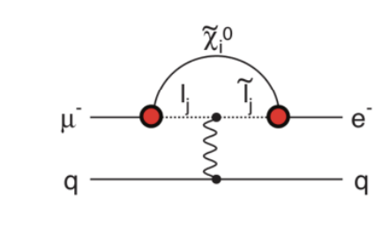
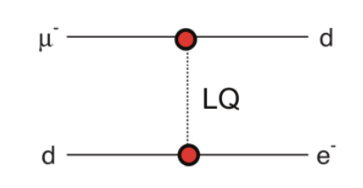
BSM Processes
Supersymmetry
Each SM particle theorized to have a superpartner
Sleptons, Squarks, Neutralinos…
A neutralino (neutral superboson) and sleptons mediate CLFV in the field of a nucleus
Heavy neutrinos
Unobserved $υ$ with quark-like Yukawa couplings
Allows mediation of $μ^{−}N→e^{−}N$
Leptoquarks
Color-triplet bosons carrying both lepton and baryon number
Have different interaction strengths with different lepton flavors
Devilbiss (2023) Unpublished

