Slide 1
Baseline Monitoring for SBND PDS Trigger
Gajendra Gurung on Behalf of SBND Collaboration
New Perspectives 2023
June 26, 2023
FERMILAB-SLIDES-23-144-V

Slide 2
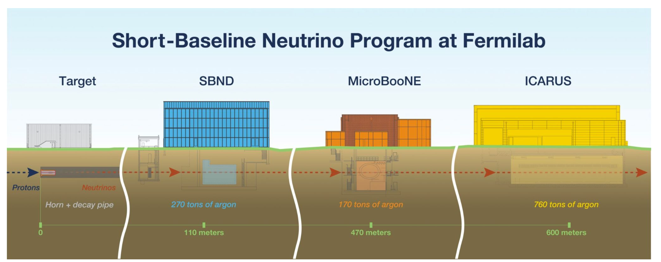
112 tons of argon
89 tons of argon
476 tons of argon
7000 𝜈 events/per day in SBND!
SBND will record 30-40x more neutrino-argon interactions than is currently available.

Slide 3
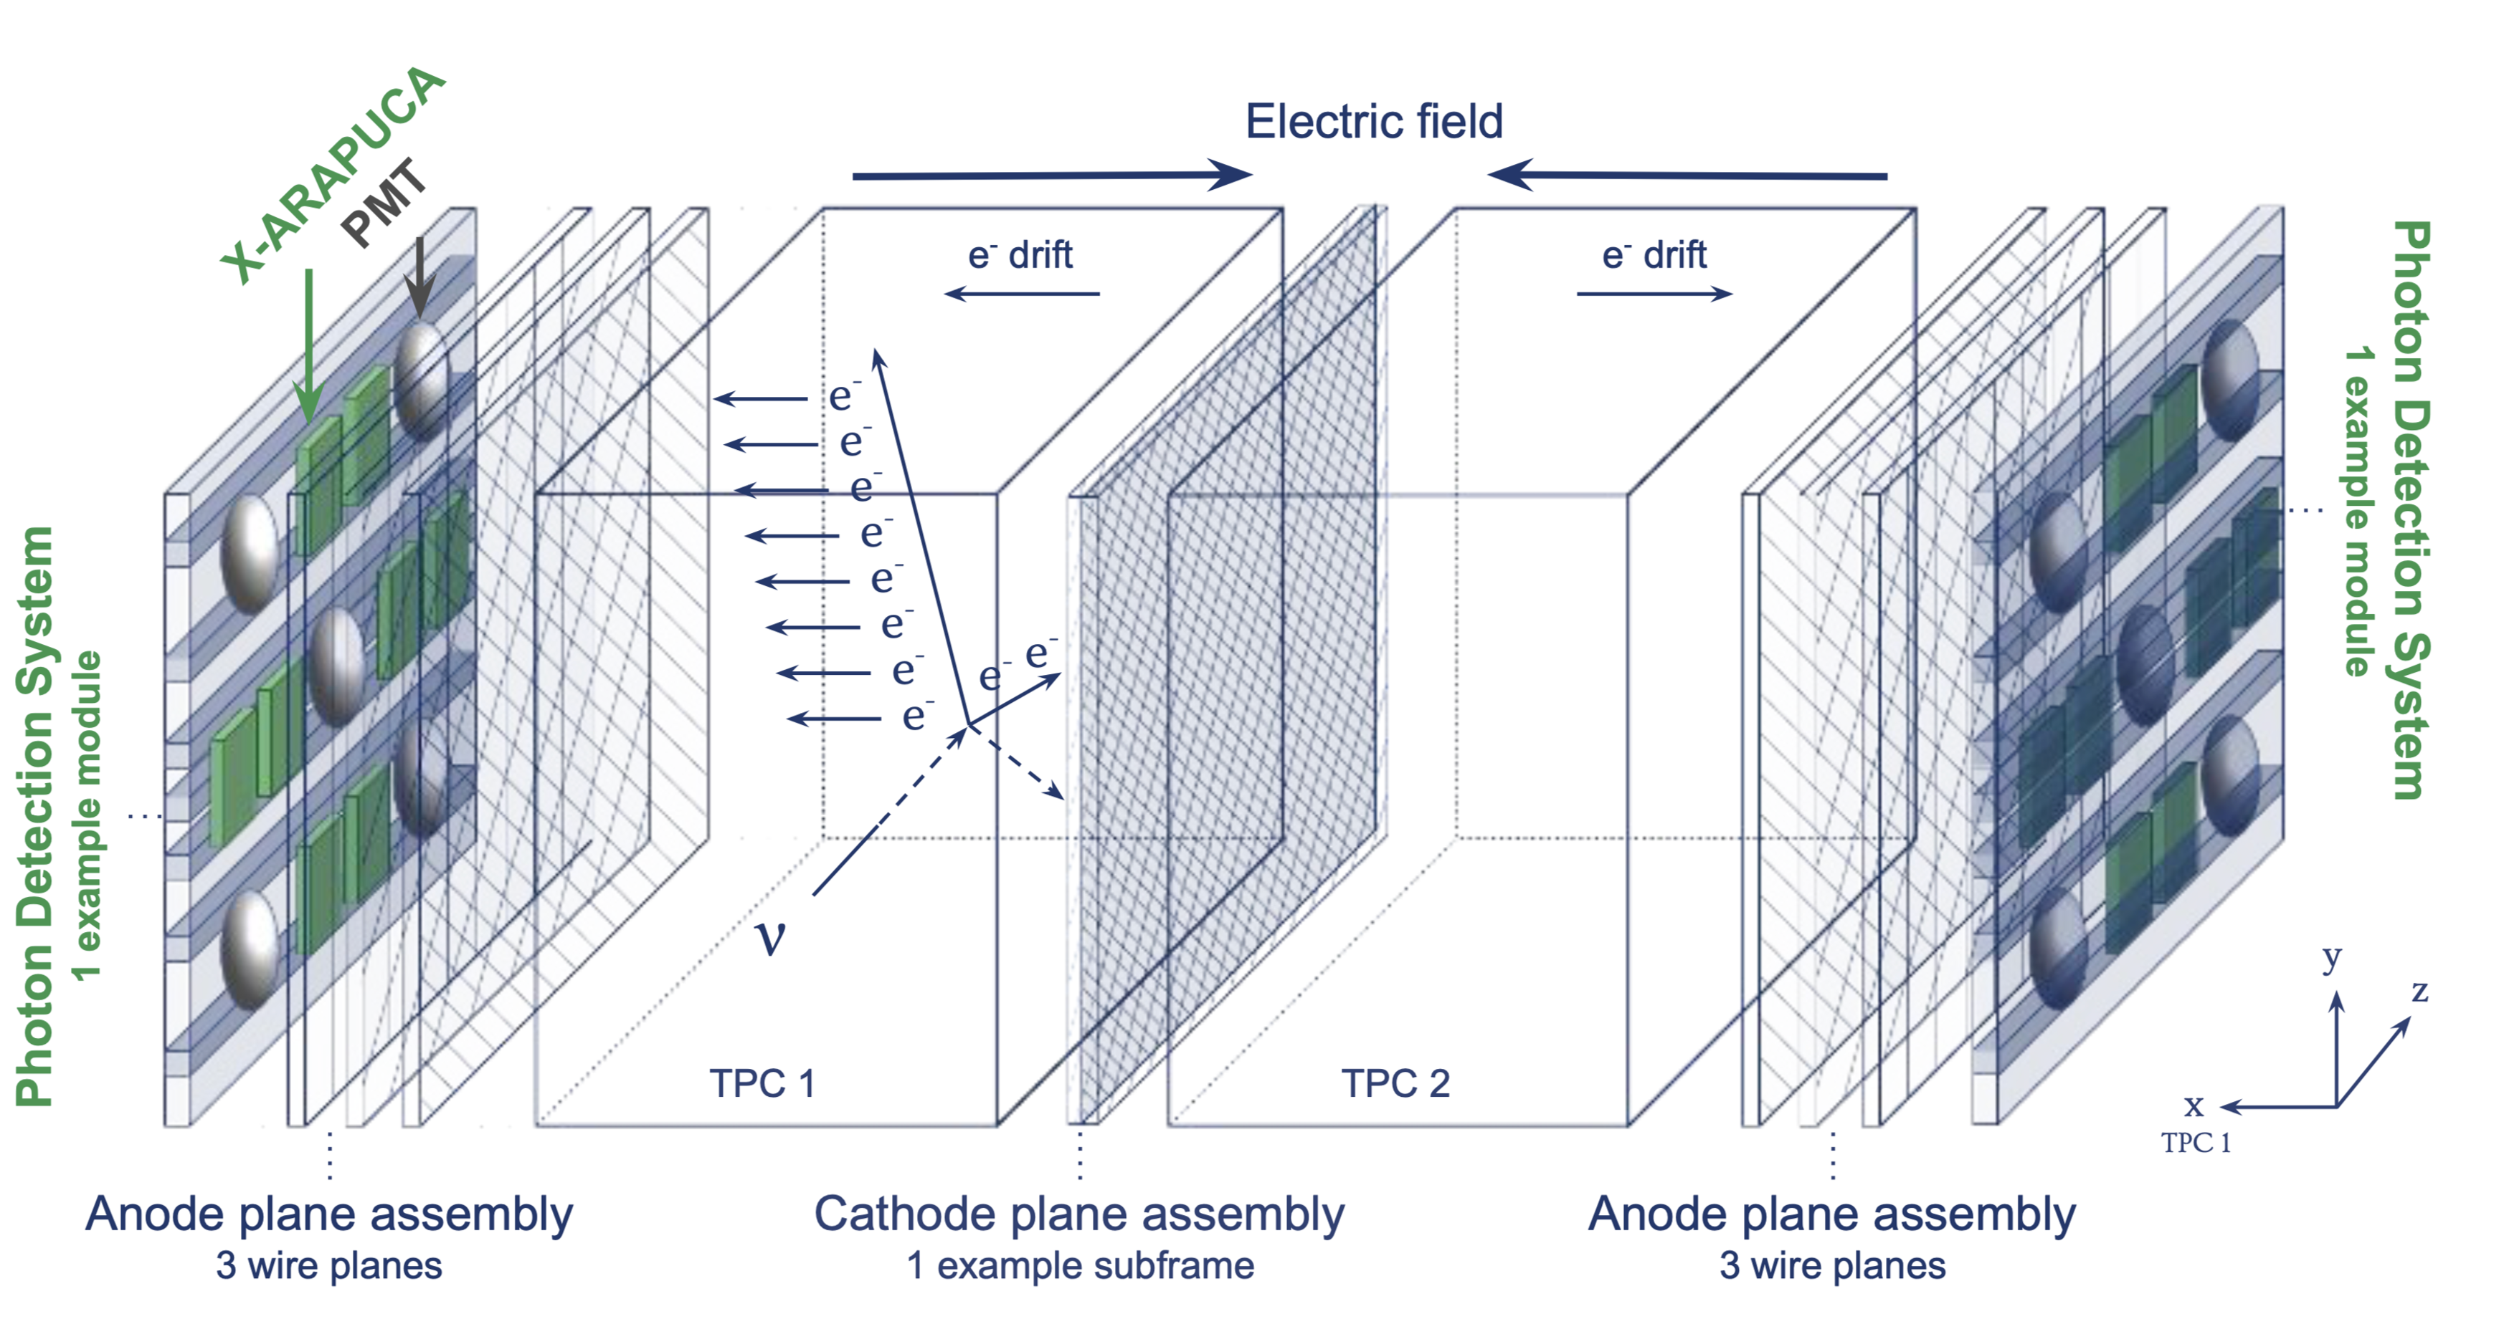
Time Projection Chamber working principle

Slide 4
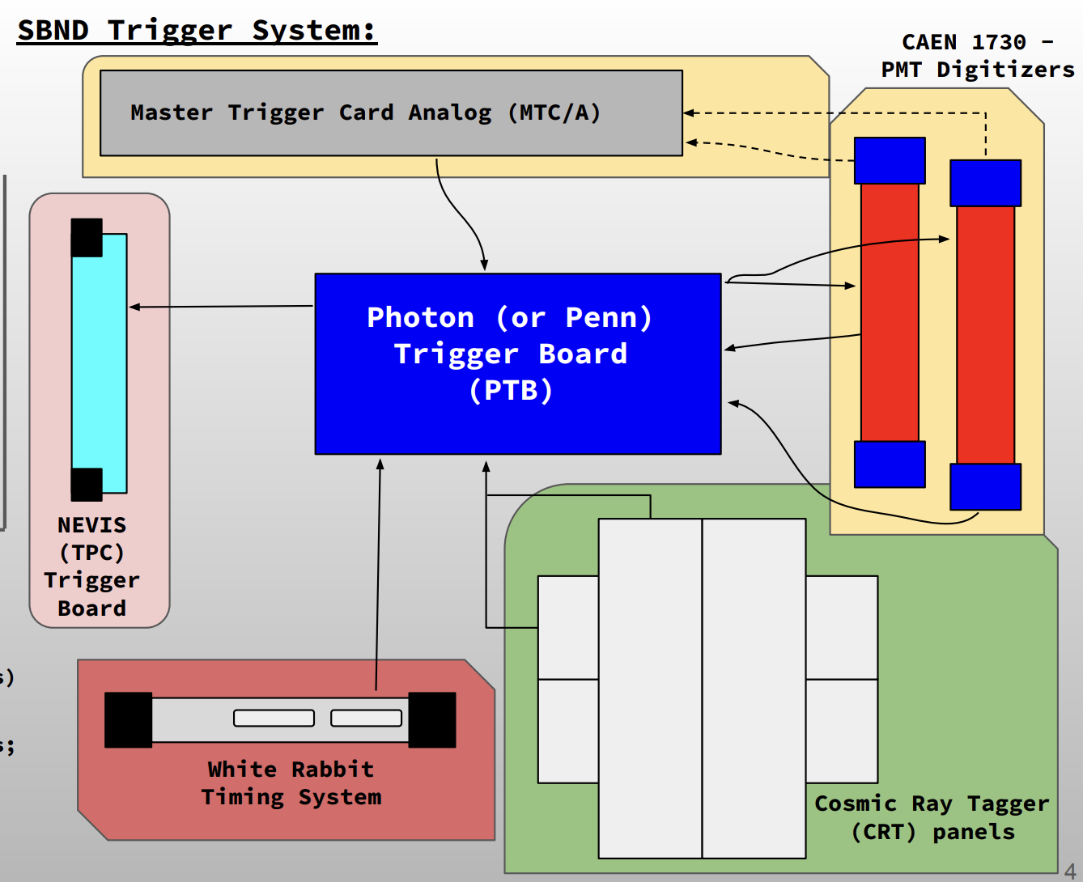
SBND Trigger Hardware
NEVIS: Dedicated to the TPC (charged particles) triggers
Photon Detection System (PDS) triggers
Cosmic Ray Triggers
Beam Early Warning (EW) Signals
PTB receives and perform logic operations with the subsystem inputs

Slide 5
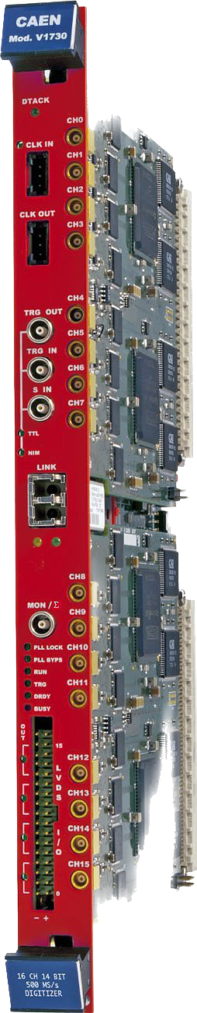
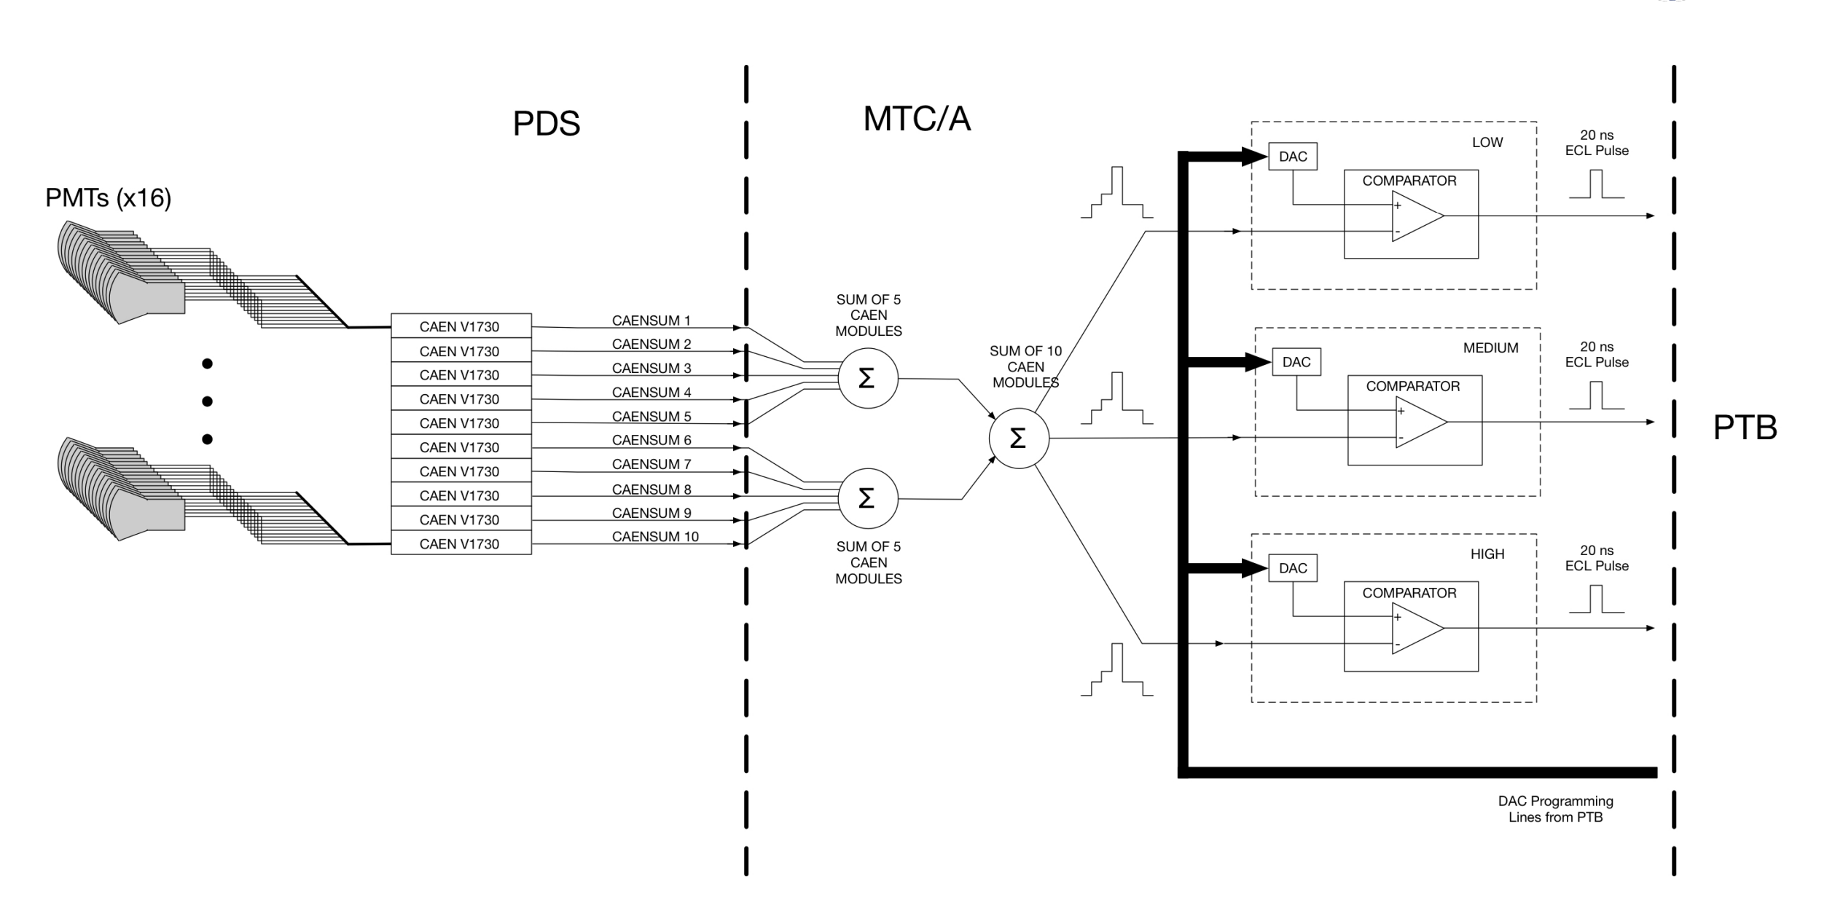
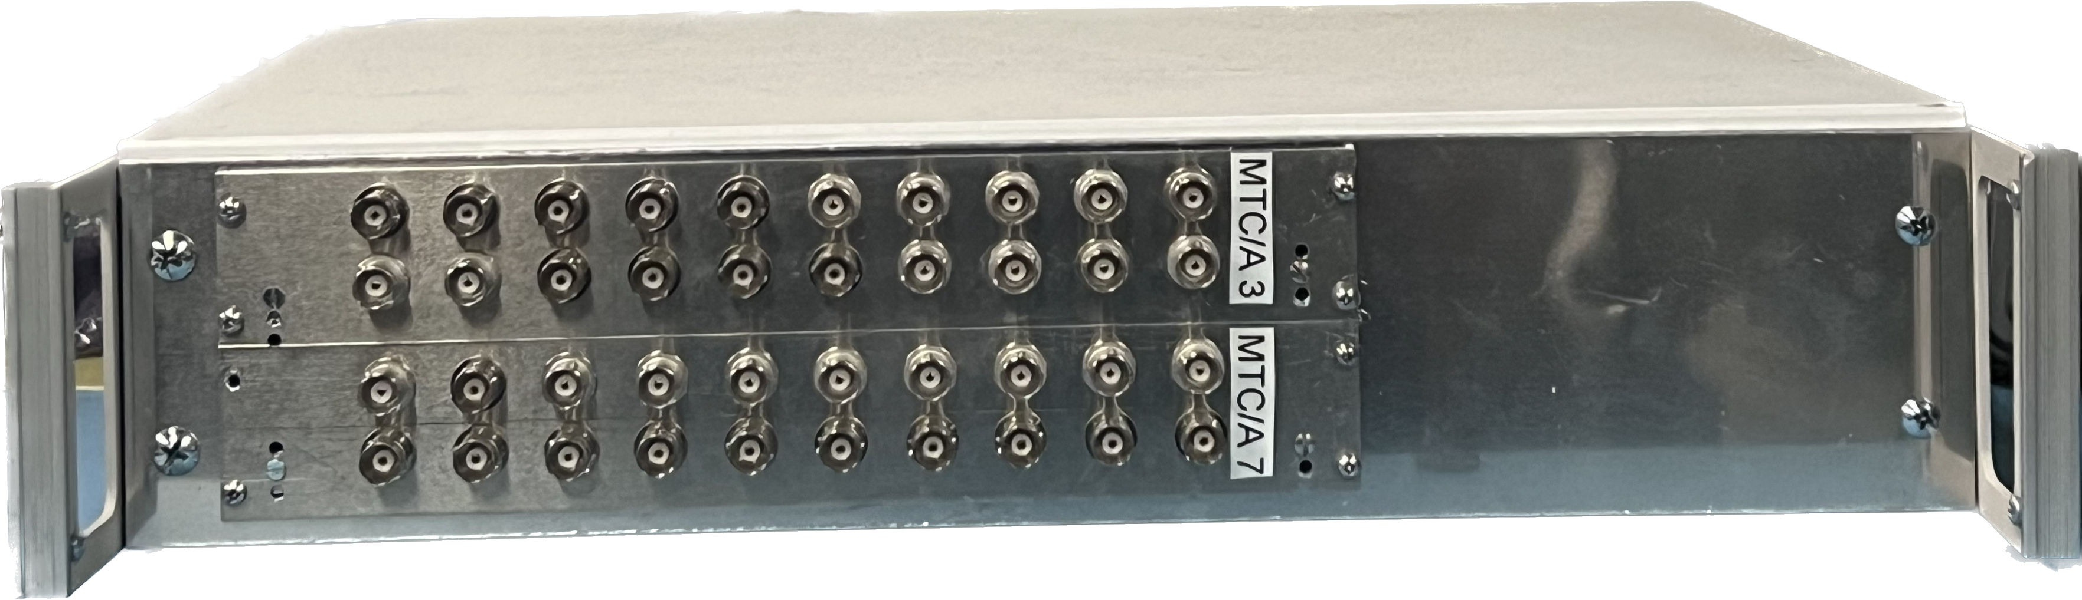
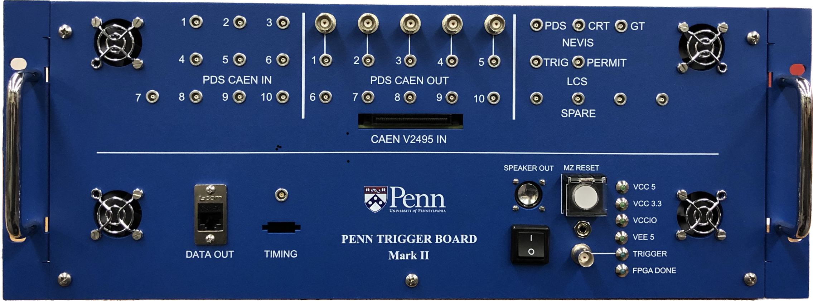
Photon Detection System Trigger Hardware
Master Trigger Card/Analog
CAEN V1730S
MTC/A receives signals from the PMT Digitizers
MTC/A sums all the signals and compare them to three individually programmed thresholds: LOW, MEDIUM and HIGH. The output of these discriminators will be the input to the PTB.
Penn/Photon Trigger Board

Slide 6
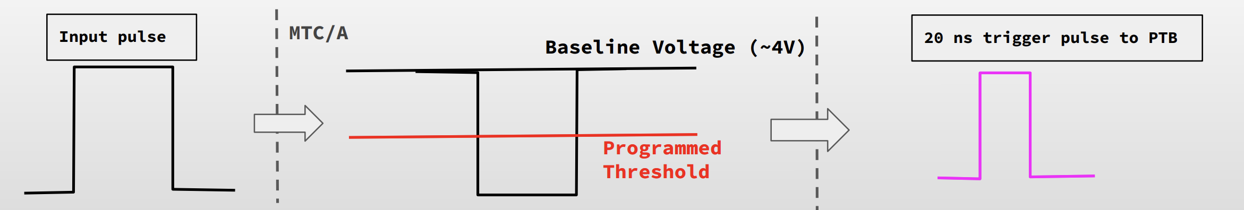
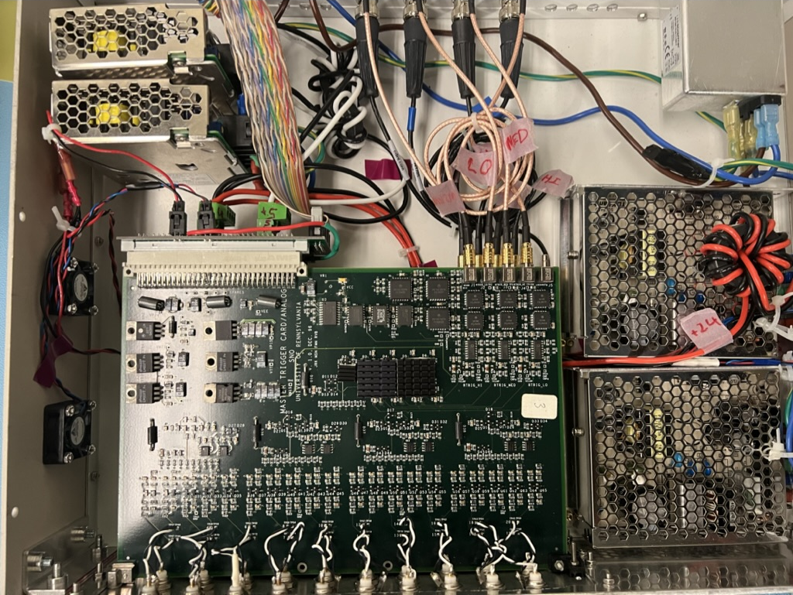
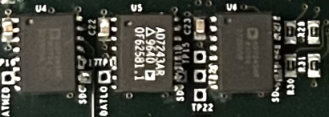
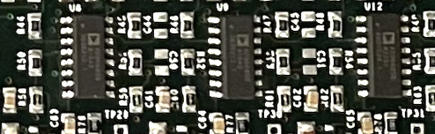
Master Trigger Card/Analog
12-Bit Serial DAC
AD7243
These set the thresholds
Ultrafast Comparators
AD96685
These compare the summed inputs from PMTs to the set thresholds
This is where the magic happens

Slide 7
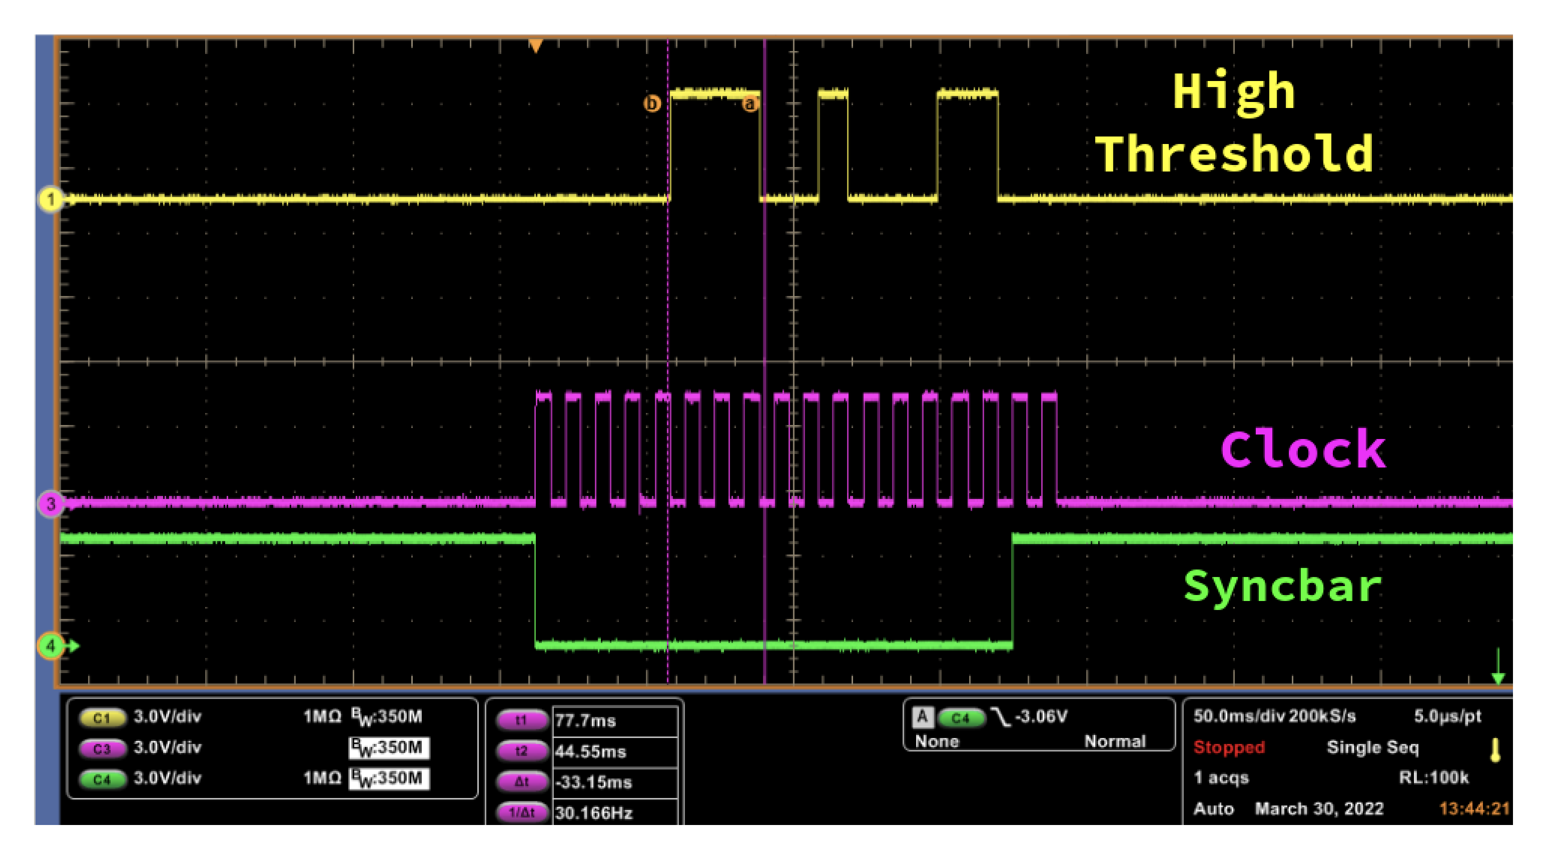
Configuring the MTC/A Threshold
The MTC/A has three 12-bit serial DACs which provide individual threshold voltages to each of the comparators.
Thresholds can be programmed between -5 V and 5 V in increments of 2.44 mV.
Setting the threshold is Hardware level programming

Slide 8

How can we make the trigger more sensitive?
threshold
  The baseline fluctuates because of thermal noise.
  Noise ∝ (Temperature)^{1/2}
baseline
What is the ideal threshold value?
  Accurately monitor the baseline.
To find the baseline, we sweep through different threshold voltages.

Slide 9
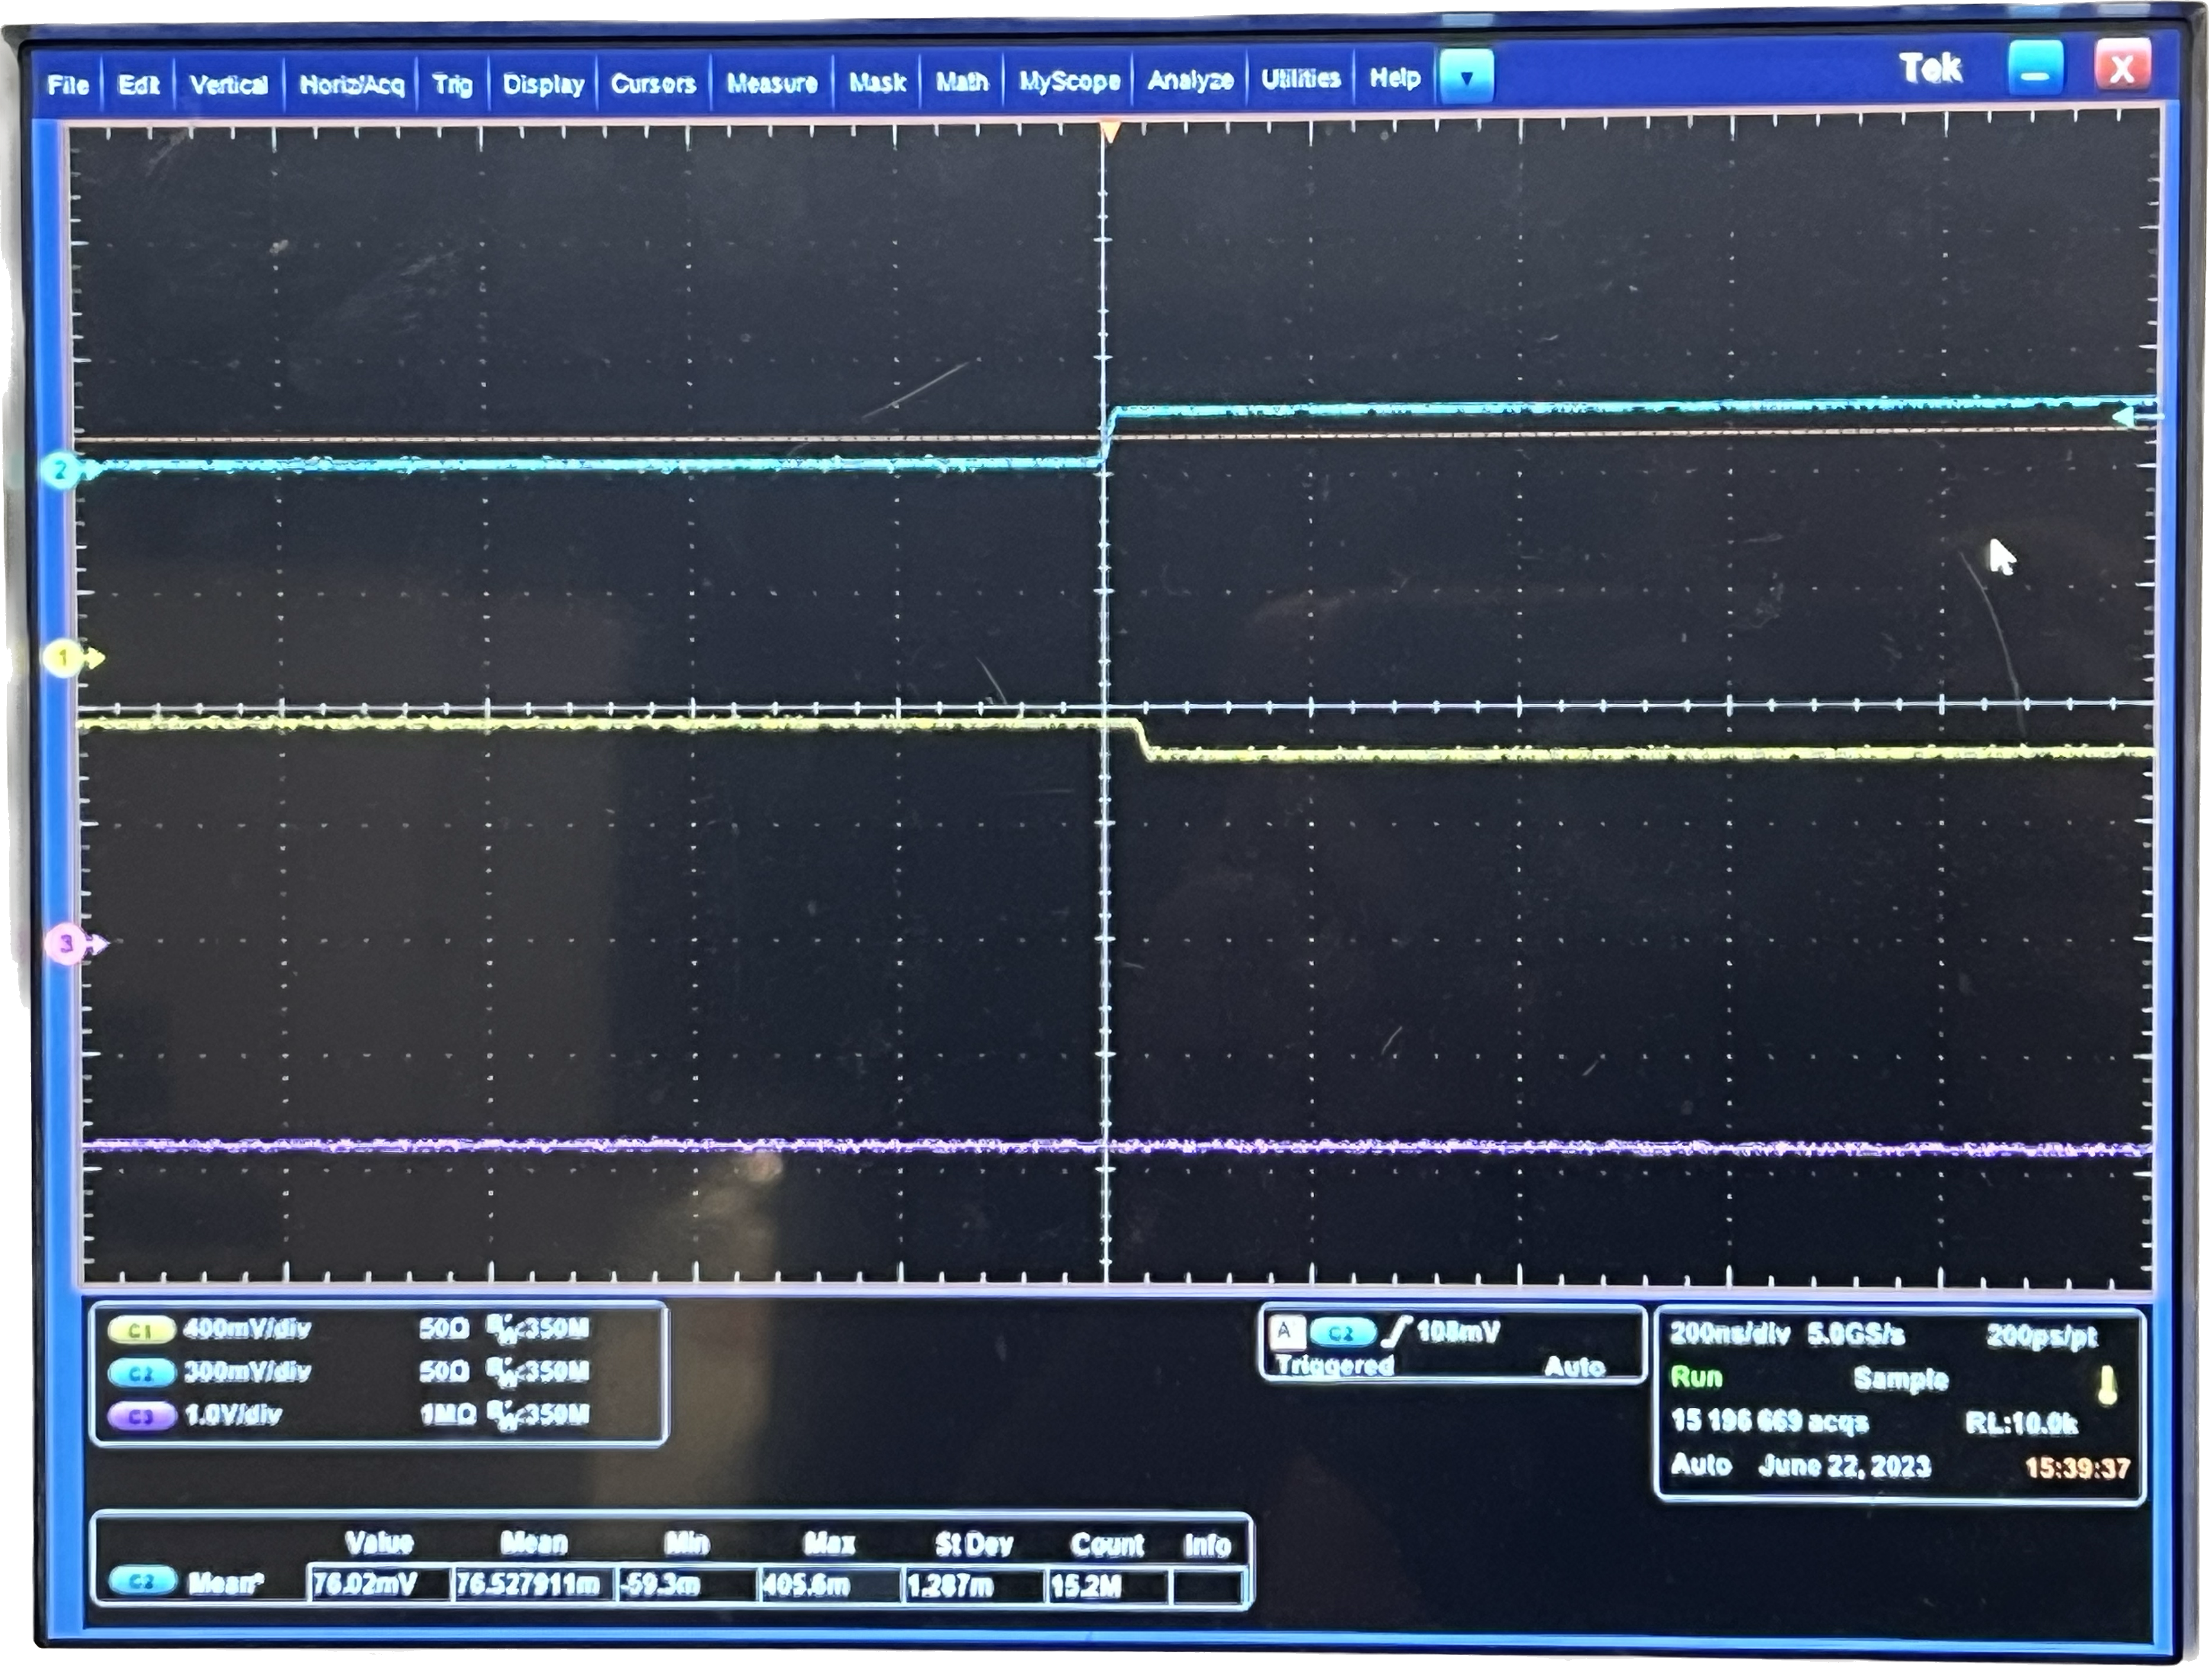
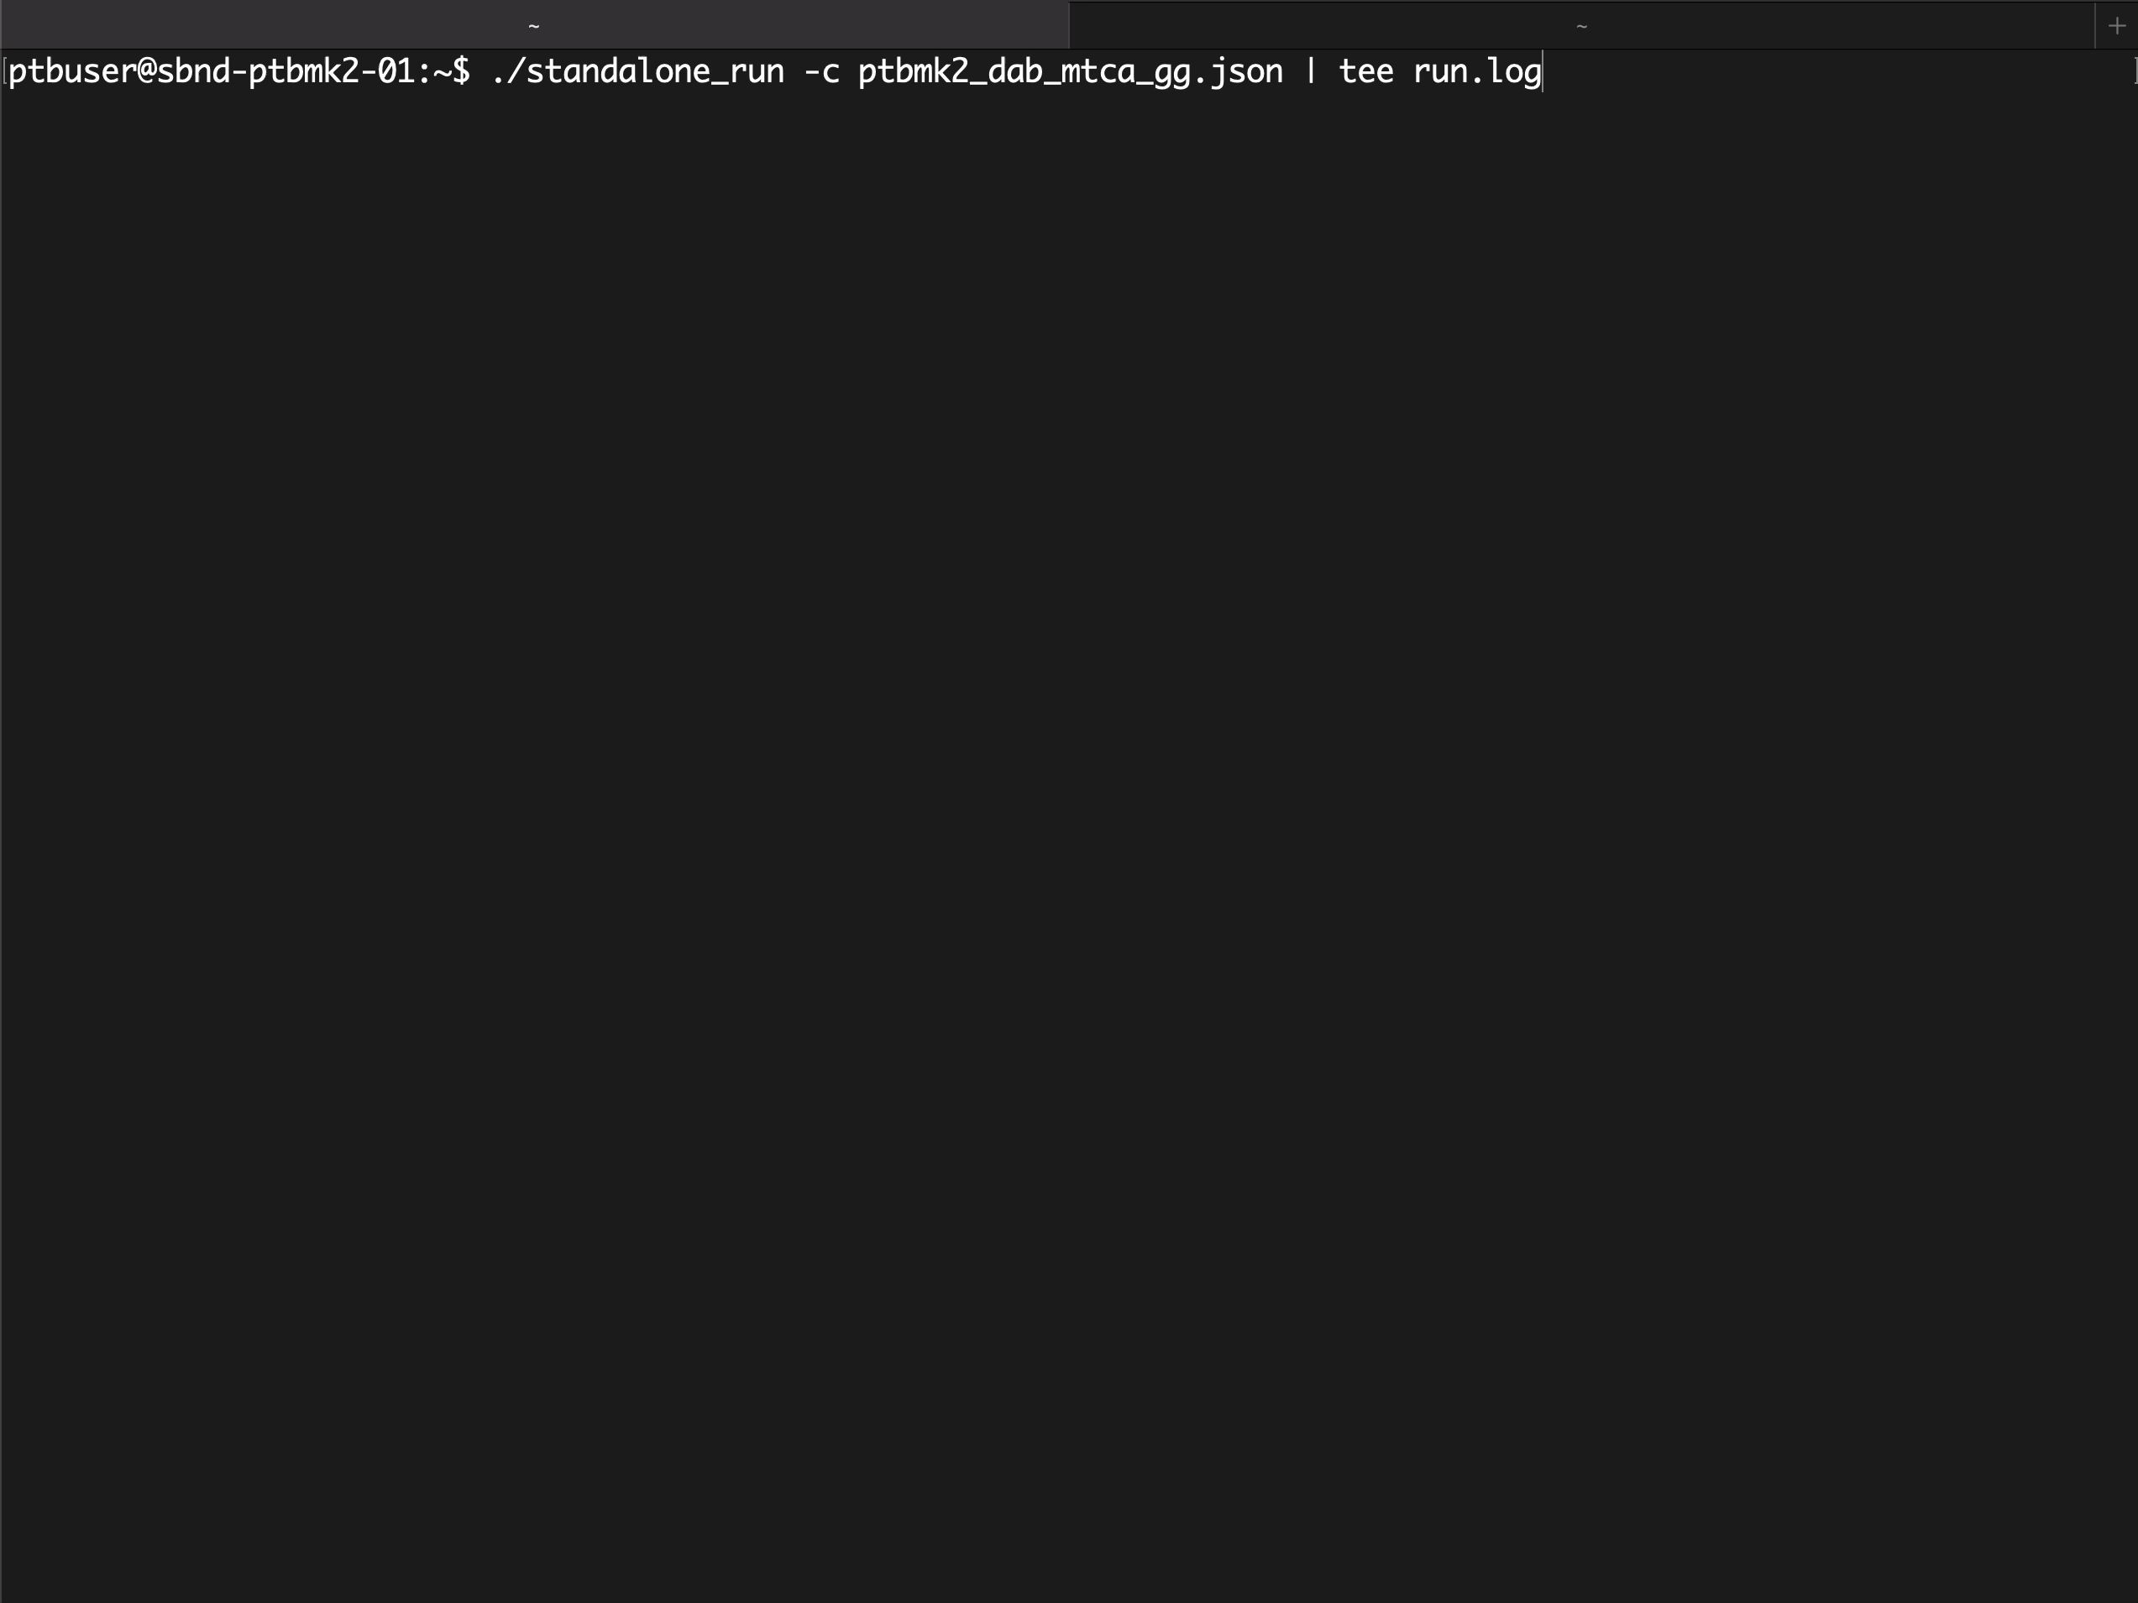
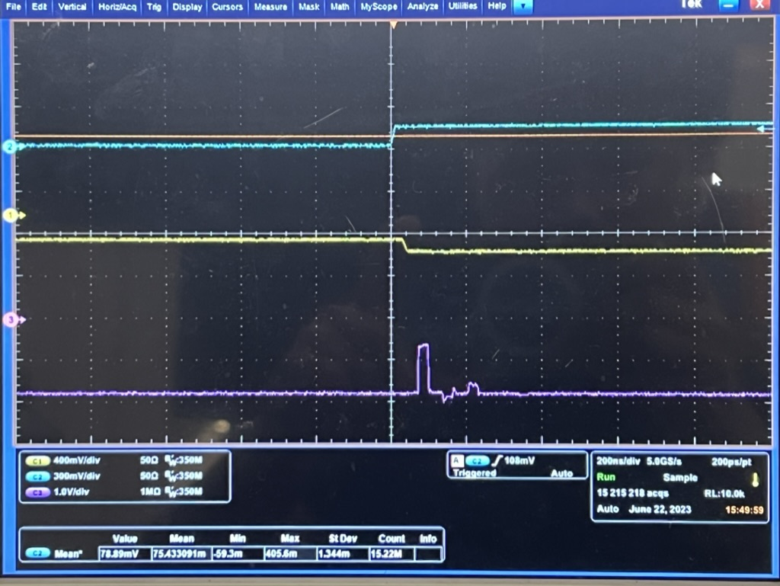
DEMO: Finding the baseline
Pulse generator input
MTC/A Sum
MTC/A Response
Pulse generator input
MTC/A Sum
MTC/A Response
20 ns trigger

Slide 10
Summary
SBND will record a leading number of neutrino interactions, which requires fast and efficient trigger capabilities
Monitoring the baseline of MTC/A will help us improve the PDS trigger system by enabling us to choose significant threshold values

Slide 11
Thank you!

