Slide 1
Constraining Cosmological Parameters from Galaxy Cluster Observables using SBI
FERMILAB-SLIDES-23-108-CSAID
Presenter:
Moonzarin Reza
Department of Physics and Astronomy, Texas A&M University, USA
moonzarin@tamu.edu
Coauthors:
Y. Zhang¹, S. Shevchuk², B. Nord^{2,3}, A. Ciprijanovic², L. Strigari⁴
NSF’s NOIRLab, USA
Fermi National Accelerator University, USA
Kavli Institute for Cosmological Physics, University of Chicago, USA
Department of Physics and Astronomy, Texas A&M University, USA
New Perspectives: June 2023
DEEP SKIES

Slide 2
Talk Outline
Overview of Cosmology
Overview of SBI
Data Generation
Results
Conclusions

Slide 3
Mass-Energy Distribution of the Universe
DM & DE distribution affect cosmological parameters
Source: National Radio Astronomy Observatory

Slide 4
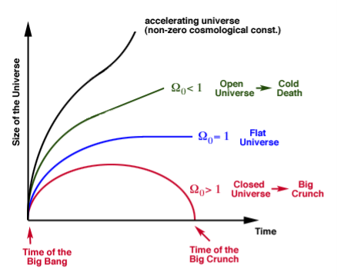
Significance of Ω_{m}
Ω₀ = Ω_{m} /Ω_{c}
Credit: https://astro.umass.edu

Slide 5
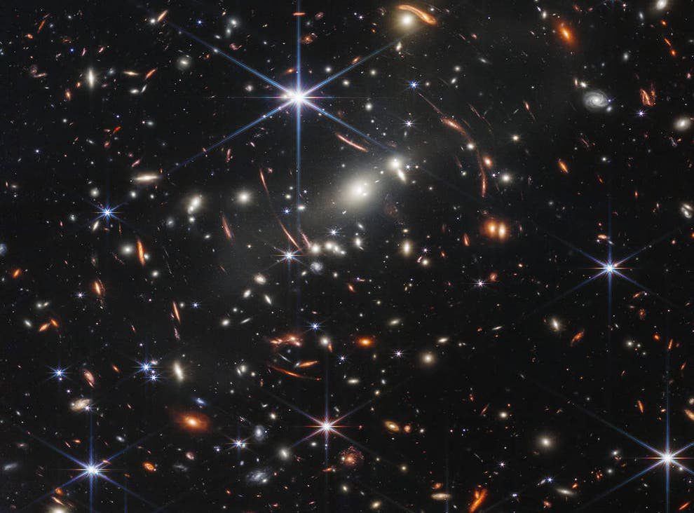
Galaxy Clusters
Largest known gravitationally-bound structures in the Universe
Mass range 10¹⁴ - 10¹⁵ M☉
Contains hundreds to thousands of galaxies
Cluster abundance can constrain cosmology
Credit: James Webb Space Telescope

Slide 6
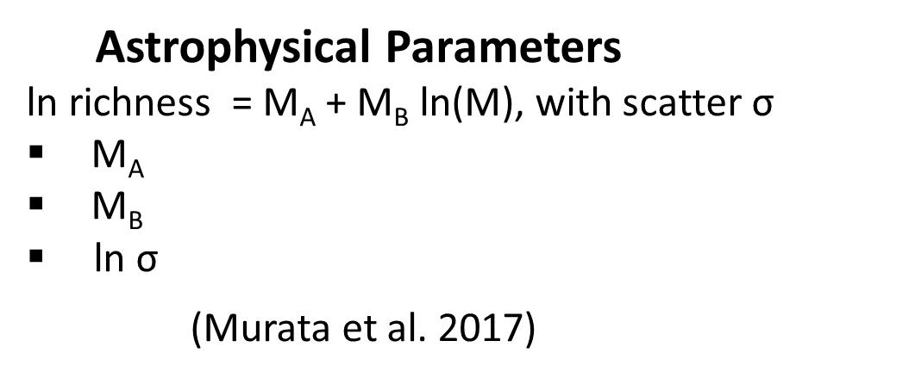
Inputs and Outputs
Inputs (Observables)
Average mass of galaxy clusters
Total number of galaxy clusters
Outputs (Parameters)
5 Fundamental Cosmological
3 Astrophysical (Cluster)
Cosmological Parameters
Baryonic density (Ω_{b})
Matter density (Ω_{m})
Hubble’s constant (H₀)
Power law index (n_{s})
Amplitude fluctuation (σ₈)
Astrophysical Parameters
ln richness = M_{A} + M_{B} ln(M), with scatter σ
M_{A}
M_{B}
ln σ
(Murata et al. 2017)

Slide 7
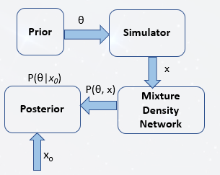
Simulation-based Inference
Working principle of SBI method

Slide 8
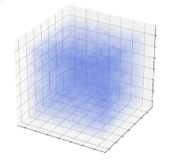
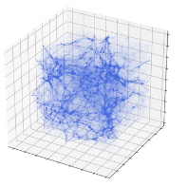
Quijote Simulations
N-body simulations: large-scale structure formation
Initial conditions of the Universe
Large scale structures
Credit: TensorFlow Blog
Characteristics:
44,100 full N-body simulations
Snapshots at multiple redshifts
Use:
Latin hypercube simulations
Variable cosmology to train ML

Slide 9
Analytical Simulations
Analytical simulations are generated by Colossus:
N = v $\int{n \left(m, z\right)| }$ Ω_{m} , σ₈)
M = v $\int{n \left(m, z\right)| }$ Ω_{m} , σ₈) * m
--- N and M are the mock observables used for training
--- n is the halomass function (depends on the model)

Slide 10
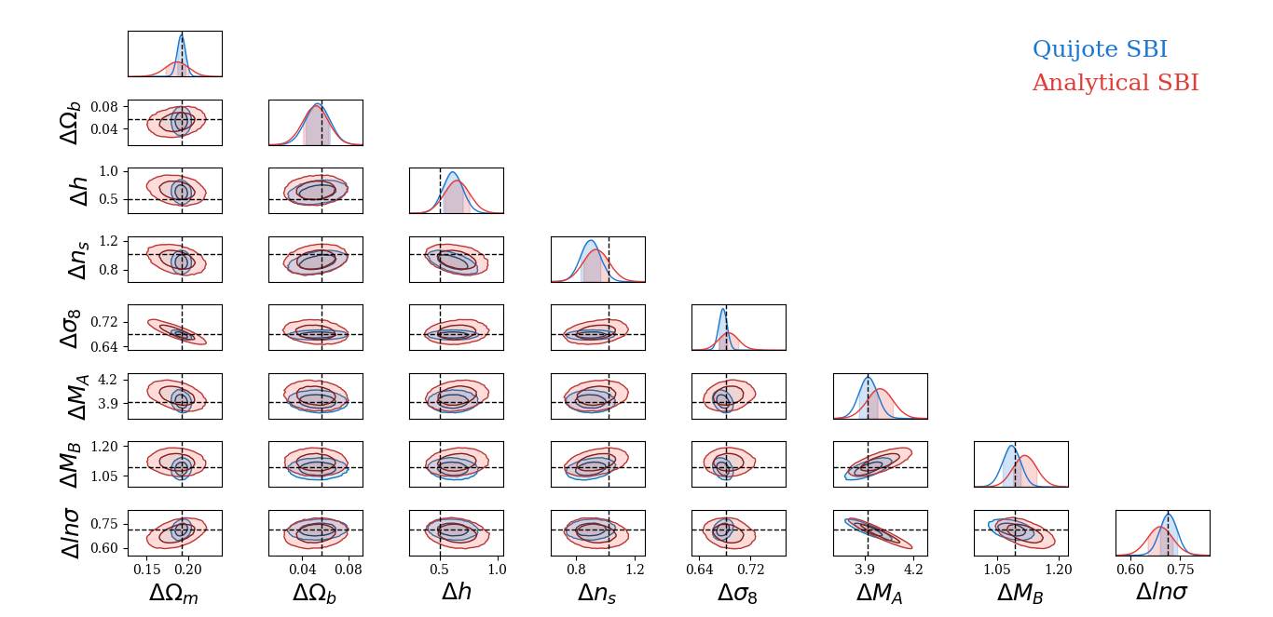
Results [Posterior Distribution]
Truth
SBI within 2σ
Bias
Analytical > Quijote
Uncertainty
Analytical > Quijote

Slide 11
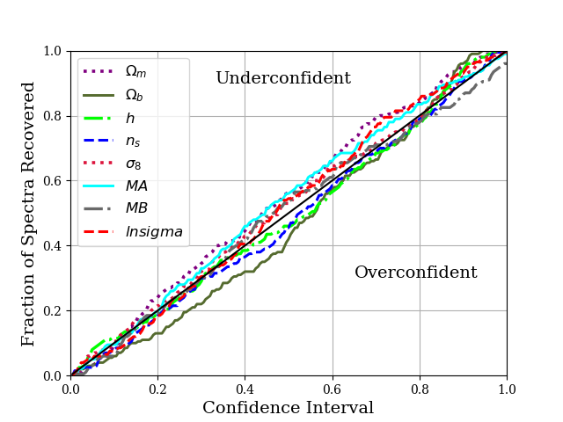
Results [Posterior Confidence]
10% underconfident for M_{A} & lnsigma
7% overconfident for Ω_{b}

Slide 12
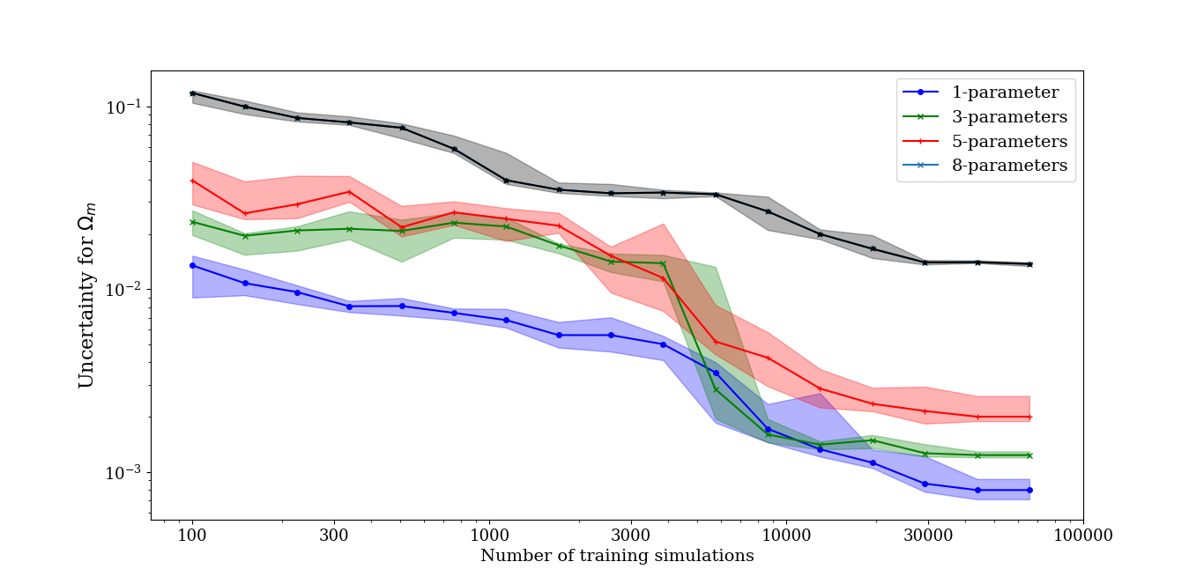
Results [Uncertainty Scaling]
No. of parameters | No. of simulations | Convergent Value
1/3/5 | 10 k | 10⁻³
8 | 20 k | 10⁻²

Slide 13
Results [Ensemble Plots]
--- Ω_{m} recovered by the errorbars
--- No trend for Ω_{b} ,h, & n_{s}

Slide 14
Results [Ensemble Plots]
--- All parameters are well constrained
--- Similar trend between true and predicted values

Slide 15
Conclusions
Simulation-based Inference
Recovers cosmological params within 2-σ region
Analytical Models
Can capture complexities of the Quijote Simulations

