Slide 1
48 Hour Summary
Patrick Dowdle
MCR Crew Chief
April 19, 2023

Slide 2
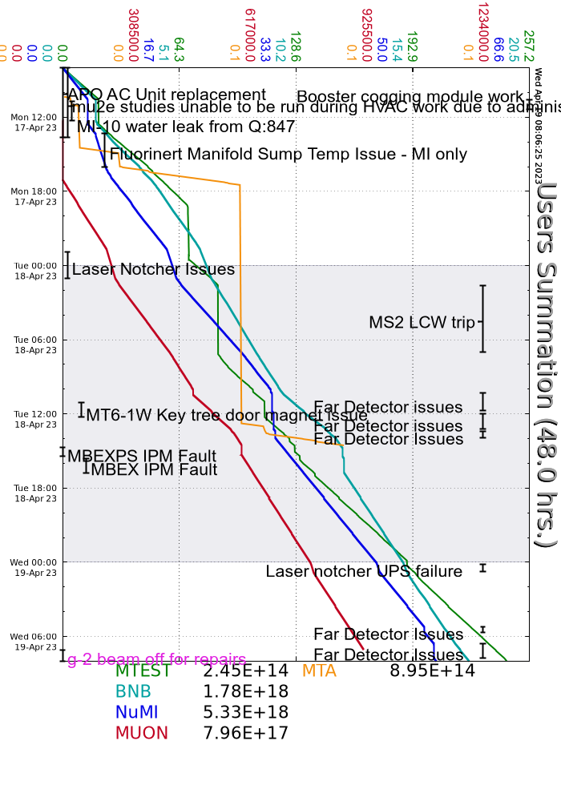
Summary
In General:
Supporting machine studies
Tuning up the complex
Monday:
~2 hour downtime for MIRF/Booster cogging module work
Leak from I:Q847 rack repaired
Flourinert skid for RR injection kickers blew a fuse to the PID controller
Ran MI only mode to NuMI/Mtest
Laser notcher stopped notching, suspected UPS
Tuesday:
MS2 LCW system tripped due to low water level, walked the enclosures did not find any obvious leaks
NOvA far detector multiple downtimes (3H)
MT6-1 West key tree would not stay closed, Interlocks put in a fix
E:MBEXPS IPM faults
Today:
Same issue with the laser notcher from Monday
NOvA far detector multiple downtimes (1.5H)
MC1 is in open access for repairs

