Slide 1
48 Hour Summary
Trey Thompson
April 21, 2023

Slide 2
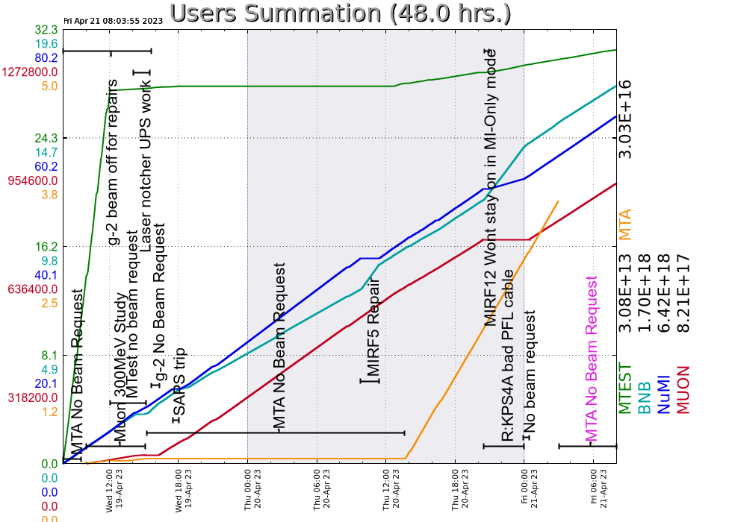
Summary
Wednesday
Prepared MC-1 for Open Access. Supported Muon Campus studies. G-2 resumed beam around ~16:15.
Ran reduced intensity to NuMI and Muon Campus for 1.5 hrs while the Laser Notcher UPS was being repaired. It continued to have issues overnight.
MI SAPS went down on Input AC Current Monitor. MIRF05 did not comeback after
Thursday
Prepared MTA for access. Their experiment was installed, ORC was signed, and begun receiving beam in the afternoon
Took down the SAPS for ~1.5 hrs to recover MIRF05
Ran BNB at 5e12/pulse during the NuMI downtime for Booster studies
Discovered a sensor/power supply issue with the MI-20 air compressor
Secured and established beam to MTest
Repaired a PFL Cabe for R:KPS4A. Had issues with MIRF12 when
running MI only mode.
Friday
Currently dealing with an issue with the Source A Extractor Voltage
Booster tuning for MI8 collimator losses
Current Conditions:
Standby

