Slide 1
Muon Campus Operation Report
Dean Still
Friday 09:00 Operation Meeting
Week of April 17, 2023

Slide 2
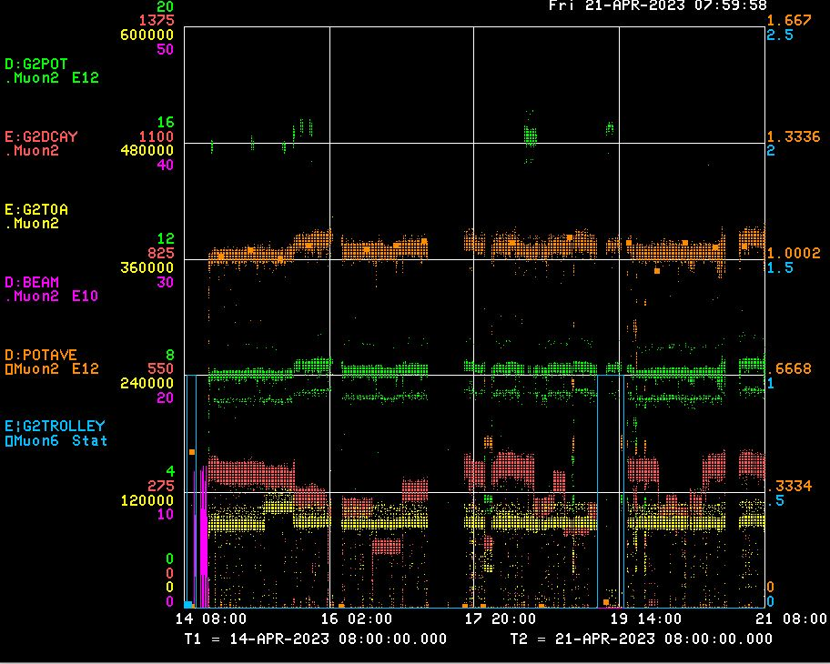
Performance for the Past Week
Protons On Target
Avg Protons on Target
Particles to Entrance of G-2 Ring
Decay Positrons in G-2 Ring
G-2 Trolley Run
8Gev Delivery Ring beam
← AP0 AC Install
← BPM Studies
← RR KPS4A PFL bad cable
← DR D:KPS5A PFL replaced
← 300 Mev Study for g-2
← g-2 repairs & 300Mev Study
<-------Weekend ------→
<------------Week Days -------------------→

Slide 3
Activities for the Past Week
G-2 Status:
Delivered beam to g-2
Work completed:
Replace Delivery Ring D:KPS5A abort kicker PFL.
Replace Recycler Ring R:KPS4A abort kicker PFL.
ESS2 power supply is back in service.
Target Blower Maintenance
AP0 AC installation started on Monday and only impacted operation 1 day. Sub-contractors are working on badging and should be ready next week.
Delivery Ring BPM system working on solving communication issues with new boards.
Studies: (1 day)
Mu2e BPM commissioning.
300 Mev EDM Study . (Morgan)

Slide 4
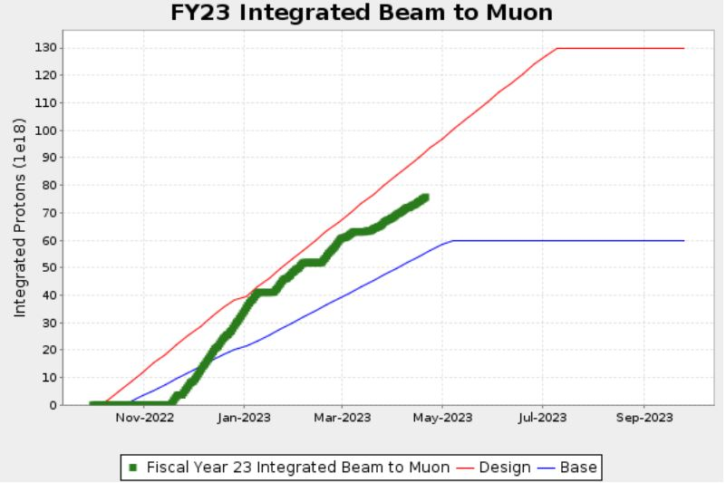
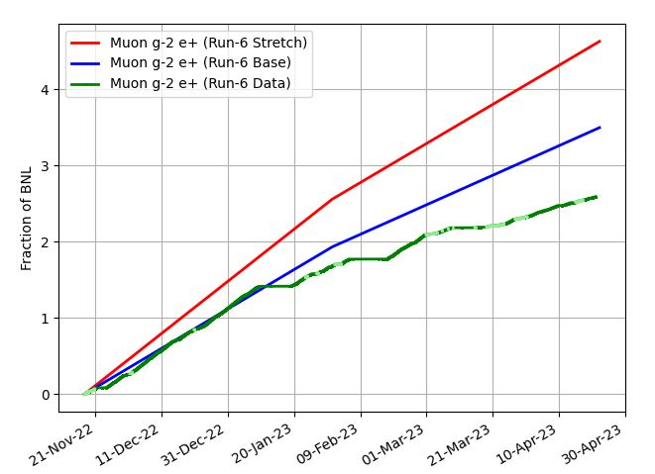
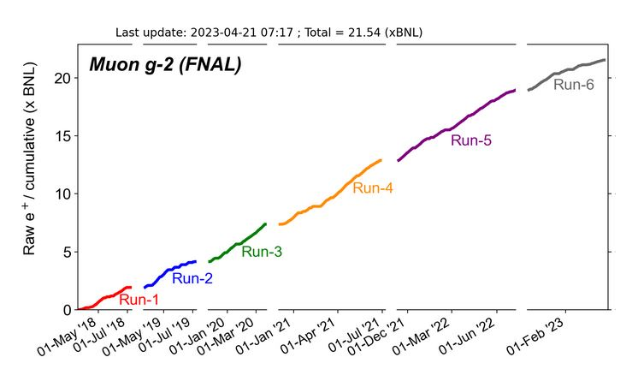
G-2 Performance – Integrated for Run 6
G-2 Experiment POT Run Goal
~4.2E20 POT
Run 6 period is Nov 2022 – June 2023
Run 6: Goal of ~x 6 BNL
Total Run: goal of x 21 BNL
Currently running 6.6 Hz
Run 6 # POT Delivered ~ 7.6E20
Run 6 Integrated ~ x 2.59 BNL
0.08 for the week
Total Integrated ~ x 21.54 BNL
Start of
Summer
Shutdown
2023
Plots as of 4/14/2023

Slide 5
Plan for Next Week
g-2 operation:
Deliver Beam to g-2
Muon Campus Plans :
AP0 AC installation work.
AC work during day shift & delivery beam to g-2 & studies in the Evening & Owls.
To work in AP0 water cage area requires 1.5 hour cool down.
Friday – Deliver beam to g-2
Saturday – Deliver beam to g-2
Sunday – Deliver beam to g-2
Monday - 0800 -1600 -- M4 beamline studies
Tuesday - 0530-1600 - AP0 AC work - No Beam to g-2
Wednesday - Booster Study Day – No beam to muon campus –
Access DR, Extraction, M4, Pre-Vault, Pre target, Fsector
Thursday – TBD
Friday – TBD
Future Planning :
G-2 ,ine
Mu2e M4
line

