Slide 1

Caption
Steve Gourlay, on behalf of the
Snowmass’21 Accelerator Frontier Conveners:
T. Raubenheimer, V. Shiltsev and S.G.
Snowmass’21 Accelerator Frontier

Slide 2
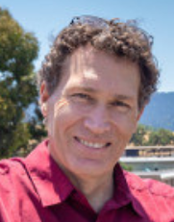
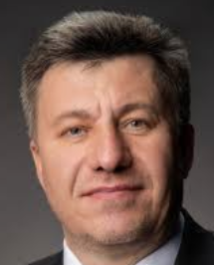
Accelerator Frontier
Caption
Steve Gourlay (LBNL -> FNAL)
Tor Raubenheimer (SLAC)
Vladimir Shiltsev (FNAL)
Description
  The Accelerator Frontier activities included discussions on high-energy hadron and lepton colliders, high-intensity beams for neutrino research and for “Physics Beyond Colliders”, accelerator technologies, science, education and outreach as well as the progress of core accelerator technology, including RF, magnets, targets and sources. Participants submitted Letters of Interest, contributed papers, took part in corresponding workshops and events, contributed to writing summaries and took part in general Snowmass'21 events.

Slide 3
Accelerator Frontier – Key Questions
Caption
  What is needed to advance the physics?
  What is currently available (state of the art) around the world?
  What new accelerator facilities could be available on the next decade (or next next decade)?
  What R&D would enable these future opportunities?
  What are the time and cost scales of the R&D and associated test facilities as well as the time and cost scale of the facilities?

Slide 4
Accelerator Topical Groups and Conveners
Caption
Topical Group |  | Topical Group co-Conveners
AF1 | Beam Phys & Accel. Education | Z. Huang (Stanford) | M. Bei (GSI) | S. Lund (MSU)
AF2 | Accelerators for Neutrinos | J. Galambos (ORNL) | B. Zwaska (FNAL) | G. Arduini (CERN)
AF3 | Accelerators for EW/Higgs | M. Ross (SLAC) | Q. Qin (IHEP, Beijing) | G.Hoffstaetter (Cornell)
AF4 | Multi-TeV Colliders | M. Palmer (BNL) | A. Valishev (FNAL) | N Pastrone (INFN, Torino) | J.Tang (IHEP, Beijing) | J.Tang (IHEP, Beijing)
AF5 | Accelerators for PBC and Rare Processes | E. Prebys (UC Davis) | M. Lamont (CERN) | R.Milner (MIT)
AF6 | Advanced Accelerator Concepts | C. Geddes (LBNL) | M. Hogan (SLAC) | P. Musumeci (UCLA) |  | R. Assmann (DESY)
AF7 | Accelerator Technology R&D
 | Sub-group RF | E. Nanni (SLAC) | S. Belomestnykh (FNAL) | H. Weise (DESY)
 | Sub-Group Magnets | G. Sabbi (LBNL) | S. Zlobin (FNAL) | S. Izquierdo Bermudez (CERN)
 | Sub-Group Targets & Sources | C. Barbier (ORNL) | Y. Sun (ANL) | F. Pellemoine (FNAL)
Plus, the Accelerator Implementation Task Force (ITF) to evaluate and compare various options
9 out of 29 are representatives of Asia and Europe; 5 women

Slide 5
Active participation by our Liaisons
AF to Theory Frontier - LianTao Wang (U Chicago)
Rare Processes - Robert Bernstein (FNAL)
Neutrino Frontier - Laura Fields (FNAL) and Alycia Marino (Colorado)
Energy Frontier - Meenakshi Narain (Brown) and Dmitri Denisov (BNL)
Instrumentation Frontier - Andy White (UTA)
Computation Frontier - Jean-Luc Vay (LBNL)
Community Engagement - Jeoren van Tilborg (LBNL)
Snowmass Young - Edith Nissen (Jlab) and Nikita Kuklev (U.Chicago)

Slide 6
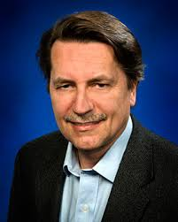
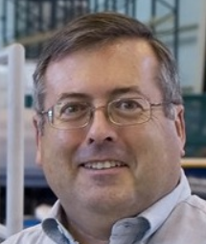
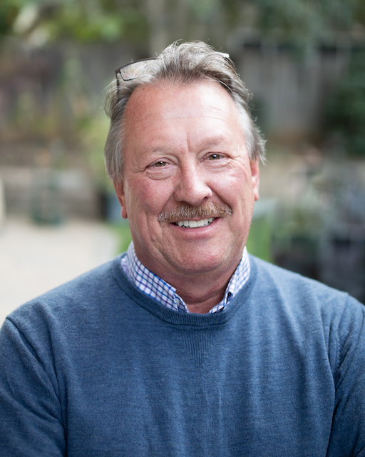
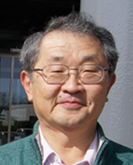
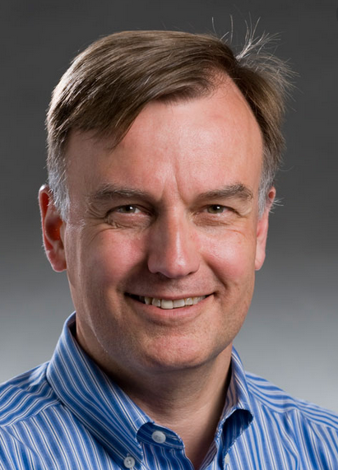
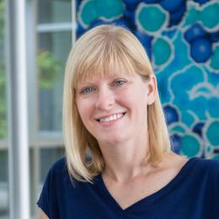
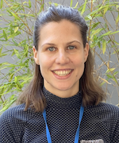
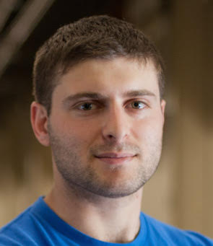
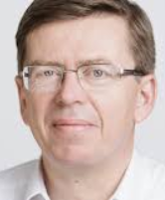
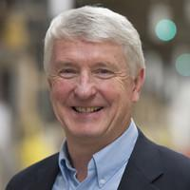
Another task of AF:
Implementation Task Force (ITF)
Caption
Charged with developing metrics and processes to facilitate
comparisons between collider proposals.
  Evaluated 32 collider proposals in terms of
  Cost and schedule
  Technical readiness, required R&D
  Power requirements, complexity
  Physics reach (impact), parameters
  Called for R&D on energy efficiency
Thomas Roser (BNL, Chair)
Philippe Lebrun (CERN)
Steve Gourlay
(LBNL)
Tor Raubenheimer (SLAC)
Katsunobu Oide (KEK)
Jim Strait
(FNAL)
See talk by Thomas Roser
at BNL Townhall
Sarah Cousineau
(ORNL)
Marlene Turner (LBNL)
Spencer Gessner (SLAC)
Vladimir Shiltsev (FNAL)
Reinhard Brinkmann
(DESY)
John Seeman
(SLAC)

Slide 7
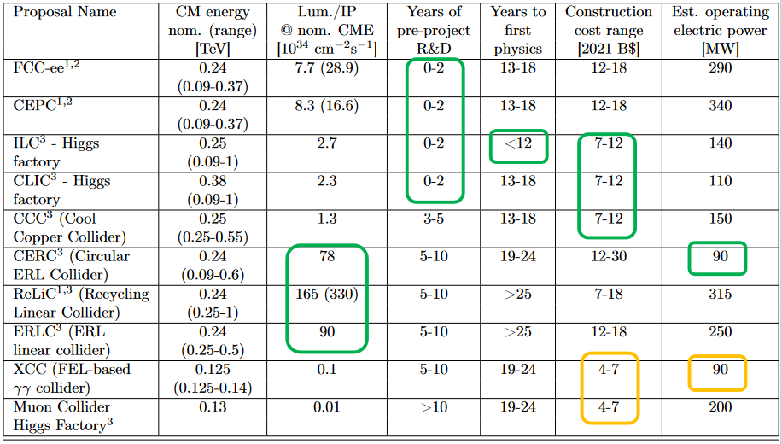
ITF Summary
Caption
Focus on colliders
Reviewed concepts to allow comparison but did not prioritize
Did not review luminosity and power consumption (proponent input)
ITF recommends (AF supports) – that R&D to reduce the cost and energy consumption of future collider projects be given high priority
Suggests that evaluations could be updated on a regular basis

Slide 8
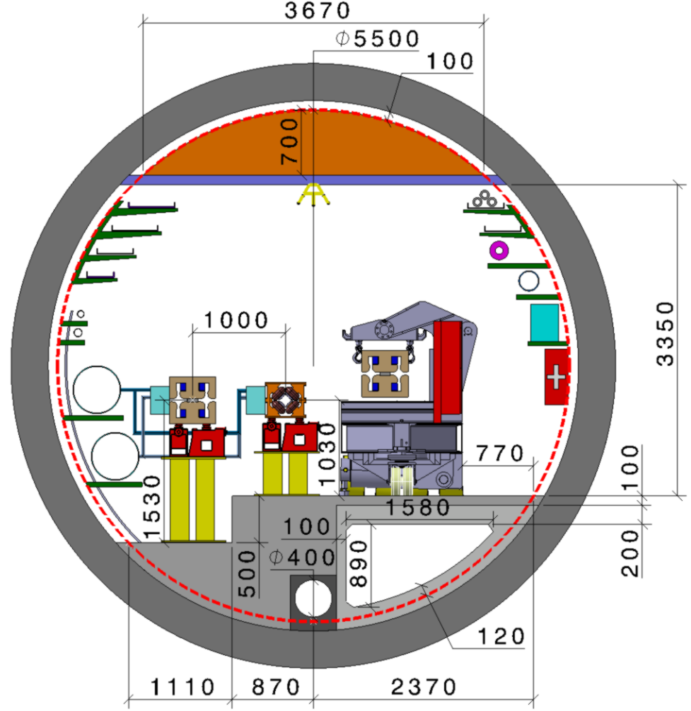
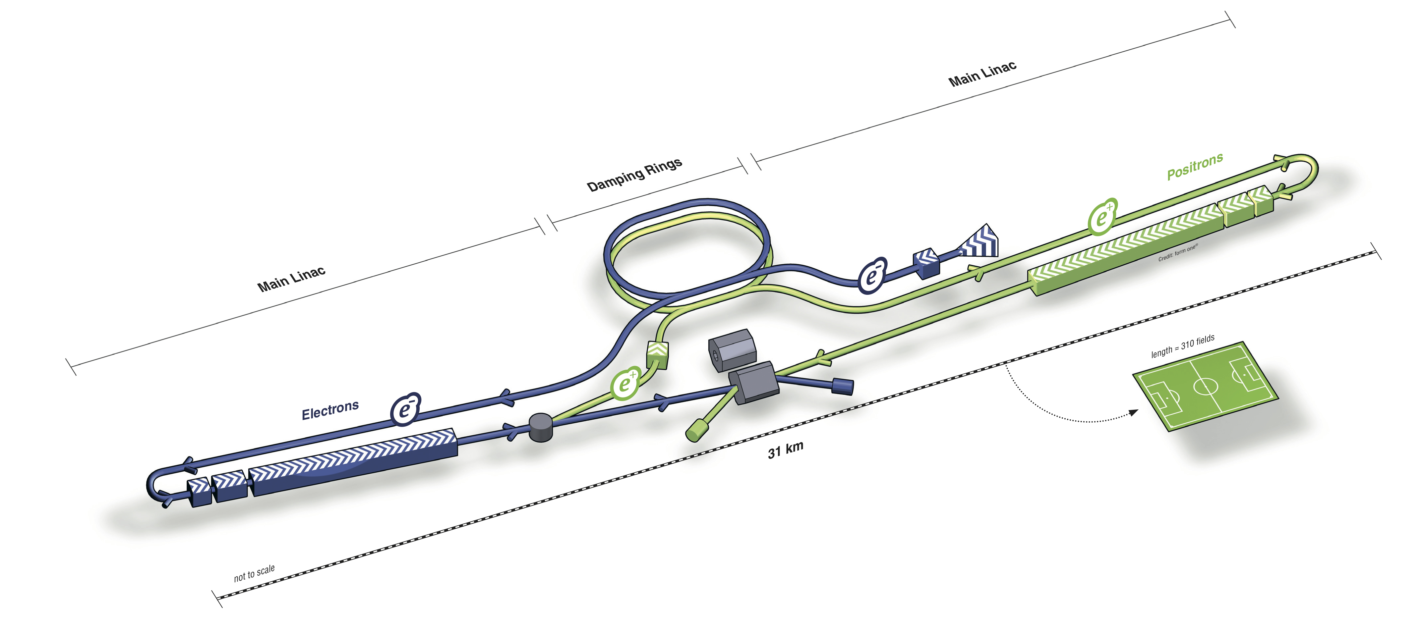

Cross-Frontier and Community Engagement
Caption
Accelerator/Energy/Theory with input from IF, RPF and NF
  Joint workshops (many)
  The Agoras (Hosted by Future Colliders Initiative at Fermilab)
    Linear e⁺e⁻ colliders
    Circular e⁺e⁻ colliders
    Muon colliders
    Circular pp and ep
    Advanced colliders
    EF conveners: Meenakshi Narain, Laura Reina, Alessandro Tricoli,
    AF conveners: Steve Gourlay, Tor Raubenheimer, Vladimir Shiltsev
      Fermilab Future Colliders group: Pushpa Bhat, Joel Butler

Slide 9
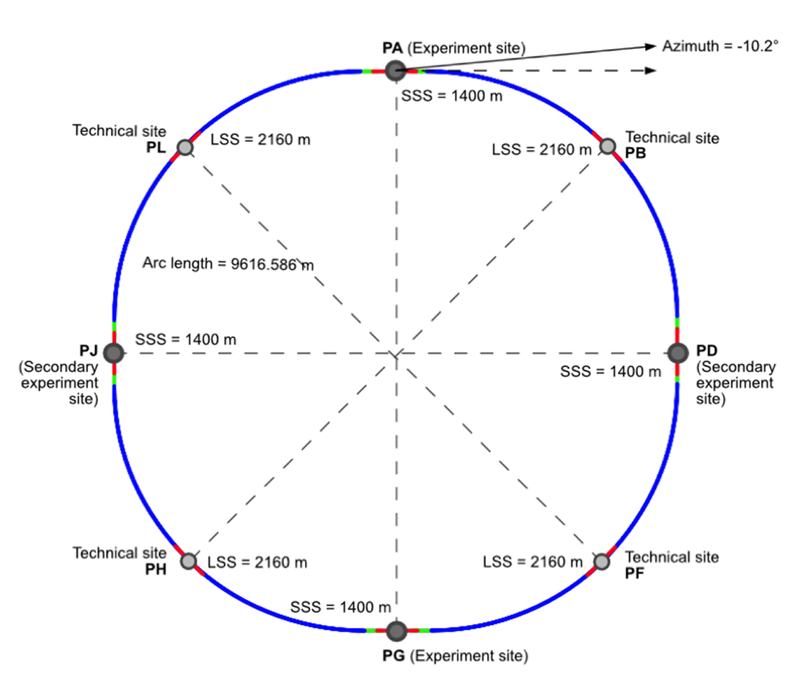
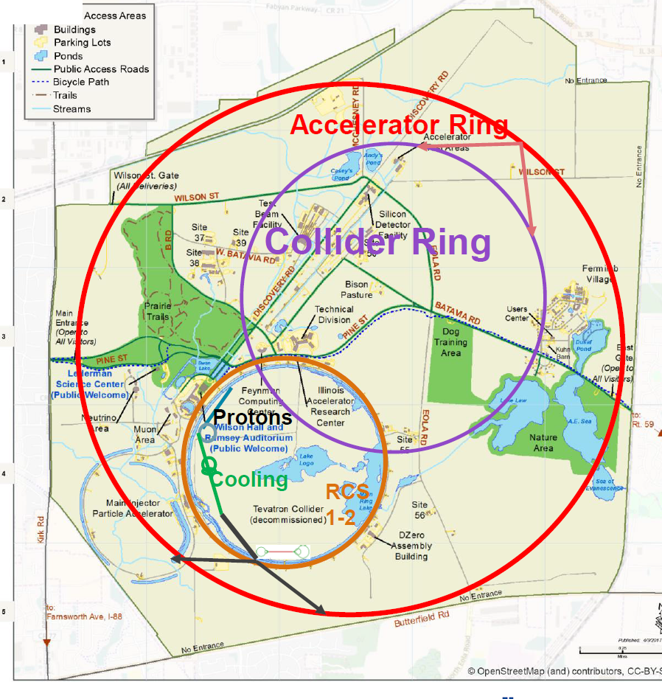
Community Forums – broaden communication
Caption
e⁺e⁻ Forum
  EF convenors: Maria Chamizo Liatas (BNL), Sridhara Dasu (Wisconsin)
  AF convenors: Emilio A. Nanni (SLAC), John Power (ANL)
  IF convenors: Ulrich Heintz (Brown), Stephen Wagner (Colorado)
  Joint EF-AF-IF Initiative
Muon Collider Forum
  Accelerator Frontier: Derun Li (LBNL), Diktys Stratakis (FNAL)
  Energy Frontier: Kevin Black (Wisconsin), Sergo Jindariani (FNAL)
  Theory Frontier: Patrick Meade (Stony Brook), Fabio Maltoni (Louvain)
  Joint EF-AF-TF Initiative
  Aspirations for energy frontier facility in the US
Based on results of the successful US-Muon Accelerator Program (MAP) that ended in 2016 and bold CERN-led initiative in Europe

Slide 10
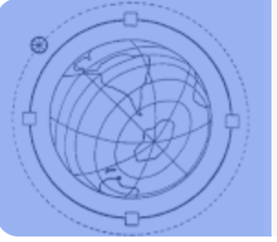
Foundation for Accelerator Frontier
Caption
Major developments since the last Snowmass/HEPAP P5 in 2013-2014
  Start of PIP-II – (international)
  Construction of LBNF/DUNE – (international/CERN)
  HL-LHC - (international/CERN)
  Emergence of a number of projects focused on EW/Higgs physics
      FCC-ee @ CERN
      CepC in China
      C³ and HELEN in the US
  Reduction of linear collider activities (ILC in Japan and CLIC at CERN)
  The end of the Muon Accelerator Program (MAP) in the US
  The start of International Muon Collider Collaboration (IMCC) in the EU
  Lots of planning exercises
      GARD and Accelerator R&D Roadmaps
      EU Strategy for Particle Physics
      EuPRAXIA . . . .
      EU Accelerator Roadmaps
HEP has evolved into a
truly global enterprise

Slide 11
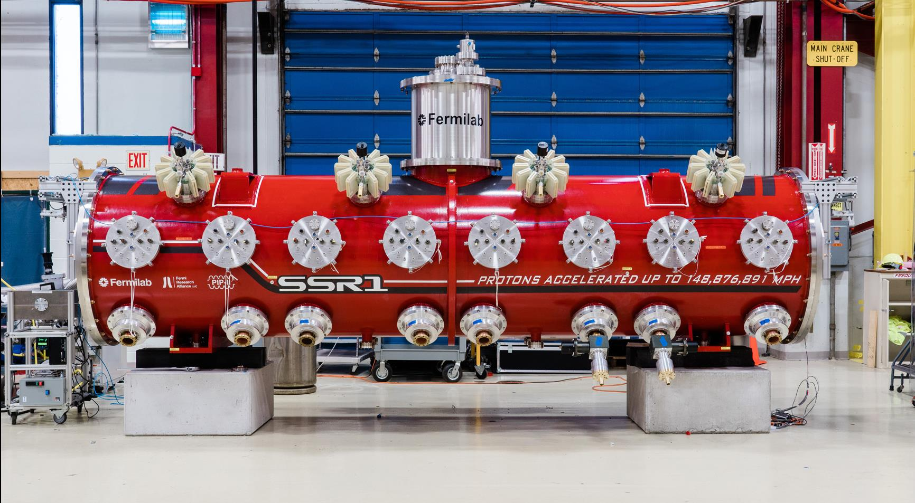
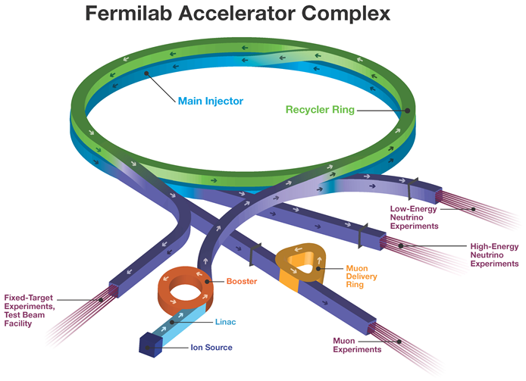
FNAL Accelerator Complex Evolution (ACE)
Update since AF Summary Report
Caption
ACE Workshop January
https://indico.fnal.gov/event/57326/
PIP-II construction and commissioning (2020’s)
Proposed ACE (2030’s)
  Part 1: > 1.2 MW proton beam
  Part 2: Booster Replacement Project (late 30’s) for reliable 2.4 MW
  to DUNE with capability and capacity to support new
  experiments and accelerator advancements
  Considerations
  Competition with Hyper-K / J-PARC – short timeline
  MI upgrade (RF and Magnets)
  Multi-MW Targets
  Performance (beam losses for various reasons)
  Muon collider compatibility
See talks by
Mary Convery
Diktys Stratakis
Options to be discussed at the ACE Science Workshop June 14 -15

Slide 12


Previous Snowmass/P5 (2013/14)
Caption
Major accelerator-related recommendations:
  Contribute to LHC and HL-LHC
  Engage in the ILC in Japan, contribute if it goes
  Build >1 MW proton source PIP-II for ν LBNF/DUNE In Process
  Provide beams for g-2 and mu2e experiments and In Process
  Reassess Muon Accelerator Program and MICE
✔︎
?
✔︎
✔︎
A follow-up 2015 Accelerator R&D subpanel recommended several thrusts :
  Beam Physics (incl. IOTA and PIP-III)
  Sources and Targets (incl. multi-MW)
  RF (high-Q, high-G, low cost)
  Magnets and materials (16 T, low cost)
  Advanced acceleration (towards wakefield colliders)
Moving ahead

Slide 13
Caption
AF provided input to the community/P5 on future facilities

Slide 14
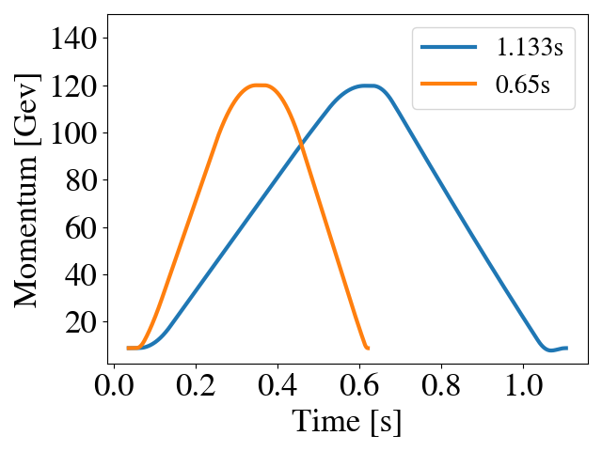
Proposed Accelerator Initiatives/Projects
Caption
For Neutrino Physics: PIP-II followed by
  0.65s cycle → 2.2MW; ASAP(ca 2031)
  Followed by the Booster replacement
For Rare Processes (DM, CLFV, etc):
  0.8 GeV PAR (Accumulator Ring) ~100kW
  AMF (Advanced Muon Facility) two rings
For Energy Frontier (colliders) – design and R&D on:
  e⁺e⁻ Higgs Factories: FCCee at CERN, C^3, ILC/HELEN
  Muon Colliders (6-10-14 TeV c.m.e.)
  In collaboration with international partners
  In coordination with corresponding physics/detector teams
Increase Main Injector Ramp Rate
NEEDS P5 APPROVAL

Slide 15
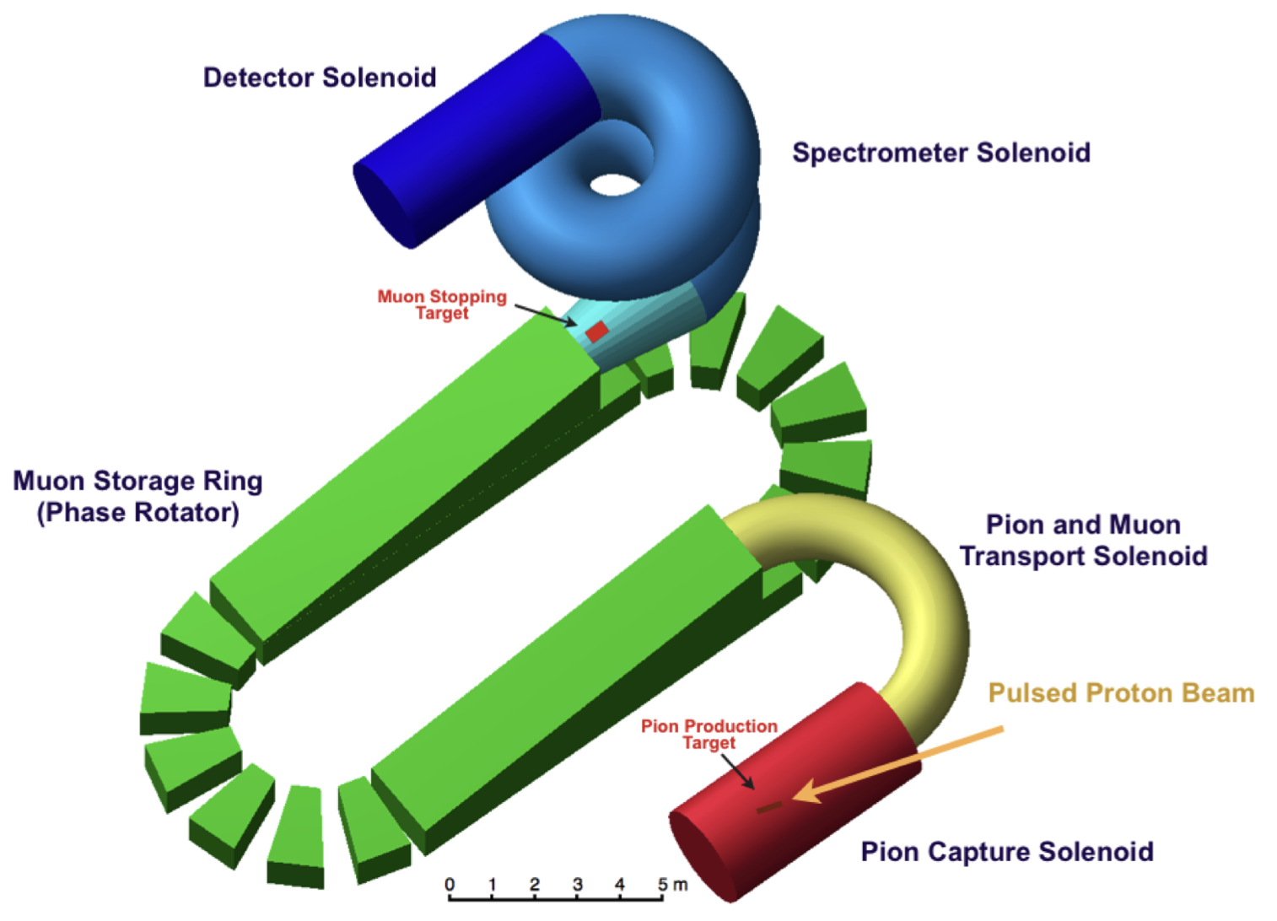
Accelerators for Rare Processes
Caption
Searches for DM, axions, EDMs, CLFV experiments, muons, light mesons, beam dump experiments . . .
Several new beam facilities requested (FNAL, SLAC, JLab, SNS)
e-beams
GeV to multi-GeV
p-beams
2 GeV CW
2 GeV pulsed from storage ring (1 MW)
8 GeV pulsed (1 MW)
120 GeV slow extraction for LBNF
Many existing and planned facilities can be utilized
arXiv:2209.06289
arXiv:2203.08278
2 GeV Facility for Muon CLFV

Slide 16
Colliders
Caption
Important:
  There are too many concepts to cover them here in any detail
  Brief technical descriptions in RMP and PDG:
    V. Shiltsev, F. Zimmermann, RMP 93, 015006 (2021);
    https://pdg.lbl.gov/2021/reviews/rpp2021-rev-accel-phys-colliders.pdf
  Detail evaluations and discussions in the Accelerator Topical Group Reports AF3, AF4, AF6 and AF7, and the ITF report:
    available at https://snowmass21.org/accelerator/

Slide 17
Colliders – AF alignment with EF
Caption
Five-year period starting in 2025
  Prioritize HL-LHC physics program
  Establish a targeted e⁺e⁻ Higgs factory detector R&D program for US participation in a global collider
  Develop an initial design for a first stage TeV-scale MuC in the US (pre-CDR)
  Support critical detector R&D towards EF multi-TeV colliders
Five-year period starting in 2030
  Continue strong support of HL-LHC program
  Support construction of an e⁺e⁻ Higgs Factory
  Demonstrate principal risk mitigation and deliver CDR for a first-stage TeV-scale MuC
After 2035
  Evaluate continuing HL-LHC physics program to the conclusion of archival measurements
  Begin and support the physics program of the Higgs Factories
  Demonstrate readiness to construct and deliver a TDR for a first-stage TeV-scale MuC
  Ramp up funding support for detector R&D for EF multi-TeV colliders

Slide 18
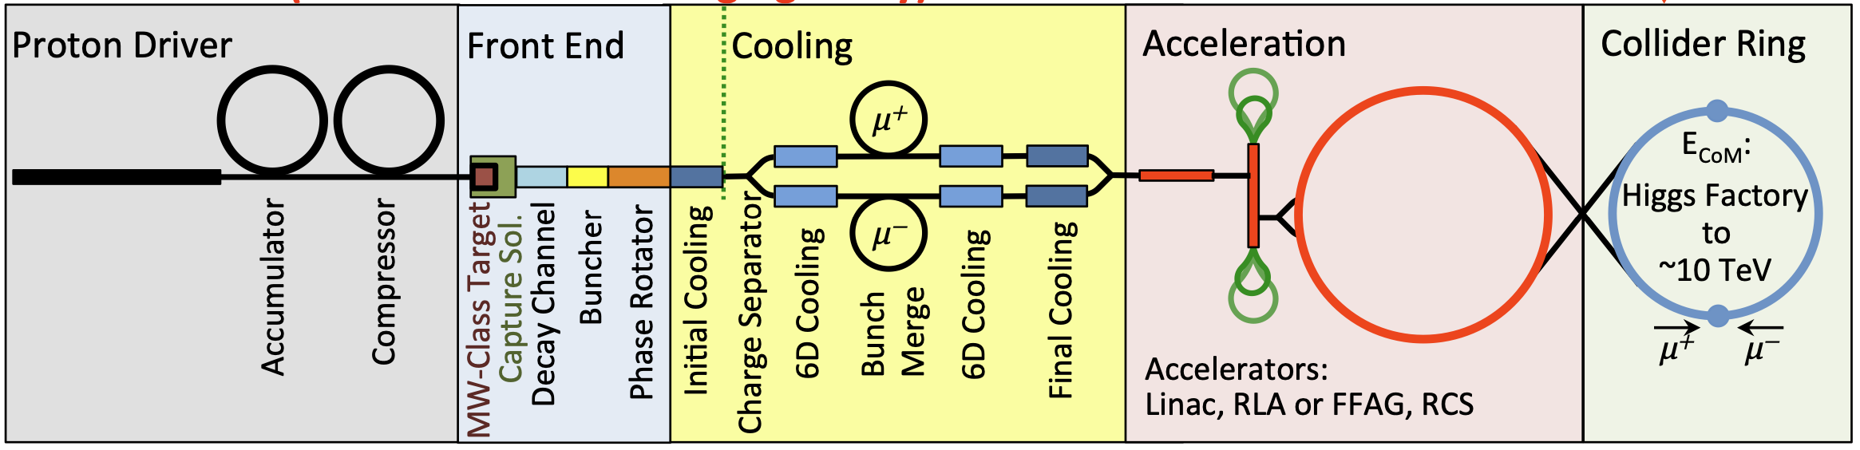
Input from the Forums
Caption
e⁺e⁻ Collider Forum w/ EF and IF
  FCCee and CepC more luminosity but $$
  ILC and C³ faster and less costly
  US to contribute to any committed Higgs Factory
  (~10 TeV) colliders: Wakefield – R&D focused on collider specs
μ⁺μ⁻ Collider Forum w/ EF and TF
  6 - 10 TeV cme - ideal
  No showstoppers, best ab⁻¹/TWh, $
  Need engineering and targeted R&D
  Develop pre-CDR/RDR by 2030
  Establish US MC organization
  Join International Muon Collider Collaboration (CERN)

Slide 19
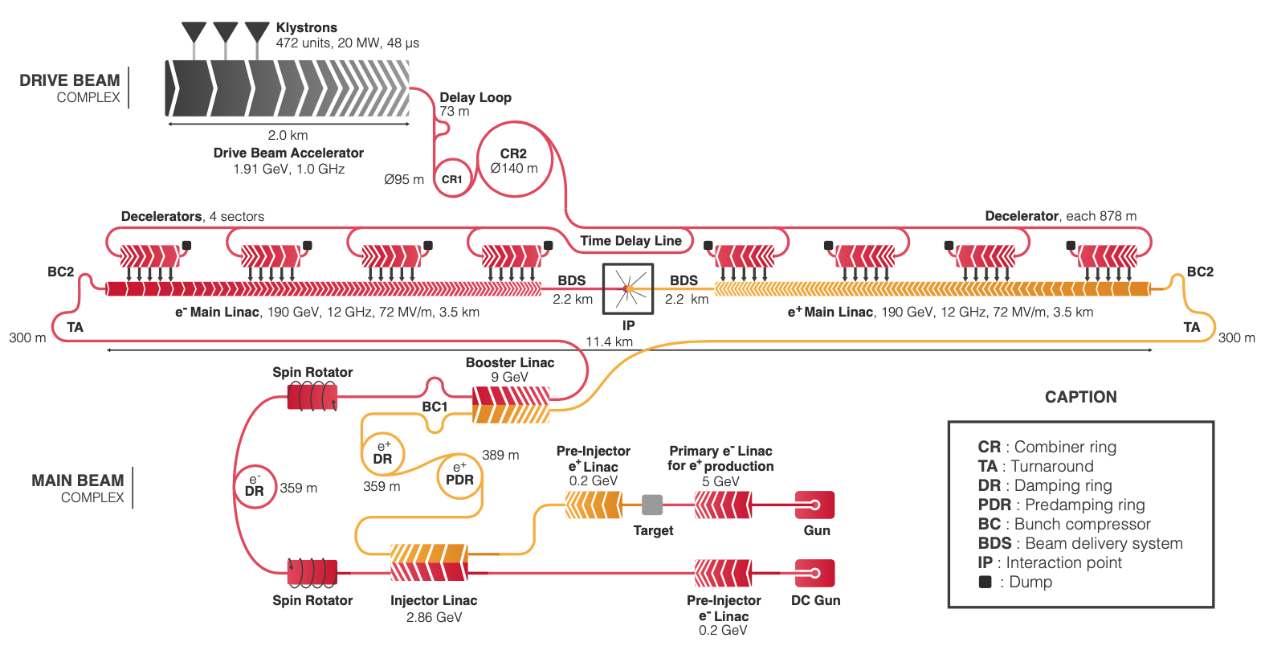
Higgs factory Proposals
(High level of maturity)
Caption
FCC-ee (CepC) Talk later
  Supported by CERN (+)
  Large footprint, power consumption (-)
CLIC
  Lower power needs, smaller footprint (+)
  2-beam, tolerances (-)
ILC
  Shovel ready, polarization (+)
  Large footprint, no decision from Japan (-)

Slide 20
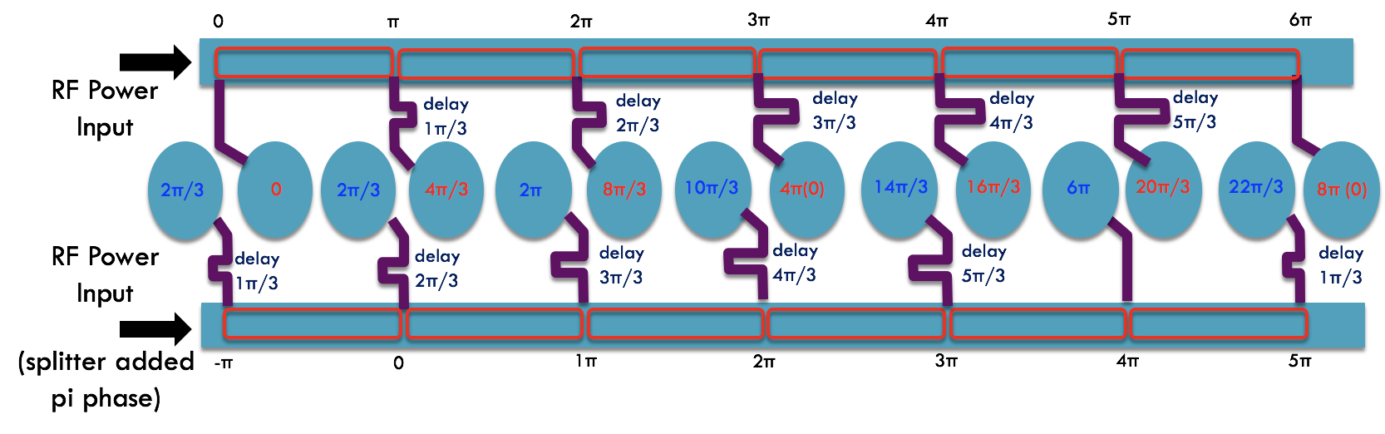
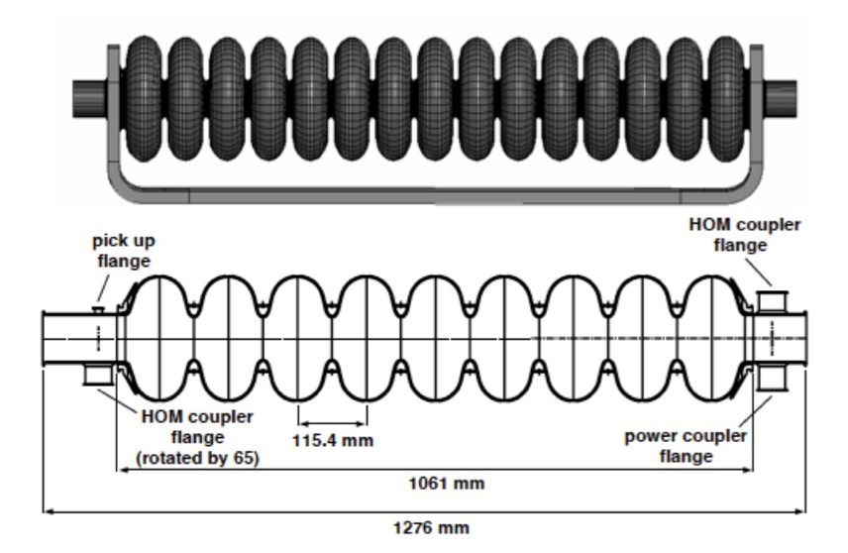
LC-Higgs Factories on FNAL site
(new development)
Caption
Must fit ~ 7km including beam delivery system
Requires RF gradients of at least 70 MV/m
Compact -> lower cost compared to ILC, CLIC
Two options
  Cool Copper Collider (C³) – 5.7 GHz @ 77K
  Higgs-Energy LEptoN (HELEN) – Traveling wave ILC, 1.3GHZ @ 2K

Slide 21
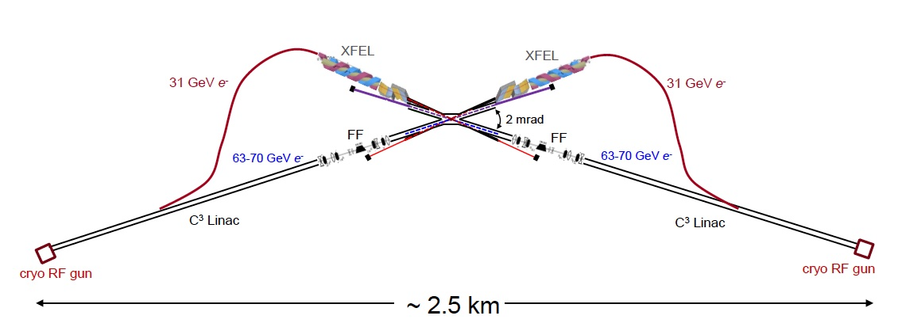
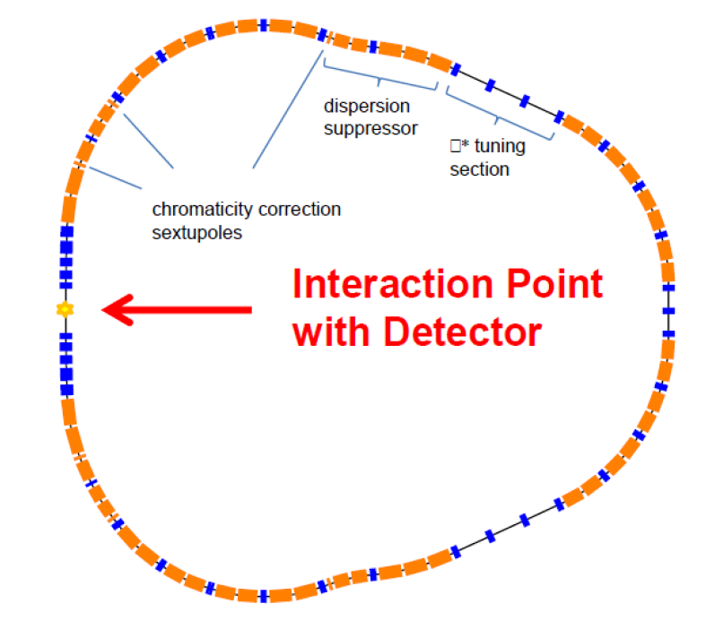
More aggressive Higgs Factory alternatives
Caption
Energy Recovery based on e⁺e- colliders (circular or linear)
  High luminosity per MW power consumption (+)
  Not yet mature (orders of magnitude in current, Q₀), long, expensive (-)
Gamma-gamma linear colliders
  Need only ½ of the energy, short, potentially less expensive, no e⁺ (+)
  Need two beyond-state-of-the-art FELs to generate gammas’s in collisions with e⁻ (-)
Muon collider Higgs factory
  Need only ½ the energy (65+65 = 130 GeV), very compact, less expensive +)
  Long development time, low luminosity but high X-section (-)

Slide 22
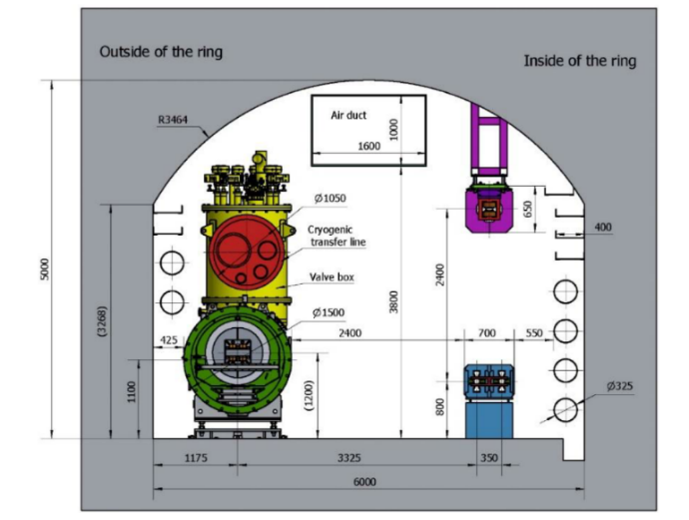
3-10 TeV/parton cme (most discussed)
Caption
CLIC-3 TeV
  Established CDR, demo facilities (+)
  Large footprint, $$$ huge power consumption (-)
FCC-hh 100/ TeV (100km tunnel)
  Re-use FCC-ee tunnel, high luminosity, LHC experience (+)
  20(?) years for magnet development 16T (-)
  For 100 TeV -> 17.8T for 91km tunnel (--)
  Recently backed down to a more practical 14T/ 80 TeV (+)
SppC-125 TeV
  Re-use CepC tunnel, ep 0.12+62.5 TeV (+)
  20T magnets
  Intermediate stage at 75 TeV with 12T magnets using Iron-based SC) (-)
Muon Collider
  Potentially lowest cost, best luminosity/TWh (+)
  6D Cooling “R”, “D” on many subsystems (-)
CepC
SppC

Slide 23
6 – 10 TeV Muon Collider on FNAL site
Caption
First design concept of up to 10 TeV collider developed
Operation at 125 GeV, 1 and 3 TeV could be intermediate stages
Capitalizes on existing FNAL facilities and expertise
  PIP-II and upgrades
  Tevatron tunnel
  Facilities for cooling, target, SRF and magnet R&D
  World-class intellectual leadership in these areas

Slide 24
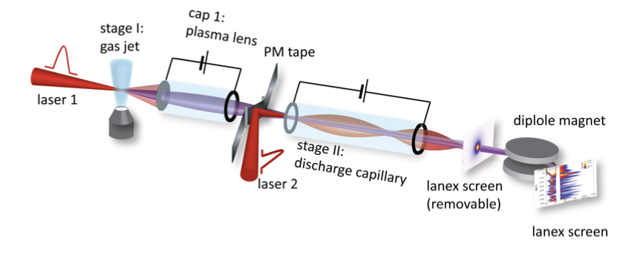
A variety of other options
Caption
Circular or linear colliders pushing the limits
  ILC-3 TeV, ERL-based Linear colliders (3 TeV), 2100 km “Collider in the Sea)
    “Just” scale-up technology (+)
    Enormous power consumption, large footprint, expensive (--)
  Wakefield acceleration (Laser, proton, structure)
    Linear ee/gamma-gamma colliders
    Most compact, perhaps cost efficient, multi-Tev collisions (+)
    More R&D needed:
    e⁺ acceleration, staging, beam quality, power efficiency . . . (-)
Additions to existing machines
  ep/eh colliders (LHeC, FCC-eh, epChina
    Very cost effective, feasible, nice additions to proton machines (+)
    High current 50 GeV ERL technology needs demonstration (3 orders of magnitude in power) (-)

Slide 25
Caption
Accelerator Frontier Messages

Slide 26
Future Facilities
Caption
The US and global community have the expertise in a broad array of accelerator technologies needed to design and construct any of the near-term HEP accelerator projects.
  “Tell us what you want, and we will build it”
  But tell us NOW. It will take time.
  Quads for LHC upgrade took 2 – 3 decades.
  AF Recommendation
  “Planning of accelerator development and research should be aligned with the strategic planning for particle physics and should be part of the P5 prioritization process.”

Slide 27
Colliders
Caption
US National Collider R&D Initiative
  Establish a targeted OHEP program
  Integrated approach to cover international efforts (FCC, ILC, IMCC . . .) and development toward feasible US options (C³, HELEN, 6 - 10 TeV MC, . . .)
  Address in an integrated fashion the technical challenges of promising future collider concepts that are not covered by the existing General Accelerator R&D (GARD) program
See talk by Pushpa Bhat

Slide 28
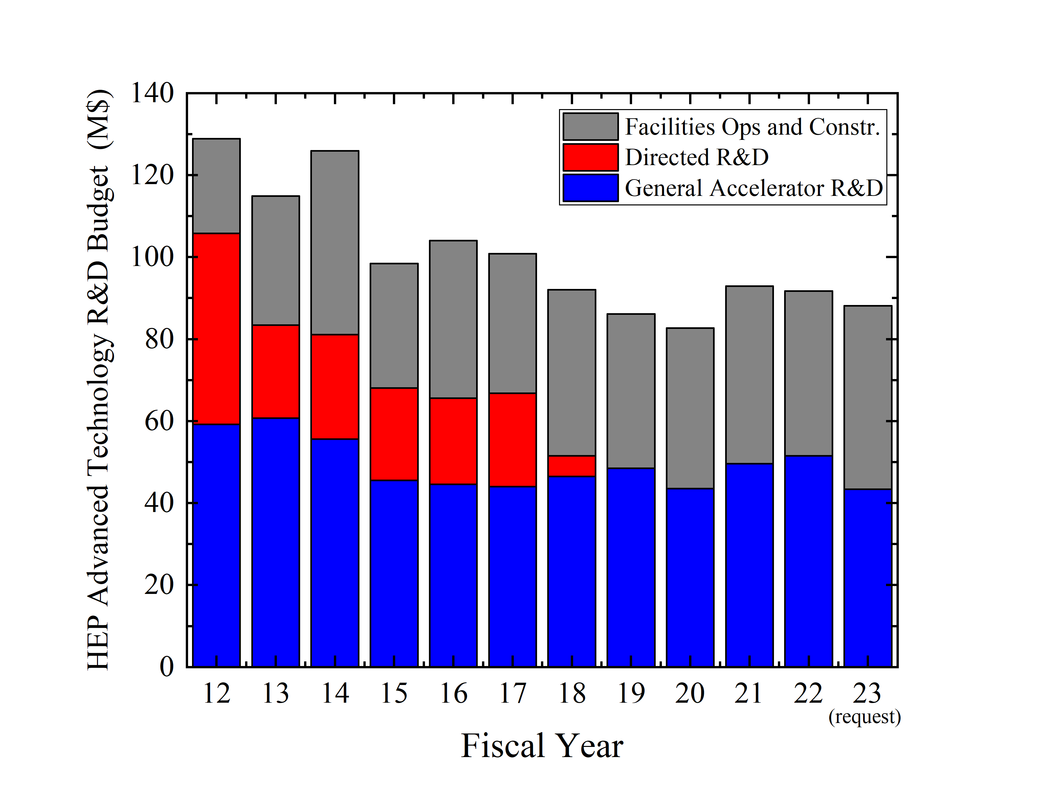
US Accelerator R&D Funding History
Caption
US ILC
US LARP (LHC)
US MAP (Muon)
Completed
Proposed for FY24 ->

Slide 29
Accelerator R&D
Caption
We have an ongoing R&D program aimed at fundamental beam physics and long-term accelerator concepts and technologies
Office of High Energy Physics (OHEP), General Accelerator R&D (GARD) program
    Accelerator and Beam Physics (ABP)
    RF Acceleration Technology (Normal and Superconducting)
    Particle Sources and Targets
    Advanced Accelerator Concepts (AAC)
    Superconducting Magnets and Materials (SCM)
All these areas have broad applicability to future accelerators with ideas from universities and labs
R&D is key to facilities for neutrinos, rare processes and colliders

Slide 30

Accelerator R&D for the next decade
Caption
Multi-MW targets
  2.4 MW for PIP-II
  1 – 4 MW for Muon Collider
Magnets for Colliders and RCS
  14 – 16 T dipoles
  40T+ solenoids
  1000 T/s rapid cycling
Wakefields
  Collider-quality beams
  Efficient drivers and staging
  Close coordination with International programs
SC/NC RF
  70 – 120 MV/m C³
  70 MV/m TW SRF
  New materials, high Q0
  Efficient RF sources
Accelerator and Beam Physics
High intensity/brightness beam acceleration and control
High performance computer modeling and AI/ML approaches
Design integration and optimization, including energy efficiency

Slide 31
Workforce
Caption
Strengthen and expand education/training programs
  Support for university-based research, including grants to involve professors in DOE lab facilities and projects
  Strengthen USPAS
  Encourage labs to accept more traineeship students including international
Outreach
  Enhance recruiting, promote colloquia at universities
DEI
  Enhance support for national undergrad recruiting class to draw women and URM talent

Slide 32
Thanks to everyone for all the hard work!
Caption
Accelerator Frontier Working Group Conveners
Liaisons (EF, IF, NF, TF, CEF, CF)
Implementation Task Force
e⁺e⁻ collider forum
Muon collider forum
Fermilab Collider Group
Convenors of the Collider and RPF Agoras
Our many international partners
And in particular . . .
  The accelerator community for their enthusiastic participation

