Slide 1
FNAL Accelerator Complex
Mary Convery, Fermilab Beams Division Director
P5 Townhall, SLAC
3 May 2023

Slide 2
Outline
Fermilab Accelerator Complex now and in the PIP-II/LBNF era
Accelerator Complex Evolution (ACE) plan
Beam to experiments under ACE plan
overview presentation on the FNAL accelerator complex R&D including LBNF, ACE, PIP-III, Targets etc
Caption

Slide 3
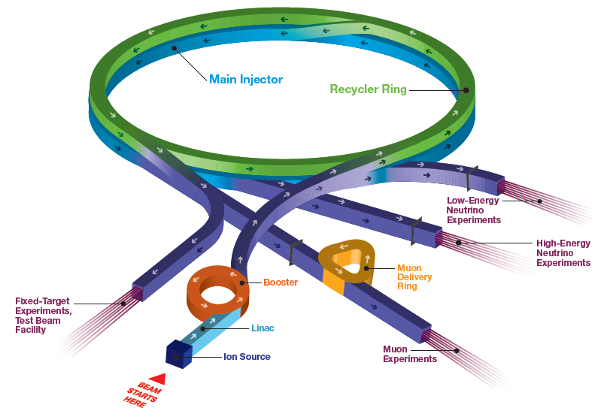
Accelerator Complex
Short Baseline Neutrino:
ICARUS, ANNIE, SBND
SwitchYard120:
test beam (FTBF),
SpinQuest
Long Baseline Neutrino:
NOvA
Muon Campus:
g-2 (completes this year), Mu2e (commissioning)
Irradiation Test Area (ITA) in Linac

Slide 4
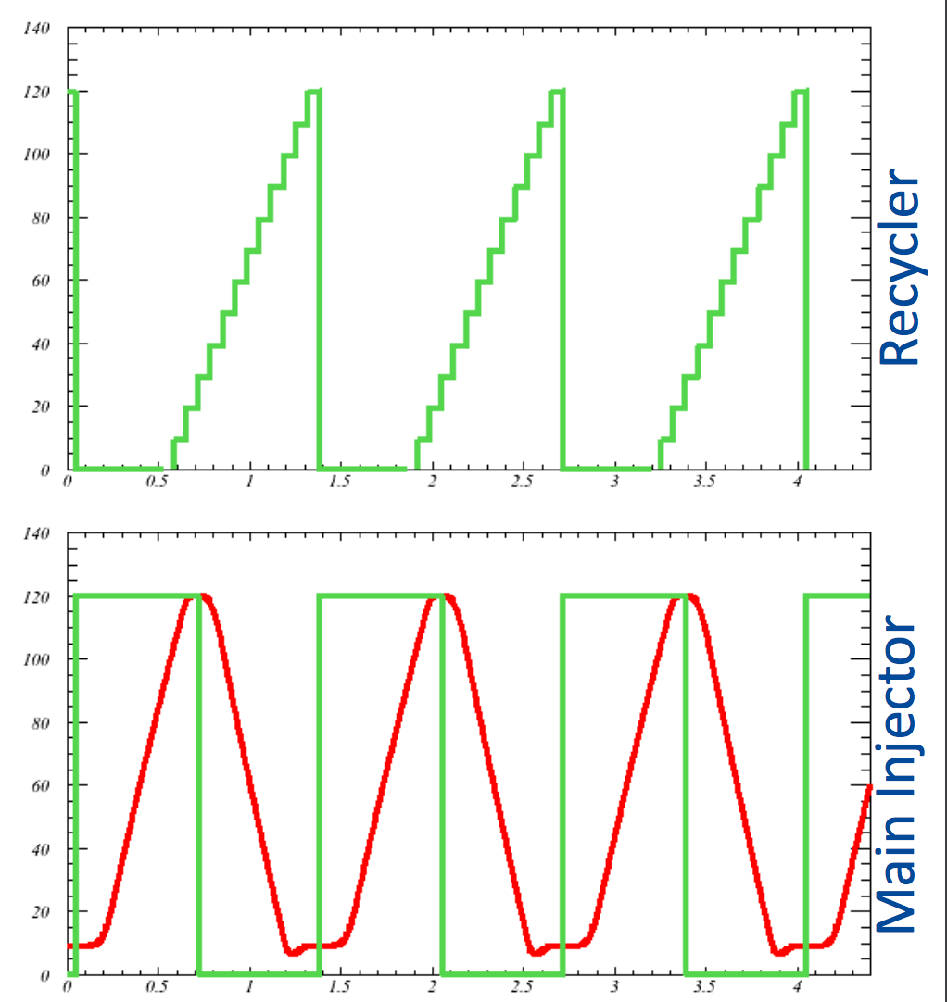

Introduction to Fermilab accelerators
$$\frac{1}{15Hz}=0.067 s$$
H⁻ linac (1970, 1993, 2012)
  400 MeV linac ~20mA
Booster synchrotron (1970)
  H⁻ stripping injection (1978)
    16 turns to ~4.7x10¹² p per pulse
  Ramp from 0.4 to 8 GeV at 15 Hz
Recycler (1998)
  3.3 km permanent magnet 8 GeV ring
  Slip-stacking 12 Booster batches, ~56x10¹² p
  Also re-bunches beam for Muon Campus
Main Injector (1998)
  8 to 120 GeV ramp, cycle time 1.2-1.4 s
1.33s cycle shown

Slide 5
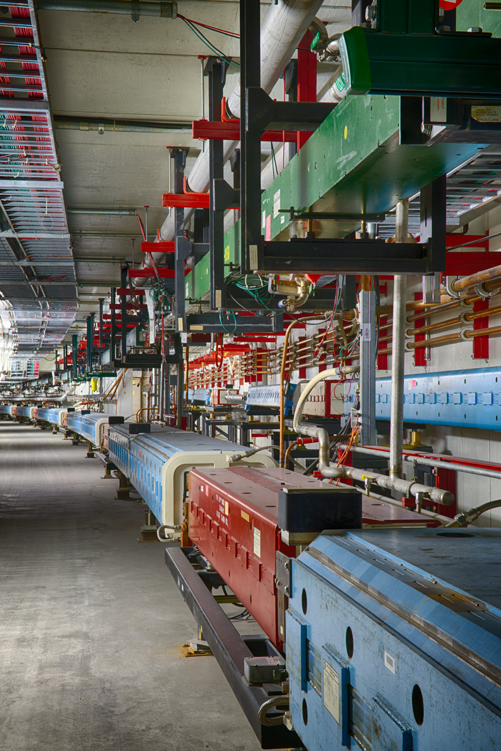
Main Injector
360 main dipole magnets
200 main quadrupole magnets originally used in the Main Ring (>50 years old)
108 sextupoles, 66 octupoles, corrector dipoles/ quads, specialty injection and extraction magnets
Twenty 53-MHz RF cavities to accelerate beam, originally used in the Main Ring (>50 years old)
170 DC and 360 ramped magnet supplies with total of 140 MVA, 40 specialty pulsed magnet supplies
The magnets, power supplies, and RF systems are cooled by low-conductivity water
MI will be >30 years old when LBNF turns on

Slide 6
Accelerator Complex in PIP-II / LBNF era (pre ACE plan)
PIP-II Project provides
  New SRF linac for injection into Booster at 800 MeV (present 400 MeV)
  Booster cycle rate upgraded to 20 Hz from 15 Hz
  Increased proton beam intensity at 8 GeV for 1.2 MW beam power from MI
LBNF/DUNE-US Project provides
  New proton beamline for up to 2.4 MW
  Target systems for 1.2 MW
  Shielding and absorber for up to 2.4 MW

Slide 7
Accelerator Complex Evolution (ACE) plan
Increase protons on target to DUNE Phase I detector by
  Shortening the Main Injector cycle time to increase beam power
  Upgrading target systems for up to 2.4 MW
  Improving reliability of the Complex
Establish a project to build a Booster replacement to
  Provide a robust and reliable platform for the future of the Accelerator Complex
  Ensure high intensity for DUNE Phase II CP-Violation measurement
  Enable the capability of the complex to serve precision experiments and searches for new physics with beams from 1-120 GeV
  Create the capacity to adapt to new discoveries
  Supply the high-intensity proton source necessary for future multi-TeV accelerator research
Previously referred to as PIP-III

Slide 8
Shortening the Main Injector cycle time
Advantages over increasing the per-pulse intensity – reduces likelihood of space charge effects and instabilities, and reduces impact of limited aperture
To shorten the MI cycle from 1.2-1.4s to 0.65s, the ramp needs to be ~twice as fast
Requires more voltage and electrical power
  Power supplies, transformers, feeders, service building size, additional tunnel penetrations, additional cooling
RF accelerating system
  Replace cavities with newer design (more volts per cavity) or add cavities of current design
Regulation, control & instrumentation
  New low-level RF, new power supply regulation/control system
Beam dynamics, losses and shielding
  Upgrade MI collimators, upgrade abort line

Slide 9
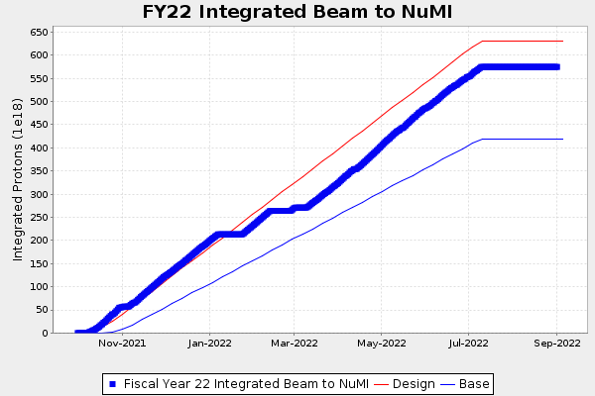
Improving reliability of the complex
Maximize beam power
  Minimize beam loss
Maximize uptime during running periods
  High reliability (replace aging equipment)
  Ability to rapidly repair equipment that breaks
Maximize length of running periods each year
  Minimize duration of annual shutdown for maintenance
ACE will
  Invest in reliability, availability and stability
  Reduce shutdown duration, improve work planning
Overall FY22 efficiency 41%, DUNE/PIP-II goal 57%

Slide 10
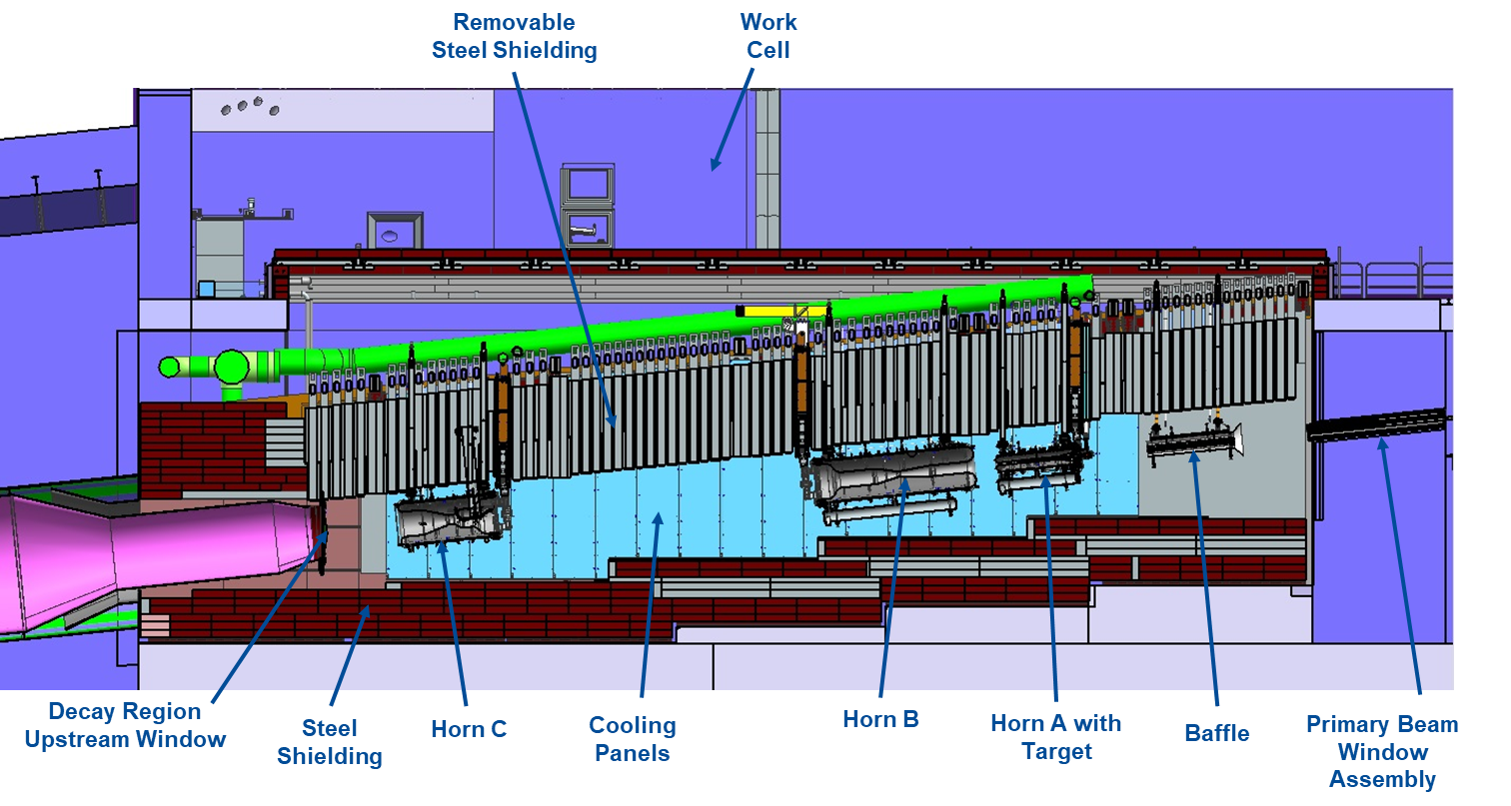
LBNF target systems
2.4 MW
2.4 MW
1.2 MW
>1.2 MW?
>1.2 MW?
>1.2 MW?
>1.2 MW?
2.4 MW
2.4 MW
2.4 MW
1.2 MW

Slide 11
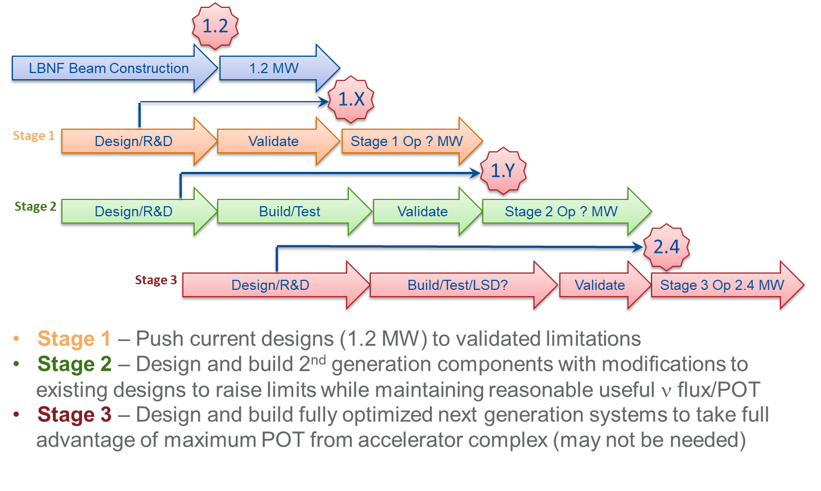
Target development staged approach
Materials R&D results needed to inform design modifications
for higher beam power

Slide 12
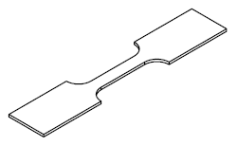
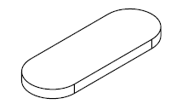

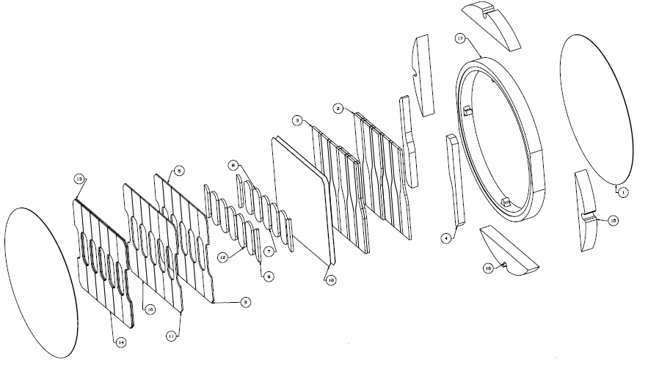
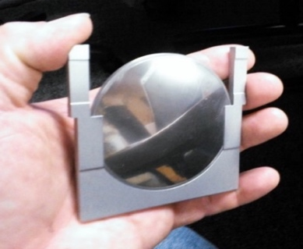
Target materials R&D on critical path to 2+ MW target
Identify candidate materials
High-energy proton irradiation of material specimens to reach expected radiation damage
Pulsed-beam experiments of irradiated specimens to duplicate loading conditions of beam interactions
Non-beam PIE (Post-Irradiation Examination) of specimens
  Material properties
  Microscopic structural changes
  High-cycle fatigue testing
Five-year cycle needs to start ASAP
Tensile specimens
Microstructural analysis specimens
Fatigue specimens
70mm

Slide 13
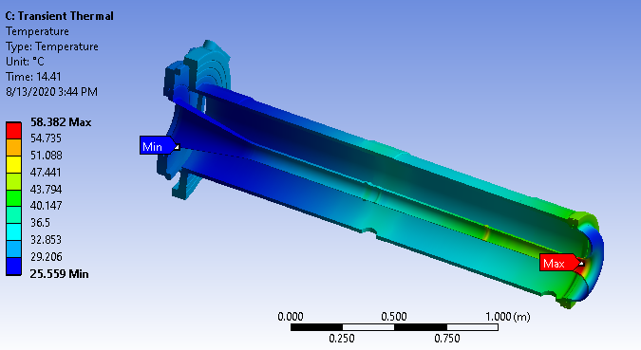
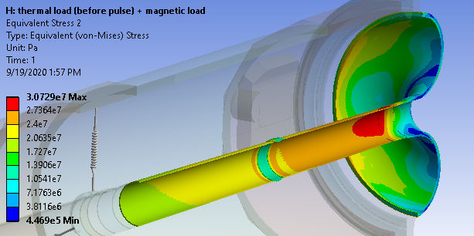
Horns for 2.4 MW performance
Horn A requires reanalysis and likely redesign
  1.2 MW analysis indicates 2.7 safety factor on fatigue endurance limit
  Likely redesign to:
    Avoid beam heating in critical locations
    Strengthen structure in critical locations
Horns B&C see less beam heating
  Safety factor: 7.3 for 1.2 MW operation
  Require reanalysis, but less likely redesign

Slide 14
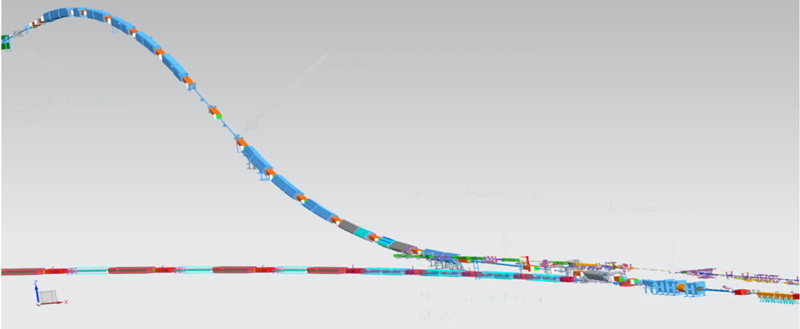
LBNF beamline
Larger power supplies to ramp twice as fast, may need more building space
Kicker power supply modifications to charge up faster
Cooling water: additional pumps to remove and exhaust additional heat
LBNF primary beamline
Main Injector

Slide 15
Impact of shortened cycle on other experiments
In a nominal 1.2s cycle at 20Hz
  12 Booster batches slip-stacked together in the Recycler, accelerated to 120 GeV in the MI, extracted to LBNF (~0.65s in Recycler)
  2 Booster batches for Mu2e rebunched in the Recycler and extracted to the Delivery Ring one bunch at a time, as the bunch is resonantly extracted from the Delivery Ring in a 0.43ms slow spill to Mu2e (~0.55s in Recycler)
  10 Booster batches available to other experiments while Mu2e beam is in the Recycler
In a 0.65s cycle (pre Booster Replacement)
  Recycler not available for Mu2e (finish Mu2e before reduce cycle time)
  1 Booster batch available to other experiments

Slide 16
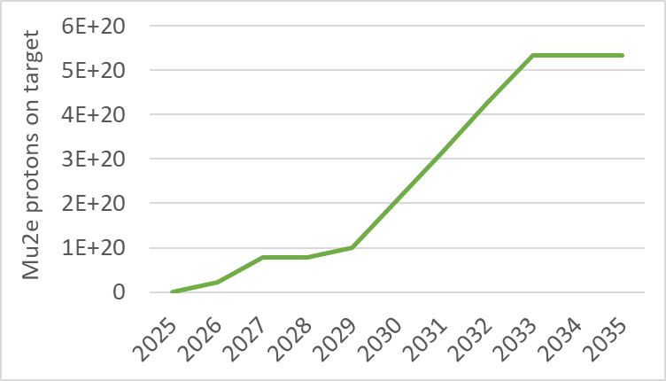
Options for beam sharing for DUNE / Mu2e
Limit beam power to DUNE (1.2s cycle) until Mu2e complete (2033)
  Mu2e beam request is 3.6x10²⁰ POT physics data, total 4.7x10²⁰ including calibration
  May be consistent with LBNF/DUNE commissioning, high-power target/horn development
Run shorter cycle time with shortened spill durations to Mu2e
  Has some effect on Mu2e physics, working with experiment to quantify
Run shorter cycle time with fewer spills to Mu2e
  Extends duration needed to obtain requested Mu2e dataset
  DUNE larger initial dataset but no overall gain
  Less efficient use of Recycler
Fermilab is committed to delivering Mu2e

Slide 17
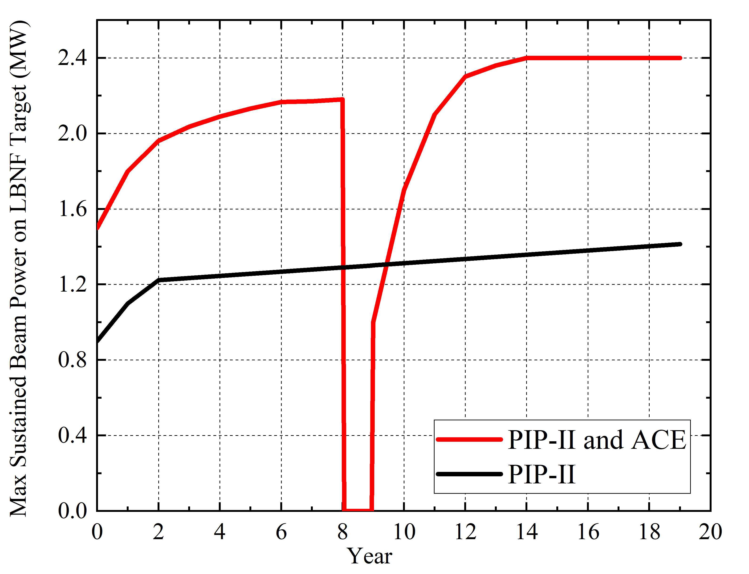
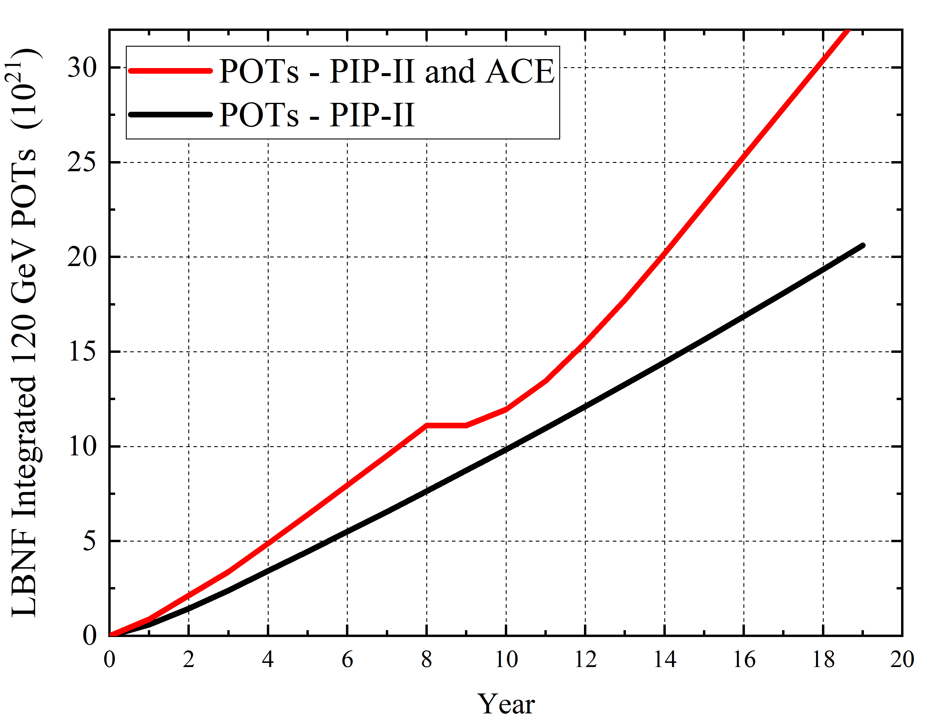
DUNE power and POT implications
Booster replacement
Mu2e complete in 2033
(Mu2e restarts 2029)

Slide 18
Booster replacement
Extend SRF Linac to higher energy or construct new Rapid-Cycling Synchrotron
Provides
  2.4 MW to LBNF
  120 GeV beam available for other experiments
Potential new science ‘spigots’:
  2 GeV Continuous Wave (CW)
  2 GeV Pulsed Beam (~ 1MW)
  8 GeV Pulsed (~ 1MW)
Platform for collider R&D
Front-end for future multi-TeV collider

Slide 19
Booster replacement options
Extend SRF Linac to higher energy or construct new Rapid-Cycling Synchrotron
Looked at 3 representative options of each type
All six configurations require an extension of the SRF Linac to 2 GeV
ACE Science workshop June 14-15 will optimize parameters
RCS
C1a) 10 Hz: Metallic vacuum chamber
C1b) 20 Hz: Ceramic vacuum chamber, larger aperture magnets, accumulator ring
C1c) 20 Hz: (C1b) with high-current linac, no accumulator ring
SRF Linac and Accumulator Ring
C2a) Basic: small increase in PIP-II current, using demonstrated XFEL RF
C2b) High current (5mA) and some RF R&D
C2c) High current and significant RF R&D

Slide 20
Example Booster replacement options and possible add-ons
Beam to Mu2e-II
2 GeV pulsed
2 GeV pulsed
2 GeV CW
8 GeV to MI or BNB

Slide 21
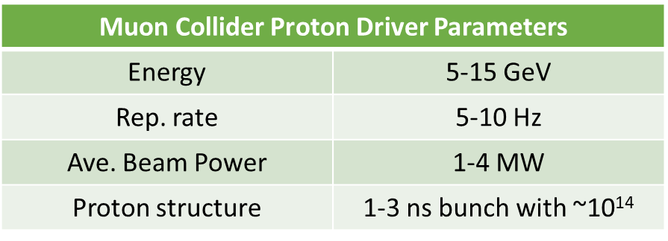
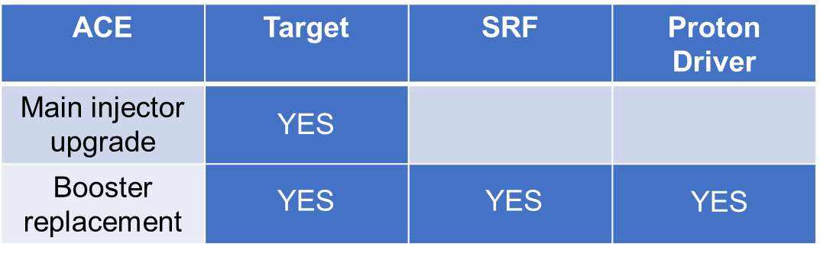
Muon Collider
See talk by Diktys Stratakis
Fermilab ACE program offers several synergies with Muon Collider R&D
The ACE Booster Replacement plan could provide a path for a Muon Collider front-end
Will be discussed at ACE Science workshop June 14-15 at Fermilab
Muon Collider synergies with ACE program

Slide 22
Summary
The Accelerator Complex Enhancement (ACE) plan capitalizes on the PIP-II investment and delivers
More protons-on-target (POT) to LBNF than PIP-II alone could provide
A Booster Replacement that will provide
  Even higher rates of POT accumulation
  A modern and flexible Fermilab Accelerator Complex
Capability
Capacity
Reliability

Slide 23
Request to P5
We ask P5 to support the ACE plan that includes the following key components
  Upgrades to Main Injector accelerator systems and infrastructure to enable beam power above 1.2MW through faster cycle time and efficient operations of the complex with the aim of achieving DUNE goals as fast as possible, performed as series of AIP and GPP between 2024 and 2032
  Accelerated profile of high-power target system R&D to enable above 1.2MW operations in DUNE Phase I
  Establishment of a Project for Booster Replacement with superior capacity, capability, and reliability to be tied to the accelerator complex at a time determined by the DUNE physics

