Slide 1
Towards a Muon Collider accelerator
Diktys Stratakis (Fermilab)
P5 Town Hall at SLAC
May 3rd, 2023
On behalf of US Muon Collider Community, International Muon Collider Collaboration, and Snowmass Muon Collider Forum

Slide 2
Why muons?
Muons as compared to protons
  Muons are elementary particles and all their energy in a collision is used
  As a result, need less collision energy for the same physics
Muons as compared electrons
  Muons emit little synchrotron radiation
  As a result, acceleration in rings possible up to many TeV
In a Muon Collider, luminosity to power ratio improves substantially with energy
A Muon Collider combines a small footprint and high energy efficiency!

Slide 3
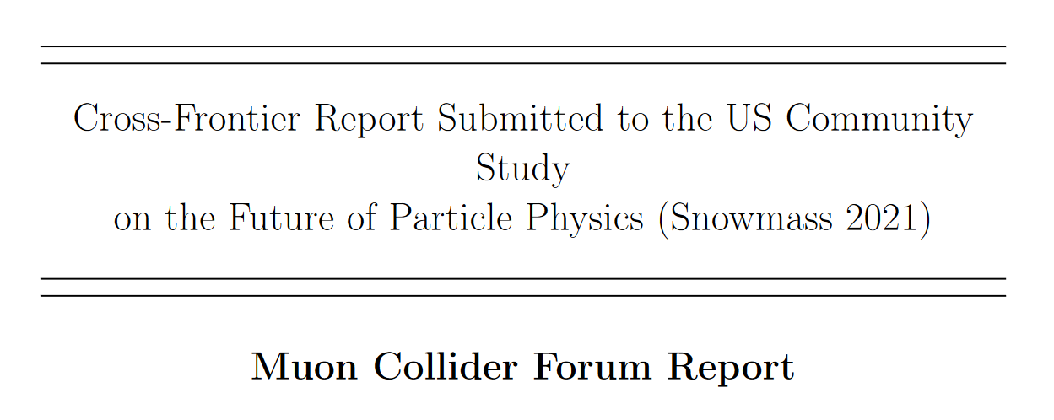
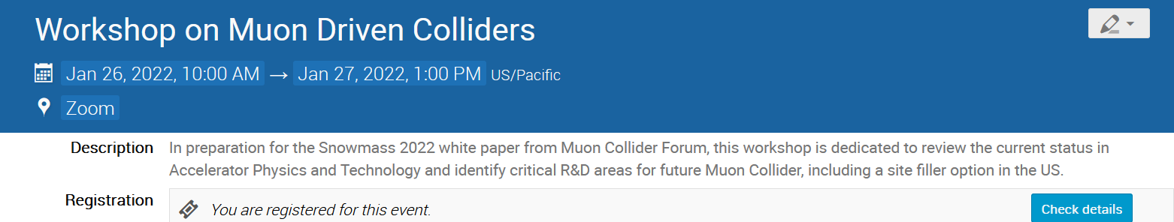
Snowmass Muon Collider Forum
  The forum established a strong collaboration between the AF+EF+TF frontiers for Muon Collider (MuC) research
  Monthly meetings and dedicated workshops for 18+ months before Snowmass
  MuC Forum report is now public: ~180 authors, 50+% are early career scientists
Forum conclusions:
  No fundamental showstoppers identified
  BUT engineering challenges exist
  Significant R&D is needed to improve a MuC risk profile
MuC was the most studied machine during Snowmass. Many new results & papers, propagated to the EF vision.

Slide 4

International Effort
In 2020, following the 2018 European Strategy process, Laboratory Director’s Group initiated a Muon Collider feasibility study
In 2022, the International Muon Collaboration (IMCC) was formed and hosted at CERN
Several US universities started to join, many more expressed interest
IMCC planning assumes a significant US participation to develop the baseline project and the best siting option (including US siting)
https://muoncollider.web.cern.ch/

Slide 5
Target parameters
The goal is to get to 10 TeV center-of-mass energy
Consider proton driver based Muon Collider
Staging at 3 TeV is the current baseline
Aim to have two detectors but only experiment assumed now

Slide 6
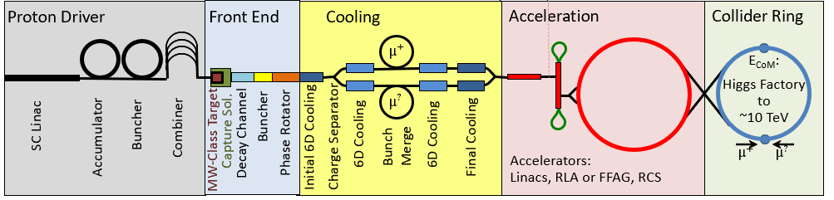
Machine overview
Muon production target
Ionization cooling to reduce 6D emittance
Collider ring for counter propagating muons
MW-scale proton driver
Capture 200 MeV bunches
Acceleration to TeV scale energy
Requires a 1-4 MW proton beam @ 5-20 GeV, compressed to 1-3 ns bunches at a 5-10 Hz frequency

Slide 7
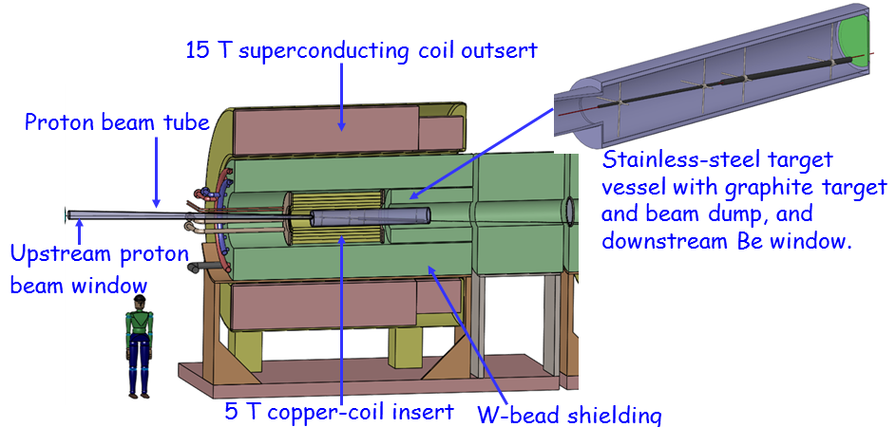
Muon Collider target: Concept & technology needs
Technology requirements for MuC targets:
  Target materials that produce high muon yield
  Placement in a high-field solenoid (15-20T) to maximize capture
  Materials tolerant to thermal shock and fatigue from MW-scale beams
  Shielding system that protects the capture magnet and surrounds
  Large solenoid aperture to allow for shielding

Slide 8
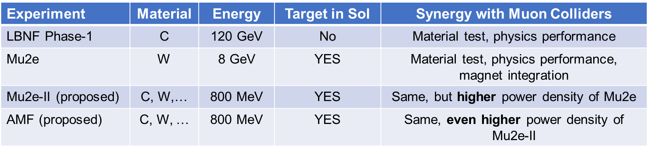
Muon Collider target: Path forward (1)
In 2007, a proof-of principle test validated the concept with a liquid Hg target. Technology was OK but some safety concerns
Recent work shows promising results with C or W but still significant R&D is needed to confirm that the target can withstand 2+ MW
This fact, combined with the strong demand of high-power targets puts the MuC in a synergistic path with many future experiments:

Slide 9
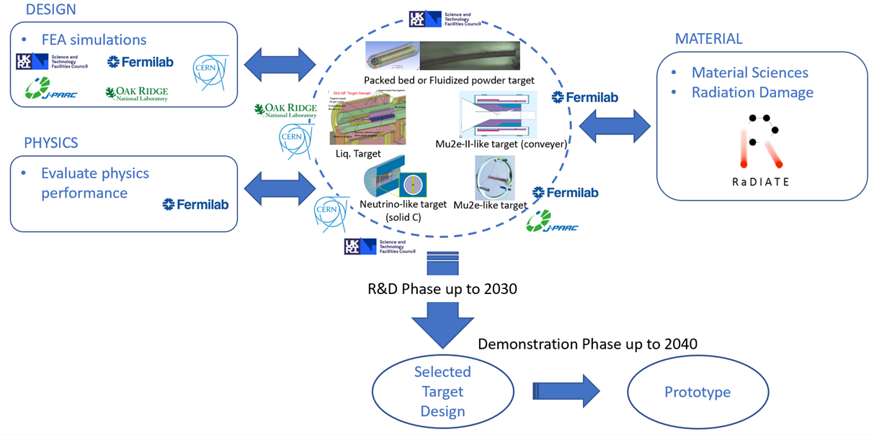
Muon Collider target: Path forward (2)
MuC targetry is included in the proposed GARD High Power Targetry Roadmap with a plan to have a prototype in the late 2030s
R&D
should start now!

Slide 10
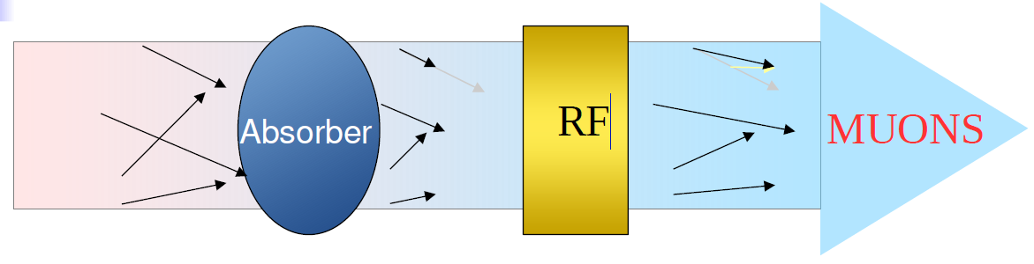
Muon Collider cooling – Concept & technology needs
Magnet
100% momentum spread
Technology requirements for MuC cooling:
  Large bore solenoidal magnets: From 2 T (500 mm IR), to 14 T (50 mm IR)
  Normal conducting rf that can provide high-gradients within a multi-T fields
  Absorbers that can tolerate large muon intensities
  Integration: Solenoids coupled to each other, near high power rf & absorbers)

Slide 11
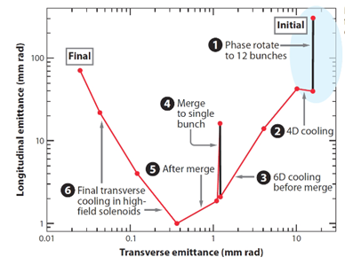
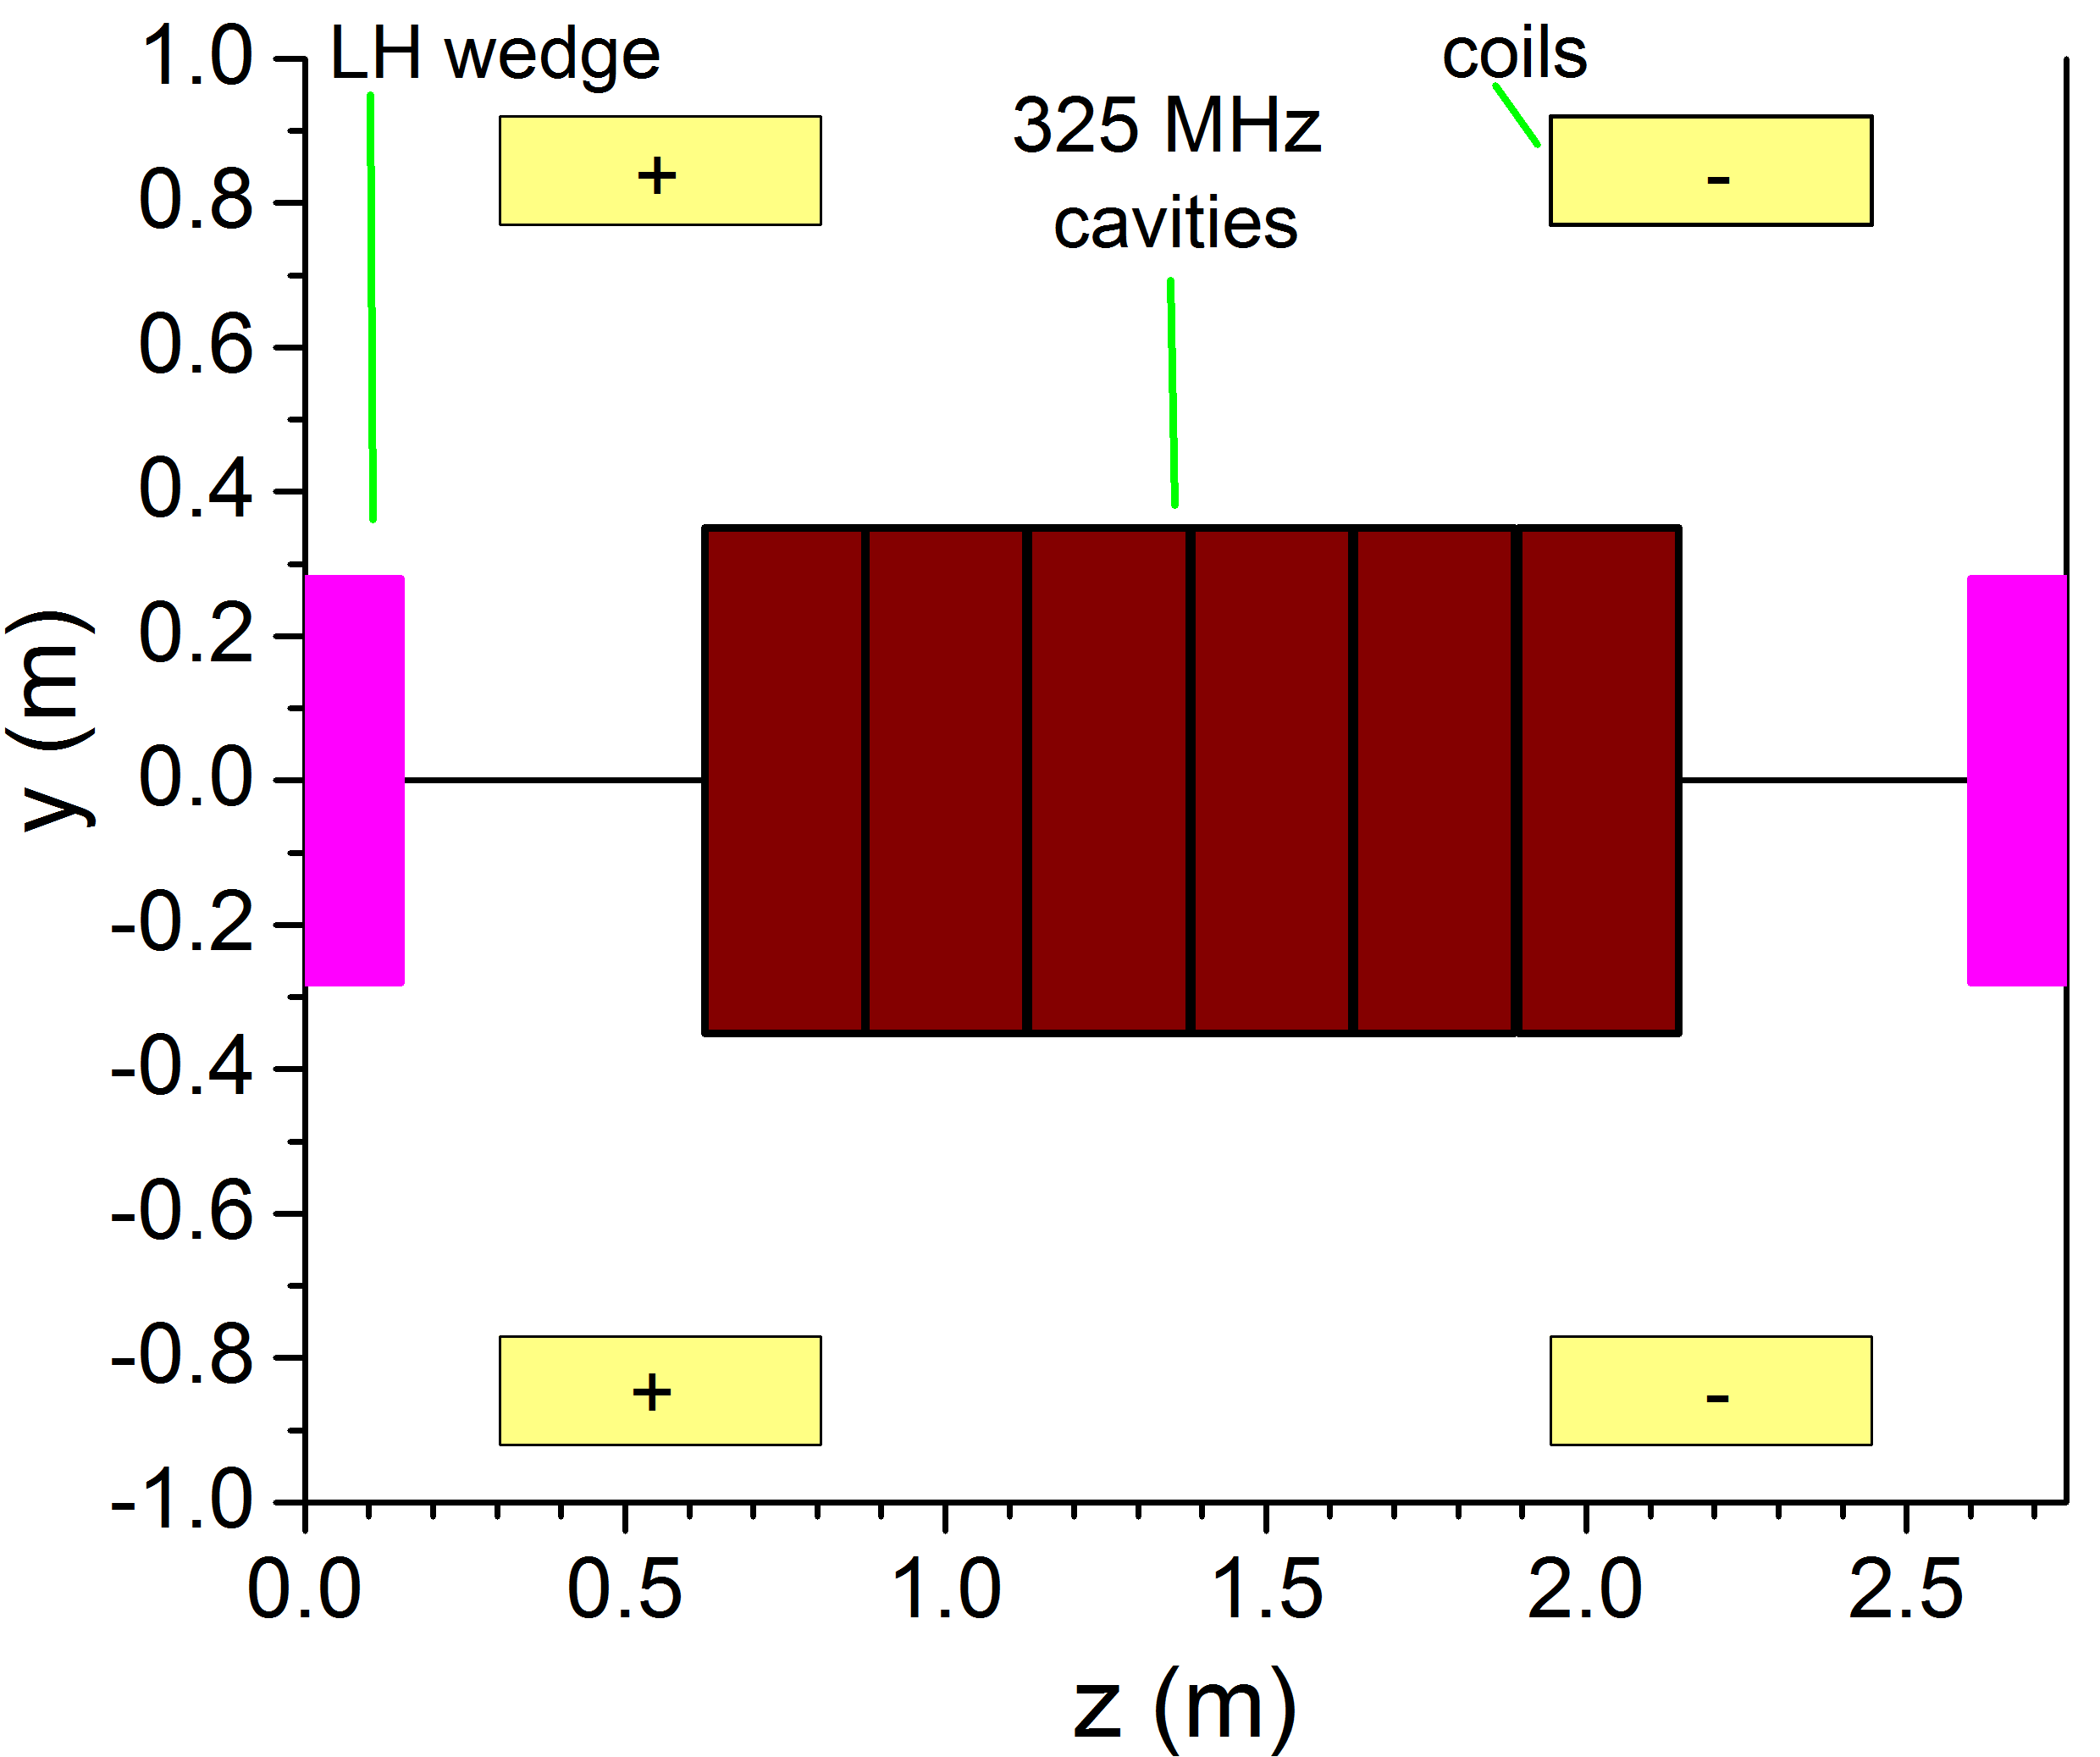
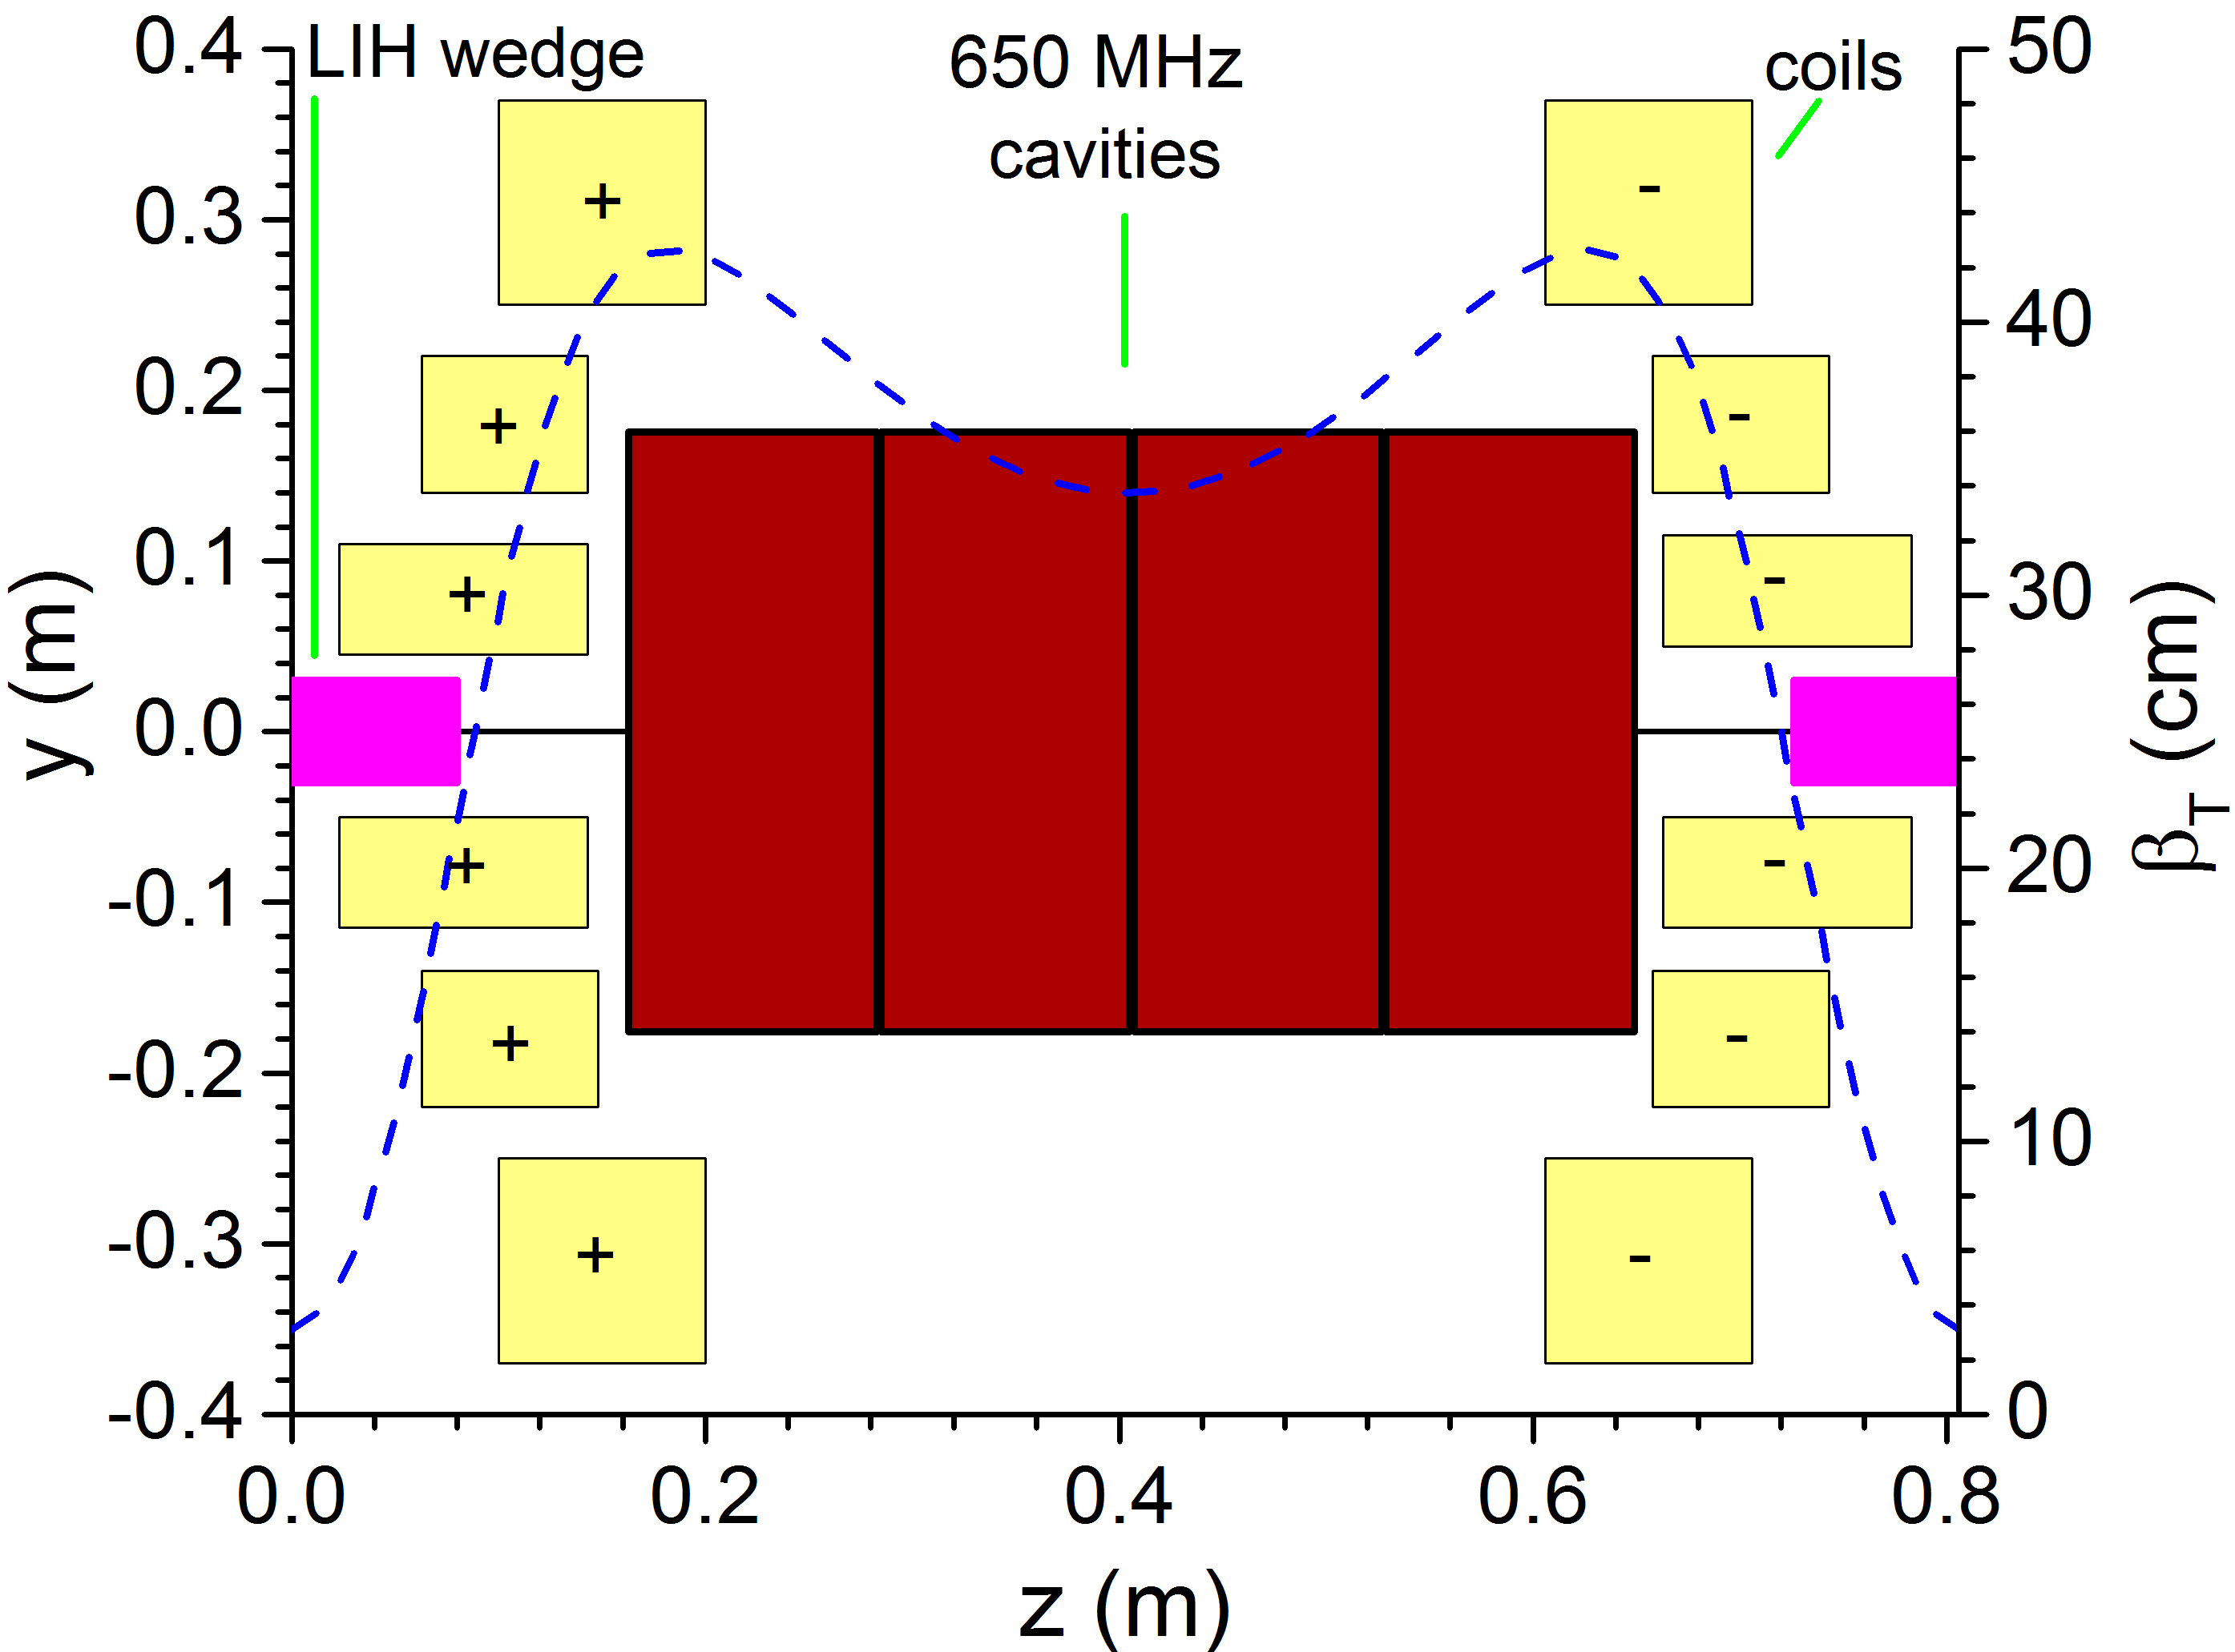
Muon Collider cooling: Path forward (design)
Good progress in all cooling section designs over the last years. BUT, the final cooling did not achieve our goals [ref]
Goals for next 5 years:
  (1) Deliver a realistic end-to-end design that meets the MuC criteria (2) take into account engineering aspects of the design and (3) improve performance with AI/ML methods and latest technology advancements
Early cell (“easy”) – 2T peak
MuC cooling requirement
Late cell ( “hard”) – 14 T peak
Now
Goal

Slide 12
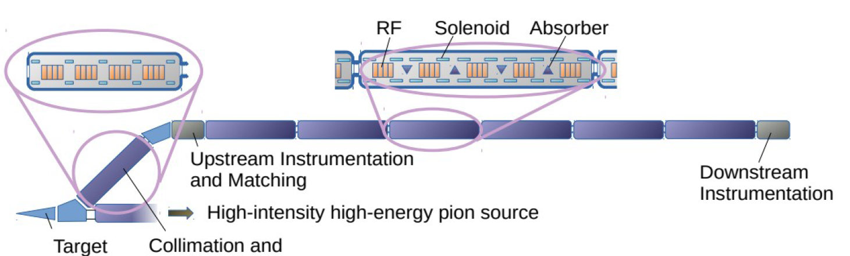
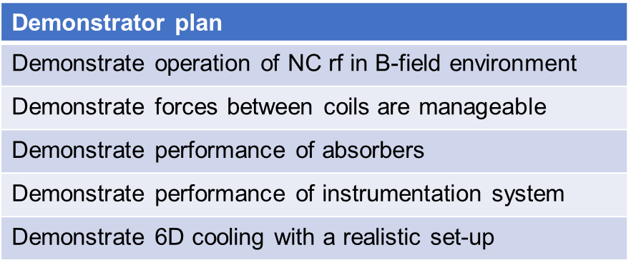
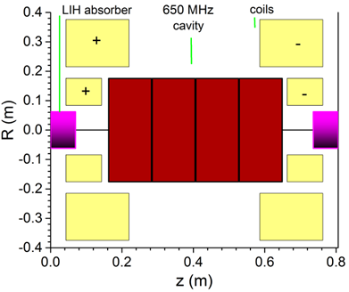
Muon Collider cooling: Path forward (demonstrator)
While the physics of ionization cooling has been shown [ref] it is critical to benchmark a realistic MuC cooling lattice
  This will give us the input, knowledge, and experience to design a real, buildable cooling channel for a MuC
  Next 5 years: (1) A conceptual design of a demonstrator facility that allows testing the technology for cooling (2) Site exploration & cost estimate of a demo facility (3) Engineering design & start fabrication of a 1.5 prototype cooling cell
Many cells
x10

Slide 13
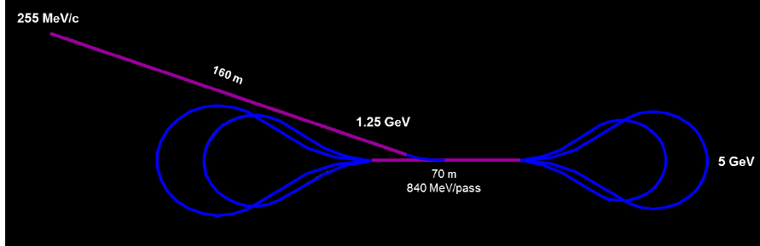
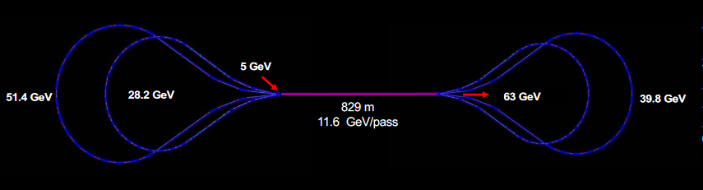
Acceleration to GeV – Concept & technology needs
1
SC RF 325 MHz
2
SC RF 650 MHz
3
SC RF 1300 MHz
Technologies requirements for a Muon Collider:
  Superconducting linacs and Recirculating linear accelerators (RLAs)
  SC RF that: (1) starts at a low frequency ~ 325 MHz, (2) operate at high-gradients

Slide 14
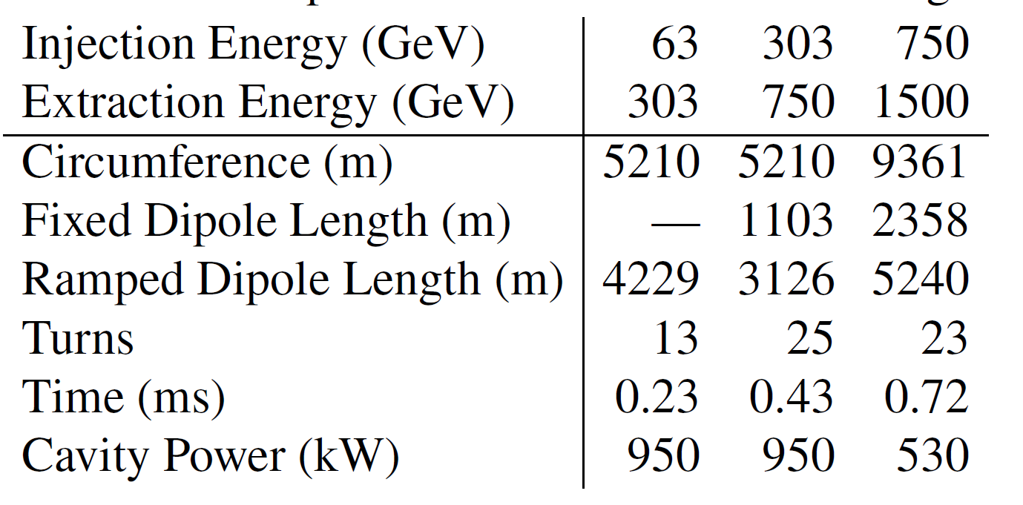
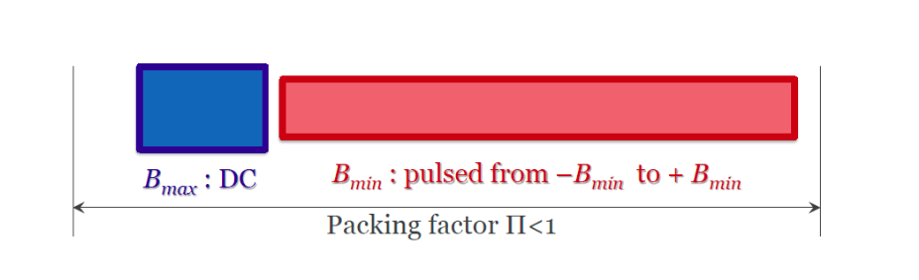

Acceleration to TeV – Concept & technology needs
1.5 TeV example
DC field
Pulsed from ${−B}_{w}$ to ${+B}_{w}$
Technologies needs for a Muon Collider
  Hybrid Rapid Cycling Synchrotron accelerators
  Fast ramping magnets (<0.5 ms) accompanied with a 8-10 T DC magnet
  Good energy storage and power management for pulsed magnets

Slide 15
Muon Acceleration: Path forward
5 cell elliptical cavities @ 650 MHz for PIP-II
Cryomodule @ 1300 MHz for LCLS-II
In the next 5 years develop self-consistent accelerator lattice designs towards a 10 TeV collider
  Investigate the beam-cavity interactions in all parts of the accelerator
Utilize the extensive experience of the US on SRF for:
  Design and testing SRF cavities for a MuC (325, 650, 1300 MHz)
  Investigate alternative superconductors for pushing the gradient
  Synergy opportunities with other programs (ILC, FCC-ee, GARD)

Slide 16
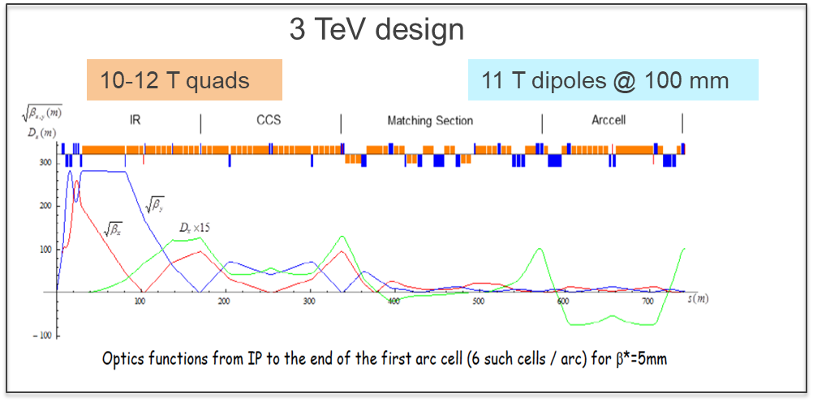
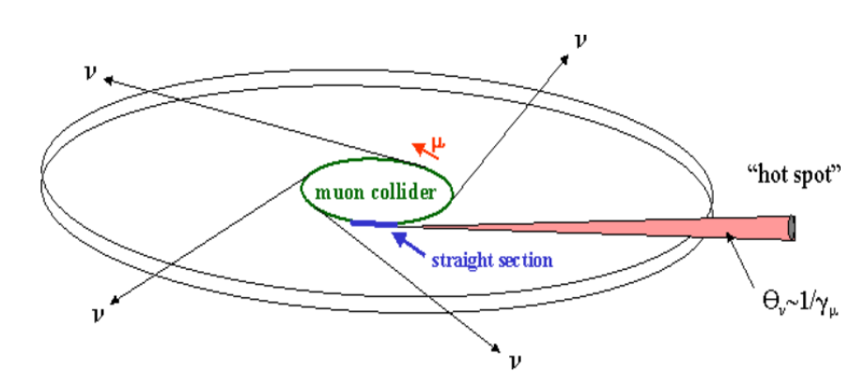
Muon Collider ring – Concept & technology needs
Technology requirements for a Muon Collider (10 TeV)
  Strong quad focusing (> 12 T at IR)
  High-field dipoles (12-16 T) with large aperture (~150 mm) for shielding
  Mitigation system for the neutrino flux from muon decays

Slide 17
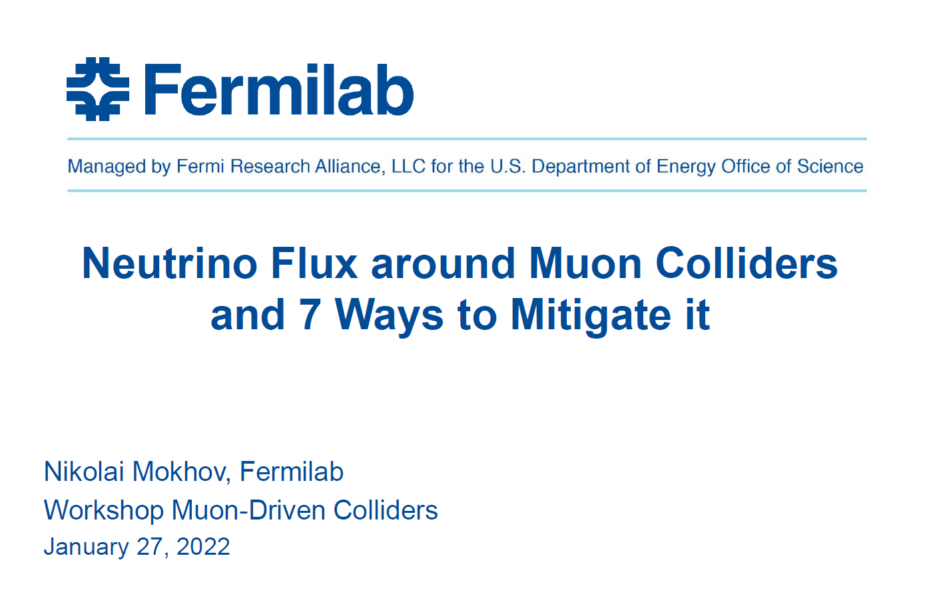
Muon Collider ring – Path forward
Lattice design in place for a 3 TeV collider with optics and magnet parameters within existing technology limits
In the next 5-years: Develop design concepts for a 10 TeV collider
  Preliminary concepts for 10 TeV published [ref] but more work is needed
  Develop conceptual magnet designs with shielding from beam decay
Several solution for Neutrino flux mitigation proposed and need to be evaluated
  Examples include situating the collider ~200 m underground [ref] or move lattice over time (next [ref] or a combination of the two
  Promising example to follow (next slide)
10 TeV radiation studies
coil
W for radiation protection

Slide 18
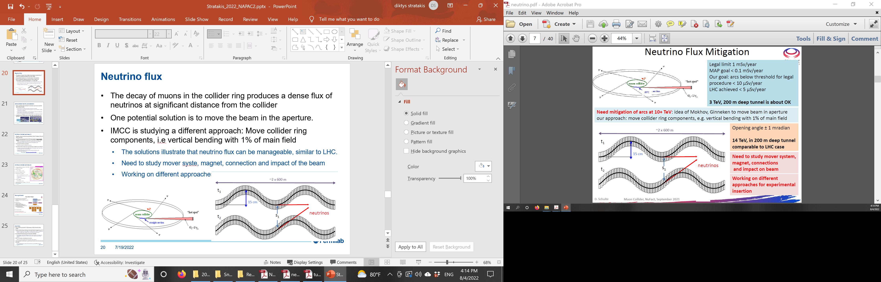
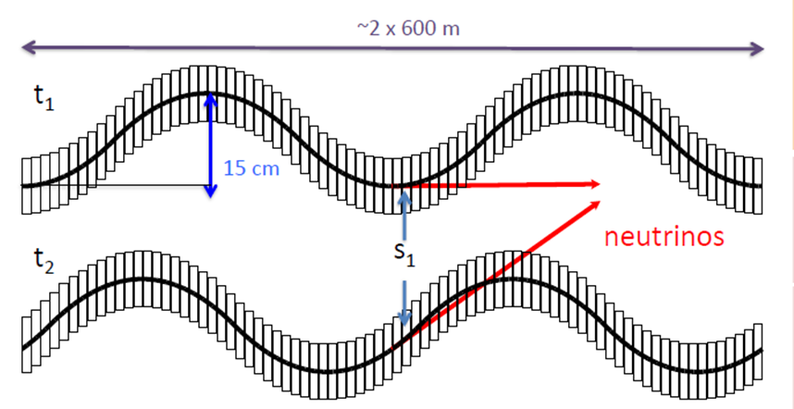
Neutrino flux mitigation system
Legal limit: 1 mSv/year
MAP goal: <0.1 mSv/year
IMCC goal: <10 µSv/year
LHC : <5 µSv/year
Solution: A mechanical system that will disperse the neutrino flux by periodically deforming the collider ring arcs vertically with remote movers; (Schulte, IPAC 22)
Could work even for 14 TeV collider at 200 m
Requires significant R&D and proof-of principle tests

Slide 19
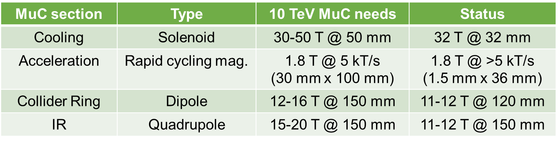
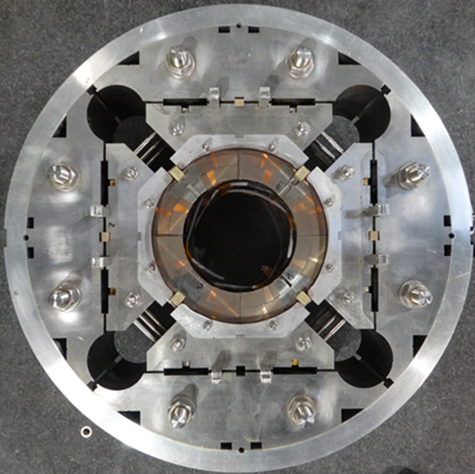
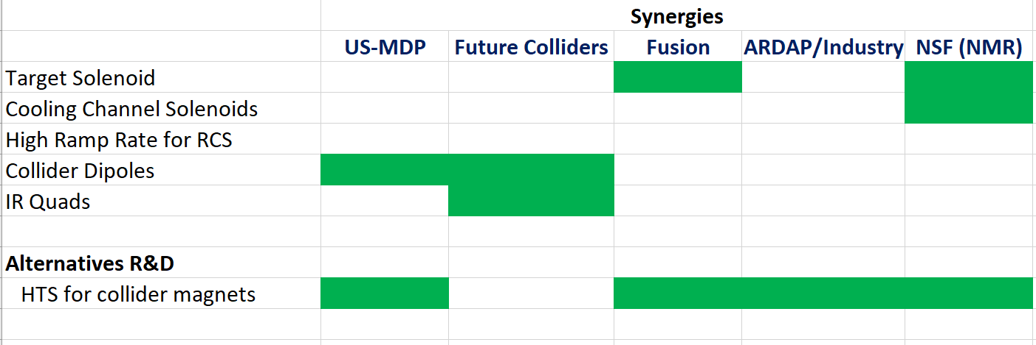
Muon Collider Magnets: Path Forward
Many synergies with other programs possible.
  However rapid cycling magnets are unique for a MuC and need out attention!
32T @ NHMFL
LHC-HL 12 T quad @ 150 mm

Slide 20
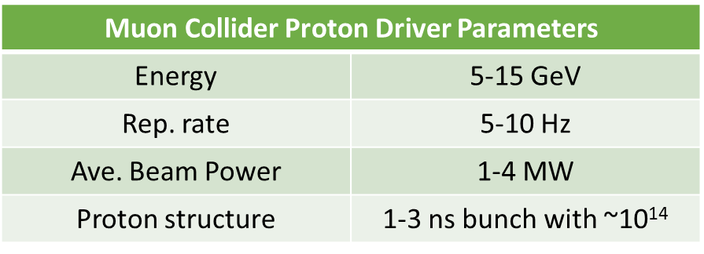
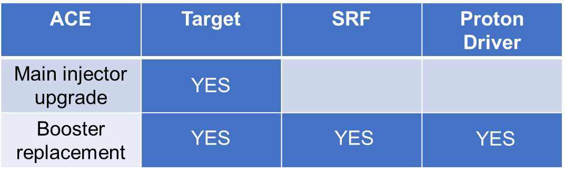
ACE and Muon Collider
Muon Collider proton driver needs are beyond existing facilities
Fermilab ACE program offers several synergies with Muon Collider R&D
The ACE booster replacement plan may provide a path for a MuC front-end
  ACE parameters are being defined. ACE physics workshop in June 14-15th will investigate synergies and options, including front-end for a MuC
Synergies with ACE program

Slide 21
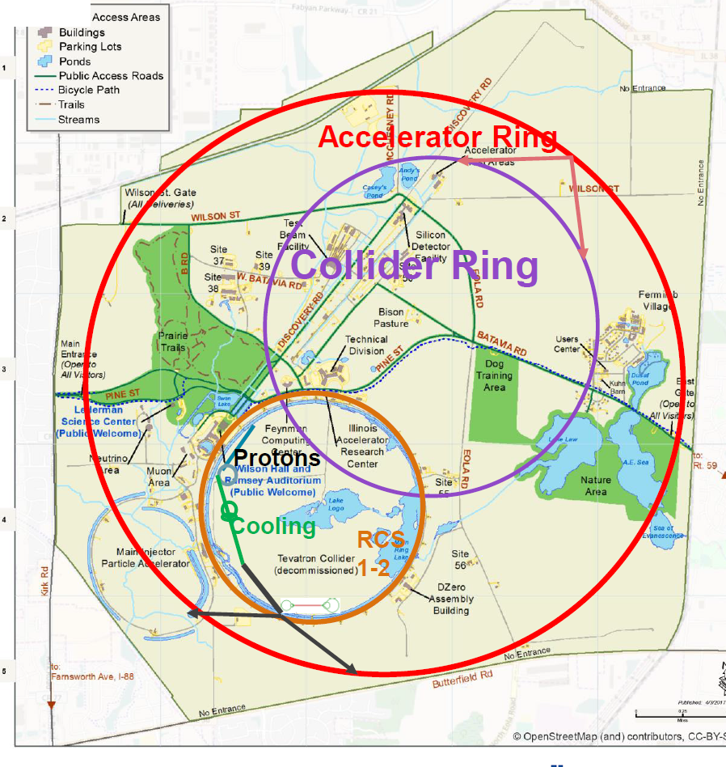
Muon Collider @ Fermilab
A concept design for a Fermilab 6-10 TeV MuC is in place
Proton source
  Post-ACE driver -> Target
Ionization cooling channel
Acceleration (3 stages)
  Linac + RLA → 65 GeV
  RCS #1, #2 → 1 TeV (Tevatron size)
  RCS #3 → 3-5 TeV (site filler)
6-10 TeV collider
  Collider radius: 1.65 km
In the next 5 years, have a baseline design including the neutrino flux mitigation system

Slide 22
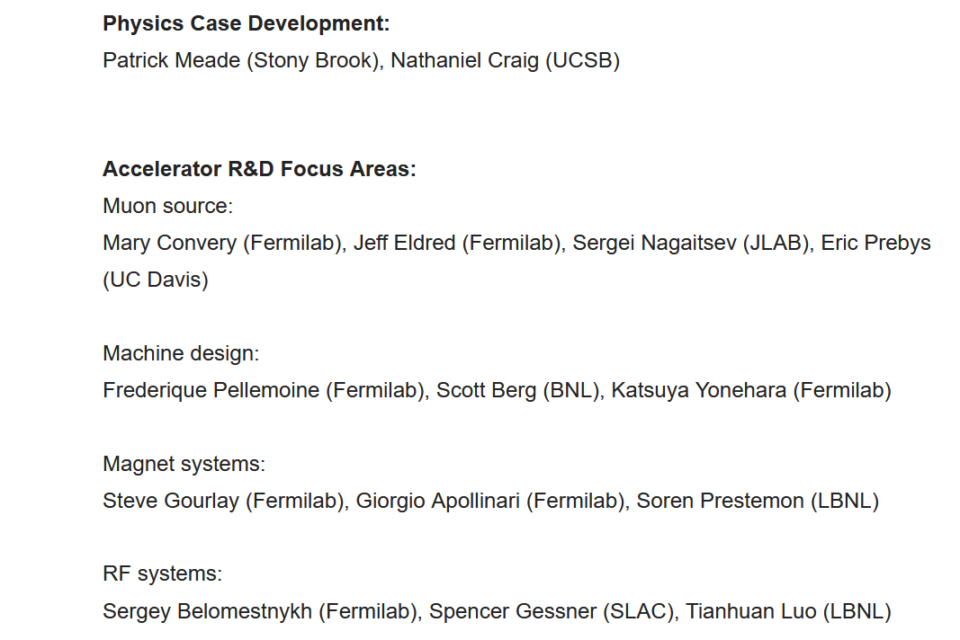
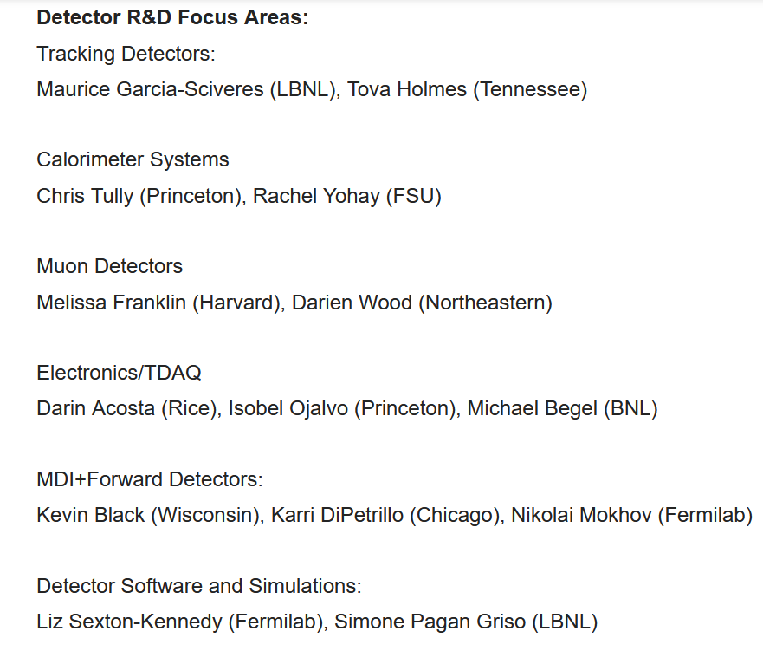
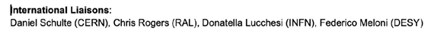
US Muon Collider R&D coordination group
In March, R&D coordination group formed to provide input to P5
Focus on key elements of 10 TeV accelerator & detector design
  Develop R&D plan, activities, budget and deliverables
  Chairs: Sridhara Dasu (Wisconsin), Sergo Jindariani, Diktys Stratakis (Fermilab)

Slide 23
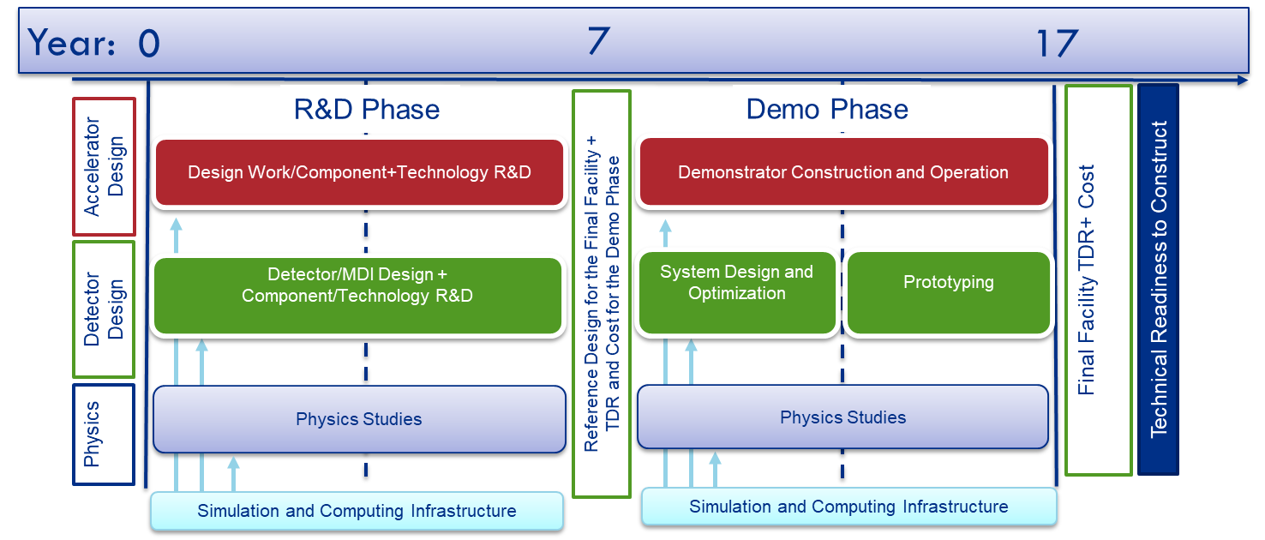
US Muon Collider timeline

Slide 24
A possible MuC US R&D roadmap for accelerator
2024-2030
Complete design & simulation of the whole MuC complex, including a neutrino flux mitigation system (include designs for a Fermilab MuC option)
  Take into account engineering aspects of the design, establish operating parameters and develop technology concepts with potential to meet these parameters
Proceed with (limited) prototyping & technology R&D
  Rapid cycling dipoles: magnet prototype, including its power deliver system
  Proton bunch compression tests at existing facilities
  Target material study & pion yield measurement at existing facilities
  Design and testing of high gradient SRF cavities (325, 650, 1300 MHz)
  Engineering design and begin fabrication of a 1.5-cell cooling cell prototype
Define what we like to further test, how and where after 2030
By 2030, achieve enough technical maturity for the construction of the demo facility in 2030s and potential construction of the collider facility in the 2040s.
Synergistic with other programs
It is crucial for the US to engage NOW if we want an MC as a future option!

Slide 25
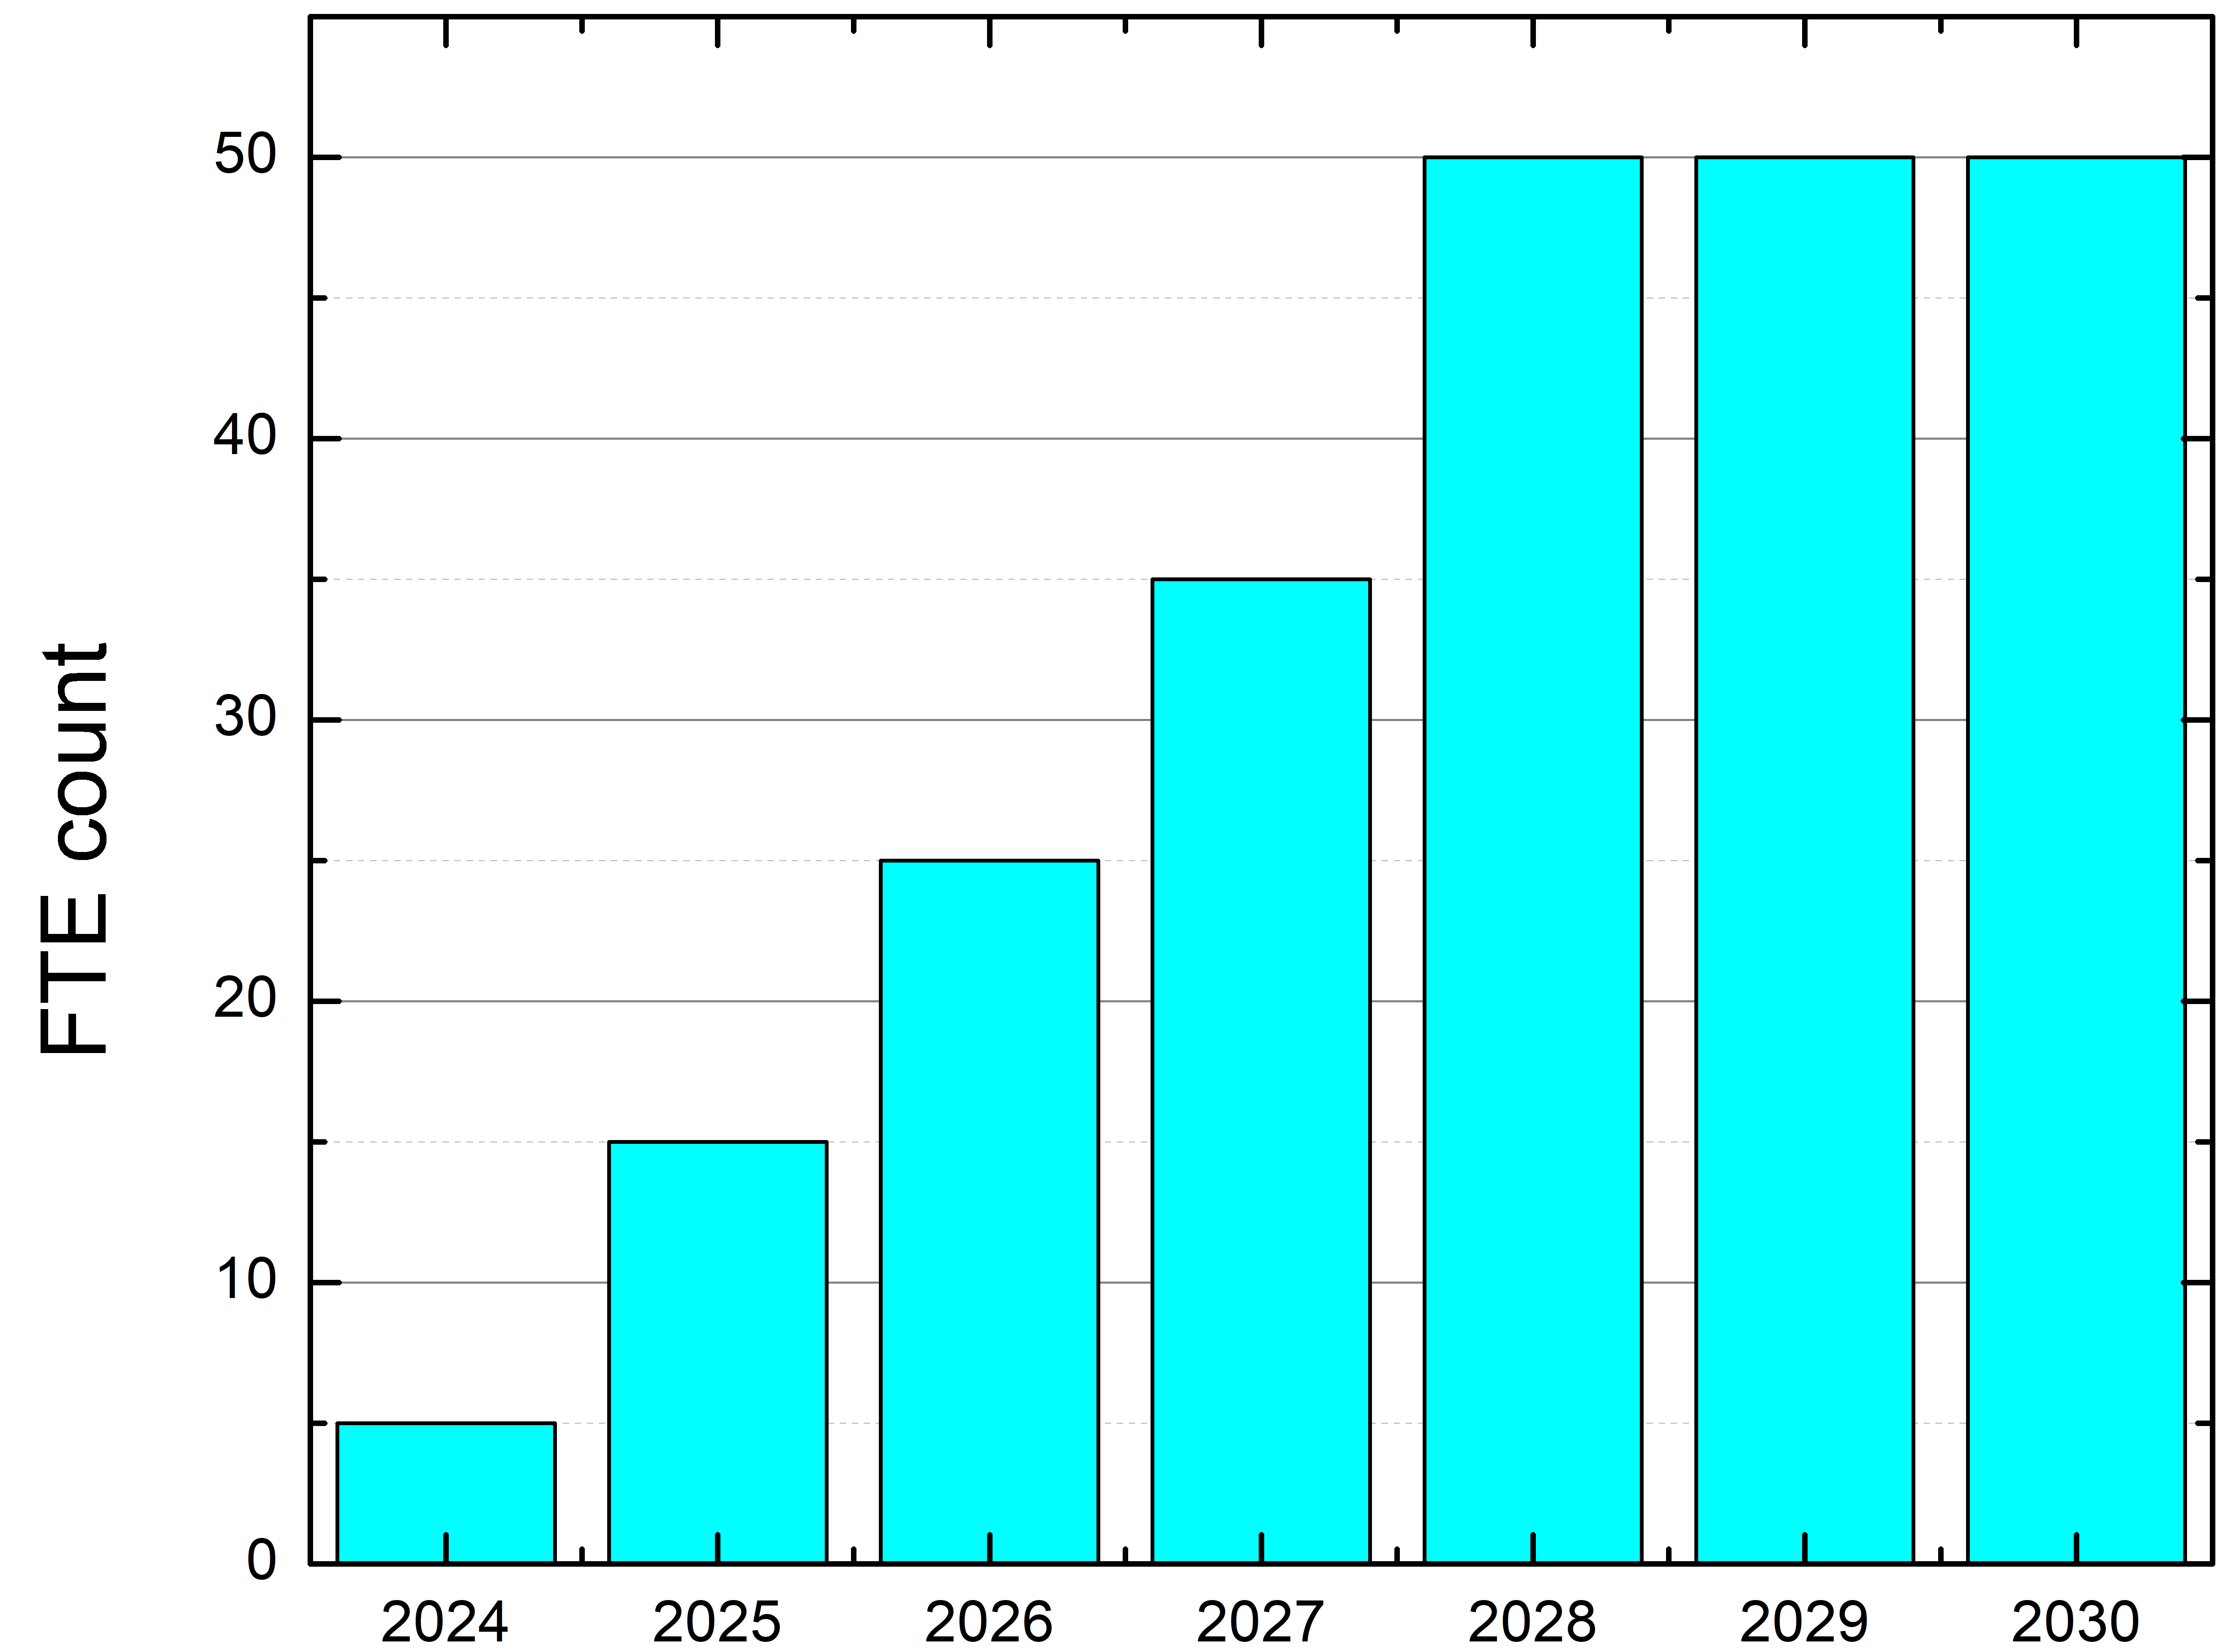
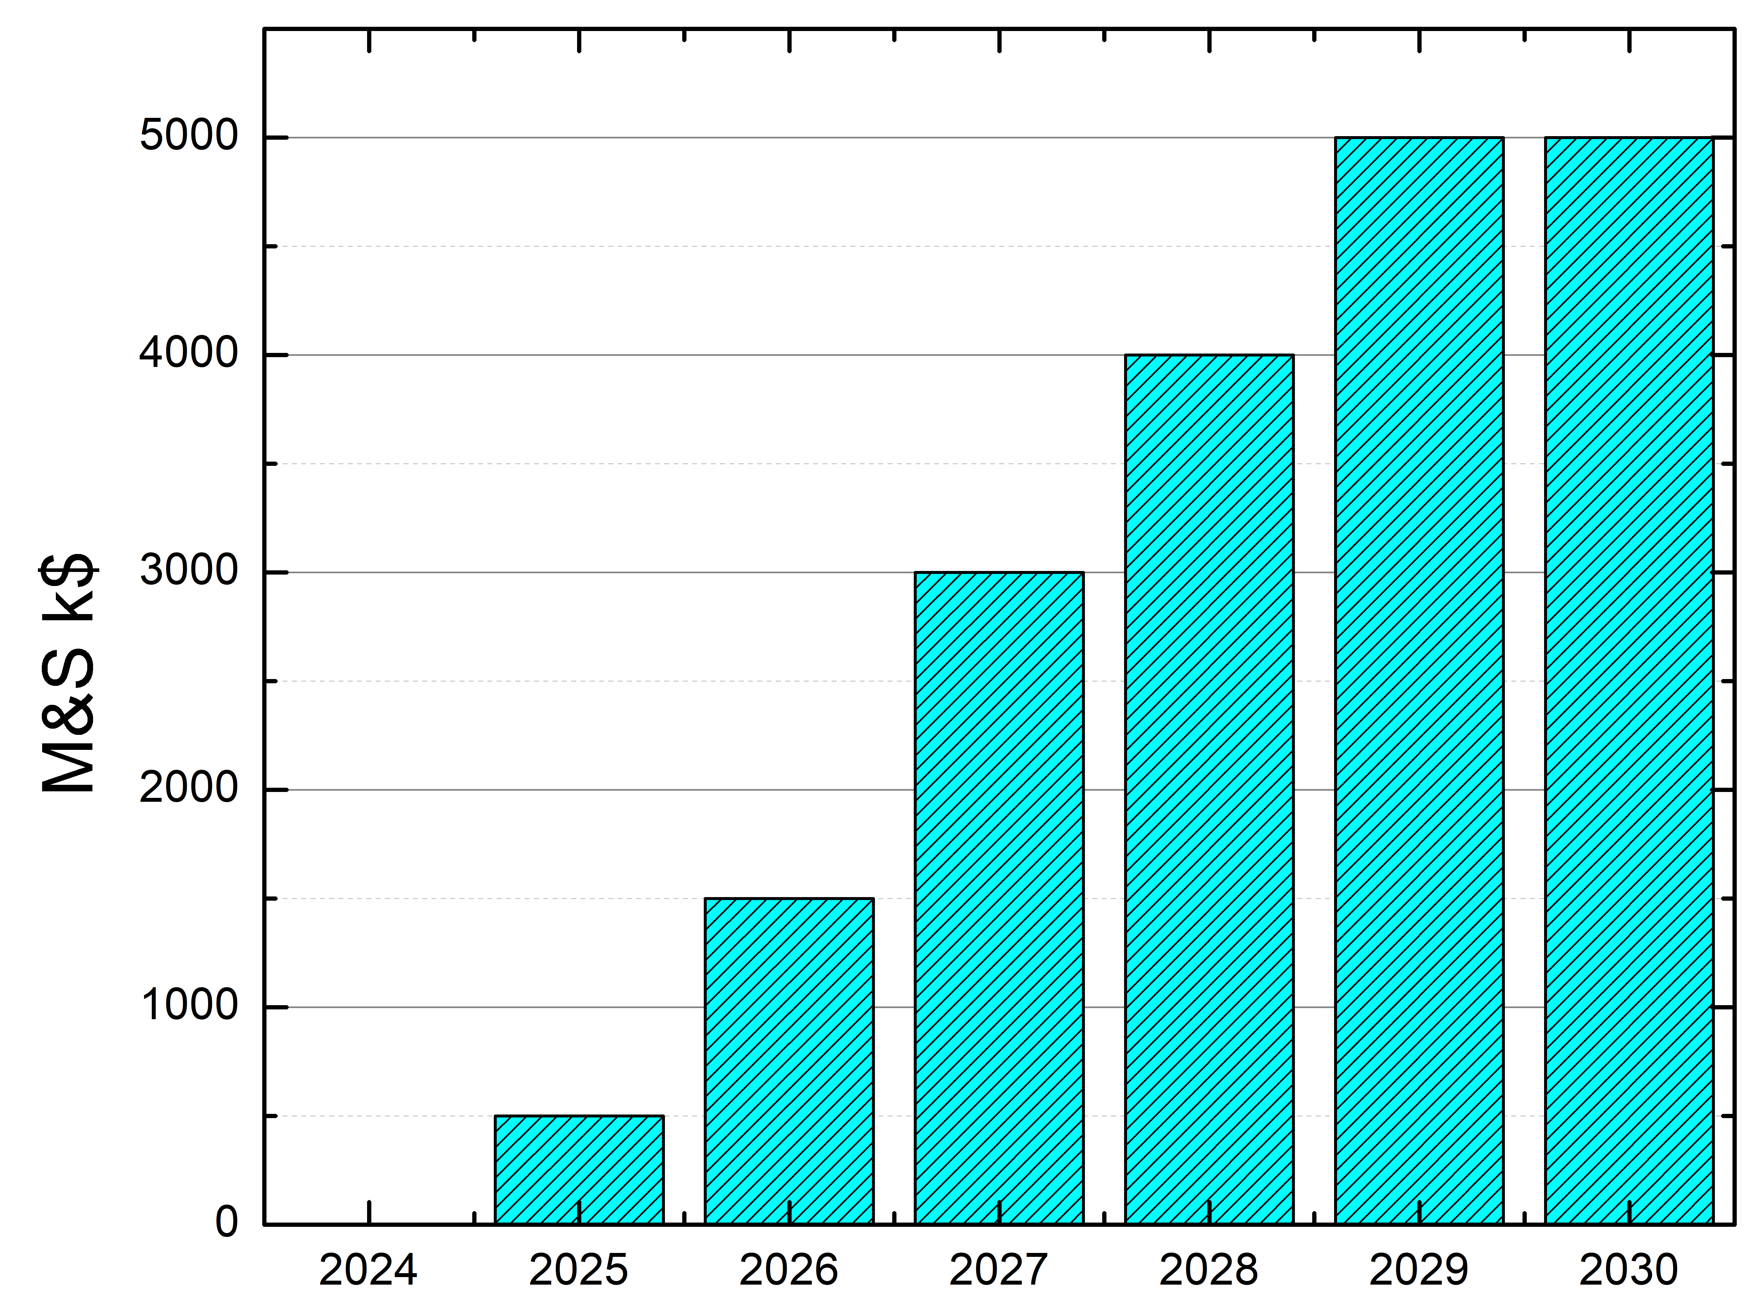
US R&D budget estimate 2024-2030 (Accelerator)
2024+: Ramp-up budget profile so that US accelerator experts can engage with the international Muon Collider effort
~2030: Goal: Deliver a MuC reference design report and a TDR report for the demonstrator facility with cost estimates
2030+: Develop technology to be ready to commit, verify performance of all components
  Significant ramp-up is needed. Cooling channel demonstrator is expected to be the cost driver

Slide 26
Summary
MC offers a unique opportunity for energy frontier collider with high luminosity
Physics & technology landscape has significantly changed recently
We have established a highly motivated group to address challenges for a Muon Collider
As also presented at BNL, we are asking P5 to:
  Recommend establishing a Muon Collider R&D program with the aim for delivering a RDR report for the final facility & TDR report for the demo facility by 2030 AND with an overall goal of having a TDR for the final facility by 2040
  Recommend that DOE and NSF recognize Muon Collider work within the AF base program proposals
  Support the formation of a US Muon Collider effort to coordinate US impact while engaging in the international effort
  Enable US to compete for hosting a Muon Collider

Slide 27
Extra

Slide 28
Muon Collider Synergies
Facility/Experiment | Physics Goals | Synergy
nuStorm | Short baseline neutrino program, including searches for sterile neutrino and cross section measurements | 100kW proton source, muon production and collection, storage ring operation
Dark Sector searches | Searches for particles from Dark Sectors produced in fixed target experiments using high intensity proton beam | MW class high-intensity proton beams
Charged Lepton Flavor Violation (e.g. AMF) | Searches for rare lepton flavor violating processing (mu2e, mu2eg, mu3e, etc) | MW class proton source, muon production and collection, storage ring
Beam dump experiments | Searches for exotic particles (dark photons, Lmu-Ltau, etc) in muon beam dump experiments | 100kW – MW proton source, muon production and collection, partial cooling and acceleration
Neutrinos from collider beam muon decays | DIS in neutrino-nucleus interactions, better nuclear PDF, atmospheric neutrinos FASERν like experiment with smaller flux uncertainties | Everything up to multi-TeV energy collider beams
Muon Ion Collider | A broad program addressing many fundamental questions in nuclear and particle physics | Everything up to multi-TeV energy collider beams

Slide 29
Muon Collider Challenges
Challenge | Progress | Future work
Multi MW proton sources with short bunches | Multi-MW proton sources have been and are being produced for spallation neutron sources and neutrino sources (SNS, ESS, J-PARC, Fermilab) | Refine design parameters, including proton acceleration to 5-10 GeV. Accumulation and compression of bunches.
Multi MW targets | Neutrino targets have matured to 1+MW. RADIATE studies of novel target materials and designs aim at 2.4MW. | Develop target design for 2 MW and short muon collider bunches. Produce a prototype in 2030s.
Production solenoid | ITER Nb3Sn central solenoid with similar specifications and rad levels produced | Study cryogenically stabilized superconducting cables and validate magnet cooling design. Investigate possibility of HTS cables.
Cooling channel solenoids | Solenoid with 30+T field now exists at NHMFL. Plans to design 40+T solenoids in place. | Extend designs to the specs of the 6D cooling channel, fabrication for the demo experiment
Ionization cooling | MICE transverse cooling results published. Long.cooling via emittance exchange demonstrated at g-2. | Optimize with higher fields and gradients. Demonstrate 6D cooling with re-acceleration and focusing
RF in magnetic field | Operation of up to 50 MV/m cavity in magnetic field demonstrated, results published | Design to the specs of the 6D demo, experimen; fabrication

Slide 30
Muon Collider Challenges
Challenge | Progress | Future work
Fast Ramping Magnets | Demonstrated 5000+ T/s with 1. 8T | We need to design a efficient power supply system for these magnets
Neutrino Flux Effects | Mitigation strategies based on placing the collider ring at 200m and introducing beam wobble has been shown to achieve necessary reduction up to 10-14 TeV | Study mechanical feasibility, stability and robustness of the mover's system and impact on the accelerator and the beams
Detector shielding and rates | Demonstrated to be manageable in simulation with next generation detector technologies | Further develop and optimize 3 and 10 TeV detector concepts and MDI. Perform detector technology R&D and demonstration.
Large aperture storage ring magnets | 12-15T Nb3Sn magnets have been demonstrated | Design and develop larger aperture magnets 12-16T dipoles
Low-beta IR collider design and dynamic aperture | Lattice design in place for a 3 TeV collider with optics and magnet parameters within existing technology limits | Develop lattice design for a 10 TeV collider

Slide 31
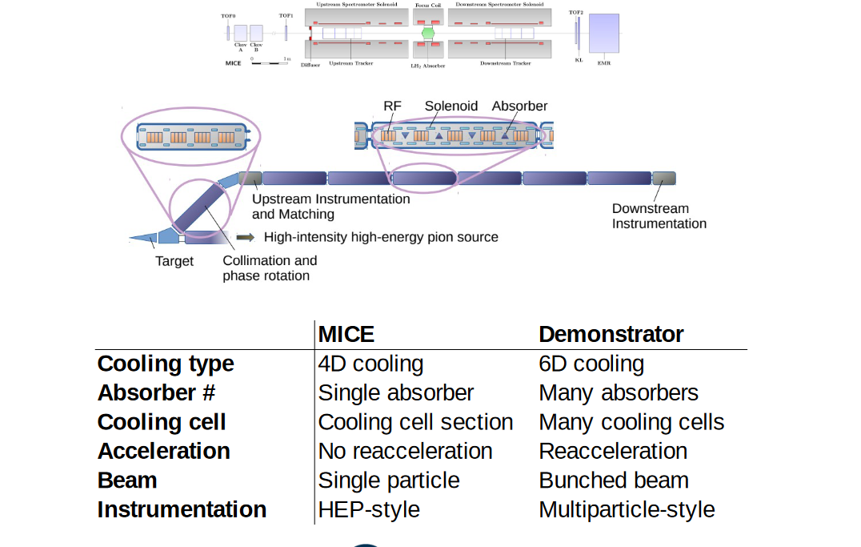
Proposed cooling demonstrator vs MICE

