Slide 1

ILC and SRF, part 2
U.S. contributions to ILC
P5 Town Hall Meeting at SLAC, May 3-5, 2023
Sergey Belomestnykh (Fermilab)

Slide 2
Introduction
U.S. coordination group prepared this input to P5 on potential U.S. contributions to ILC.
  Members of the group are S. Belomestnykh (Fermilab), S. Gessner (SLAC), D. Rubin (Cornell), G. White (SLAC), with contributions from many others
The U.S. accelerator community has a long history of involvement in ILC:
  Made major contributions in developing many ILC accelerator technologies, including Superconducting RF (SRF), and to the ILC Global Design Effort (GDE) and Technical Design Report (TDR)
  Continued to actively participate in accelerator studies at Accelerator Test Facility (ATF) at KEK and in the IDT accelerator working group (WG2)
U.S. accelerator expertise is required for the realization of the ILC, and substantial deliverables to ILC accelerator construction (~1/3) are needed for this global project.
With a recommendation from P5 and DOE approval, we hope that support will be extended to the ITN phase and beyond
  This presentation focuses on the pre-construction activities
  ITN activities lead to preparatory phase activities and construction responsibilities

Slide 3
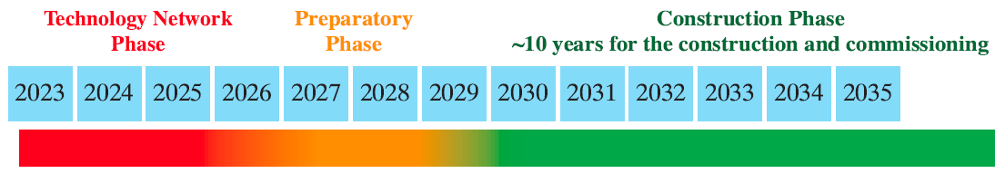
Potential U.S. contributions to ILC
The U.S. community is interested in partnering on the following areas:
  Main Linac (ML) and SRF, including crab cavities
  Polarized electron source
  Polarized and electron-driven positron source options
  Damping rings
  Beam delivery system
  Simulations, software management and global systems
form “KEK’s Physics Program in the next 10 years”
M. Yamauchi
P5 Town Hall at BNL, April 13, 2023

Slide 4
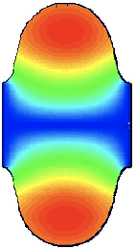

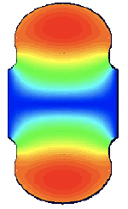
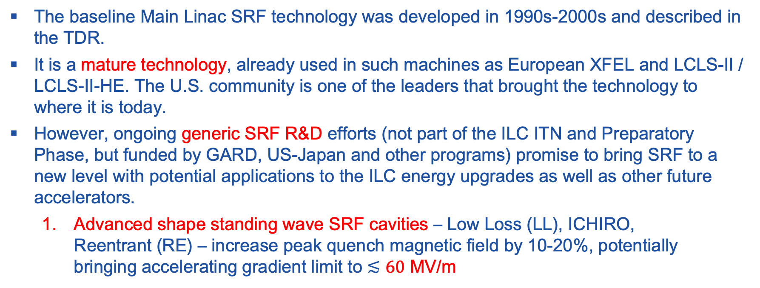
SRF technology for ILC-250 and beyond present limits
The baseline Main Linac SRF technology was developed in 1990s-2000s and described in the TDR.
It is a mature technology, already used in such machines as European XFEL and LCLS-II / LCLS-II-HE. The U.S. community is one of the leaders that brought the technology to where it is today.
However, ongoing generic SRF R&D efforts (not part of the ILC ITN and Preparatory Phase, but funded by GARD, US-Japan and other programs) promise to bring SRF to a new level with potential applications to the ILC energy upgrades as well as other future accelerators.
  Advanced shape standing wave SRF cavities – Low Loss (LL), ICHIRO, Reentrant (RE) – increase peak quench magnetic field by 10-20%, potentially bringing accelerating gradient limit to $≲60$ MV/m
ILC
LL/ICHIRO
RE

Slide 5
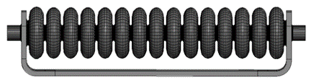
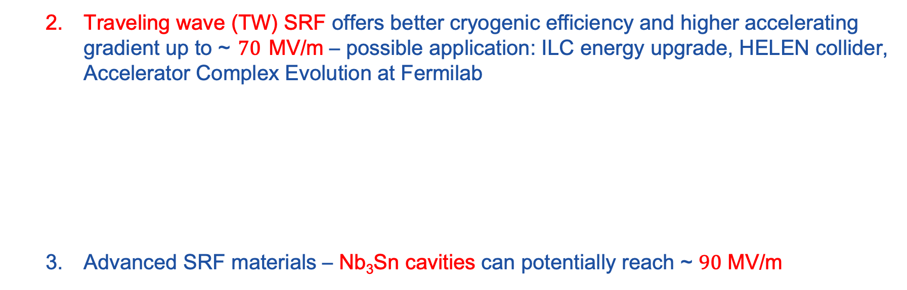
SRF technology R&D
  Traveling wave (TW) SRF offers better cryogenic efficiency and higher accelerating gradient up to ~ $70$ MV/m – possible application: ILC energy upgrade, HELEN collider, Accelerator Complex Evolution at Fermilab
  Advanced SRF materials – Nb₃Sn cavities can potentially reach ~ $90$ MV/m

Slide 6
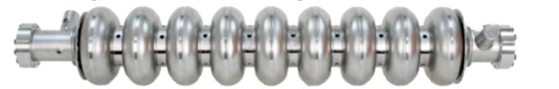
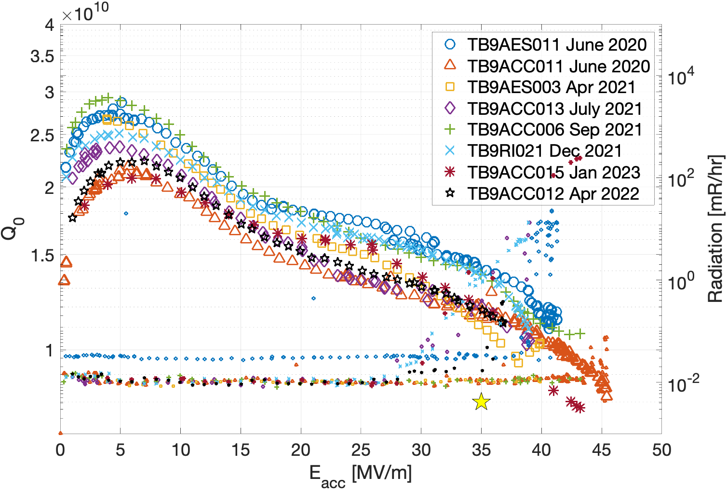
U.S. participation in ITN: WP-prime 1
SRF cavity production readiness
    Optimize the production process based on recent advances in cavity surface treatment (first on single-cell cavities, then on 9-cell cavities) – confirm via cavity exchange between regions
    Establish the cavity design compliant with the Japanese High Pressure Gas Safety (HPGS) regulation in close collaboration with KEK
    Transfer the cavity treatment to industry, order a set of cavities (2 batches for Americas during ITN, 4 cavities per batch), confirm performance yield. Continue with larger statistics through the Preparatory Phase
2-step low-temperature baking (single-cell cavities)
Grassellino et al. https://arxiv.org/abs/1806.09824

Slide 7
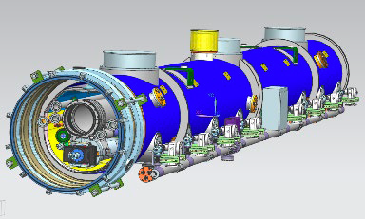
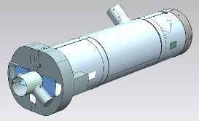
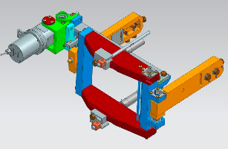
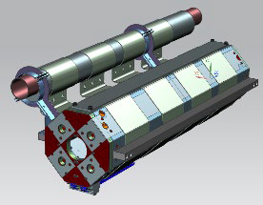
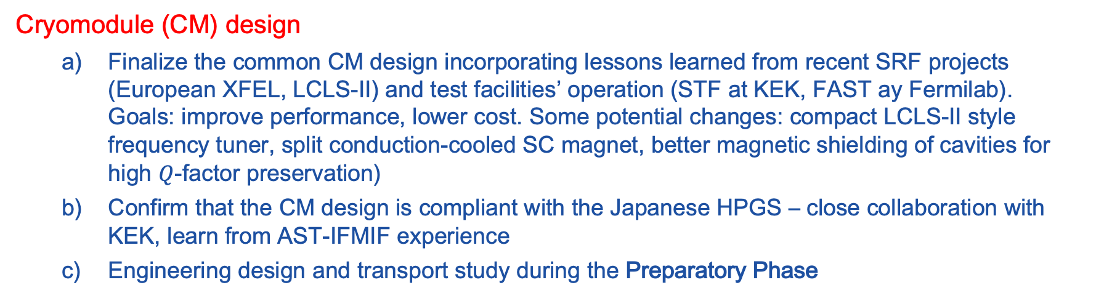
U.S. participation in ITN: WP-prime 2
Cryomodule (CM) design
      Finalize the common CM design incorporating lessons learned from recent SRF projects (European XFEL, LCLS-II) and test facilities’ operation (STF at KEK, FAST ay Fermilab). Goals: improve performance, lower cost. Some potential changes: compact LCLS-II style frequency tuner, split conduction-cooled SC magnet, better magnetic shielding of cavities for high $Q$-factor preservation)
      Confirm that the CM design is compliant with the Japanese HPGS – close collaboration with KEK, learn from AST-IFMIF experience
      Engineering design and transport study during the Preparatory Phase
Cavity magnetic shield
Compact frequency tuner
SC magnet package
ILC cryomodule

Slide 8
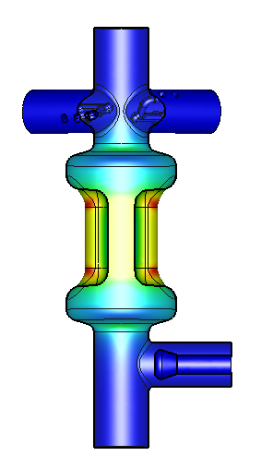
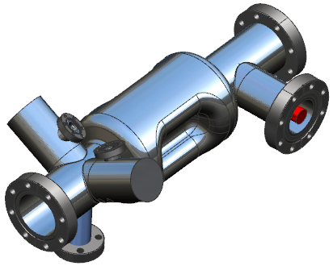
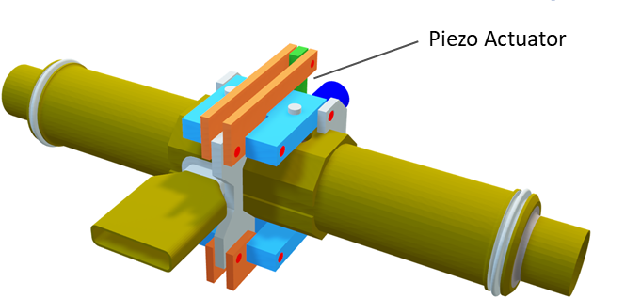
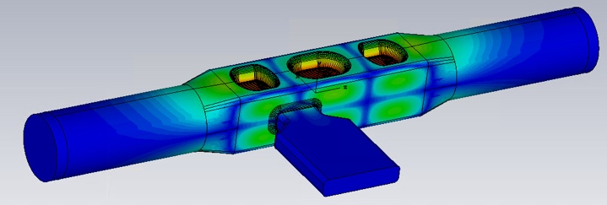
U.S. participation in ITN: WP-prime 3
SRF Crab Cavity (CC) development
      HL-LHC R&D and prototyping demonstrated viability of compact cab cavity designs. ILC team has initiated efforts on re-optimization of the CC design. 5 designs were under initial consideration.
      After the recent first down-selection review, 2 designs were selected to proceed to the next stage. Both designs are from the U.S. teams: RF Dipole cavity (ODU/JLAB) and QMiR cavity (FNAL)
      Next stage: development and testing of a prototype cavity of each design (KEK will provide Nb material); demonstration of synchronized operation with the two prototypes (possibly in UK); selection of the final cavity design
      Engineering design of the cryomodule for the selected CC design during Preparatory Phase
RF Dipole 1.3 GHz crab cavity (ODU/JLAB)
QMiR 2.6 GHz crab cavity (FNAL)
“Dressed” cavity with frequency tuner
HOM2
FPC
FPC
HOM1

Slide 9
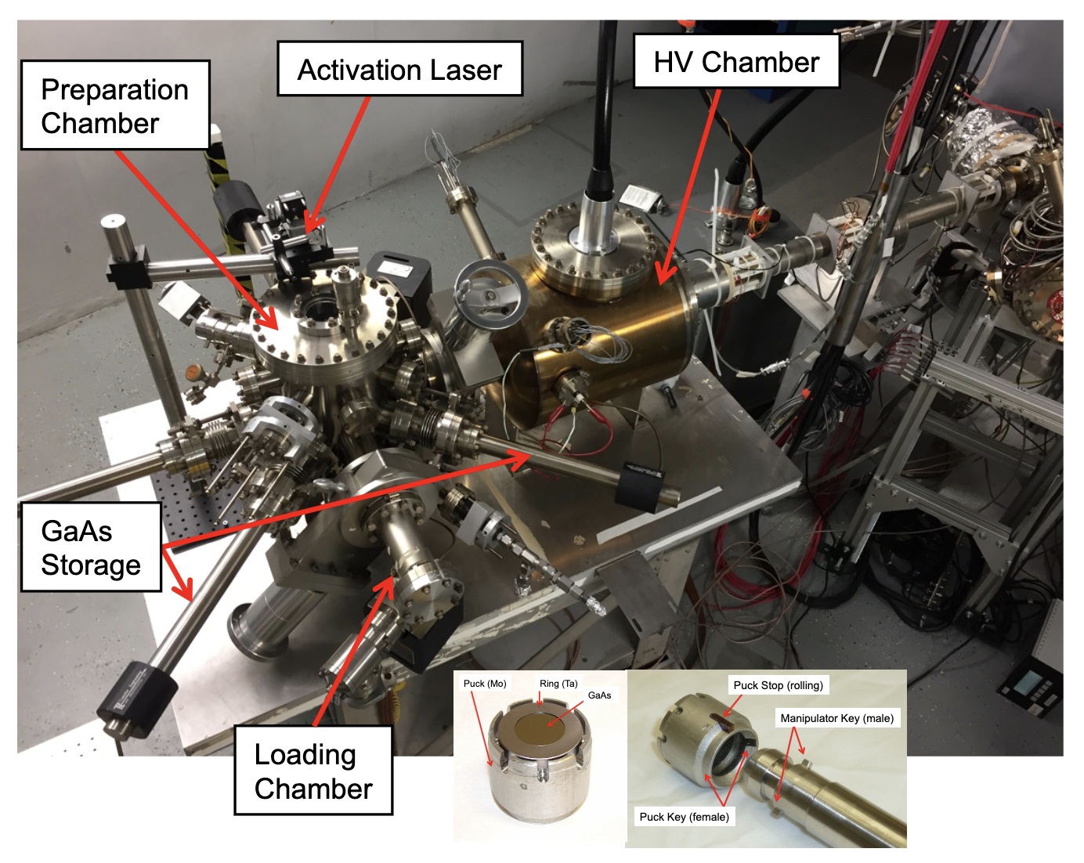
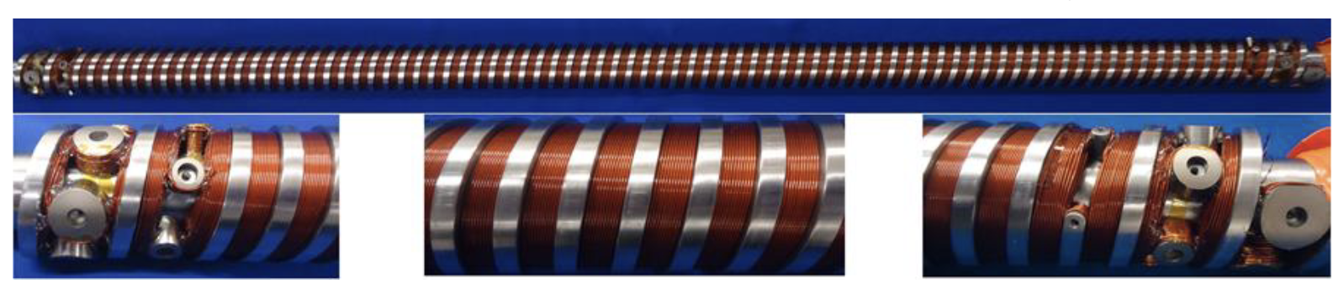
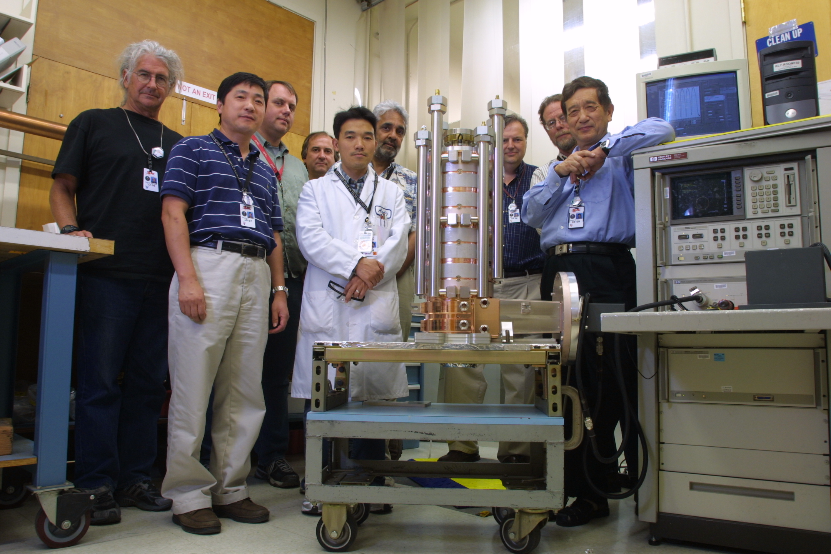
Other WPs: polarized $e^{−}$ and $e^{+}$ sources, WP-prime 4-7
Polarized electron source design
Capture and acceleration for positron source
Undulator technology for positron source
Polarized Electron Source at JLab,
P. Adderley et al., Phys. Rev. Acc. Beams (2010)
Superconducting Helical Undulator at Argonne, M. Kasa et al. Phys. Rev. Acc. Beams (2020)
L-Band Capture Section at SLAC
F. Wang et al., PAC09 (2009)

Slide 10
Other WPs: Damping rings (DRs), WP-prime 12&14
The damping ring described in the TDR satisfies the basic requirements. However, developments in magnet technology, high current positron storage rings (SuperKEKB), low emittance light sources, fast kickers, and optimization of the collider parameters, in the decade since, suggest some refinement and reevaluation of the ring design and instrumentation. The U.S. community has significant expertise in design and operation of storage rings.
The U.S. community is interested in partnering on the following DR areas:
DR system design
  Revisit lattice design. Consider combined function/hybrid magnets. Modify injection and extraction straights for consistency with anticipated kicker properties. – ITN Phase
  Magnet design: normal magnets and SC damping wigglers. Because of the very high synchrotron radiation in the wiggler straight, and the required electron cloud mitigation, design of the vacuum chambers in that region should be integrated with the engineering design of the magnets. – Preparatory Phase
  Magnet design: permanent magnets. Design of permanent magnets (a possible alternative to electromagnetics) can begin when the lattice design is finalized – Preparatory Phase

Slide 11
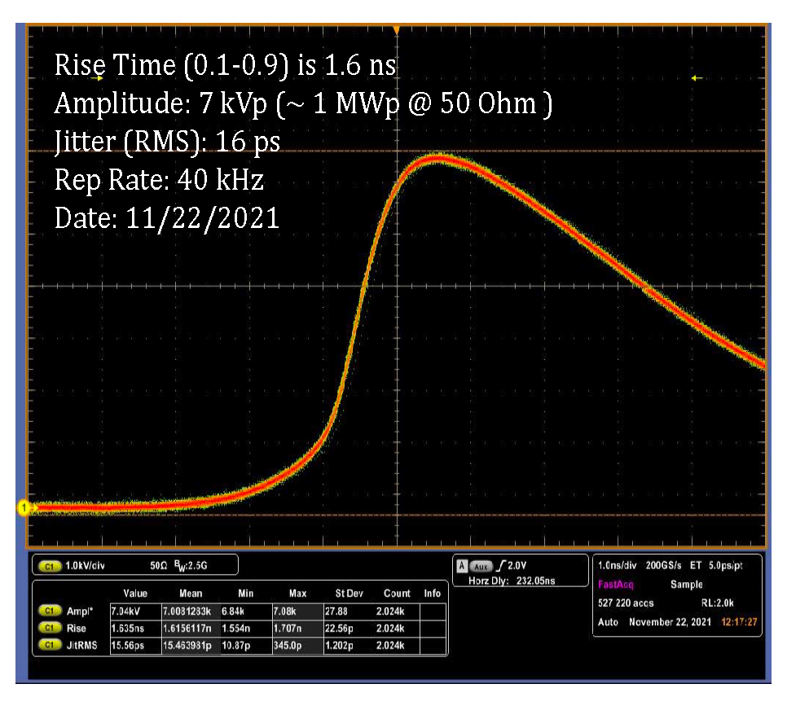
Other WPs: Damping rings
Collective effects (electron cloud, ion trapping and fast ion instabilities) – ITN Phase
  Once the design of the lattice is finalized, the thresholds should be reevaluated.
  Fast ion instability feedback should be developed (simulations and scaling from SuperKEKB HER) and possibly tested with beam (if not done already at SuperKEKB)
DR injection/extraction kickers: System design, prototyping, and stability test – ITN / Preparatory Phase
Other opportunities for Preparatory Phase / Construction: vacuum chamber, SRF system, instrumentation, SC wigglers, magnets
Demonstration of ns rise time, MW power pulse at SLAC

Slide 12
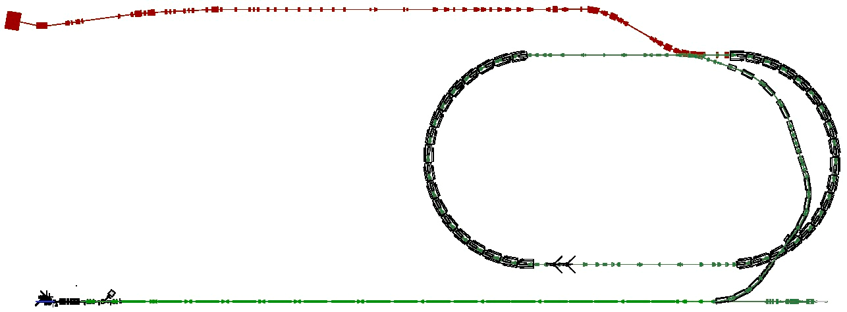
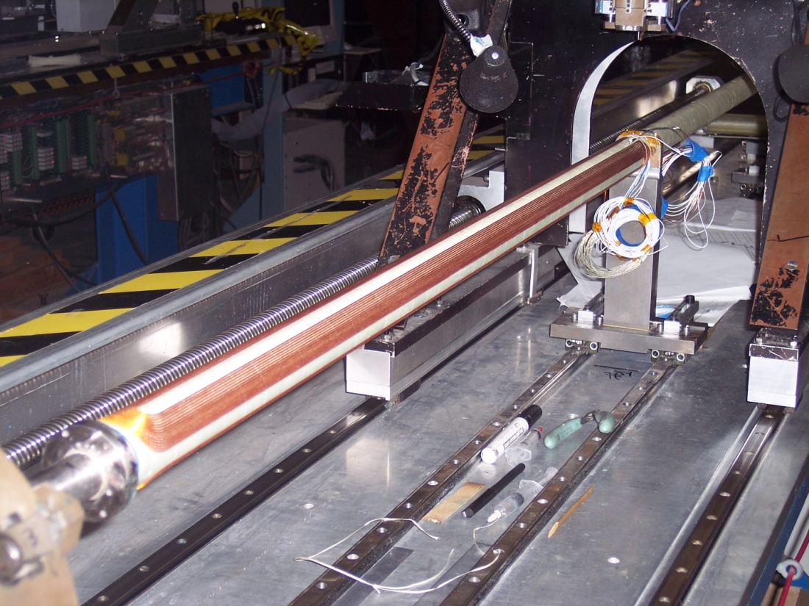
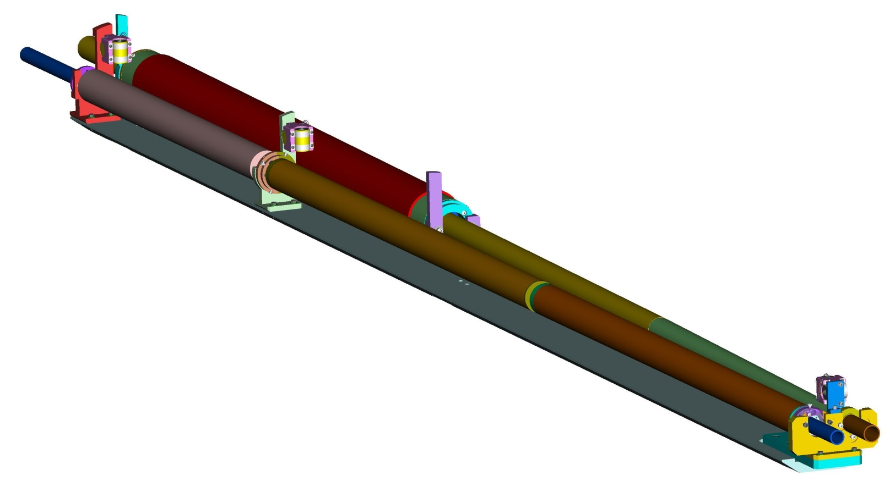
Other WPs: Beam delivery system (BDS), WP-prime 15&16
BDS design
  Participation in the ATF3 studies, e.g., wakefield and magnetic multi-pole characterization and mitigation
  Machine Learning applications to Final Focus System (e.g., Bayesian optimized luminosity tuning) – possible to also demo @ ATF3? (Strong accelerator-focused ML group at SLAC)
  Fast-kicker hardware for emergency abort dumps (synergy with DR)
  MDI work
Final doublet design optimization
  Direct-wind technology for SC FD magnet complex assembly (BNL-specific)
  Strong need for full-scale prototype and vibration tests at 2 K, need to complete efforts started many years ago – this is arguably priority #1 for outstanding BDS R&D – large consequences if fail to meet vibration tolerances in terms of re-design work for BDS/MDI
QD0 split coil winding
QD0 split coil variant
Lead End
ATF2 Beamline
Investigation of the focus lens system
Extraction Line
Quadrupole
KEK-ATF
ATF Damping Ring
Low energy beam production
Sextupole Correction Package
Lead-End
QD0 Half Coil
Non-Lead-End
QD0 Half Coil
IP End

Slide 13
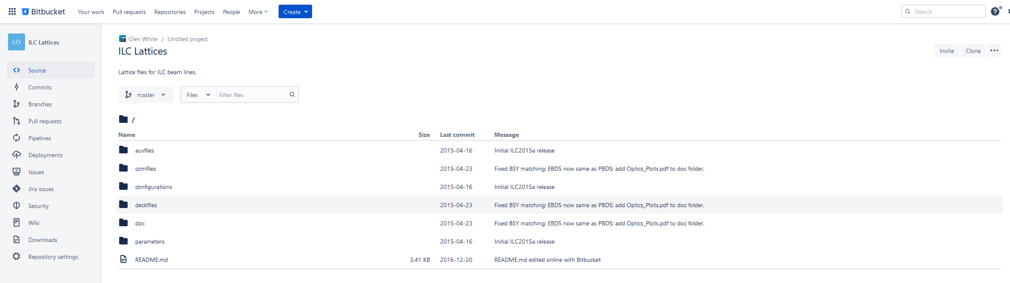
Simulations, software management and global systems
The U.S. ILC community is also interested in
  Integration & management of all optics decks, enforcement of change control, software repository management, etc.
  Start-to-end tracking simulation framework

Slide 14
Possible U.S. budget through ITN and Preparatory Phases
Total ~ 80M$ for ITN and Preparatory phases
Including FTEs increasing from 13.7 in 2025 to 50.6 in 2030

Slide 15
U.S. accelerator expertise relevant to ILC
 | ANL | BNL | Cornell | FNAL | JLAB | LBNL | ODU | SLAC
Main Linac SRF |  |  | ✘ | ✘ | ✘ |  |  | ✘
Crab cavities |  |  |  | ✘ | ✘ |  | ✘
Polarized e- source |  | ✘ | ✘ |  | ✘ |  |  | ✘
Undulators for polarized e+ source | ✘ |  |  |  |  | ✘ |  | ✘
DR system design & subsystems (SRF, vacuum chamber, magnets, instrumentation …) | ✘ | ✘ | ✘ | ✘ | ✘ | ✘ |  | ✘
Beam optics, collective effects … | ✘ | ✘ | ✘ | ✘ | ✘ | ✘ |  | ✘
Fast kickers |  |  |  | ✘ |  |  |  | ✘
BDS design |  |  |  | ✘ | ✘ |  |  | ✘
Final doublet |  | ✘ |  | ✘ |  | ✘

Slide 16
Summary
ILC’s Technical Design Report (TDR) was published in 2013 by the ILC Global Design Effort (led by Barry Barish)
SRF technology has matured. Large SRF accelerators (such as at European XFEL and LCLS-II / LCLS-II-HE) are under operation or construction
  In addition, SRF technology is being improved for higher performance through R&D programs, such as U.S.-Japan cooperation, DOE/HEP GARD, etc.
The important and time-consuming remaining R&D items will be conducted through the ILC Technology Network, a global collaboration program
  KEK obtained funding for this R&D and with the IDT initiated this activity in April
It is envisioned that engineering design and prototyping will be during the Preparatory Phase preceding ILC construction
The U.S. accelerator expertise is required for the realization of the ILC

