Slide 1
9 AM Meeting
Keymonty Bullock
MCR Crew Chief
Monday, April 24, 2023

Slide 2
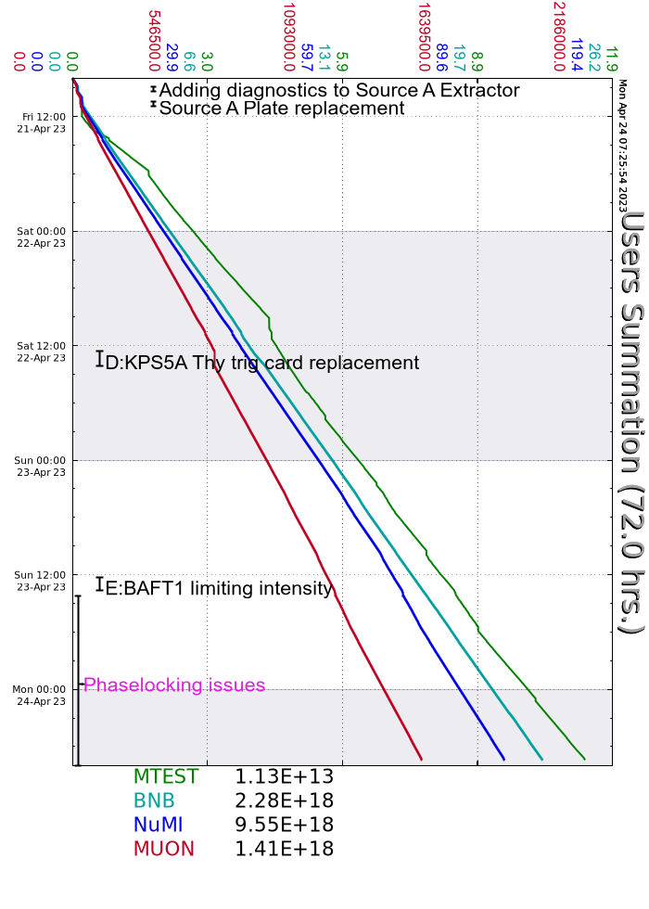
Since Wednesday…
D:KPS5A trip. Thyratron trigger card needed to be replaced.
Issues regarding beam extraction from Booster to Recycler.
Experts investigating further today
E:BAFT1 temperature issues.
Reduced turns until it stabilized.
Mu2e studies will occur today
Walkthroughs on off-shifts
Beam to NuMI, MTest, BNB

