Slide 1
48 Hour Summary
Spencer Schiefelbein
April 26, 2023

Slide 2
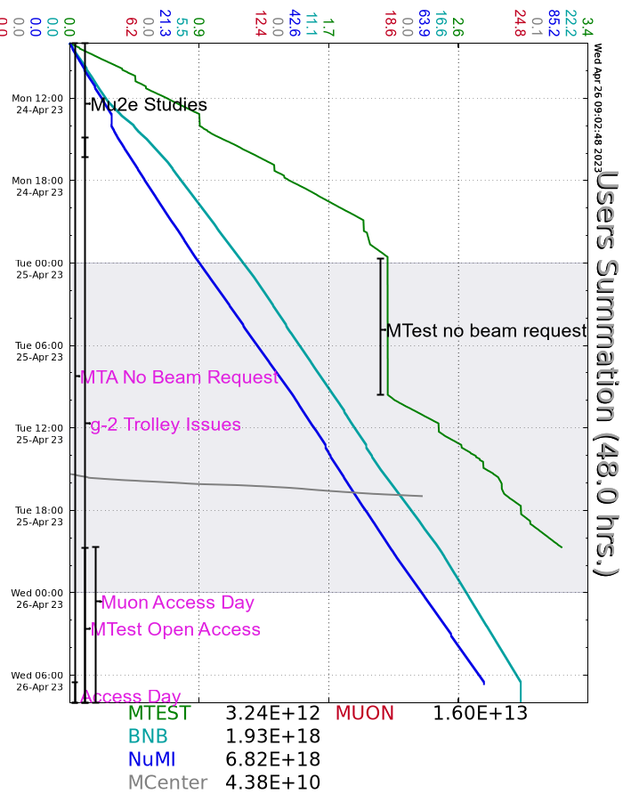
Since Monday
Monday:
Investigations continued for Booster/RR RF/Phase locking issues
Water added to CUB spheres
ITA sample removed
Mu2e studies
MIRF11 modulator replacement
Tuesday:
Investigations continued for Booster/RR RF/Phase locking issues
RR 2.5MHz amplifier LCW system chiller coolant added
Mu2e studies
MC71 and 2 search and secured
Critical device test
Established beam to MC7 (no users yet)
Wednesday
Beam off in the morning for Linac/Booster studies day
M4, Extraction, PreVault, PreTarget, Delivery Ring, Enc B, Enc C,D,E, F1-F3, prepared for access
BS707 Failure mode – Interlocks to investigate today
MI65 target hall cooldown in progress
Currently:
Booster and Linac Studies Day

