Slide 1
Long-term Community Engagement with US Industry for the Next High Energy Physics Collider
Yoko Kawai Parker, Brandon Whitney,
Peter Sincerny

Slide 2
Vision for an Improved Government / Industry Partnership
Our shared goal : domestic products and services will be available to support the next US-based DOE accelerator facility as well as future DOE, DoD, and industry requirements.
Industry “Wish List” for the DOE Accelerator Community
Early involvement during the design and planning stages
Fair and equitable contracting
A phased design/bid/build approach
Cost-Plus-Fixed-Fee (CPFF) contracts, rather than Firm-Fixed-Price (FFP) for development programs
A long-term commitment to prioritize the development and sustainment of domestic suppliers
In accordance with the intent of the Buy American Act of 1933, preference should be given for US-made products for federal procurements.
Regular and predictable demand to maintain a stable workforce, continually growing in capability
Advanced Accelerator Concepts (AAC) Workshop - 2024

Slide 3
US High Energy Physics Community – Budgets / Priorities
Large scale accelerator facility construction and upgrades in the United States (US) are funded through the DOE Office of Science:
High Energy Physics (HEP), Basic Energy Sciences (BES), and Nuclear Physics (NP) are the primary drivers of accelerator advancement
FY2024 Budget of approximately $4.5B, 17% of the total $52B DOE budget
* requested
Problem Statement:
The United States government high energy physics community develops state-of-the-art particle accelerator technologies, which are later manufactured abroad, because US-based firms are not consistently prioritized for government programs of record.
In contrast, the high energy physics communities in Europe and Asia work to nurture their domestic industrial bases.
DOE Office Of Science Budget ($ in M) |  | FY2022 | FY2023 | FY2024 | FY2025*
 | Advanced Scientific Computing Research | 1,035 | 1,068 | 1,033 | 1,153
 | Basic Energy Sciences (BES) | 2,308 | 2,534 | 2,504 | 2,582
 | Biological and Environmental Research | 815 | 909 | 836 | 945
 | Fusion Energy Sciences | 713 | 763 | 805 | 844
 | High Energy Physics (HEP) | 1,078 | 1,166 | 1,196 | 1,231
 | Nuclear Physics (NP) | 728 | 805 | 771 | 833
 | Isotope R&D and Production | 82 | 109 | 154 | 184
 | Accelerator R&D and Production | 18 | 27 | 29 | 31
 | Workforce Development for Teachers and Scientists | 35 | 42 | 42 | 43
 | Science Laboratory Infrastructure | 291 | 281 | 294 | 295
 | Safeguards and Security | 170 | 184 | 200 | 195
 | Program Direction | 202 | 211 | 237 | 246
 | Office of Science Program Total | 7,475 | 8,100 | 8,100 | 8,583
 | BES, HEP, NP total | 4,114 | 4,505 | 4,471 | 4,646
Advanced Accelerator Concepts (AAC) Workshop - 2024

Slide 4
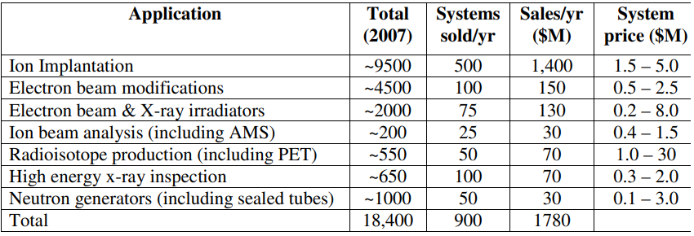
Global Industrial Base for Accelerators
Industrial/commercial Accelerator Business (2009)
Global need for accelerator technologies remains high, creating a strong demand signal for the high energy physics community.
More than 30,000 accelerators are in use around the world per an IAEA report.
> 97% are used for commercial purposes
[1] Review of Industrial Accelerators and Their Applications, International Topical Meeting on Nuclear Research Applications and Utilization of Accelerators, 2009 R.W. Hamm, R&M Technical Enterprises, Inc
The state-of-the-art particle accelerator technologies nurture the industrial bases in various applications
Advanced Accelerator Concepts (AAC) Workshop - 2024

Slide 5
Impact of DOE and DoD Procurement Decisions : A Case Study
Two active US-based companies in the Superconducting Radio Frequency (SCRF) manufacturing space:
Niowave - focused on the Industrial medical isotope market with little present interest in supporting DOE accelerator R&D
C.F. Roark - supported multiple DOE programs primarily for welding / metal fabrication
A third US company, Advanced Energy Systems (AES), formerly a leading SCRF and NCRF supplier for more than 20 years
In 2012 the US Navy abruptly terminated the INP FEL project and AES lost $24M in backlog overnight
By 2014, AES focus had turned to the LCLS-II procurement. However, the DOE and SLAC elected to source the 280+ cavities from two EU suppliers (Research Instruments and Zanon).
This was in direct contrast to the prior XFEL procurement, where EU officials evaluated the social impact of their project as well as cost, bolstering the competitive advantage of European suppliers
The cavities utilize technology developed at US Laboratories and Universities, with American tax dollars
Despite its prior technical successes, AES was no longer able to compete in price with the successful EU SCRF manufacturers and received no further LCLS-II or FRIB awards
During this same period, AES was struggling with cost overruns on the fixed-price NSLS-II RF cavities and the Fritz-Haber-Institut (FHI) der Max-Planck-Gesellshaft FEL.
Given these circumstances AES was forced to close its doors in 2016, creating a gap in US capability
[2] Nurturing the Industrial Accelerator Technology Base in the US
Advanced Accelerator Concepts (AAC) Workshop - 2024

Slide 6
State of US-based Accelerator Technology Supply Chain
Four tiers of accelerator technology (AT) supplier in the US:
SBIR (Small Business Innovative Research) houses
Specializing in software simulation and modeling (e.g. Tech-X, RadiaSoft),
Developing niche products including RF diagnostics (e.g. RadiaBeam, Euclid Technologies)
Manufacturing other mostly one-off products (e.g. Euclid Technologies for SCRF and other products)
Mid- to large-sized firms for whom DOE Accelerator Technology (AT) is a sideline business that can be profitably engaged in on an occasional basis, without negatively impacting their core business
An example is CPI and the LCLS-II HE fundamental power couplers
Intermediate-sized companies producing AT components
Such as power supplies, magnets, high-vacuum products, electronics etc. DOE Accelerator R&D projects are a secondary, but profitable, market for these suppliers due to crossover with commercial product lines
Numerous successful firms (of varying sizes) in established Industrial markets for lithography, medical X-ray, oncology and contraband detection accelerators (e.g. Axcelis, Varian, AS&E, etc.)
Do not actively pursue DOE AT R&D projects because of the perceived risk and volatility
Notably missing are modest-sized US companies that fabricate undulators, SCRF cavities, precision magneto-optics and other specialized products.
There is currently no US equivalent to Research Instruments GmbH.
[2] Nurturing the Industrial Accelerator Technology Base in the US
Advanced Accelerator Concepts (AAC) Workshop - 2024

Slide 7
How Domestic Industrial Participation Benefits the AT Community
The US accelerator technology industry is currently in an atrophied state
State-of-the-art technologies achieved with US government investment have supported industry based in foreign countries
Some key accelerator components have no established domestic suppliers
Little motivation for US industry to invest their funding to develop such
Lack of investment prohibits technology succession within industry
…but it can be recovered with target investment and benefit the AT Community
To increase resilience of the supply chain (with more options)
Provide a knowledgeable in-country workforce to support assembly, integration, and testing at DOE sites
Foster increased efficiency through stable market demand: incremental quality improvements, shorter lead-times, and more cost-effective solutions for future projects
To leverage the economic and social impact of government investment in accelerator science, technology and facilities
Providing industry opportunities to advance their core competency and develop long-term accelerator technology roadmaps
Creates the business case for private sector internal research and development (IRAD) investment
Supports local hiring / talent recruitment efforts including university programs
[2], [3]
Advanced Accelerator Concepts (AAC) Workshop - 2024

Slide 8
Industry Challenges Supplying National Laboratories
National Laboratories procurements tend to be viewed as “high risk” by industry:
Type of contract required, Firm-Fixed-Price (FFP) vs. Cost-Plus-Fixed-Fee (CPFF) is not consistent with the risks to commercial businesses
High level of complexity is common
Conceptual design choices (technology locked in before industry involvement) may be cost-prohibitive
Soft requirements often exist that cannot be fully described in request for proposal (RFP/RFQ) document
R&D nature of the scope
Likelihood of scope creep (chasing greatness) and associated cost overrun
Long-lead component requirements from highly specialized / sole source suppliers increase risk for the prime contractor
Introduction of special processing steps that cannot be incrementally tested, leading to potentially disastrous rework risk
Proposal development for a complex project is time consuming and intense work for a company
Not supported by the short turn-around times often requested
A high degree of mutual trust between the national laboratories and industry partners is necessary for successful outcomes
Such a trust can be built up only by working together
If the national labs are pushed to make more self-funding, the opportunity of trust building for a future large project might be non-existent
Federal Acquisition Regulations (only applicable to US-based companies) reduce price and schedule competitiveness
Requirements for compliance drive high indirect (burden rates), greater administrative burden, lengthen time to place procurements, etc.
Most large Government contractors will not issue FFP bids for one-off manufacturing after recent financial losses from supply chain issues coupled with high inflation.
Advanced Accelerator Concepts (AAC) Workshop - 2024

Slide 9
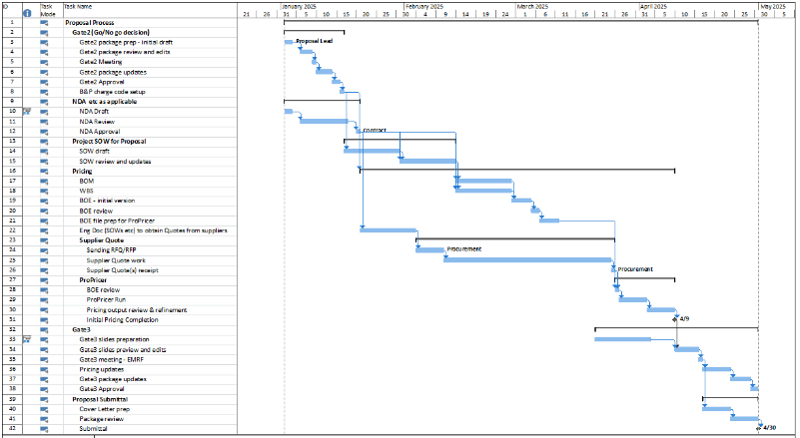
Proposal Development for One-Off Systems is Challenging
Developing a proposal for a complex, one-off system is typically a project in its own regard!
The design must be sufficiently developed for pricing.
Lack of comparable recent project requires “bottoms-up” costing
Subcontractor and supplier bids need to be solicited (requiring SOWs, high-level specifications etc.)
BOEs developed in accordance with Federal Acquisition Regulation (FAR) requirements
Internal management reviews to be completed (how much risk are we assuming?)
Not uncommon for a significant portion of the potential future profit to be spent on developing a proposal for a job that is not guaranteed
Advanced Accelerator Concepts (AAC) Workshop - 2024

Slide 10
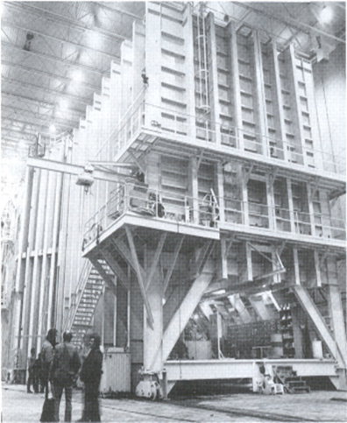
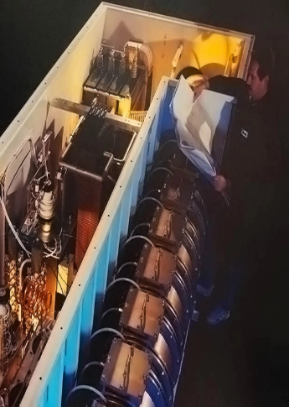
Applied Technologies Inc. (ATI) Overview
For more than 60 years the scientists and engineers at ATI have been at the forefront of pulse power technology and development
In fact, ATI staff coined the term “pulse power” in 1962
Our legacy continues under the FISICA platform, positioned to meet the growing demands of industry
ATI is an example of a domestic organization with complementary resources and capabilities to support the development and construction of the pre-injector linac for the future Electron-Ion Collider (EIC)
Advanced Accelerator Concepts (AAC) Workshop - 2024

Slide 11
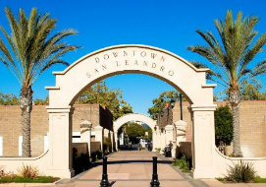
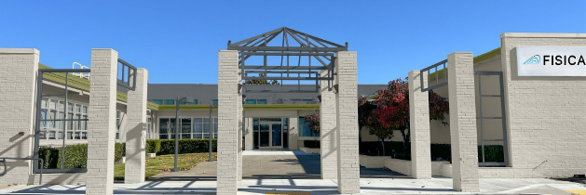
FISICA San Leandro Site
Our 170k sq. ft facility at 2700 Merced St., San Leandro, CA is conveniently located < 5 miles from the Oakland International Airport (OAK), ~20 miles from San Francisco, and ~30 miles from San Jose
In the R&D and innovation hub of the San Francisco Bay Area, in proximity to:
Three major national laboratories (LBNL, LLNL, and SLAC)
Prestigious universities, including the University of California, Berkeley and Stanford
A large pool of approved suppliers and custom fabricators
Advanced Accelerator Concepts (AAC) Workshop - 2024

Slide 12
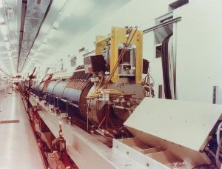
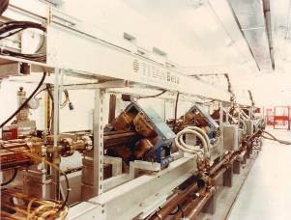
ATI Experience: Turnkey RF LINAC Projects
E-beam Sterilization Systems
More than 40 systems have been designed, fabricated, and installed
Primarily 10 MeV S-band LINACs with ~300 mA peak beam current at >300Hz
Some experience with L-band LINAC systems
Experience of ATI under previous company name, Titan Beta, in the 1990’s
CRANE high current RF LINAC, L-band 20 - 60 MeV
800 MeV S-band LINAC delivered to Frascati, Italy
Brookhaven 200MeV LINAC
LINAC for Radiation Chemistry Research at Notre Dame
ATI maintains the experience, expertise, and tools to design, manufacture, and deliver turnkey LINAC systems
Advanced Accelerator Concepts (AAC) Workshop - 2024

Slide 13
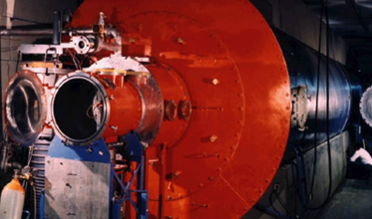
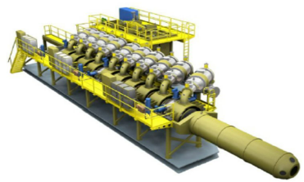
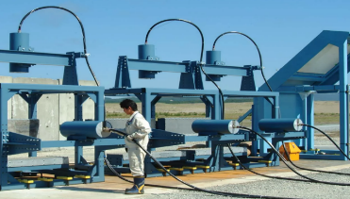
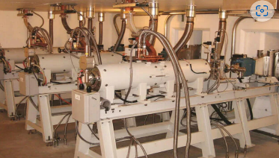
ATI’s Four Mission-focused Product Lines
Electromagnetic Services
Electromagnetic Systems
Flash X-ray / Radiography (FXR)
Electron Beam Sterilization
Off-the-shelf and custom solutions for the most demanding applications
Advanced Accelerator Concepts (AAC) Workshop - 2024

Slide 14
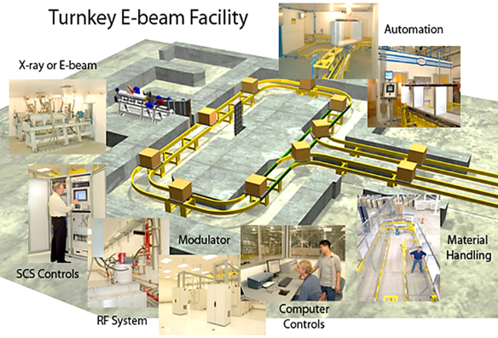
ATI E-beam Sterilization Systems
ATI has designed and delivered over 26 turnkey E-beam systems for sterilization of medical devices, medical consumables, and phytosanitary / agricultural purposes.
Each turnkey facility consists of one or more 10MeV / 18-25kW S-Band LINAC (Linear Accelerator) beamlines
With over one million hours of operational time logged worldwide, our systems are designed to operate more than 7,000 hours per year
ATI can provide the overall facility and radiation shielding design or tailor the system around customer requirements
Information and Control Systems incorporating SureTrack®
Safety Systems and Associated Equipment
ATI Offers a Variety of Material Handling Systems, Including:
Floor Mounted Power & Free Material
Horizontal Beam and Carrier Conveyance
Vertical Beam and Box/Tray Conveyance
Overhead and Motorized Roller Conveyors
Advanced Accelerator Concepts (AAC) Workshop - 2024

Slide 15
ATI E-beam Sterilization Systems
Advanced Accelerator Concepts (AAC) Workshop - 2024

Slide 16
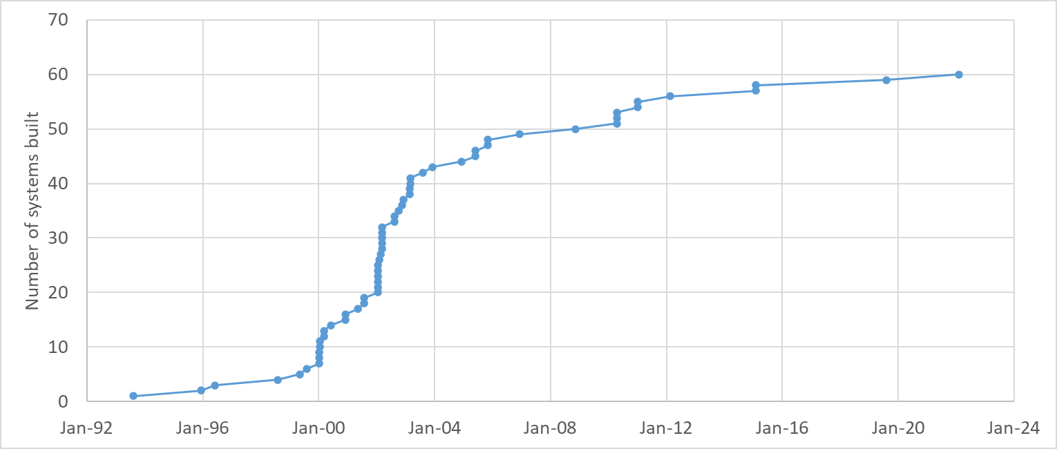
Relevant ATI Experience: Turnkey sterilization/irradiation LINAC
Acquisition by
L3 Technologies
(June, 2005)
Spares / repairs / upgrades are main activities
S-band linac power increase project completed (Internal R&D) 2024
1st Titan beta e-beam sterilization system for medical product on-line
SureBeam system on-line for ground-beef irradiation
[6] CAARI talk

Slide 17
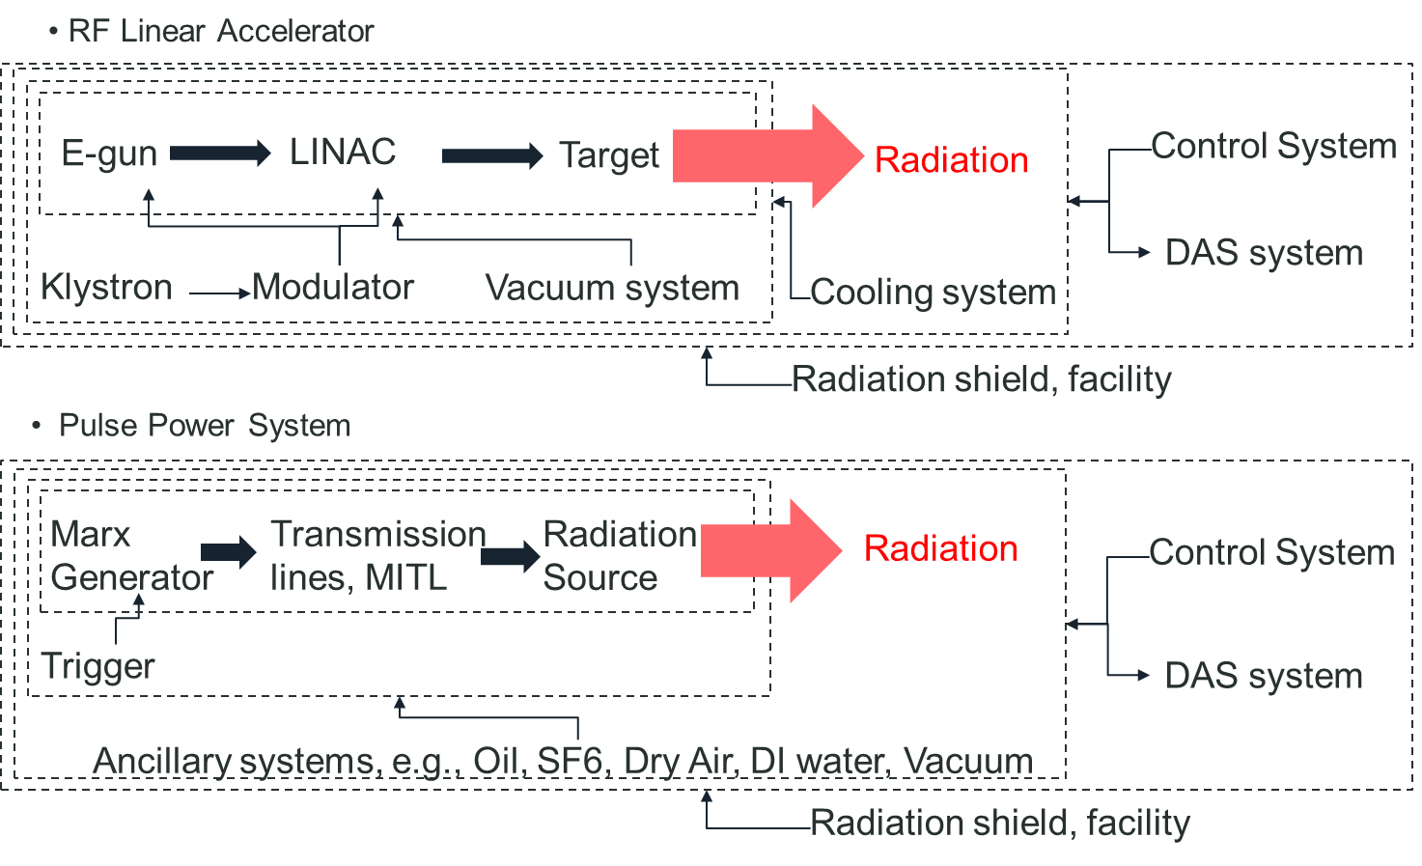
ATI Central Theme - Generating Radiation
Large overlap of technology areas
ATI’s business base as a DoD supplier for large pulsed power system has allowed us to remain an OEM for turnkey RF LINAC systems (which would otherwise be financially unfeasible)
Advanced Accelerator Concepts (AAC) Workshop - 2024

Slide 18
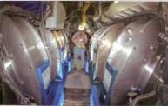
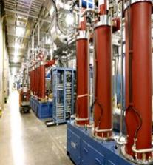
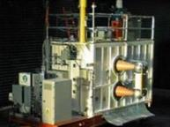
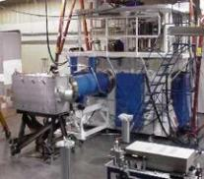
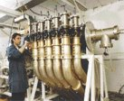
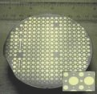
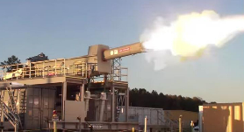
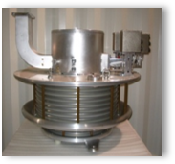
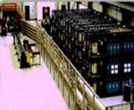
Electromagnetic Systems
Over the last ~60 years the constituents of FISICA ATI have designed/built (or contributed to the development of) numerous pulse power systems for the US and allied countries
Pulsed Electron Beam and X-ray Sources
Flash X-ray / Radiographic systems for the imaging of ballistics and subcritical explosive events
Pulsed Plasma Devices
High Power Microwave (HPM) and Electromagnetic Pulse (EMP) Systems for Susceptibility / Lethality Testing
Lightning Simulators
High Energy Systems and Capacitor Banks for Shipboard Applications, such as Electromagnetic Aircraft Launch (EMALS) and Railguns
Support of DOE research facilities and FFRDCs, including SNL, LLNL, LANL, and ORNL
Advanced Accelerator Concepts (AAC) Workshop - 2024

Slide 19
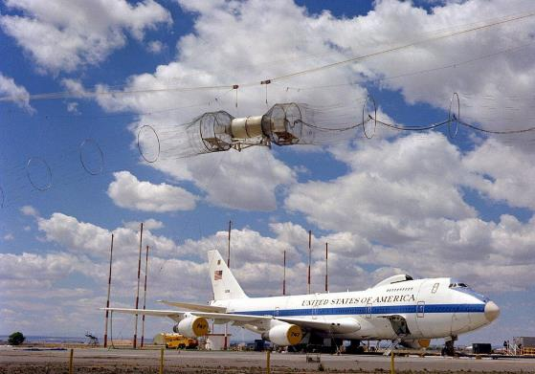
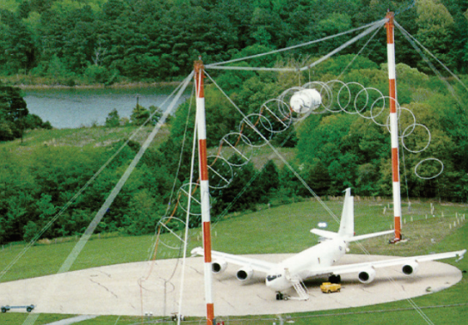
Electromagnetic Systems : EMP Simulators
ATI has designed, built, installed, and tested more than 30 EMP simulators worldwide to test the susceptibility of aircraft, ground vehicles, and other equipment.
EMP simulator HAGII-C
Operational Performance of the Horizontal Fast Rise EMP Pulser at the Patuxent River EMP Test Facility, D. Belt, A. Mazuc, K. Sebacher Naval Air Systems Command Patuxent River, V. Bailey, V. Carboni, C. Eichenberger, T. Naff, I. Smith, T. Warren, B. Whitney, L-3 Communications, Pulse Sciences, 2013 IEEE Pulsed Power Conference
https://en.wikipedia.org/wiki/Electromagnetic_pulse
Advanced Accelerator Concepts (AAC) Workshop - 2024

Slide 20
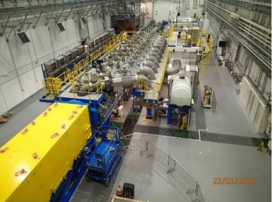
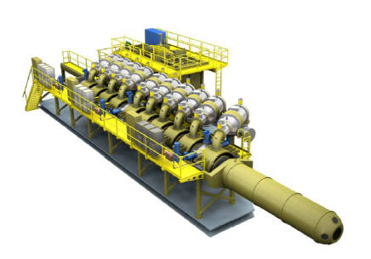
Large-Scale Systems Design and Manufacturing Capability
ATI designed and manufactured the 7.5MV “Merlin” Induction Voltage Adder (IVA) for the Atomic Weapons Establishment (AWE) to provide state-of-the-art radiography capability to the Teutates UK/France joint team.
Note: All images on this page have been cleared for public release.
Advanced Accelerator Concepts (AAC) Workshop - 2024

Slide 21
ATI PMO - Building Large Pulsed Power and Accelerator Systems
Our tailorable program management methods have been successfully demonstrated on a wide range of design, manufacturing, and testing efforts ranging from $0.1M - $100M+
Documented Project Execution Plans (PEPs), updated throughout the project lifecycle
Emphasis on customer collaboration through weekly calls, regularly scheduled technical interchange meetings (TIMs), and stage gate reviews
Resource-loaded Integrated Master Schedules in Microsoft Project
Earned Value Management (EVM) capability
SOX-compliant Estimate at Completion (EAC) management with quarterly Integrated Program Management Reviews
Risks, Issues, and Opportunity Management in accordance with DoD guidelines
Management of large subcontracts, integrated consultant teams, external engineering firms, procurement efforts with thousands of BOM line items, etc.
Advanced Accelerator Concepts (AAC) Workshop - 2024

Slide 22
ATI Systems Engineering Expertise
Requirements Management
Development and Maintenance of Interface Control Documents (ICDs), Systems Engineering Management Plans (SEMPs), System/Subsystem Specifications, Quality and Inspection Plans, and Factory and Customer Site Acceptance Test Plans
Requirements management (definition, allocation, decomposition, etc.) in various tools including IBM Rational DOORS
Documented requirements verification methods (analysis, inspection, demo, test) through design and development stage gates
System Requirements Review (SRR) at program onset and System Verification Review (SVR) after commissioning
Reliability, Availability, and Maintainability (RAM)
Concept of Operations (ConOps) Reviews
Fault tree models, Failure Mode, Effects, and Criticality Analysis (FMECA), etc.
Safety as a Subsystem
Hazard Identification (HAZID) and Hazard and Operability Studies (HAZOPS)
Ionizing and non-ionizing radiation safety and hazard mitigation
SIL-rated safety controls (interlocks, e-stops, etc.)
Advanced Accelerator Concepts (AAC) Workshop - 2024

Slide 23
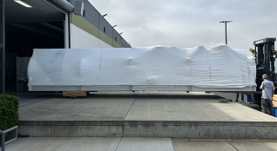
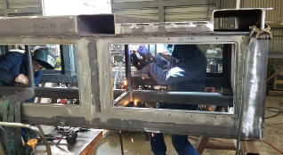
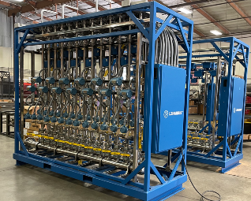
FISICA Supply Chain Capacity
FISICA procurement and supply chain team consists of 28 staff (buyers, subcontract managers, planners, expediters, etc.) leveraging an annual spend of ~$100M (est. FY22)
Extensive approved supplier list (ASL) for both commercial off-the-shelf (COTS) parts, custom fabricated parts and assemblies, and support equipment
Deep bench of West Coast machine shops, welding houses, and fabricators specializing in one-off production requirements to stringent standards (including DoD, DOE, and nuclear)
In-house CNC machining, welding, and paint capability (Simi Valley, CA), brazing furnace (Menlo Park, CA), and Industrial 3D Printer (San Leandro, CA)
Strategic partnership with a local company specializing in control system manufacturing and custom wire harness assemblies
Routine execution of end-to-end logistics (packaging, transportation, rigging/material handling, assembly at DoD and DOE sites, etc.) for sensitive high-value equipment
Advanced Accelerator Concepts (AAC) Workshop - 2024

Slide 24
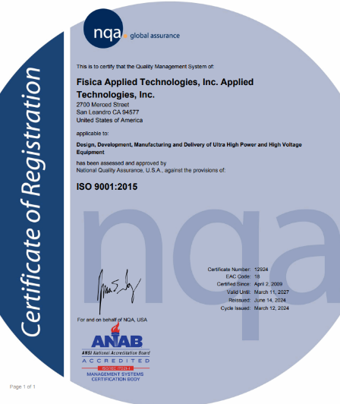
ATI Quality Management System (QMS)
ATI is ISO 9001:2015 accredited and audited annually
Maintains a full suite of QMS standard operating procedures (SOPs) and Work Instructions (WIs)
All system, subsystem, and part drawings are revision controlled via ATI Document Control process
Supplier concessions and deviations are captured via the SCDR process and disposition determined by the manufacturing review board (MRB)
Full-time on-site Quality Manager and Inspector
On-site inspection lab and CMM
Experienced with DOE 18100 weld requirements including subsections for pipe welding and structural steel
Advanced Accelerator Concepts (AAC) Workshop - 2024

Slide 25
ATI Capability Summary
Building Large Pulsed Power and Accelerator Systems
Large-Scale Systems Design and Manufacturing Capability
Engineering
CAD
Modeling & Simulation
R&D
Prototype
In-house machine shop
Project Management Office & tailorable program management methods
Systems Engineering Expertise
Supply Chain Capacity
ATI Quality Management System (QMS) ISO9001 certified

Slide 26
Vision for an Improved Government / Industry Partnership
Industry “Wish List” for the DOE Accelerator Community
Early involvement during the design and planning stages
Allows industry partners time to plan the required workforce and production capacity
Supports design for manufacturability / value engineering and buy-in from production stakeholders (reducing risk)
Fair and equitable contracting
A phased design/bid/build approach (eliminates the uncertainty associated with bidding a one-off system without a fully developed Bill of Materials)
Cost-Plus-Fixed-Fee (CPFF) contracts, rather than Firm-Fixed-Price (FFP) for development programs
Facilitates a partnership approach to management of the project, rather than placing all execution risk on the contractor.
Most large Government contractors will not issue FFP bids for one-off manufacturing after recent financial losses from supply chain issues coupled with high inflation.
A long-term commitment to prioritize the development and sustainment of domestic suppliers
In accordance with the intent of the Buy American Act of 1933, preference should be given for US-made products for federal procurements.
Regular and predictable demand to maintain a stable workforce, continually growing in capability
Our shared goal is that domestic products and services will be available to support the next US-based DOE accelerator facility as well as future DOE, DoD, and industry requirements.
Advanced Accelerator Concepts (AAC) Workshop - 2024

Slide 27
References
[1] Review of Industrial Accelerators and Their Applications, International Topical Meeting on Nuclear Research Applications and Utilization of Accelerators, 2009 R.W. Hamm, R&M Technical Enterprises, Inc
[2] Nurturing the Industrial Accelerator Technology Base in the US, A. M. M. Todd, AMMTodd Consulting; R. Agustsson, A. Murokh, M. Ruelas, RadiaBeam Technologies, LLC; D. L. Bruhwiler, RadiaSoft LLC., K. Yoshimura, Research Institute for Interdisciplinary Science, Okayama University; J. W. Rathke, J. W. Rathke Engineering Services, J. Chunguang, A. Kanareykin, Euclid TechLabs LLC.; S. C. Gottschalk, STI Magnetics V. Yakovlev, Fermilab, Snowmass 2022
[3] CAN THE U.S. COMPETE. IN BASIC ENERGY SCIENCES? Critical Research Frontiers and Strategies. A report by the BESAC Subcommittee on International Benchmarking (2021)
[4] Linear electron accelerators for radiation processing, M. Demsky, Corad Ltd, APAE 2015
[5] Workshop on Energy and Environmental Applications of Accelerators, 2015
[6] Beam power increase for S-band 10 MeV turn-key sterilization system, A. Tylenda, et.al., CAARI-SNEAP 2024
Advanced Accelerator Concepts (AAC) Workshop - 2024

Slide 28
Thank You

