Slide 1
Programmable-trajectory ultrafast flying focus pulses
Manfred Virgil Ambat (he/him)
Advanced Accelerator Concepts Workshop
Naperville, IL
July 21 – 26, 2024

Slide 2
Programmable, spatiotemporal control of ultrashort laser pulses offers tunability for laser-based applications
Summary
Flying focus pulses feature an intensity peak that can travel at any velocity, independent of the group velocity, over distances much longer than a Rayleigh range
We outline a generalized method for designing optical configurations that produce flying focus pulses with ultrashort duration and arbitrary, longitudinal focal trajectories at velocities close to the speed of light
We propose an axiparabola for extending the focal range and a deformable mirror – spatial light modulator pair to dynamically control the focal trajectory
Simulations demonstrate the flexibility of exotic focal trajectories for laser-based applications

Slide 3
Collaborators
J. L. Shaw, J. J. Pigeon, K. G. Miller, T. T. Simpson, D. H. Froula, and J. P. Palastro

Slide 4
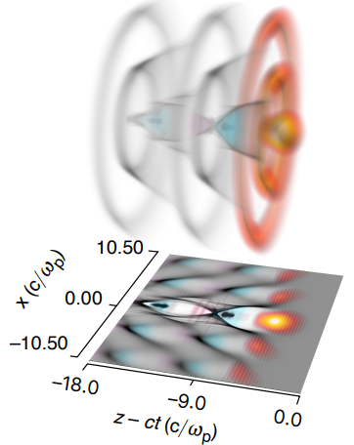
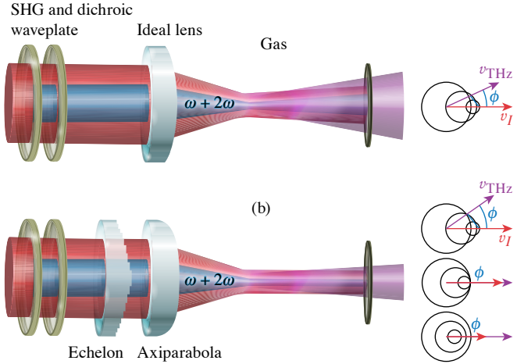
Flying focus pulses offer optimization of laser-based applications that require velocity matching or extended interaction¹⁻³
Additional talks about this topic:
J. P. Palastro (Monday, WG6, 4:20pm)
D. Ramsey (Tuesday, WG6, 2:30pm)
Laser wakefield acceleration⁴
THz Generation⁵
¹ Sainte-Marie et al. Optica 4, 10 (2017)
² Froula et al. Nat. Photonics 12, 5 (2018)
³ Palastro et al. Phys. Rev. Lett. 124, 13 (2020)
⁴ Miller et al. Sci. Rep 13, 21306 (2023)
⁵ Simpson et al. Phys. Rev. Res. 6, 013041 (2024)

Slide 5
Ultrafast flying focus pulses require optics that produce an extended focal range
Spatial control

Slide 6
Ultrafast flying focus pulses require optics that produce an extended focal range
Spatial control

Slide 7
By separately controlling the focal times via radial group delay, the focal trajectory can be controlled
Spatial control
Spatial + temporal control

Slide 8
By separately controlling the focal times via radial group delay, the focal trajectory can be controlled
Spatial control
Spatial + temporal control
Exotic spatiotemporal control
Ambat et al. Opt. Express 31, 19 (2023)

Slide 9
The axiparabola¹ is one optic that produces an extended focal range
Spatial control
¹ Smartsev et al. Opt. Lett. 44, 14 (2019)
Nominal focal length, f₀ = 50 cm | Optic radius, R = 5 cm | Extended focal range, L = 1 cm

Slide 10
The axiparabola is one optic that produces an extended focal range
Spatial control
The axiparabola naturally produces an accelerating focal trajectory, thus requiring separate optics to control the focal time of the pulse via radial group delay.
Nominal focal length, f₀ = 50 cm | Optic radius, R = 5 cm | Extended focal range, L = 1 cm

Slide 11
By tailoring the radial group delay, the trajectory of the ultrafast flying focus can be controlled
Temporal control

Slide 12
By tailoring the radial group delay, the trajectory of the ultrafast flying focus can be controlled
Temporal control
$$v_{f}\left(t\right)=1.000c$$

Slide 13
By tailoring the radial group delay, the trajectory of the ultrafast flying focus can be controlled
Temporal control
$$v_{f}\left(t\right)=1.001c$$
$$v_{f}\left(t\right)=1.000c$$

Slide 14
By tailoring the radial group delay, the trajectory of the ultrafast flying focus can be controlled¹
Temporal control
$$v_{f}\left(t\right)=1.001c$$
$$v_{f}\left(t\right)=1.000c$$
$$v_{f}\left(t\right)=0.999c$$
¹ Ambat et al. Opt. Express 31, 19 (2023)

Slide 15
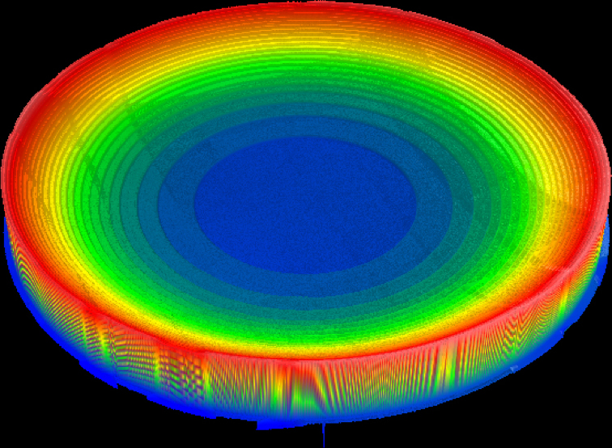
The recently proposed¹ and demonstrated² radial echelon provides a reflective approach to structuring the radial group delay
RGD optics
1 cm
¹ Palastro et al. Phys. Rev. Lett. 124, 13 (2020)
² Pigeon et al. Opt. Express 32, 1 (2024)

Slide 16
The recently proposed¹ and demonstrated² radial echelon provides a reflective approach to structuring the radial group delay
RGD optics
1 cm
¹ Palastro et al. Phys. Rev. Lett. 124, 13 (2020)
² Pigeon et al. Opt. Express 32, 1 (2024)

Slide 17
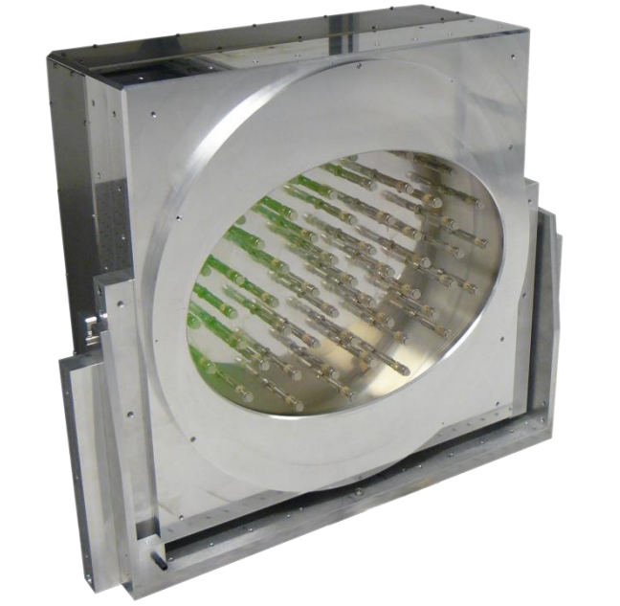
To improve upon the static echelon, adaptive optics can be used to tailor the radial group delay
RGD optics
CMOS Backplane
Liquid crystals
Glass
V_{LC} = 0
Incident wavefront
V_{LC} ≠ 0
Reflected wavefront
V_{LC} = 0
Echelon
Deformable Mirror¹
Spatial Light Modulator
¹ ISP Systems

Slide 18
To improve upon the static echelon, adaptive optics can be used to tailor the radial group delay^{1, 2}
RGD optics
CMOS Backplane
Liquid crystals
Glass
V_{LC} = 0
Incident wavefront
V_{LC} ≠ 0
Reflected wavefront
V_{LC} = 0
Deformable Mirror
Spatial Light Modulator
¹ Li and Kawanaka Commun. Phys. 3, 1 (2020)
² Ambat et al. Opt. Express 31, 19 (2023)

Slide 19
To improve upon the static echelon, adaptive optics can be used to tailor the radial group delay^{1, 2}
RGD optics
Deformable Mirror
¹ Li and Kawanaka Commun. Phys. 3, 1 (2020)
² Ambat et al. Opt. Express 31, 19 (2023)

Slide 20
To improve upon the static echelon, adaptive optics can be used to tailor the radial group delay^{1, 2}
RGD optics
CMOS Backplane
Liquid crystals
Glass
V_{LC} = 0
Incident wavefront
V_{LC} ≠ 0
Reflected wavefront
V_{LC} = 0
Deformable Mirror
Spatial Light Modulator
¹ Li and Kawanaka Commun. Phys. 3, 1 (2020)
² Ambat et al. Opt. Express 31, 19 (2023)

Slide 21
Programmable-trajectory ultrafast flying focus pulses offer rapid tunability of a wide variety of focal trajectories
An accelerating focus can be used to control the trapping and acceleration of electrons in a laser wakefield accelerator
Ambat et al. Opt. Express 31, 19 (2023)

Slide 22
Programmable-trajectory ultrafast flying focus pulses offer rapid tunability of a wide variety of focal trajectories
A pulse with an oscillating focal point could provide a novel method for quasi-phase-matching nonlinear optical processes
Ambat et al. Opt. Express 31, 19 (2023)

Slide 23
Programmable, spatiotemporal control of ultrashort laser pulses offers tunability for laser-based applications
Conclusions
Flying focus pulses feature an intensity peak that can travel at any velocity, independent of the group velocity, over distances much longer than a Rayleigh range
We outline a generalized method for designing optical configurations that produce flying focus pulses with ultrashort duration and arbitrary, longitudinal focal trajectories at velocities close to the speed of light
We propose an axiparabola for extending the focal range and a deformable mirror – spatial light modulator pair to dynamically control the focal trajectory
Simulations demonstrate the flexibility of exotic focal trajectories for laser-based applications

Slide 24
Additional slides

Slide 25
Adaptive optics, such as deformable mirrors and spatial light modulators, offer dynamic programmability of the focal trajectory.
RGD optics
Li and Kawanaka, Sci. Rep. 10, 1 (2020)
Ambat et al. Opt. Express 31, 19 (2023)

Slide 26
Figure 4
This figure shows the electric field of the laser pulse modified by the RGD optics. Insets show the fine structures within a 500 um x 15 fs window. Laser propagates from left to right.

Slide 27
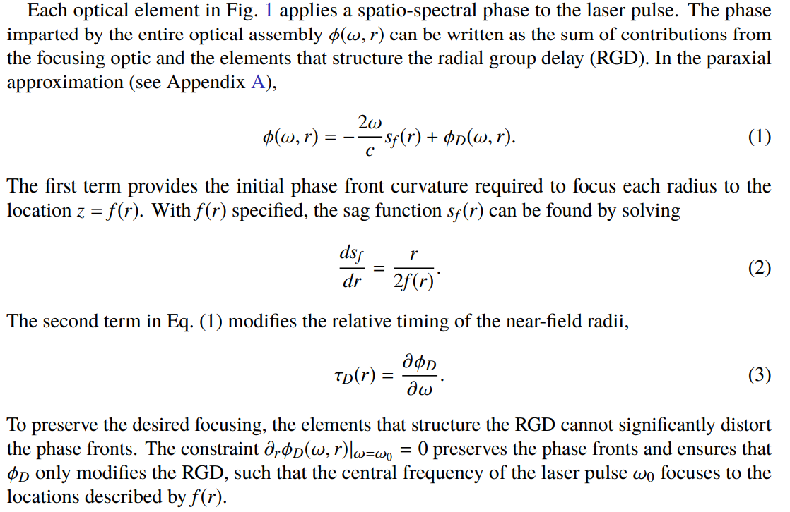
Derivation of the ultrafast flying focus

Slide 28
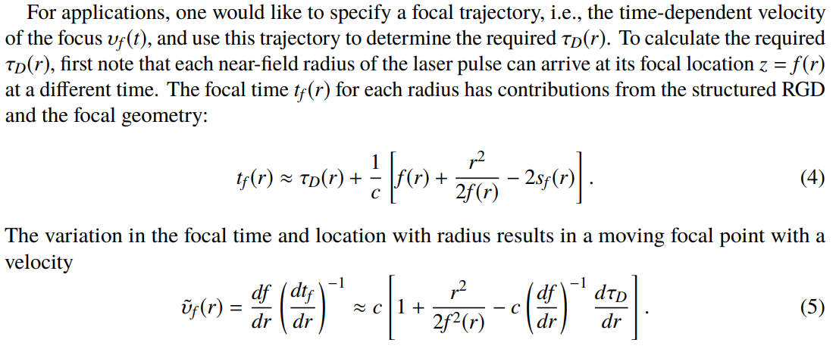
Derivation of the ultrafast flying focus

Slide 29
Derivation of the ultrafast flying focus

Slide 30
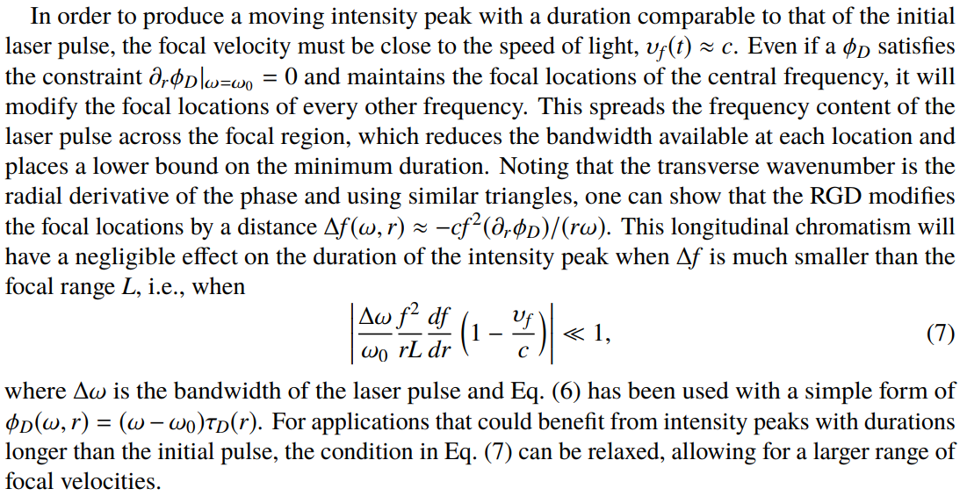
Derivation of the ultrafast flying focus

Slide 31
Figure 5
The maximum on-axis intensity of flying focus pulses with vf = c created using (a) an echelon or a DM-SLM pair with an SLM pixel size of (b) p = 200 µm, (c) p = 100 µm, and (d) p = 50 µm.
As the SLM pixel size goes to zero, the intensity of the echelon is recovered.

Slide 32
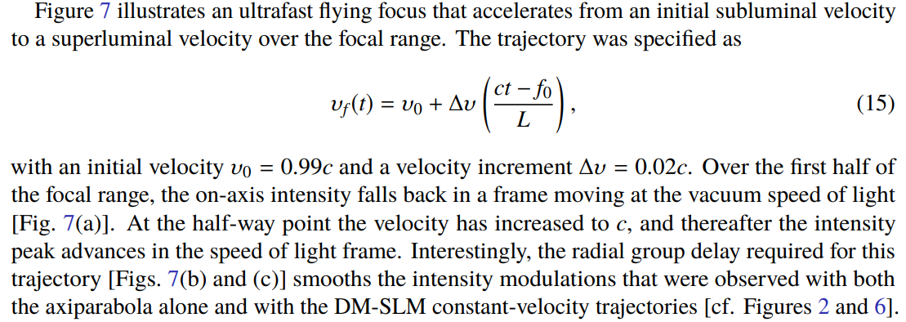
An accelerating focus can be used to control the trapping and acceleration of electrons in a laser wakefield accelerator.

Slide 33
A pulse with an oscillating focal point could provide a novel method for quasi-phase-matching nonlinear optical processes

