Slide 1








Injection of collider-quality e-beams in plasma accelerators
A. Jain¹, J. Yan¹, J. Palastro², T. Simpson^{2,*}, J. Pierce³, W. B. Mori³, N. Vafaei-Najafabadi¹
¹Stony Brook University, ²University of Rochester, ³UCLA
* Currently at Johns Hopkins University

Slide 2
Synthesis
Plasma accelerators create accelerating gradients that are hundreds of times higher than conventional accelerators
A “plasma photoinjector” for a collider application needs to create
  Low emittance (<100 nm)
  High charge (order of nC)
  Trapezoidal shape for low energy spread in subsequent accelerating plasma stages
By applying the spatiotemporal pulse shaping to two-color ionization injection, such plasma photoinjector can be demonstrated at ATF

Slide 3
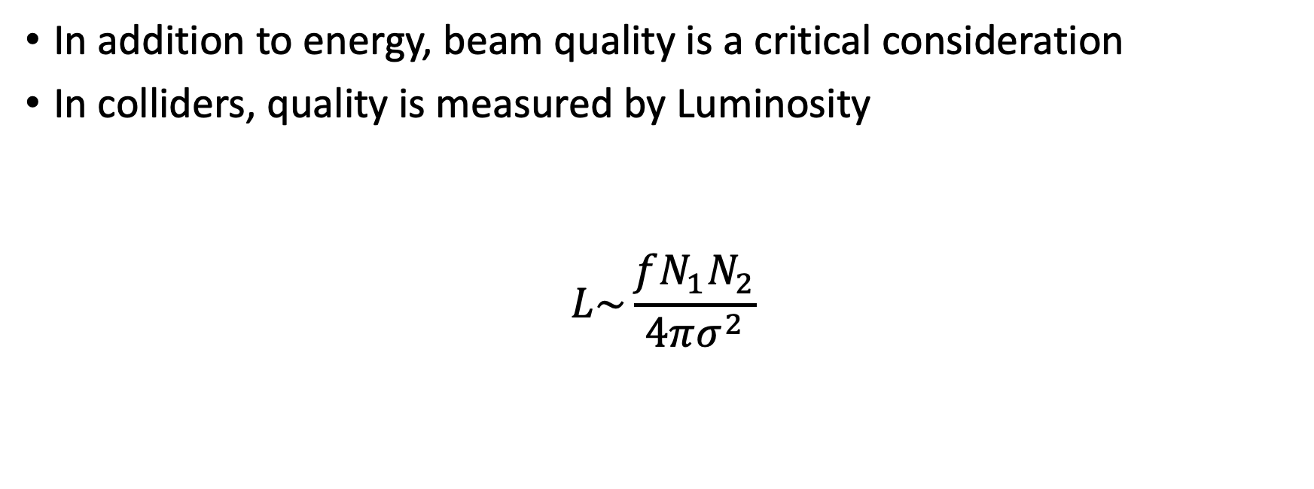

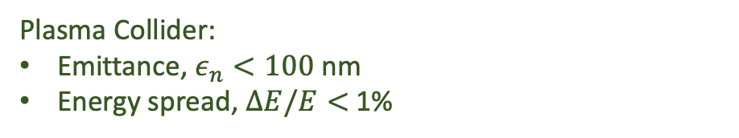


Luminosity
In addition to energy, beam quality is a critical consideration
In colliders, quality is measured by Luminosity
$$L\sim \frac{fN_{1}N_{2}}{4πσ^{2}}$$
Beam collision rate $⟹$High rate
Beam charge $⟹$High charge
Plasma Collider: $f\sim 50$kHz
Plasma Collider:$Q\sim 200$ pC , ${10}^{9} e^{−}$
Focusability $⟹$ low emittance and energy spread
Plasma Collider:
Emittance, $ε_{n}<100$ nm
Energy spread, $ΔE/E<$ 1%
$L↑ ⟹ε_{n}↓$ & $ΔE/E↓$ & Q $↑$
C.B. Schroeder et al 2023 JINST 18 T06001
DOI 10.1088/1748-0221/18/06/T06001
Notes:
Having a high acceleration gradient is not enough, you also need a high quality beam
Luminosity determines number of events (collisions) per second

Slide 4
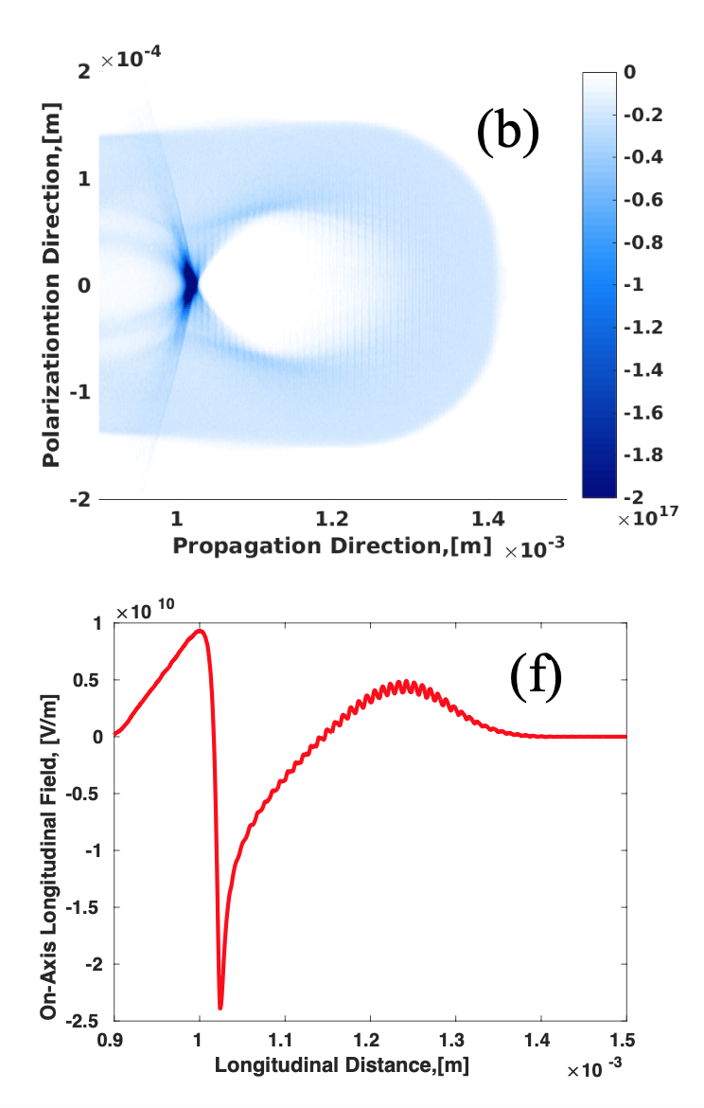
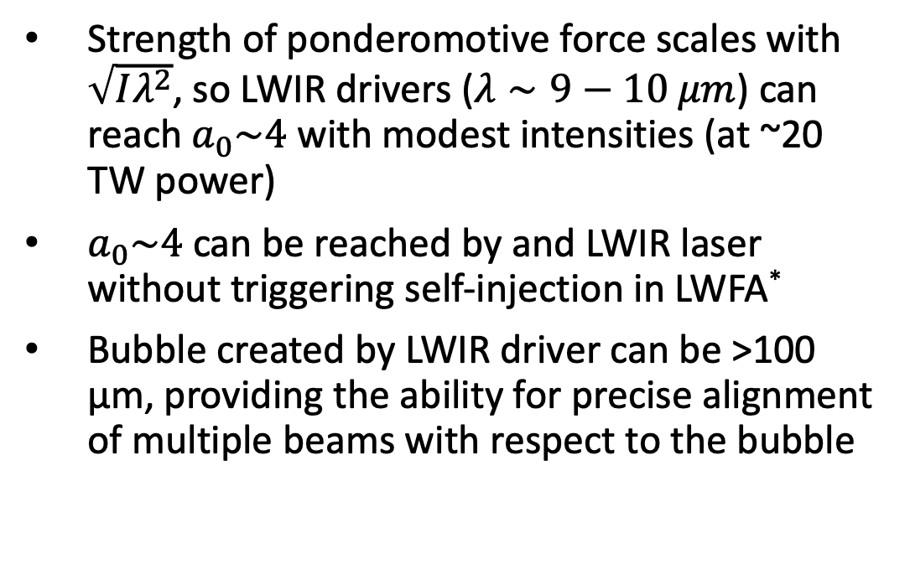
A relatively low-power LWIR laser generates a clean, highly nonlinear wakefield
P. Kumar, Physics of Plasmas, 28, 013102 (2021)
Strength of ponderomotive force scales with $\sqrt{Iλ^{2}}$, so LWIR drivers ($λ∼9−10 μm$) can reach $a_{0}\sim 4$ with modest intensities (at ~20 TW power)
$a_{0}\sim 4$ can be reached by and LWIR laser without triggering self-injection in LWFA*
Bubble created by LWIR driver can be >100 µm, providing the ability for precise alignment of multiple beams with respect to the bubble
$a_{0}=3.8$,
P=20 TW,
𝜏=0.5 ps,
$n_{e}=2×{10}^{16}$cm⁻³
* See A. Jain, Proceedings of AAC 2022
Notes:
LWIR drives clean wakefield

Slide 5
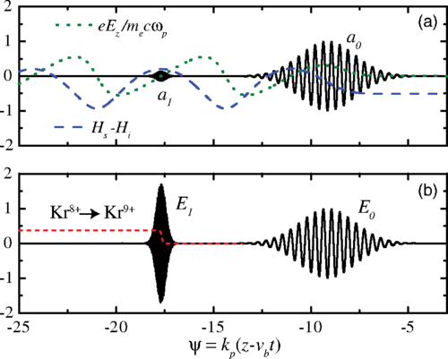
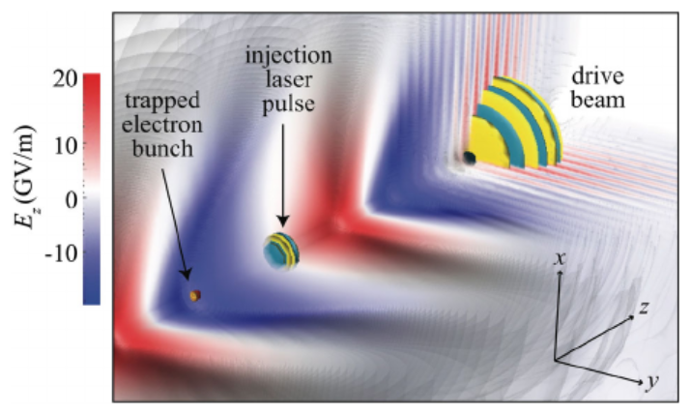
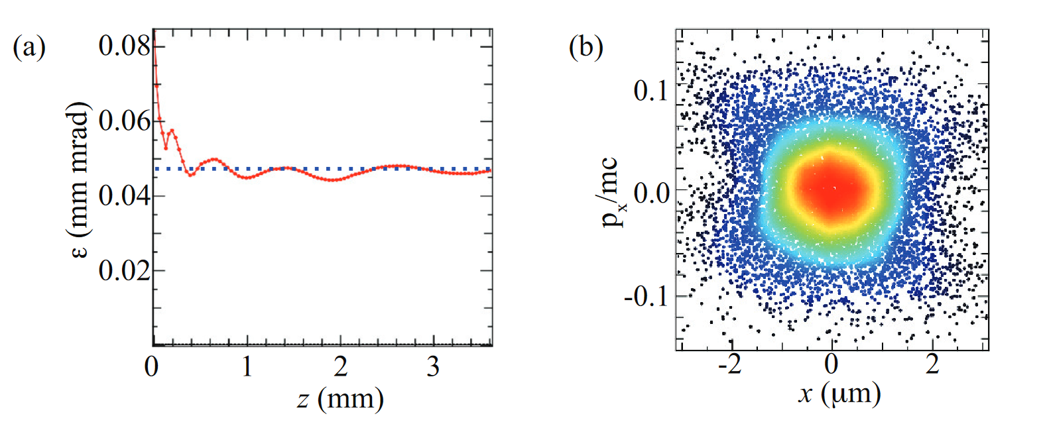
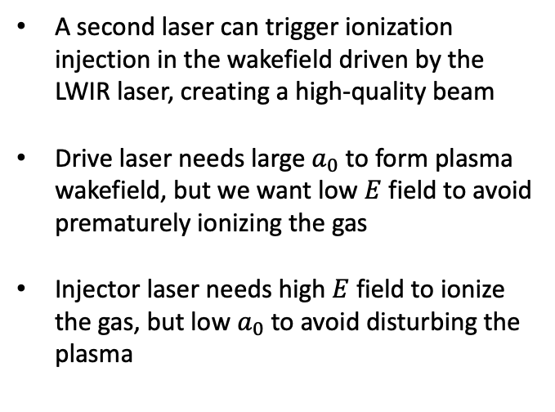
Two-color ionization injection
Very intense, small $a_{0}$
Less intense, large $a_{0}$
A second laser can trigger ionization injection in the wakefield driven by the LWIR laser, creating a high-quality beam
Drive laser needs large $a_{0}$ to form plasma wakefield, but we want low $E$ field to avoid prematurely ionizing the gas
Injector laser needs high $E$ field to ionize the gas, but low $a_{0}$ to avoid disturbing the plasma
Schroeder, PRSTAB 17, 101301 (2014)
Yu, PRL 112, 125001 (2014)
Excellent phase space
Low emittance
Schroeder, European Conference on Lasers and Electro-Optics (2015)
See also Xu, PRSTAB, 17, 061301 (2014)

Slide 6
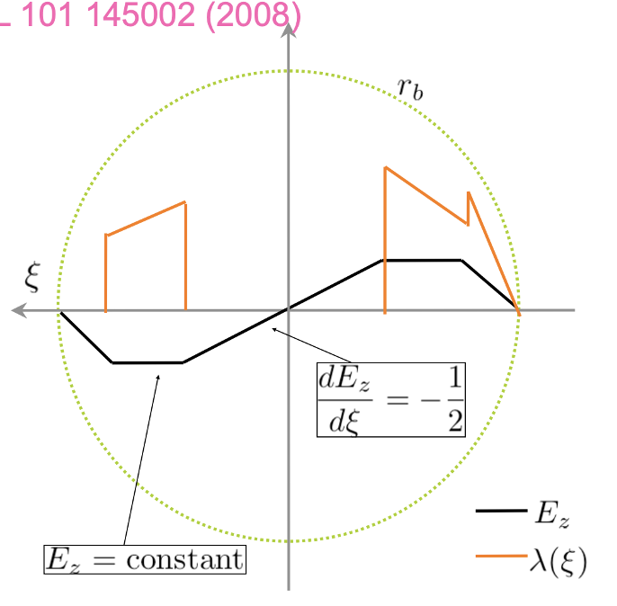
Shortcomings:
The charge produced is low (3-30 pC)
Lack of beam loading results in relatively large energy spread (few %)
Key constraint is a very localized injection of high-quality electrons
Solution:
Inject a trapezoidal beam and flatten the plasma wakefield through beamloading
M. Tzoufras, Phys. Rev. Lett. 101, 145002 (2008)

Slide 7
Varying the location of ionization is possible through spatiotemporal control of the ionizing laser
By varying the chirp, the region of peak intensity (focus) can be made to travel at any velocity
D. H. Froula, Nature Photon 12, 262–265 (2018)

Slide 8
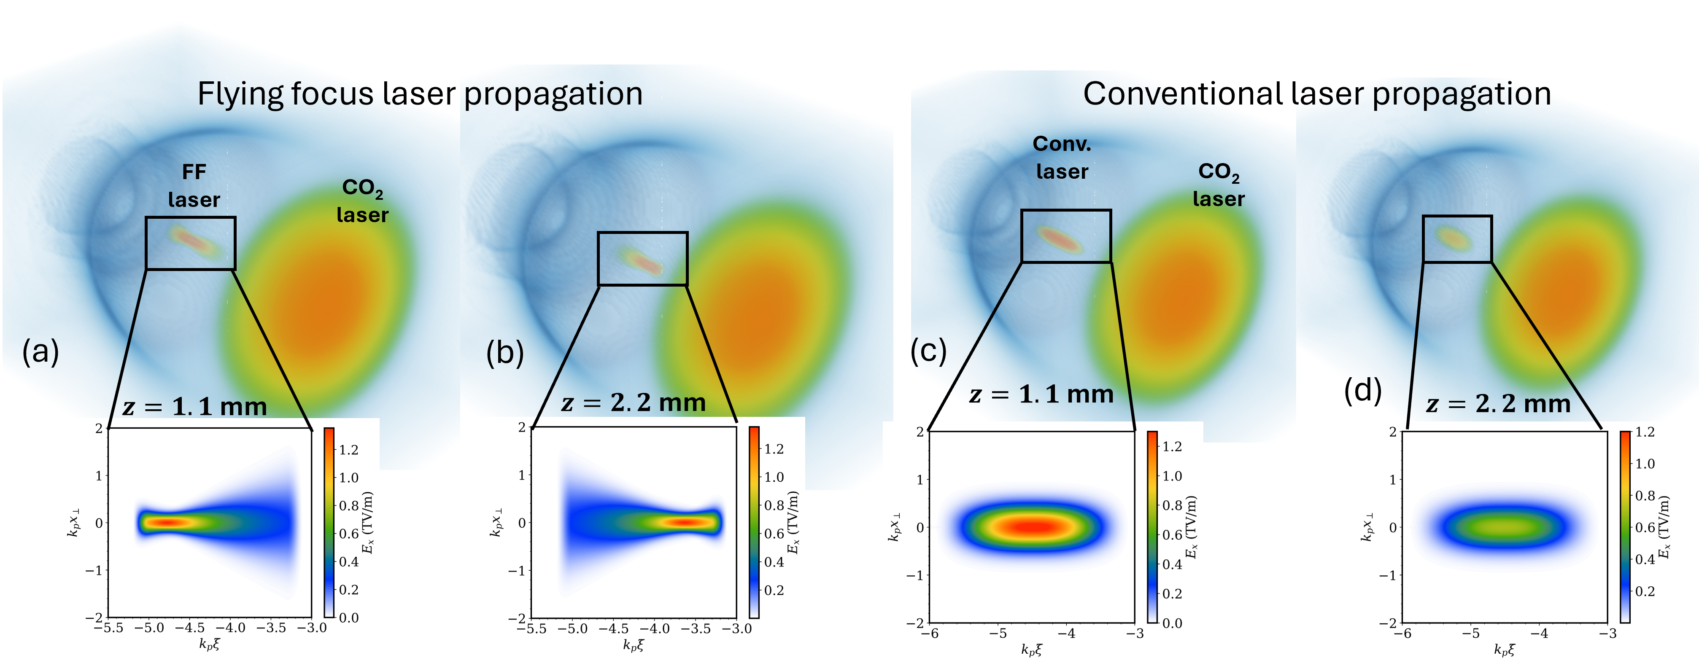
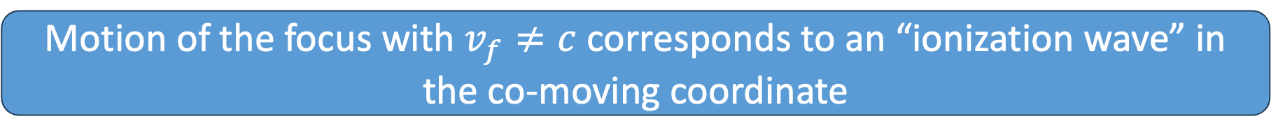
Varying the location of ionization is possible through spatiotemporal control of the ionizing laser
Motion of the focus with $v_{f}≠c$ corresponds to an “ionization wave” in the co-moving coordinate

Slide 9

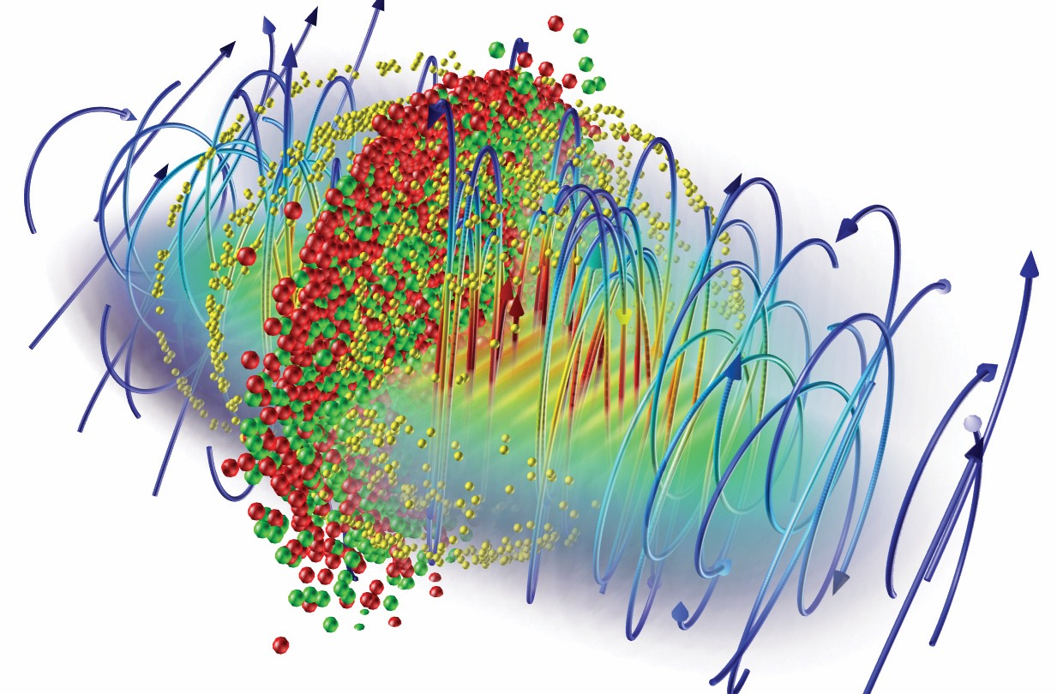



Open source
40+ research groups worldwide are using OSIRIS
300+ publications in leading scientific journals
Large developer and user community
Detailed documentation and sample inputs files available
Using OSIRIS 4.0
Visit osiris-code.github.io
OSIRIS framework
Massively Parallel, Fully Relativistic
Particle-in-Cell Code
Parallel scalability to 2 M cores
Explicit SSE / AVX / QPX / Xeon Phi / CUDA support
Extended simulation/physics models

Slide 10
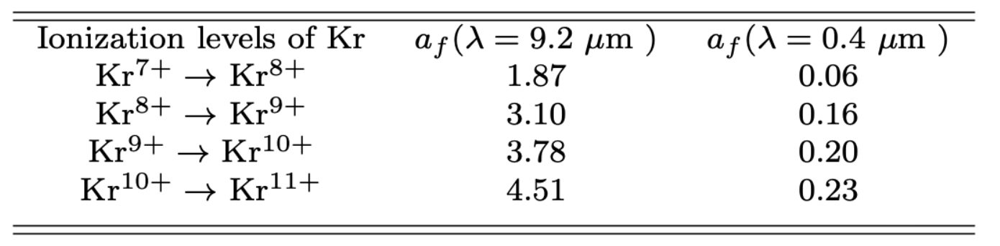
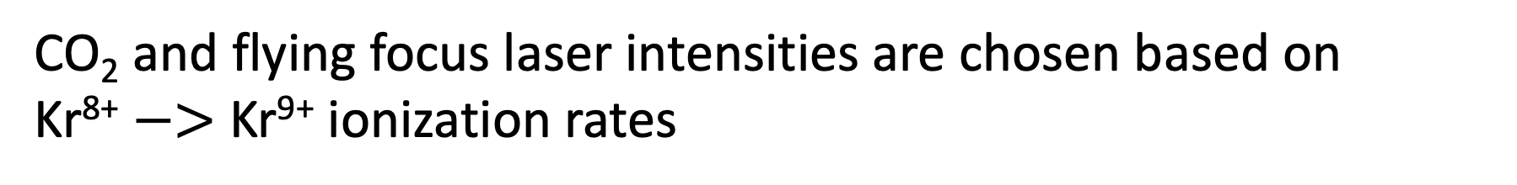
CO₂ and flying focus laser intensities are chosen based on Kr⁸⁺ $−>$ Kr⁹⁺ ionization rates
CO₂ laser- $a_{0}=2.7$, $w_{0}=105 μm$, $τ_{FWHM}=350 f$s, $λ_{0}=9.2 μm$
FF laser- $a_{0f}=0.17$, $w_{0f}=6.8 μm$, $λ_{0}=0. 4 μm,v_{f}=1.04 c$
Notes:
Also below the level of self injection

Slide 11
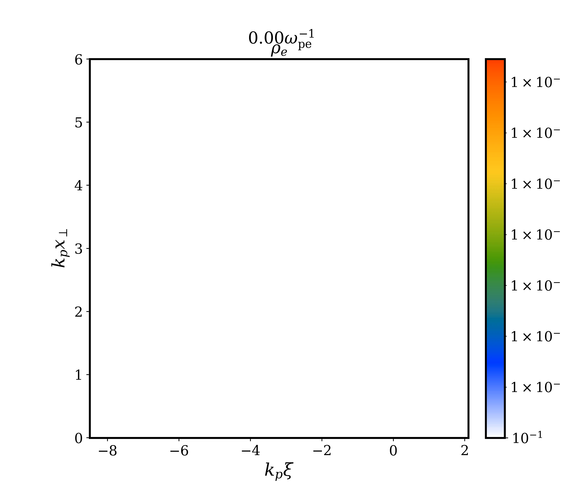
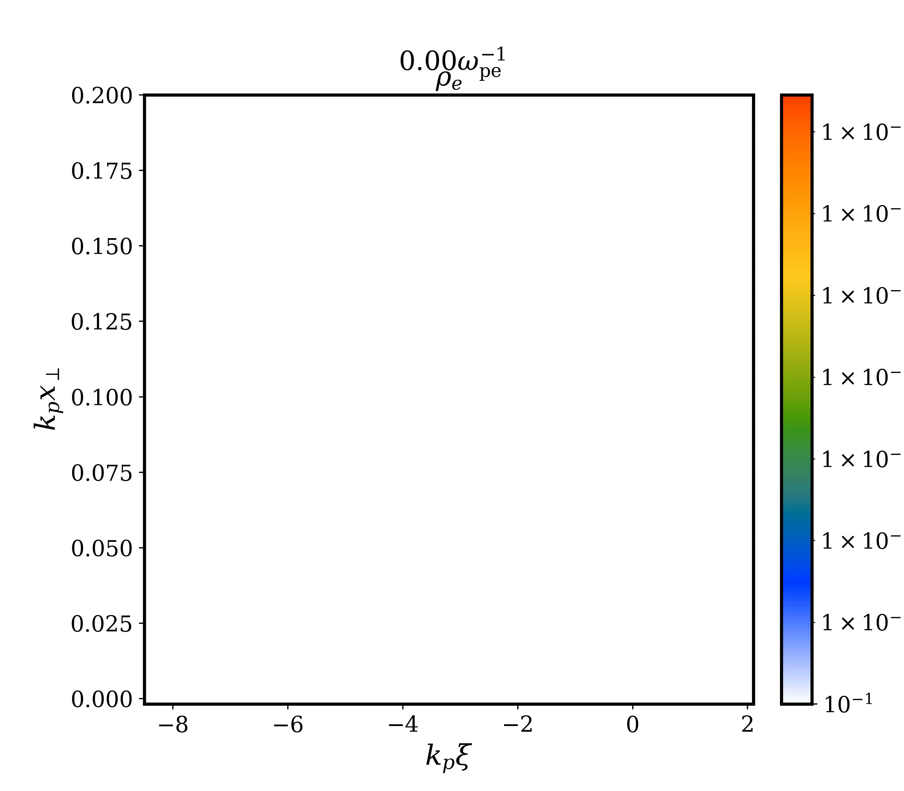

Ionization wave in the co-moving coordinate results in an extended region of injection
Plasma density
Injected electrons
CO₂ laser- $a_{0}=2.7$, $w_{0}=105 μm$, $τ_{FWHM}=350 f$s, $λ_{0}=9.2 μm$
FF laser- $v_{f}=1.04 c$, $w_{0f}=6.8 μm$, $λ_{0}=0. 4 μm, a_{0f}=0.17$
Plasma: $n_{0}=2×{10}^{16} cm^{−3}$, $\frac{1}{k_{p}}=37.6 μm$, L= 4 mm

Slide 12
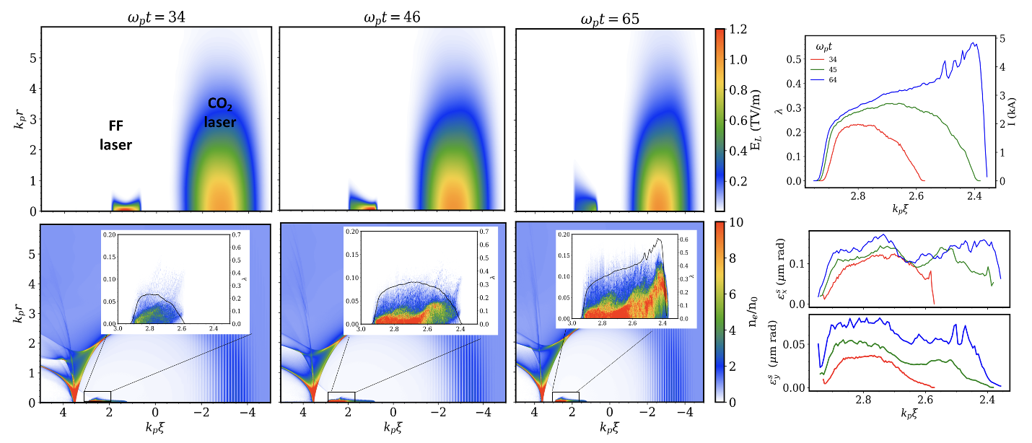
The injected beam is gradually assembled with the motion of the ionization front

Slide 13
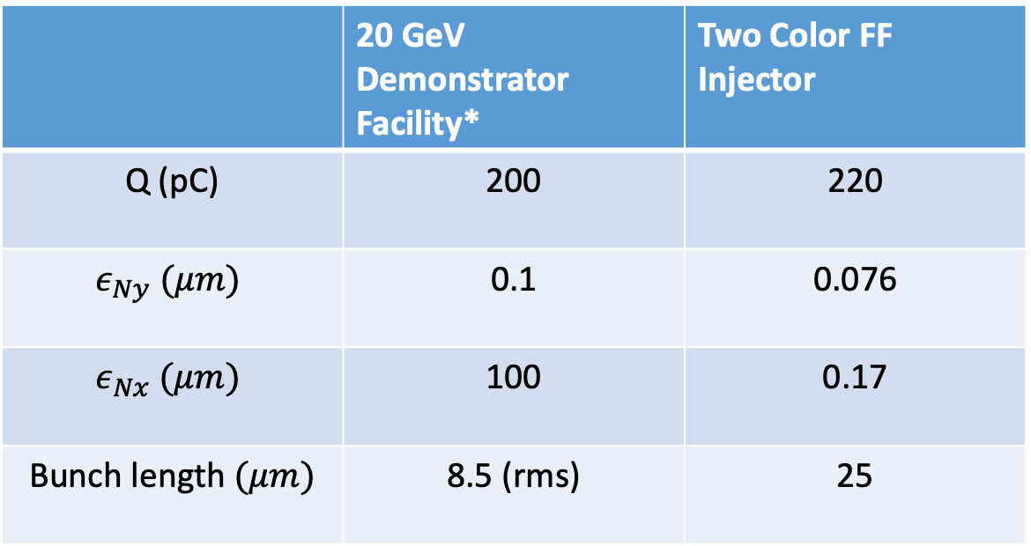
Charge and emittance are consistent with collider requirements
 | 20 GeV Demonstrator Facility* | Two Color FF Injector
Q (pC) | 200 | 220
$$ε_{Ny} (μm)$$ | 0.1 | 0.076
$$ε_{Nx} (μm)$$ | 100 | 0.17
Bunch length $(μm)$ | 8.5 (rms) | 25
*C.B. Schroeder et al 2023 JINST 18 T06001

Slide 14
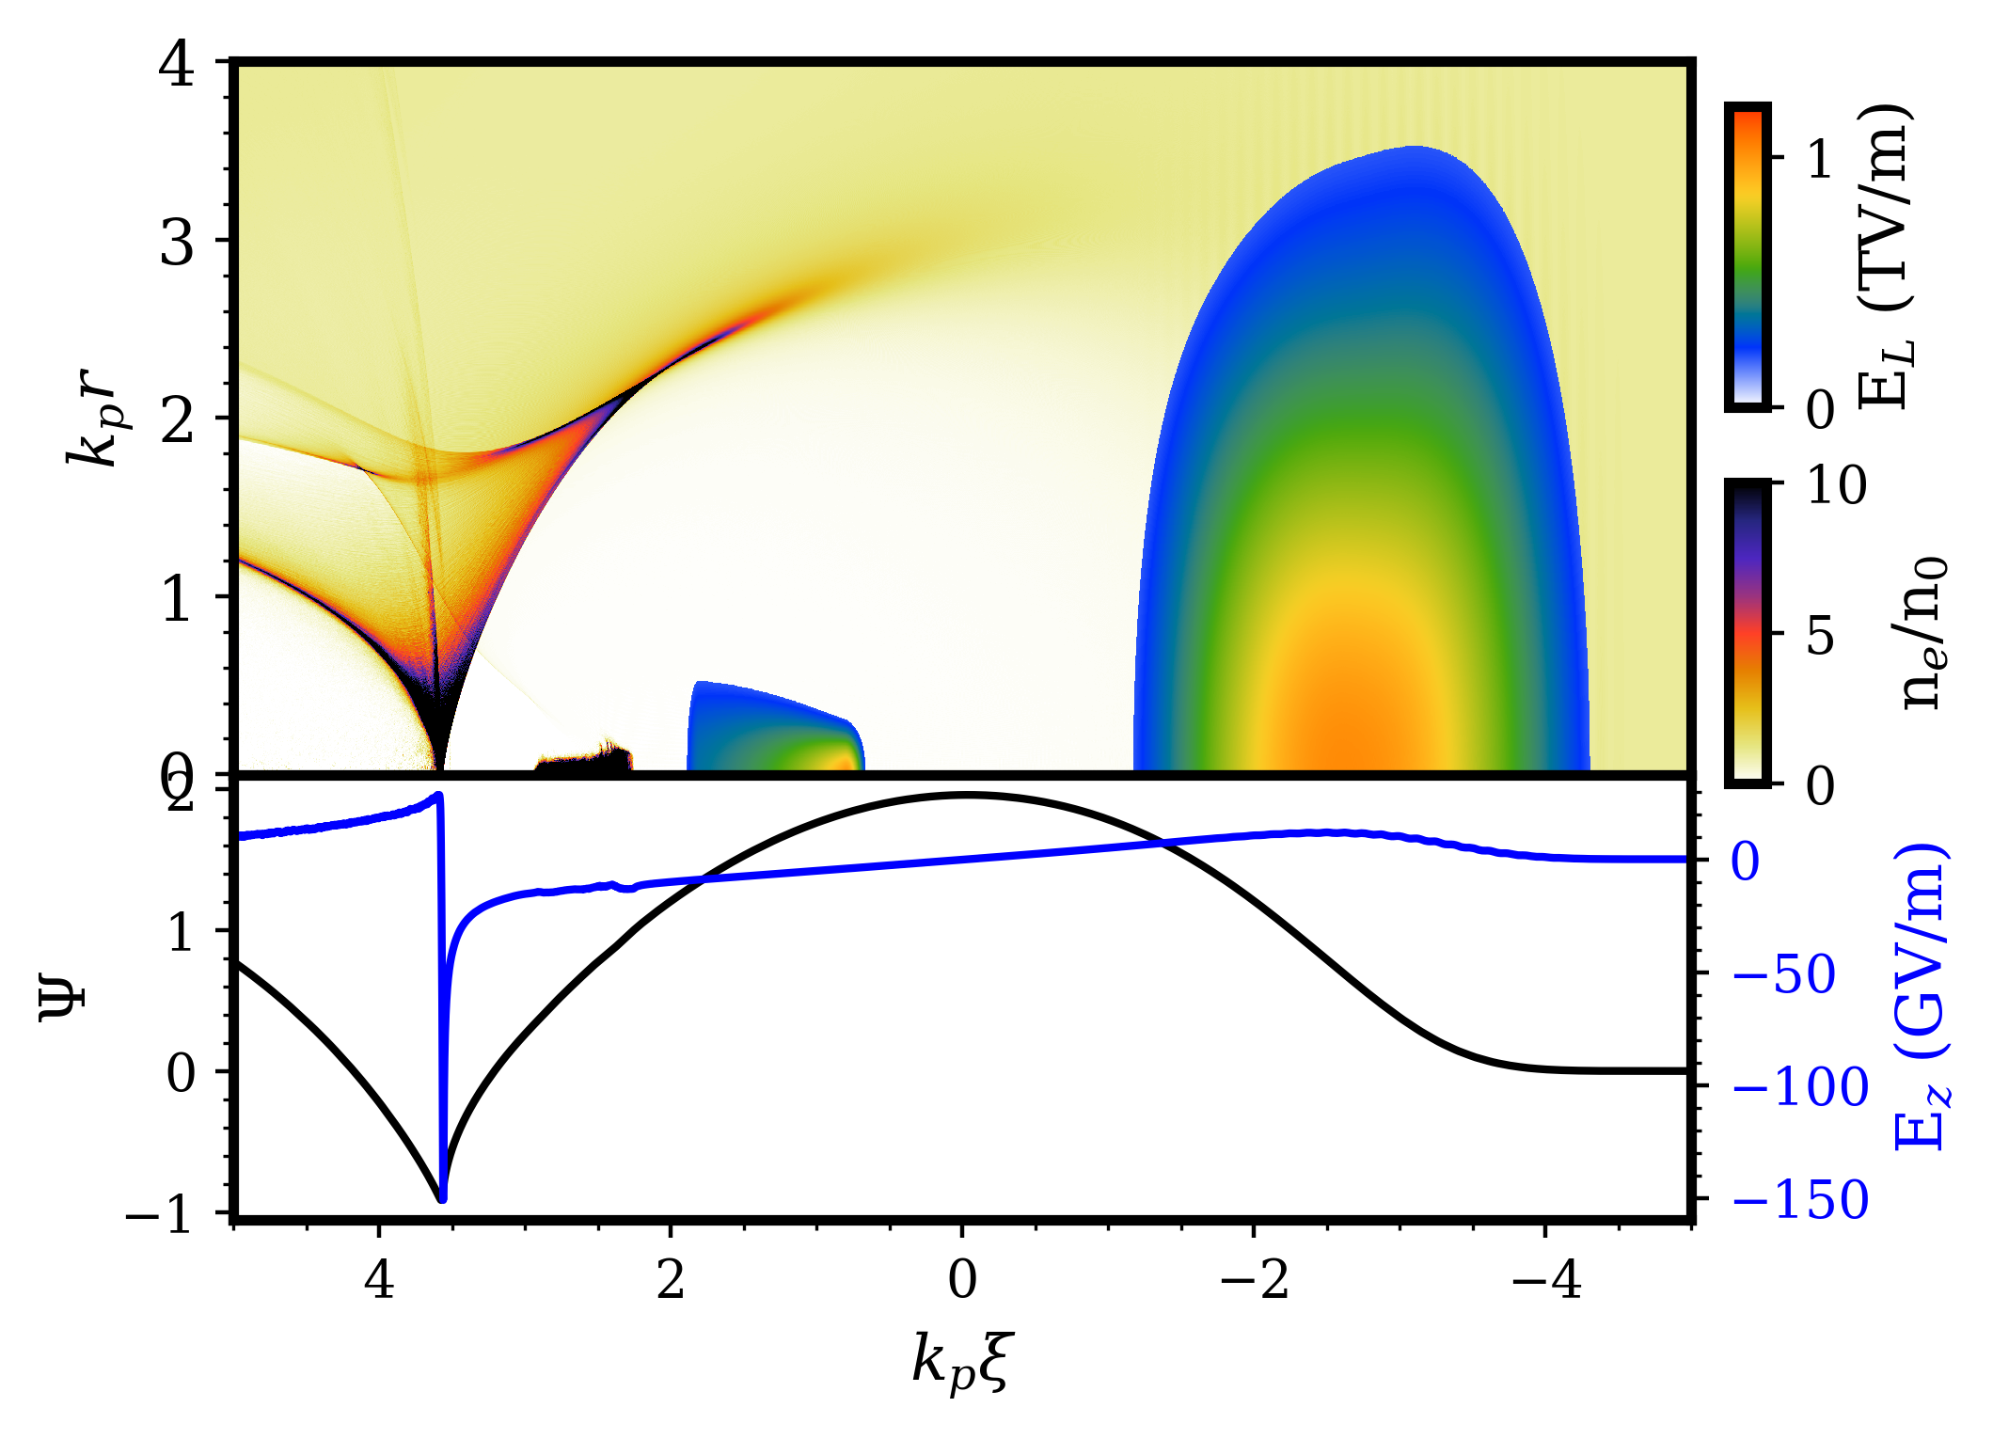
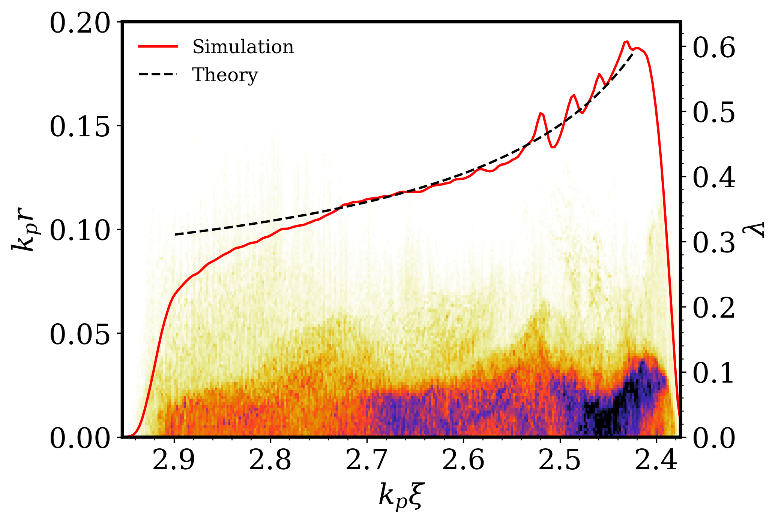


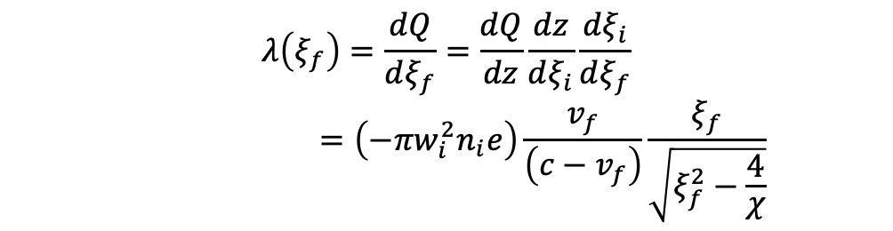
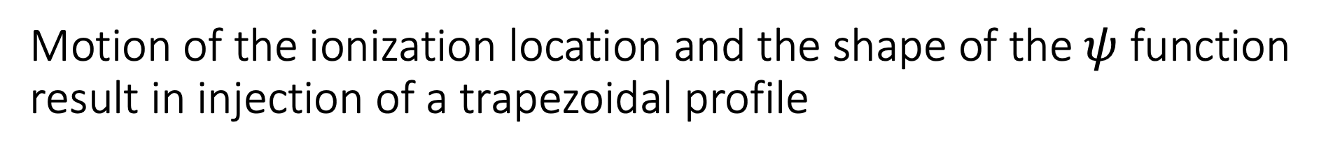





Motion of the ionization location and the shape of the $ψ$ function result in injection of a trapezoidal profile
$$λ\left(ξ_{f}\right)=\frac{dQ}{dξ_{f}}=\frac{dQ}{dz}\frac{dz}{dξ_{i}}\frac{dξ_{i}}{dξ_{f}}$$
$$=\left(−πw_{i}^{2}n_{i}e\right)\frac{v_{f}}{\left(c−v_{f}\right)}\frac{ξ_{f}}{\sqrt{ξ_{f}^{2}−\frac{4}{χ}}}$$
Plasma formed by ionization of Krypton gas
(a)
Plasma wake driven by CO₂ laser pulse
CO₂
laser
$$r_{b}(ξ)$$
(c)
FF laser
$$r_{m}$$
$$25 μm$$
(b)
$$Ψ_{i}$$
$$Ψ_{f}$$
$$ξ_{f}$$
$$ξ_{i}$$
A. Jain, in preparation

Slide 15
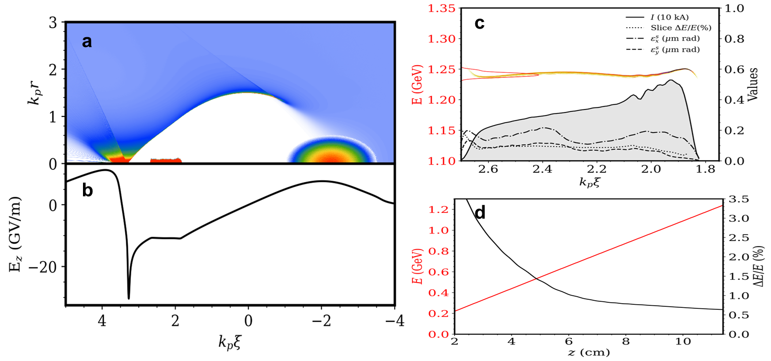
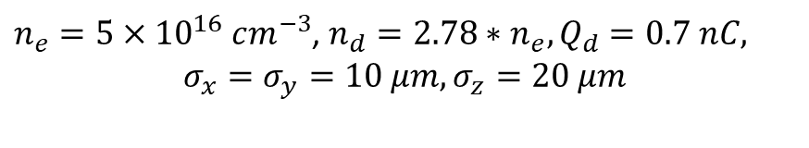
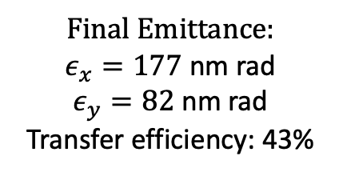
Beam generated in this photo injector can be accelerated in subsequent stages at 10 GeV/m and at high efficiency
Final Emittance:
$ε_{x}=177$ nm rad
$ε_{y}=82$nm rad
Transfer efficiency: 43%
$n_{e}=5×{10}^{16} cm^{−3}$, $n_{d}=2.78∗n_{e}, Q_{d}=0.7 nC,$
$$σ_{x}=σ_{y}=10 μm, σ_{z}=20 μm$$
A. Jain, in preparation

Slide 16
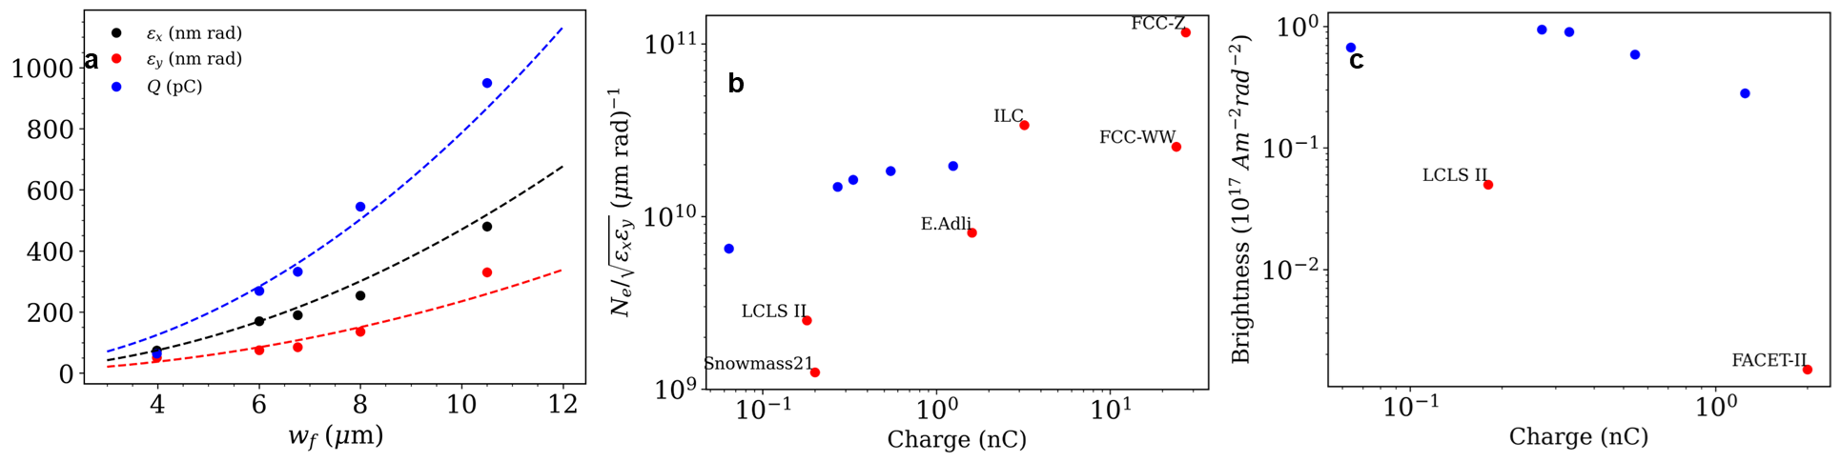
This method can easily be scaled to higher charge, albeit with higher emittance
A. Jain, in preparation

Slide 17
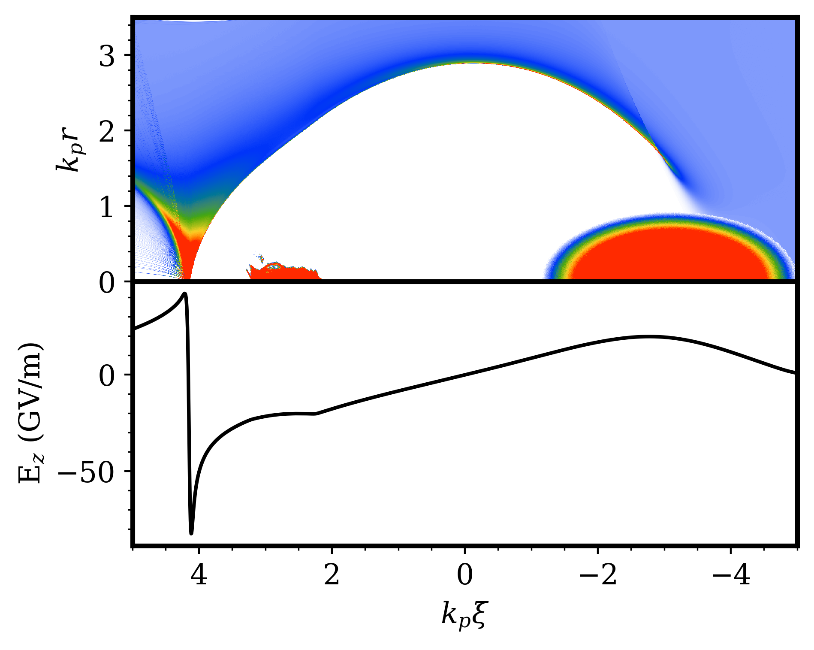
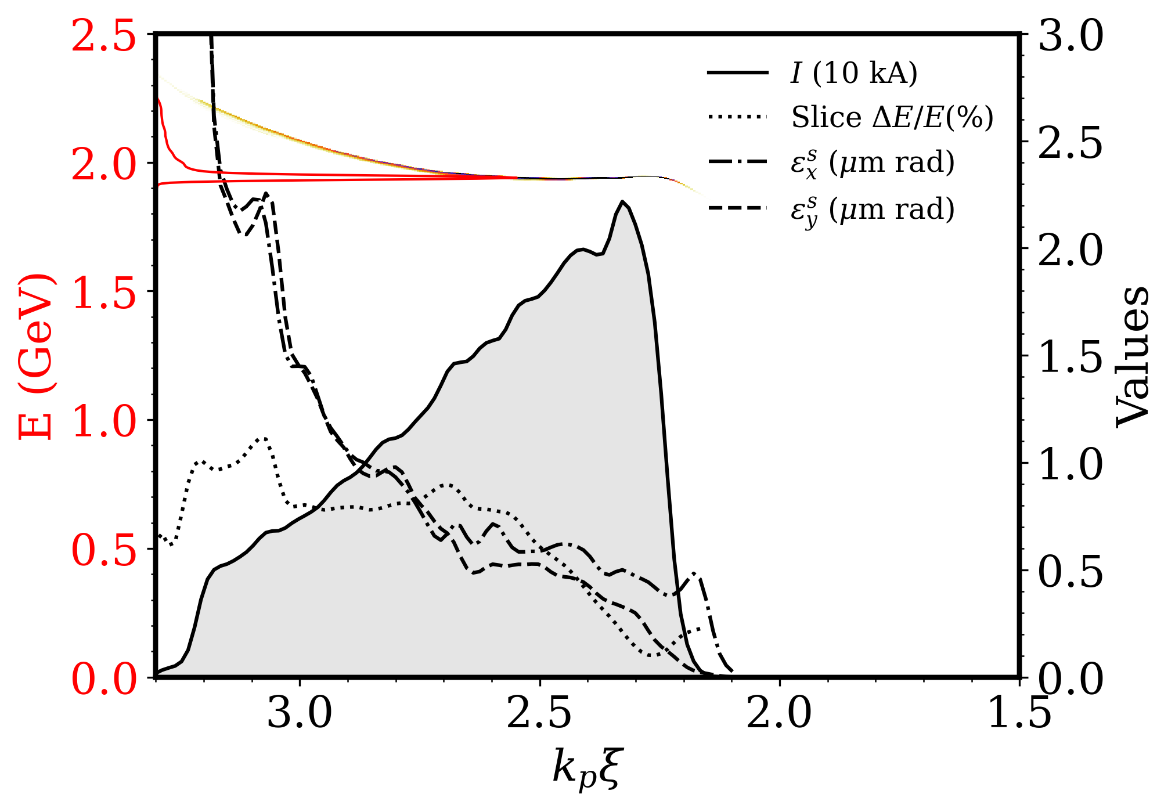
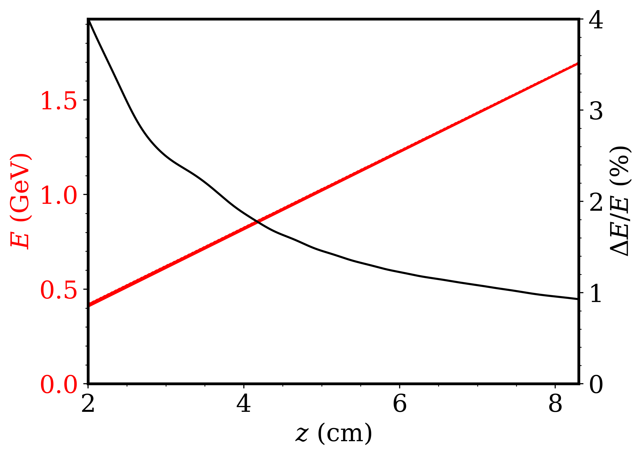
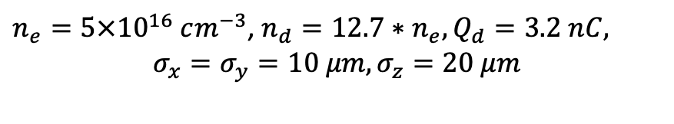
Beam loading of the nC beam
$n_{e}=5×{10}^{16} cm^{−3}$, $n_{d}=12.7∗n_{e}, Q_{d}=3.2 nC,$
$$σ_{x}=σ_{y}=10 μm, σ_{z}=20 μm$$

Slide 18

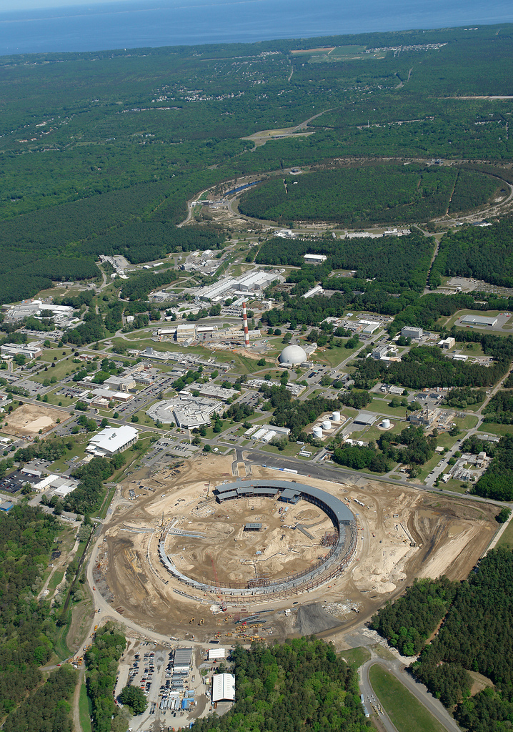
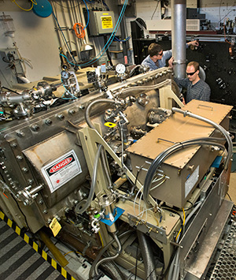
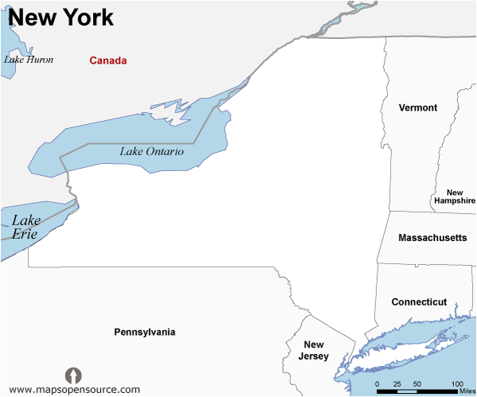
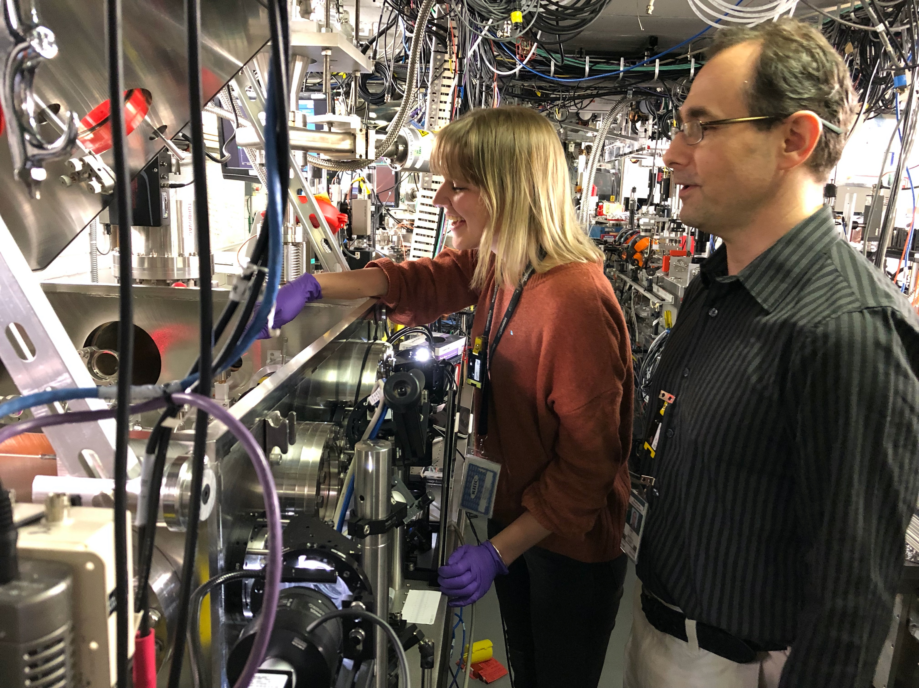
BNL’s Accelerator Test Facility (ATF) has unique infrastructure
for developing such photoinjector.
New York
RHIC
ATF
NSLS
Dr. Irina
Petrushina
Multi-TW discharge-pumped CO₂ laser
• 8J, 2 ps (2024)
• 10 J, 0.5 ps (projected 2027)
TW – class Ti:Sapphire Laser
Dr. Rafal
Zgadzaj
Synched S-band
linac (50 MeV, 100 fs)

Slide 19
Full-energy post-compressor
500 fs
5 TW
Seed from the present
CPA laser
2 ps
5 TW
✔️ State of the art
⚙️ post-compression
100 fs
25 TW
Seed from a CPA laser
with 10-mJ seed
500 fs
15 TW
⚙️ 10-mJ seed
See M. Polyanskiy, Monday 5:40, on enabling LWIR upgrades

Slide 20
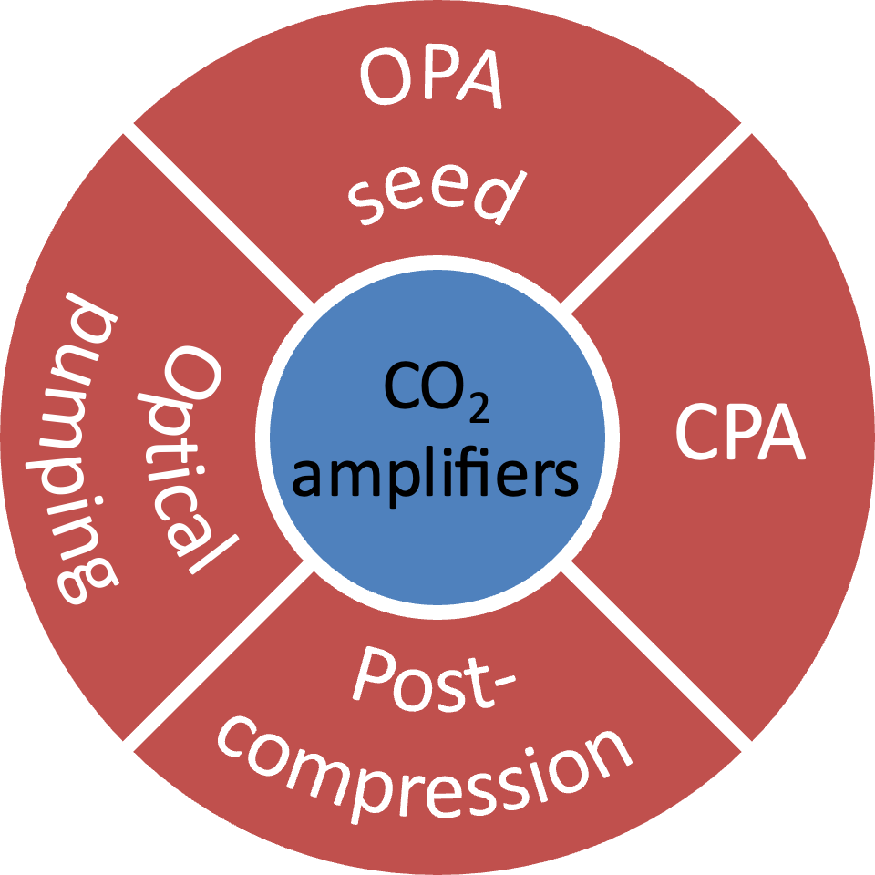
Hybrid L-WIR laser architecture
Gas
⚙️
2014
InTech (2012)
Solid
state
2010
Opt. Express 19, 7717 (2011)
✔️
✔️
⚙️
2019
Optica 2, 675 (2015)
OSA Continuum 3, 459 (2020)
2030+
Photonics 8, 101 (2021)
Opt. Express 29, 31455 (2021)
⚙️
2025
Opt. Express 29, 31714 (2021)
Front. Phys. 10, 1390225 (2024)
See M. Polyanskiy, Monday 5:40, on enabling LWIR upgrades

Slide 21
Integration of Ti:Saph at ATF
Parameter | Value | Comments
Energy (compressed) | >15 mJ (@1.5 Hz) | Compressed on target. <5% std long-term variation To be increased to 100 mJ @ 12 Hz
Energy (stretched) | >200 mJ | Out of 4-pass amplifier <8% std long-term variaiton
Duration | <70 fs | FWHM
Focused spot size | <4 µm FWHM | With F/1.5 OAP <1µm std pointing stability (~25µrad std)
Polarization | Vertical | Horizontal available upon request
Synchronization | Synchronized to the facility 81.6 MHz master clock | Rough timing (ns) by SRS delay generators. Fine adjustments (~10fs) by phase tuning the oscillator (Coherent Vitara+Synchrolock)
Transport line+ compressor transmission | 60%
Peak intensity | >10¹⁸ W/cm²
Beam size in transport | <1.5” | Limited by aperture of vacuum line between Nd:YAG and Gun Hutch rooms
Addition of Ti:Saph is represents an important upgrade in the capabilities of ATF

Slide 22
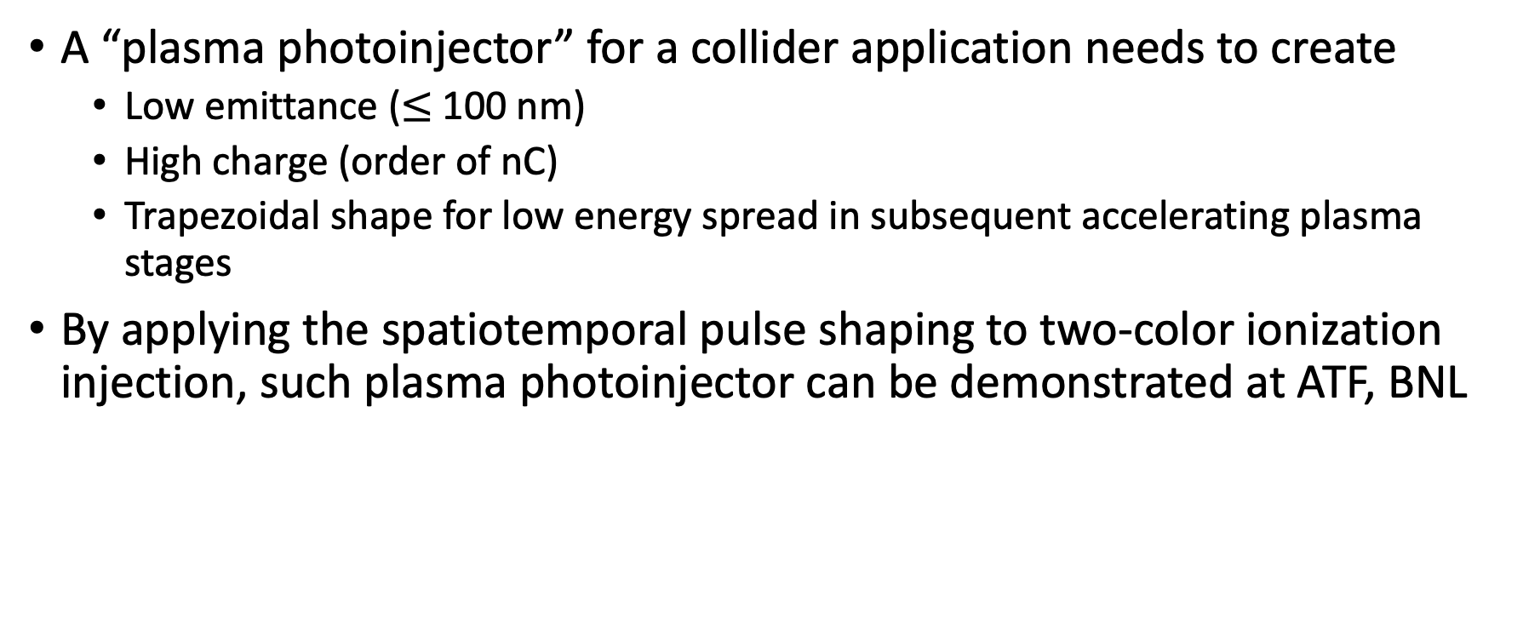
Summary
A “plasma photoinjector” for a collider application needs to create
  Low emittance ($≤$ 100 nm)
  High charge (order of nC)
  Trapezoidal shape for low energy spread in subsequent accelerating plasma stages
By applying the spatiotemporal pulse shaping to two-color ionization injection, such plasma photoinjector can be demonstrated at ATF, BNL

Slide 23
The End

Slide 24
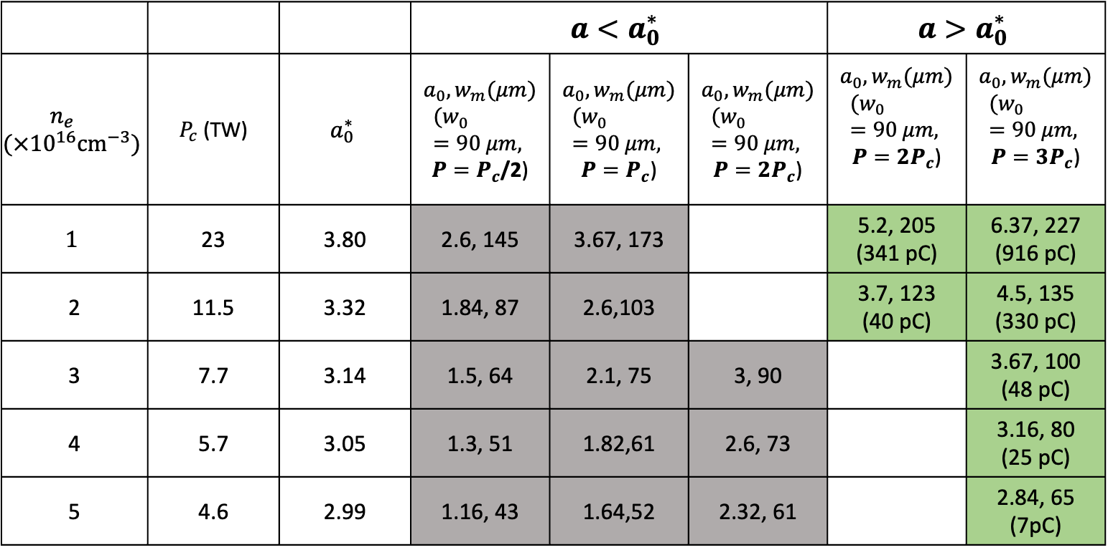
Self Injection of CO₂ Driven Wakes
 |  |  | $$a<a_{0}^{∗}$$ |  |  | $$a>a_{0}^{∗}$$
$$n_{e}$$ $$({×{10}^{16}cm}^{−3})$$ | $P_{c}$ (TW) | $$a_{0}^{∗}$$ | $a_{0}, w_{m}(μm)$ $${(w}_{0}=90 μm,$$ $P=P_{c}$/2) | $a_{0}, w_{m}(μm)$ $${(w}_{0}=90 μm,$$ $P=P_{c}$) | $a_{0}, w_{m}(μm)$ $${(w}_{0}=90 μm,$$ $P=2P_{c}$) | $a_{0}, w_{m}(μm)$ $${(w}_{0}=90 μm,$$ $P=2P_{c}$) | $a_{0}, w_{m}(μm)$ $${(w}_{0}=90 μm,$$ $P={3P}_{c}$)
$$1$$ | 23 | 3.80 | 2.6, 145 | 3.67, 173 |  | 5.2, 205 (341 pC) | 6.37, 227 (916 pC)
2 | 11.5 | 3.32 | 1.84, 87 | 2.6,103 |  | 3.7, 123 (40 pC) | 4.5, 135 (330 pC)
3 | 7.7 | 3.14 | 1.5, 64 | 2.1, 75 | 3, 90 |  | 3.67, 100 (48 pC)
4 | 5.7 | 3.05 | 1.3, 51 | 1.82,61 | 2.6, 73 |  | 3.16, 80 (25 pC)
5 | 4.6 | 2.99 | 1.16, 43 | 1.64,52 | 2.32, 61 |  | 2.84, 65 (7pC)

Slide 25
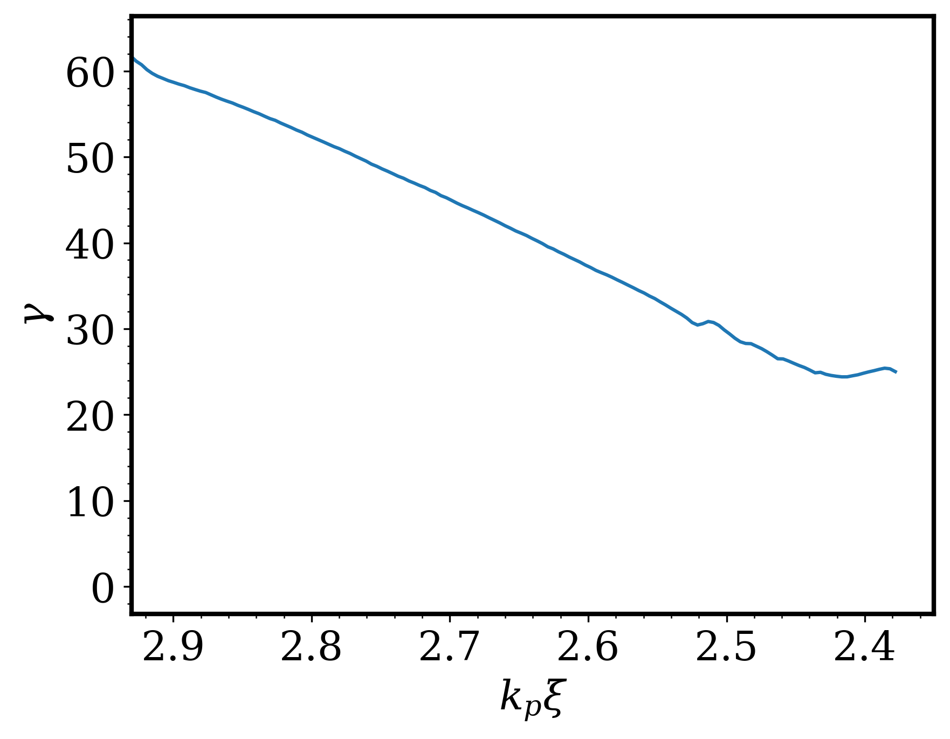
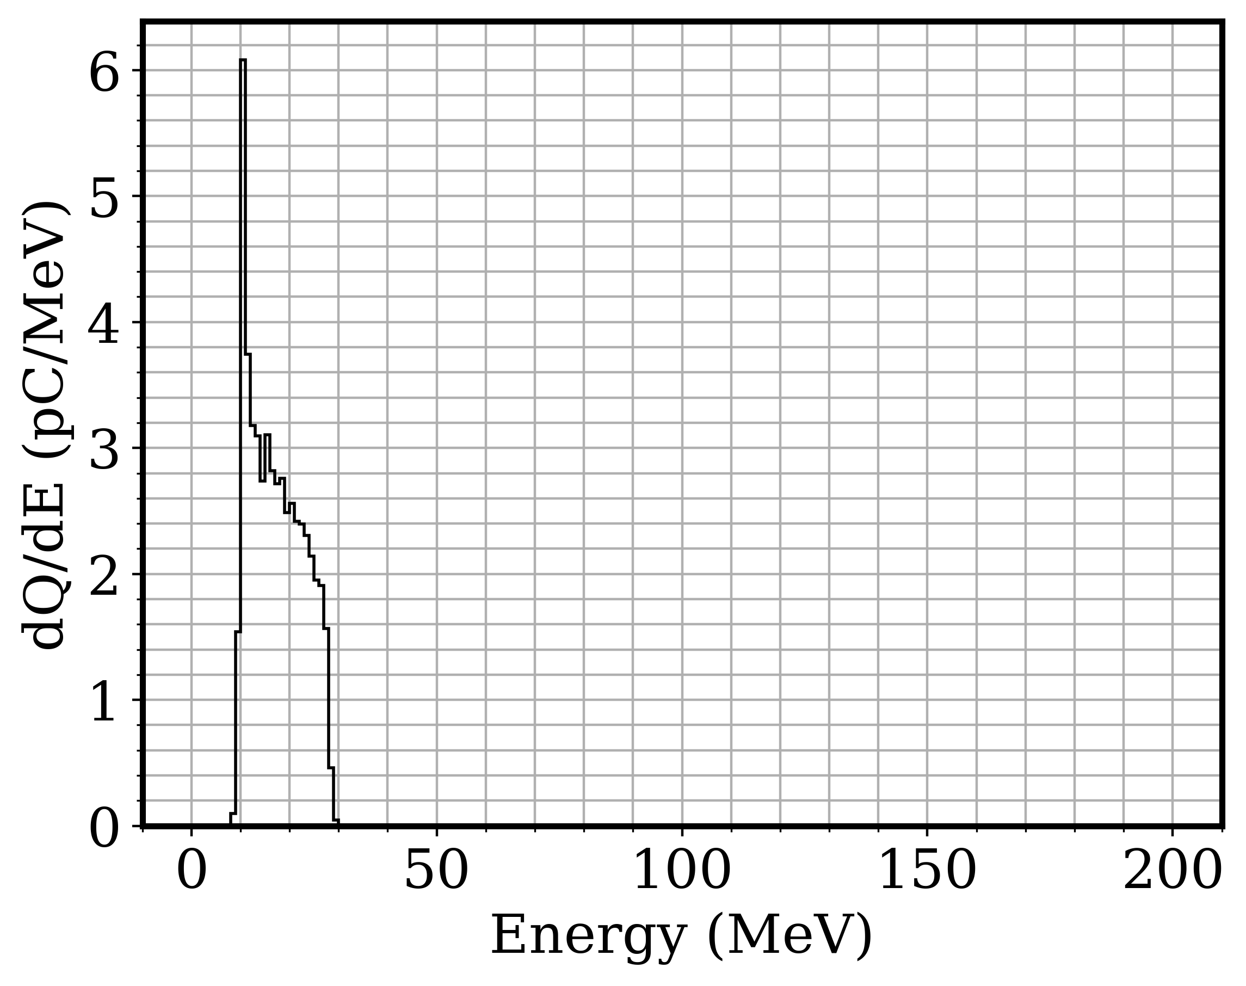
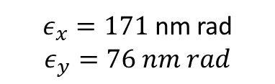
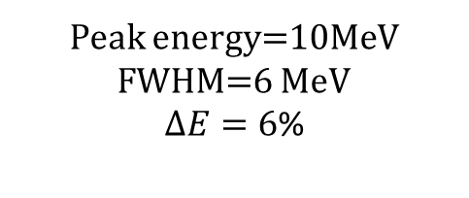
Beam energy after injection stage
$ε_{x}=171$ nm rad
$$ε_{y}=76 nm rad$$
Peak energy=10MeV
FWHM=6 MeV
$ΔE=6$%

Slide 26
Beam loading of the nC beam

Slide 27
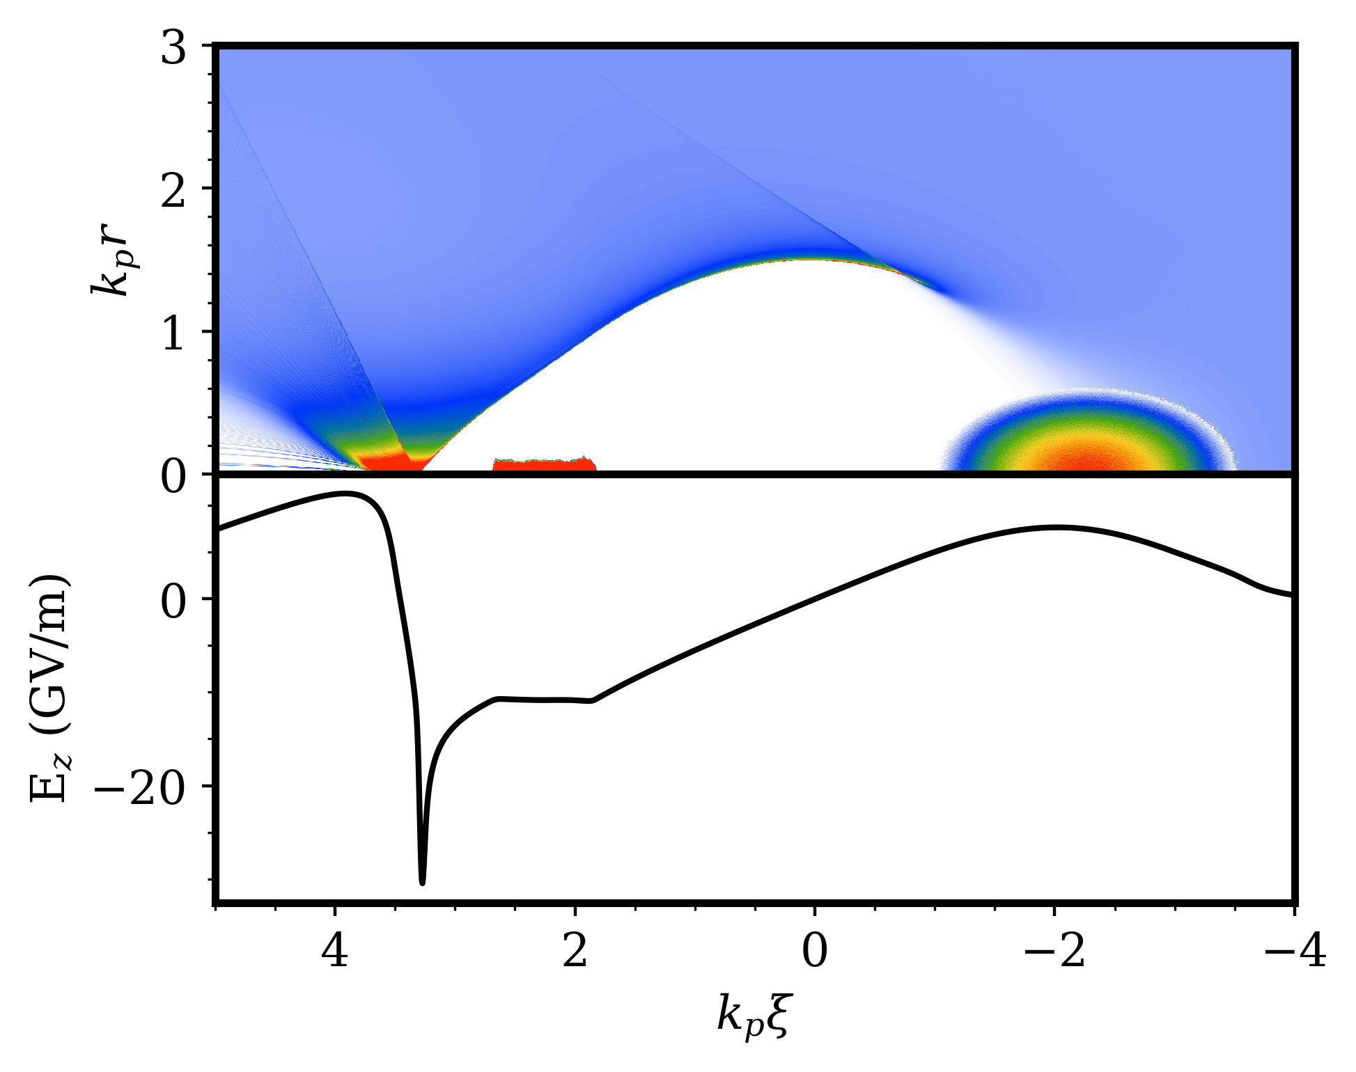
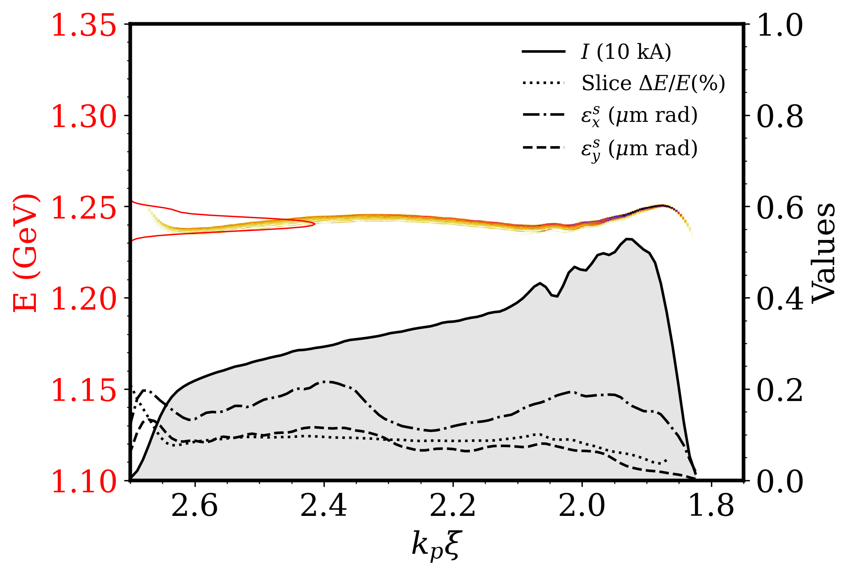
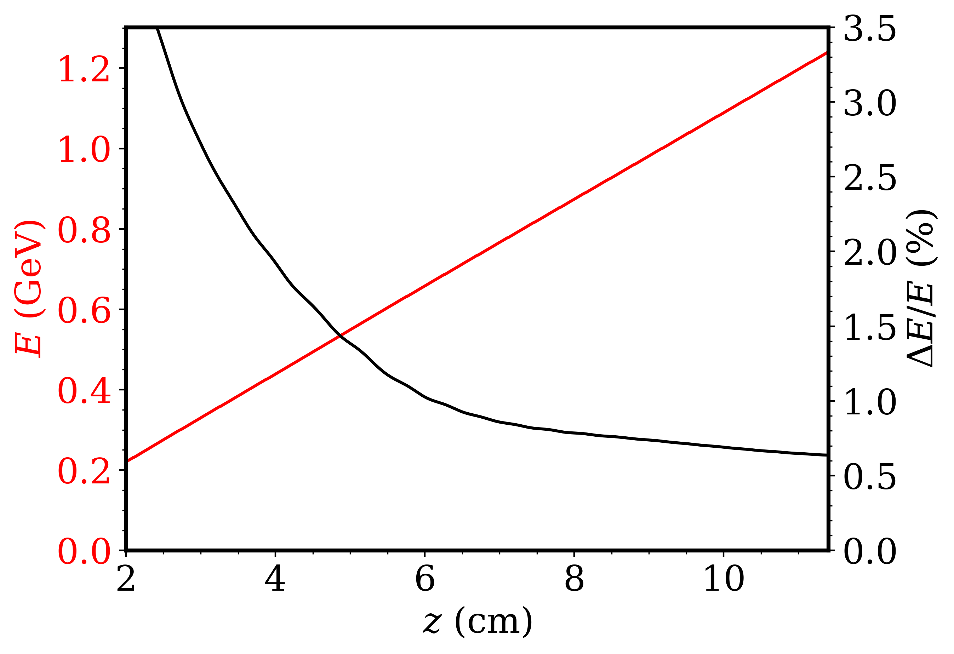


a
$Q= 220$pC
$Q= 1$nC
e
b
f
c
g
d
d

Slide 28
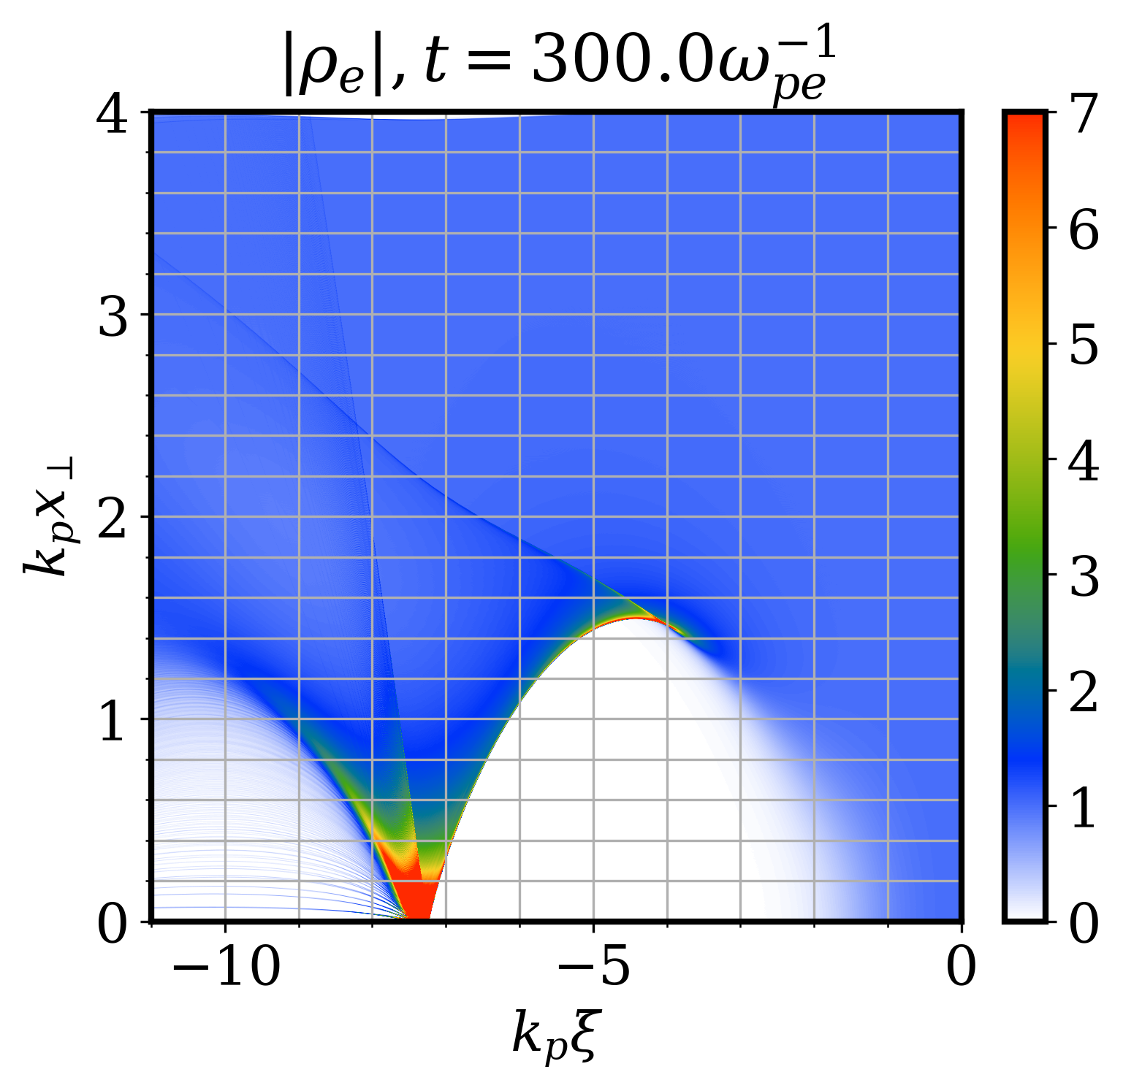
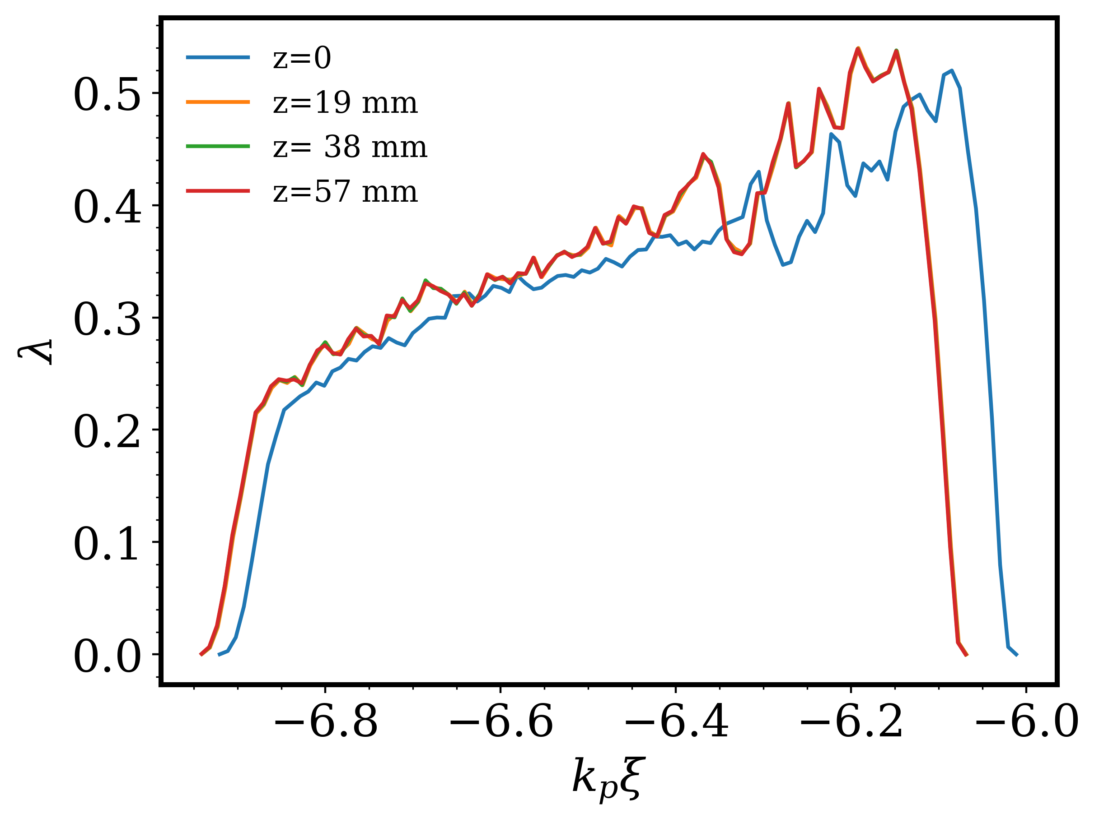
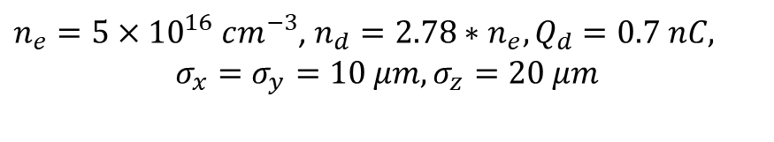

$$R_{b}=1.4$$
$n_{e}=5×{10}^{16} cm^{−3}$, $n_{d}=2.78∗n_{e}, Q_{d}=0.7 nC,$
$$σ_{x}=σ_{y}=10 μm, σ_{z}=20 μm$$
Slope= 0.22

Slide 29
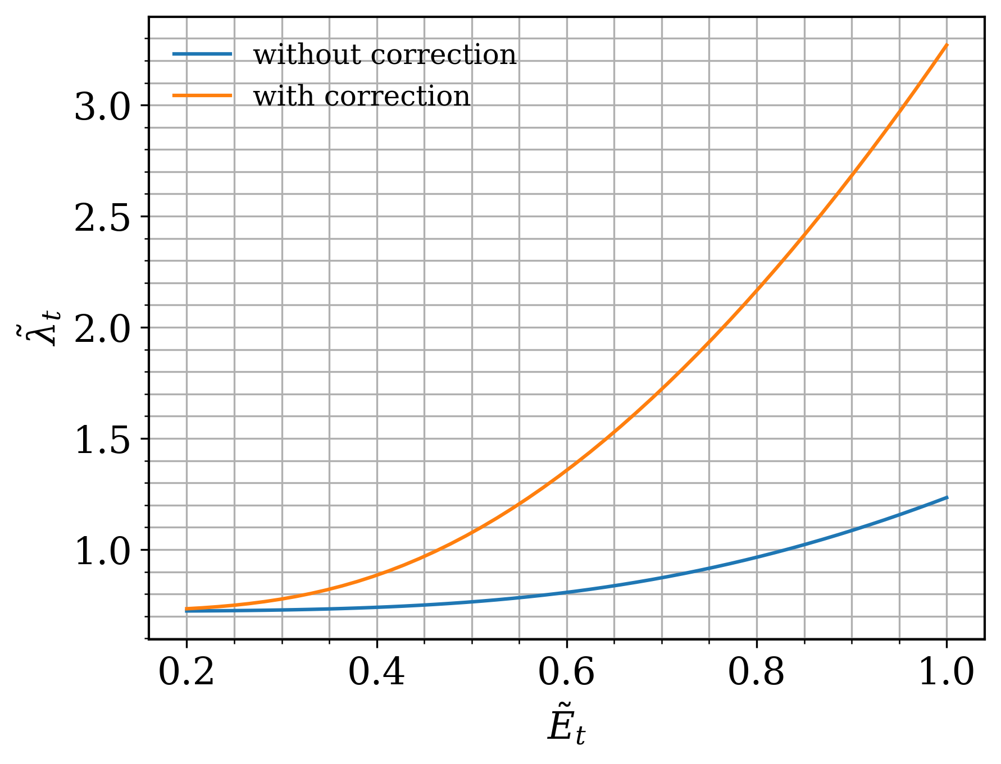
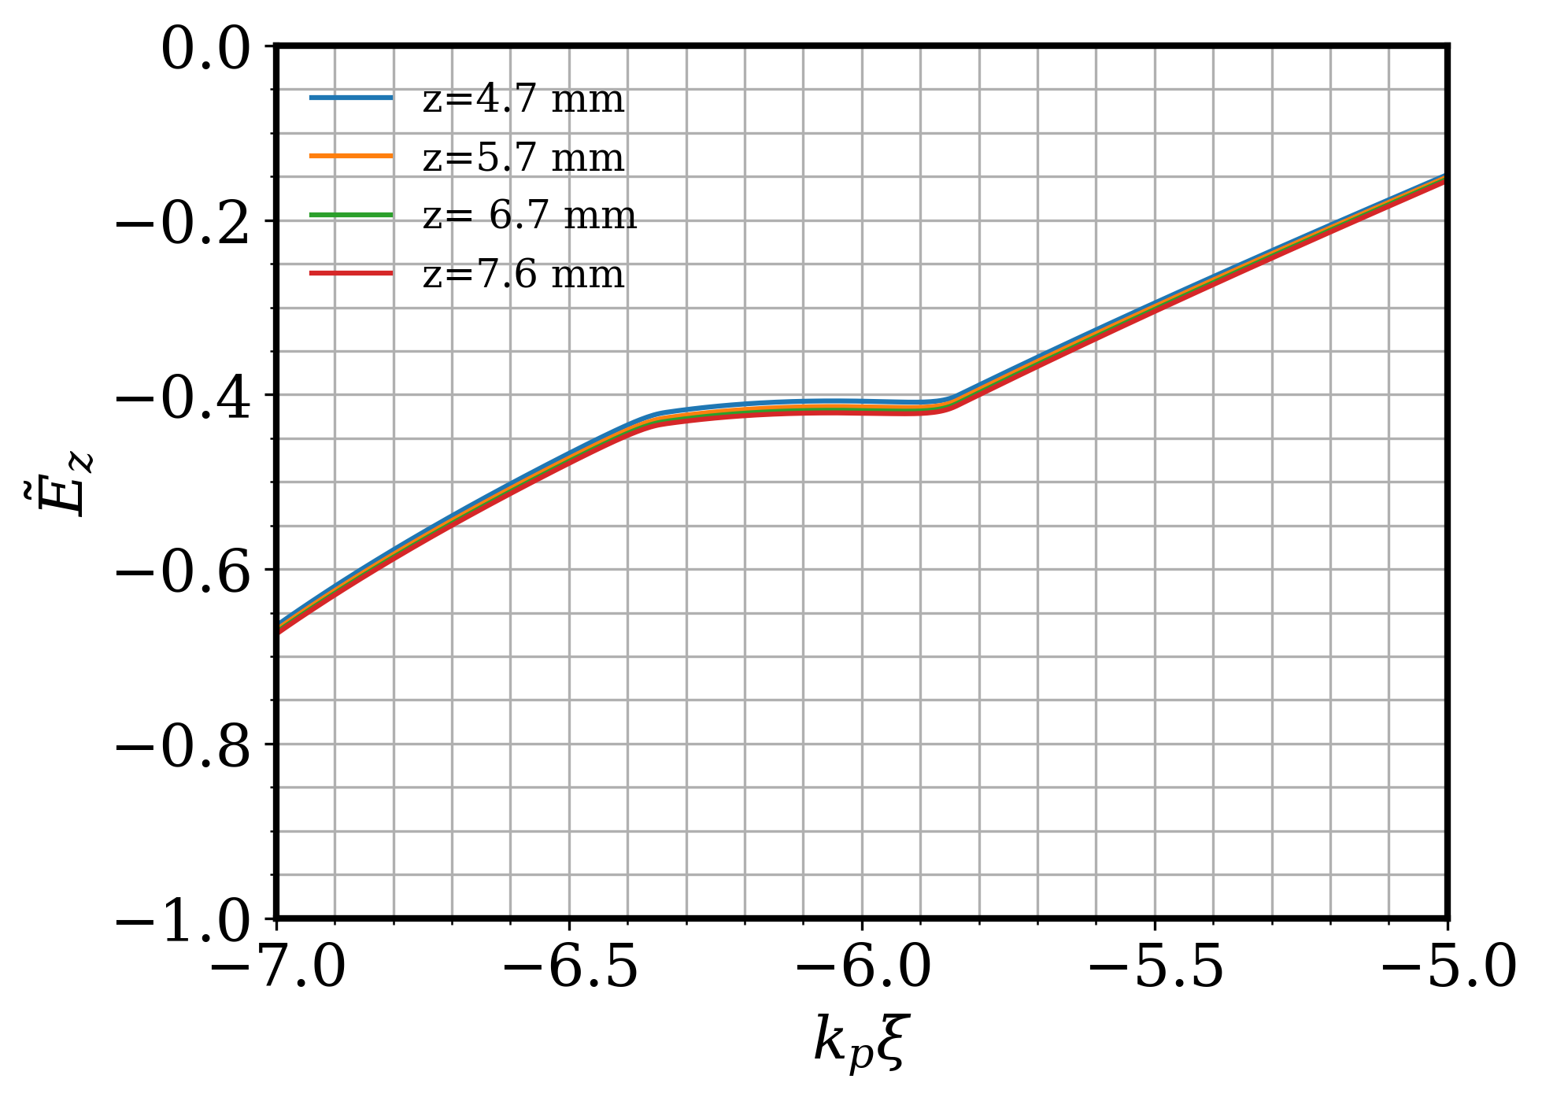
Beam Loading Physics

Slide 30
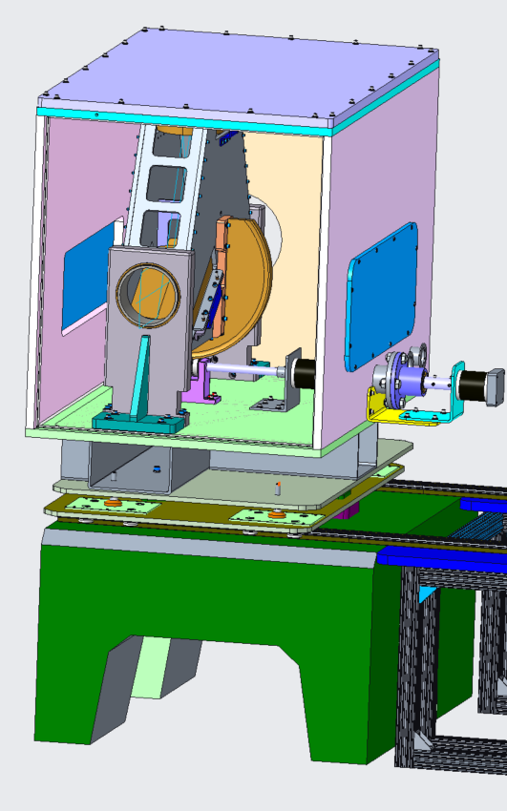


Recent infrastructure upgrade allow the delivery of 2-ps, <5Tw pulses to IP
Flexible polarization rotator (FPR)
Nonlinear pulse compressor
Test chamber
Experimental Hall
FEL Room
Compressor
Shielding wall
CO₂
Seed Laser Table
YAG
YAG
CO₂
plasma
Final amplifier
CO2 Room
Plasma shutter
See M. Polyanskiy, Monday 5:40, on enabling LWIR upgrades

Slide 31

Two Compressors Enable Integration of the Ti:Saph at User IPs

