Slide 1
Short wavelength drivers of laser plasma acceleration and strong field QED
Sponsored by NRL base program and DOE
  D.F. Gordon, B. Hafizi, M. Wolford, Tz. Petrova
  Naval Research Laboratory
  D. Younis
  University of Rochester
7/23/2024

Slide 2
Excimer lasers as sources of ultra-short pulse deep UV
Krypton Fluoride
Argon Fluoride
Wavelength = 248 nm
Gain Bandwidth ~ 5 THz
Shortest Pulse ~ 60 fs
Thermal Conductivity ~ 9.5 mW/m*K
Wavelength = 193 nm
Gain Bandwidth ~ 10 THz
Shortest Pulse ~ 30 fs
Thermal Conductivity ~ 17.9 mW/m*K
Highly simplified picture of excimer lasing:
Ar+
Ar
ArF*
ħω
F-
F

Slide 3
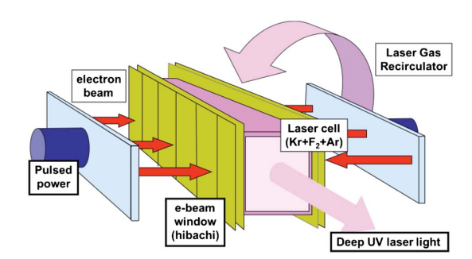
Electron beam pumping

Slide 4
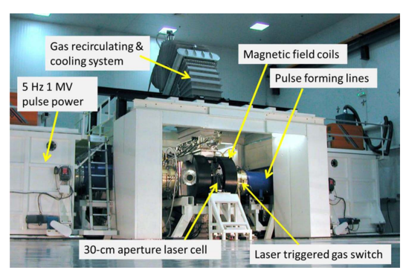
Electra Amplifier
Dual 500 kV, 100 kA e-beams
5 Hz repetition rate
30 cm aperture
100 cm gain length
Demonstrated lasing
750 J at 248 nm
200 J at 193 nm

Slide 5
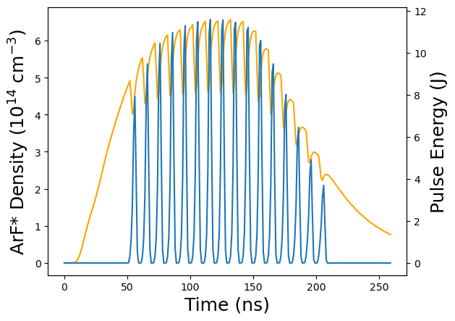
PW burst mode in the deep UV – ORESTES simulation
Pumping continues for O(100) ns, and repumping time is ~2 ns.
The technique of multiplexing allows this fact to be exploited to produce multiple pulses.
Can we multiplex with PW pulses?

Slide 6
Excimer multiplexing as a path to many stage LWFA
LONG PULSE AMPLIFIER
(~ 100 nsec)
Last Pulse
Demultiplexer
Array
(mirrors)
Technique developed for laser fusion efforts on NIKE laser.
Can this be applied to LWFA staging in the Electra bay?
(6 beams have been multiplexed)
Timing and spatial overlap accuracy needs to be examined.
Multiplexer
Array
(beam splitters)
First Pulse
FRONT END
( 5 nsec)
Target
Only three pulses shown for clarity

Slide 7
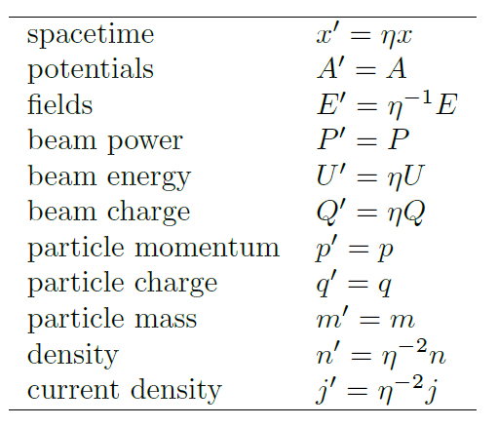
Scaling with Wavelength
Scale all parameters such that underlying physical equations are invariant
Vlasov-Maxwell system is invariant under these transformations.
If there is a known scenario, it can be scaled exactly to the extent that collisions/reactions are negligible.
Example: reducing wavelength increases field for the same power and less energy.

Slide 8


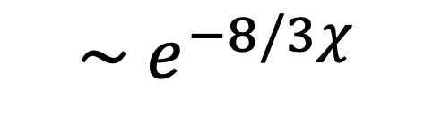

Nonlinear Breit-Wheeler Pair Creation
$$ω_{X}+nω⟶{e^{−}e}^{+}$$
SLAC E144 observed a case where n=5 (barely).
In the limit of large n, process is characterized by
For χ<<1 the rate is exponentially small
$$\sim e^{−8/3χ}$$
For 10 PW laser and few GeV electrons expect >10⁻⁴ pairs per electron
Notes:
The process complementary to strong field QED gamma emission is the Furry picture version of Breit-Wheeler pair creation, sometimes called nonlinear Breit-Wheeler. In this process, a single high energy photon encounters a strong classical field, and creates a pair in vacuum. The 5-photon version of this process was observed in the 1990’s during the SLAC E144 campaign. Although this is not the focus of the present talk, one must account for this process in a general strong field QED plasma.

Slide 9
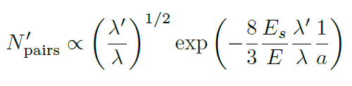
SF-QED effects increase exponentially with decreasing wavelength
Mainly a manifestation of larger fields at smaller wavelengths
Assumes SF-QED has a small effect on the overall dynamics
Ignores technological constraints

Slide 10
Laser-guided pairs as mediators of gamma generation
ℏω ~ 1 eV
P ~ 100 PW
ℏω ~ 100 MeV
P ~ 100 TW
Prepare collision of laser pulse and gamma pulse in vacuum
EP Pairs
0-5 GeV, ±10 pC
As the pulses cross nonlinear Breit-Wheeler pair creation ensues
Laser +
pairs +
x-rays
Pairs in self-guided equilibrium,
X-rays constantly emitted,
Laser constantly depleted
residual

Slide 11
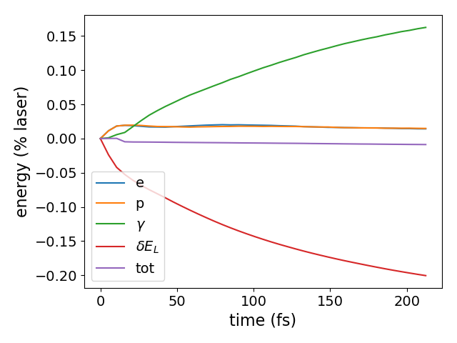
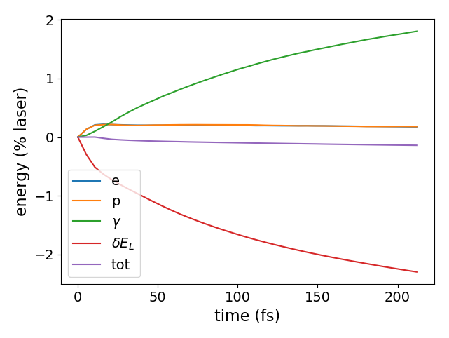
Conversion efficiency with various seed energies
100 MeV seed
1 GeV seed

Slide 12
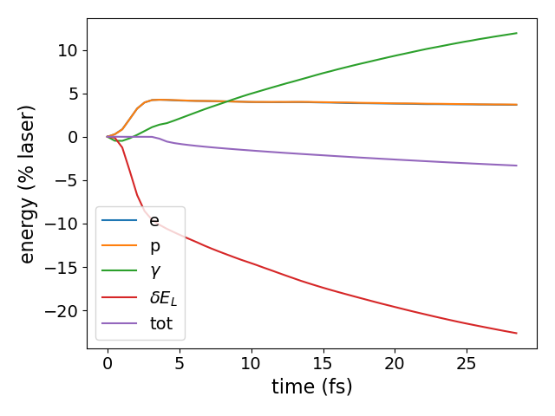
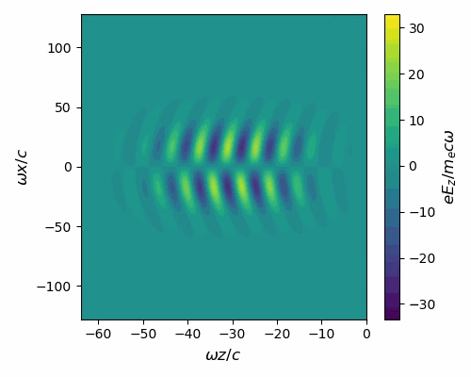
Excimer laser scenario (with KrF wavelength)
Laser parameters: a=600, 200 J, 0.25 um, 60 PW (pulse duration fictitious)
Energy flow
Pump depletion most obvious in axial field

Slide 13
Short wavelength drivers for laser acceleration
For a desired particle momentum, less laser energy is needed
Charge per bunch is reduced
Density and current density is increased
  However, downstream, these can be reduced for a fixed spot size
Repetition rate may be faster because
  Gas load on chamber is reduced
  Smaller plasma, faster plasma recovery
  Multiplexing: many shots per pumping cycle
In terms of ion acceleration, critical density may be accessible in low density foams
To account for the various constraints, PIC simulation is needed

Slide 14
Caveats
Optical Damage
  Two photon absorption can be a major issue at 193 nm
  Fused silica has been found to degrade quickly
  Calcium fluoride is more resistant to 2-photon absorption
    However susceptible to x-ray damage
    Also limited aperture size
  Magnesium fluoride has been found to have poor performance at 193 nm
  Fluorine-doped fused silica may be a solution
    Testing is needed
Timing and alignment
  Tendency toward smaller tolerances in the deep UV system
  Scaling down is not a requirement, but fixed scale requires significant study

Slide 15
Conclusions
Excimer multiplexing may be useful for LWFA staging
  Possible low-cost risk-reduction measure on the way to EP collider
SF-QED remains difficult to access experimentally
  Copious gamma production is a persistent characteristic
  Gammas can be used to create pairs, either by conventional means (Bethe-Heitler) or by a further SF-QED process
Short wavelengths might access SF-QED with less laser power
  Energy advantage is even greater, but for bandwidth constraint
  High level parameters suggest PW facility is possible using an existing main amplifier
  Major issue is compressor design
  Supply of optics useful at 193 nm may be an issue

Slide 16
BACKUPS

Slide 17
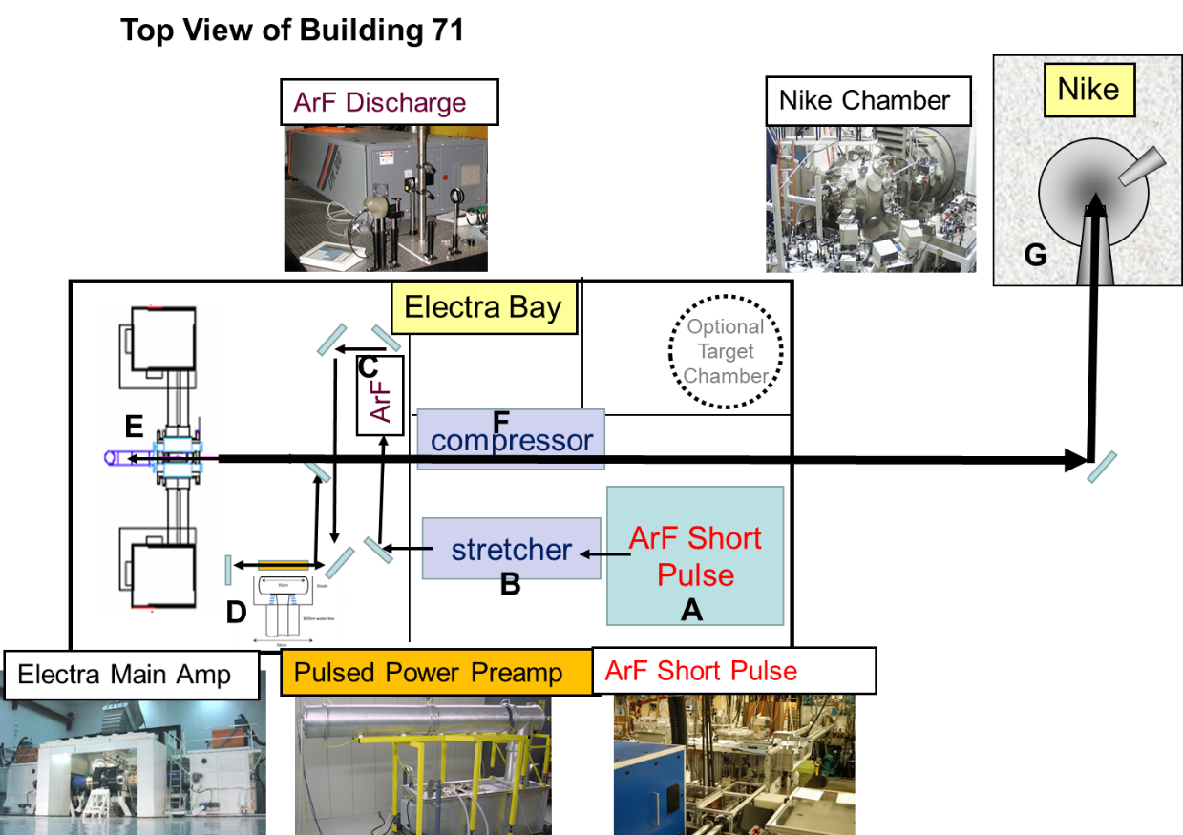
Vision for PW class ArF laser facility
Nominal parameters:
5 Hz
10 J
33 fs
193 nm

Slide 18
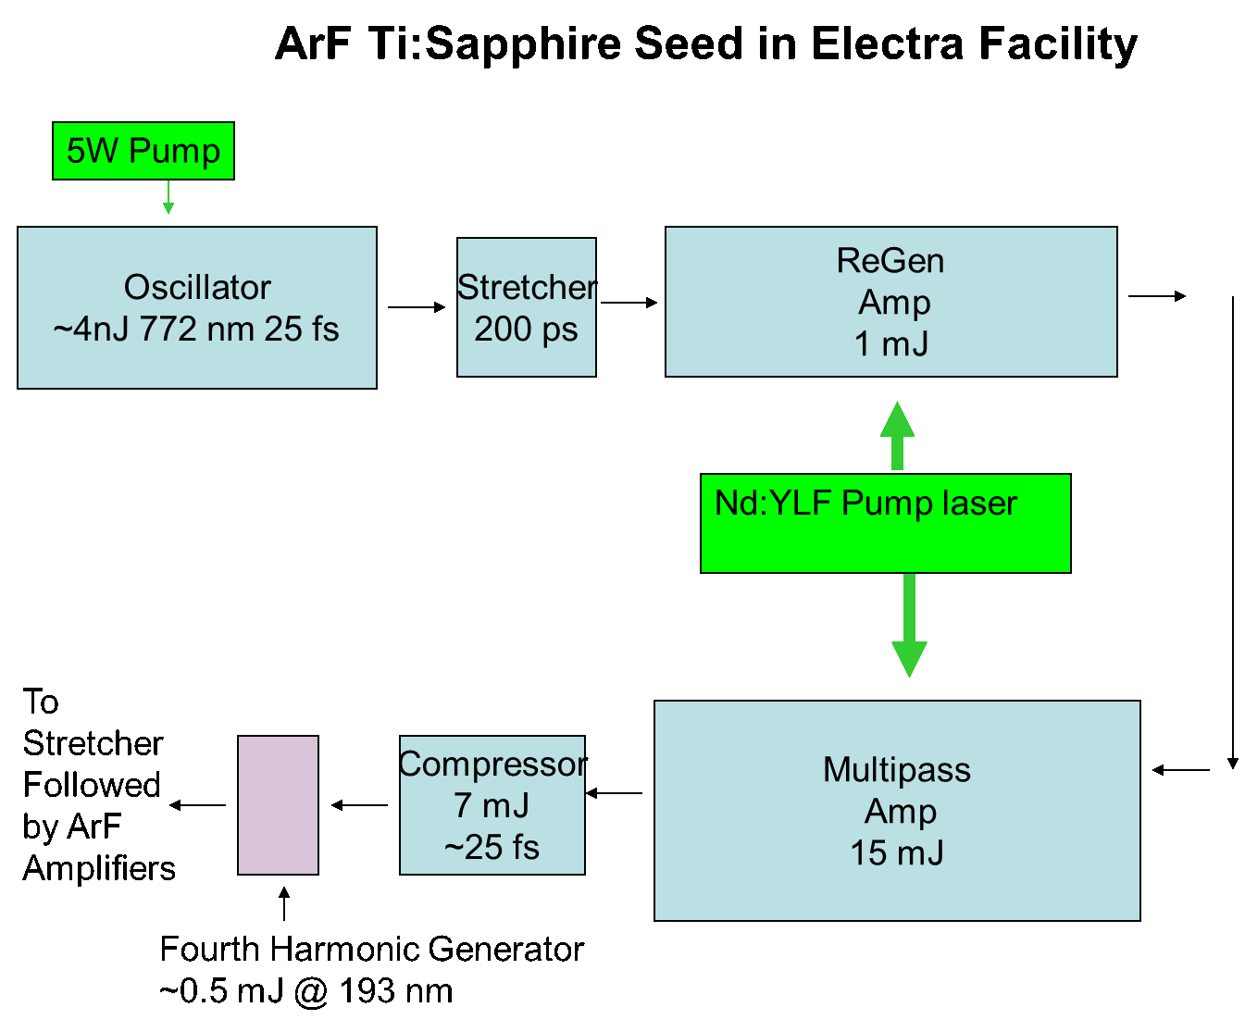
Concept for ultra-short seed for ArF facility
Sub 200 nm fourth harmonic is discussed, e.g., in P. Susnjar et al., Opt. Comm. 528, 129031 (2023)

Slide 19
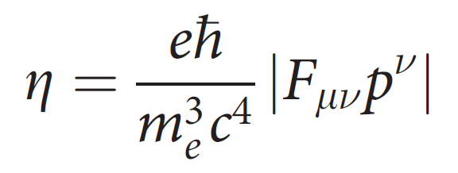
Strong field quantum-electrodynamics
Strong field QED is important if in the rest frame of an electron the Schwinger field is attained
E_{S} = Schwinger field = 1.3x10¹⁸ V/m
Focused intensity to produce E_{S} in lab frame is 2.3x10²⁹ W/cm²
Strong field parameter
Even 10 PW laser cannot come close, so we require energetic electrons to make up the difference
Notes:
A strong field quantum electrodynamically is one that approaches the Schwinger field, about 1e18 V/m. Even with 10 PW lasers we are probably going to be 6 orders of magnitude from this value. However, because of the fact that the normalized vector potential is large, energetic electrons often fall out of the interaction. Then, in the rest frame of the electrons, it is possible to approach the Schwinger field, and this is sufficient for enabling SFQED.

Slide 20





Nonlinear Compton Scattering / Quantum Synchrotron*
In general, total emission probability depends on
Typical frequency multiplication:
Nonlinear enhancement (Thomson limit):
Volkov State
”Rolls over” due to radiation damping for
With 10 PW laser expect 4-5 orders of enhancement, 10-100 MeV photon energy
* For details see S.V. Bulanov et al., Plasma Phys. Rep. 41, 1 (2015)
Notes:
Nonlinear Compton scattering corresponds to the diagram where the dressed electron’s are the so-called Volkov states, that is, solutions of the Dirac equation in a plane wave. In the Furry picture diagram, the unprimed k is the wavevector of the plane wave, while the primed k is the wavevector of the emitted photon. What is compelling is that the frequency multiplication goes like a^3, and the cross section goes like a^2. Because the lasers we are considering can reach an “a” of more than 100, the prospects for generating copious high energy photons look promising. Beyond this value of a, it is expected that the yield starts to roll over due to radiation damping. For details on this, see the paper by Bulanov et al..

Slide 21
QED-PIC Method using turboWAVE
F₁₁
F₁₂
dF₁₁
dF₁₂
F₂₁
F₂₂
dF₂₁
dF₂₂
Push and move particles using interpolated fields
Work out currents through cell walls
Use currents to update the fields
Emit gammas,
Spawn pairs using new interpolated fields
The classical field is self-consistent on the large scale
The classical field is treated as external on the QED scale

Slide 22
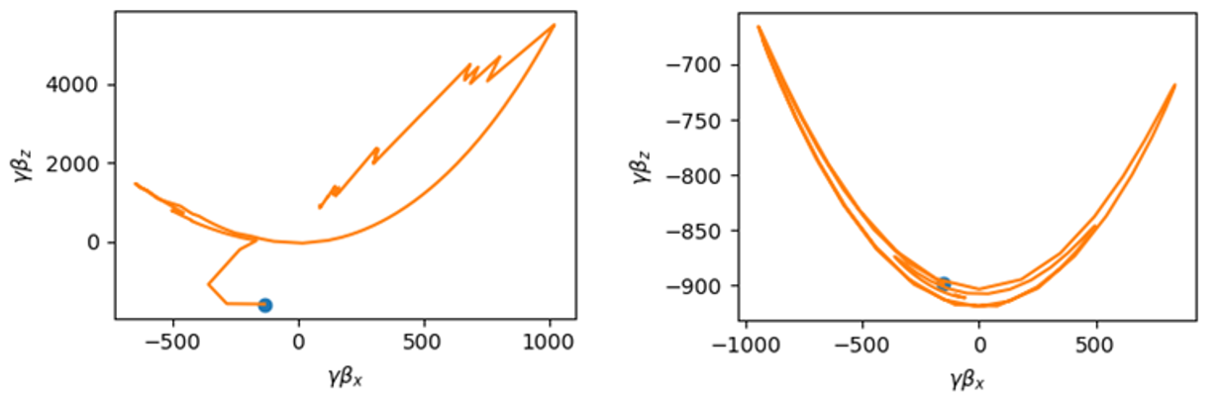
Quantum recoil provides inward force on pair plasma
Strongly radiating particle (left) vs. non-radiating particle (right)

Slide 23
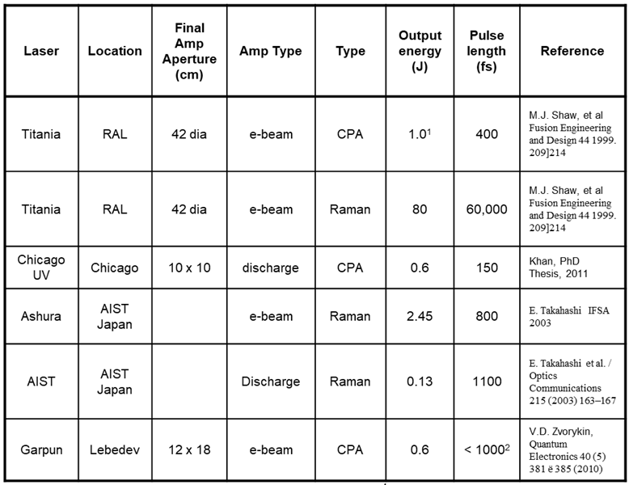
Historical pulsed excimer lasers.
TW has been achieved.
Just about all the work has been with KrF. Very little seems to have been done with ArF.

Slide 24
SF-QED references (small sample)
W.H. Furry, Phys. Rev. 81, 1 (1951)
  Foundational analytical framework for SF-QED cross sections
C. Bamber et al., Phys. Rev. D 60, 092004 (1999)
  Detailed account of SLAC experiment observing multi-photon Breit-Wheeler pair creation
C.P. Ridgers et al., Phys. Rev. Lett. 108, 165006 (2012)
  Establishes the QED-PIC methodology
A. Henderson et al., HEDP Phys. 12, 46-56 (2014)
  Few percent conversion using Texas Petawatt Laser
K.V. Lezhnin et al., Phys. Plasmas 25, 123105 (2018)
  ELI Beamlines’ prediction of tens of percent conversion due to nonlinear Compton, based on QED-PIC, accounting for pre-plasma effects

