Slide 1
Update on the progress of the E-320 SFQED experiment
A. Knetsch on behalf of the E-320 Collaboration
SLAC National Accelerator Laboratory

Slide 2
The collaboration
Carleton University, Ottawa, Ontario, Canada | Thomas Koffas
Aarhus University, Aarhus, Denmark | Christian Nielsen, Allan Sørensen, Ulrik Uggerhøj
École Polytechnique, Paris, France | Sébastien Corde, Pablo San Miguel Clave, Mickael Grech, Aimé Matheron, Sebastian Meuren (PI), Caterina Riconda
Technical University (TU) of Darmstadt | Stephan Kuschel, Christian Rödel
MPI für Kernphysik, Heidelberg, Germany | Antonino Di Piazza, Christoph H. Keitel, Matteo Tamburini
HI Jena and University of Jena, Germany | Harsh, Felipe Salgado, Jannes Wulff, Matt Zepf
Universidade de Lisboa, Portugal | Thomas Grismayer, Luis Silva, Marija Vranic
Imperial College London, UK | Stuart Mangles
Queen’s University Belfast, UK | Niall Cavanagh, Elias Gerstmayr, Gianluca Sarri, Matthew Streeter
California Polytechnic State University, CA USA | Robert Holtzapple & students
Lawrence Livermore National Laboratory, CA USA | Félicie Albert
SLAC National Accelerator Laboratory and Stanford PULSE Institute, Menlo Park, CA USA | Robert Ariniello, Phil Bucksbaum, Christine Clarke, Angelo Dragone, Alan Fisher, Frederico Fiuza, Alan Fry, Spencer Gessner, Siegfried Glenzer, Carsten Hast, Mark Hogan, Chris Kenney, Alexander Knetsch (POC), Doug McCormick, Rafi Mir-Ali Hessami, Brendan O’Shea, David Reis, Tania Smorodnikova, Douglas Storey, Glen White, Vitaly Yakimenko
University of California Los Angeles, CA USA | Chan Joshi, Warren Mori, Brian Naranjo, James Rosenzweig, Oliver Williams, Monika Yadav
University of Colorado Boulder, CO USA | Chris Doss, Michael Litos
University of Nebraska - Lincoln, NE USA | Matthias Fuchs, Junzhi Wang
Former members | Zhijiang Chen, Henrik Ekerfelt, Erik Isele

Slide 3
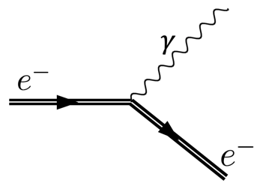
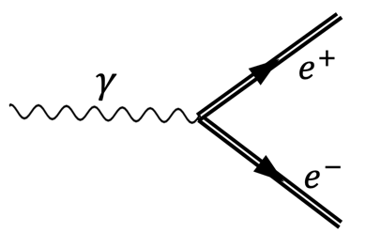
SFQED processes we are studying
$$(iℏγ^{μ}∂_{μ}$$
$$−eγ^{μ}A_{μ}^{ext}$$
$$−mc)ψ=0$$
Non-linear inverse Compton scattering :
Non-linear Breit-Wheeler pair creation :
$$e^{−}+nω→e^{−}+γ$$
$$γ+nω→e^{−}+e^{+}$$
$$χ=ɣ\frac{E}{E_{s}} E_{s}=\frac{m^{2}c^{3}}{e\text{ħ}}\sim {10}^{18}\frac{V}{m}$$
Schwinger critical field
$$χ>1$$
onset of nonlinear effects
$$a_{0}>1$$
onset of non-perturbative physics
$$a_{0}=\frac{e E}{m ω }$$
Laser-beam collisions

Slide 4
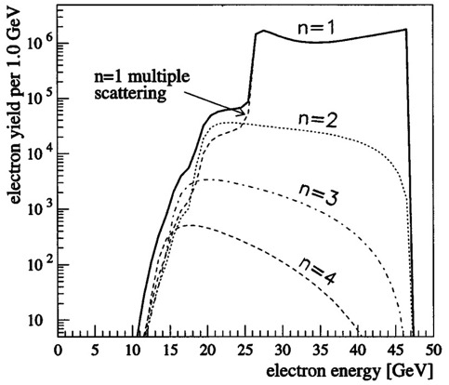
E-144: previous study of nonlinear Compton scattering at SLAC
E-144: observed onset of nonlinear effects
SLAC E-144 (simulation) Bula et al., PRL 76 (1996) Bamber et al., PRD 60 (1999)
~ 50 GeV electrons + ~ 10¹⁸ W/cm² laser intensity: a0 ≲ 0.5, χ ≲ 0.5

Slide 5
Accessible parameters at FACET-II
Yakimenko et al., PRAB 22, 101301 (2019)
FACET-II electron beam parameters
FACET-II laser parameters
Up to 2 nC bunch charge
~ 10 GeV beam energy
Bunch length (rms) < 100 µm
~ 300 mJ on target
~ 50 fs pulse length
a₀ > 1
χ ~ 1

Slide 6
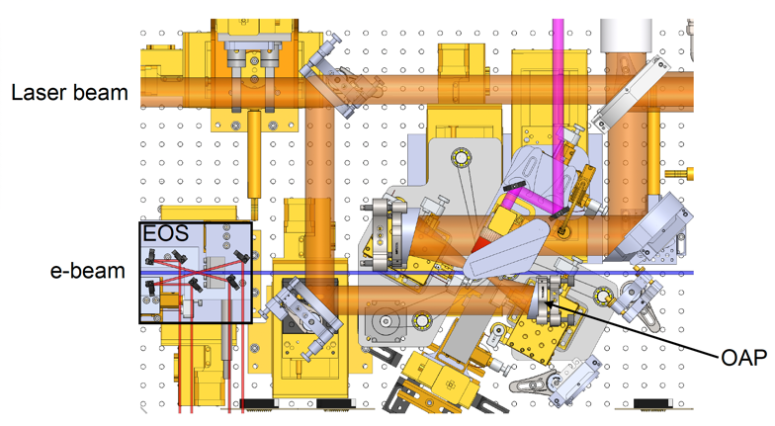
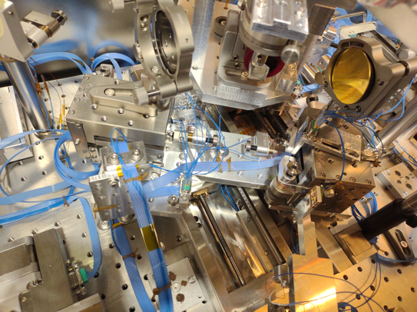
The E-320 interaction point

Slide 7
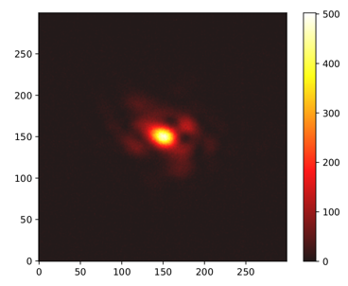
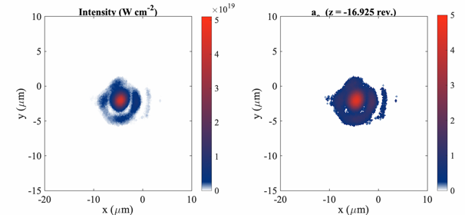
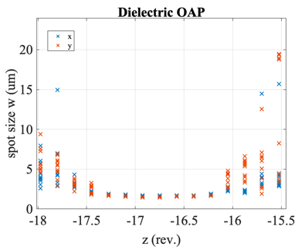
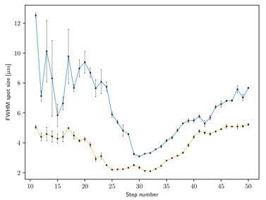
Improved laser parameter
Status 2022
Status 2024
Beam diameter | 40 mm
f# | ~ 2
wavelength | 0.8 μm
Spot size (w₀) | 1.4 x 1.7 μm
Pulse duration | ~ 48 fs
Energy on target | 0.28-0.38 J
Max a₀ | ~ 4.5
Focal scan
Extensive work on wavefront improvements
Intensity and focal quality greatly improved
Major contributions by J. Wang, and R. Ariniello

Slide 8
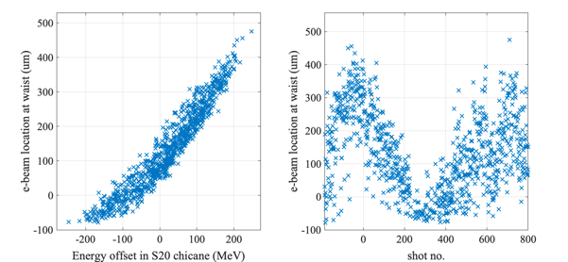
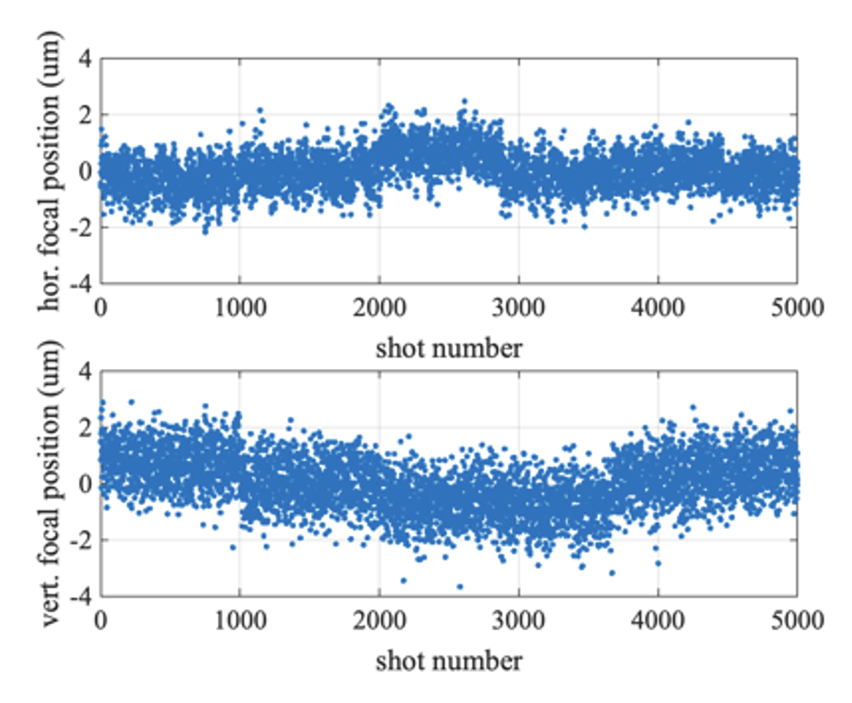
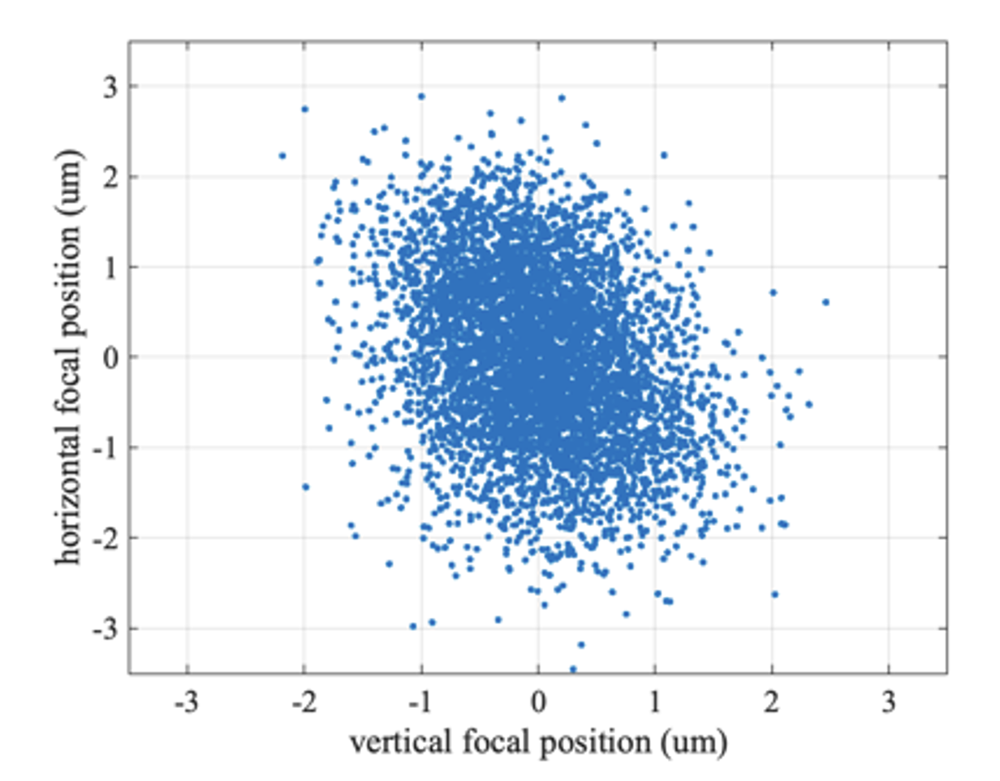
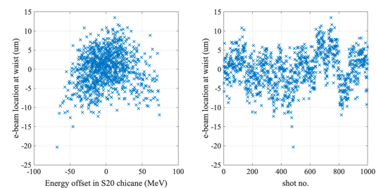
Stability of experiment
Laser focal stability
Electron beam transverse stability
Dominated by drift and dispersion
E320_05469
σ_{x} = 0.65 um
σ_{y} = 0.94 um
Improved accelerator setup: Jitter only
Sub-um position jitter for laser focus measured
Few-um position jitter for e-beam achievable
E320_06968

Slide 9
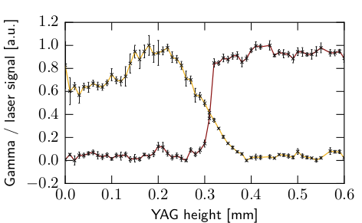
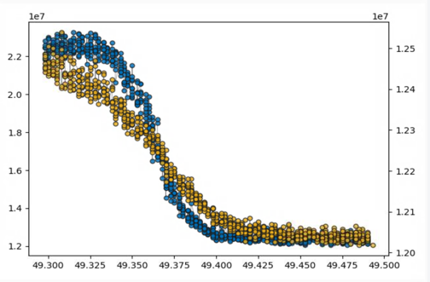
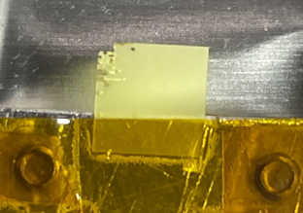
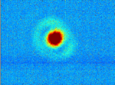
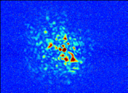
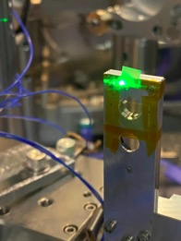
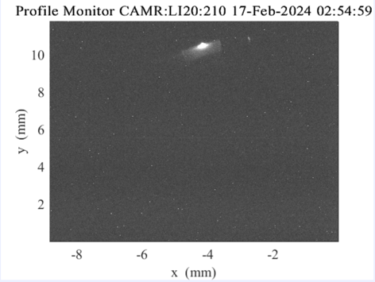
Finding spatial overlap: knife-edge scan
Old procedure: YAG position scan
But… beams are too intense
Peripheral knife-edge scan
Yellow = YAG scintillation
Blue = gamma-ray yield
Laser spot:
Fully blocked by YAG (left) vs. full transmission (right)
Electron beam:
Bremsstrahlung and scintillation when intercepted by YAG

Slide 10
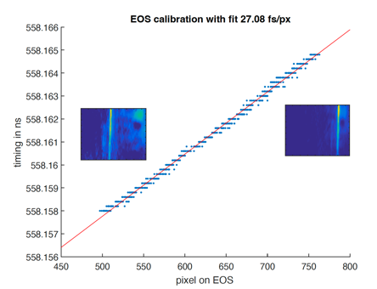
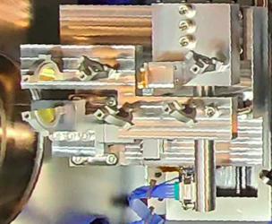
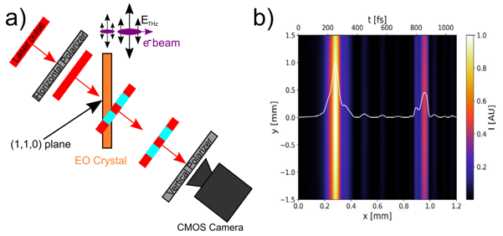
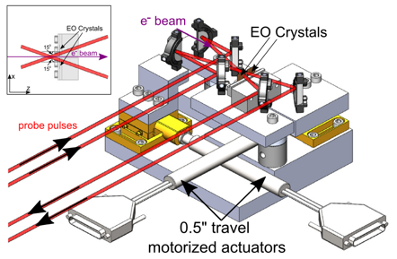
Shot-to-shot timing information via EOS (UC Boulder)
electro-optical sampling (EOS) measures relative time-of-arrival between laser and e-beam
Shot-to-shot non-invasive time-stamping
Dial in collisions with EOS signal
EOS installed in the picnic basket
Hunt-Stone et al., NIMPRA 999, 165210 (2021)

Slide 11
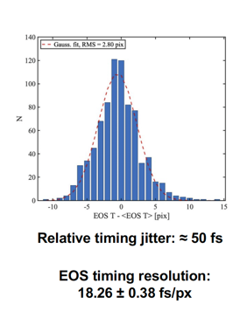
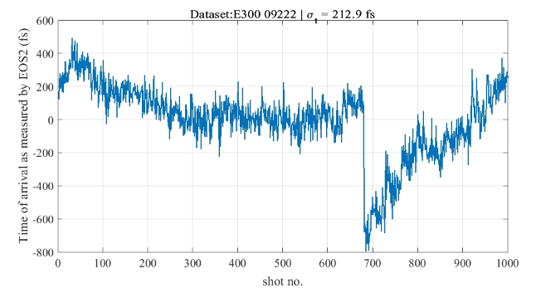
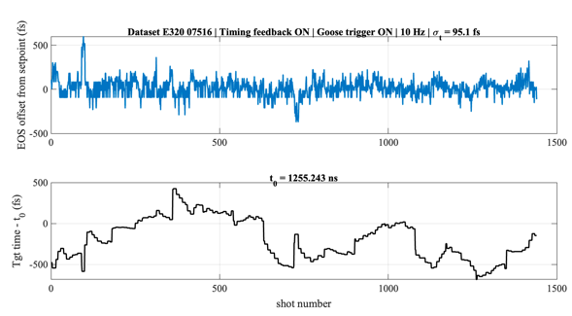
Relative time-of-arrival stabilization
Time-of-arrival jitter as low as 50 fs measured
Time-of-arrival drift can vary up to ~1 ps
Drift compensation: PID loop between EOS-measured TOA and laser target time reduces variation to < 100 fs

Slide 12
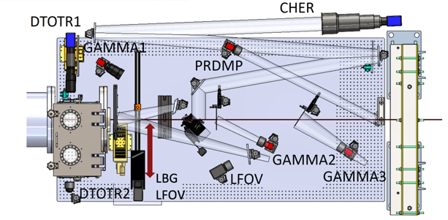
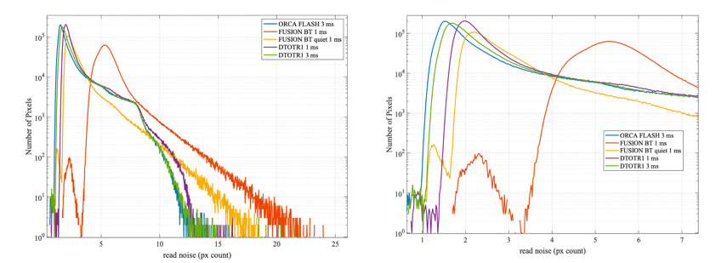
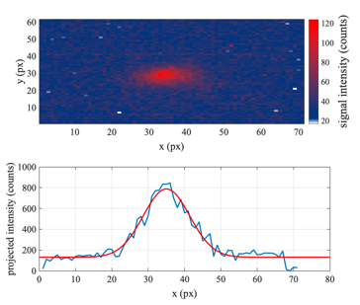
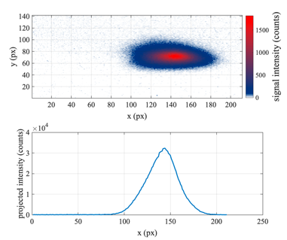
Electron detection: High charge sensitive screen
Dark current charge: 306.9 +- 19.9 fC
Insertable light-tight detector
Charge calib. 4.8 +- 0.3 e⁻/count
Peak noise level ~ 2 counts

Slide 13
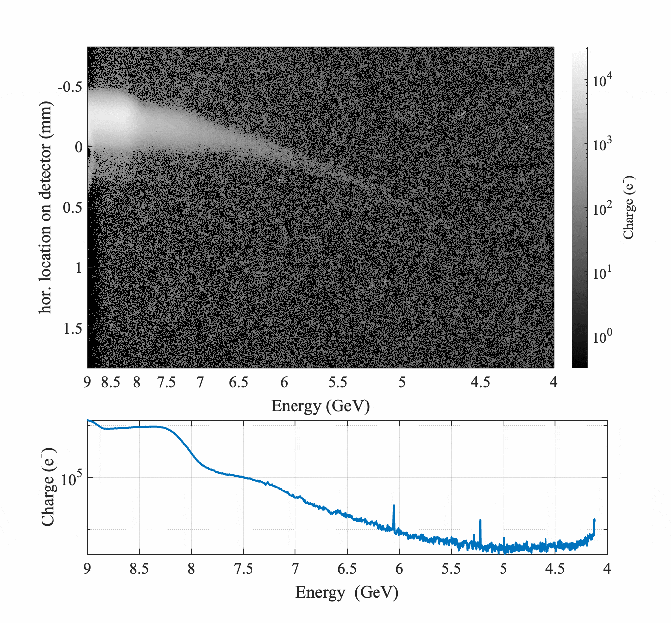
Performance example

Slide 14
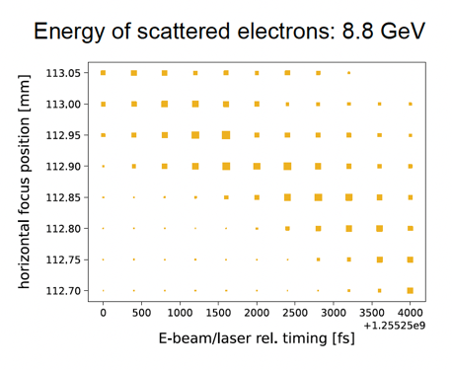
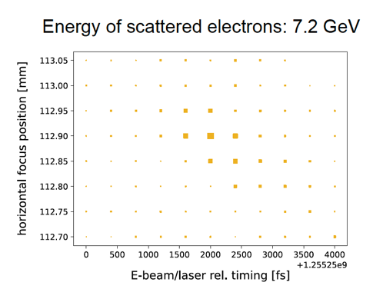
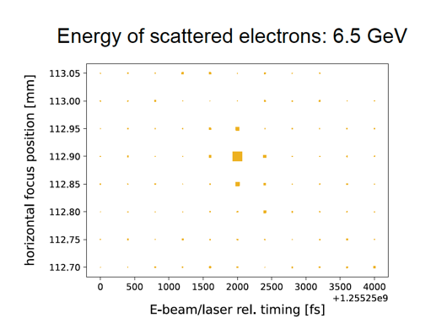
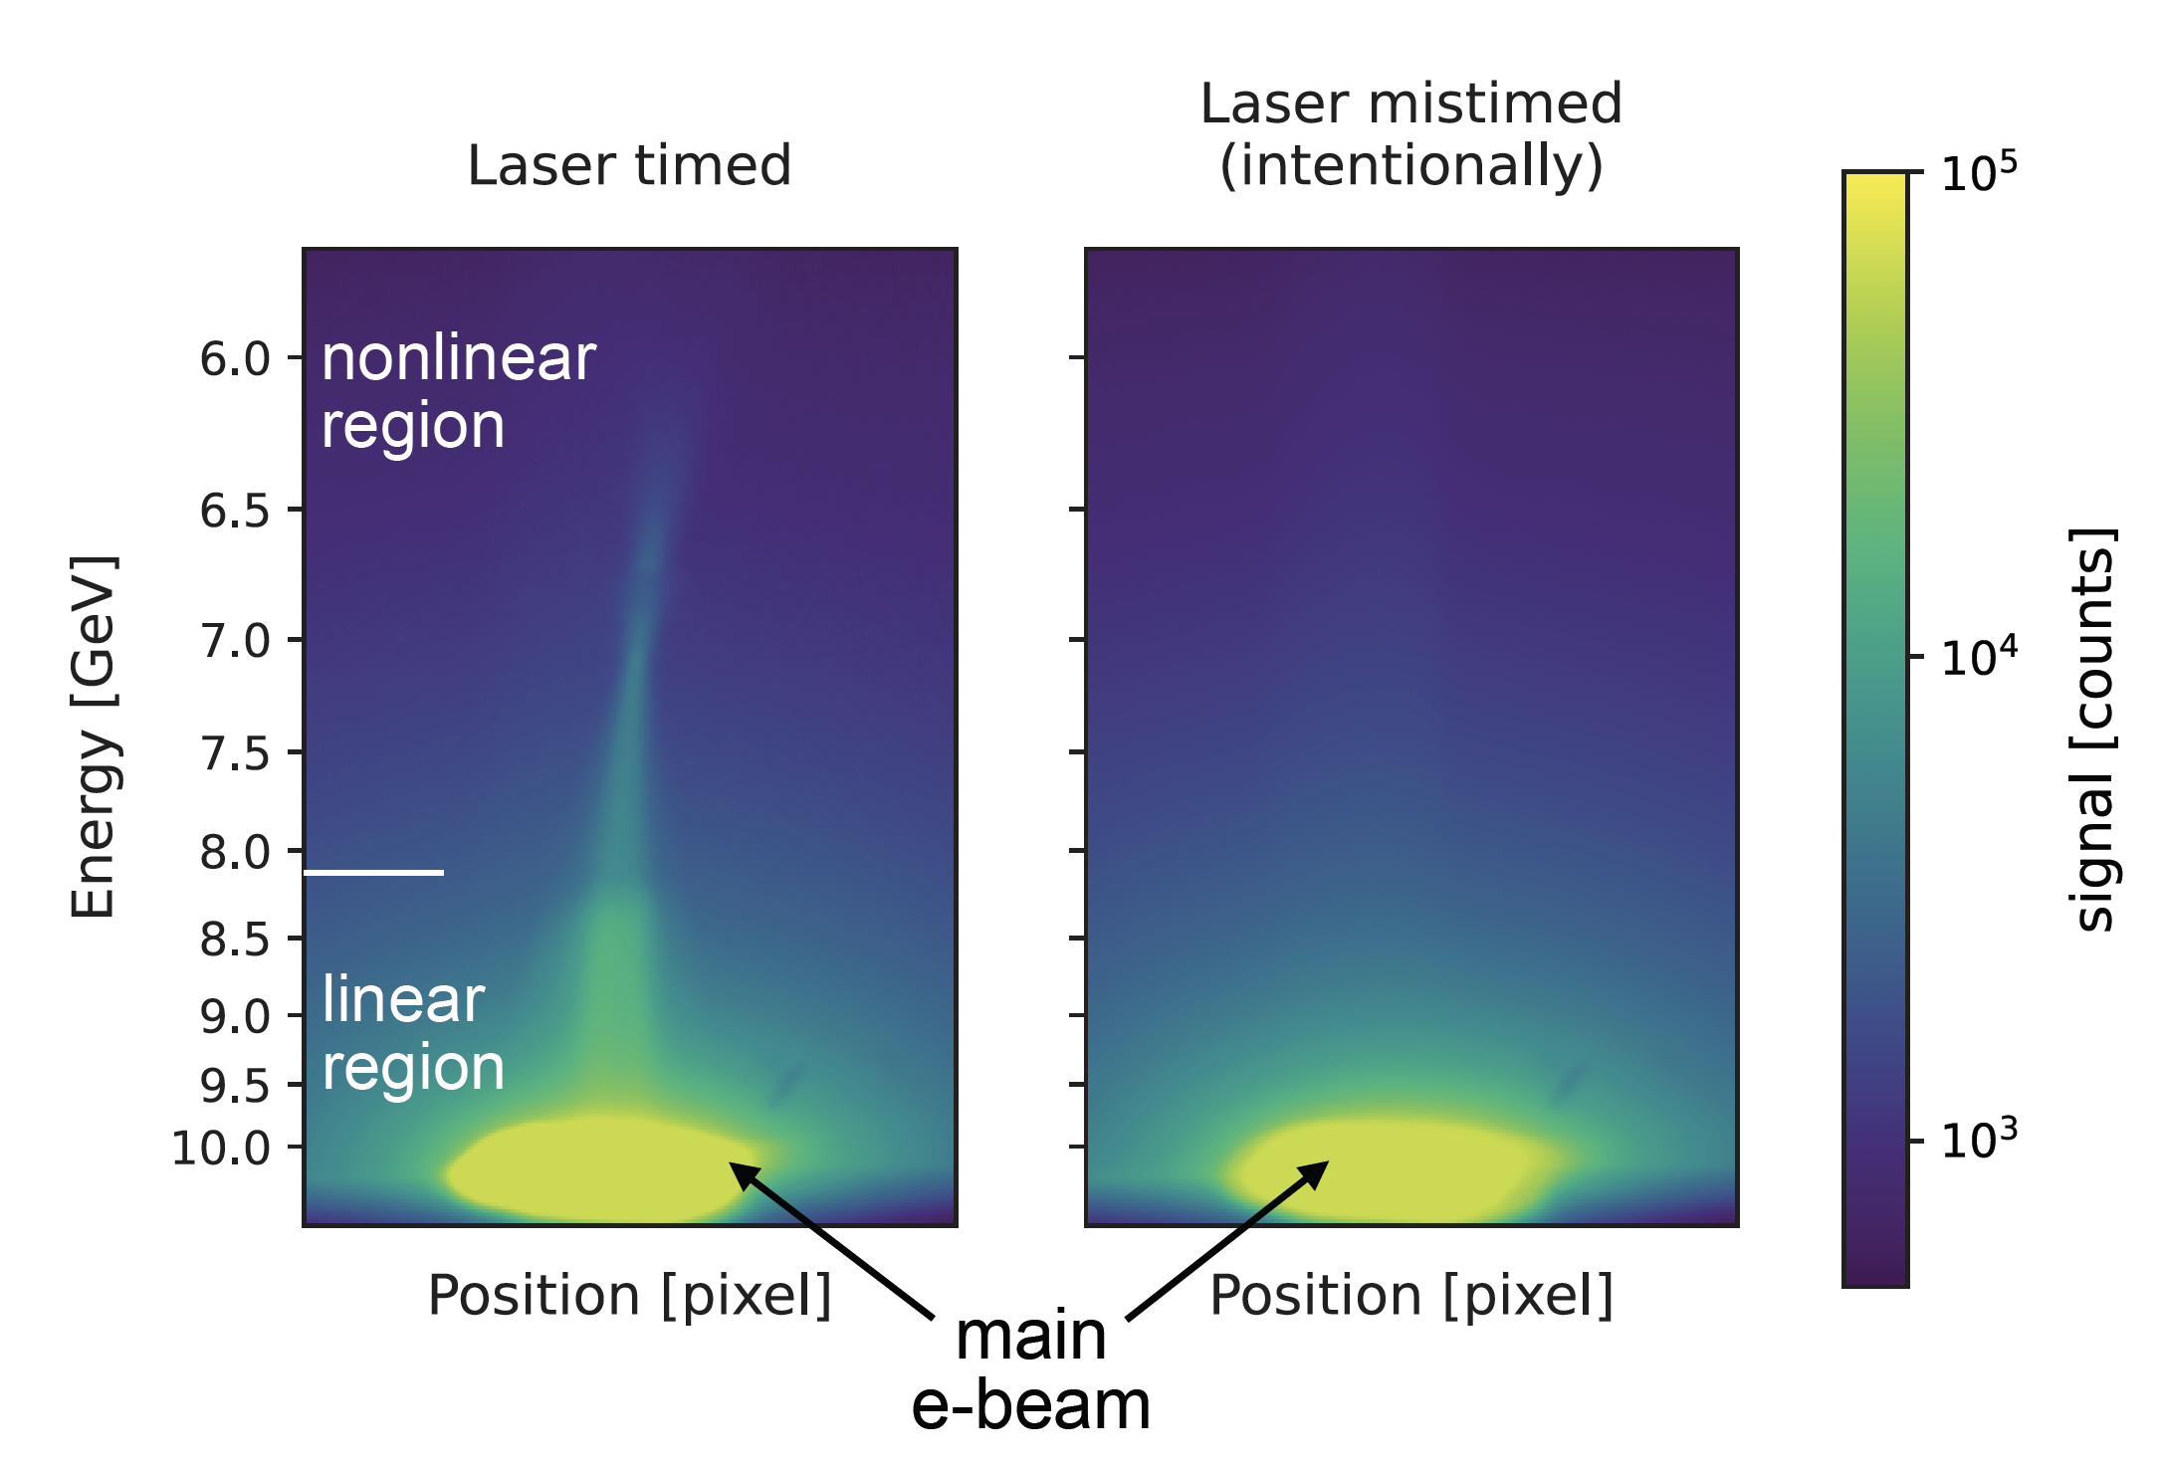
Dialing in highest intensity on electron beam
n=1
n=2 (non-linear)
n>2 (non-linear)
Coarse timing scan to find highest intensity interaction conditions
Low- and high-intensity interaction populations due to geometry
Higher-order scattered electrons have higher sensitivity on peak a₀
analysis plots by T. Smorodnikova

Slide 15
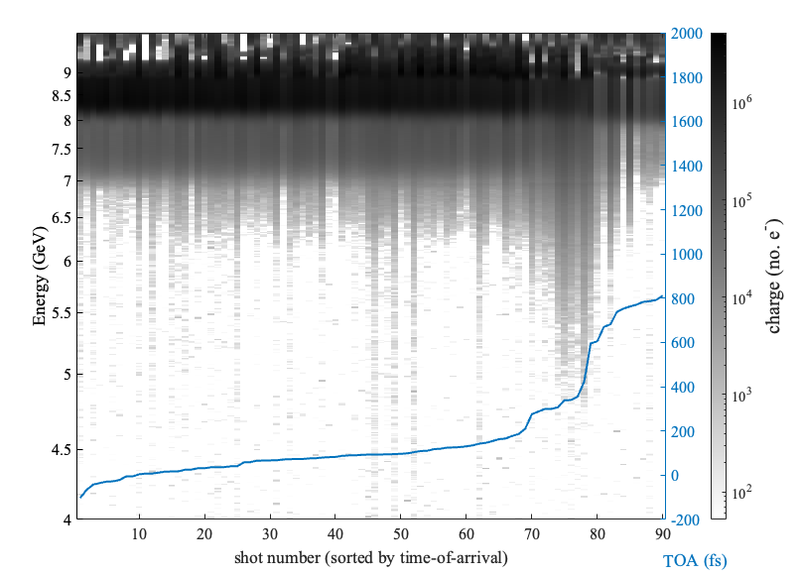
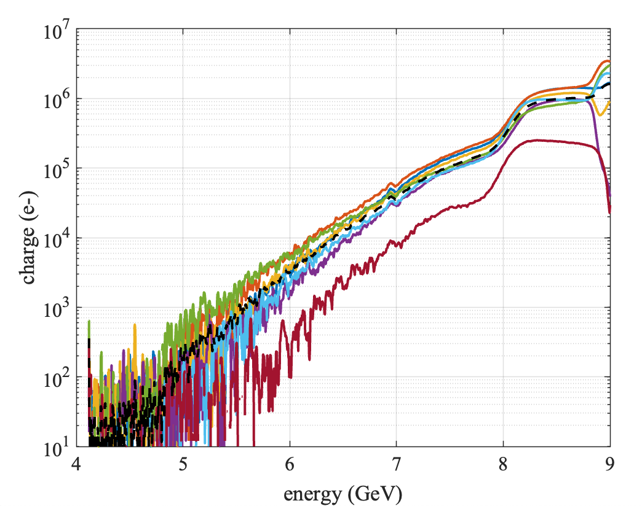
Multi-shot averaging
EOS reveals timing-dependence of interaction
Shots grouped by time-of-arrival show show similar results
Possibility for improved SNR by multi-shot averaging

Slide 16
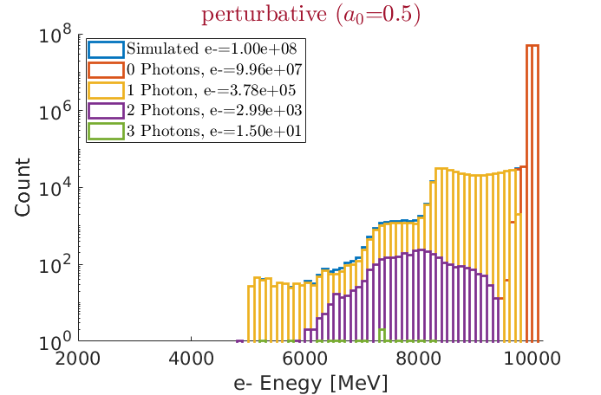
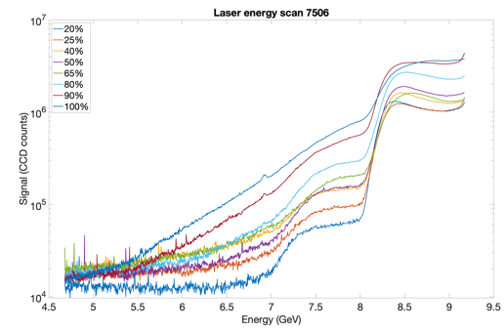
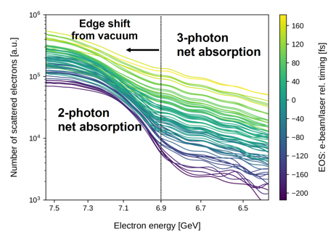
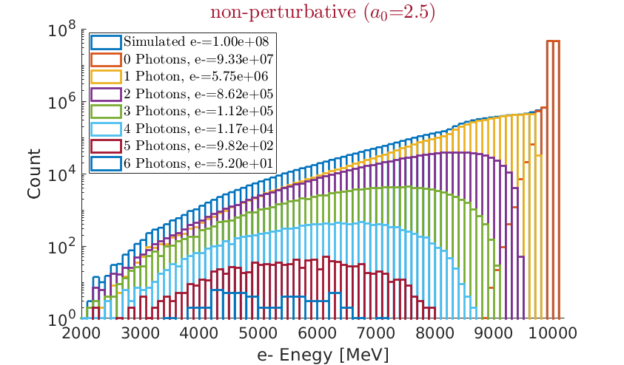
Evidence of transition to non-perturbative regime
Simulation
Data
With a₀ exceeding unity, a transition to a continuous spectrum is expected
The transition to continuous marks the transition to the non-perturbative regime
Laser energy scans as well as timing scans show great resemblance of simulation prediction
Simulation plots by R. Holtzapple, analysis plots by T. Smorodnikova and J Wang

Slide 17
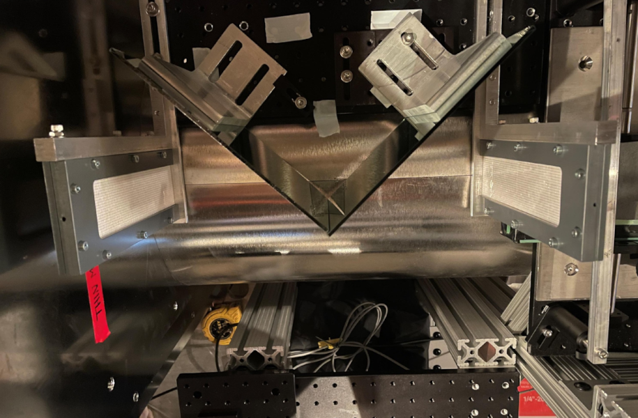
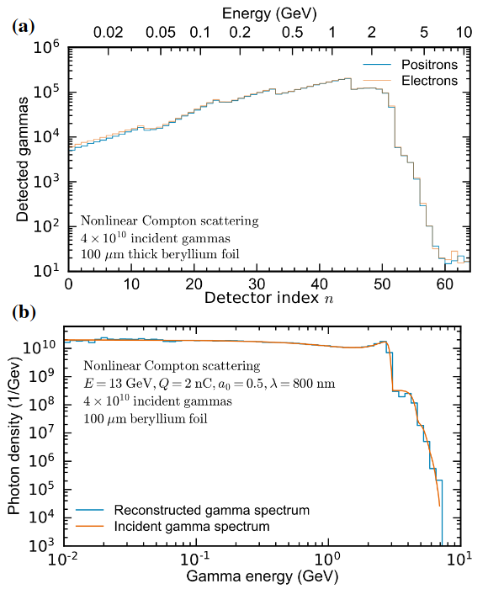
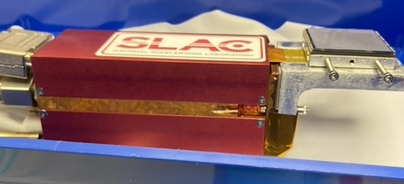
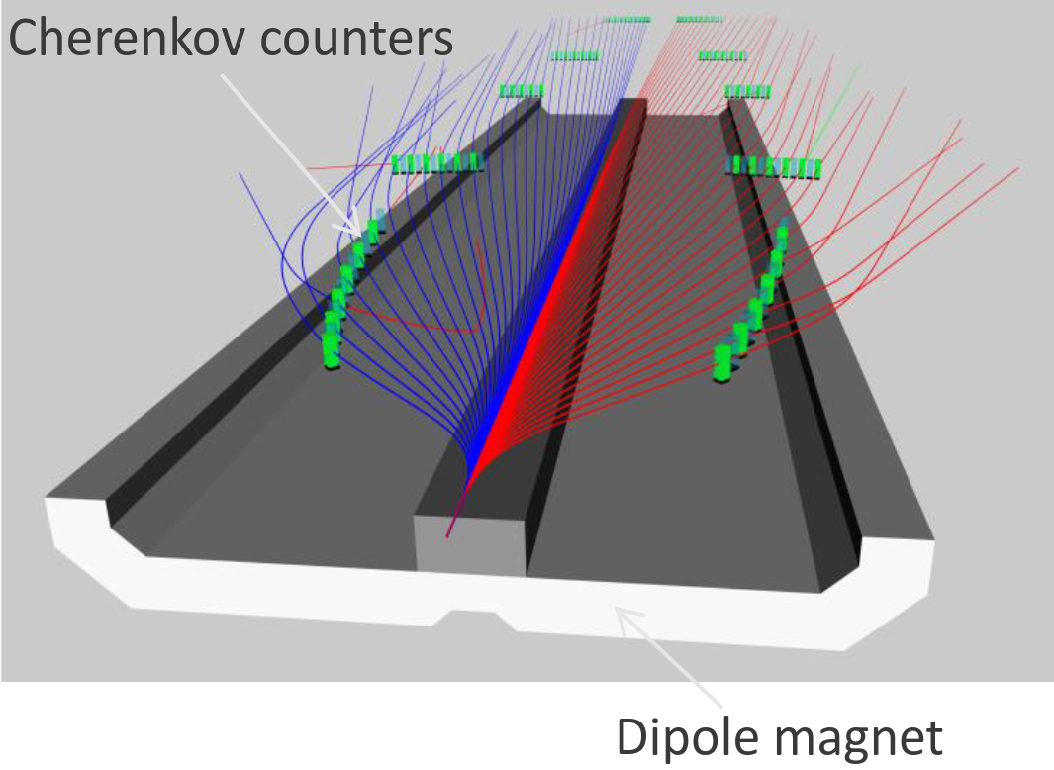
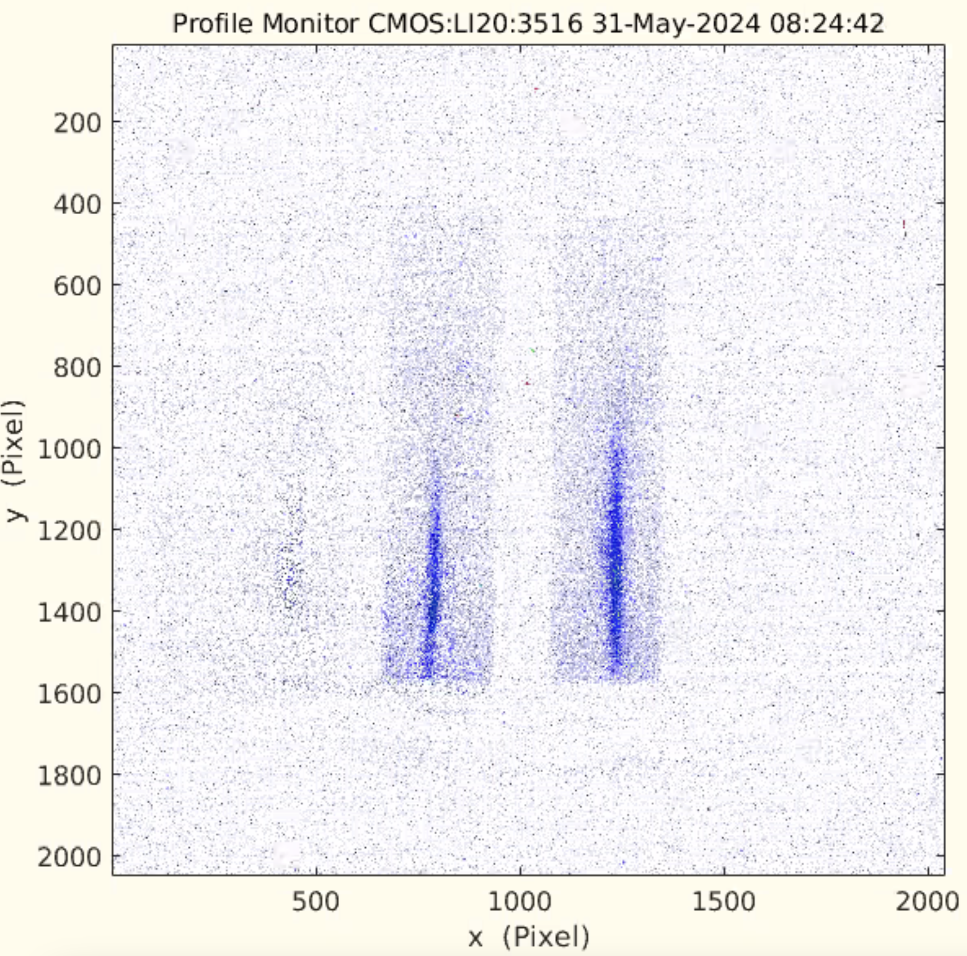
Outlook for E-320: More data - more detectors !
Positron tracking and Cherenkov calorimeter (Jena)
Single electron detection with ePix module provided by the SLAC detector group
(Chris Kenney et al.)
Gamma pair spectrometer (UCLA): energies: 0.1-10 GeV
gamma spectrum can be reconstructed
B. Naranjo et al., IPAC2021 THPAB269, THPAB270 (2021)
based on: Salgado et al. NJP 24 (2021)
LUXE
Cherenkov tubes detector testing
Gamma ray profiler
Weizmann institute

Slide 18
Thank you for your attention! Questions ?

