Slide 1



Sub-THz passive detector performance evaluation with RadiaBeam photoinjector
Maksim Kravchenko,
RadiaBeam Technologies, LLC

Slide 2
Outline
General overview of the problem
FET detector general concepts
Laboratory testing
Beam testing with RadiaBeam ICS photo-injector

Slide 3
Abstract
The wakefield accelerators, based on THz and mm-wave structures, is an active area of research aiming at a severalfold higher accelerating field and better wall plug power efficiency than conventional linear accelerators. Concurrently to accelerator development additional components are required for constant beam parameters and position monitoring. As the electron beam passes through a metal waveguide with corrugated walls a sub-THz Cherenkov radiation is formed. Using different components (modes) of this radiation one can derive the needed beam parameters. At the same time detecting sub-THz signal has its own challenges both in handling time resolution and peak amplitude.
In this work we report the evaluation results of a candidate passive THz detectors, based on the gate-modulation of the conductance channel by the incoming radiation in field effect transistor (FETs), supplied by TeraSense. The first set of measurements was performed on a bench in the millimeter wave laboratory at the Advanced Light Source (APS) of the Argonne National Laboratory and the second set of measurements was performed using the 4.5 MeV RadiaBeam photoinjector and the 10 cm long corrugated wave guide. The design and performance of the optical system including the polymethyl-pentene (TPX)-based lens and vacuum window used in the electron beam measurements is also described.

Slide 4
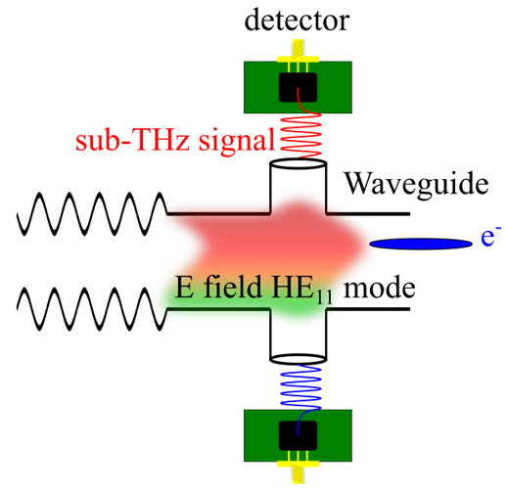
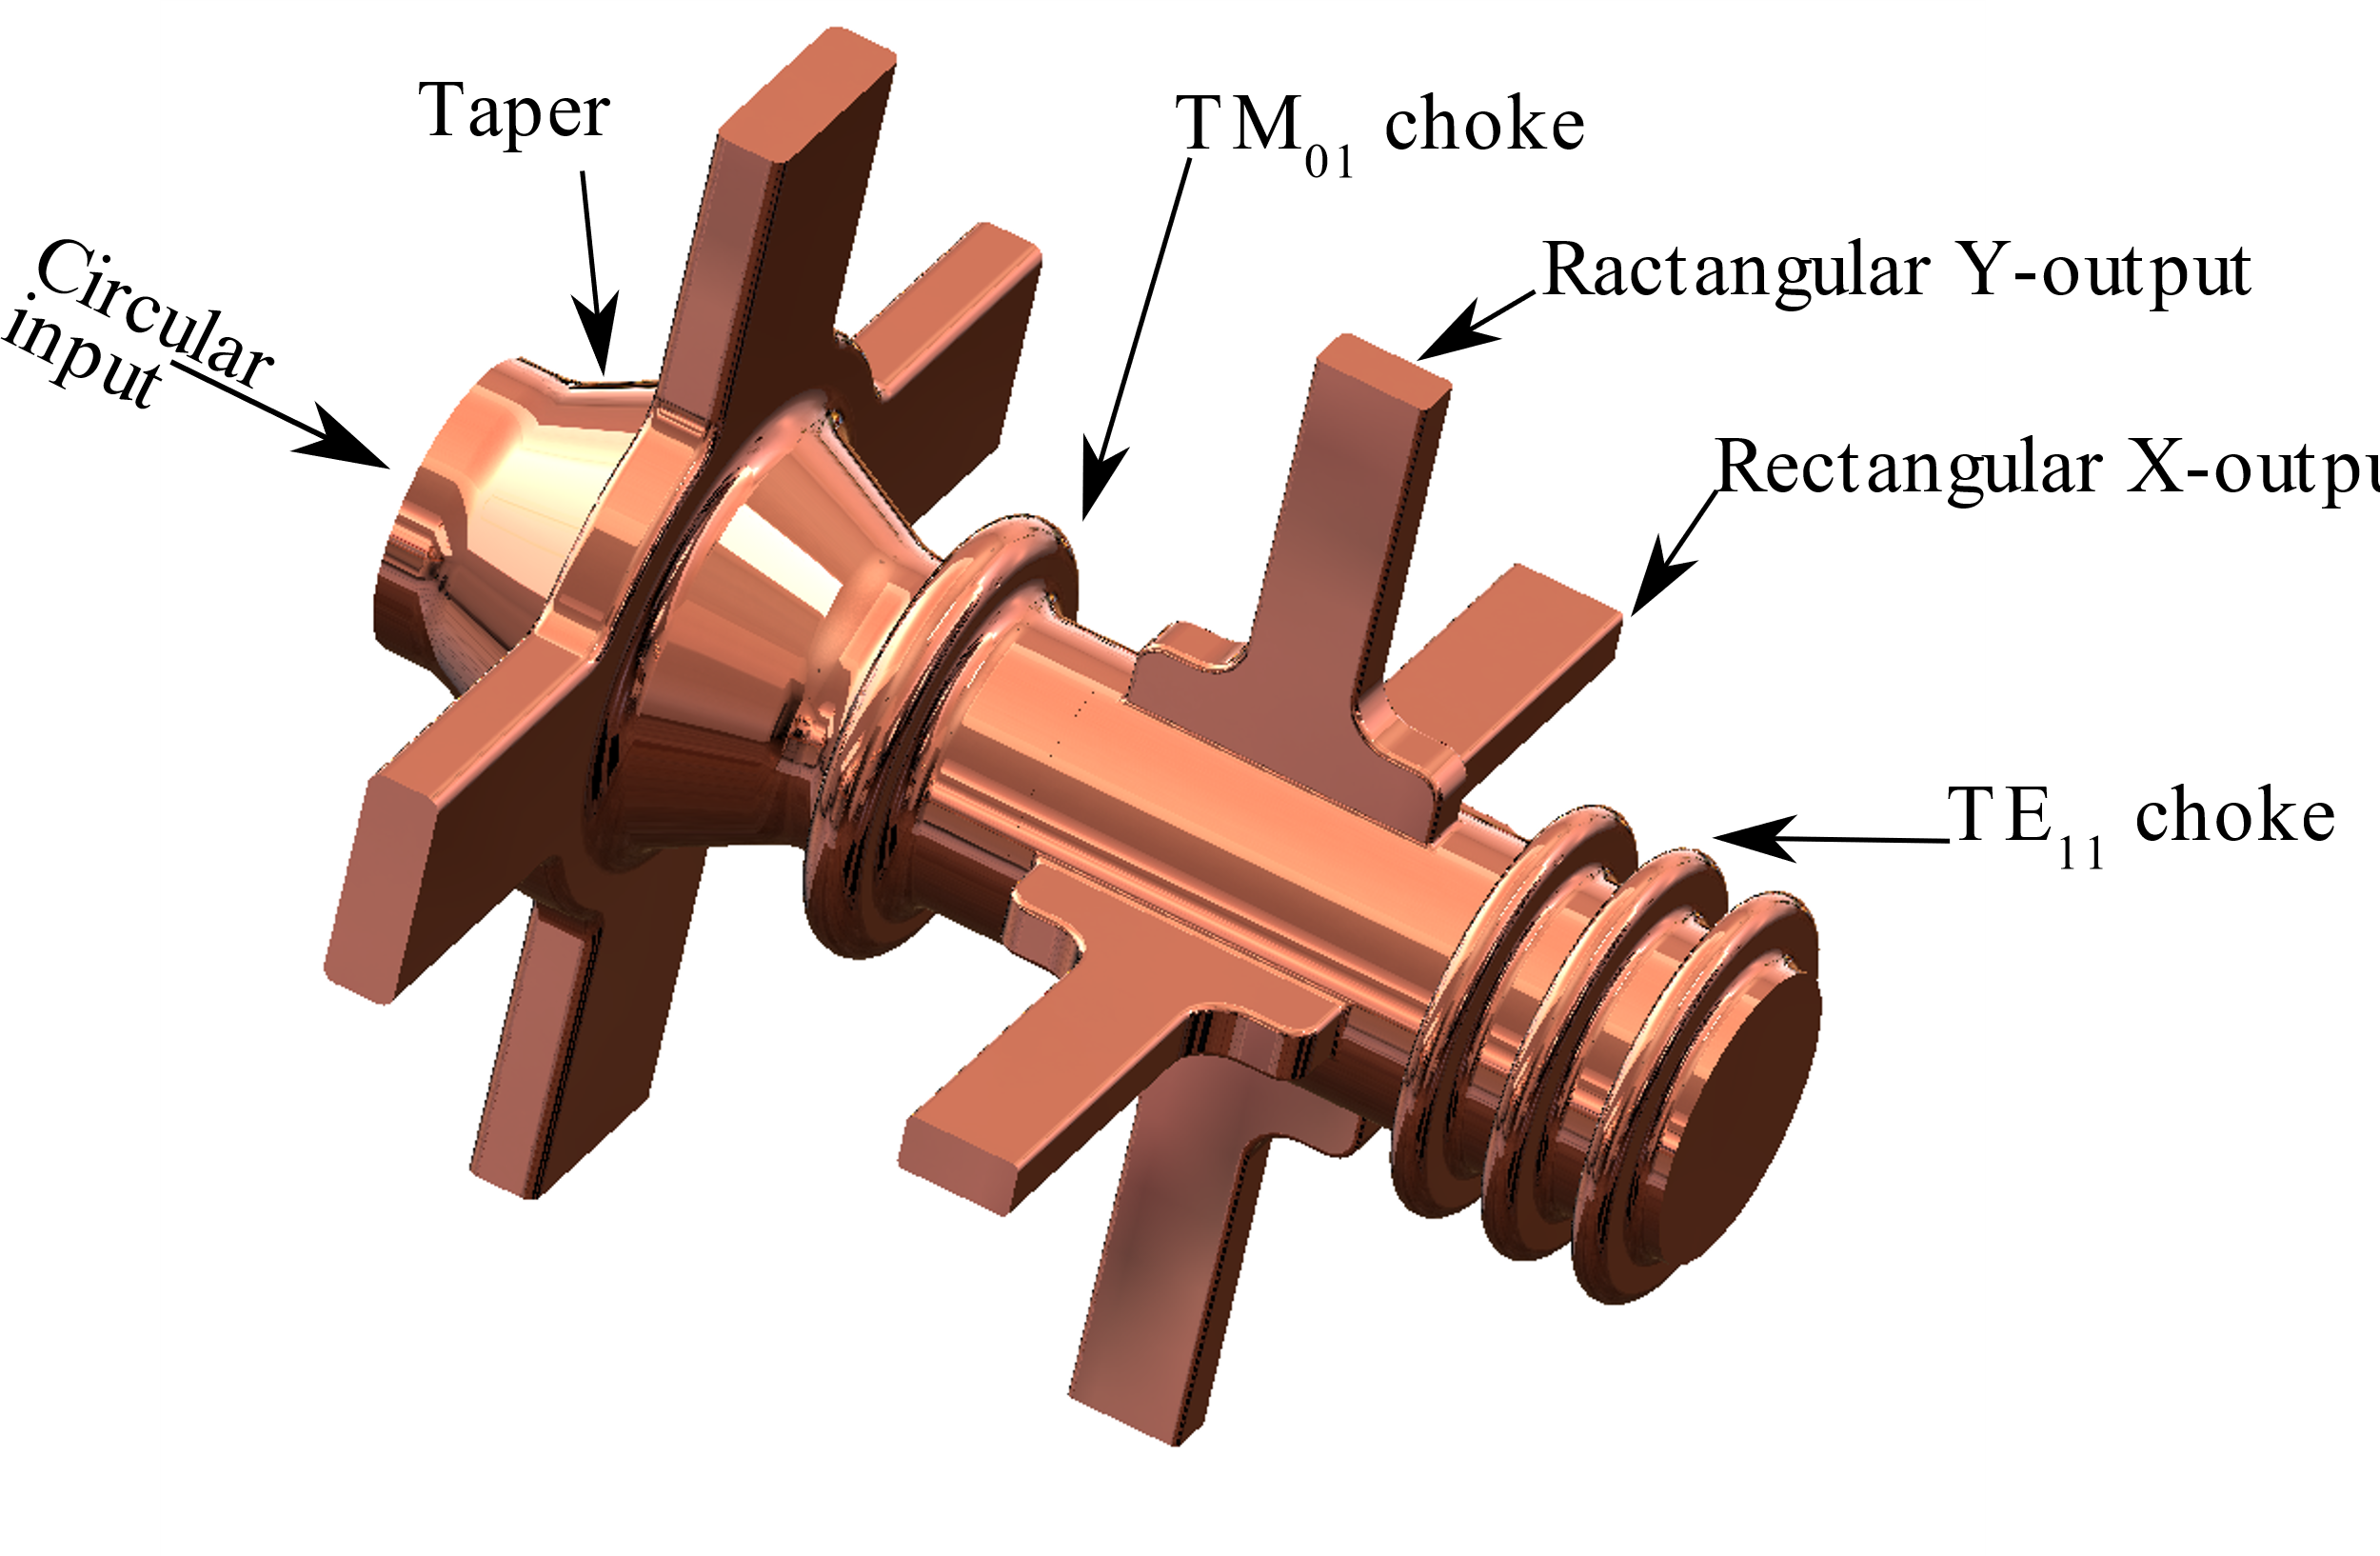
DOE SBIR Project
Integrated Offset Monitor for a Sub-THz Structure Wakefield Accelerator (DE-SC0022791)
Siy, A.; Behdad, N.; Booske, J.; Waldschmidt, G.; Zholents, A. Electromagnetic Design of the Transition Section between Modules of a Wakefield Accelerator. Physical Review Accelerators and Beams 2023, 26, 012802, doi:10.1103/PHYSREVACCELBEAMS.26.012802/FIGURES/21/MEDIUM.

Slide 5
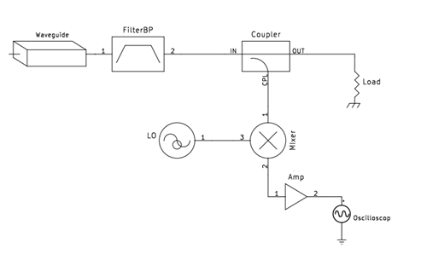
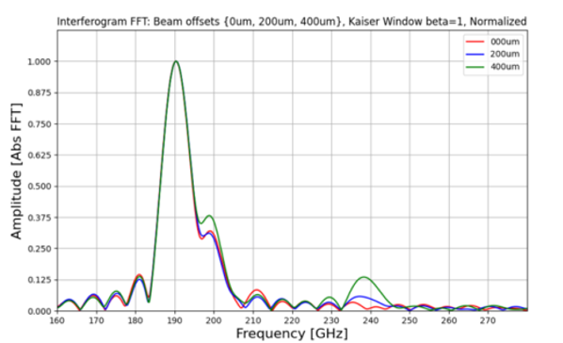
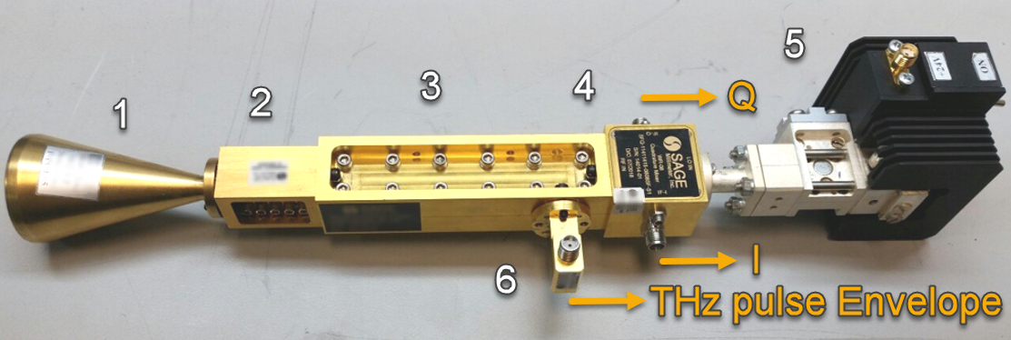
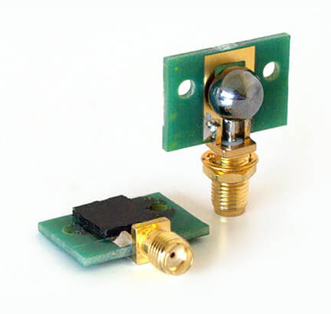
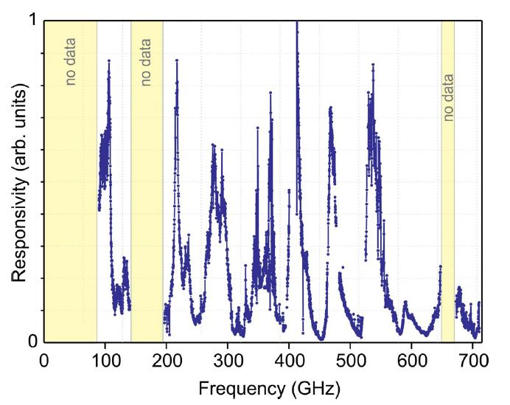
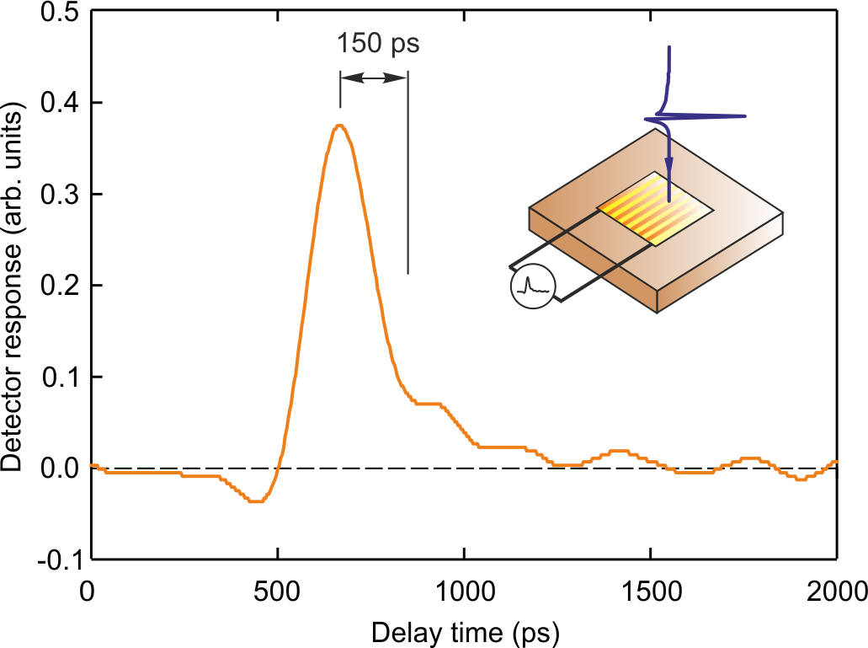
Detector chose
Initial plan was to re-use RadiaBeam sub-THz Schottky detector (110 GHz) that would be optimized to the 190 GHz range and configured with ultrafast oscilloscope.
But further analysis showed that a more compact and passive solution is possibly available. That would be a Field Effect Transistors (FET) detectors from TeraSense.
Kutsaev, S.V et al. Pulse Length Monitor for Breakdown Diagnostics in THz and Mm-Wave Accelerators. Photonics 2021, 8, 442. https://doi.org/10.3390/photonics8100442
A. Lisauskas et al., “Terahertz responsivity and low-frequency noise in biased silicon field-effect transistors,” Appl Phys Lett, vol. 102, no. 15, Apr. 2013, doi: 10.1063/1.4802208/125983.

Slide 6
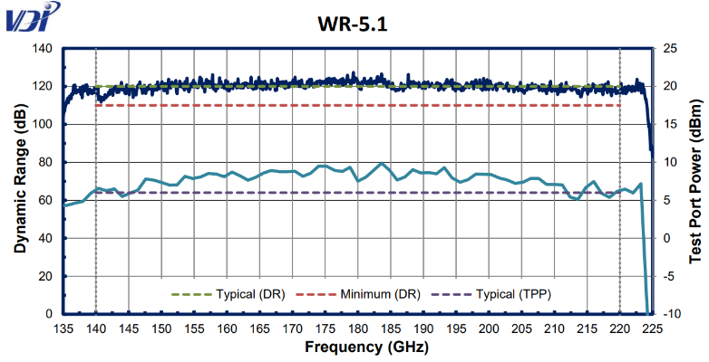
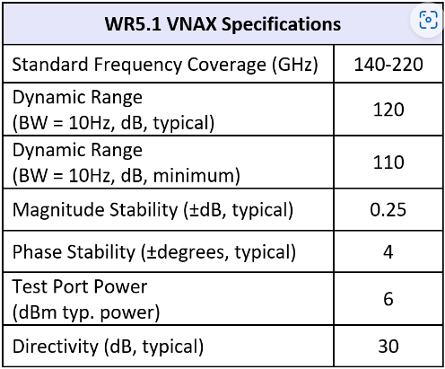
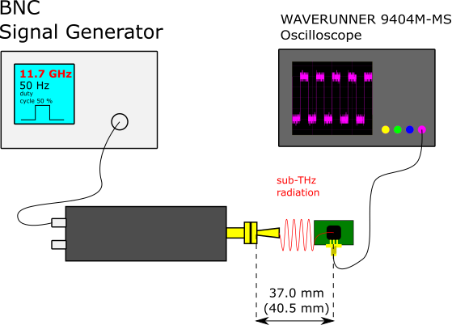
Detector Testing at ANL mm-Wave lab
Setup description. Fast sub-THz detector was located in front of the VDI WR5.1 frequency extender with freq. multiplier 12 driven by a BNC 100kHz – 20 GHz Signal Generator (Fig. 1). The dynamic range of the freq. extender is shown on Fig. 2. The BNC signal generator was set to output 50 Hz pulse of drive signal in range from 11.7 to 18.3 GHz (duty cycle 50%) pulses
Detector was connected to the WAVERUNNER 9404M-MS Oscilloscope with 50 ohm termination (Fig. 3).
Figure 2. VDI frequency extender output parameters
Figure 1. Simple representation of the test setup
Figure 3. Scope trace of the Fast sub-THz detector
receiving 176.4 GHz signal

Slide 7
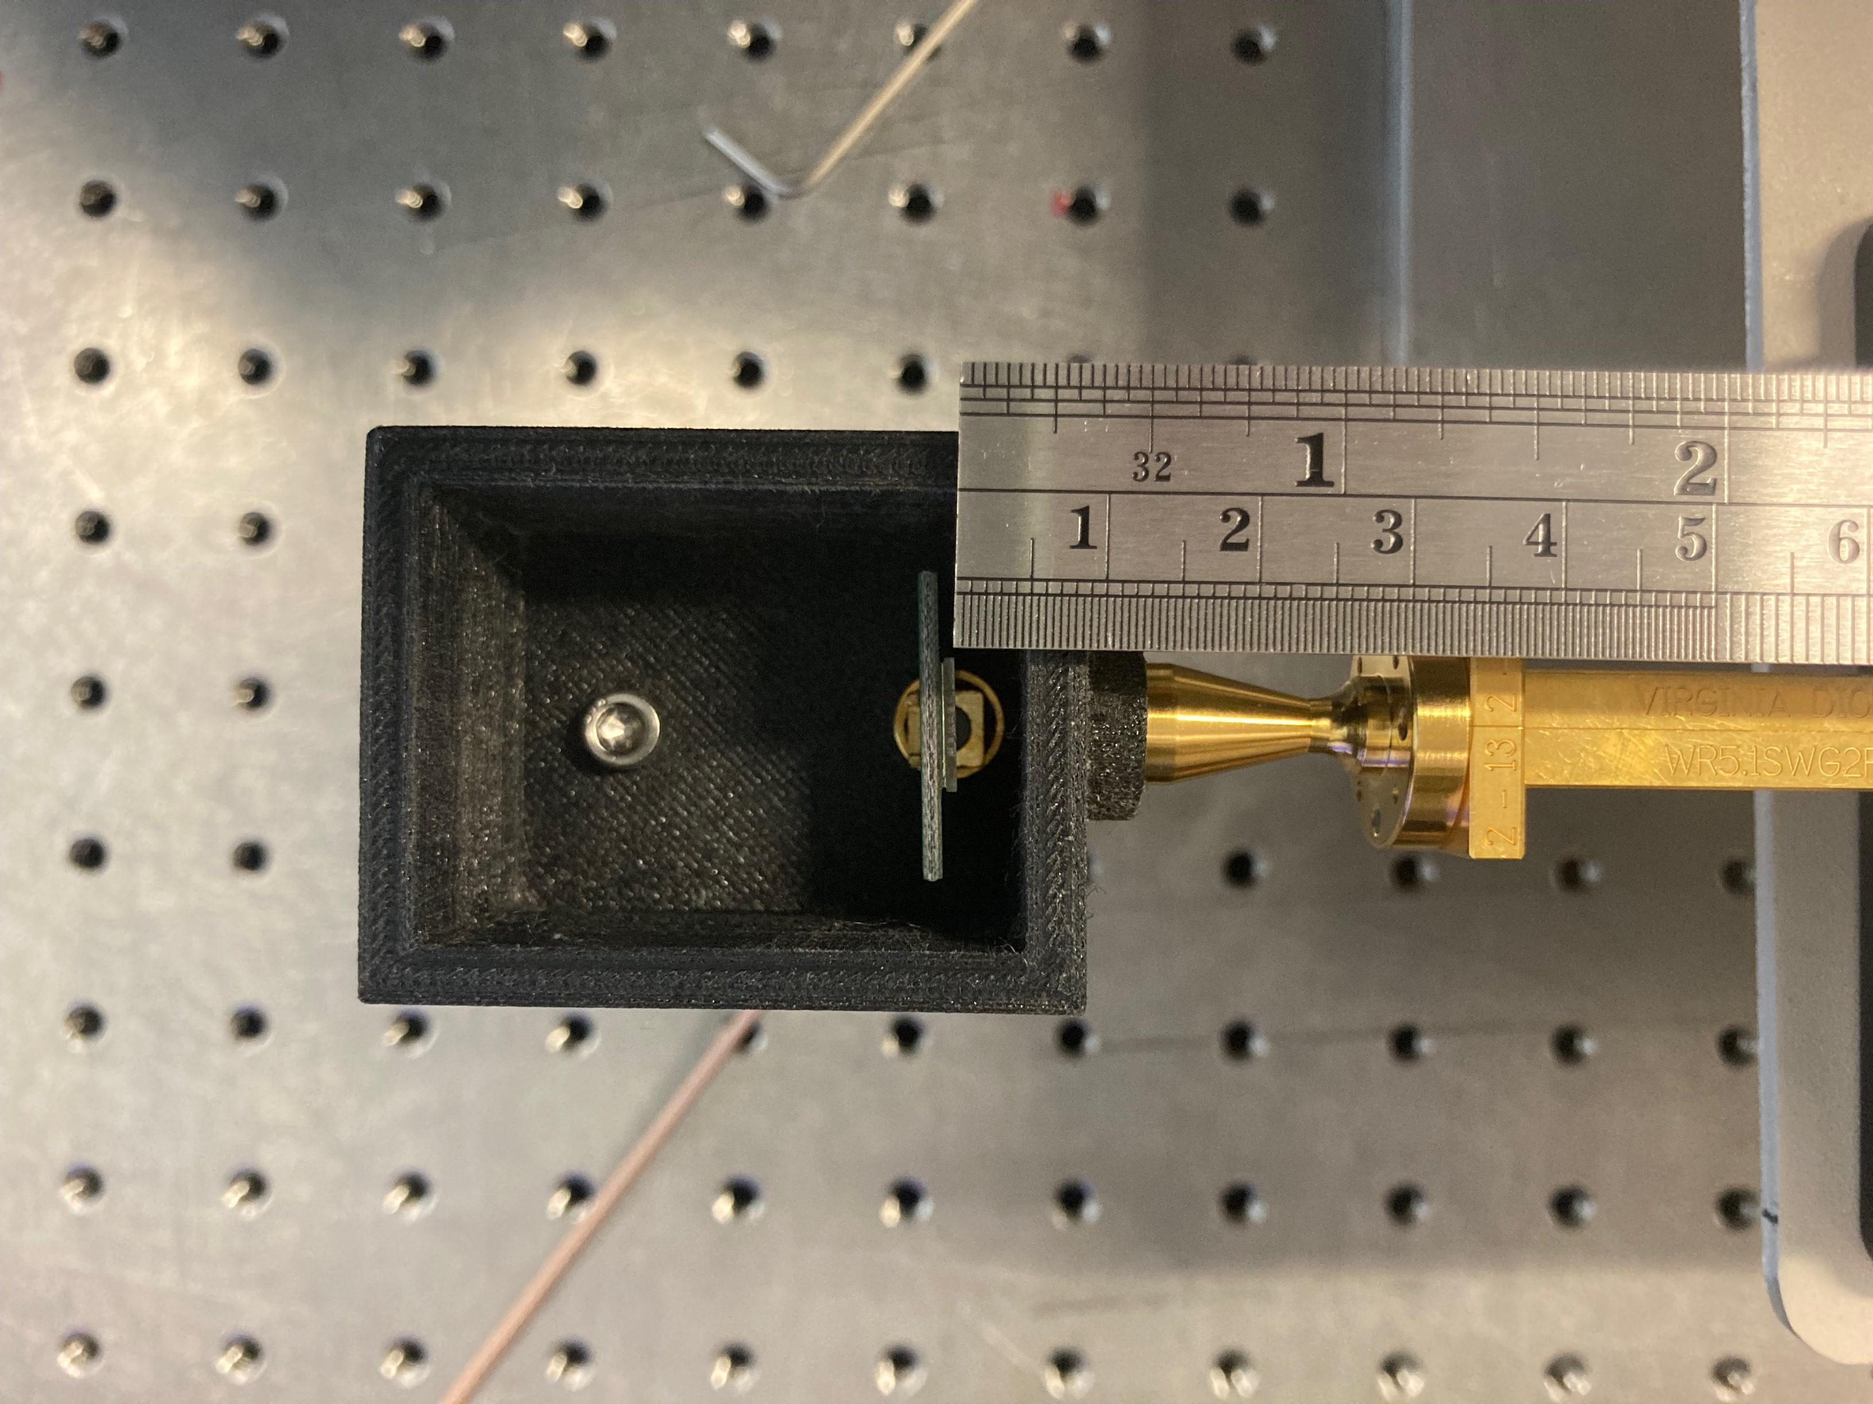
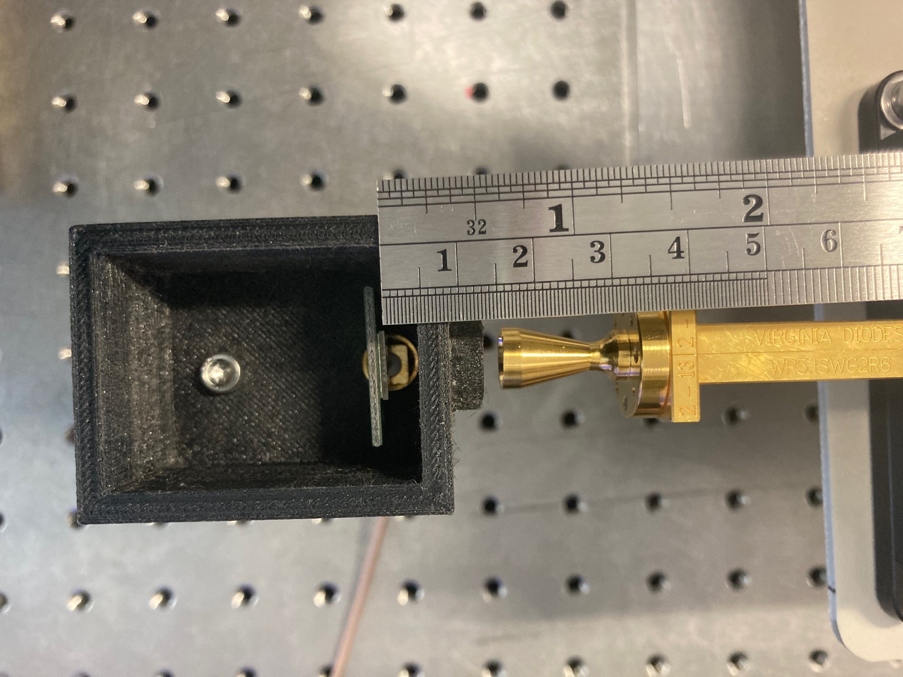
Detector Testing at ANL mm-Wave lab
Shift or not?
37.0 mm
The reason for shifting detector was to find out if there are any parasitic reflections or standing waves generating dropdowns and spikes in signal readings.
40.5 mm

Slide 8
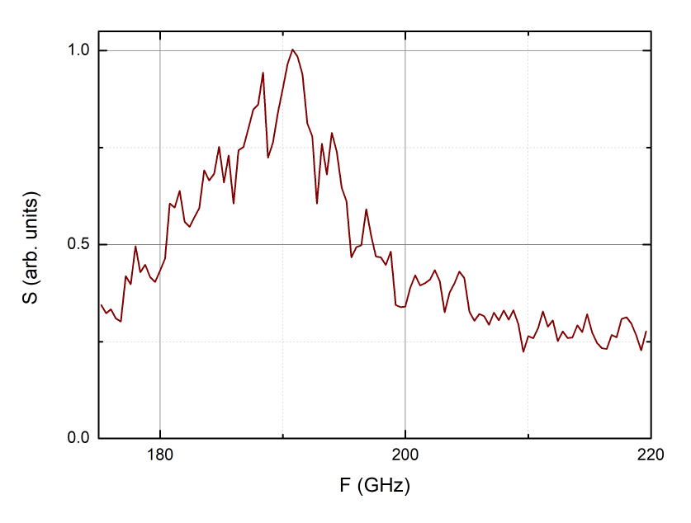
Detector Testing at ANL mm-Wave lab
This is the TeraSense data from the datasheet (Fig. 1) for the Fast sub-THz detector.
Same spikes and dropdowns in signal readings are observed if compared with test at ANL (Fig. 2). Additional information from the manufacturer needed to verify their measuring approach.
Figure 2. Comparison of the collected data and datasheet one
Figure 1. TeraSense datasheet data for the
Fast sub-THz detector response vs frequency

Slide 9
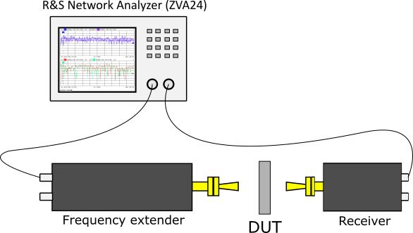
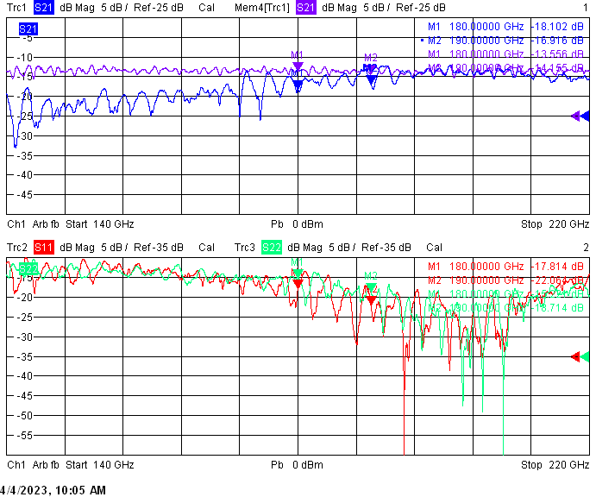
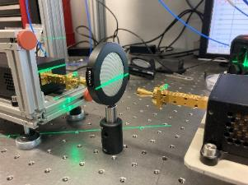
Band Pass Filter testing

Slide 10
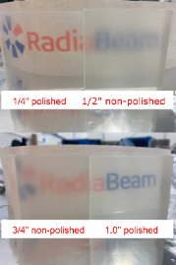
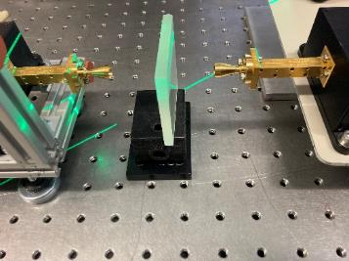
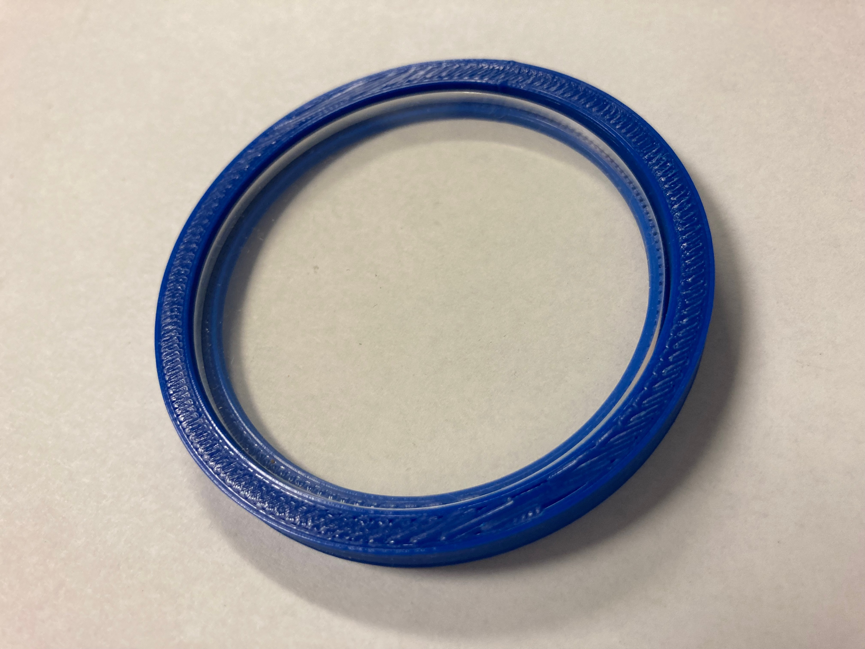
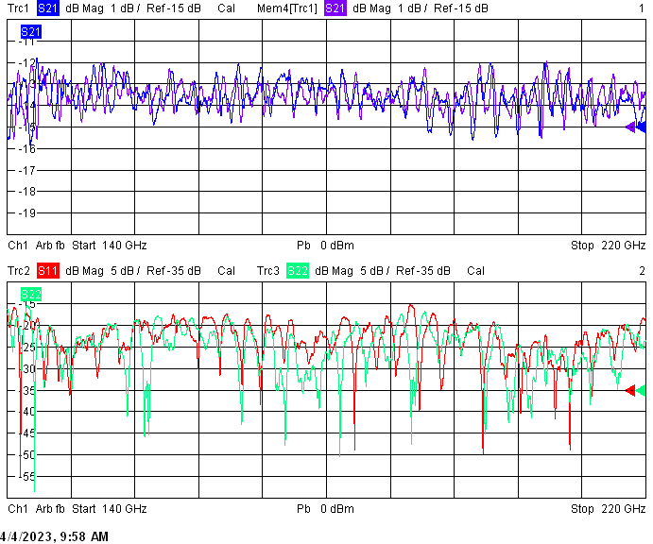
Initial Experimental Plan at ATF
Additional testing for sub-THz transparent material for vacuum window was tested. TPX material machined and polished at RadiaBeam showed full transparency to the sub-THz radiation within the 140 – 220 GHz range and is considered to be a more affordable alternative to the TYDEX option.
TYDEX TPX window

Slide 11
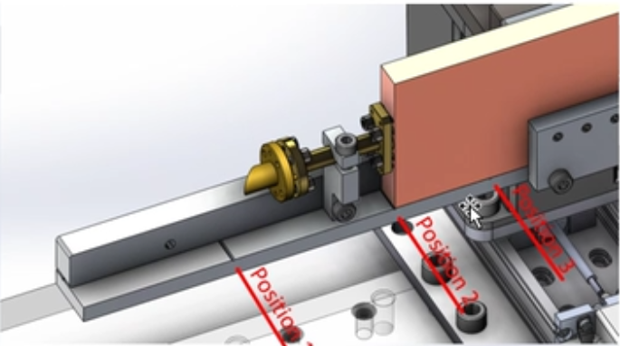
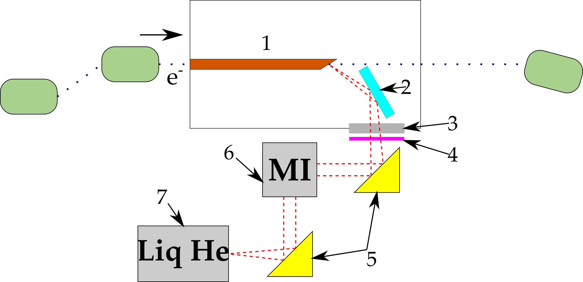
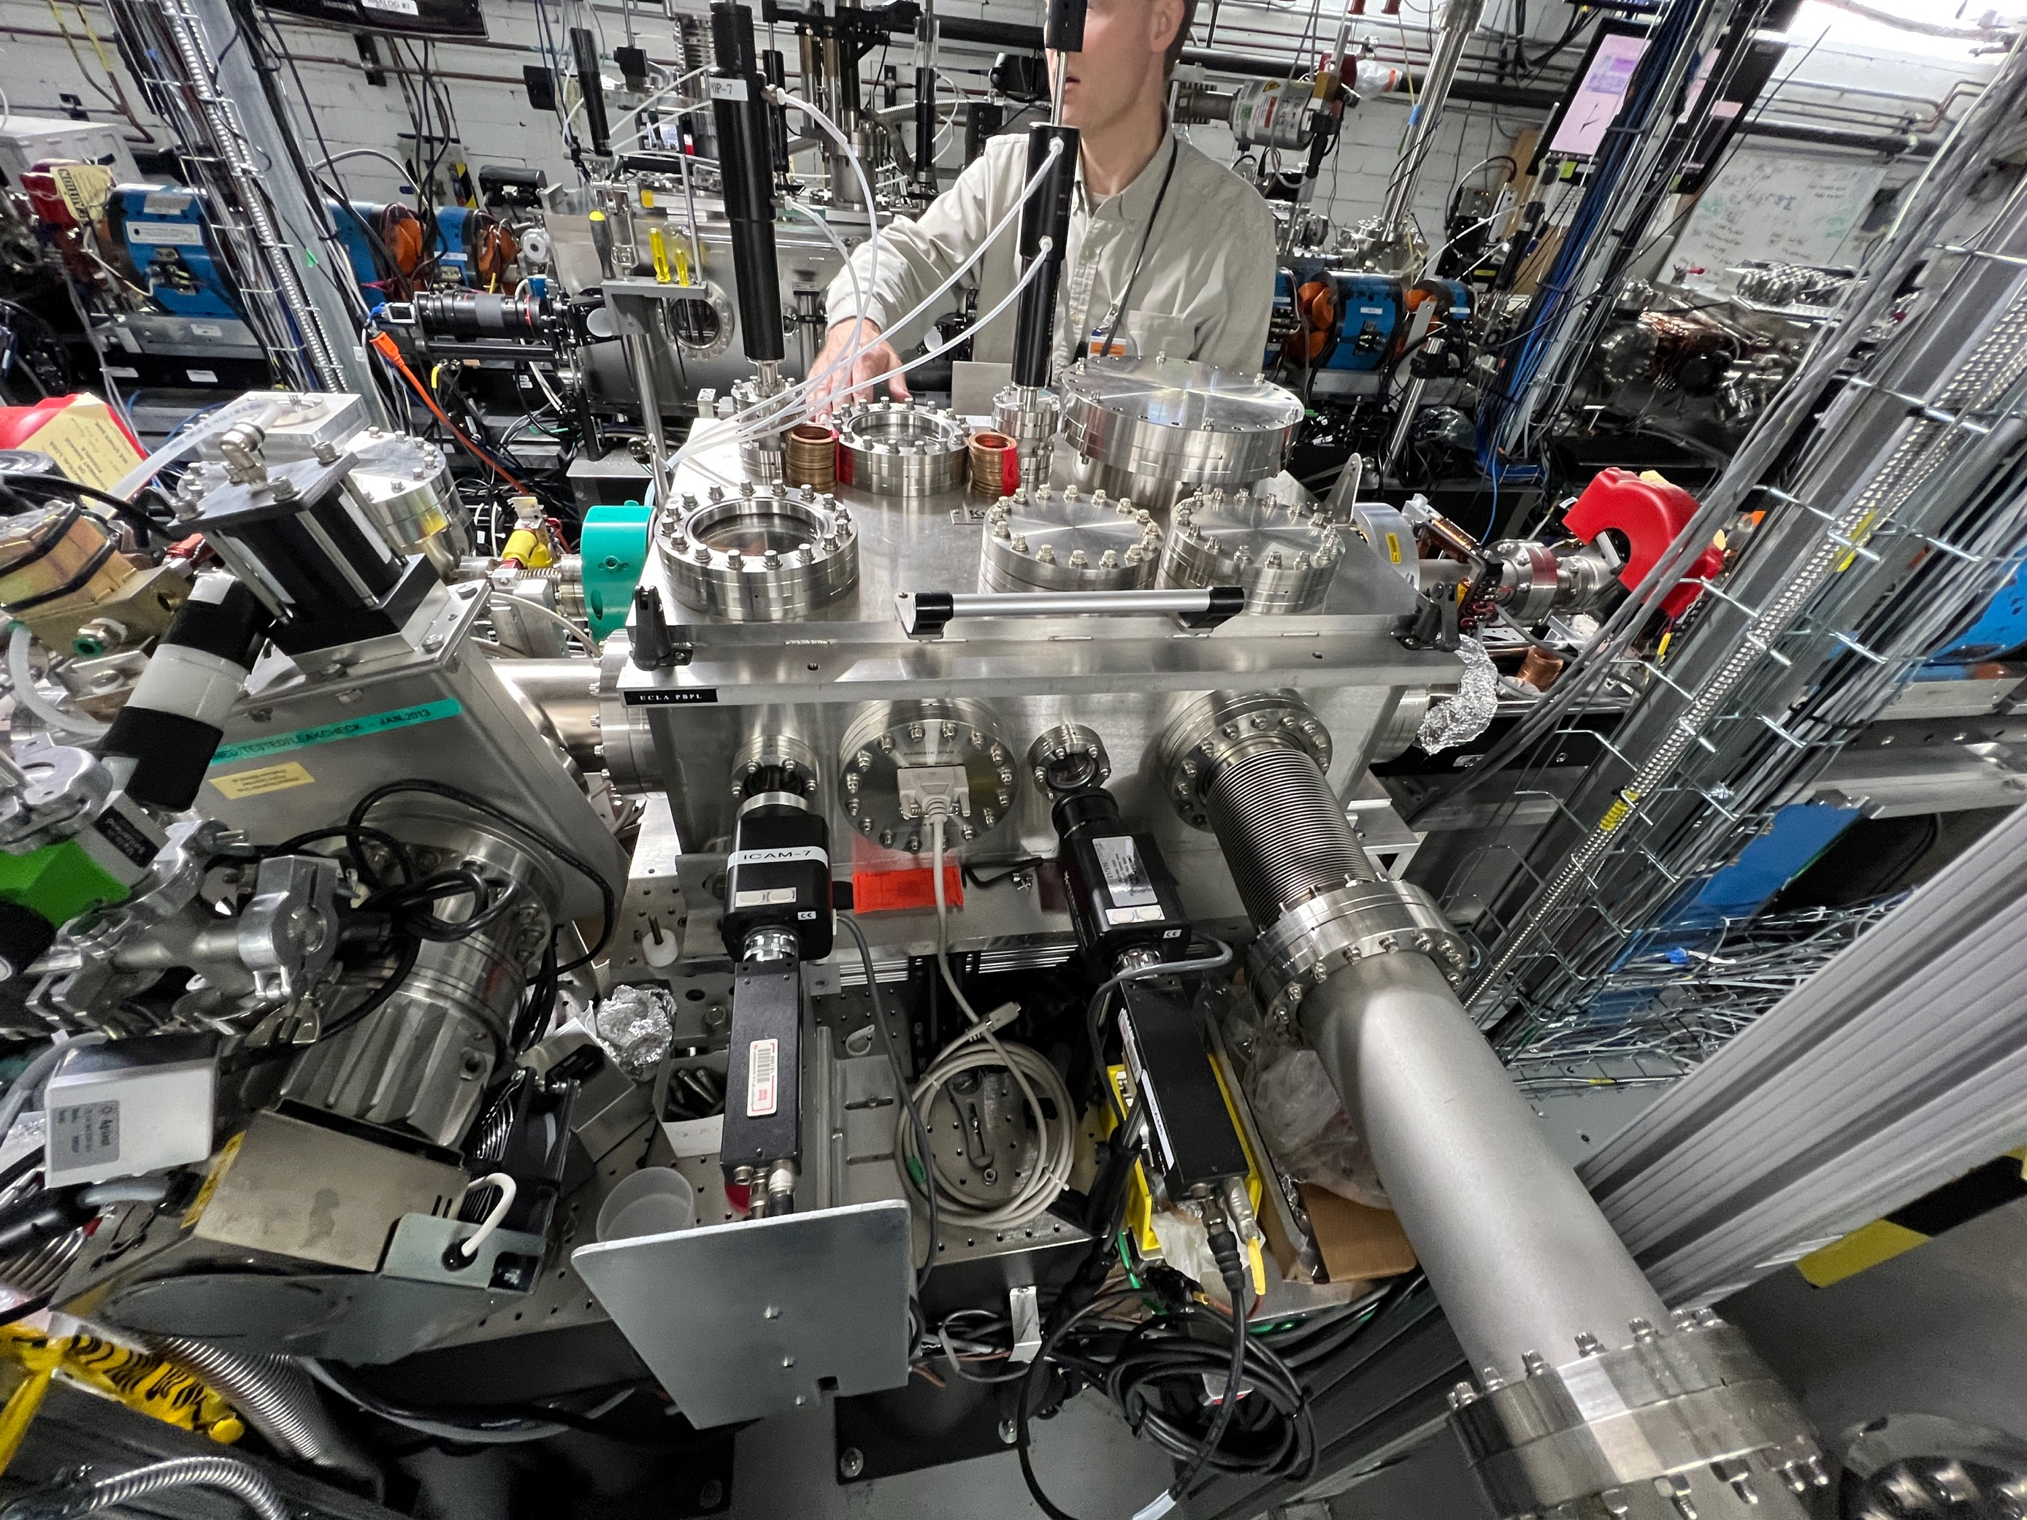
Initial Experimental Plan at ATF
The first stage of the experiment at the ATF will be characterizing emitting radiation from the corrugated waveguide by liquid Helium cooled bolometer provided by ATF facility and then by THz detector provided by RadiaBeam. The principal scheme is shown on the right:
1 – corrugated waveguide
2 – 2” flat mirror
3 – TPX window
4 – variable polarization filter
5 – OAP mirrors
6 – Michelson Interferometer
7 – He-cooled bolometer
Exit port 1
Area for THz optics table with detector placement

Slide 12

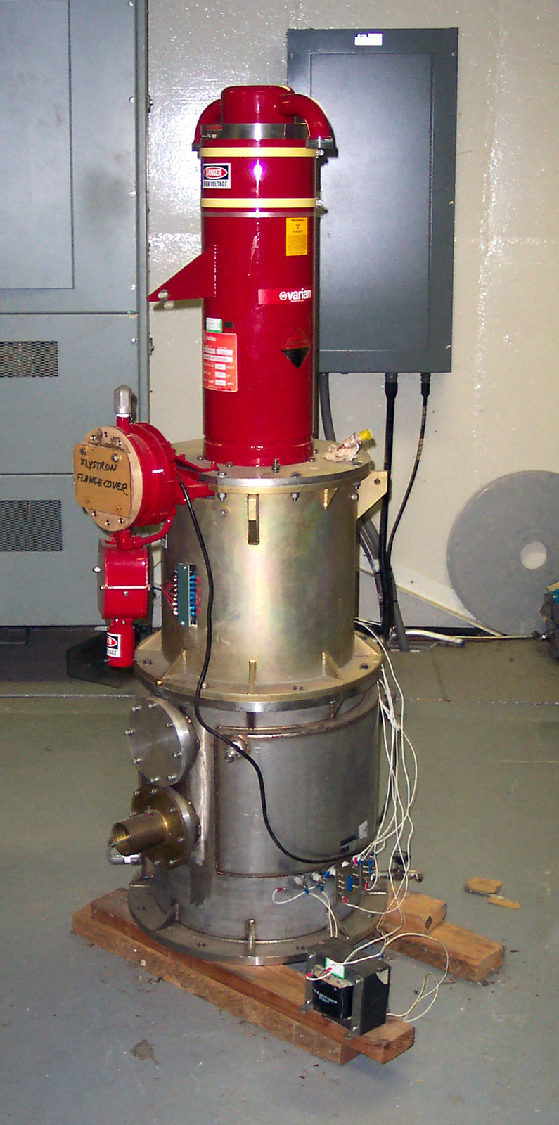

Slide 13
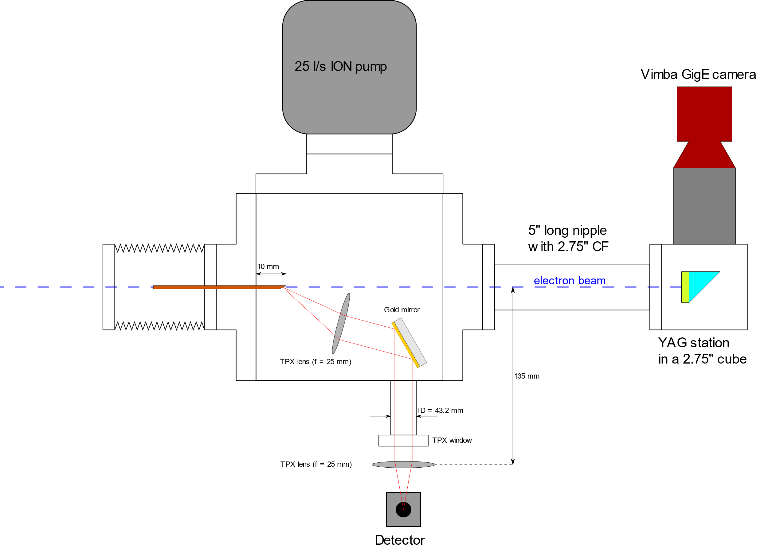
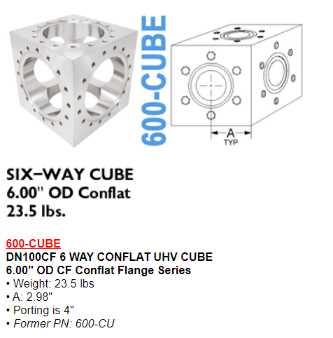
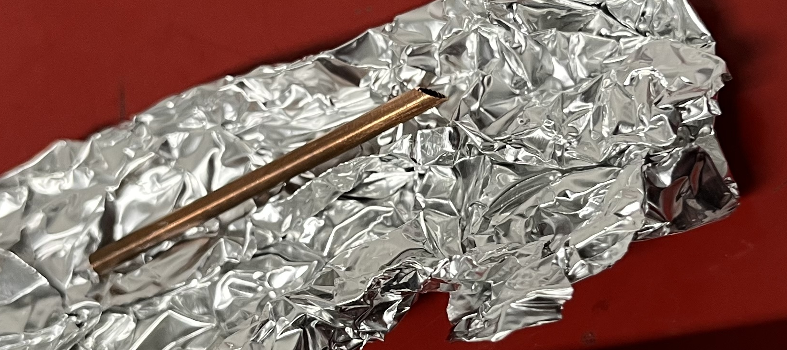
The RadiaBeam experiment rush planning
Use 6” OD CF 6-way cube to make an assembly
3 mm OD, 100 mm long

Slide 14
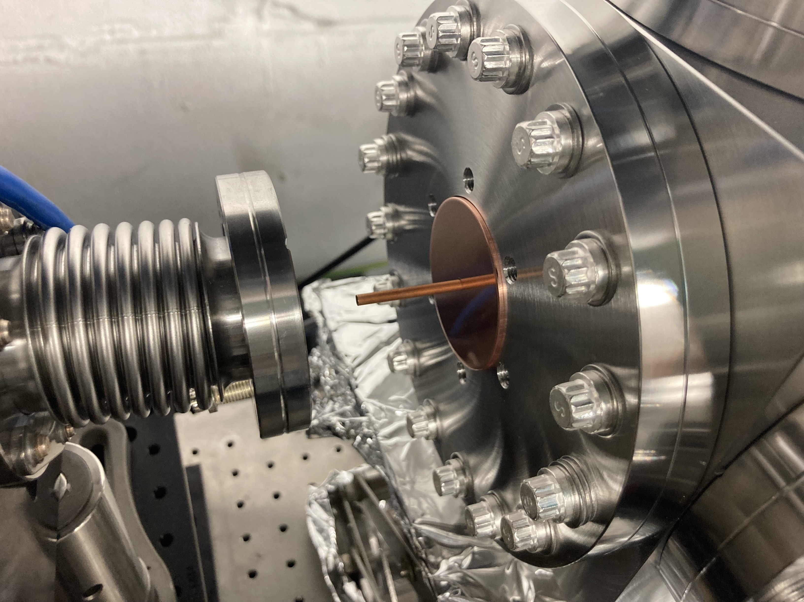
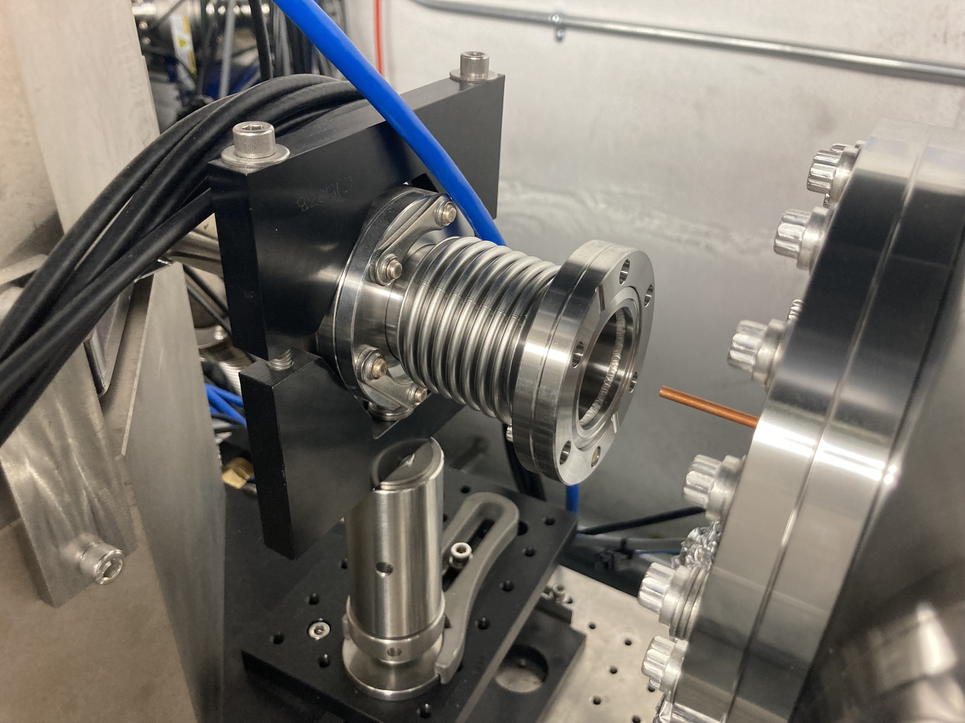
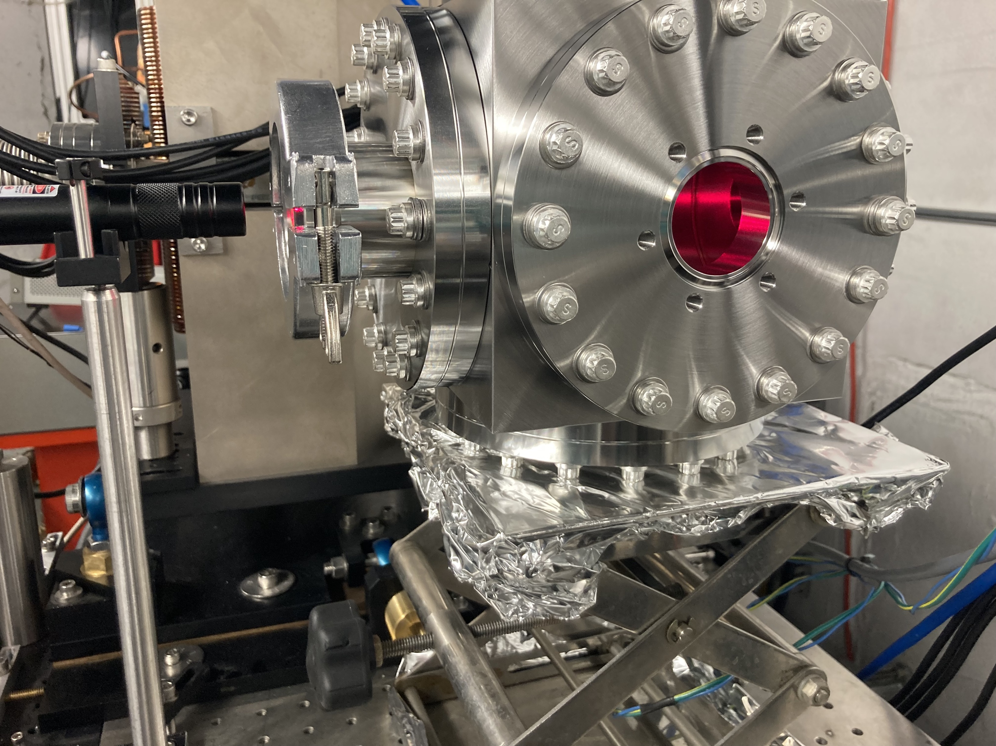
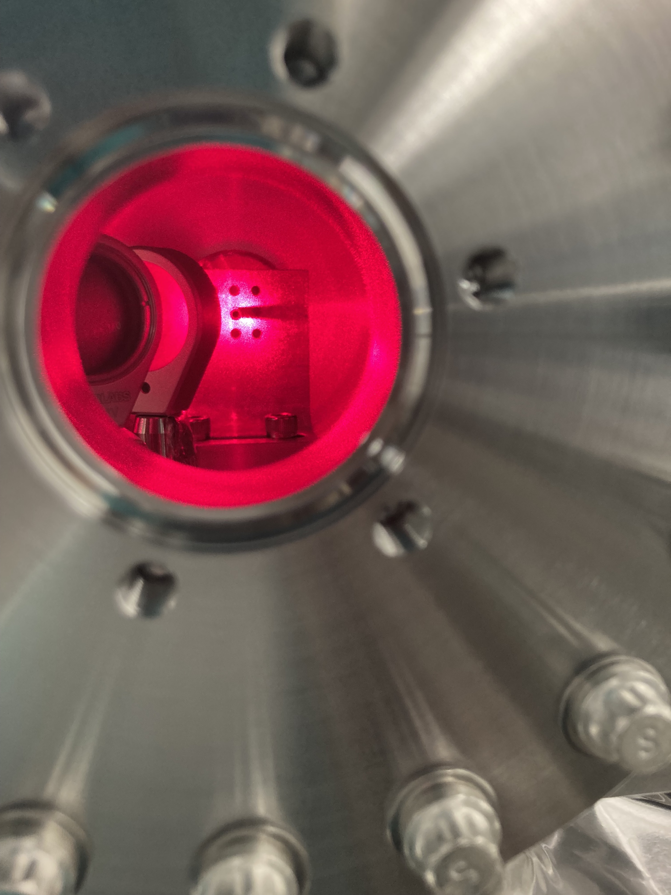
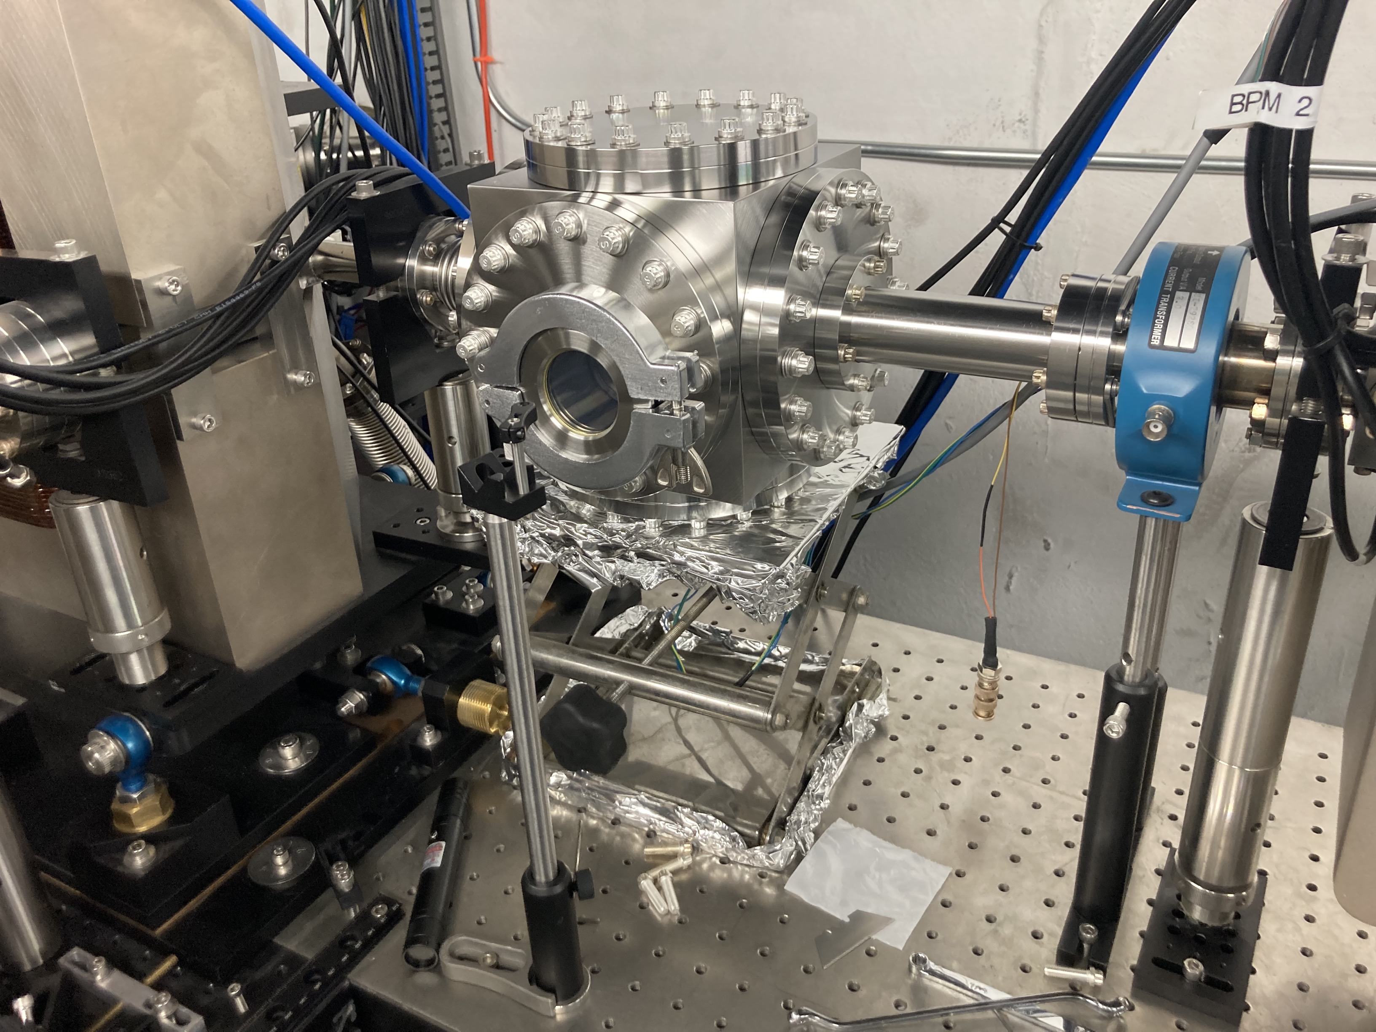
The actual setup

Slide 15
The signal it is?
Distinguished signal was achieved related to the presence of the e-beam
Scope traces of noise levels without e-beam
Scope trace of the IOM signal

Slide 16
Response to Charge/Bunch length
Phase change was performed and response to its change was recorded. The response was obvious but we suspect it is more charge and alignment driven rather than the bunch compression effects it.

Slide 17
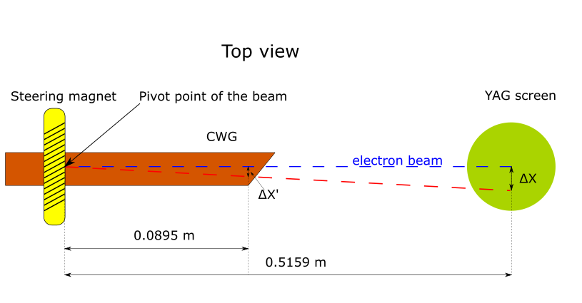
Response to the beam yaw angle
The beam was steered with a 4th steering magnet creating an offset angle
CWG exit offset (mm)

Slide 18
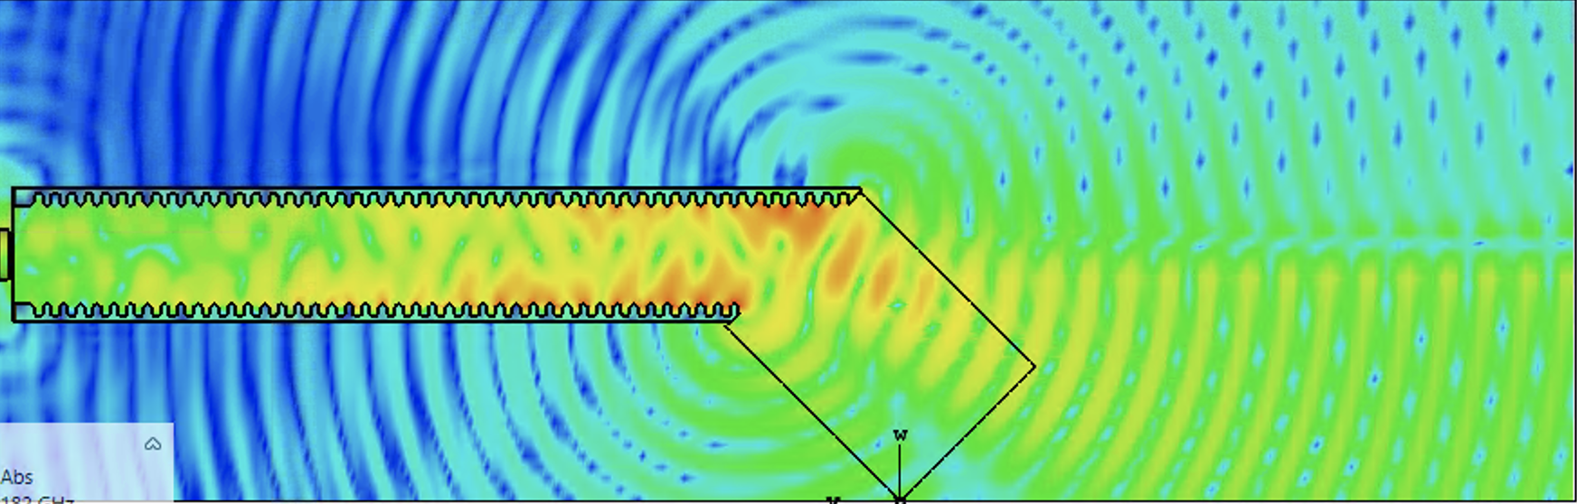
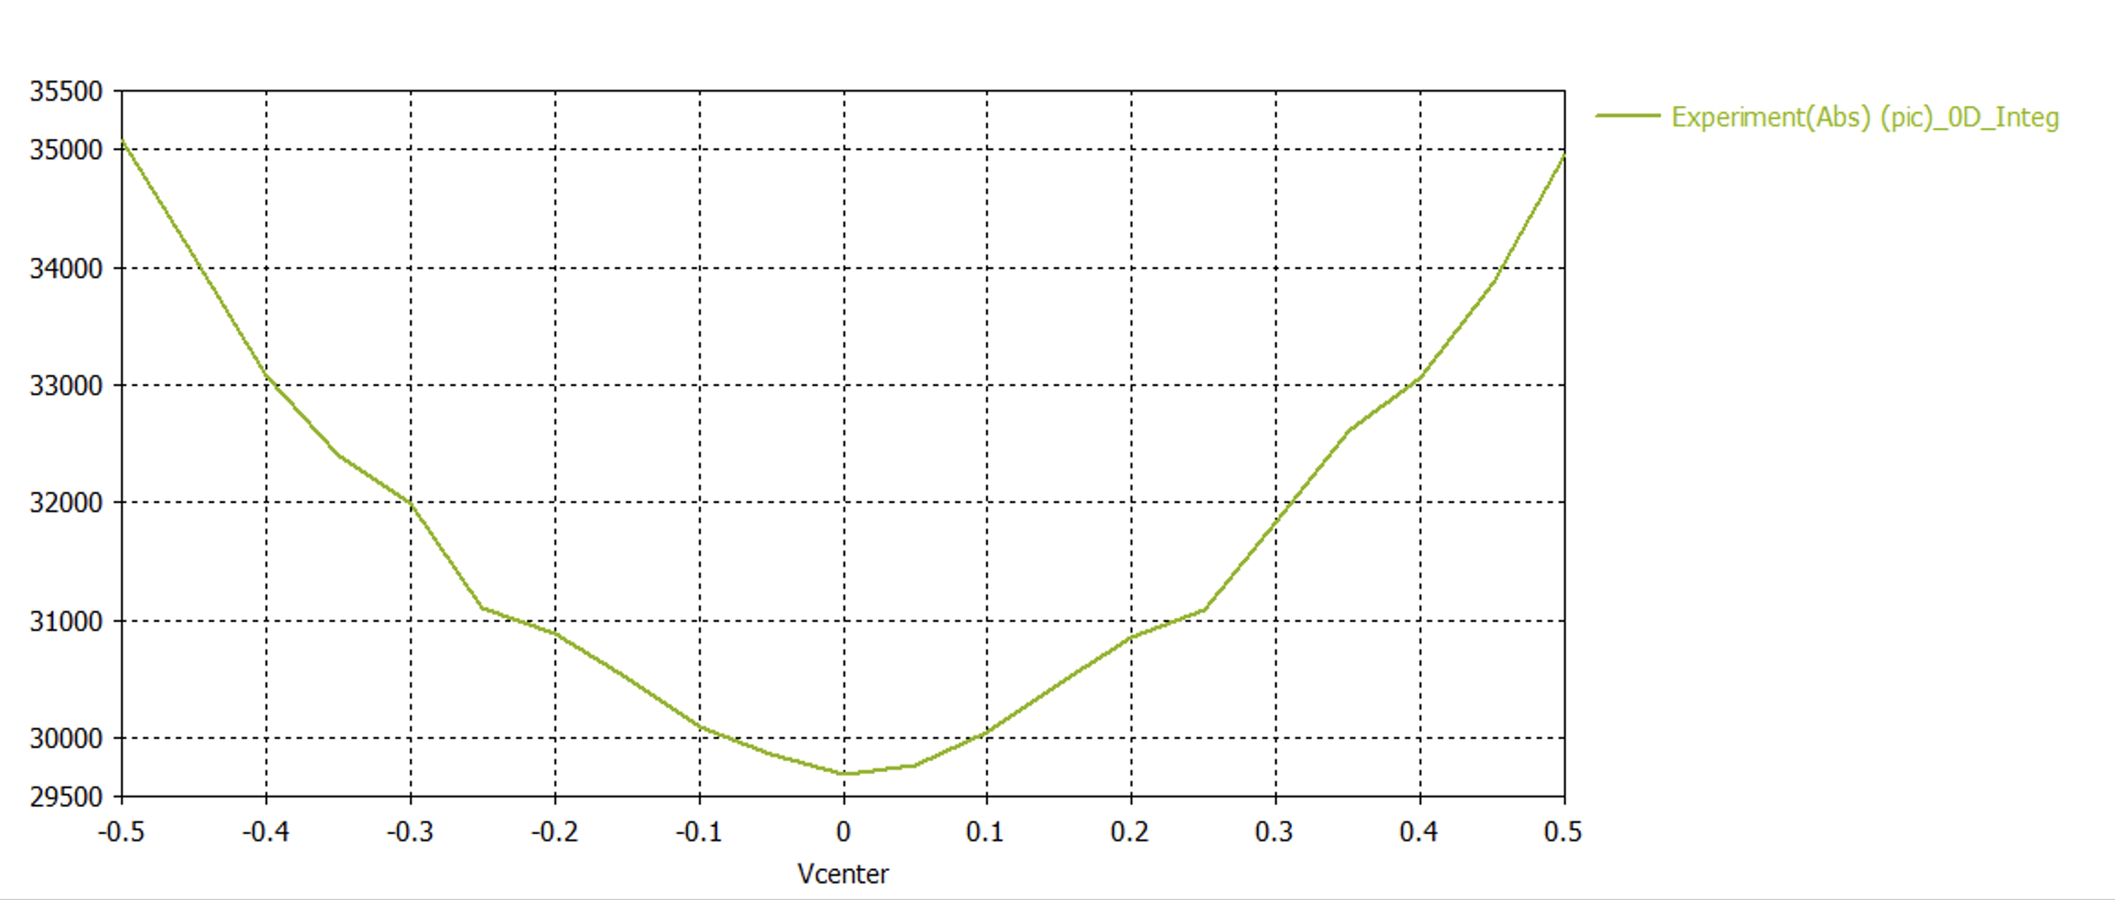
Aftermath
Shown on the right are after thought CST simulation repeating the test setup.
The bottom plot shows the signal amplitude dependency on the beam off-axis position. It can be clearly seen that the expected dependency is non-linear, which brings questions regarding the linear dependency in the experiment.
The main culprit of such difference is considered to be scraping of the e-beam on the walls of the CWG.

Slide 19
Conclusions
TeraSence FET sub-THz detector was tested in lab environment and with actual e-beam inside the corrugated waveguide for wakefield acceleration
The performance in terms of sensitivity was lower than expected, but was sufficient for the simple signal detection
Additional subcomponents (band path filter, translucent and THz transparent vacuum window material) where evaluated as well showing acceptable level of performance within current application.
Colinear wakefield accelerators require a complete online knowledge of the beam position along the whole path and thus require new approaches both compact and cost effective. Possible solutions already exist but need more investigation and work with detector’s manufacturers in order to fulfil the required requirements and optimize the cost.

Slide 20
Contributors
Loic Amoudry¹,
Nathan Burger¹,
Maksim Kravchenko¹,
Sergey V. Kutsaev¹,
Alex Murokh¹,
Branco K. Popovic²,
Alexey Pronikov¹,
Geoff Waldschmidt²,
Alexander Zholents²
1 RadiaBeam Technologies, LLC, Santa Monica, CA, 90403
2 Argonne National Laboratory, Lemont, IL, 60439

Slide 21
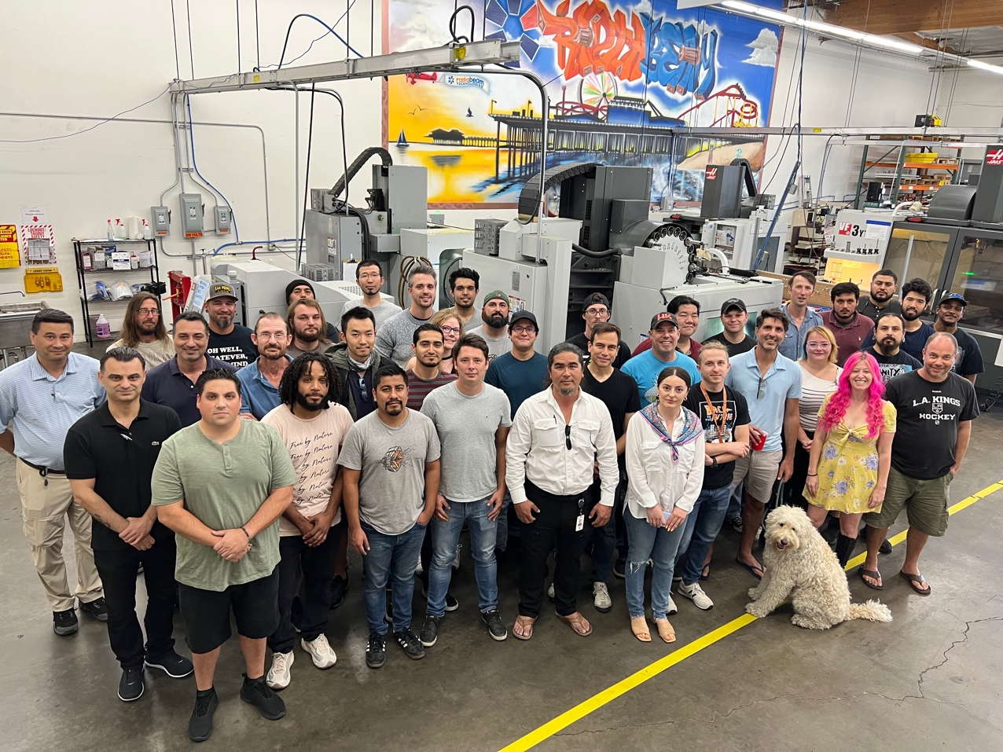
Thank you for your attention!

