Slide 1




Application of laser-plasma accelerators to future linear colliders
Carl Schroeder, C. Benedetti, J. Osterhoff, T Zhou, E. Esarey
Lawrence Berkeley National Laboratory
July 23, 2024
NIU Naperville Conference Center
Work supported by the U.S. DOE, Office of Science, Office of High Energy Physics, under Contract No. DE-AC02-05CH11231

Slide 2
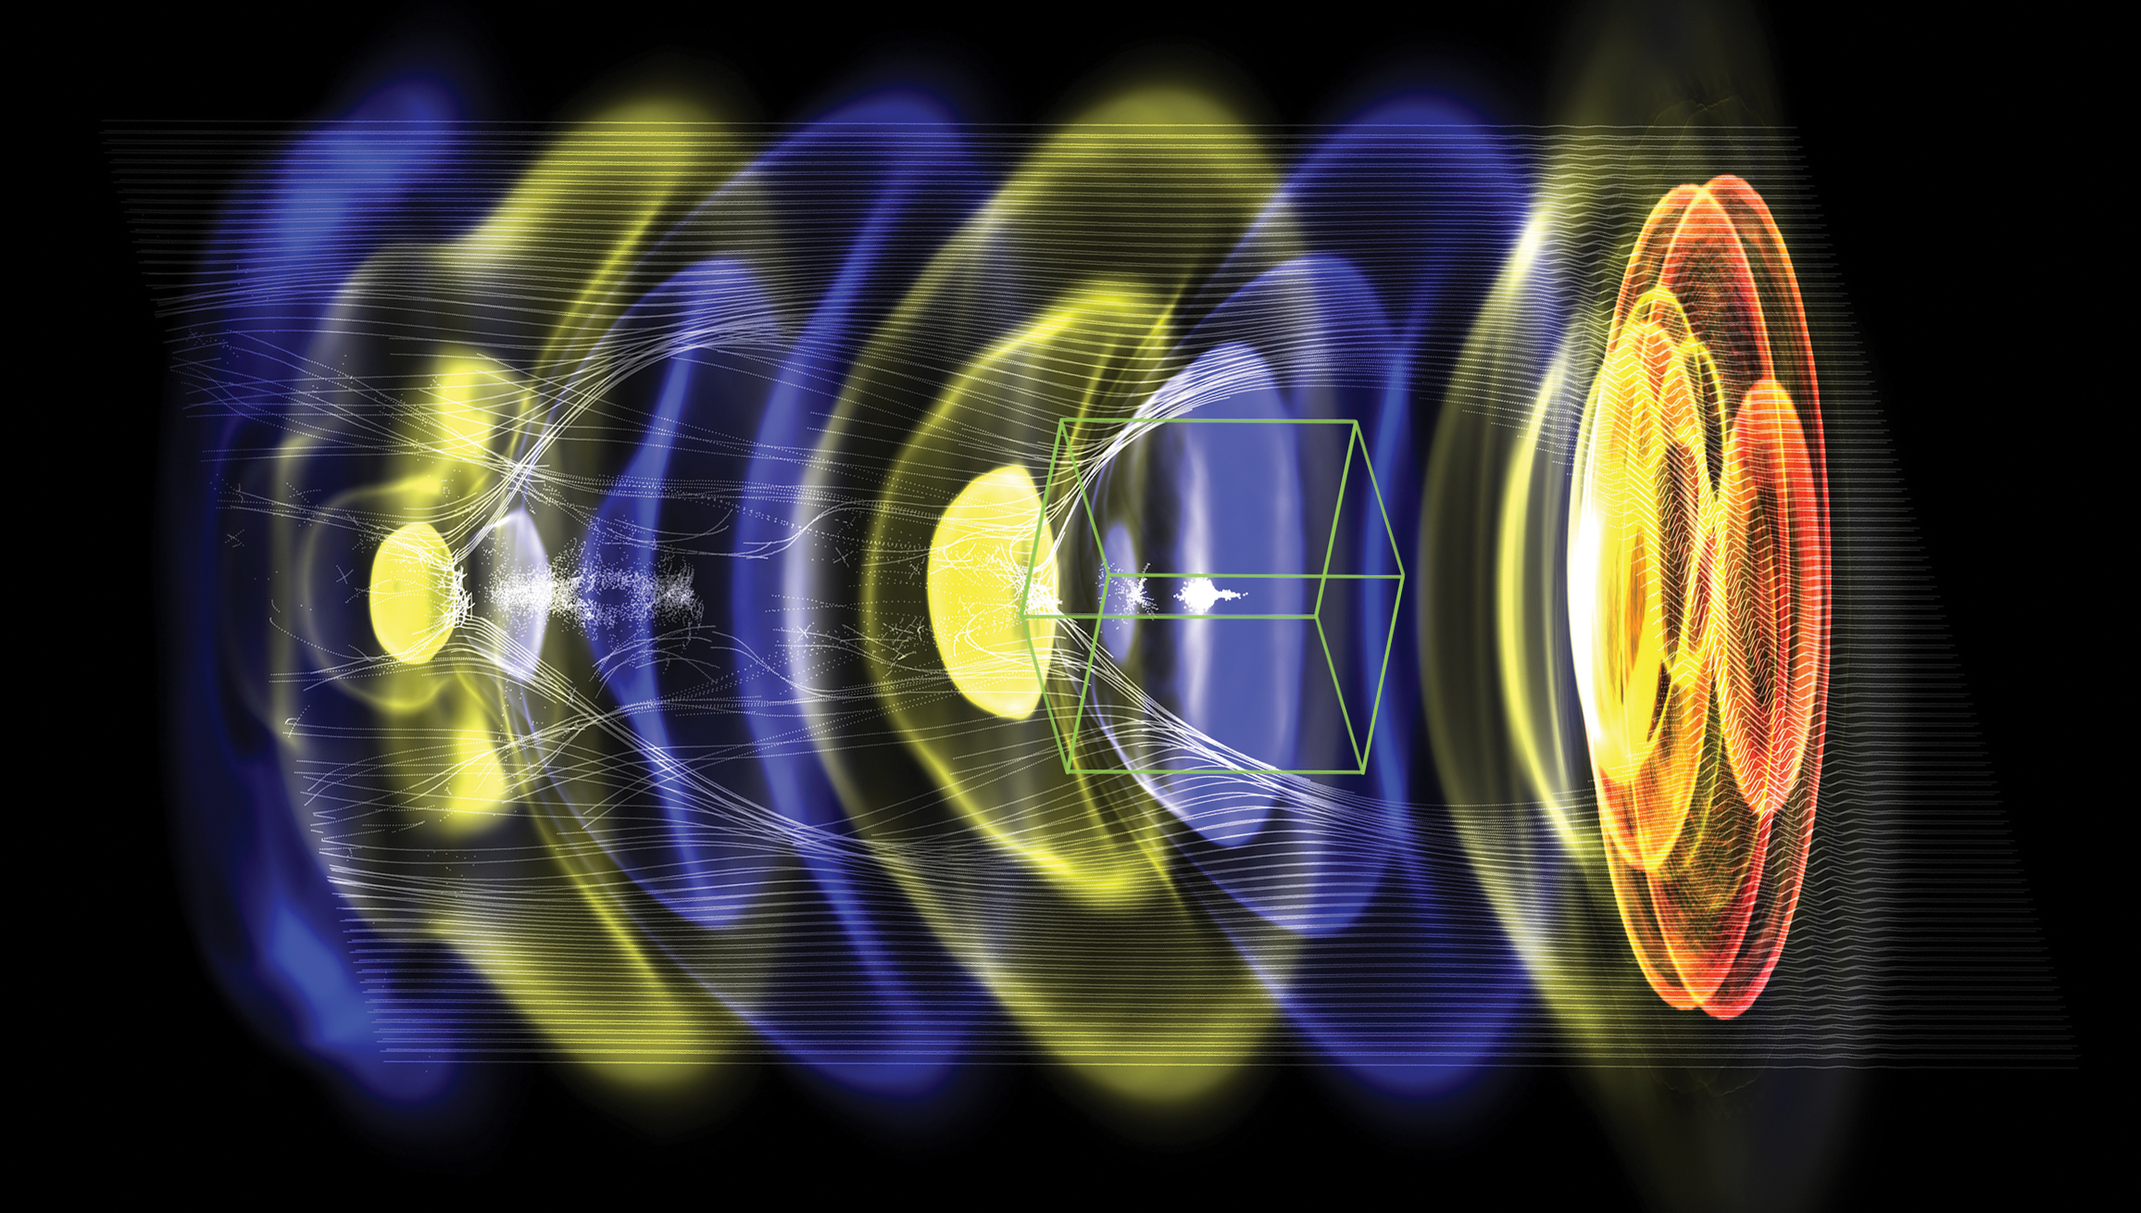
Outline
Laser-plasma accelerators (LPAs) produce ultra-high field gradients (~1-100 GV/m), accelerating ultra-short bunches (~1-10 micron)
LPA-based collider design (10 TeV CM):
  High gradient collider linacs (geo. gradient ~1TeV/km)
  High charge/bunch, maximize L/P
Example of LPA stage for plasma-based linac
  High efficiency with beam quality preservation
Laser driver characteristics for the collider application
  R&D toward high average power laser drivers based on coherent combination of fiber lasers
WarpX
Intense laser (red) drives a density wave (blue to yellow) in plasma, electrons (white) are trapped and accelerated with fields of order 10 GeV/m

Slide 3
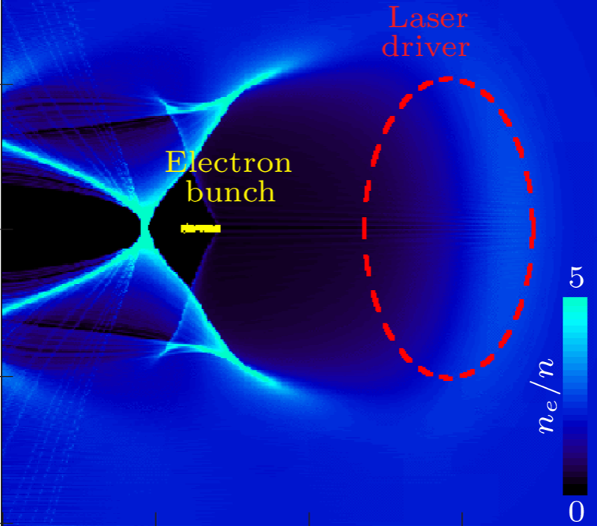
Plasma accelerator, laser driver, and accelerated beam characteristics set by plasma density
C. Benedetti
Schroeder et al. PRL (2011); Benedetti et al PRE (2015)
laser propagation direction
Accelerator length limited by laser energy depletion:
Accelerating gradient:
Energy gain:
~ plasma wavelength, λ_{p}
Laser energy:
Charge/bunch:
Pulse duration:
Lower plasma density yields higher energy beams; requires more laser energy.
Laser depletion (and high gradient) necessitates LPA staging to reach high energy.
Plasma density choice determines required laser parameters; in practice, available laser (with laser energy/pulse and wavelength) determines plasma density

Slide 4
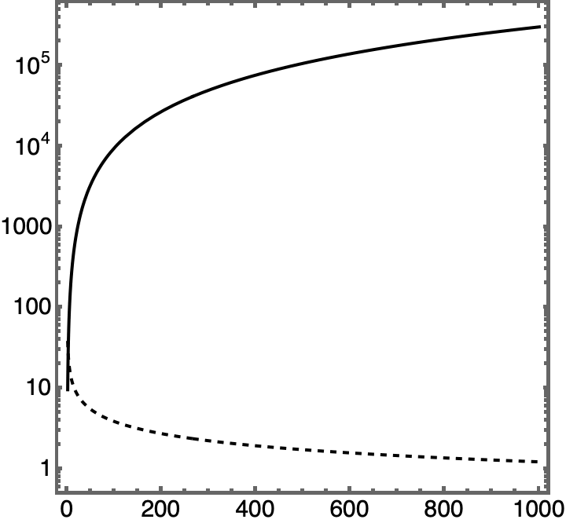
Higher energy beams requires staging plasma accelerators
Once driver energy is depleted, new driver must be coupled into plasma
In laser-driven plasma accelerator: (energy gain) ~1/(plasma density)
For resonant plasma wake excitation: (laser energy) ~ λ_{p}³ ~(plasma density)^{3/2}
Laser energy [J]
Gradient [GV/m]
Beam Energy gain [GeV]

Slide 5
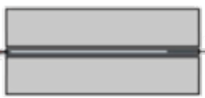
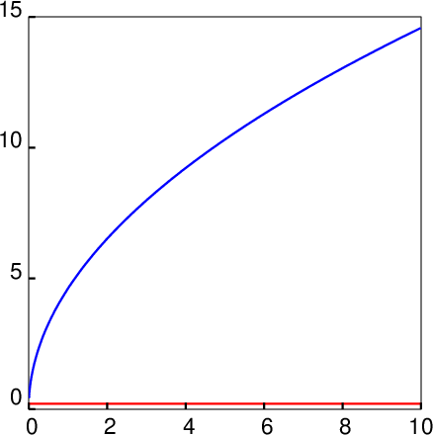
Interstage coupling determined by e-beam not laser driver
e-beam
focusing
laser
Space required for laser coupling L_{c, laser} determined by laser intensity @ plasma mirror (I_{pm}~10¹⁶ W/cm²); for example L_{c, laser} = 0.2 m @ n=10¹⁷ cm⁻³
LPA stage
LPA stage
e-beam
plasma
mirror
L_{c, e-beam}
L_{c, laser}
L_{c, e-beam} (assuming ideal active plasma lens w/ gradient 2000 T/m)
Determined by focusing gradient and beam energy
→ L_{c, e-beam} ~ (energy)^{1/2} , for fixed gradient
Coupling distance [m]
Inter-stage distance grows as energy increases
L_{c, laser} = 0.2 m
@ n=10¹⁷ cm⁻³
Sarah Schröder “Inter-stage coupling of plasma accelerators” Poster
Beam energy [TeV]

Slide 6
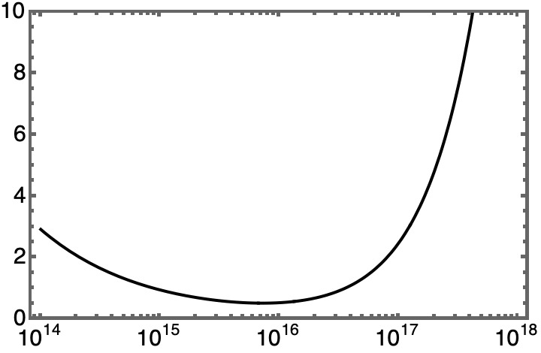
Minimizing linac length (“construction cost”)
Staged LPAs:
<Lc> = 5 m
LINAC length [km] (to 5 TeV)
Lc, interstage coupling distance
Advantage of laser-drivers: compact driver coupling with plasma mirrors
Operational plasma density [cm⁻³]

Slide 7
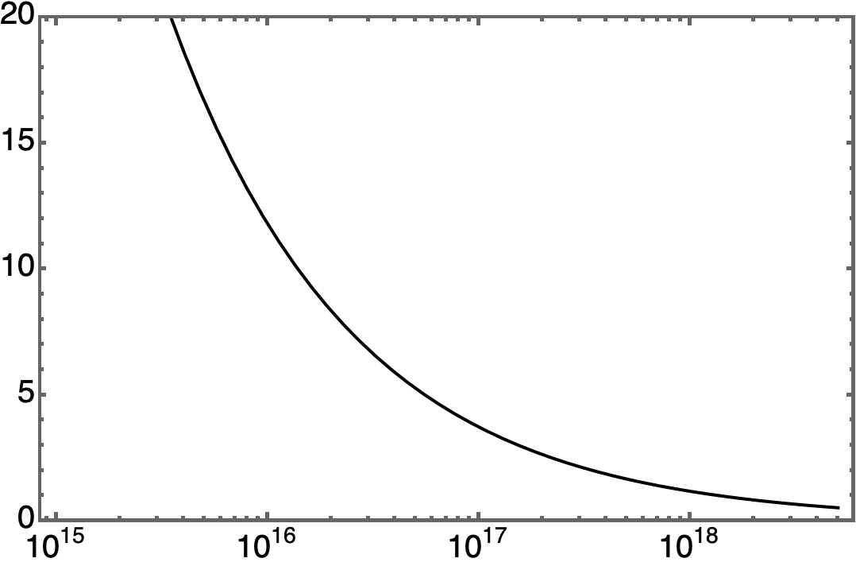
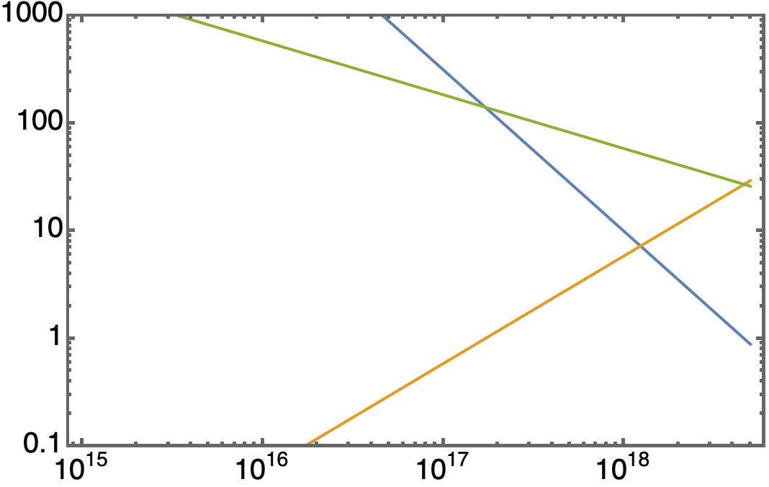
Operating density determines required laser driver
@ 10 TeV CoM
assuming ε² =10⁴ nm²
High density: higher gradient (reduced linac length, reduced construction costs) and low charge/bunch (reduced L/P, increased operation costs)
Low density: Lower gradient (increased linac length, increased construction costs) and high charge/bunch (increased L/P, reduced operation costs)
Beamstrahlung may limit charge/bunch for e+/e- collider
          Operating density range: ~ 10¹⁷ cm⁻³
          Laser technology requirements:
          Laser energy/pulse ~ 1-100 J
          Rep rate ~ 1-10s kHz
          Average laser power ~100kW
Luminosity / Power
[10³⁴cm⁻²s⁻¹ / 100MW]
P_{avg}[kW]
U_{L}[J]
Laser bandwidth:
Laser wavelength λ=1µm
f[kHz]
Operational plasma density [cm⁻³]

Slide 8
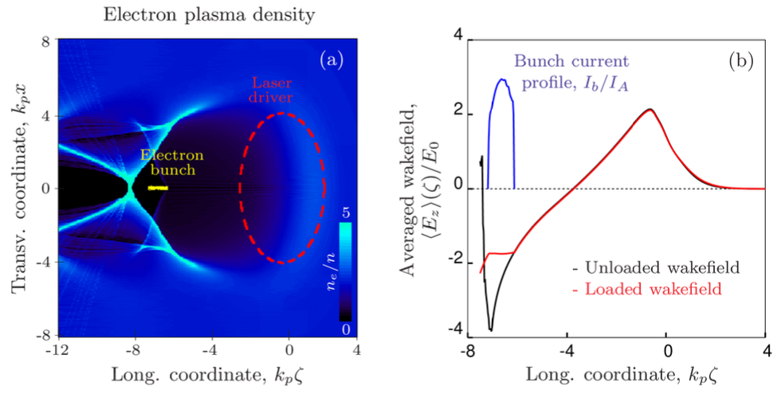
Example LPA stage for laser-plasma-based linac
Schroeder et al. J. Inst. (2022)
Laser: U=50 J, λ₀=1.0 um, a₀=4.5, T₀=80 fs, w₀=36 mm
Plasma: n₀= 3.4x10¹⁷ cm⁻³, stage length = 3.1 cm, linear taper (+74%)
ΔW_{bunch}= 3.1 GeV (~100 GV/m)
Q_{bunch}= 1.2 nC, L_{bunch} =9.3 um,
Energy spread = 0.1%
Wake-to-bunch energy transfer = 43%
Laser driver depletion = 20%
325 stages/TeV

Slide 9
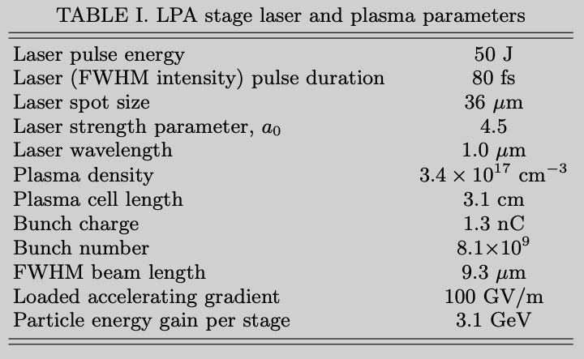
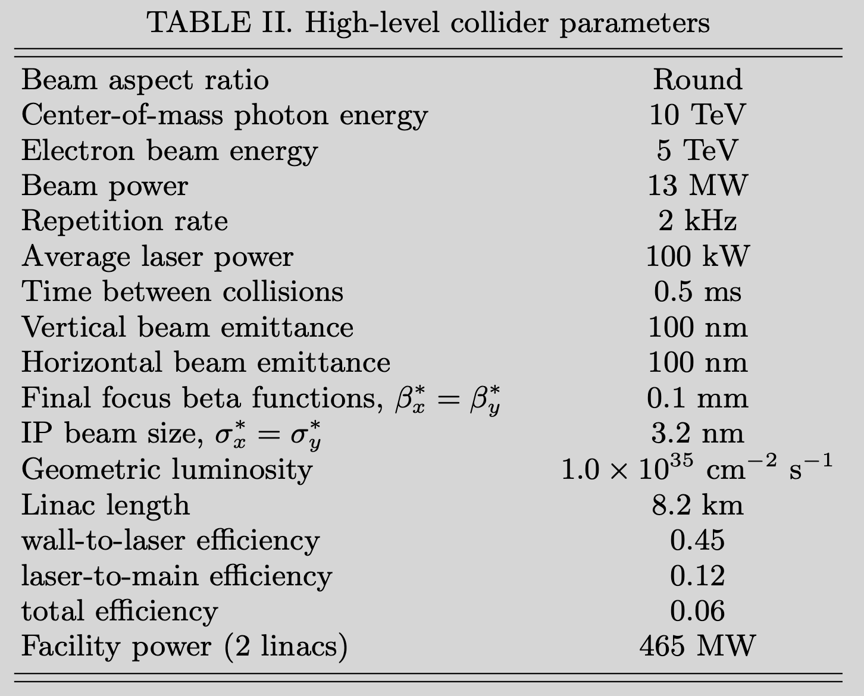
Collider (ee or γγ) example parameters
Notes:
Oide limit for focusability: >2.6 nm
Beamstrahlung parameter Y=2850 (δ=1)
Round beam generation (100nm)
Novel BDS system for round beams

Slide 10
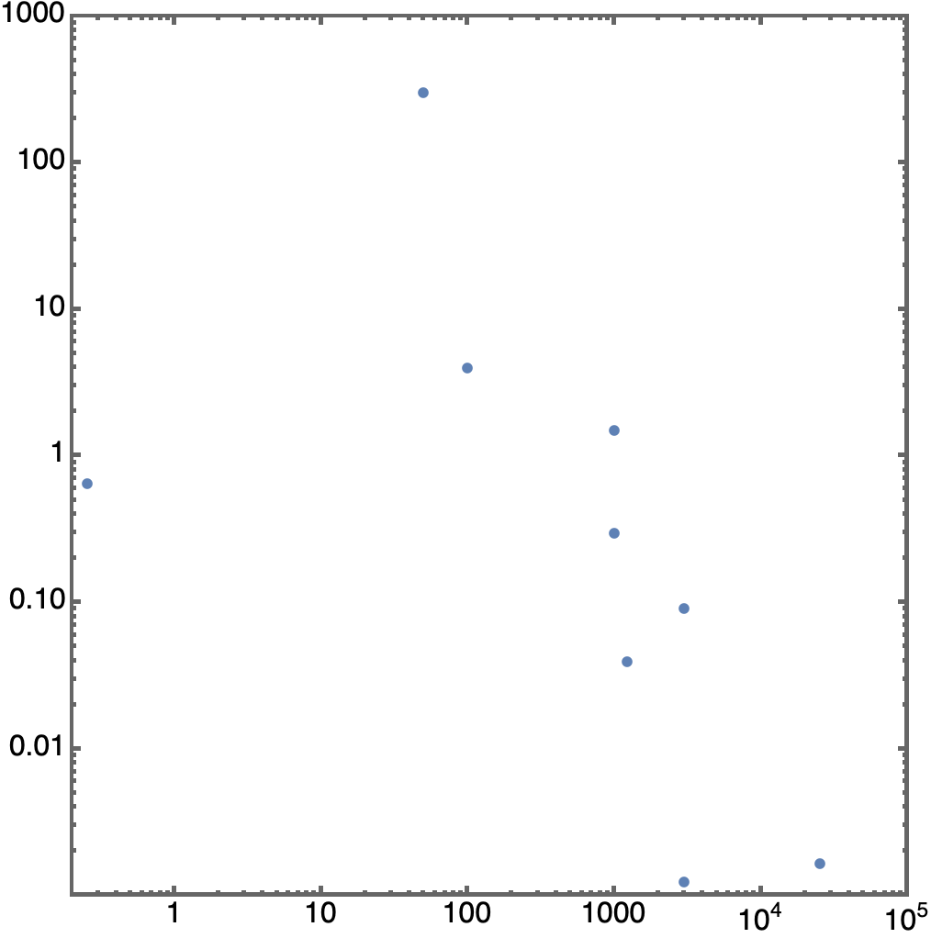
Laser technology R&D required for collider
Present ~10sJ-class Ti:Sa laser systems operate at 1-10Hz (~10-100W average power), with low efficiency (quantum defect fundamentally limits efficiency for Ti:Sa laser systems: 532 nm pumping / 800 nm lasing; ~33% thermal loss)
Collider application will require ~100kW average power with >30% efficiency
  Promising emerging laser architectures
  Tm:YLF (λ=1.9µm), R&D at LLNL
  Coherent combination of fiber lasers (λ=1µm),
  R&D at LBNL, Michigan, Jena
    potential for highest efficiency (~50%)
    1µm (minimize # of accelerator stages)
    monolithic design for robustness, serviceability, etc.
collider requirements
~100kW
~100TW
> 30% effic.
fibers scalable,
efficient
J-class kHz systems
kBELLA (LBNL) – fiber, planned
technically
feasible
(available
near-term)
average laser power [kW]
KALDERA (DESY) – Ti:Sa, planned
coherent combination
MEC-U (SLAC, planned; glass)
~30 mJ
fiber lasers
Ti:Sa perf. ceiling
(quantum defect, cooling)
L3-HAPLS (ELI-BL)
existing
laser
systems
CoReLS (Korea)
BELLA (LBNL)
NSF OPAL (Rochester, planned; OPCPA)
ZEUS (Michigan)
peak laser power [TW]
Laser tech path for collider
Can not address collider needs

Slide 11

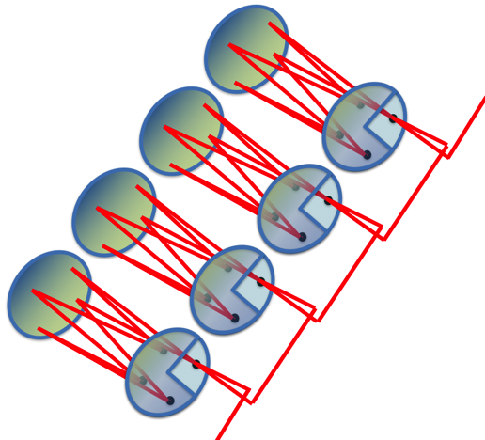
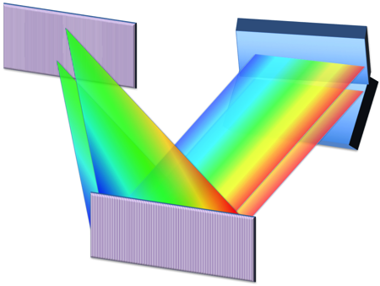
Coherent combing of fiber lasers path to high average power
spectral
splitter
stretchers and
pre-amplifiers
Concept: Use high efficiency, high average power fiber lasers, and add them coherently for high pulse energy
Combine 100’s fibers spatially x 100 pulses temporally for collider energy needs
  Stack 100 pulses in 1 fiber to get >10mJ, sub-kW
  Combine 100’s fibers to get Joules, 100’s kW
  Relies on control of laser phase of each pulse
oscillator
power
amplifiers
λ₁
spatial
combiners
λ₂
λ₃
spectral
combiners
…
Yb-doped fibers:
diode pump at 976 nm , lase at 1030 nm
Large surface/vol. ratio = excellent thermal energy handling
total efficiency wall-to-laser of ~40-50%:
- electrical-to-optical of diode pumped lasers = 60%
- optical-to-optical of fibers = 90%
- combining fibers = 85%
pulse compressor
Achieved to-date:
81 pulses stacked temporally (>10 mJ)
Spatially combined 8, 100fs beams (90% efficiency)
3 channels spectrally combine to 42 fs
Next step: 27 spatial beams, 81 temporal pulses, 3 spectral bands (200mJ, 1kW)
temporal
stackers
Tong Zhou “Coherently-combined fiber lasers for driving plasma accelerators at kHz repetition rates”
Wed Morning
output

Slide 12
Conclusions
Linacs based on staging plasma accelerators: ~1 TeV/km geo. gradient
  Proper beamloading and tapering: low energy spread (0.1%), high efficiency (>40%), high gradient
  Minimal emittance growth (<nm) owing to scattering in plasma (due to strong focusing)
  Synchrotron emission low (dE/E~10⁻³ ) for collider-relevant emittances (<100nm)
  Hosing suppressed via coherent ion motion
  Ion motion results in horizontal-vertical coupling and round beams
Laser-plasma-based collider:
  Positron acceleration is a challenge, requires R&D and demonstrations of new concepts
  Gamma-gamma (or e-e-) colliders are promising option with demonstrated wakefield technology
    Scattering using 0.33um (~10J laser) with 5TeV beam (x~300>>4.82)
  Collider sub-systems (BDS, damping, injector, etc.) require development
High average power laser system R&D required
  coherent combination of fiber lasers promising path to high average, high peak power, and high efficiency short-pulse lasers

