Slide 1
Transverse plasma density redistribution in discharge capillaries for plasma acceleration
Advanced Accelerator Concepts Workshop, Naperville, July 21st - 26th 2024
Advait Kanekar, Judita Beinortaite, Jonas Björklund Svensson, Lewis Boulton, Matthew James Garland, Harry Jones, Gregor Loisch, Mathis Mewes, Trupen Parikh, Felipe Peña, Sarah Schröder, Maxence Thévenet, Stephan Wesch, Matthew Wing, Jonathan Wood and Richard D'Arcy
FLASHFORWARD‣‣

Slide 2
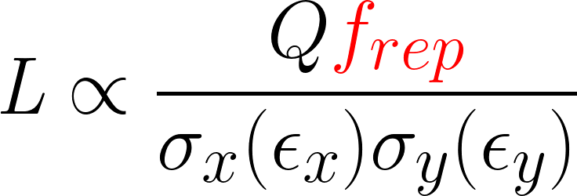
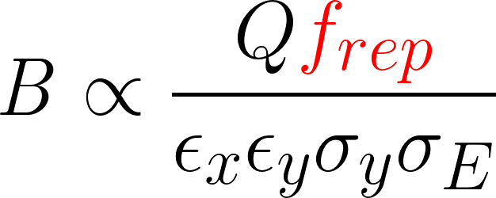
Motivation for high-repetition-rate
Goal: To develop a plasma stage for the applications in future FEL and collider facilities
To be able to accelerate electron beams at high-repetition rates need:
High-repetition-rate bunch trains
Plasma Characteristics that are identical at short-time scales (μs)
Density, ionisation fraction, density ramps, transverse gradients
| Transverse Density Redistribution in Discharge Capillaries | Advait Kanekar | 2x.07.2024 | AAC Naperville 2024

Slide 3
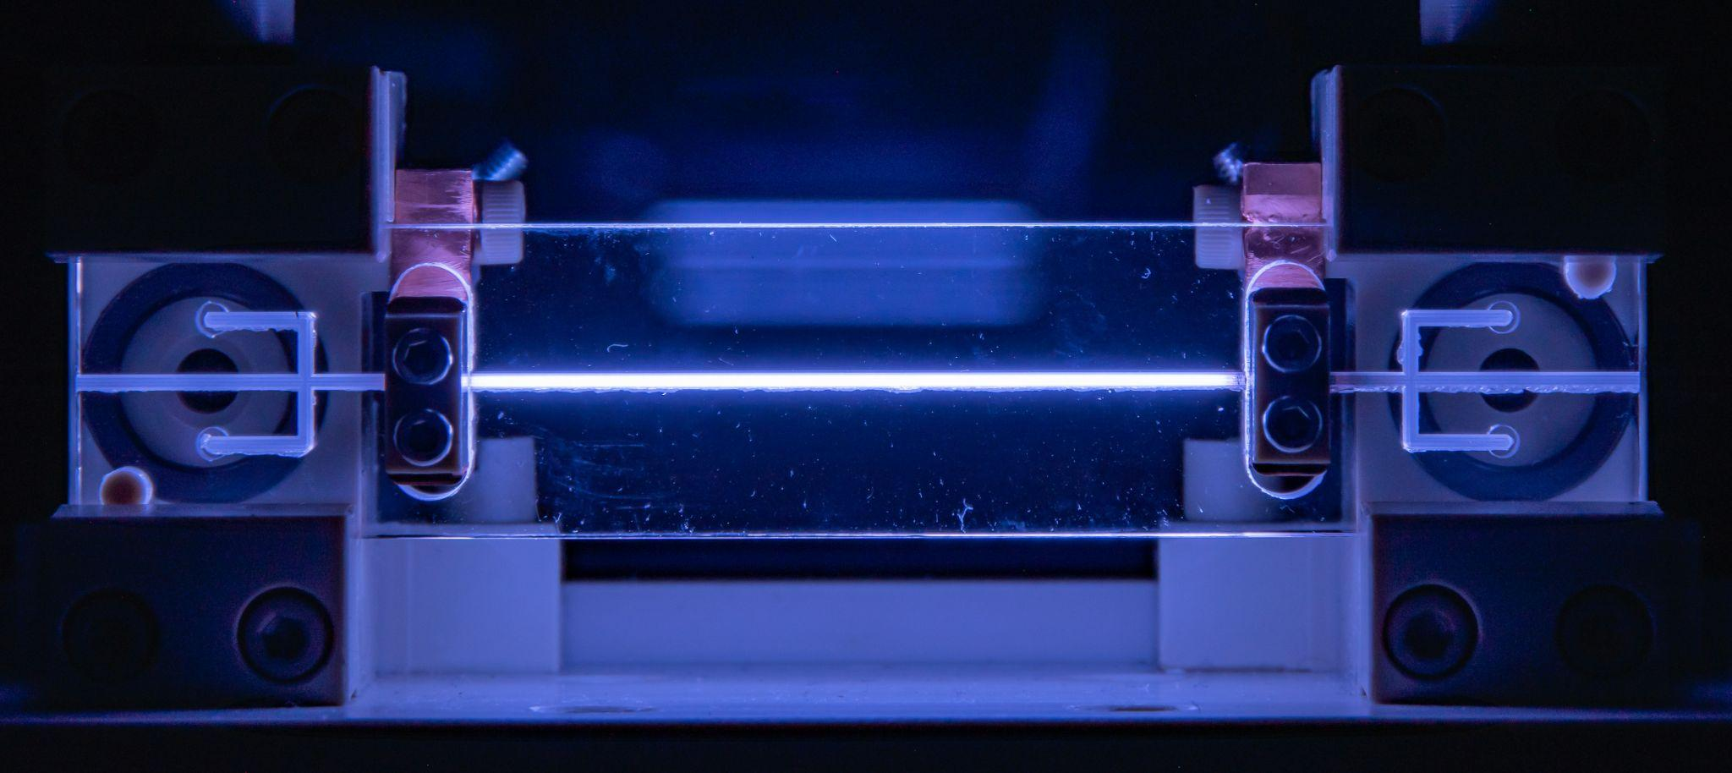
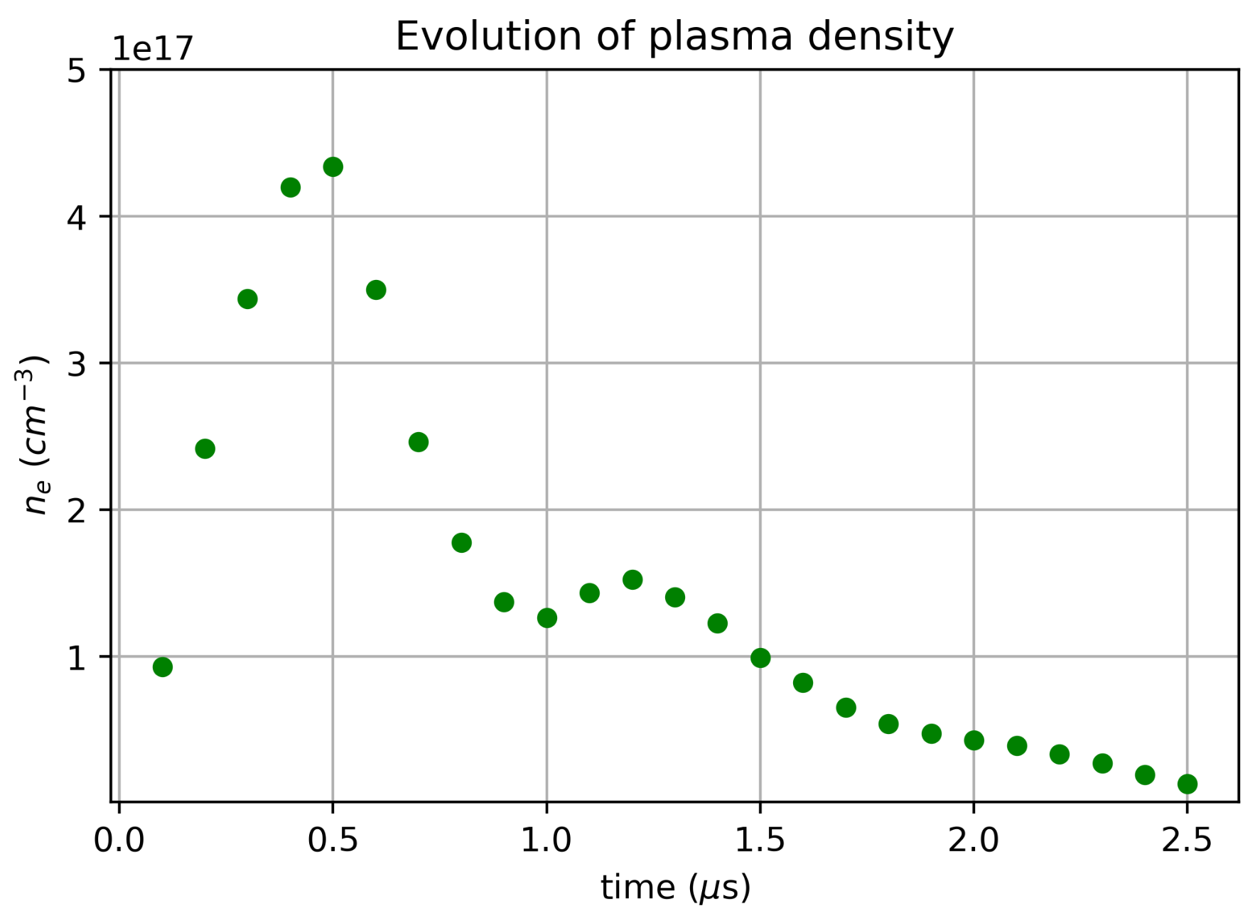
Plasma Sources at FLASHForward
Discharge capillaries made of sapphire
Filled with Argon or Hydrogen
Ionised by high voltage discharge ~ 24 kV
Aim for O (10¹⁶ cm⁻³ )plasma density for optimal working point
Plasma density quickly evolves due to a combination of
Expulsion
Recombination
Occur on the μs timescale
Need to investigate temporal and spatial evolution of plasma to understand these effects
Electrodes
Expulsion
Expulsion
50 mm
Gas inlets
| Transverse Density Redistribution in Discharge Capillaries | Advait Kanekar | 2x.07.2024 | AAC Naperville 2024

Slide 4
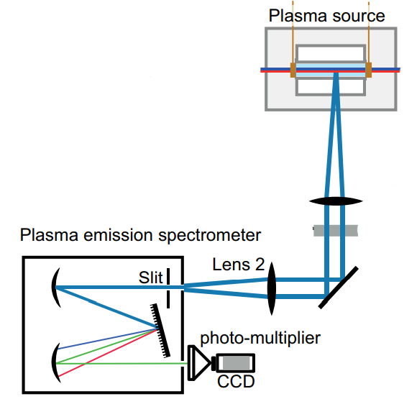
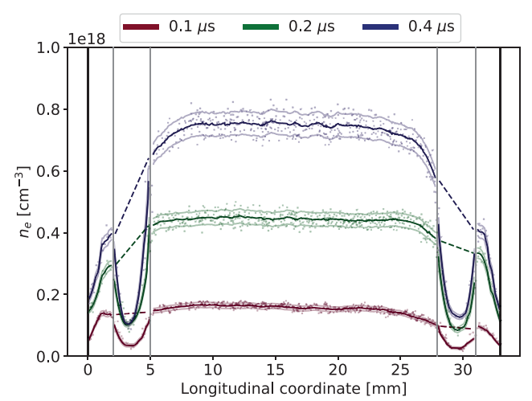
Direct Plasma Density Measurement
Optical Emission Spectroscopy
Determine density by measuring pressure broadening of H-Alpha
Get radially integrated information
The plasma we generate is hot (~3 eV) and mostly evolves radially
To operate at higher repetition rates we need to understand the radial behaviour in greater detail
Need diagnostic methods which give us radial behaviour…
M. J. Garland et al, Review of Scientific Instruments 92, 013505, 2021
| Transverse Density Redistribution in Discharge Capillaries | Advait Kanekar | 2x.07.2024 | AAC Naperville 2024

Slide 5
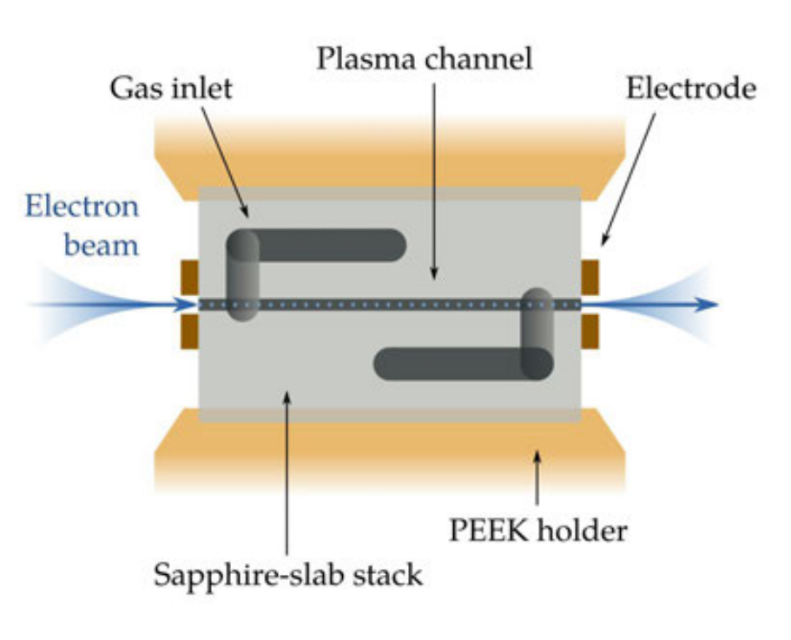
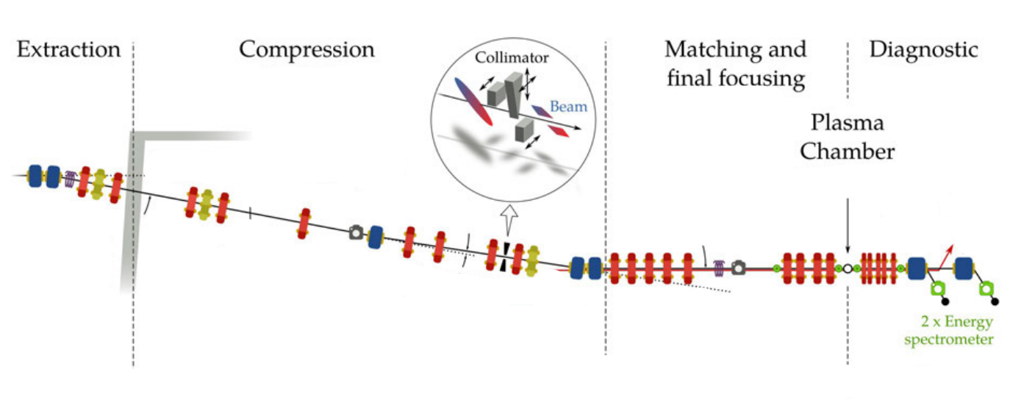
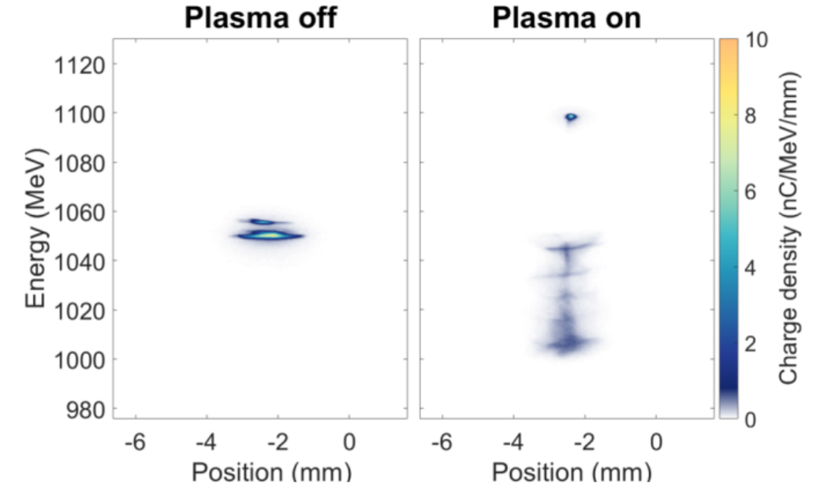
FLASHForward beamline overview
From FLASH Linac:
E ≤ 1.35 GeV
Q = 1 nC
ε = 𝒪(1) mm mrad
$σ_{E} <$ 1 %
Courtesy of P. González Caminal
| Transverse Density Redistribution in Discharge Capillaries | Advait Kanekar | 2x.07.2024 | AAC Naperville 2024
Notes:
blehblebhehblehblehbelhel

Slide 6
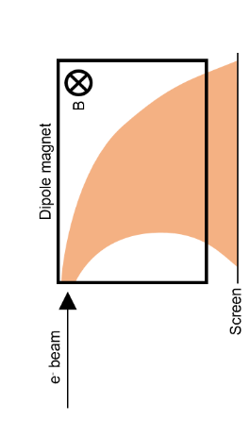
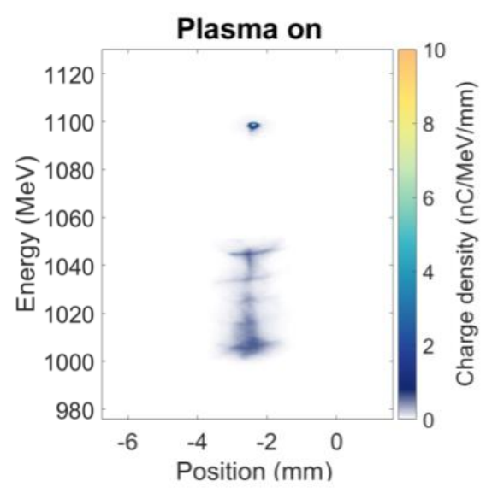
Beam-based measurement technique
Drive e⁻ beam
Plasma source movably vertically
Parameters used:
E = 1.2 GeV
Q = 200 pC
$ε_{x,y}$ = 3.4, 1.3 mm mrad
$I_{peak}$ = 0.8 kA
180 fs duration
Image electrons which have the maximum energy loss
Maximum energy loss of the beam can be related to the plasma density
By moving position of plasma target w.r.t beam can resolve radial profile
By varying the time of beam arrival can resolve plasma temporally
| Transverse Density Redistribution in Discharge Capillaries | Advait Kanekar | 2x.07.2024 | AAC Naperville 2024

Slide 7
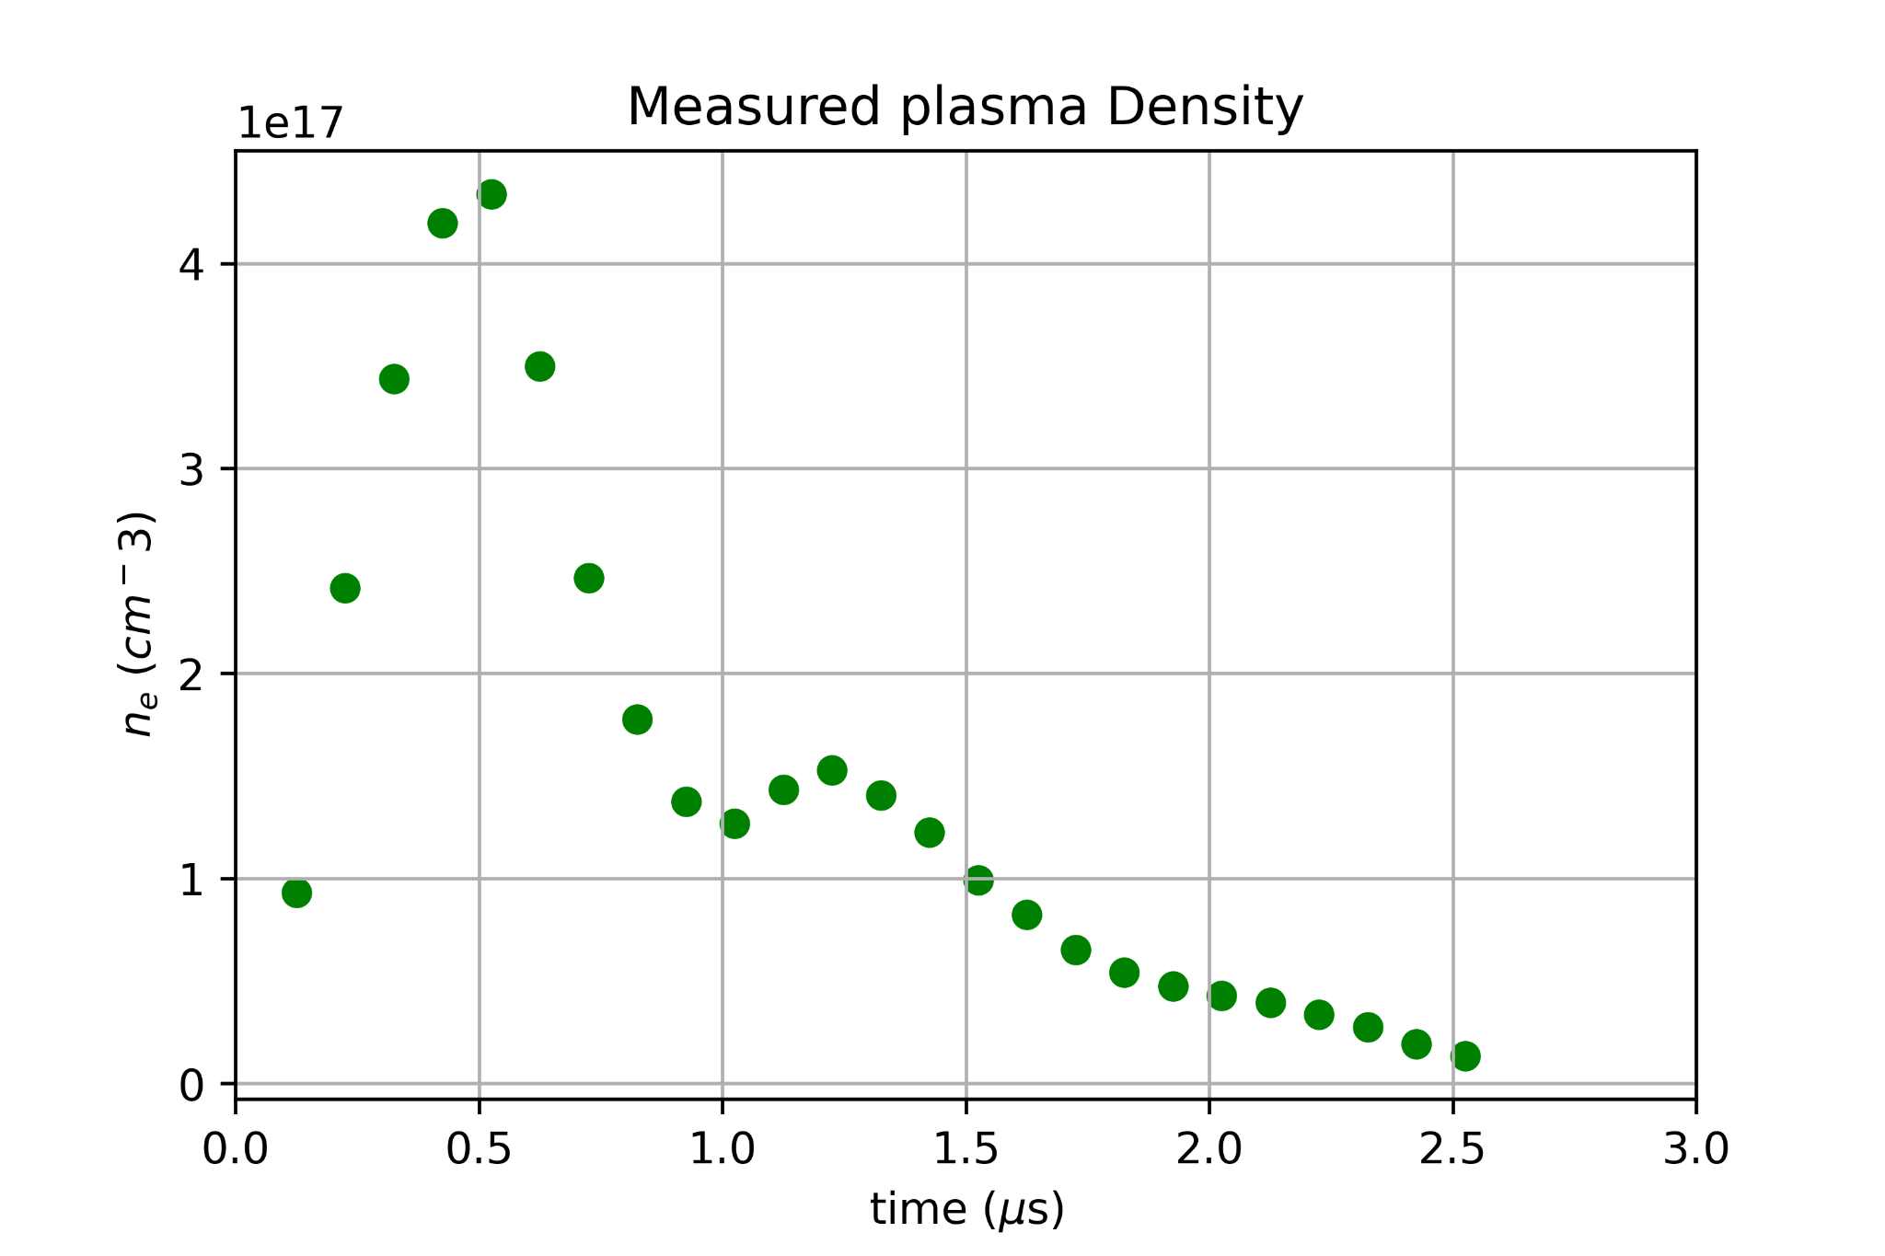
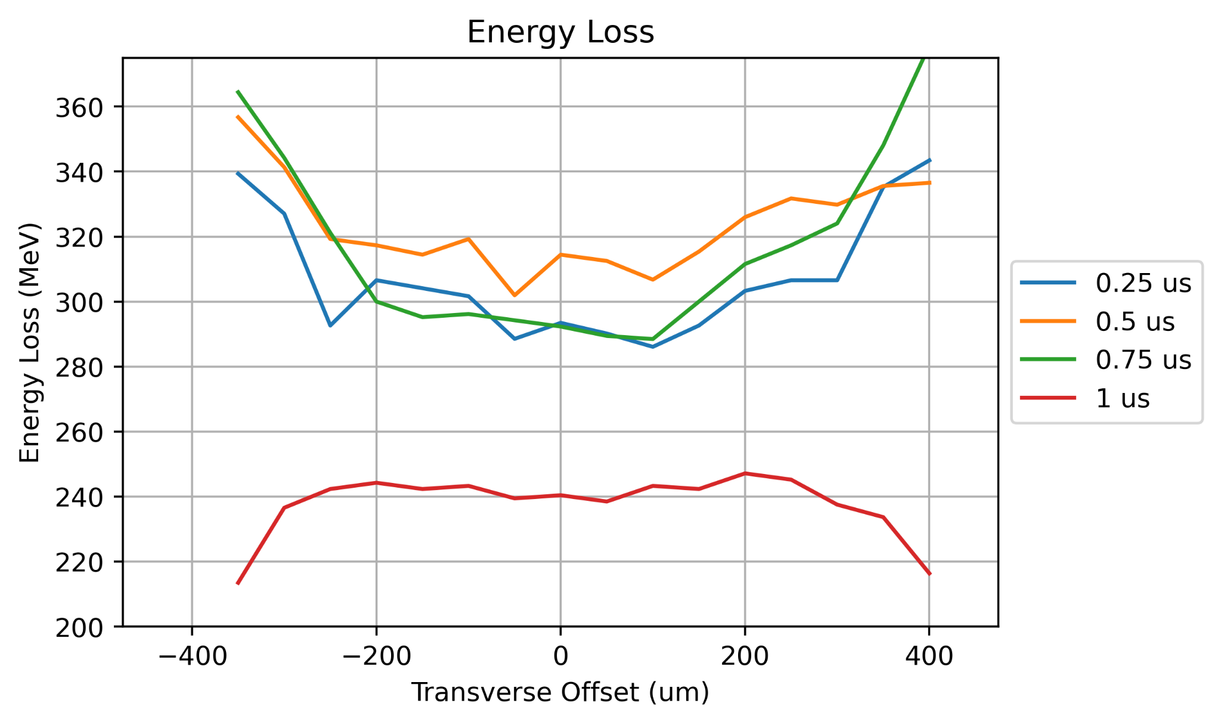
Results
At earlier times we see a plasma density gradient that has lower density at the centre
After 1 μs, the profile flattens out and density is lower towards the edge of the capillary
Why is the density initially lower on axis?
What is causing the redistribution?
| Transverse Density Redistribution in Discharge Capillaries | Advait Kanekar | 2x.07.2024 | AAC Naperville 2024

Slide 8
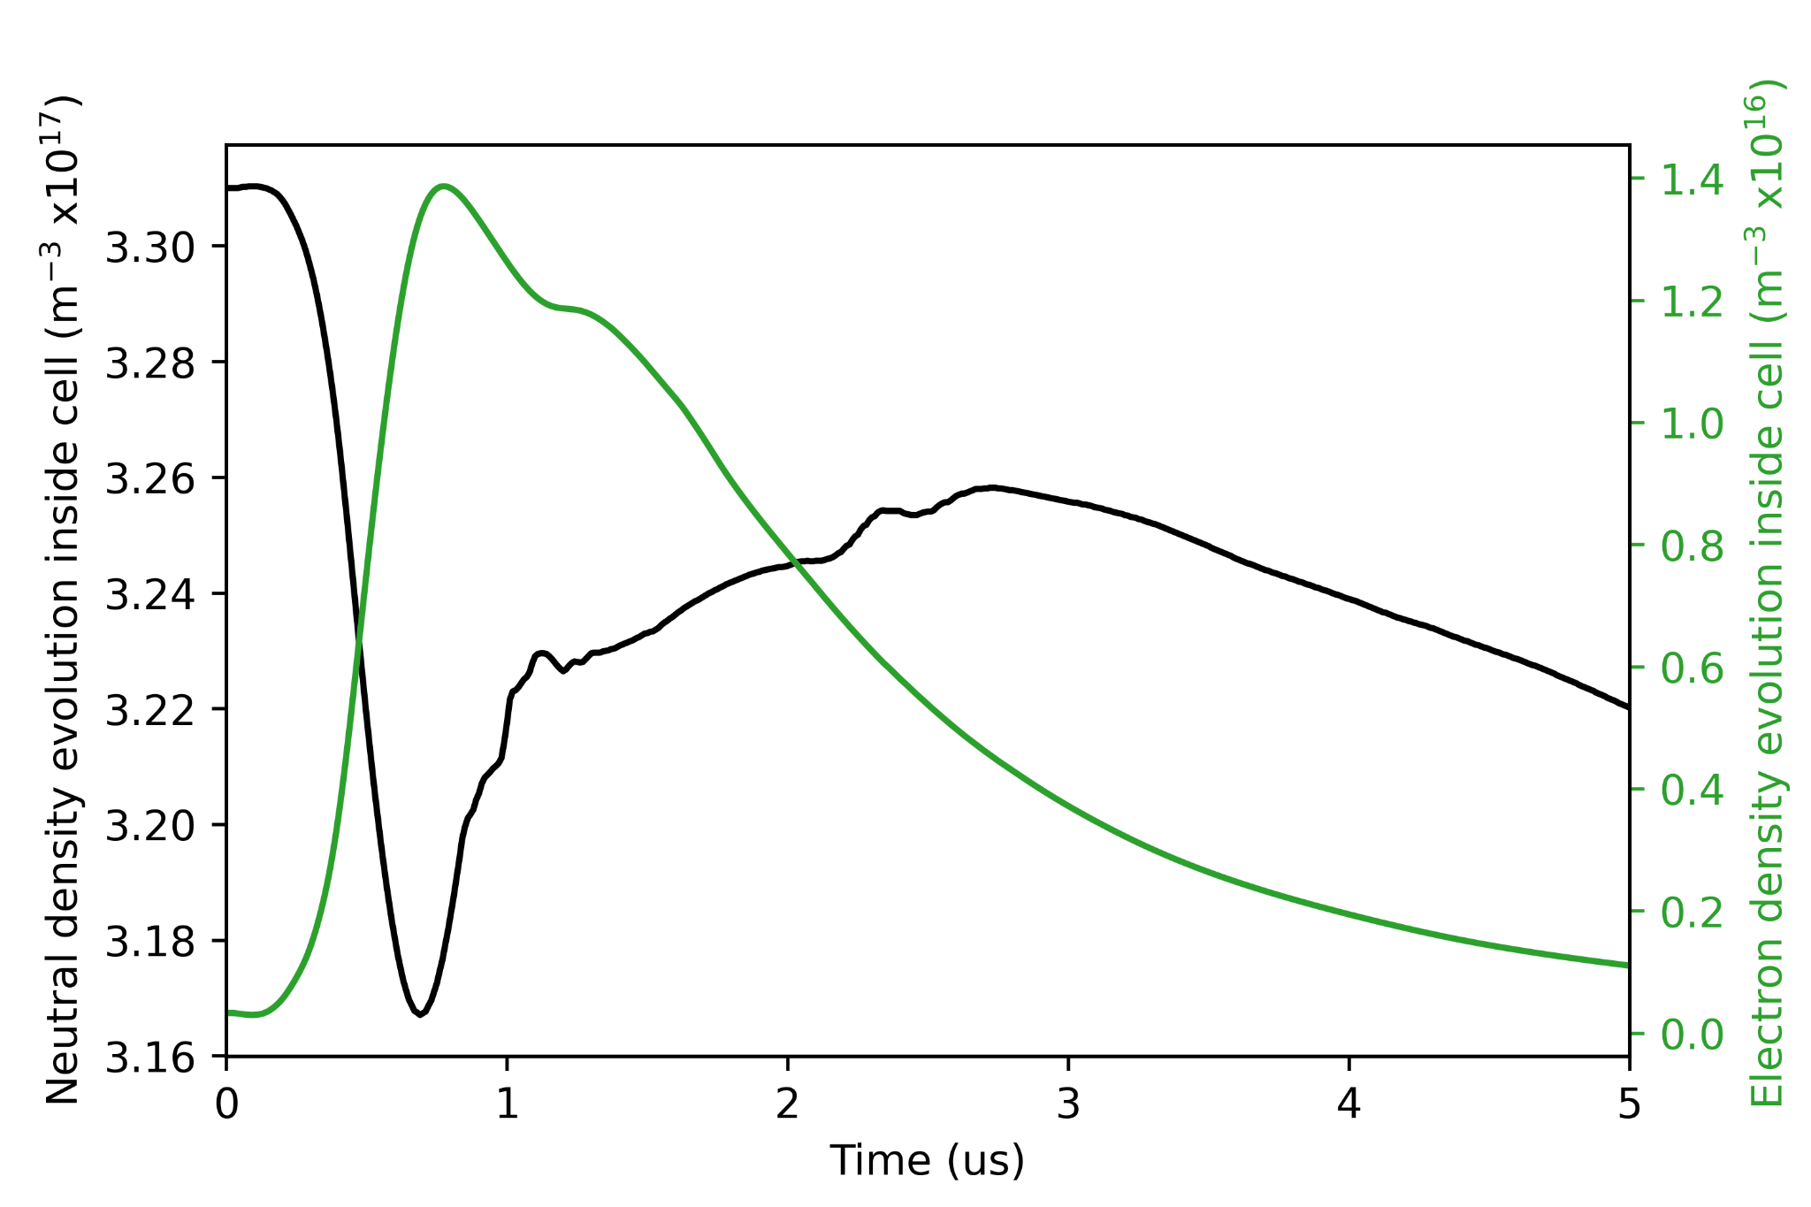
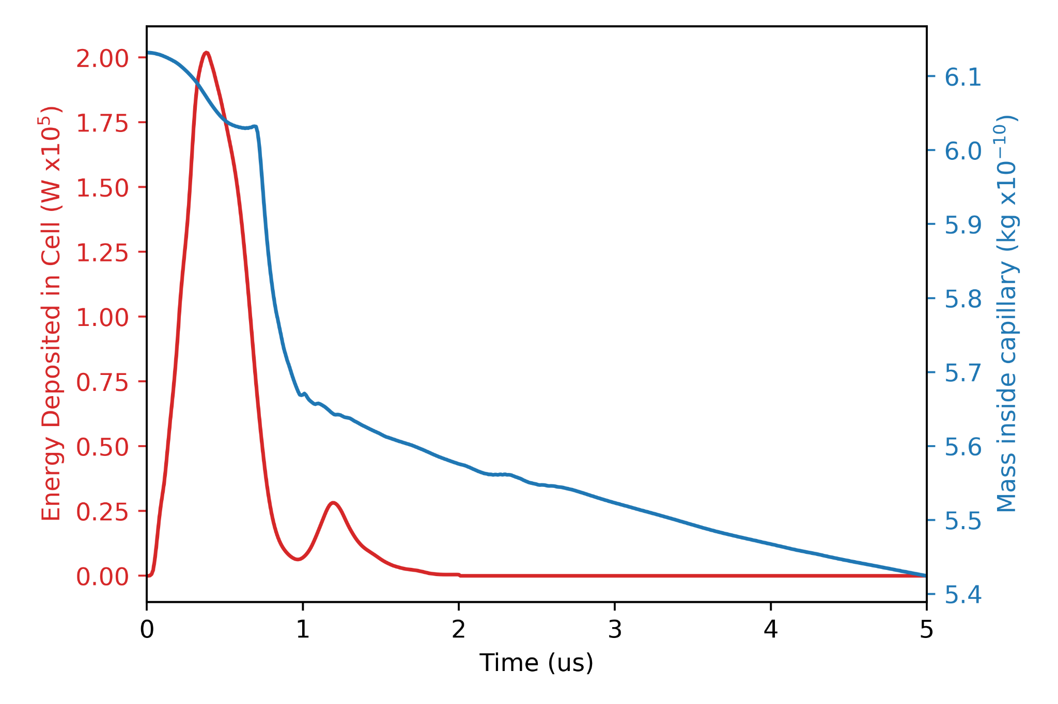
Hydrodynamic Plasma Model
Based on model previous used to model HOFI channel formation (look at reference)
Single Fluid, quasineutral, two temperature, non-local thermal equilibrium (ionisation state is tracked with collisional rates) plasma
2D axisymmetric geometry
Simple inlet
Vacuum chamber to allow expansion of gas
Simulate a single discharge through a capillary filled with Hydrogen gas and allow resulting plasma to expel and recombine
All data is preliminary and publication is pending by Mathis Mewes
S. M. Mewes et al, Phys. Rev. Res., 5.033112, 2023
| Transverse Density Redistribution in Discharge Capillaries | Advait Kanekar | 2x.07.2024 | AAC Naperville 2024

Slide 9
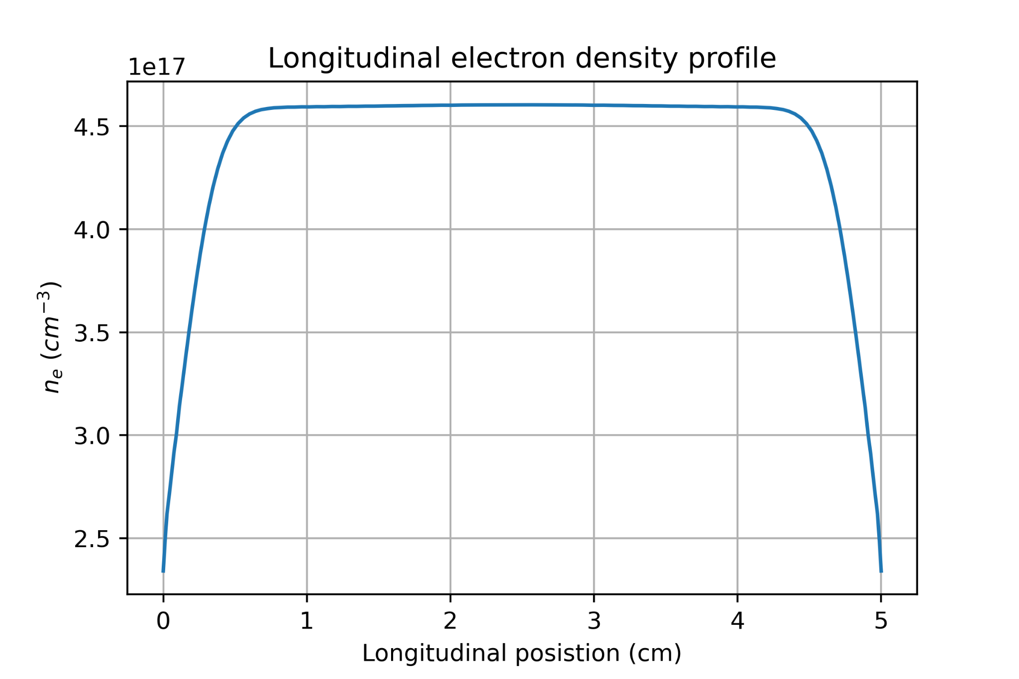
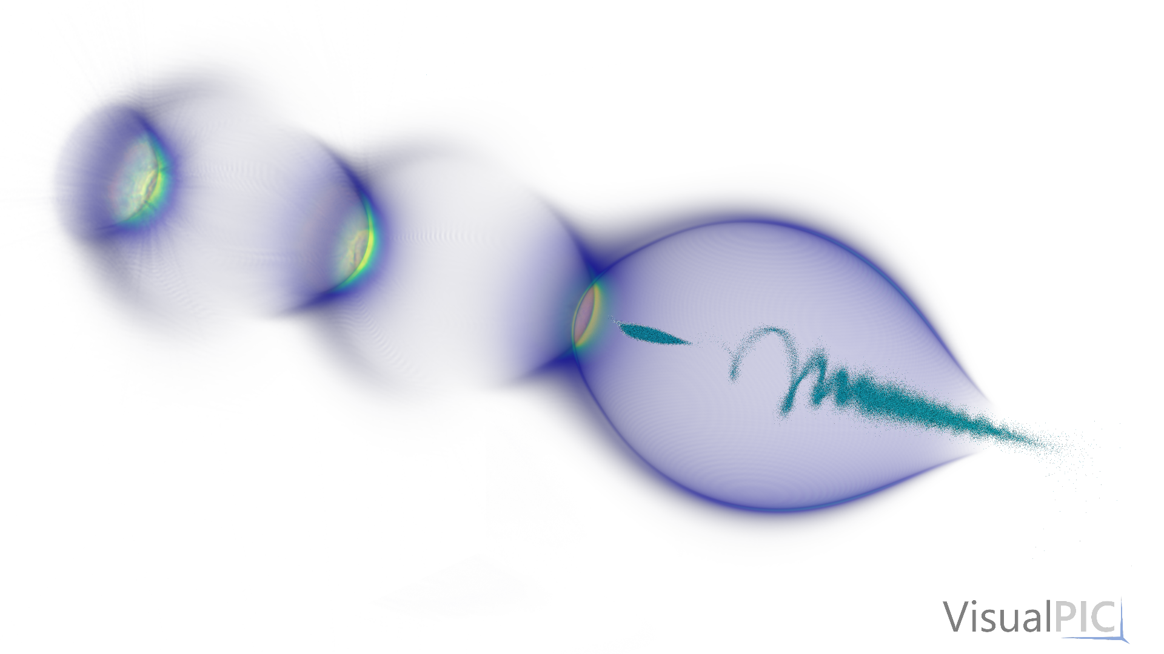
Plasma code + PIC (HiPACE++)
Preliminary
S. Diederichs et al, Comput. Phys. Commun. 278, 108421 (2022)
Generate plasma profiles for different offsets and times using the plasma code. Input these profiles into PIC simulations with the characterised FLASHForward beams from the experiment. Inputs for the simulations need to be good:
Plasma code
Physics model
Starting gas distribution
Input current pulse
HiPACE++
Well characterised and represented input beam
HiPACE++ is openly available (https://github.com/Hi-PACE/hipace)
| Transverse Density Redistribution in Discharge Capillaries | Advait Kanekar | 2x.07.2024 | AAC Naperville 2024

Slide 10
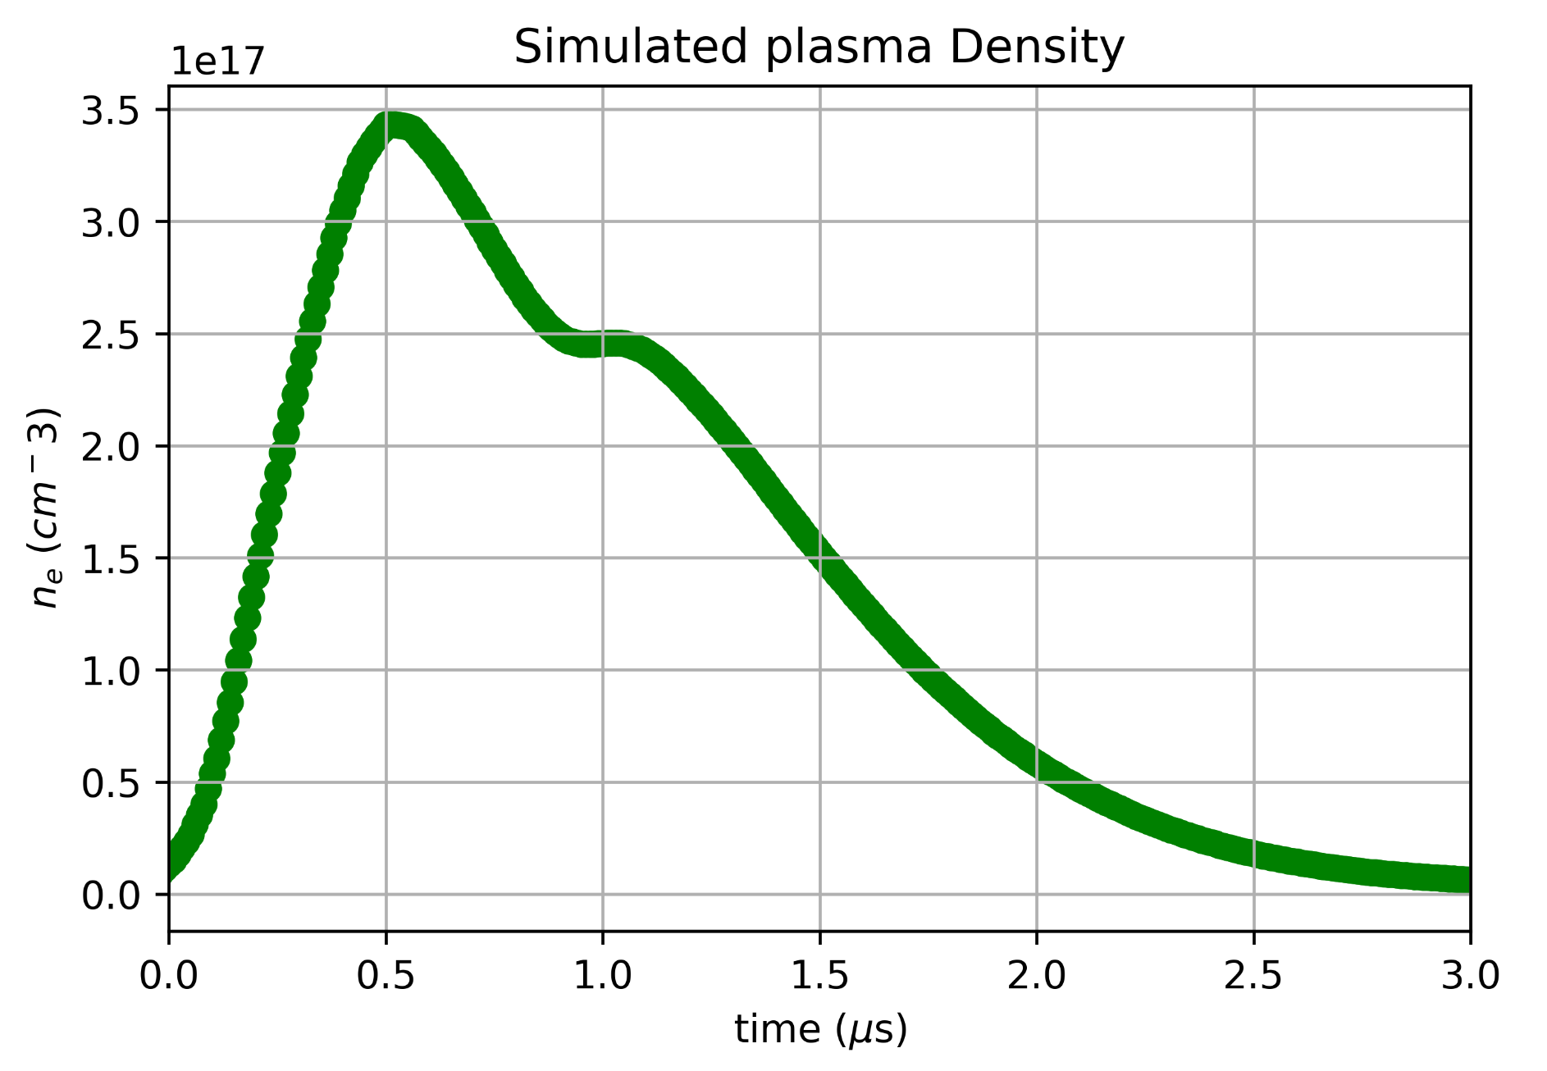
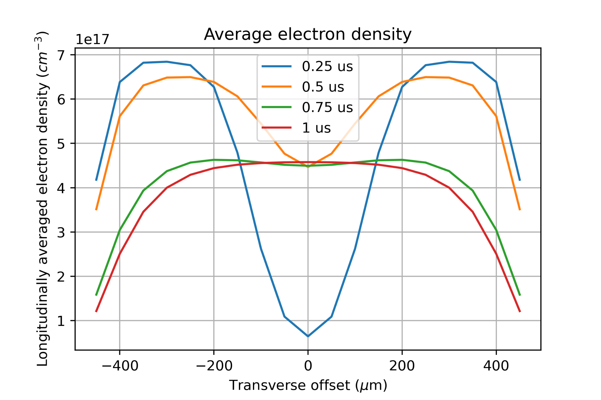
Output from Plasma model
Electron Density in capillary
time
r
Preliminary
Preliminary
z
Predicts a lower density on axis at earlier times
Direction of transverse gradient reverses at later time
Flat top develops at approximately 1 μs
Preliminary
| Transverse Density Redistribution in Discharge Capillaries | Advait Kanekar | 2x.07.2024 | AAC Naperville 2024

Slide 11
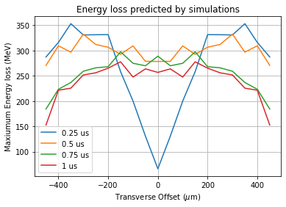
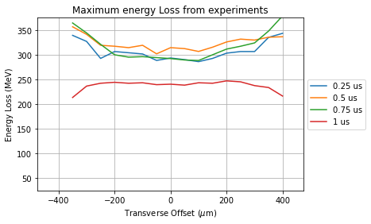
Comparison
Overall see a similar magnitude of energy loss
Both show lower density on axis
In simulations, at 0.75 μs, the gradient has already reversed, do not see this in experiment
On axis energy loss predicted at 0.25 μs is too low
Preliminary
| Transverse Density Redistribution in Discharge Capillaries | Advait Kanekar | 2x.07.2024 | AAC Naperville 2024

Slide 12
Comparison
Overall see a similar magnitude of energy loss
Both show lower density on axis
In simulations, at 0.75 μs, the gradient has already reversed, do not see this in experiment
On axis energy loss predicted at 0.25 μs is too low
Preliminary
| Transverse Density Redistribution in Discharge Capillaries | Advait Kanekar | 2x.07.2024 | AAC Naperville 2024

Slide 13
Comparison
Preliminary
Current pulse does not travel uniformly thought the capillary at the start
Due to unphysical initial condition
In current state still representative of later times
Preliminary
| Transverse Density Redistribution in Discharge Capillaries | Advait Kanekar | 2x.07.2024 | AAC Naperville 2024

Slide 14
Summary and Outlook
It is crucial to understand the temporal and spatial evolution of plasma density at μs time scale
Possible to used a beam-based measurement to probe radial plasma density evolution
Can use hydrodynamic plasma simulations to understand this radial behaviour
By combining MHD with PIC, can re-create experimental results
Need to strive to get better agreement between measurements and simulations
Need better input parameters for Hydrodynamics simulations
Develop a technique to determine electron density from driver energy loss profile
| Transverse Density Redistribution in Discharge Capillaries | Advait Kanekar | 2x.07.2024 | AAC Naperville 2024

Slide 15
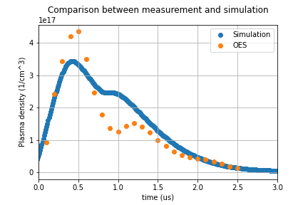
Comparison
Preliminary
Preliminary
| Transverse Density Redistribution in Discharge Capillaries | Advait Kanekar | 2x.07.2024 | AAC Naperville 2024

