Slide 1
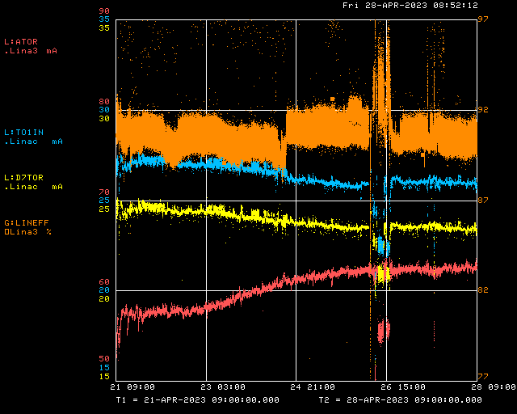
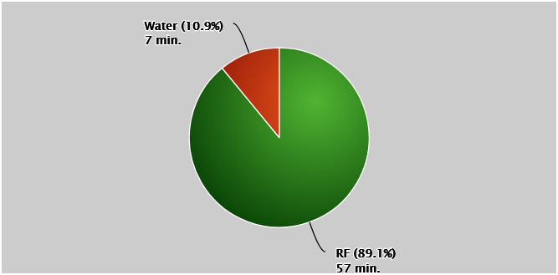
Linac/Preacc Operation (Apr 21 – Apr 28)
RFQ Drift
QPS218
PREACC: (0 min)
LINAC: (5 hr 13 min)
Notable Events:
All Week: KRF2/5 CS Faults, GR3MID Regulation Issues
W: Proton Source Studies Day (400 MeV Buncher Phase Rotation Study, 400 MeV Energy Study), Leaky Fan Coil on KRF3
Th: Replaced phase shifter card at Debuncher LLRF and retuned
Downtime Requests:
~1 hr opportunistic for KRF3 fan coil
Unknown for GR3MID troubleshooting

