Slide 1
AD 0900 Scheduling Meeting
M. Murphy
9 o’clock Meeting
28 April 2023

Slide 2
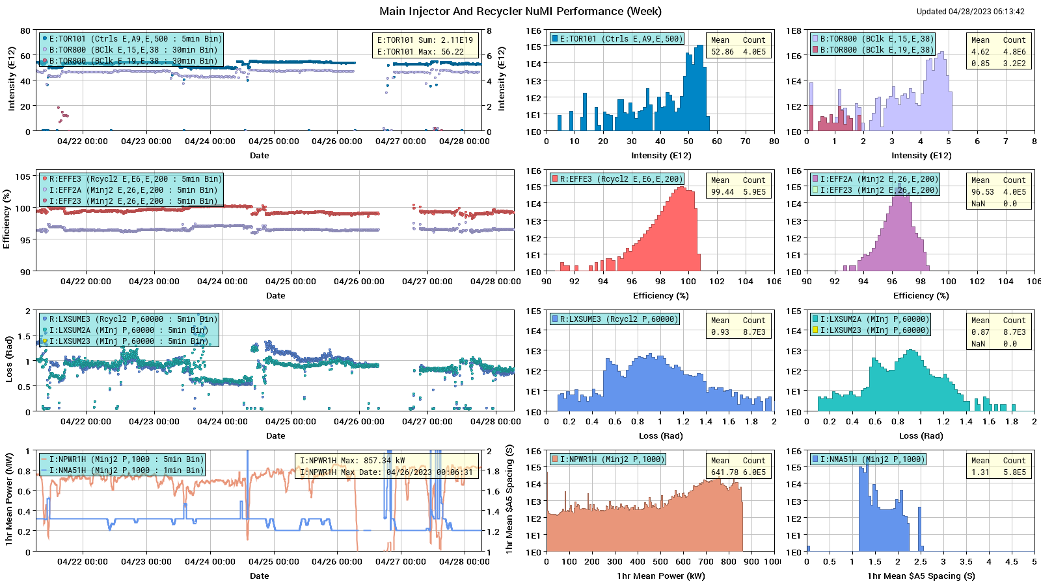
Machine Performance for NuMI

Slide 3
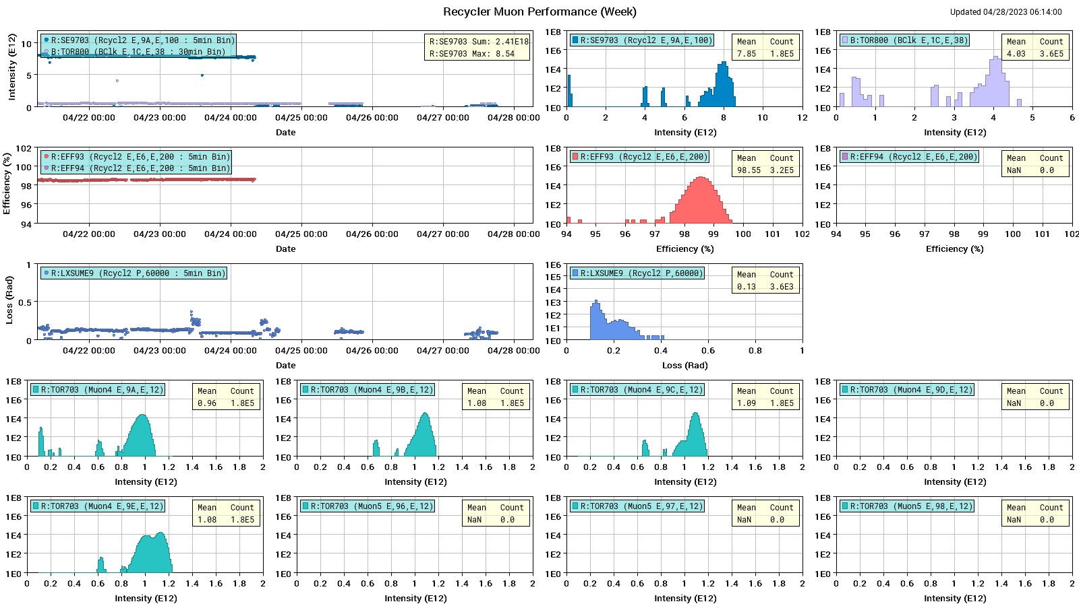
Machine Performance for Muon

Slide 4
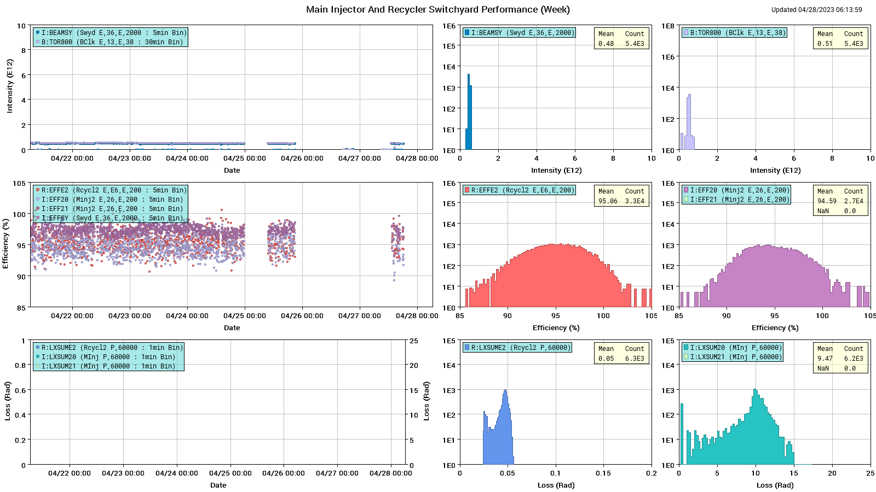
Machine Performance for Switchyard

Slide 5
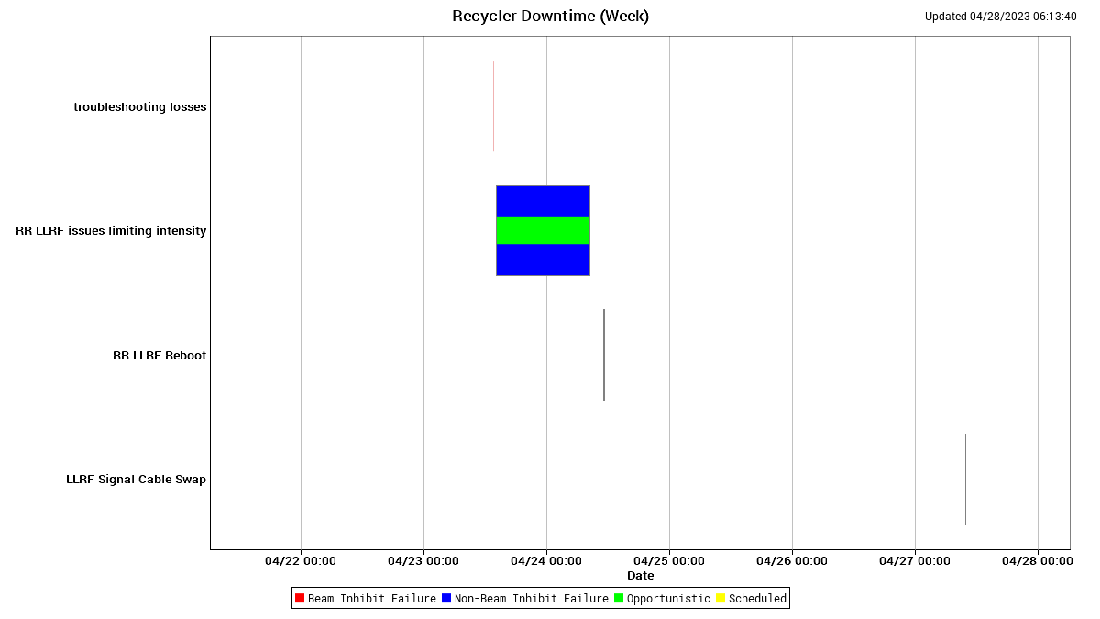
Down Time in Recycler

Slide 6
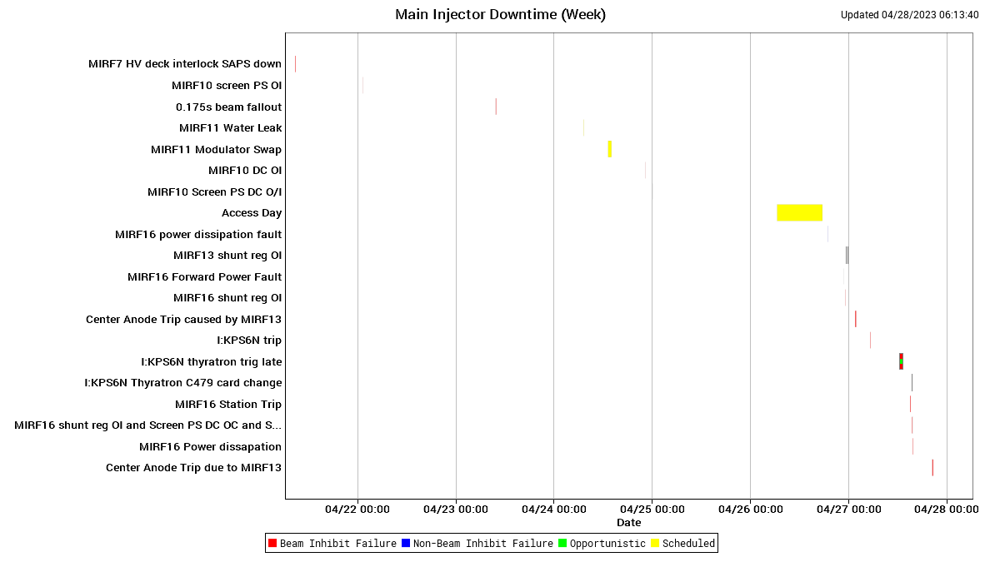
Down Time in Main Injector

Slide 7
Accomplishments for the Week
Recycler:
Protons to Muon Campus as requested.
Trying to identify cause of spurious LLRF problem.
Main Injector:
2.1 E19 protons delivered to NuMI.
Protons to SY users as requested.
Successfully addressed various small jobs in tunnel during Wednesday access period.
RF group replaced PAs on stations MIRF12 & 13 during access.
Continued looking for mechanism of NuMI baffle heating.
MIRF16 tripping on power dissipation fault; this fault is believed to be errant. It also has a problem with its bias tuner power supply. It is currently off but will be further investigated today.
7
MI Department Meeting | M. Murphy
4/28/23

Slide 8
Studies & Issues
Studies
No beam studies this week.
Issues:
Starting on Sunday afternoon there was a RR LLRF intermittent failure. When it happens, the curves do not play out. Several incremental & prudent hardware changes have not resolved it to this point.
Request down time – 1hour? – to replace the RR LLRF CPU card this morning.
8
MI Department Meeting | M. Murphy
4/28/23

