Slide 1
Muon Campus Operation Report
Dean Still
Friday 09:00 Operation Meeting
Week of April 24, 2023

Slide 2
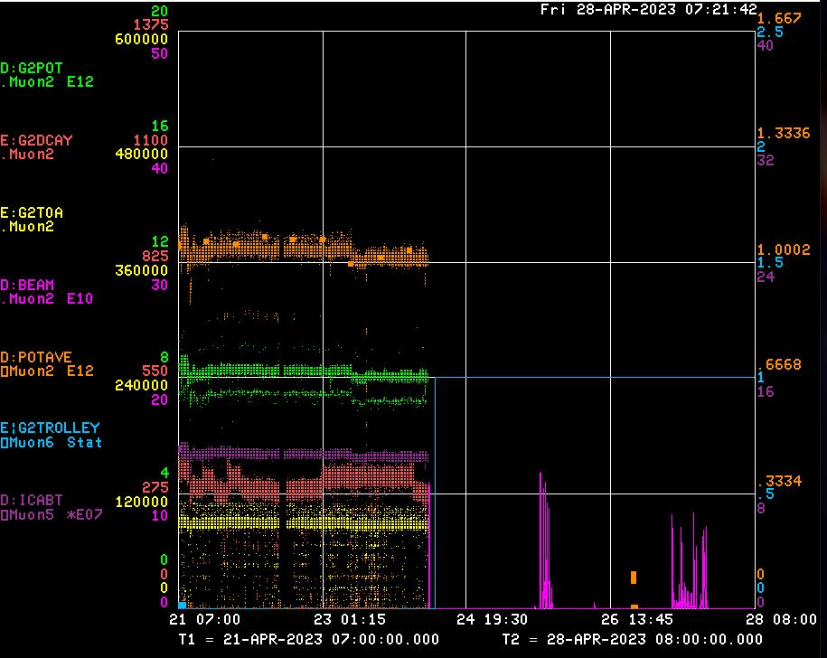
Performance for the Past Week
Protons On Target
Avg Protons on Target
Particles to Entrance of G-2 Ring
Decay Positrons in G-2 Ring
G-2 Trolley Run
8Gev Delivery Ring beam
← D:KPS5A card failure
← M4 Beamline Studies
← RX M4 Beamline Studies
← M4 Beamline Studies
← RX M4 Beamline Studies
← Booster Study Day – MC access
← g-2 repair magnet ->
measurement system
<-------Weekend ------→
<------------Week Days -------------------→

Slide 3
Activities for the Past Week
G-2 Status:
Delivered beam to g-2
Work completed:
Muon Campus abort kicker D:KPS5A card failure.
Replace power supply D:HT905.
Issues with power supply D:SXSIN tripping on ground fault. Calibrated GF set point.
Impacted by RR 2.5Mhz RF cooling system coolant refill.
Target Blower Maintenance
Beam Stop BS707 had failure required investigation.
Delivery Ring BPM system continue working on solving communication issues with new boards.
Removed a number of CAMAC crates in muon campus with no or few cards.
Accessed Wed. Completed work,
Valved in PWC302&PWC204,
Prep work for spill monitor
Looked for water leaks
Installed spill monitor BLM system at M4DA
Installed
Studies: (3 day)
Mu2e M4 beamline studies to calibrate ion chambers and TLM’s .
Mu2e M4 beamline studies to commission the M4 auto tune program with input from multiwires .
Mu2e Resonant Extraction and M4 beamline studies to improve extraction efficiency.
Mu2e Resonant Extraction and M4 beamline studies to get M4 multiwires working.
Mu2e Resonant Extraction to take data with Mu2e Tune Tracker.

Slide 4
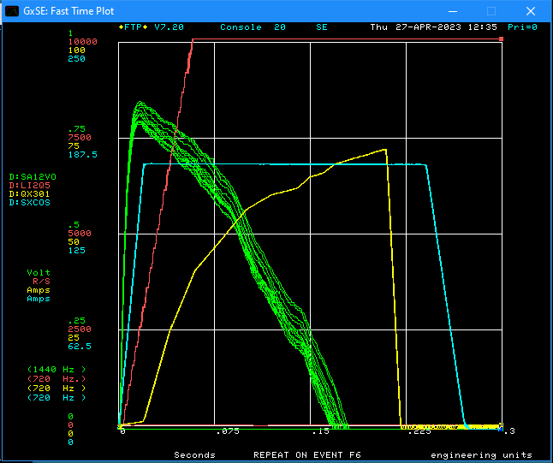
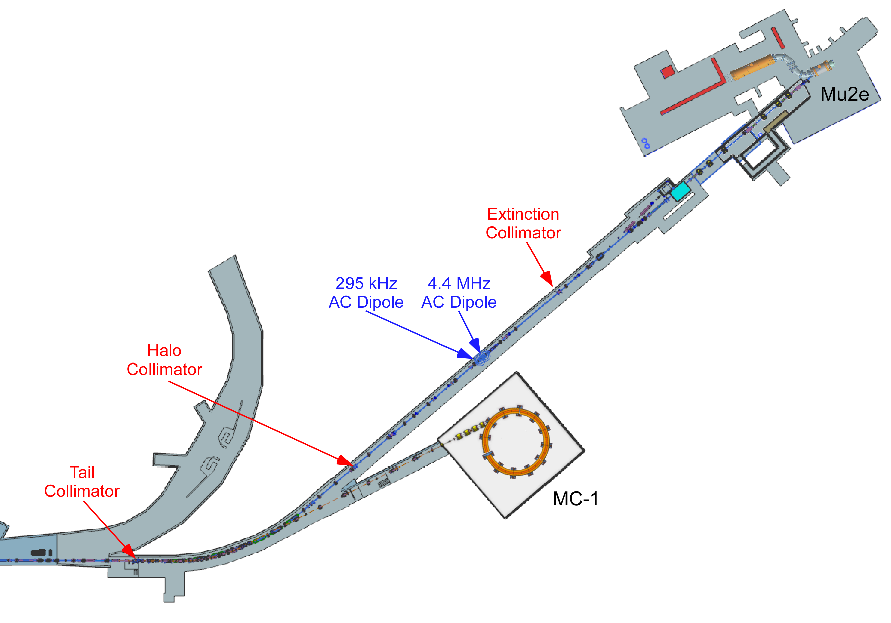
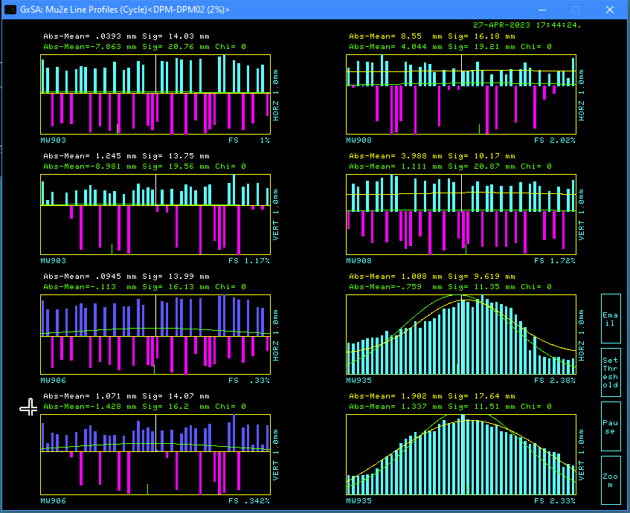
Comments On Resonant Extraction (RX) Studies
Goal RX Studies:
Work on and demonstrate Mu2e Resonant extraction with 1of 2 Electro Static Septa (ESS).
Current Status:
Demonstrated RX extraction to M4 diagnostic Absorber
Improved efficiency of extracted beam from 1% to ~25%
ESS2 design voltage is 85kv. Conditioned ESS2 ~ 55kv.
Design spill length = 45msec - Testing at 300msec.
Commissioning a new BPM system – not functional at this point.
We believe we cannot make any more significant progress without having a functioning DR BPM system. There is just too much too much unknown orbit work to complete.
Attempted to make all the M4 MW’s work. So far we have a handful of PWC’s working. We need focused time with experts present to make this work.
We also tried to use the tune tracker for the 50msec ramp but it gives confusing data. Again, We need focused time with experts present to make this work.
Ring BLM at 2Q5
Extracted beam from DR
SXSIN – sextupole ramp
QX ramp
M4 multiwire (MW)

Slide 5
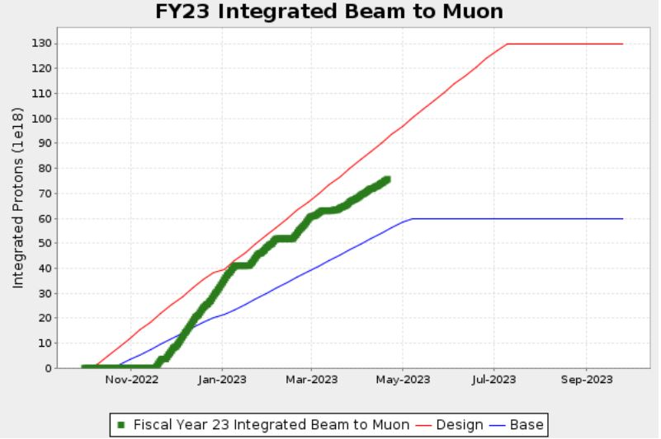
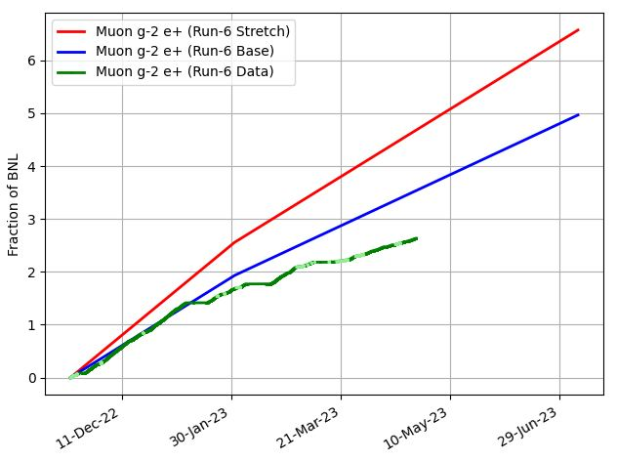
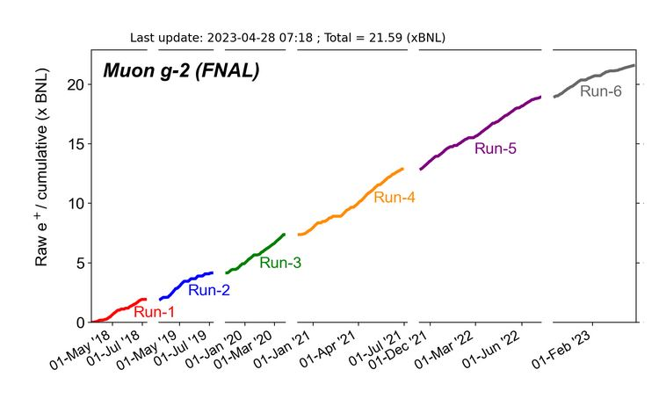
G-2 Performance – Integrated for Run 6
G-2 Experiment POT Run Goal
~4.2E20 POT
Run 6 period is Nov 2022 – June 2023
Run 6: Goal of ~x 6 BNL
Total Run: goal of x 21 BNL
Currently running 6.6 Hz
Run 6 # POT Delivered ~ 7.6E20
Run 6 Integrated ~ x 2.64 BNL
0.08 for the week
Total Integrated ~ x 21.59 BNL
Start of
Summer
Shutdown
2023
Plots as of 4/14/2023

Slide 6
Plan for Next Week
g-2 operation:
Deliver Beam to g-2
Muon Campus Plans :
AP0 AC installation work.
AC work during day shift & delivery beam to g-2 & studies in the Evening & Owls.
To work in AP0 water cage area requires 1.5 hour cool down.
Friday 0730-1400 AP0 AC work – No Beam – Evening Deliver beam to g-2
Saturday – Deliver beam to g-2
Sunday – Deliver beam to g-2
Monday - Possible Down to AP0 AC installation work – Depends on Badging
Tuesday - 0800 -1600 -- Possible Mu2e Study Day
Wednesday - 0800 -1600 -- Possible Mu2e Study Day
Thursday – Possible Down to AP0 AC installation work – Depends on Badging
Friday – Possible Down to AP0 AC installation work – Depends on Badging
Future Planning :
G-2 ,ine
Mu2e M4
line

