Slide 1
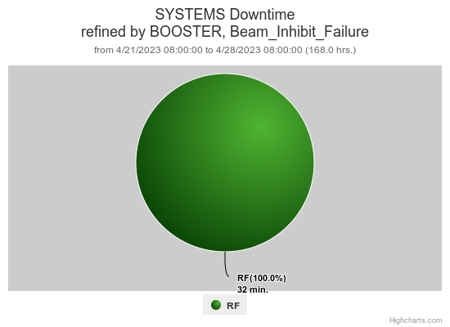
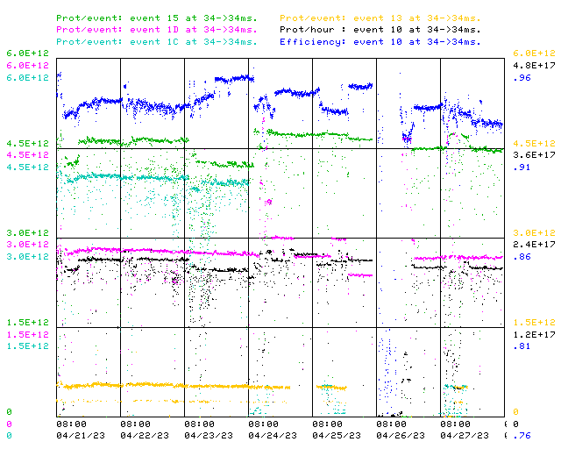
Booster Operations 04/21/23 – 04/28/23
F
F
Sa
Su
M
Tu
W
Th
F
Downtime this week:
~ 32 minutes
A few minor RF trips
Booster Studies
Also:
Very productive Study Day on Wed
Debuncher phase scan
Booster placed in DC mode
Flat Injection Study
High Intensity Tuning & Study Prep
BRF10 modulator was repaired & online.
BRF15 down due to repeated gaps
BBPL06 BPM node timing connection fixed
Debuncher gradient regulation repaired, new operating point. Tuning up.
First $15 in train for NuMI still having occasional extraction OAA issues
20Hz upgrade effort at E4R continues.
Thanks to Ops for diligence & tuning on the off shifts!
Debuncher Repair/Tune
This week:
Beam to NuMI, ~4.5-4.8E12 per pulse
Beam to Muon ~ 4.0E12 per pulse, 13T >1E12 pot
Beam to BNB variable per conditions
Beam to SY as requested
Beam for machine studies as requested
Booster Studies Day

