Slide 1
48 Hour Summary
Spencer Schiefelbein
March 28th, 2022

Slide 2
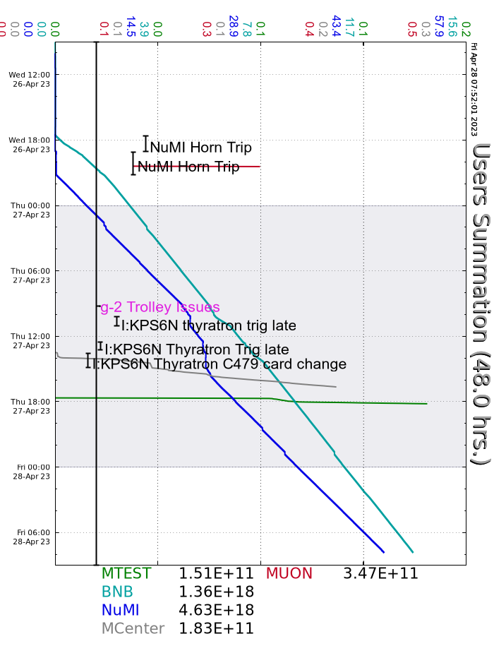
Summary
Wednesday
Linac/Booster Studies day
S:Q100 sprayer leak repaired
BS707 safety switches replaced
Resecured Enc B after inadvertent drop
NuMI horn supply A testing
Swapped back to Supply B
Thursday
Mu2e studies
Debuncher work
F:MT5Q2 repaired
Beam established to Mcenter
RR LLRF troubleshooting throughout day
NuMI Kicker troubleshooting throughout day
MIRF16 troubleshooting
Friday
LRF3 gradient fluctuations worsening
AP0 HVAC work began this morning – no beam to Muon Campus
Current Conditions:
NuMI: 840kW
BNB: 3.82 E16 p/hr

