Slide 1
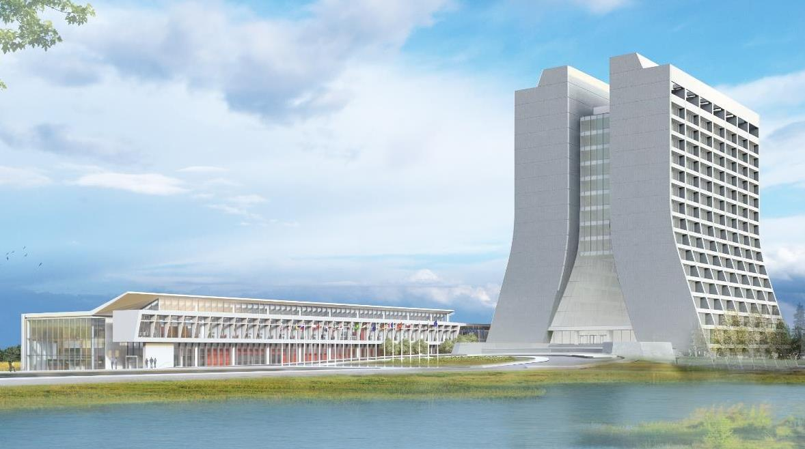
Infrastructure Services Division Updates
Pressing Issues / Special Topic: 5-year facilities maintenance needs plan. Will include but not be limited to roof systems, hvac, lighting, hardscape(asphalt/concrete).
Utility Outages – See the QR code for the most current outage
Road Closures – Road F and then Discovery Rd.
Items of note
PM’s for the month include:
Crane Inspections
Generators and more
Emergency Light EOL Replacement is being planned
Roof Projects Planning (for 5 year plan)
Paving/Stripping Schedule Prep
Contractors Onsite – Contractors are becoming more frequent as weather improves and various projects start.

Slide 2
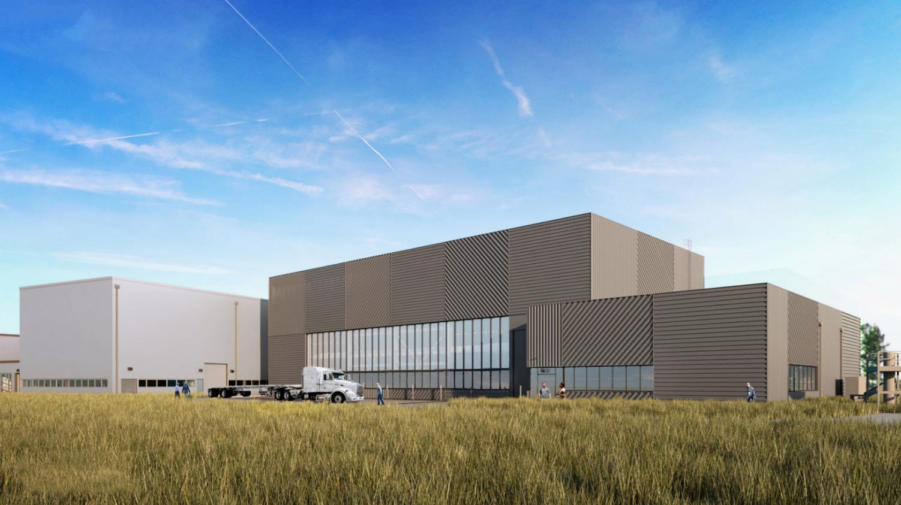
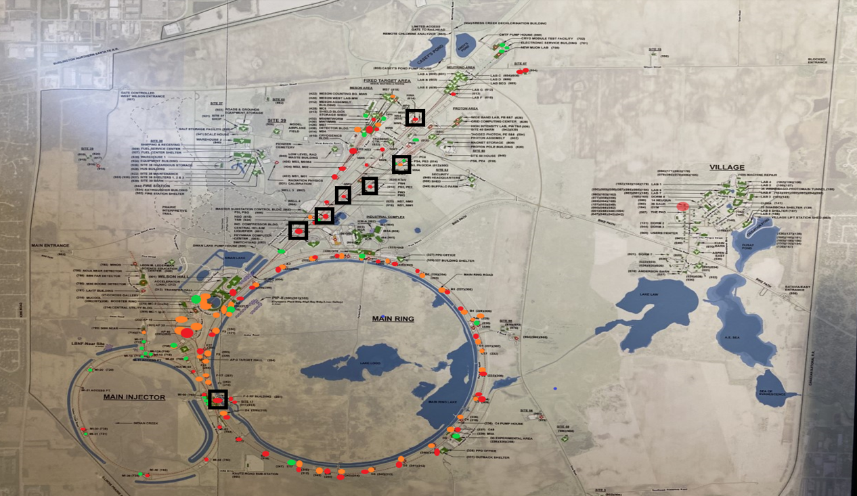
Currently reviewing the EOL Roof situation for AD.
Out of 159 sites there are 56 are at the end of life, or past.
And we are working with 111 work orders for roofing issues.
Our 5 year plan is turned in and will address this situation.
Part of the planning is based on facility importance to mission of the lab.
Special Topic: Roof Work

Slide 3
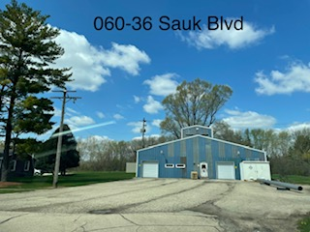
Currently planning a 5 year plan for paving, stripping, rebuilding of substrate for future projects.
Currently under review are
MI-8 (207)
MI-65 (708)
Aspen East (060)
Special Topic: Paving/Stripe Planning

Slide 4
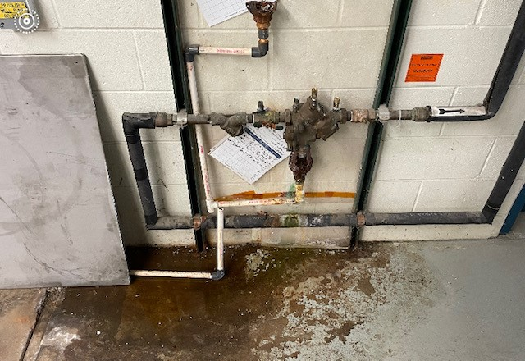
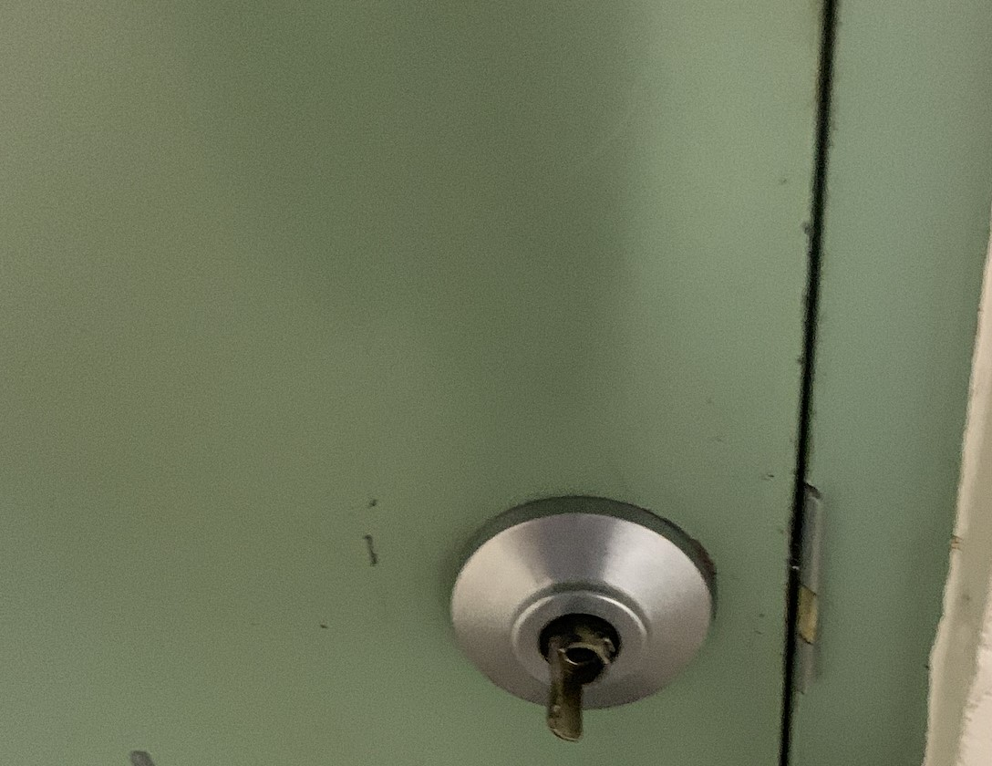
AFM Recent Activities
Back Flow Preventor C-0
AFM’s participated in Procurement training.
Tracking and/or working on projects at varying stages of completion. (office refurbishments, exterior door replacements, EOL lighting replacements)
Responded to reported unplanned maintenance needs.
Fire door handle A-0

Slide 5
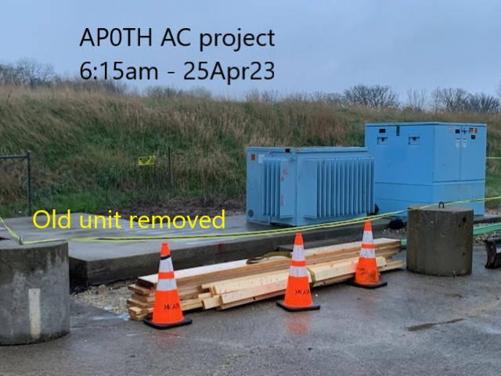

Slide 6
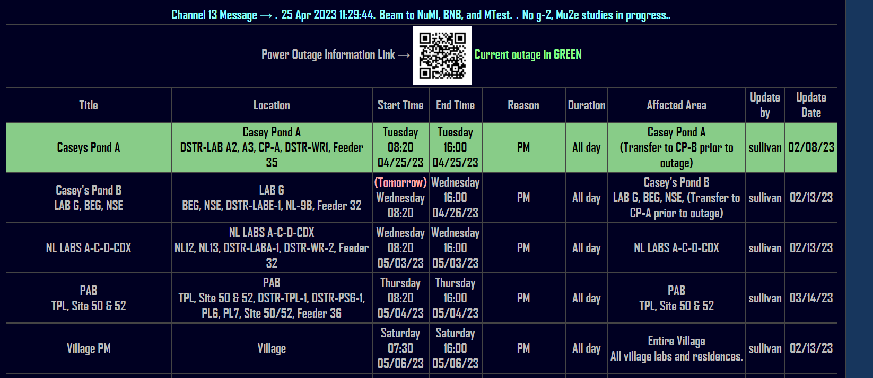
Utility Outages

Slide 7
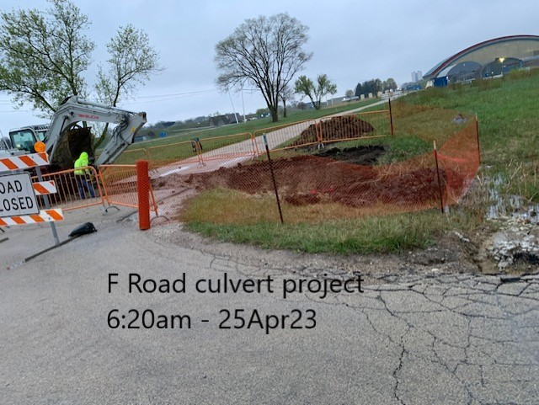
Road Closures
Culvert project has started and closures will be ongoing.

Slide 8
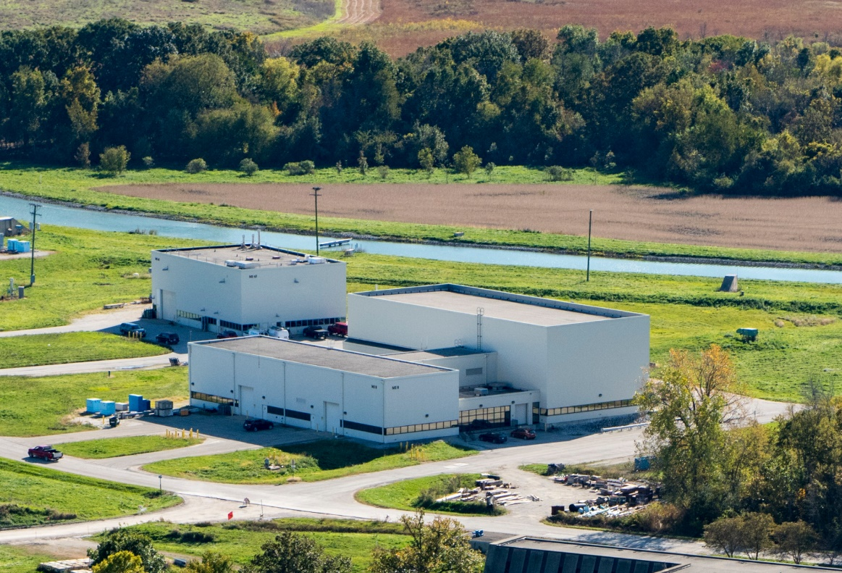
Items of Note

Slide 9
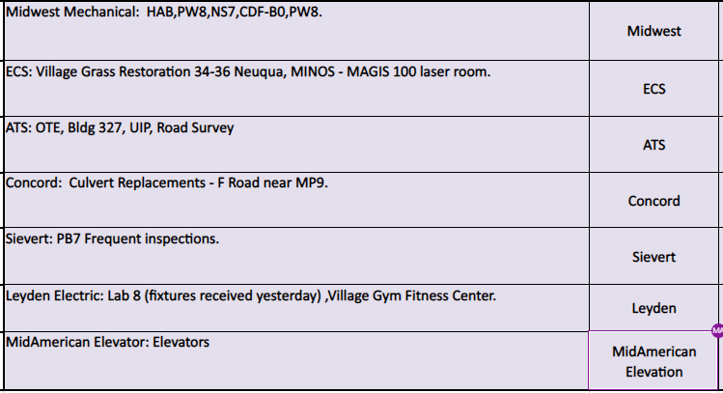
Contractors on Site

Slide 10
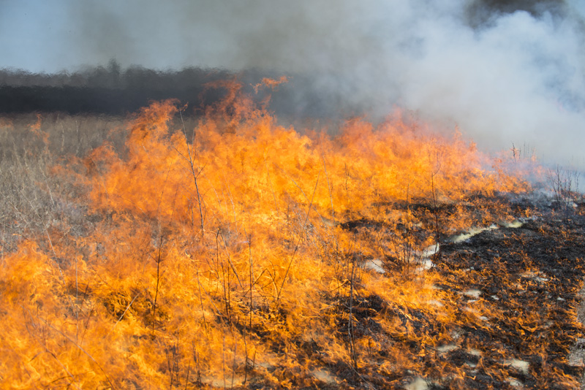
Prairie Burns
None Scheduled

