Slide 1
72 Hour Summary
Patrick Dowdle
MCR Crew Chief
May 1, 2023

Slide 2
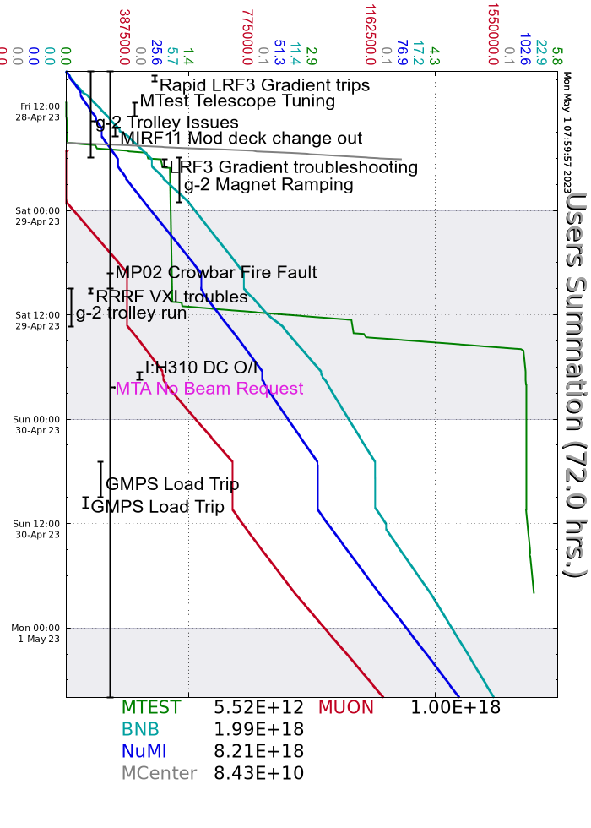
Summary
In general:
Fought RR LLRF and LRF3 gradient issues all weekend
Lots of tuning
Friday:
1 hour downtime to swap RR LLRF components
Established beam to Muon (Mu2e studies first then g-2) after AP0 HVAC work
Saturday:
B:MP02 PS fault on #2, EE support switched from supplies 2&4 to 1&3
I:H310 DC O/I, regulator was replaced
Sunday:
GMPS trip on water temp/cap pressure high, prepared for access and Booster Group and Rad Safety went in and put a jumper on the pressure switch
MS2LVL low, MSD filled the system
Today:
Muon 95 faulty temp sensor, mixing valve needs to be adjusted manually
MI-20 LCW pump #1 tripped, running fine on 2&3
Currently:
730 kW to NuMI
3.19E16/hr to BNB
1.02E12 POT to Muon
Beam to MTest

