Slide 1
SQMS Center – Recent Achievements & Looking Ahead
Akshay Murthy
Deputy Head, Qubits and Materials Department, SQMS Division
Fermilab Users Meeting 2023
June 30th, 2023
FERMILAB-SLIDES-23-157-SQMS-TD

Slide 2
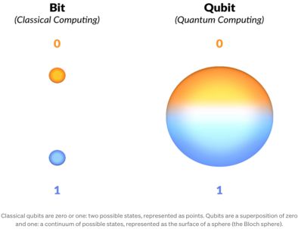
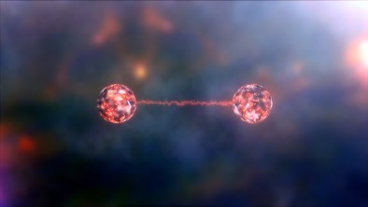
Quantum Information Science
Growing field of science and technology, combining physics, mathematics, computer science, and engineering
Goal: understand and apply fundamental laws of quantum physics – superposition, entanglement – to acquire, transmit, and process information
QIS opportunities are attracting interest of scientists and technologists and promoting unprecedented interactions across traditional disciplinary boundaries
2

Slide 3
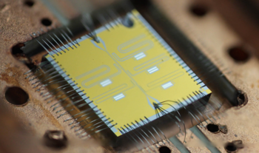
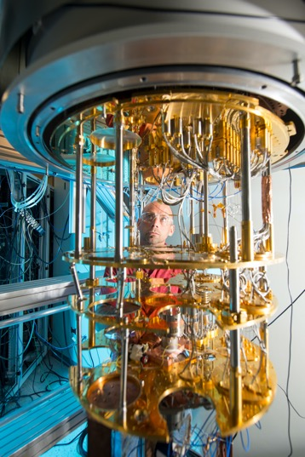
Challenges of building quantum computers
Requires qubit that can be manipulated without being confused with other possible states of the system
Maintain the quantum coherence of superposition long enough to perform gate operations
3
Notes:
Right now, quantum computers are years away
Trade-offs between techologies

Slide 4
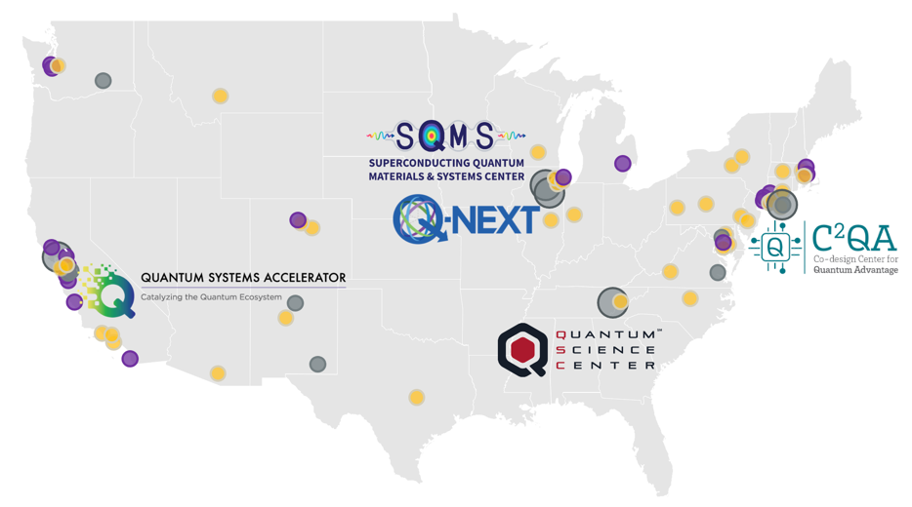

Partnerships across academia, industry & national labs
The DOE centers bring together multidisciplinary collaborations of 1,200 experts, including 600 students and postdocs, across 80 academic, industry and national science institutions in 21 states and DC.
Through institutional partnerships,
the centers unite unique capabilities, expertise and facilities.
Answering fundamental open questions in QIS
Leveraging DOE user facilities for advanced materials analysis and device fabrication
Training a new and diverse quantum workforce
Technology transfer – rapid cycle from discovery to commercialization
Accelerating scaling up and production
Developing national standards
Lead DOE national laboratory
National laboratory or science institution
Technology company
University
4

Slide 5

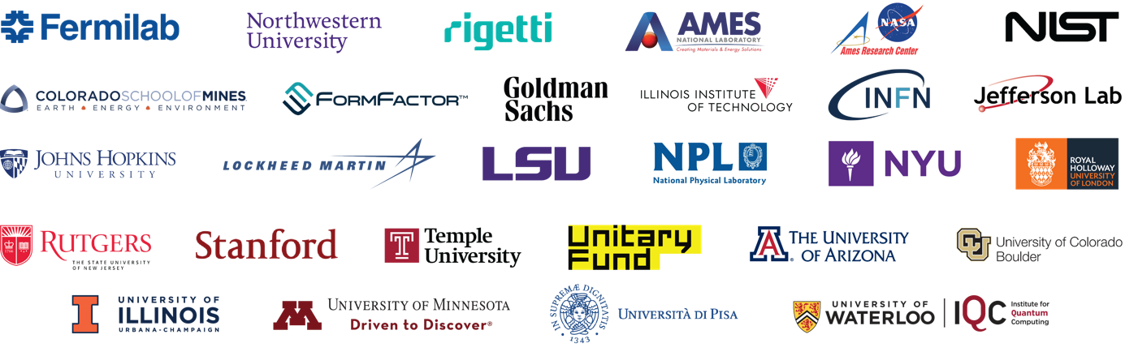
28 Partner Institutions
>450 Collaborators
A DOE National Quantum Information Science Research Center, led by Fermilab
A mission driven, multi-institutional and multidisciplinary collaboration leveraging investments at DOE national labs, academia, industry and several other federal and international entities

Slide 6

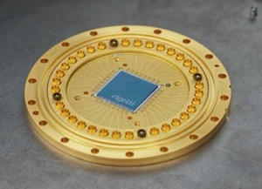
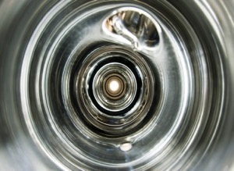
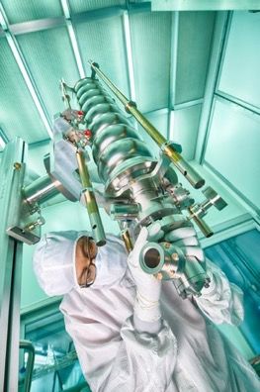




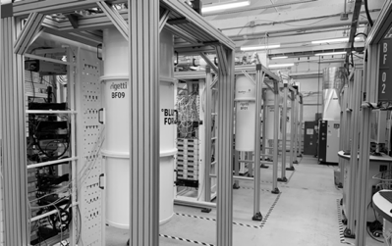
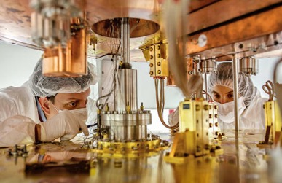
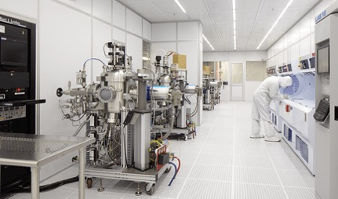
Mission: Attacking QIS Cross-Cutting Challenges
SQMS Mission
“bring together the power of national labs, industry and academia to achieve transformational advances in the QIS major cross-cutting challenge of understanding and eliminating the decoherence mechanisms in superconducting 2D and 3D devices, with the goal of enabling construction and deployment of superior quantum systems for computing and sensing."
6
Akshay Murthy – SQMS Center

Slide 7
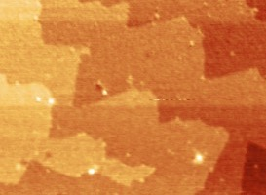
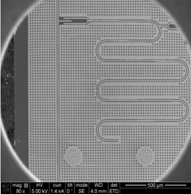
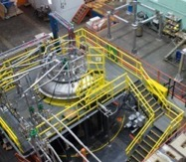
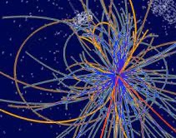
SQMS Goals: Science & Technology Innovation Chain
Materials
High-coherence devices
Systems integration
New platforms for
quantum computing & sensing
Quantum advantage
Developing a full understanding of sources of decoherence via a systematic, fundamental science approach
Demonstrating devices with systematically and consistently higher coherence at different SQMS partners
Preserving device high performance through the process of integrating into more complex systems
Deploying quantum computing and sensing facilities of innovative architectures and improved performance
Demonstrating quantum computing and sensing advantage for particle physics and other scientific applications
SQMS bridges the gap between ideas and large-scale realizations
via the unique center-wide, multidisciplinary coordinated approaches
7
Akshay Murthy – SQMS Center

Slide 8
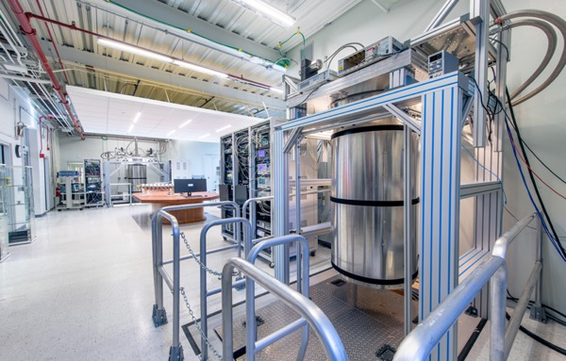
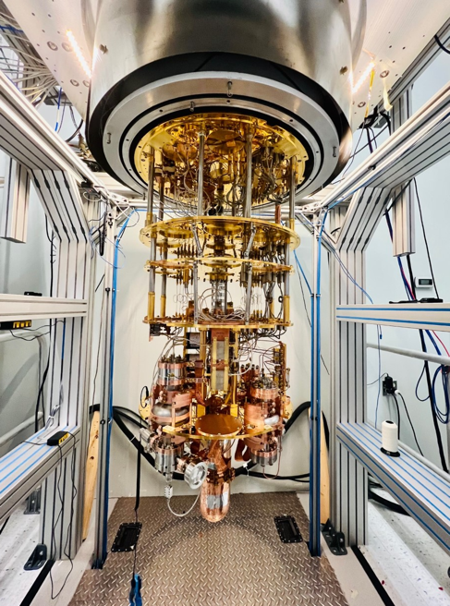
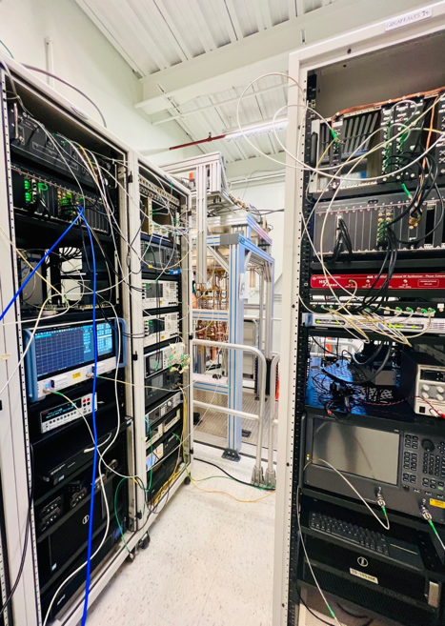
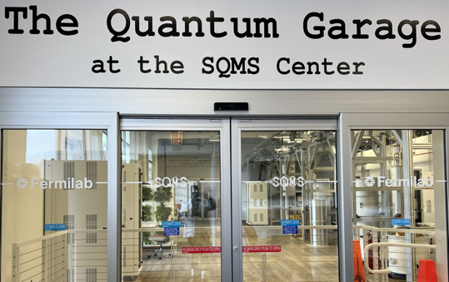
SQMS facilities: Fleet of new quantum testbeds
8

Slide 9
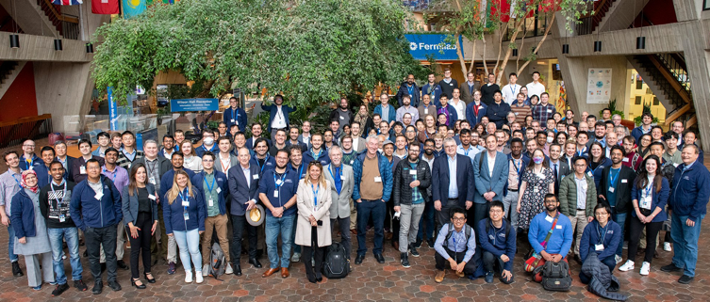
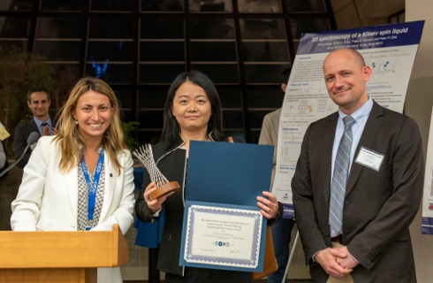
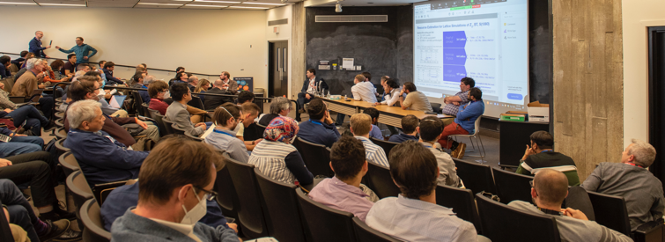
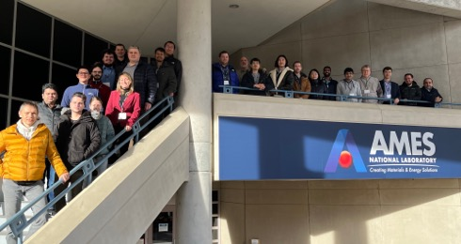
Growing an Ecosystem and a Diverse Quantum Workforce
9

Slide 10
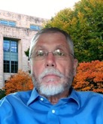
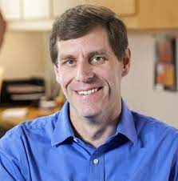
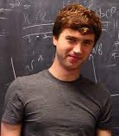
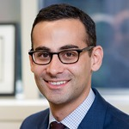
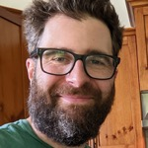
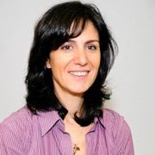
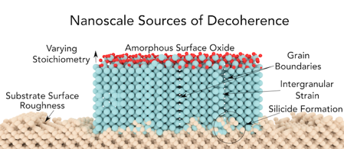


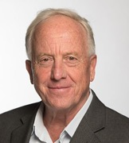
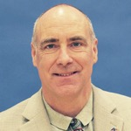
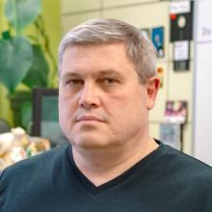
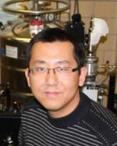







SQMS theorists and experimentalist ‘co-design’ to target decoherence
M. Hersam
A. Romanenko
Characterization
Theory
First-principles Materials
Superconductivity
Disorder and Dynamics
Cryo SEM, TEM
TOF-SIMS
Light sources
XRR, XRD, APT
SRF cavities
J. Rondinelli
J.. Sauls
J. Mutus
Spectroscopies
Magneto-Optical
Scanning Tunneling
Point Contact Tunneling
M. Iavarone
Transport
V. Chandrasekhar
Y. Krasnikova
London Penetration
NMR/muSR
Microwave
TeraHertz
J. Zasadzinski
M. Kramer
R. Prozorov
J. Wang

Slide 11
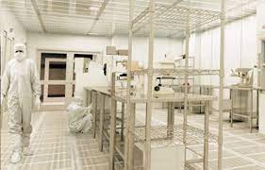

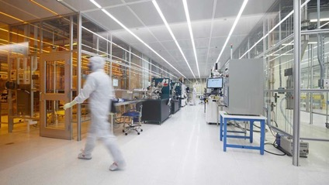

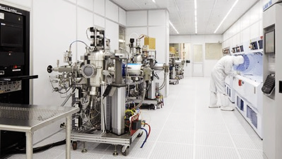
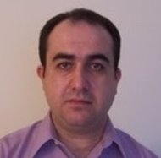
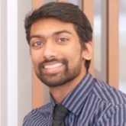
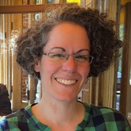
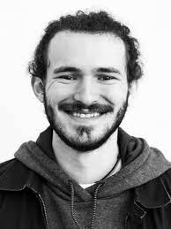
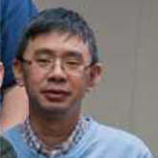
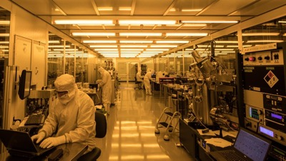
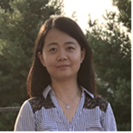
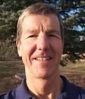
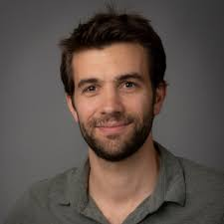
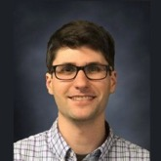
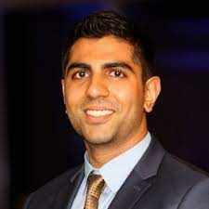
SQMS National Qubit Nanofabrication Taskforce
SQMS coordinated study/process flow across FNAL-UChicago, NIST, Rigetti, Northwestern foundries to address material losses
Demonstrate reproducibility of improved qubit coherence
Mustafa Bal​
Fermilab
Akshay Murthy
Fermilab
Ella Lachman
Rigetti Computing
Shaojiang Zhu​​
Fermilab
​
Francesco Crisa’, Fermilab
6/30/23
Grassellino - SQMS
Lin Zhou
Ames National Lab
Pete Hopkins,
NIST
Florent Lecoq, NIST
Nik Zhelev, NU
Yuvraj Mohan
Rigetti Computing

Slide 12
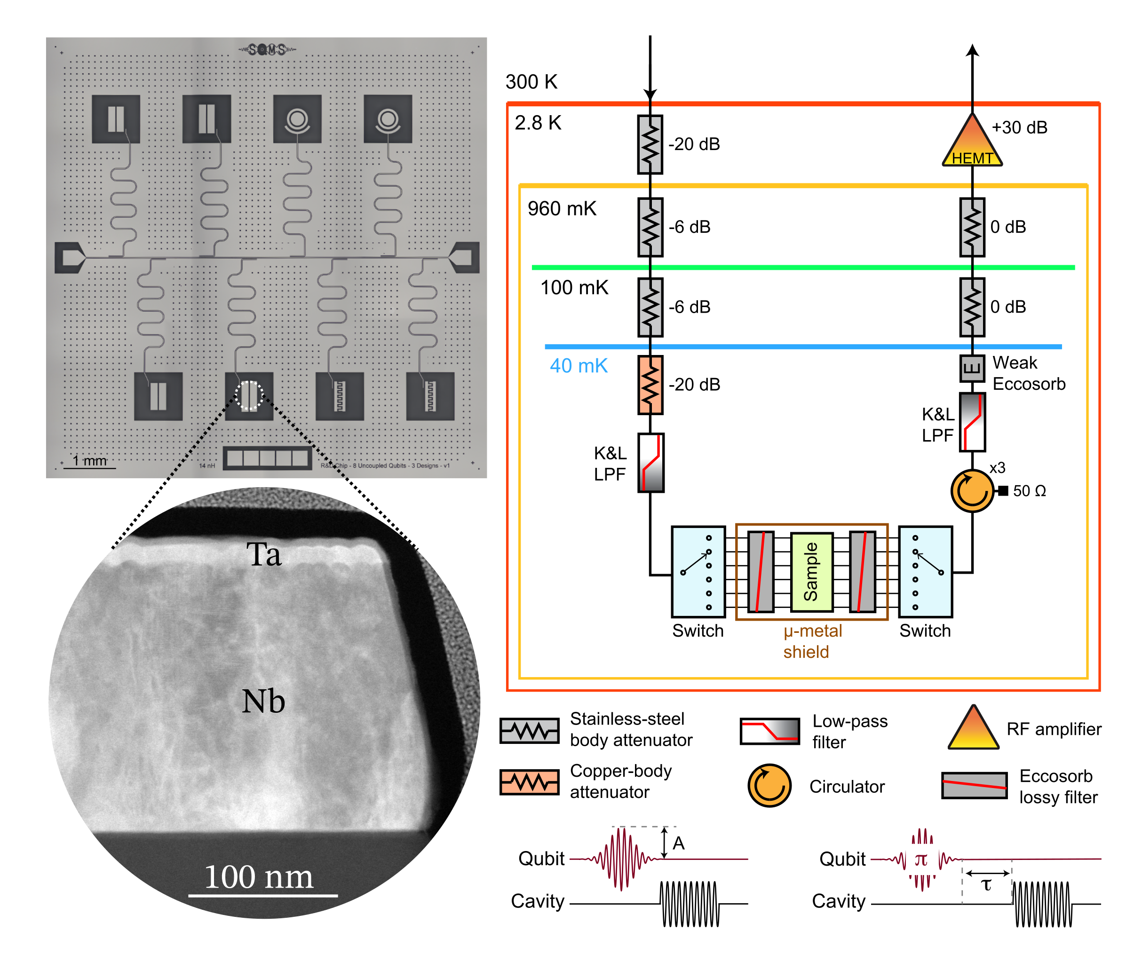

Milestone: Advanced coherence in encapsulated qubits
Sapphire Substrate
Silicon Substrate
Bal et al., arxiv:2304.13257
12

Slide 13
Milestone: Advanced coherence in encapsulated qubits
Sapphire Substrate
Encapsulation Strategies lead to the significant systematic coherence advancement confirming the approach
Silicon Substrate
Bal et al., arxiv:2304.13257
13

Slide 14

Significance of the results
World-wide landscape of 2D qubit coherences
SQMS Best T₁:
Nb/Si → 451 us
Nb/sapphire → 198 us
SQMS 2D qubits are now at the forefront of the national and world-wide efforts
14

Slide 15
Near-term Goals: 2D Qubit Materials Roadmap
10 μs
100 μs
1 ms
2D Device Coherence
Eliminate sources of decoherence at Josephson Junction
Identify sources of decoherence emerging from multi qubit chips
Eliminate sources of decoherence at Nb/air interface
Identify sources of decoherence
Eliminate sources of decoherence from bulk substrate
Eliminate sources of decoherence in superconducting thin film
Year
2021
2022
2023
2024
2025
15

Slide 16


World record coherence 3D cavities in quantum regime
A. Romanenko et al, Phys. Rev. Applied 13, 034032, 2020
200x
Technology originally developed for accelerators
Fermilab is world leader in SRF
2 seconds of coherence demonstrated
Foundational Result upon which the SQMS center was built
16

Slide 17


SQMS 3D SRF approach
Novel QPU architectures
Long coherence allows going from qubit to “qudit” approach (use d energy levels instead of traditional 2)
ONE nine cell SRF cavity + ONE transmon =
SQMS 100+ qubits processor
Scalability
> 100 qubits with just few input/output lines
Science
Directly probing the quantum to classical transition : ”Schrodinger cat” states of record large scales
New physics (dark photon and axion) searches with orders of magnitude improved sensitivity
Physics simulations enabled by the all-to-all qubit connectivity
17

Slide 18



Milestone: Incorporated Transmon into SRF Cavity
5
4
3
2
1
Achieved photon counting
0
18

Slide 19















Milestone: Incorporated Transmon into SRF Cavity
Wigner tomography
1
$$\left|3\right\rangle$$
Fock $|1⟩$
$$\left|2\right\rangle$$
Parity
0
$$\left|1\right\rangle$$
$$\left|0\right\rangle$$
Achieved long-lived quantum states
-1
$$τ≈0.95 \text{ms}$$
1.5
$$\left|3\right\rangle$$
Fock $|2⟩$
$$\left|2\right\rangle$$
Parity
0.0
$$\left|1\right\rangle$$
$$\left|0\right\rangle$$
-1.5

Slide 20



Near-Term Goals: Design Multiqubit Architecture
Crosstalk issues
Faster scaling: $d^{N}>2^{N}$
All-to-all coupling
Manipulator
Storage
Transmon
Coupler
CPU
BUS
RAM
20

Slide 21
Quantum Sensing for Fundamental Physics
Quantum sensing: the use of quantum properties of light or matter to enhance sensitivity of measurements.
Sensing effort is driven by applying our SRF cavities and quantum devices towards physics goals:
  Probing Dark sectors:
    New light particles: Dark photons and axions.
    Either as the dark matter, or as “just” new particle.
    A multi-search goal. Our most engaging science goal.
  Precision tests:
    Tests of the standard model (electron g-2, Euler-Heisenberg)
    Tests of quantum mechanics
  Gravitational waves:
    Expanding the frequency for GW detection beyond LIGO/VIRGO
21

Slide 22















SQMS theorists & experimentalist ‘co-design’ to develop new experiments
SRF + QIS capabilities enable new particle searches of unprecedented sensitivity and precision
R. Harnik
co-design
Y. Kahn
A. Berlin
P. Graham
Theory
Options for mode setups + sensitivity
S. Rajendran
B. Giaccone
J.. Sauls
Prototypes
Materials and Devices
S. Posen
Systems design, testing
(measure cross-talk, Q for various modes, readout)
Improved Q, sensitivity, controls
C. Braggio
R. Cervantes
G. Gabrielse
Cervantes et al., arxiv:2208.03183
Brady et al PRX Quantum 3 (2022) 3, 030333

Slide 23




23

Slide 24

Dark SRF: ”Light shining through wall” Experiment
10²⁵ SM photons
SC wall
ε
ε
Necessary to match cavity frequencies!
Emitter cavity,
in the accelerator regime, high field
Receiver cavity,
in the low field regime
High Q₀: enhances probability of detecting power excess due to dark photons
High Q₀: increases number of photons
24

Slide 25


Dark SRF: phase 1 → results
Thermal run vs Search run
Search run conducted at
6.2 MV/m (= 0.6 J stored energy)
New 95% confidence level exclusion limit on dark photon parameter space
Both runs consistent to 1σ
Romanenko et al., Phys. Rev. Lett. 130, 261801 (2023)
25

Slide 26
Dark SRF: phase 1 → results
Thermal run vs Search run
Search run conducted at
6.2 MV/m (= 0.6 J stored energy)
Goals for Phase 2:
Achieve deeper exclusion through DR measurements
Improve frequency stability over time
New 95% confidence level exclusion limit on dark photon parameter space
Both runs consistent to 1σ
Romanenko et al., Phys. Rev. Lett. 130, 261801 (2023)
26

Slide 27

  Summary & Looking Ahead
  Through robust partnerships across the U.S. and abroad as well as extensive investments in quantum infrastructure, the SQMS center has delivered exciting progress across the science + technology innovation chain:
  Leading edge coherence times in 2D superconducting qubits
    Next steps: Targeted removal of additional sources of decoherence
  Demonstration of long-lived quantum states in cavity-qubit system
    Next steps: Design and deployment of multiqubit cavity/qubit architectures
  Exploring new areas of dark photon parameter space
    Next steps: Experimental improvements to achiever deeper exclusion

Slide 28
Appendix

Slide 29

Dark SRF: phase 1 → measurement protocol
  Excite emitter to desired field and match its frequency to receiver
  Search for Dark photon for ~30min
  Verify frequency matching
  Cross-talk check
  Thermal background check
Step 1 & 3
LHe
P_{t}
P_{in}
P_{t}
HEMT

