Slide 1
Updates in Scientific Computing at Fermilab
Shreyas Bhat, CSAID, Scientific Computing Systems and Services Division
FNAL Users Meeting
29 June 2023
Notes:
‹#›

Slide 2
Outline
CSAID and the resources we provide to users
Highlights from CSAID in the past year
New plans for 2023-24 for CSAID
The many ways to get access to a GPU

Slide 3
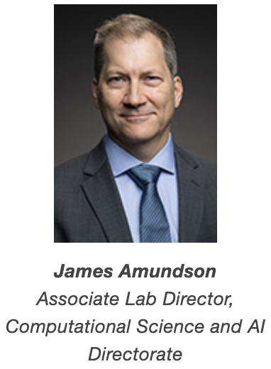
The Computational Science and AI Directorate
Last fall the Computing Sector split into the Information Technology Division (mostly what was Core Computing) and the Computational Science and AI Directorate (mostly what was Scientific Computing)
CSAID consists of three divisions and has extensive ties to the Lab AI Office
CMS, DUNE lab computing coordinators
CSAID
AI Office
Scientific Computing Systems and Services
Data Science, Simulation, and Learning
Real-time Processing Systems
Division Head: Margaret Votava
Division Head: Adam Lyon
Division Head: Nhan Tran
Batch computing
Data management
Computing infrastructure
Monitoring
First line user support
Simulation (Geant4, GENIE, …)
ML research
LQCD software
Computational Science R&D
Software frameworks
DAQ System Eng. and Ops
Quantum & astrophysics systems
Data-Intensive Systems
Scientific Linux Development
Keynote speaker
All divisions have personnel who participate in experiment science activities
Notes:
For each division, give a couple of examples, move on.

Slide 4
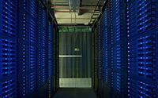
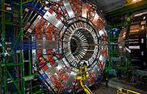
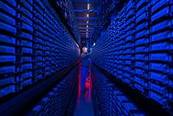
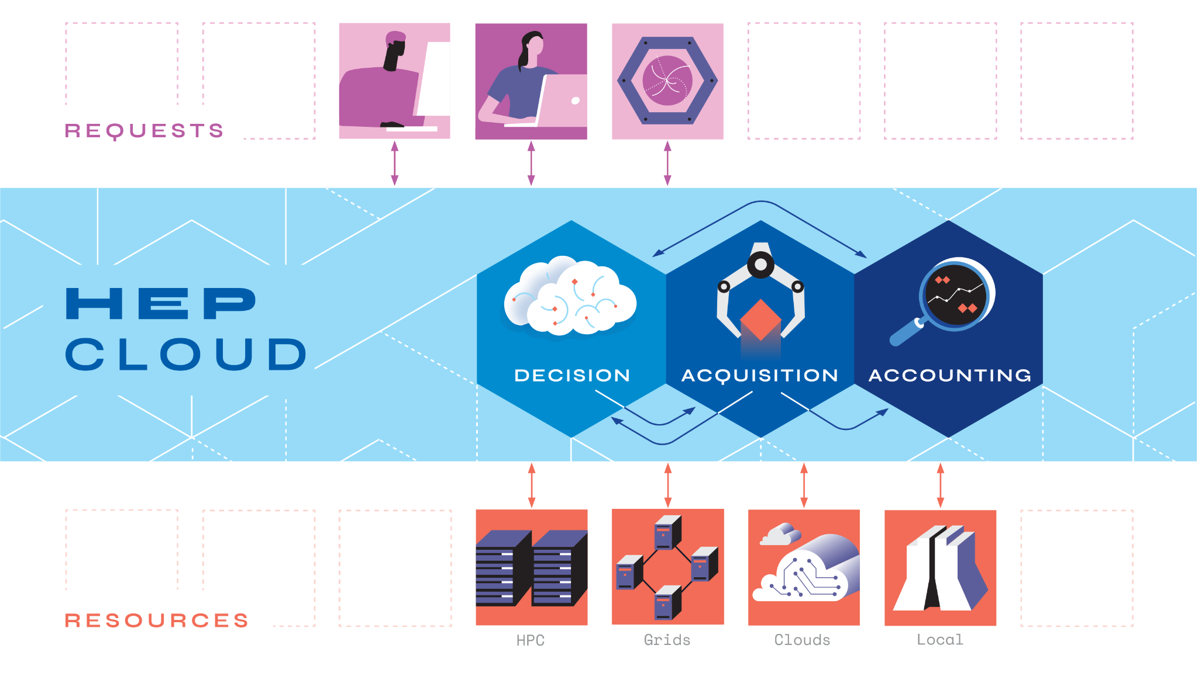
Some of the Resources We Provide at Fermilab
GPGrid Cluster
Data Storage and Handling/Active Archive Facility
CMS Tier1 Center
Elastic Analysis Facility
Wilson Cluster-Institutional Cluster/Lattice QCD Cluster
HEPCloud
4
Notes:
“These are some of the resources we provide to Fermilab users”
GPGrid: General Purpose grid cluster for user jobs to run on. If you’re submitting a “batch job” with a tool like jobsub, it goes here if onsite.
Data Storage/AAF: Long-term storage of scientific data. Both onsite/offsite access
CMS Tier 1: Archival/active storage, processing of CMS data
Wilson Cluster: HPC cluster for all of Fermilab. Will talk about it later.
LQCD: HPC cluster for highly specialized theory groups.
HEPCloud: Resource provisioning across wide variety of sources like Grid, Commercial cloud, HPC, allocations.
EAF: Local JupyterHub deployment for all of Fermilab, giving access to CPU, GPU resources.

Slide 5
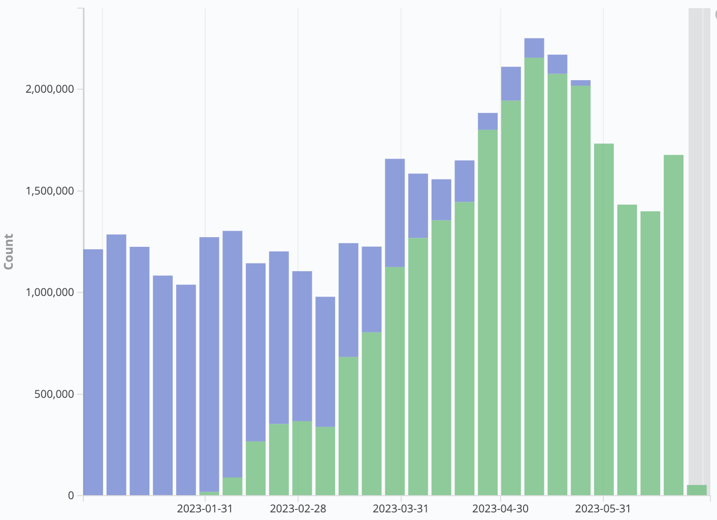
Highlights from the Scientific Computing Systems and Services Division
X509 Proxy to Token Authorization in FIFE Batch Job Submission
Moved job submission authorization to tokens, via jobsub_lite (see next slide)
Carried out experiment production workflows at HPC centers via HEPCloud
Formed CREST committee to plan future of facility
Started the migrations off of Scientific Linux 7
Elastic Analysis Facility (EAF) in production with full 8x5 support (more on this later)
2E6
Jobsub_lite Go-live
# Jobs
1E6
01/2023
07/2023
X509 Proxy-Based Auth
Token-Based Auth
Notes:
EOL for SL7 is June 30, 2024
Scientific Computing Systems And Services Division
Some of puppet management stuff is in Alma 8. Lattice QCD/Wilson Cluster in process of being transitioned to EL8. EL9 next year.
CREST: Facility evolution (Oli’s group; Lisa). Future of GPGrid, EAF, WC, etc.
If anyone asks about IBM: We’re aware, and considering options. As we decide anything, we’ll be sure to make appropriate announcements

Slide 6
Transition to Token-Based Authorization
This year, we rolled out major change to grid authorization: X509 Proxies → Tokens
SciTokens (https://scitokens.org)/HTCSS IDTOKENs are form of JSON Web Token (JWT), which implements OAuth2 standard (think “Sign in with your Google Account”)
Shift from “Who are you” (X509 Proxies) to “What can you do?” (SciTokens)
Has allowed experiments to enforce more fine-grained access control to resources, especially storage
Used/supported by all FIFE services: jobsub_lite, POMS, SAMWEB client, dCache
Tokens used for internal authorization as well (e.g. GlideinWMS): Fine-grained access control within infrastructure too!
Notes:
In case of objections: Better to be doing this transition now rather than next year, when we’re at SL7 EOL and conference rush

Slide 7
Transition to Token-Based Authorization (2)
Before - many of these components used copies of the same X509 proxy.
Now - disparate, appropriately-scoped tokens for different services
Glidein
startd
Job
collector
schedd
HTC Central Manager
CVMFS
J-TOKEN
Job
CE
Job
Job
Frontend
Factory
IDTOKEN
P-TOKEN
S-TOKEN
Image credit: M. Mambelli
Notes:
Just quickly note the different kinds/scopes of tokens throughout entire batch submission system. Don’t linger here for more than 10 seconds.

Slide 8
Highlights from the Data Science, Simulation and Learning Division
Supporting experiments with Scientists who are computing experts and Computing Professionals
Cutting edge research and development
AI for cosmology, CMS, neutrino experiments (eg, tracking)
Computer science and physics publications
Snowmass leadership roles and report contributors
Developing and supporting community tools
GENIE, GEANT4, CMSSW, art, LArSoft, Marley, Root and more

Slide 9
Highlights from the Data Science, Simulation and Learning Division
Listening to the experiments for software needs
DUNE framework requirements → R&D / LDRD on frameworks
Hosted LArSoft Multithreading and Acceleration Workshop
Experiences, problems, solutions related to resource / throughput optimization and efficient high performance computing (HPC) / supercomputer utilization to lead common tool development
Contributed to AI in Production Workshop
Working with experiments to improve toolkit integration
Hosted Frameworks Workshop
Framework design concepts, art development, experiment requirements
Highlighted needs for HPC, improved documentation
HPC for LArTPC reconstruction
Notes:
First and Last points - get clarification

Slide 10
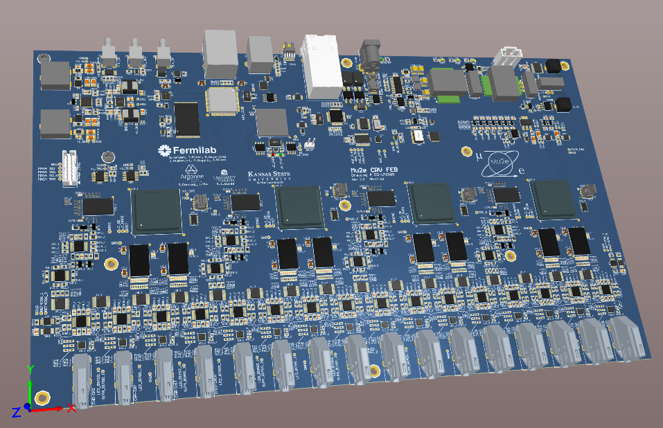
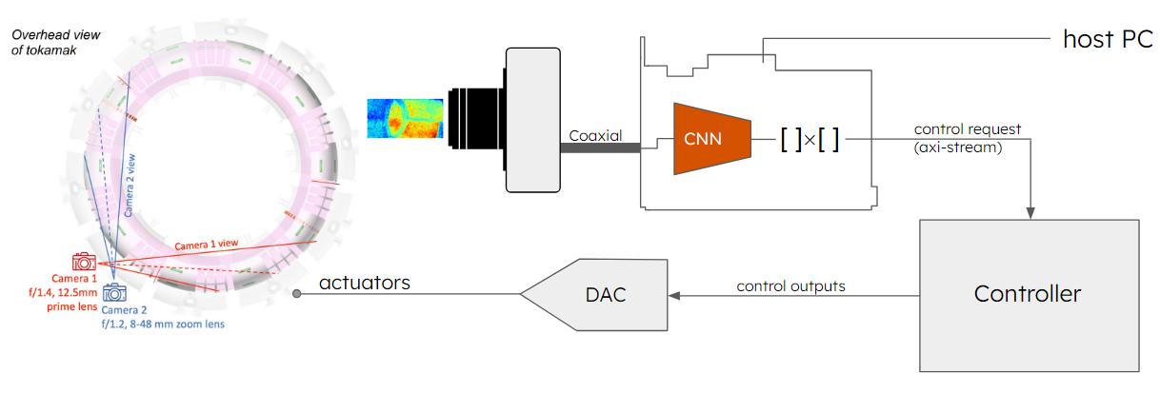
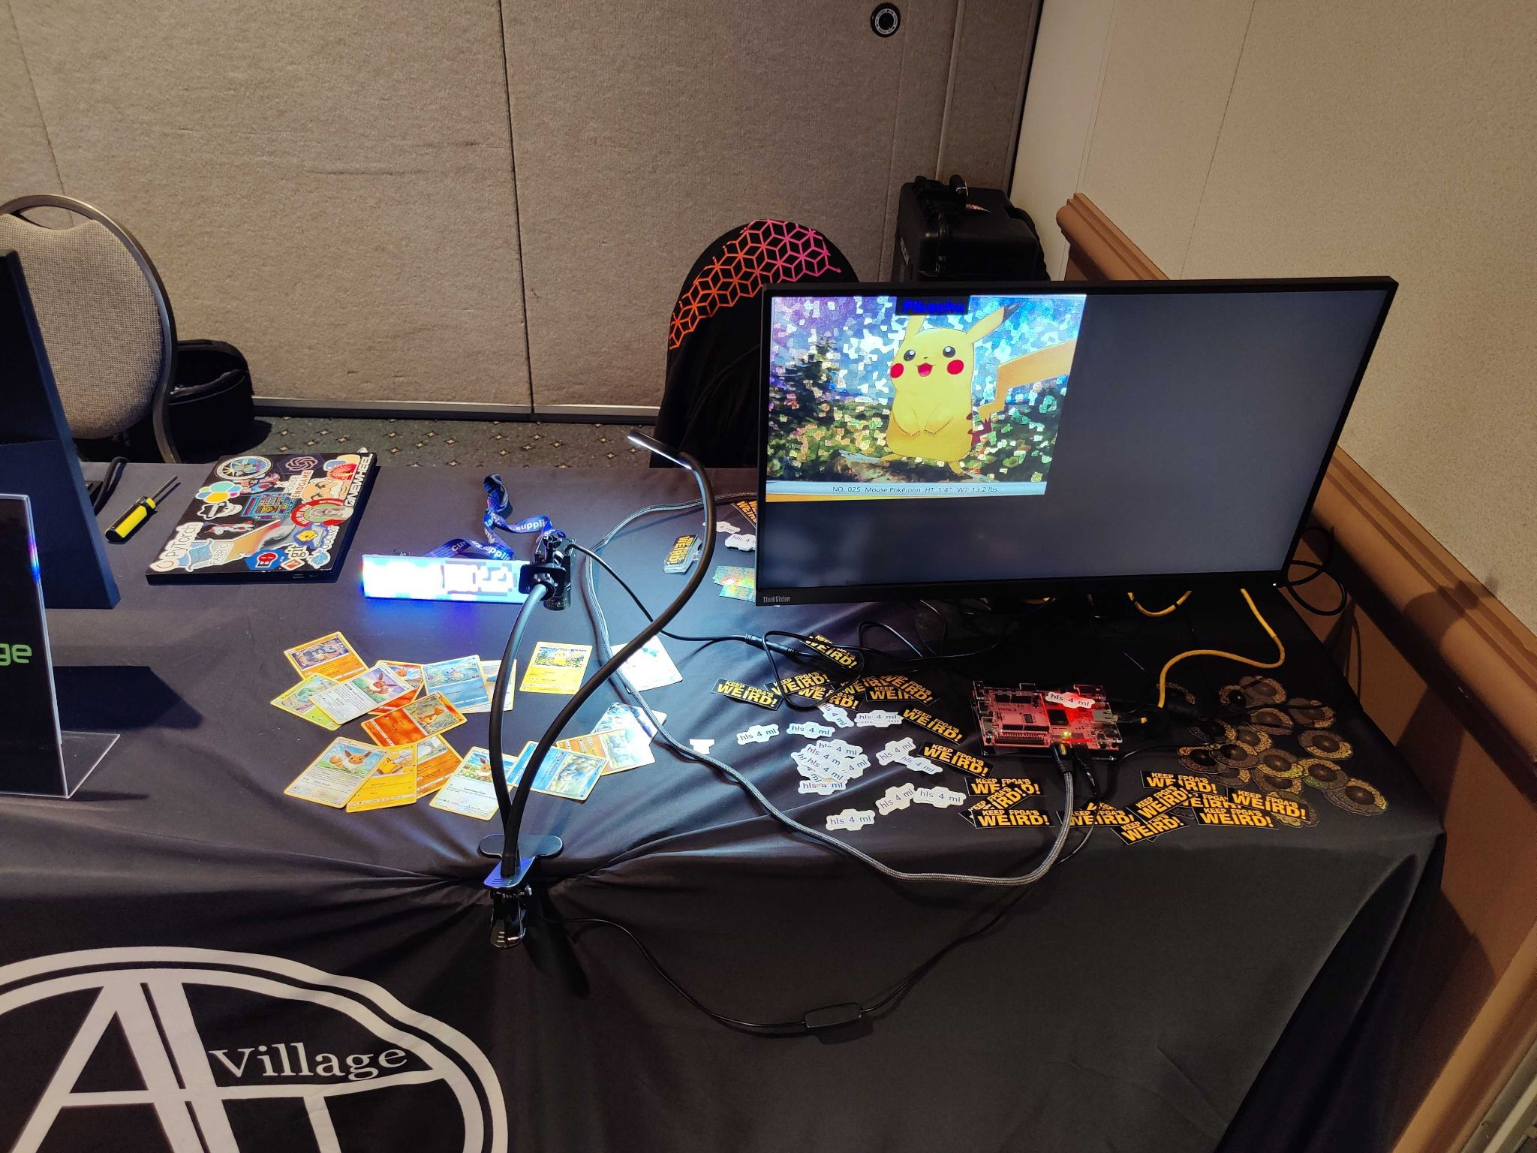
Highlights from the Real-Time Processing Systems Division - Data-Intensive Systems Department
Leading Accelerator Data Acquisition and Controls hardware modernization effort (ACORN)
Developing readout hardware and firmware for multiple experiments (including DUNE, PIP-II, Mu2e, CMS)
Supporting particle tracking for multiple Test Beam users.
AI/ML: Leading low-latency ML in hardware package (hls4ml)
Leading research on ML architectures optimized for low-power FPGA applications.
Tech transfer for other sciences (fusion, microscopy, etc.)
Outreach to broader communities (DEFCON): real-time, FPGA-based, image identification demos
Physics Research Equipment Pool (PREP)
Notes:
– Rewriting control system (collaborating)
What is hls4ml: High Level Synthesis 4 Machine Learning:
translates ML models, normally in Python (keras, tensor-flow, ...) to HLS (c/c++ and some optimization notes)
then there are tools to compile HLS to Verilog (low level programming language for FPGAs)
Pics:
Top: mu2e readout board of some type
Middle: We think it’s Test Beam
Bottom pic: FPGA w/ Camera

Slide 11
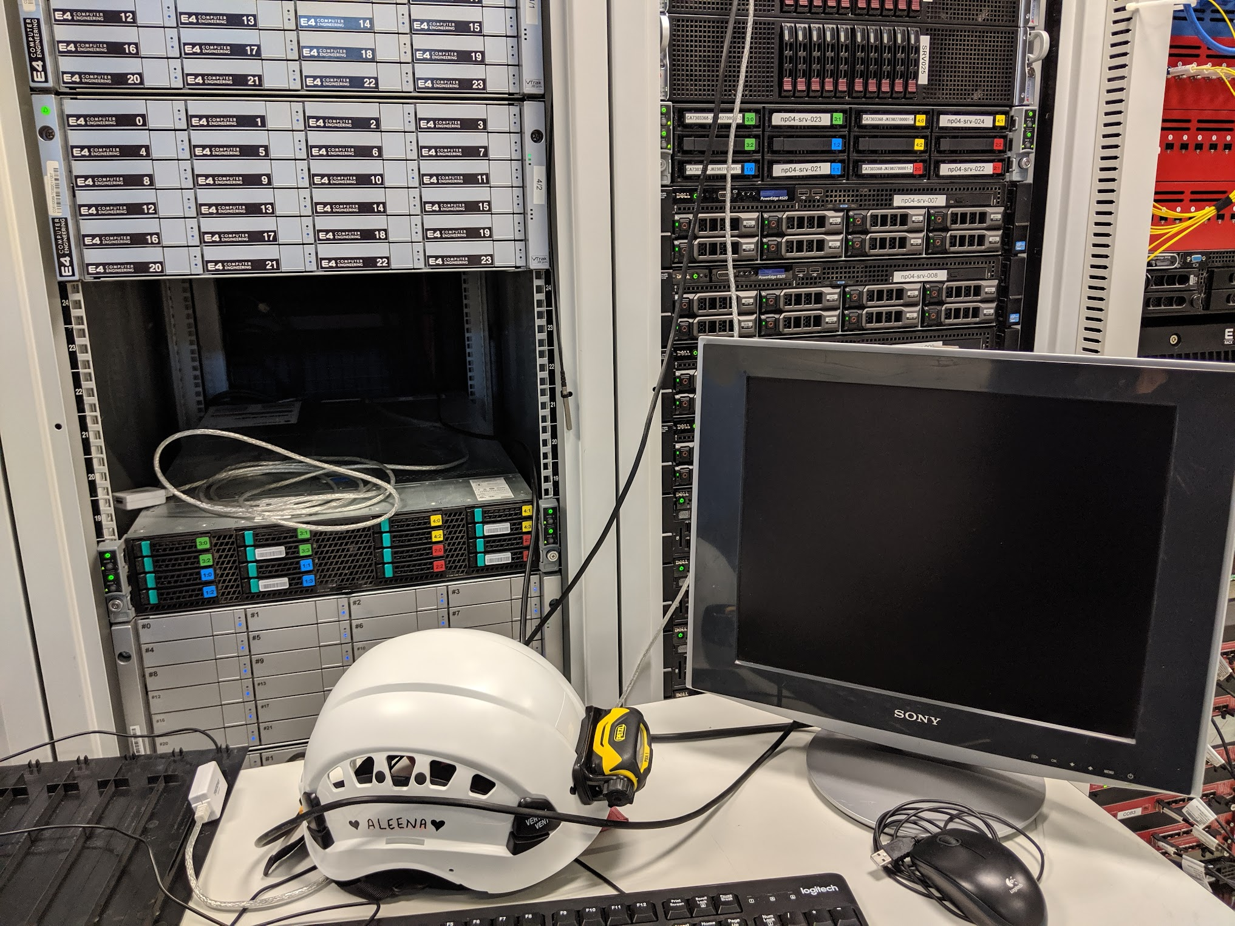
Highlights from the Real-Time Processing Systems Division - DAQ Systems Engineering and Operations
DAQ Software Development
DUNEDAQ
coordination roles in DAQ consortium, several major releases/milestones this year
ArtDAQ/OTSDAQ
development and support for mu2e, SBN, various test beam efforts
Providing online support for running and upcoming experiments and test stands
DUNE
DUNEDAQ and US Project management
ProtoDUNE-II, coldboxes, global test stands
Linux Distribution
Support SL7 until End of Life (June 30, 2024)
Linux Steering
11

Slide 12
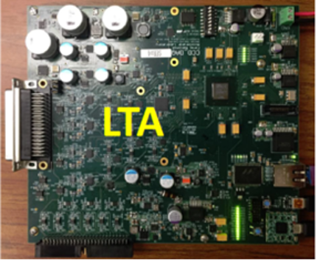
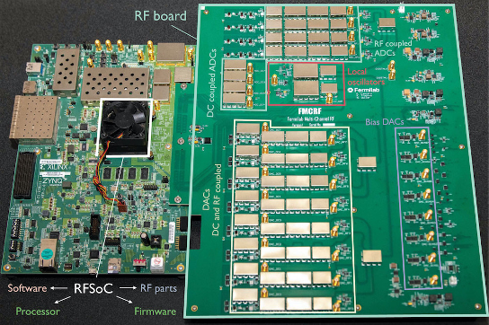
Highlights from the Real-Time Processing Systems Division - Quantum & Astrophysics Systems Department
The LTA (Low Threshold Architecture), supports all CCD and skipper-CCD instrumentation at Fermilab and collaborators.
Dark matter experiments: DAMIC, SENSEI and Oscura 10Kg.
Space-LTA for future space mission.
Used for readout of quantum imaging with skippers and Coherent Neutrino Nucleus Scattering experiments.
QICK (Quantum Instrumentation Control Kit): A comprehensive, control and readout system for QIS (Quantum Information Science), including quantum computing, quantum networks, and quantum sensors
Adopted by and supporting a growing community of over 200 institutions (Labs, academia and industry).
Types of qubits: superconducting, AMO, NV-centers, trapped ions, spin.
Sensors, e.g. MKIDs, RF broadband, SNSPDs, quantum capacitor, etc.
Notes:
Don’t go into the individual points here. Mention the LTA, and the QICK
LTA: Low-threshold signals
QICK: Integrate RF signals into readout systems
Develop and Maintain LTA and QICK
TODO: What is CCD/skipper-CCD?

Slide 13
New plans for 2023-24 from the various divisions
Continue transition from proxies to tokens
Help manage transition away from SL7
Monitoring industry activity
Steering Linux development in light of recent events
Continue to investigate replacing NAS with CEPH
Expanding GPU expertise for scientific computing
Focusing support on DUNE & Mu2e following recent reviews
Continue supporting experiments in DAQ/Real-time processing
Hardware purchases (More on this later)

Slide 14
Highlights from AI Office
Lots of interesting stuff going on in the AI office
See Tia Miceli’s upcoming talk
Let’s say you need a GPU…
Notes:
Tia will be discussing this more in detail, but we’re going to focus on the hardware side of this

Slide 15
So you need a GPU…
AI Practitioners have ready* access to the following resources
Elastic Analysis Facility (EAF)
Wilson Cluster, through experiments and/or dedicated projects
GPU clusters at remote sites via usual job submission tools through experiments
HPC centers such as NERSC through experiments and HEPCloud
Other HPC centers with individual/university/experiment allocations (CAN be integrated with HEPCloud!)
Each type has slightly different strengths and weaknesses, along with different interfaces
“When you come to a fork in the road, take it.” - L. P. “Yogi” Berra
*commercial clouds are also possible, though access is less ready (and no large common pool available)
Slide Credit: K. Herner

Slide 16
Elastic Analysis Facility
Jupyter Hub deployment with general CPU and GPU-enabled notebooks available. Highly scalable, customizable, and replicable elsewhere
GPUs are available through https://analytics-hub.fnal.gov (must be on-site or on VPN for now)
They are finite of course, but A100s now deployed
Latest documentation is at https://eafjupyter.readthedocs.io/en/latest/. In particular, look at the server and notebook options section to see what’s in each flavor (CVMFS also available)
Slide Credit: K. Herner

Slide 17
EAF (2)
How do I get an account?
Anyone with a services account can log in, but follow your experiment’s usual instructions
Can I customize the environment and packages?
Yes. Several things are possible with preamble scripts, mamba, pip, spack etc. See the instructions about customizing: https://eafjupyter.readthedocs.io/en/latest/02_customization.html
What storage is available?
24 GiB work area in Ceph as home area, usual /nashome areas (FIFE/DUNE/Cosmic), usual LPC /uscms NFS areas also available
Streaming with xrootd also works to access larger storage elements
Just added 10 TB of scratch space - admins reserve right to delete anything older than 7 days if it gets full (/scratch/7DayLifetime)
https://eafjupyter.readthedocs.io/en/latest/01_storage.html
Slide Credit: K. Herner

Slide 18
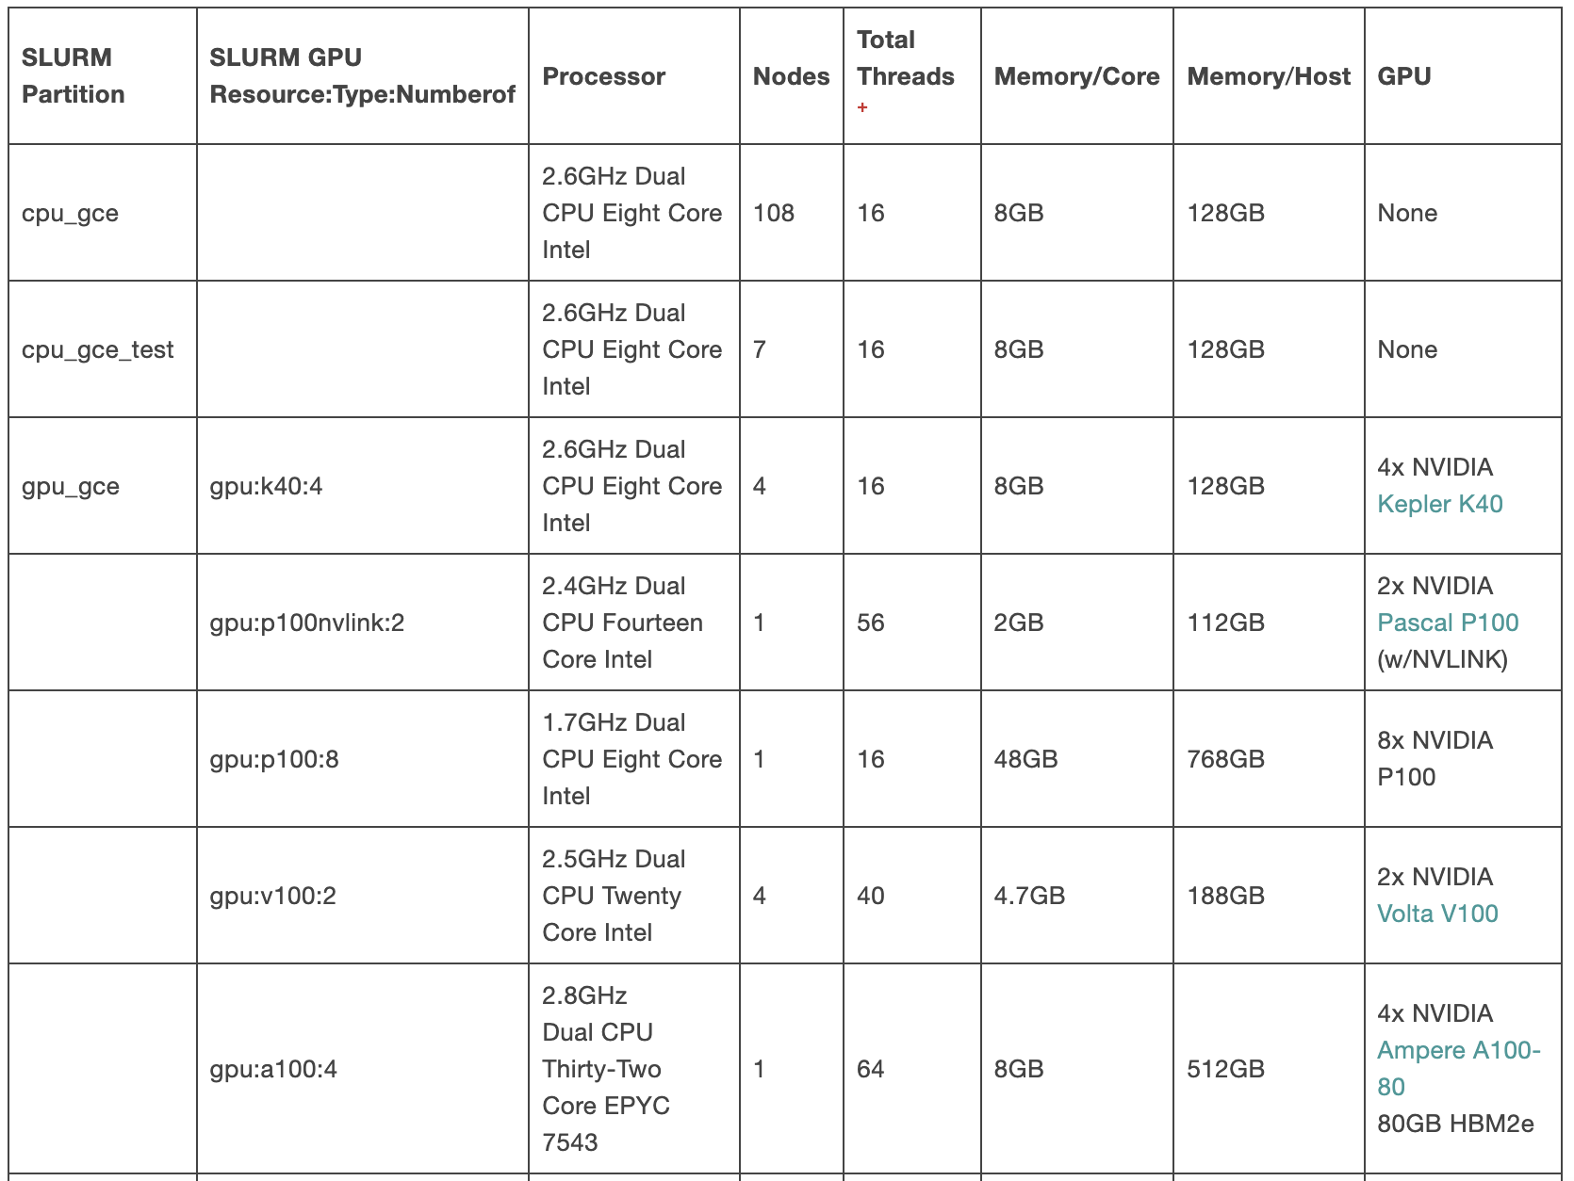
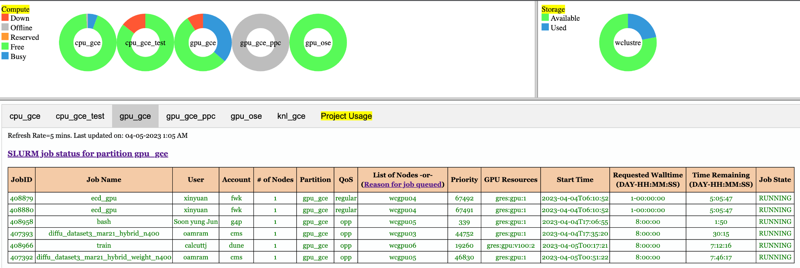
GPUs via Wilson Cluster
The Wilson Cluster is available to all of FNAL either through experiments/departments or specific projects (focused on a particular area; could be sub-project of an experiment, but do not have to be part of something larger)
Available GPUs range from K80s (100) to A100s (4); base OS is SL7
More information available at https://computing.fnal.gov/wilsoncluster/
There is a SNOW form to be added to a project (automatically added to base experiment projects)
Rumors persist that queue times are interminable for the GPUs: generally not true
No GPU
No GPU
Slide Credit: K. Herner

Slide 19
GPUs on External Clusters
Several sites have GPUs available; accessible via usual job submission commands for IF/CF expts (separate for CMS)
As of now, user is responsible for specifying appropriate container
Hardware ranges from a few years old up to A100s depending on the site. Contact FIFE for details.
Several advantages to using these resources
Very little competition for them (i.e. no long queues a la NERSC)
No finite allocations!
GPGrid will be getting GPU nodes; could consider more if demand (more later)
NERSC Perlmutter (both CPU and GPU queues) available via HEPCloud for currently onboarded expts (CMS, DUNE, g-2, Microboone, Mu2e, Nova)
Contact your experiment’s production group
Slide Credit: K. Herner

Slide 20
HEPCloud and other HPC centers
It is also possible to integrate other HPC center or commercial cloud allocations into HEPCloud; contact HEPCloud team
Advantages include not having to learn separate infrastructures at every different site
Some HPC centers offer testbed platforms for AI/ML apps; see ANL as one example
GlideinWMS and HEPCloud are working to provide GPUs as a Service (GaaS)
GPUs will be shared between all jobs running on a node (fractional use possible)
Slide Credit: K. Herner
Notes:
If you and/or your institution is interested in other HPC/cloud allocations, contact HEPCloud team

Slide 21
Future Hardware Additions at FNAL
CSAID is planning to buy roughly $500k of GPU workers equipped with A100s
Form factor not yet decided (2 or 4 GPUs per node)
Expect this will provide up to a few dozen GPUs
Looked at Hopper cards but decided better bang for the buck with A100s given our typical models
Machines will have NVLink, Infiniband, ethernet
Distribution among the various clusters not decided yet. Depends a bit on needs, demand, and stakeholder requirements
One could imagine shifting machines between clusters as demand ebbs and flows between different areas (requires sufficient lead time)
Slide Credit: K. Herner
Notes:
- Will LQ2 be open to non-Lattice QCD folks? No, for now. Need more funding for that.
- New nodes will be distributed amongst GPGrid, EAF, WC, etc.
- Basically - whatever protocol you need will be there
- Various clusters to get new hardware: EAF, GPGrid, Wilson Cluster

Slide 22
Summary
Lots of exciting activity going on in Scientific Computing
Wide variety of resources now available from interactive containers to grid slots to large blocks on HPC centers
Different tools for different jobs: don’t hesitate to contact division personnel even if it’s just to consult about what’s the best option
How? Contact your experiment liaison/spokesperson or open an “Ask a Question” ticket to Distributed Computing Support in ServiceNow
WE WANT TO HEAR FROM YOU!!!

Slide 23
Thank you!
Thanks to all who contributed to this talk: J. Boyd, G. Cancelo, B. Coimbra, V. Di Benedetto, J. Eisch, L. Goodenough, K. Herner, B. King, A. Lyon, M. Mambelli, R. Rechenmacher, K. Retzke, E. Snider, N. Tran, M. Votava

Slide 24
Backup Slides

Slide 25
Data-Intensive Systems Department
Accelerator Controls Operations Research Network (ACORN):
Leading Accelerator Data Acquisition and Controls hardware modernization effort.
DUNE:
Photon Detection System readout hardware: DAPHNE for FD-1 and Analog and Digital signal over fiber R&D for FD-2.
PIP-II:
High-speed digitization and low-latency processing system for machine protection.
Mu2e:
Data acquisition system hardware, firmware and software development, teststands and installation.
CMS:
Outer Tracker production testing and correlator trigger firmware.
Test Beam:
Particle tracking support for multiple users.
AI/ML
Presented a real-time, FPGA-based, image identification demo at DEFCON in Las Vegas
Major contributions to HLS4ML low-latency ML software.
Leading research on ML architectures optimized for low-power FPGA applications.
Enabled real-time inference on frame grabber FPGA for optical instability tracking and suppression in Fusion experiments.
Physics Research Equipment Pool (PREP)
Slide Credit: J. Eisch

Slide 26
More details on using GPUs on HTC clusters
Simply add --lines=’+RequestGPUs=1’ to your submission if using jobsub.
As of now, user is responsible for specifying appropriate container (use the --singularity-image option and make sure the image is available to the worker, usually via CVMFS). One could imagine the division maintaining a container including CUDA, IF there is demand for it. Must also be sure data transfer in/out is possible

Slide 27
HEPCloud as a gateway to HPC and LCF
NERSC Perlmutter (both CPU and GPU queues) available via HEPCloud for currently onboarded expts (CMS, DUNE, g-2, Microboone, Mu2e, Nova)
Contact your experiment’s production group
Demonstrations of Inference server setups
No true “co-scheduling” of GPU servers w/ other workflows on non-GPU queues yet
Ad-hoc or requires partitioning between workflow components
No support for MPI workflows currently within HEPCloud
Need to rely on local slurm batch queue

