Slide 1
Microelectronics to enable the next-generation of HEP experiments
Davide Braga on behalf of Microelectronics Division
Fermilab’s 56th Users Meeting
29 June 2023

Slide 2
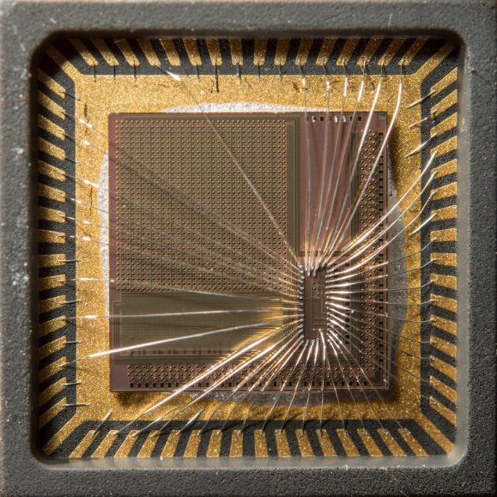
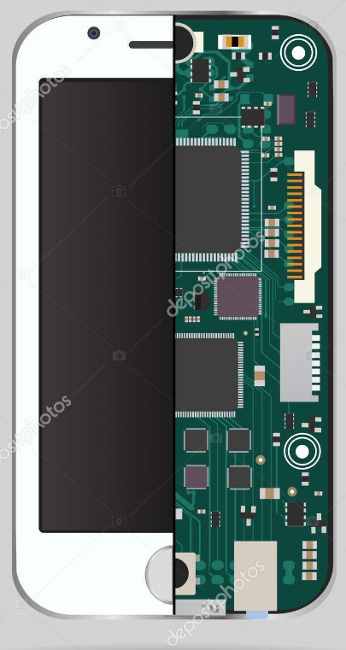
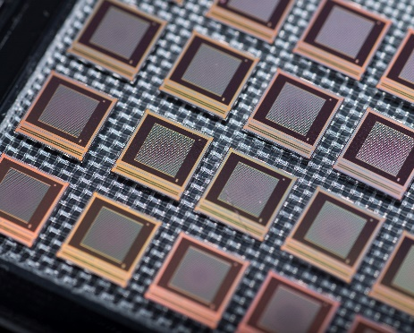
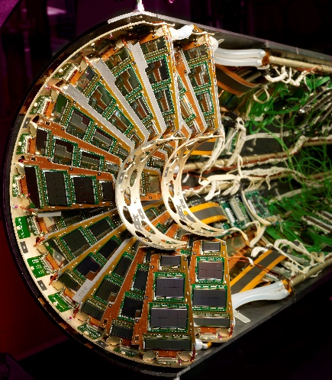
Fermilab Integrated Circuits Design Capabilities and Mission
ACADEMIC RESEARCH
INDUSTRY – PRODUCT DRIVEN
NATIONAL LABS: ADVANCED SCIENTIFIC INSTRUMENTATION
Support interdisciplinary research
Enables new scientific discovery and foundational engineering
Novel solutions
Mission: new knowledge and education of students
Support scientific experiments operating in extreme environments
Mid-size scaling for large experiments
Mission: robust performance over several decades
Support consumer electronics
Mature designs
Mission: incremental product driven design
Technology readiness level

Slide 3
Growth of Integrated Circuit design over ~ 4 decades at Fermilab
Highly specialized expertise in developing robust custom microelectronics with long-term reliability over decades
Investigate novel solutions and ensure technology development to enable mid-volume prototyping
Increased complexity: 2016: 0.5B transistors in ~cm² -> 2021: 2B transistors in ~mm² (shifting the burden from design to verification)
Since 2010's
Since 1980's
Ionizing radiation
>1 Grad (1000x higher than outer space)
Extreme flux for single event effects
- Collider Experiments (FCC, HL LHC)
Cryogenic electronics (77K – 100K)
- Neutrino experiments (DUNE), Dark matter experiments (Skipper CCDs)
Deep Cryogenic electronics (~ 4K)
- Dark matter experiments (Cryogenic detectors e.g. SNSPDs, TES etc.), Quantum Information Science
Superconducting electronics (~100 mK)
- Quantum Information Science for HEP
(TWPAs, JPAs for ADMX)
Since 2019
New 2022

Slide 4
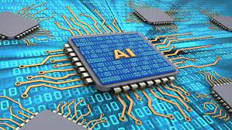
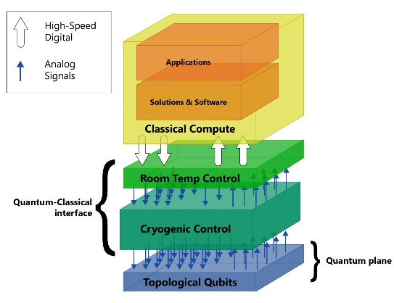
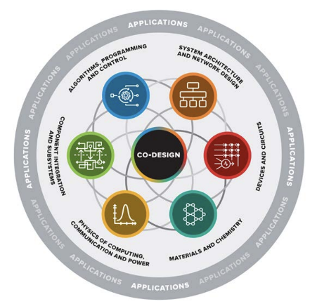

ASIC Design at Fermilab
ETD: Emerging Technology Directorate
(HEP/ ASCR/DOD/NASA)
CSAID: Computational Science and AI Directorate (HEP/ASCR)
Quantum
Artificial Intelligence
OPTT
Technology Transfer
CMS/DUNE
Microelectronics Codesign
PPD: Particle Physics Directorate
PPD, ETD, CSAID, AD, etc. (HEP/BES/ASCR/NP/FES)

Slide 5
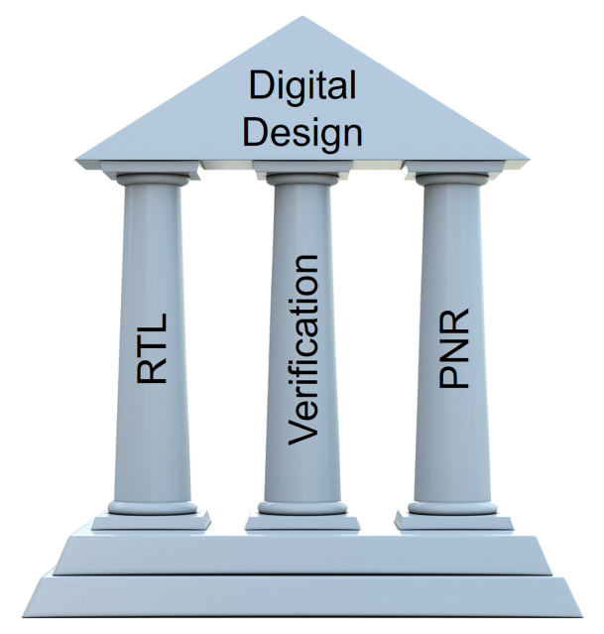
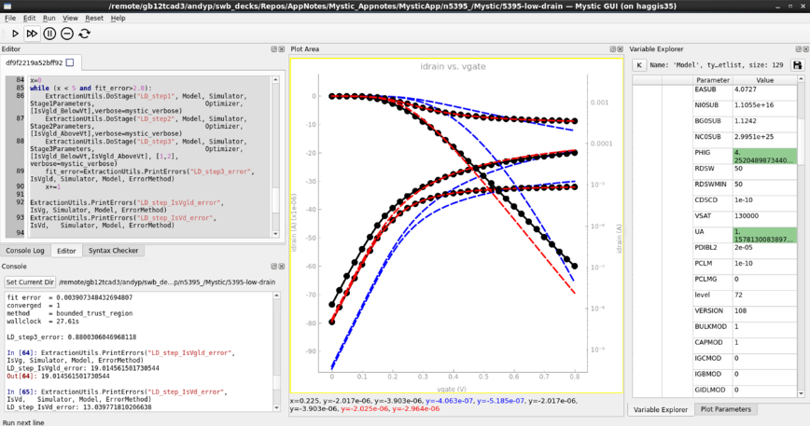

Core competencies
Analog and Mixed Signal Design
Low noise, low-power front end circuits
High frequency (e.g. PLL, VCOs)
Sensor interface and codesign
Digital Design and Verification
Design, placement and verification
RTL, Synthesis, P&R
Functional and formal verification
Testing, modeling and characterization
Robotic testing for mid-volume chip characterization (100K chips)
Cryogenic test stands (77K and 4K)
Development of extreme environment technology models for cryogenic and rad-hard chips
Automated 12” wafer prober
Radiation testing at Fermilab Irradiation Test Area

Slide 6
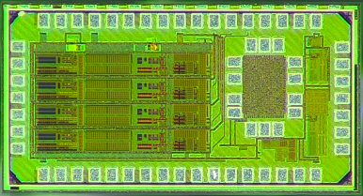
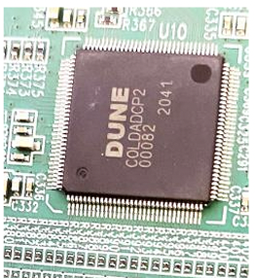
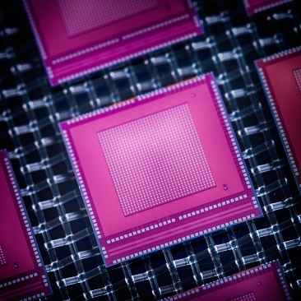
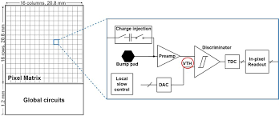
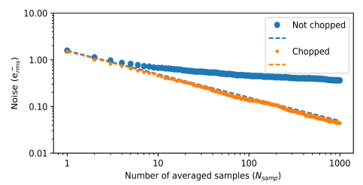
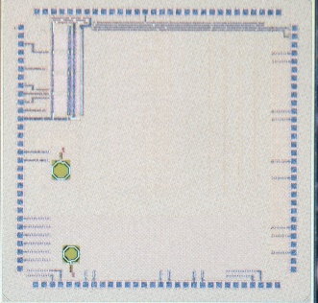
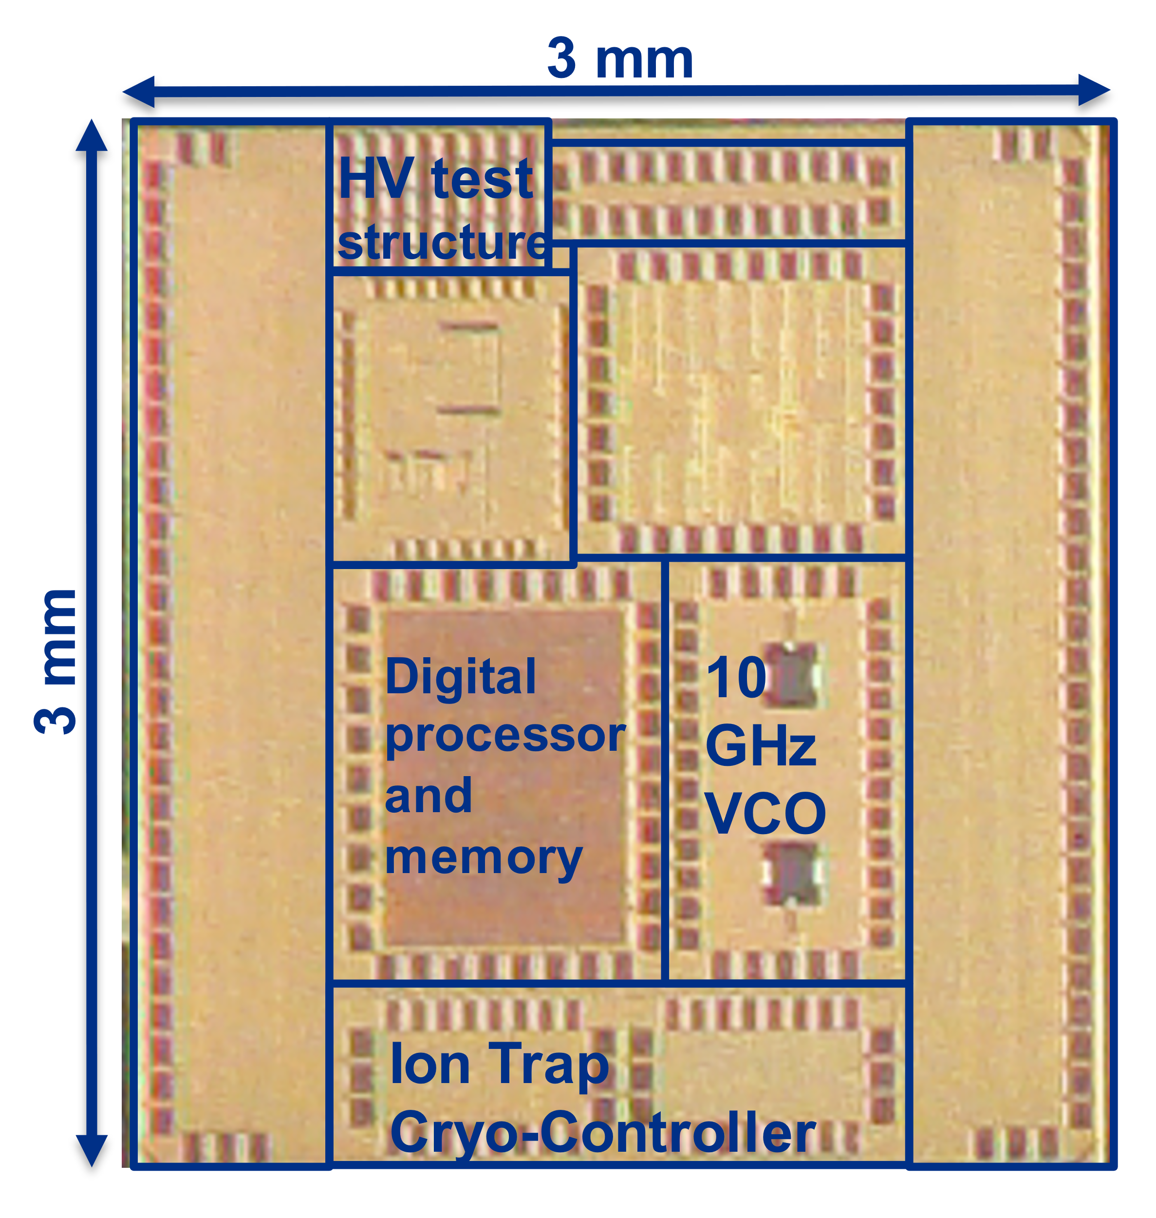
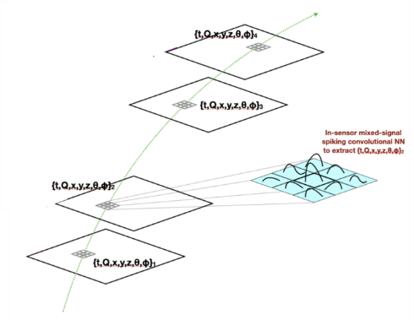
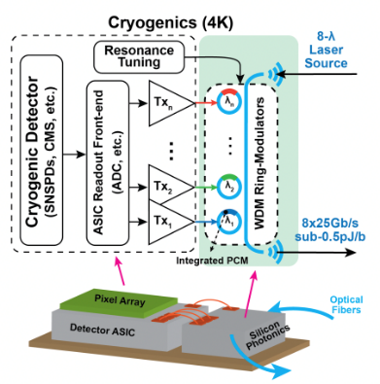
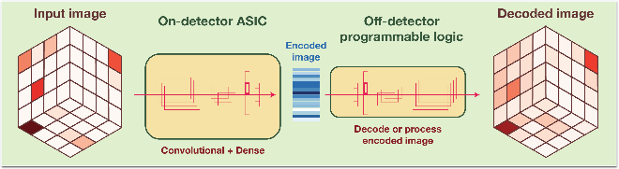
IMPACTFUL HARDWARE DEVELOPMENT
Ultra-Low Noise Sensing (Dark matter detectors) | Ultra-High Frame rates (Xray detectors) | Picosecond timing (HL LHC detectors) | Operation in extreme radiation/ cryogenic (HL LHC/ DUNE) | Edgeless 3D ICs (HEP / BES light sources)
High speed cryogenic data converters (with Microsoft) | Quantum Support Chips | AI-on-chip (ultra-fast data processing) | AI-in-pixel (minimizing data movement) | High-speed Photonic links (low power communications)
MIDNA

Slide 7
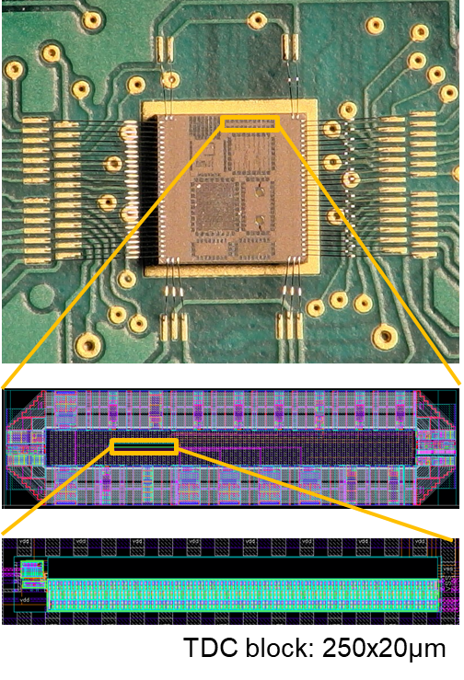
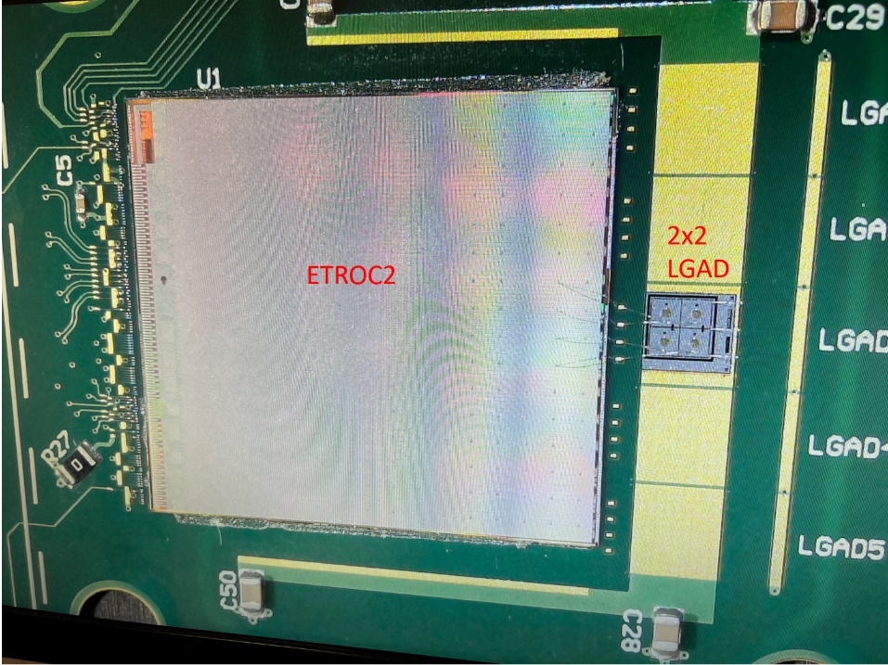
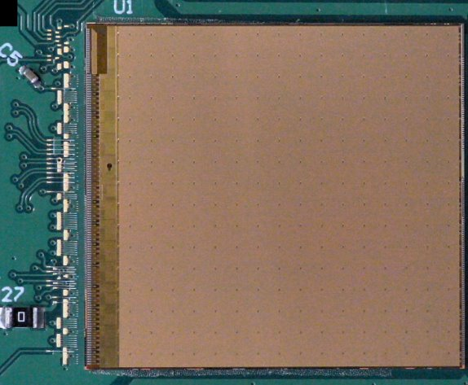
Fast Timing
ETROC
LGAD readout ASIC for CMS Endcap Timing Layer
16x16 pixel, full reticle chip in 65nm
ETROC2: full size, full functionality prototype currently being tested
Per-pixel TDC with self calibration scheme to compensate for process variation, temperature, and power supply voltage
Sensor+ASIC time resolution of 40ps
Constant Fraction Discriminator
65nm CMOS
does not require offline corrections or calibrations
Achieves 15ps for 20fC signal
ASIC TDC
Time-to-digital converter test structure for SNSPD readout
Cryogenic operation (4K)
22nm CMOS
Demonstrates better than 8ps timing resolution at 4K (300uW)

Slide 8
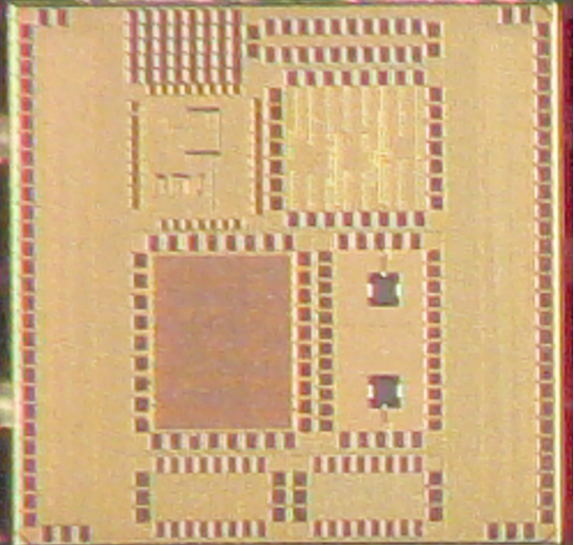






Quantum support chips
3 mm
HV test structure
TDC
Noise test structure
ADC – cap array
cryoCMOS for Quantum
QUANTUM SENSING
Portable optical atomic clocks
(Joint DOE-DOD development)
cryoCMOS model and tool-kit development (4K)
cryoCMOS workshops (e.g. IceQubes, IEEE Quantum week)
3 mm
Atomic Clocks
Atomic Clocks
Digital processor and memory
10 GHz VCO
Ion Trap
Cryo-Controller
QUANTUM COMPUTING
Utility scale QC
ADC: 12b, 10 GSPS, < 100mW, operating at 4K
Quantum Science Center
Cryoelectronics for Ion-Trap based QC
Co-design system for Spin-Liquid simulations
Multi-tier compact cryogenic system
Eliminating cryogenic isolators and circulators, combining superconducting electronics with cryoCMOS
QUANTUM COMMUNICATION
SNSPD
Low Noise amplifier, Photon counting and picosecond timing
[space science applications, dark matter detection]
Notes:
Here are my Notes:

Slide 9

AI ASICs
AI chiplet: AI Autoencoder ECON
On-detector Edge Compute for Adaptive-Autonomous Real time data processing at the Large Hadron Collider
  Algorithm Co-design: Low power (2nJ/inference), Low latency (25ns), Radhard operation
  Adaptive programable interface for various detector geometries and evolving detector conditions
Energy Efficient Edge AI hardware
Chiplet, on-chip-edge, in-pixel
Types of NN: DNN-Digital CMOS, Digital SNN, Analog NN (SRAM, ReRAM, ECRAM)
To our knowledge, the first AI ASIC in HEP (all of DOE??)
AI-driven integrated heterogenous systems
Beyond system-on-chip: Heterogenous Compute On-chip
Electronic – Photonic Integration
In-memory compute
Incorporate Industry/ Open source IP: ARM/RISC cores
Heterogenous Detector stack: Sensors, Neuromorphic Layer (Novel Materials), Mixed signal electronics, Photonics
AI tools and design methodology
Open source tool and design methodology: hls4ml, backend compatible for ASICs, extending to eFPGAs, mixed signal and beyond CMOS (CrossSim – Sandia), ESP
Industry and community driven: A large community from a variety of applications. Industry adding Open-source to tool plug-in

Slide 10

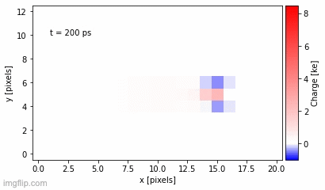
Real-time tracking for pixel detectors
Cluster shapes and Pulse information for filtering out low p_{T} particles
NN classifier identifies and saves clusters from tracks with p_{T} > 2 GeV
≥ 95% data reduction by saving only high p_{T}
Low power implementation
Proton-proton
collisions at
40 MHz
Compact algorithms for data reduction through featurization
Predict physics information (x,y,θ,ɸ) and meaningful error (UQ) on particle position, angle
Potential for reduction of track seeds ⟶ saves time & computing resources down the line
Silicon pixel sensors
12.5x50 µm pitch, 100 µm thick
Simulation
link
Technology development to enable on-sensor computing
Ultra low power in-memory compute chips
3D integration for optimized data processing
Leverage emerging technologies such as novel CMOS compatible memristors

Slide 11
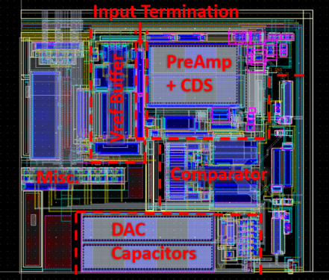
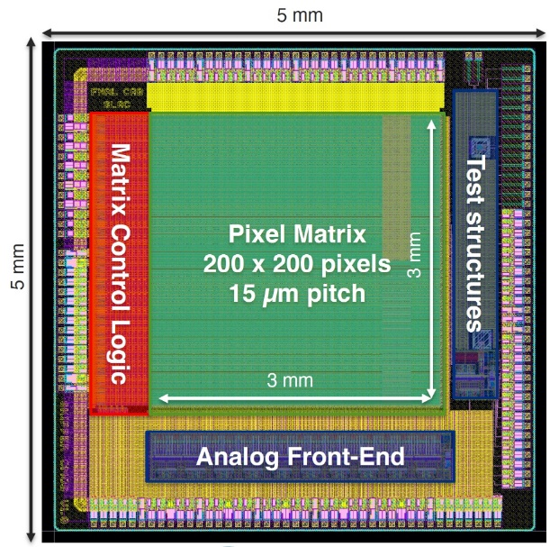
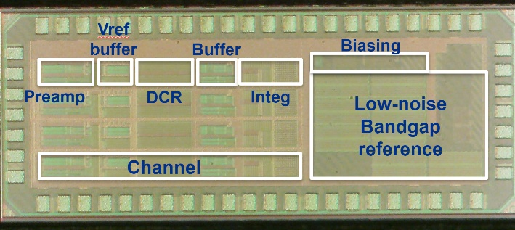
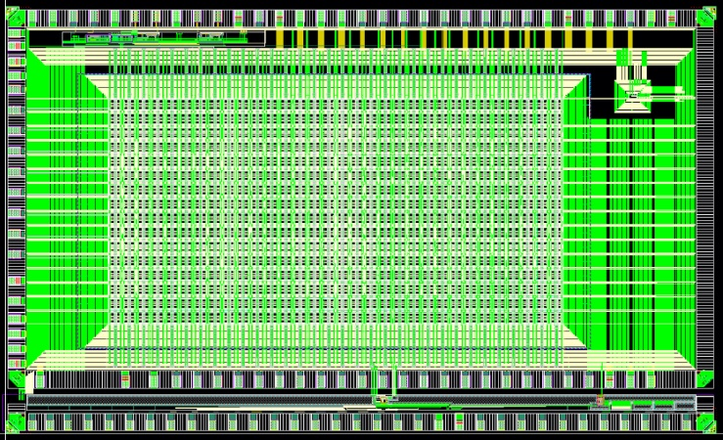

Skipper CCD and CCD-in-CMOS readout
Skipper CCD readout: MIDNA
State-of-the-art noise performance (~3e- noise performance)
Cryogenic operation (100K)
On-chip analog pile-up to reduce readout time
100x lower power, extremely small footprint, significantly reduced cost
Excellent test performance
Skipper CCD-in-CMOS Sensor
Collaboration with leading CMOS foundry (Tower Semiconductor) to develop Skipper-CCD in commercial CMOS process
Prototyped ASIC has ~400 variations (pixel designs/process splits) to evaluate best design
Testing underway, so far demonstrated detection, charge transfer, and skipping
Full-reticle large area prototype to follow
Highly-parallel readout ASIC for Skipper-on-CMOS
Developed low-power in-pixel ADC for highly parallel readout (→ high frame rates)
Per-pixel 10b ADC for massively parallel readout
First two prototypes under test
Full-reticle ASIC in 2023
10b, 100KSPS in-pixel ADC (~30x30µm)
SPROCKET ASIC: 64x32 pixels (09/22)
Image sensor ASIC
Testing at Fermilab

Slide 12
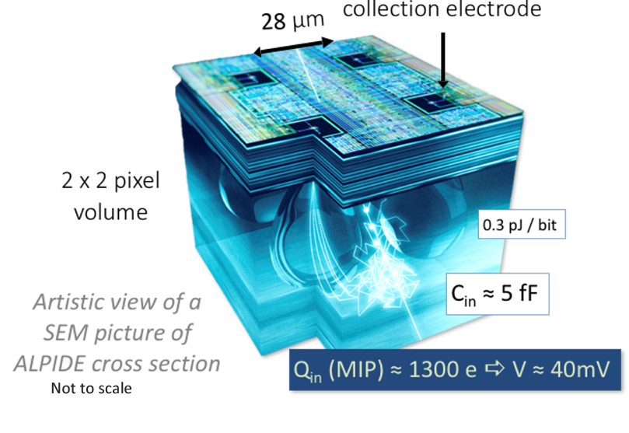
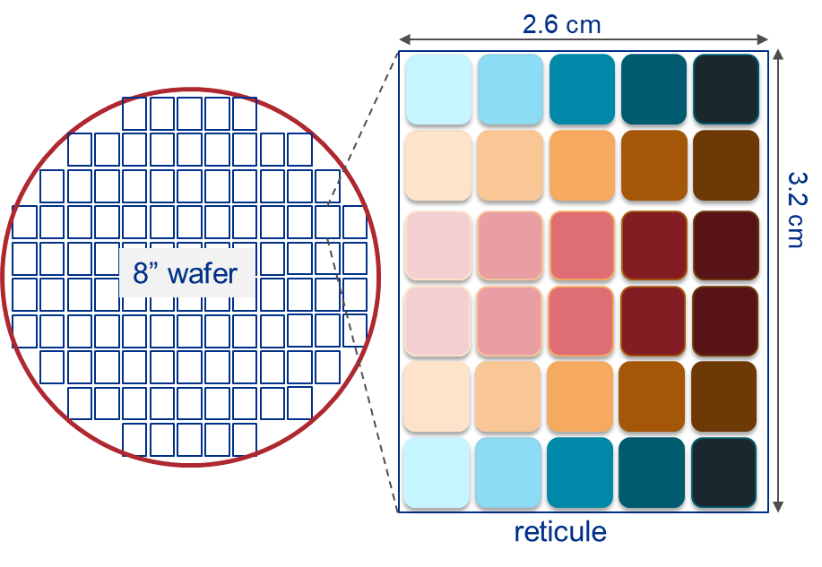
CMOS Sensors Vision
GOALS for a HEP community-driven CMOS sensor development
Enable US manufactured sensor capability for HEP experiments
Optimize the process to enable various types of sensors ubiquitously used in HEP (MAPS, MAPS with timing, Digital SPADs, LGADs, CMOS LGADs)
Co-design sensor and readout electronics
Enable the broad adoption of the development across HEP community
PARTNER with SKYWATER TECHNOLOGIES
Strong academic support for device simulation and testing
Engineering run with various designs on a high resistivity wafer
High-throughput testing of sensors at Fermilab

Slide 13
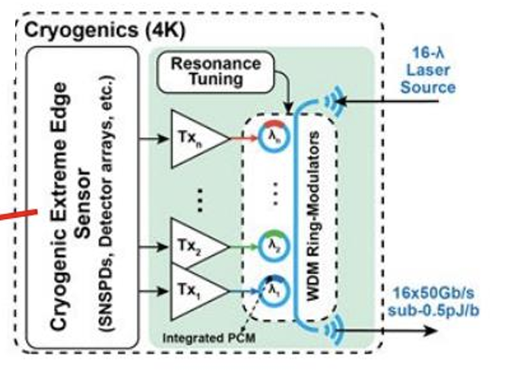
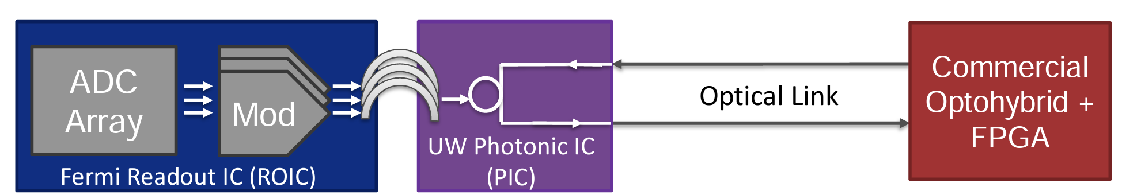
Silicon Photonics
Goal: Integrated sensing - edge computing – communication
Creating high bandwidth, low power interconnect for sensor networks
Preliminary use case: Pixel detectors → 1M pixels generate > 1 Tbps data zero-suppressed data; with edge computing we can get to 30 – 100 Gbps
High bandwidth data transmission integrated with chips
Cryogenic data transmission (100K to 4K)
Rad-hard data transmission

Slide 14
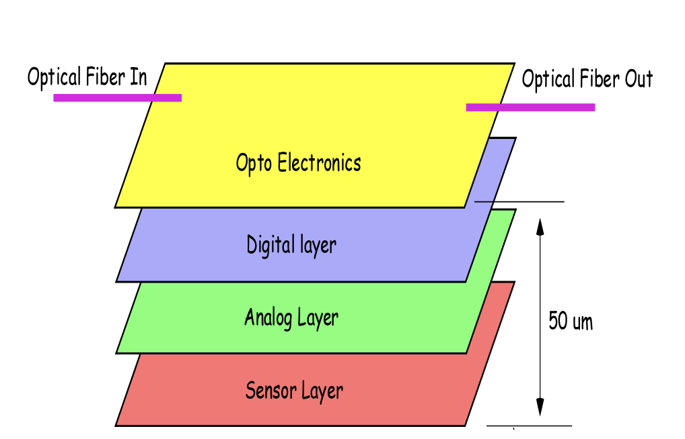
3D ICs – community driven for DOE applications
Fermilab started pursuing 3D integration in 2006
Work with partners (university, national labs, industry) to create a 3D IC Consortium
Create pathway for DOE applications
Work with vendors to setup standards/processes for low-mid volume prototyping

Slide 15







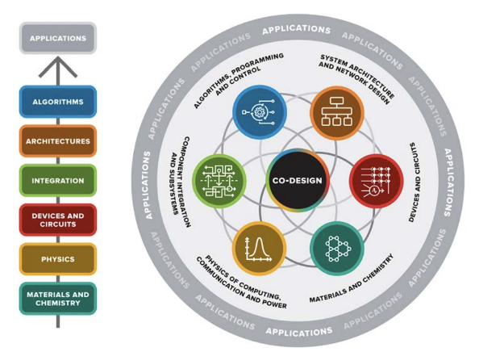

DOE Microelectronics Codesign Activities
DOE Microelectronics Codesign Teams:
"Hybrid cryogenic detector architectures for sensing and edge computing enabled by new fabrication processes"
Fermilab led jointly funded by HEP + BES + ASCR + FES
  Massively parallel readout for x1000 speed improvement of Skipper-in-CMOS: SPROCKET
  Development of rad-hard particle detectors based on superconducting nanowires for fast timing (EIC)
  CryoCMOS and beyond-CMOS superconducting electronics for edge computing
  Cryogenic system integration for scaling
CMOS and beyond CMOS for rad-hard neural networks
Rad-hard, Neuromorphic Neural Network for front-end data processing
Beyond-CMOS: Blue Sky R&D
CMS Pixel detector replacement R&D (TSMC 28 nm)
Working in conjunction with ORNL-led codesign team - ABISKO

Slide 16
Thank You!
Many topics not covered in this presentation
If interested, please contact us!

Slide 17
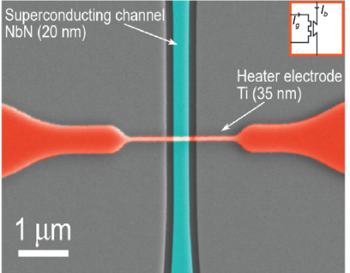
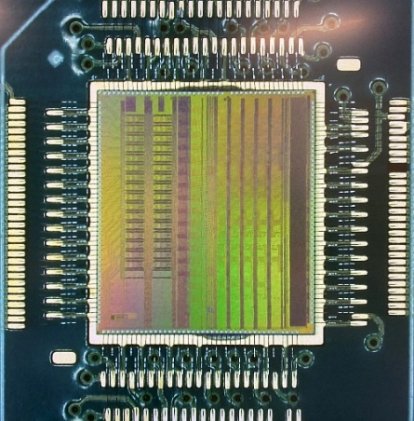

DOE Microelectronics Co-Design Research:
“Hybrid Cryogenic Detector Architectures for Sensing and Edge Computing enabled by new Fabrication Processes” (HYDRA)
Advancement of two complementary classes of cryogenic state-of-the-art single-photon and particle detectors:
the Skipper CCD-in-CMOS silicon detector
a hybrid detector platform based on superconducting nanowires
Development and co-design of:
advanced fabrication and integration techniques
novel optimized hybrid readout architectures
cryo-ASICs and cryotron-based superconducting electronics for integrated sensing and data reduction at source, through feature extraction and edge computing.
SNSPD
xTrons
cryoASIC

Slide 18
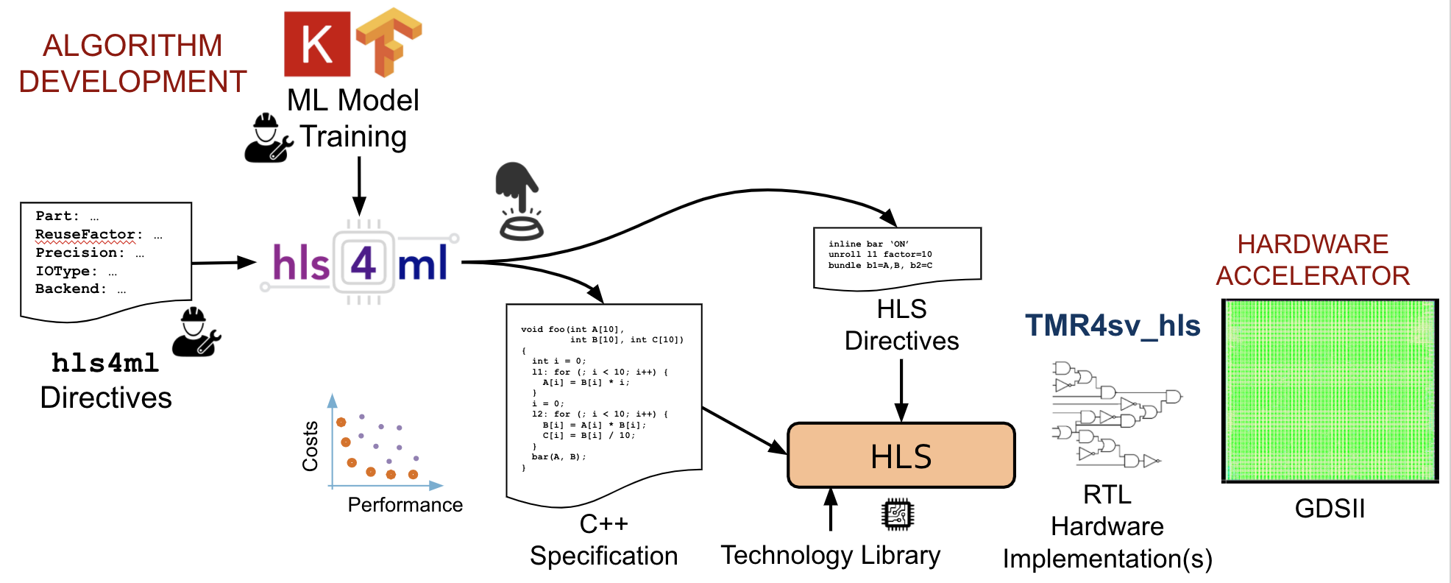
Design Methodology: Physics driven hardware co-design
Algorithm development based on Physics data
hls4ml simplifies the design of on-chip ML accelerators
    | hls4ml directives | << | HLS directives |
    C++ library of ML functionalities optimized for HLS
TMR4sv_hls: Triple Modular Redundancy tool for System Verilog & HLS

Slide 19
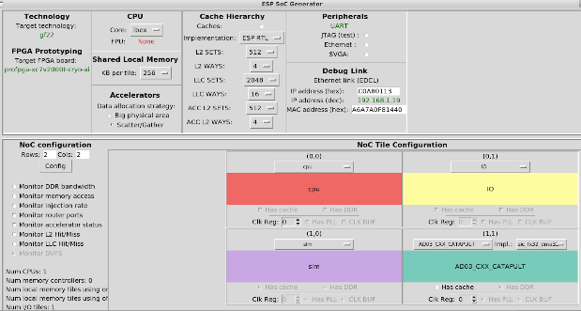
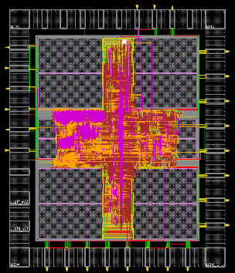
Scalable Quantum Control
System-on-Chip
          Platform for Scalable Quantum Control = ESP + FlexLogix eFPGA
            ML running on eFPGA/SoC in the cryostat for scalable quantum control
            Methodology: hls4ml + Catapult HLS + Synplify + FlexCompiler
            Architecture: eFPGA integration in SoC tile(s)
          Quantum control applications
            Data acquisition, model training, model evaluation, hardware synthesis
              State preparation (Control)
                Workshop on Quantum Computing Software 2022
              Readout, Error correction
            Early emulation on FNAL QICK looking for collaborators for demonstration
uC
CryoAI, 22nm
    Digital test chip to evaluate low power cryogenic performance of digital backend at lower core voltages
    Design and integration of an ML Accelerator (AutoEncoder for Anomaly Detection – IoT MLPerf Tiny)
    Chip & board fabricated – Ongoing testing
    ESP simulation for future respin

Slide 20
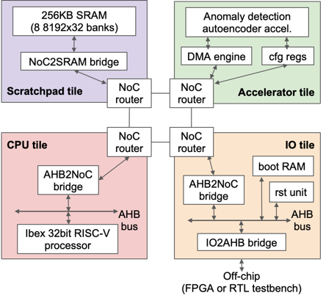
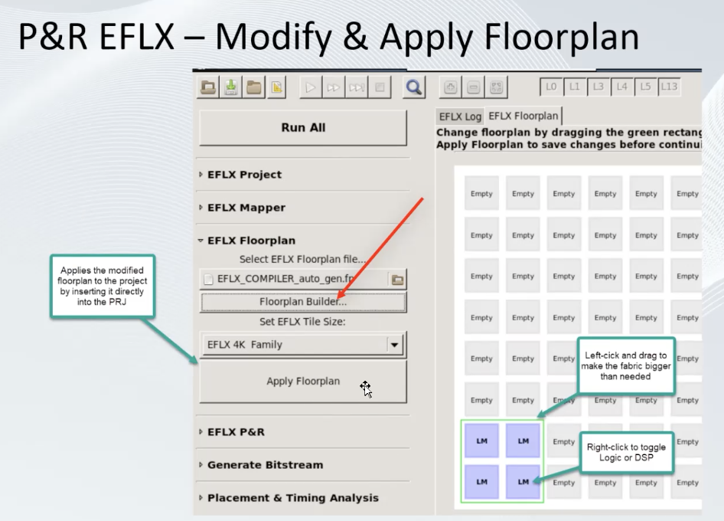
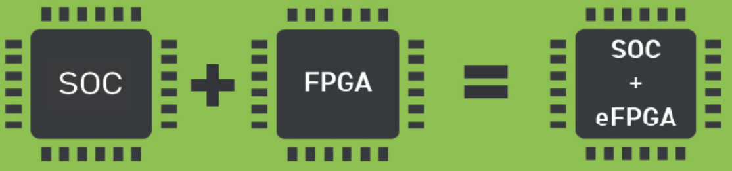
Reconfigurable Edge AI – Solve the HEP data challenge
Collaboration with Columbia U. & Northwestern U.
Edge AI: Combining two established open-source platforms (ESP and HLS4ML) into a new system-level design flow to build and program a System on chip
  In the modular tile-based architecture, we integrated a low-power 32-bit RISC-V microcontroller (Ibex), 200KB SRAM-based memory, and a neural-network accelerator for anomaly detection utilizing a network-on-chip.
Embedding FPGAs on detector: Radhard/ cryogenic eFPGA on-chip – with Flex Logix (22nm / 28nm). Establishing design flow and investigating extreme environment performance

Slide 21
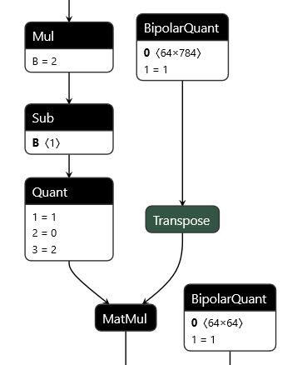
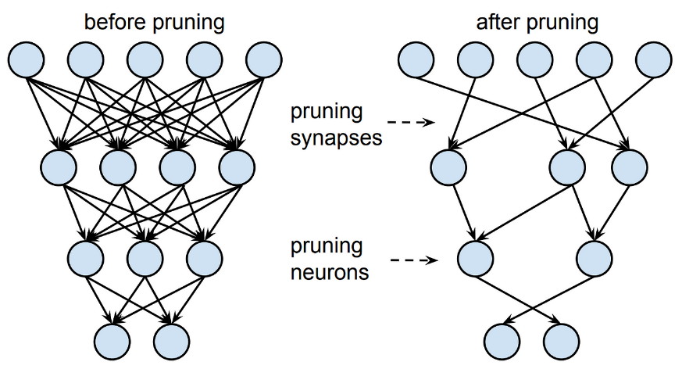
OPEN SOURCE TOOLS & EDGE AI
Develop efficient edge ML algorithms
  Quantization and sparsity, optimization techniques
  Physics-inspired and robust inverse algorithms
Build user-driven, open-source workflows for algorithm-hardware codesign
  Democratizing powerful edge ML for a broad range of scientific applications and industry
  Workforce development, multi-disciplinary collaborations, and education/demos/tutorials

