Slide 1
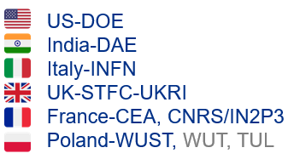
Proton Improvement Plan-II (PIP-II): An Overview
PIP-II is a partnership of:
Abhishek Pathak, Research Associate, PIP-II
Users Meeting-2023
June 27 -30 2023

Slide 2
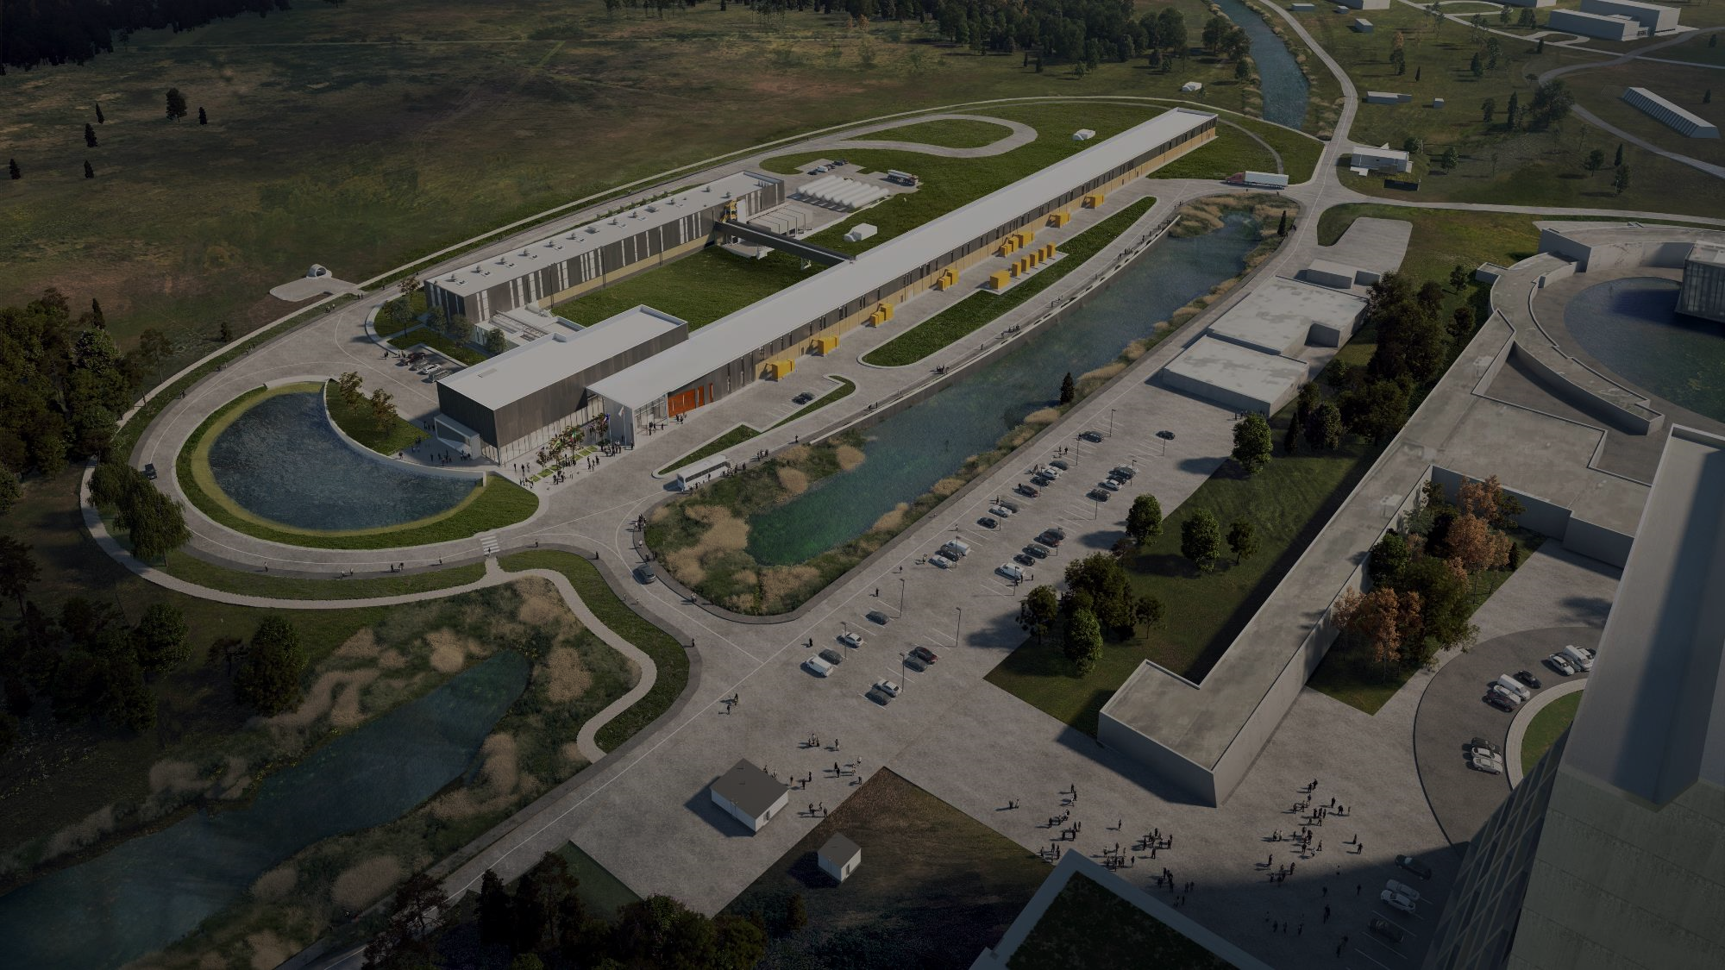
1
PIP-II Mission & Scope
2
International Confluence
Outline
3
Design
4
Status
5
Schedule

Slide 3
PIP-II MISSION & SCOPE
The Fermilab's PIP-II project is a key upgrade that's constructing a superconducting Linac, powering future experiments, enabling the world's strongest neutrino beam for LBNF/DUNE, and nurturing extensive physics research for decades ahead.
RFQ
$β_{opt}=0.$112
2.1-10 MeV
HWR
$β_{opt}=0.$112
2.1-10 MeV
SSR-1
$$β_{opt}=0.22$$
10-32 MeV
SSR-2
$β_{opt}=0.$475
32-177 MeV
LB-650
$β_{opt}=0.$65
177-516 MeV
HB-650
$β_{opt}=0.$971
516-800 MeV
Booster
20 Hz
IE=800 MeV
Main
Injector

Slide 4
PIP-II MISSION & SCOPE
The Fermilab's PIP-II project is a key upgrade that's constructing a superconducting Linac, powering future experiments, enabling the world's strongest neutrino beam for LBNF/DUNE, and nurturing extensive physics research for decades ahead.
RFQ
$β_{opt}=0.$112
2.1-10 MeV
HWR
$β_{opt}=0.$112
2.1-10 MeV
SSR-1
$$β_{opt}=0.22$$
10-32 MeV
SSR-2
$β_{opt}=0.$475
32-177 MeV
LB-650
$β_{opt}=0.$65
177-516 MeV
HB-650
$β_{opt}=0.$971
516-800 MeV
Booster
20 Hz
IE=800 MeV
Main
Injector
800 MeV, 2 MA H- Beam
Beam Transfer Line

Slide 5
PIP-II : BEAM PARAMETERS
Position | Current, mA | Beam Energy (MeV) | Velocity $$β=v/c$$ | Emittance, H/V, norm $(μ$m) |  | Emittance, Long.,norm, ($μ$m) |  | Beam Size, H/V,Trans., typ., mm | Beam length, deg@162.5 MHz | Energy spread, (%)
 |  |  |  | rms | 99.99% | rms | 99.99% | rms | rms | rms
LEBT | 5.2 | 0.03 | 0.008 | 0.18 | 1.2 | NA | NA | 5 | NA | NA
RFQ Exit | 5 | 2.1 | 0.067 | 0.21/0.21 | 3.87/4.0 | 0.34 | 6.0 | 1/0.5 | 7.1 | 0.4
MEBT output | 2 | 2.1 | 0.067 | 0.21/0.2 | 2.95/2.68 | 0.35 | 7.35 | 1.89/1.84 | 7.71 | 0.6
HWR output | 2 | 10 | 0.145 | 0.24/0.24 | 6.06/6.15 | 0.33 | 8.0 | 1.31/1.23 | 1.93 | 0.3
SSR1 output | 2 | 32 | 0.256 | 0.25/0.25 | 4.91/4.43 | 0.33 | 11.12 | 1.65/1.61 | 1.07 | 0.18
SSR2 output | 2 | 177 | 0.541 | 0.23/0.27 | 5.23/6.61 | 0.33 | 12.13 | 1.64/1.72 | 0.61 | 0.06
LB650 output | 2 | 516 | 0.764 | 0.24/0.27 | 6.54/6.73 | 0.32 | 12.89 | 1.68/2.17 | 0.3 | 0.04
HB650 output | 2 | 833* | 0.848 | 0.24/0.27 | 6.49/7.02 | 0.32 | 12.18 | 1.56/2.09 | 0.25 | 0.03
BTL | 2 | 800* | 0.842 | 0.24/27 | 6.49/7.02 | 0.32 | 12.18 | 1.3/1.3 | 4.5 | 0.03

Slide 6
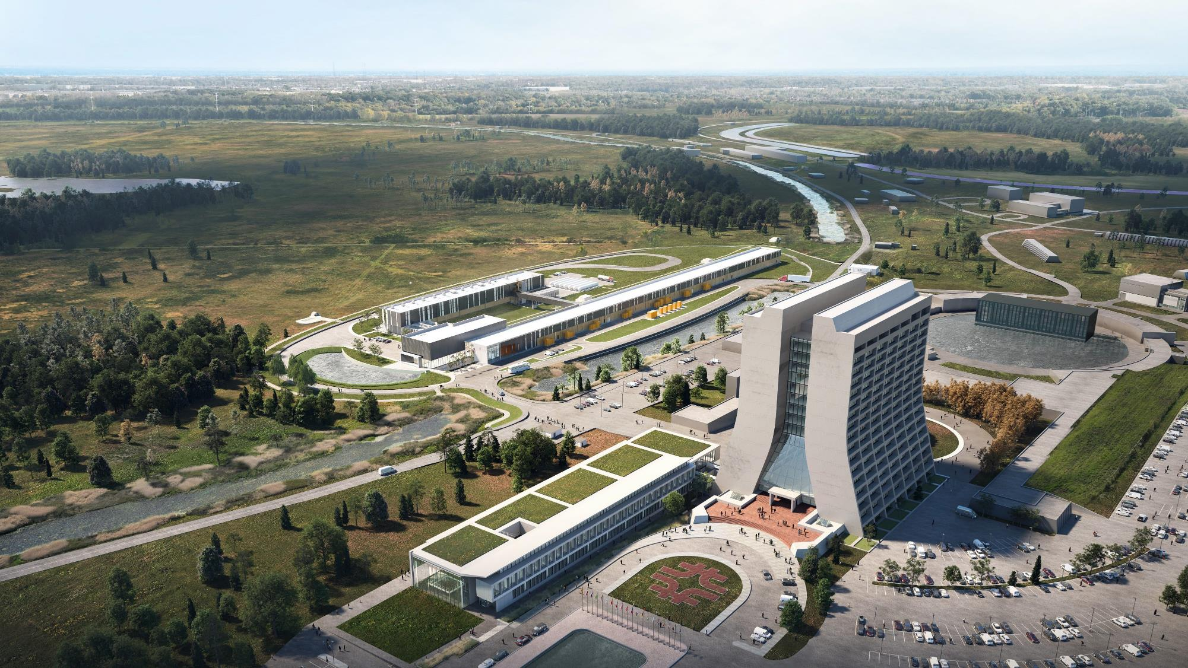
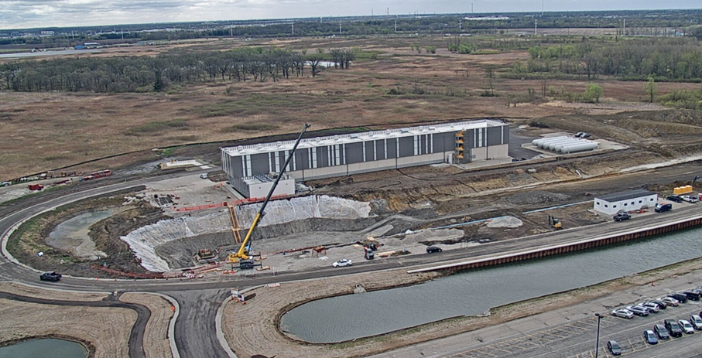
Main Injector
Transfer Line
PIP-II
SRF Linac
Booster
PIP-II will provide a highly capable, reliable, upgradeable and expandable scientific infrastructure with significant savings to DOE

Slide 7
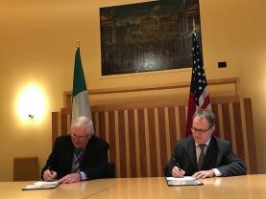
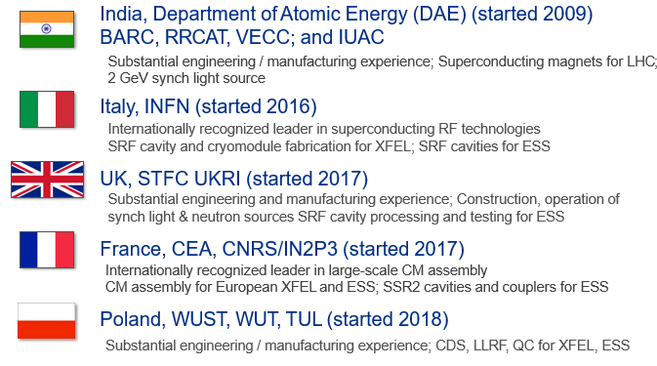
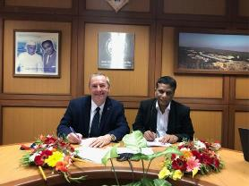
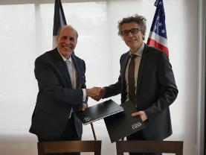
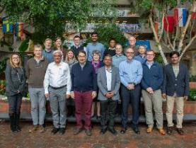
A Confluence of International Expertise and Capabilities

Slide 8
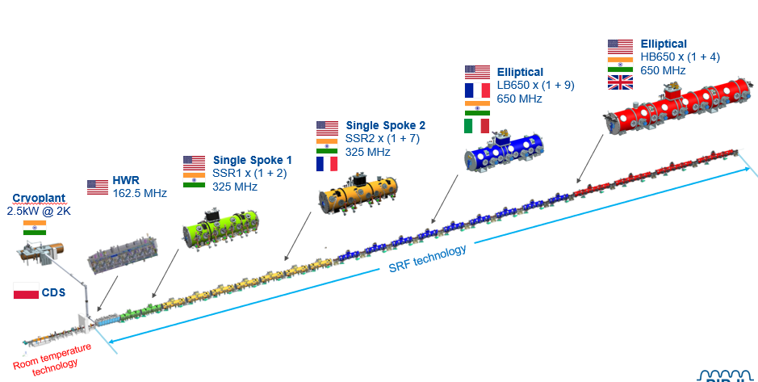
A Confluence of International Expertise and Capabilities
PIP-II represents the inaugural accelerator project within the United States that has been constructed with substantial international contributions, leveraging unparalleled global expertise and capabilities.

Slide 9
PIP-II : SC LINAC PHYSICS DESIGN
Performance Requirements Met: Integrated PIP-II accelerator designs have been successfully completed.
Integrated Design: Accelerator Physics (AP) is incorporated into PIP-II systems design.
Driven by Physics: The design of accelerator systems, including Fermilab accelerator upgrades, is guided by physics requirements.
System Parameters: Comprehensive studies (PIP2IT) have confirmed the selection of system parameters.
Continued Studies: Synergistic studies are ongoing to improve the understanding of Fermilab accelerator complex performance in the PIP-II era.

Slide 10
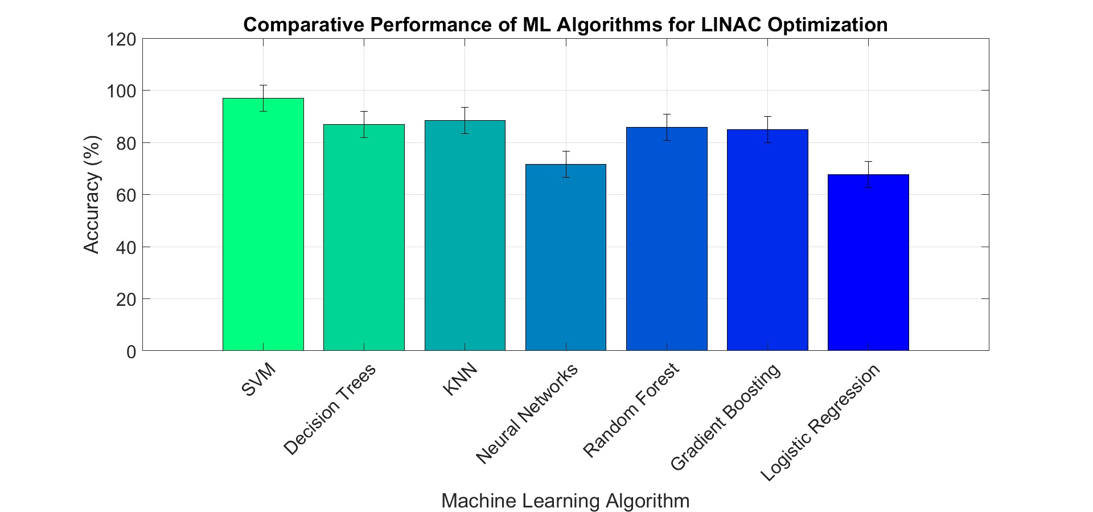
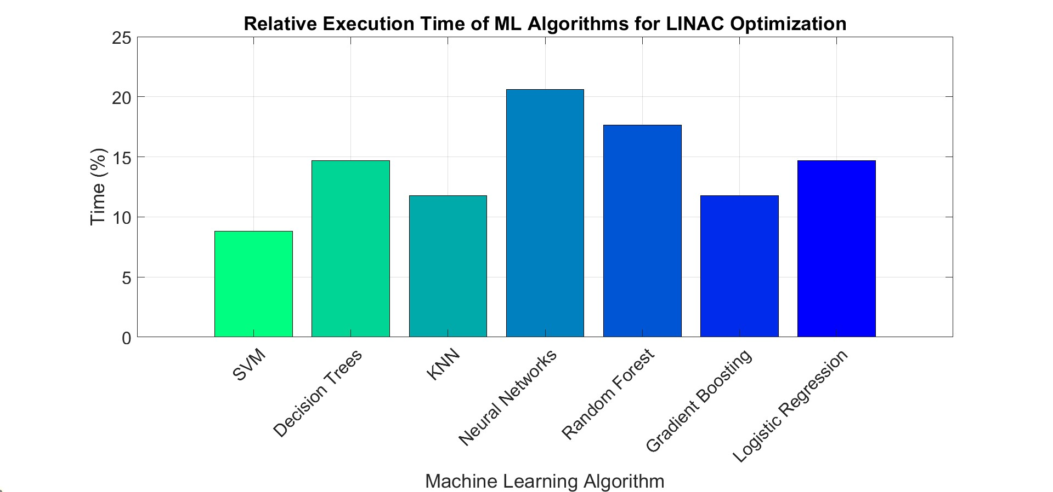
ML for beam dynamics & linac tuning
Incorporation of Machine Learning: An assortment of sophisticated Machine Learning methodologies has been judiciously applied and meticulously compared in an endeavor to accelerate beam dynamics simulations and enhance the efficiency of linac tuning procedures.
Utilizing SVM for Precision Tuning: The majority of our tuning endeavors exploit Support Vector Machine (SVM) algorithms owing to their superior performance and robustness in our domain-specific tasks.

Slide 11
BEAM DYNAMICS IN BOOSTER
Modified Optics: Booster 400 MeV optics were scaled to 800 MeV, with modifications made for PIP-II injection.
RFQ Tracking: Realistic Linac beam distribution has been tracked from the RFQ.
Foil Model: Foil model has been successfully integrated into simulations.
Intensity Limits and Losses: PIP-II mitigates intensity limits and losses in Booster through:
Space Charge Tune-shift Reduction: This has been reduced by a factor of 2 – 4 at 800 MeV injection.
Transverse Emittances: These have met set requirements.
Electron Cloud: The electron cloud has been simulated, showing a small impact at PIP-II intensity.
Beam Losses: Beam losses are at the 2% level with 2-stage collimation in BTL and increased aperture extraction magnets.

Slide 12
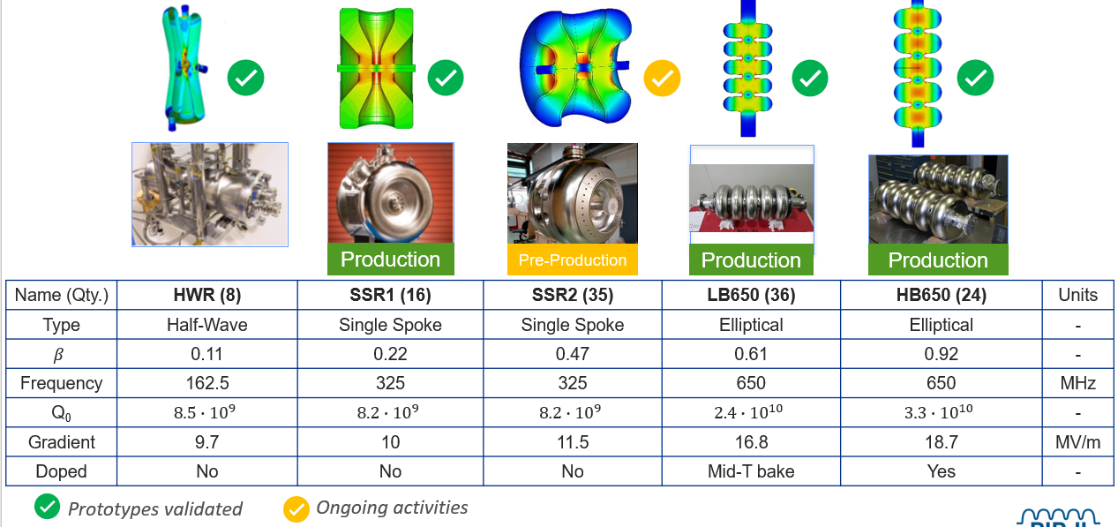
PIP-II SRF CAVITIES

Slide 13
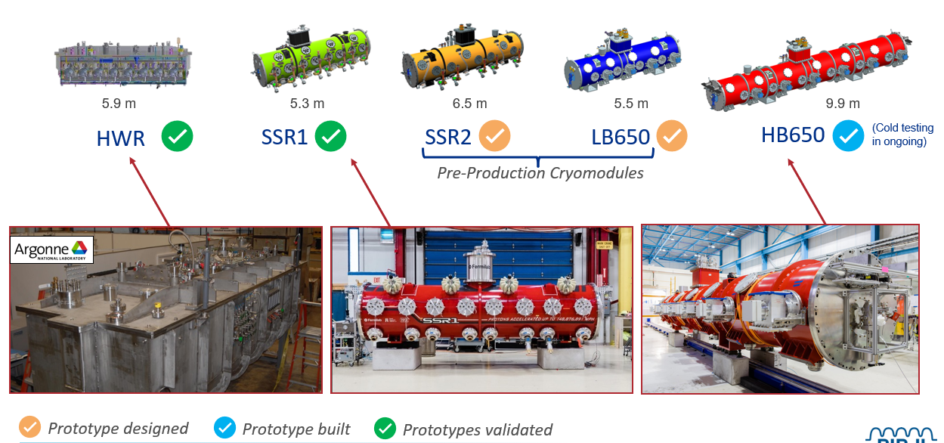
PIP-II: SRF CRYOMODULE FLAVOURS

Slide 14
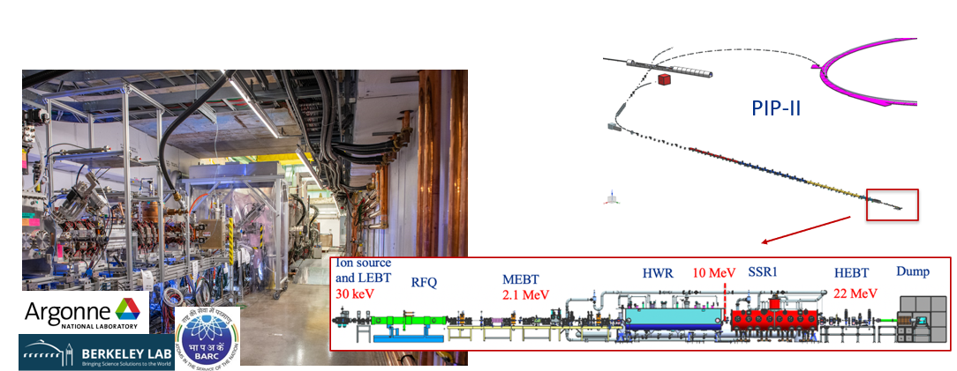
PIP2IT AS A TESTBED FOR PIP-II TECHNOLOGY
PIP2IT successfully demonstrated LBNF beam parameter and full acceleration up to the first two linac cryomodules.

Slide 15
PIP-2IT TRANSITION TO CRYOMODULE TEST STAND
PIP2IT accelerator was disassembled, and area converted into the 650 MHz and 325 MHz cryomodule test stands
Cold RF testing of prototype HB650 CM in progress

Slide 16
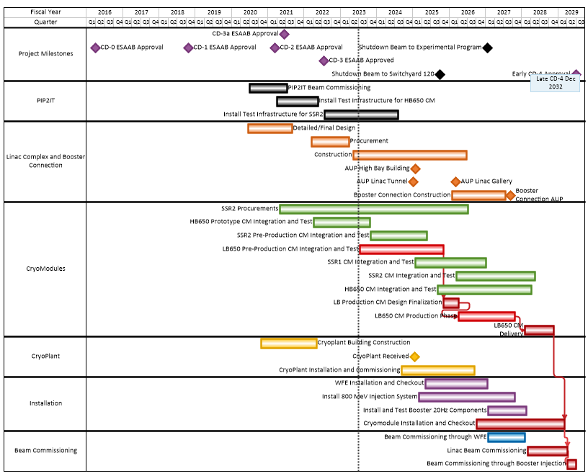
SCHEDULE SUMMARY – Early completion April 2029

Slide 17
SYNOPSIS
Enabling Intense Neutrino Beams: PIP-II is poised to facilitate the world’s most intense neutrino beam directed towards the LBNF/DUNE, thus modernizing Fermilab’s accelerator complex and empowering scientific discoveries for many forthcoming decades.
Project Milestone: PIP-II has successfully secured CD-3 approval, commencing the project execution phase and foreseeing delivery in the year 2028.
Innovative Collaborations: PIP-II is pioneering unprecedented paths as the inaugural DOE/SC accelerator to be constructed with substantial international contributions.
International Partnerships: Our international collaborations have been making commendable technical progress by finalizing designs, demonstrating pivotal technologies, and initiating project construction.
Broad Support: The PIP-II project continues to receive robust support from a wide spectrum of entities including Fermilab, our partners, the physics community, the Office of Science, DOE, and Congress.
17
6/28/2023
Abhishek Pathak | Proton Improvement Plan-II (PIP-II): A Comprehensive Overview

Slide 18
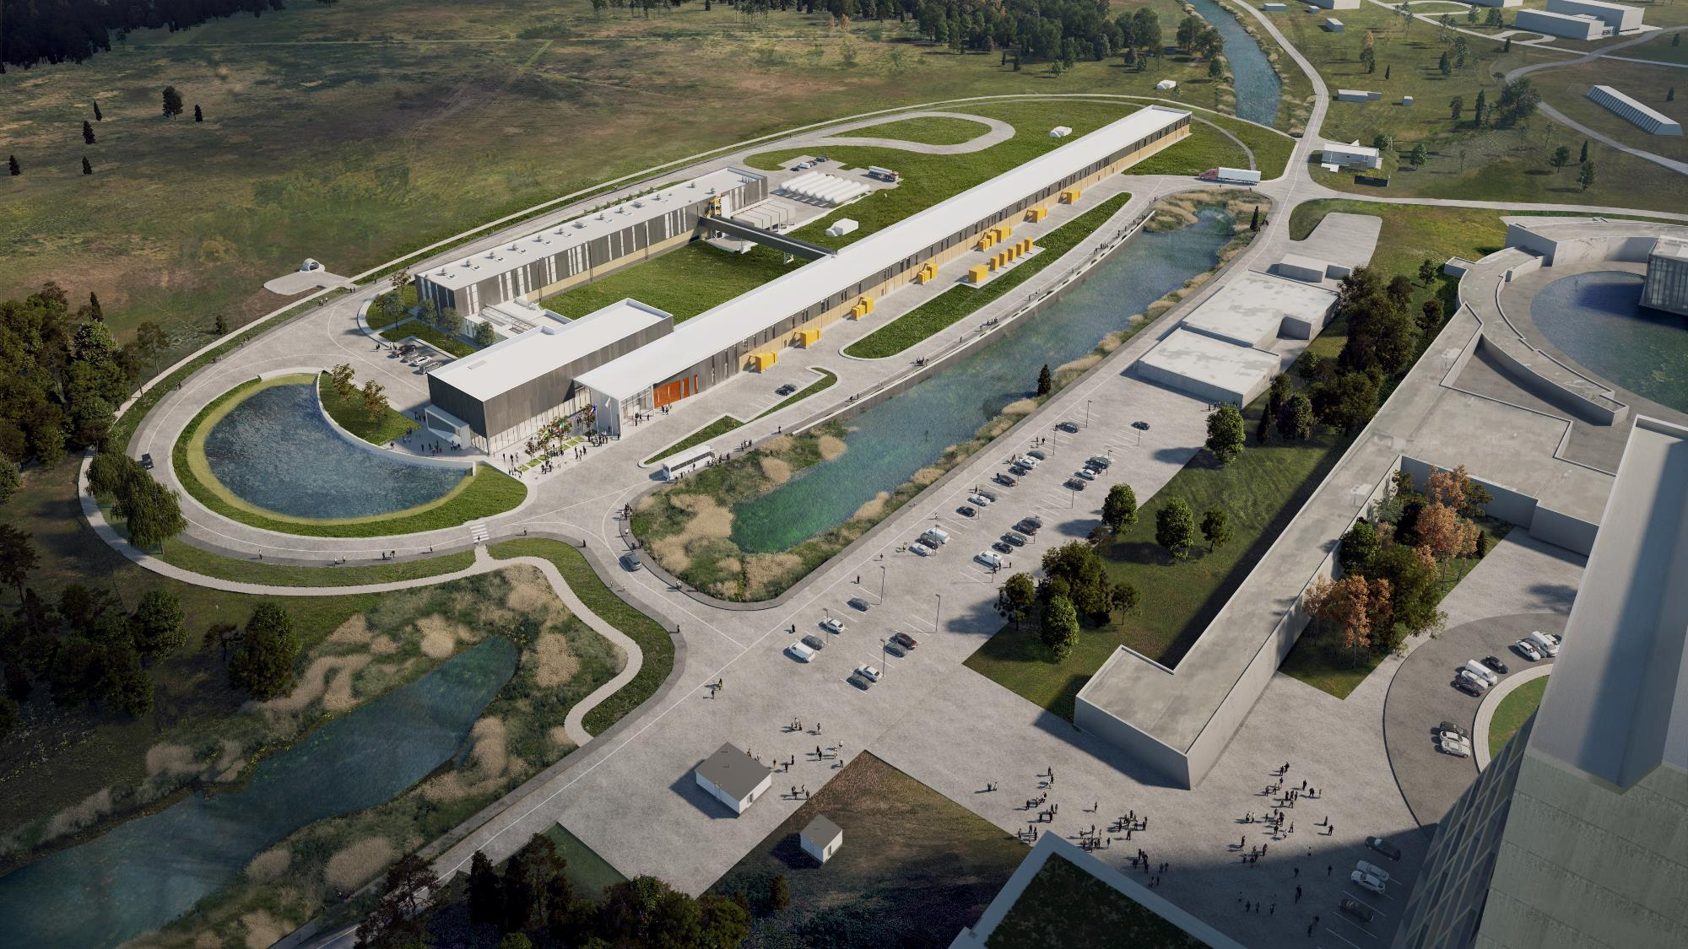
PIP-II
Thank You
Follow us:
www.pip2.fnal.gov
@PIP2accelerator
/showcase/pip-ii/

