Slide 1
New Ideas for the Accelerator One Injector to Save Them All, A Matter of Time
A.P. Schreckenberger
Associate Scientist | Main Injector Department
2023-06-28

Slide 2
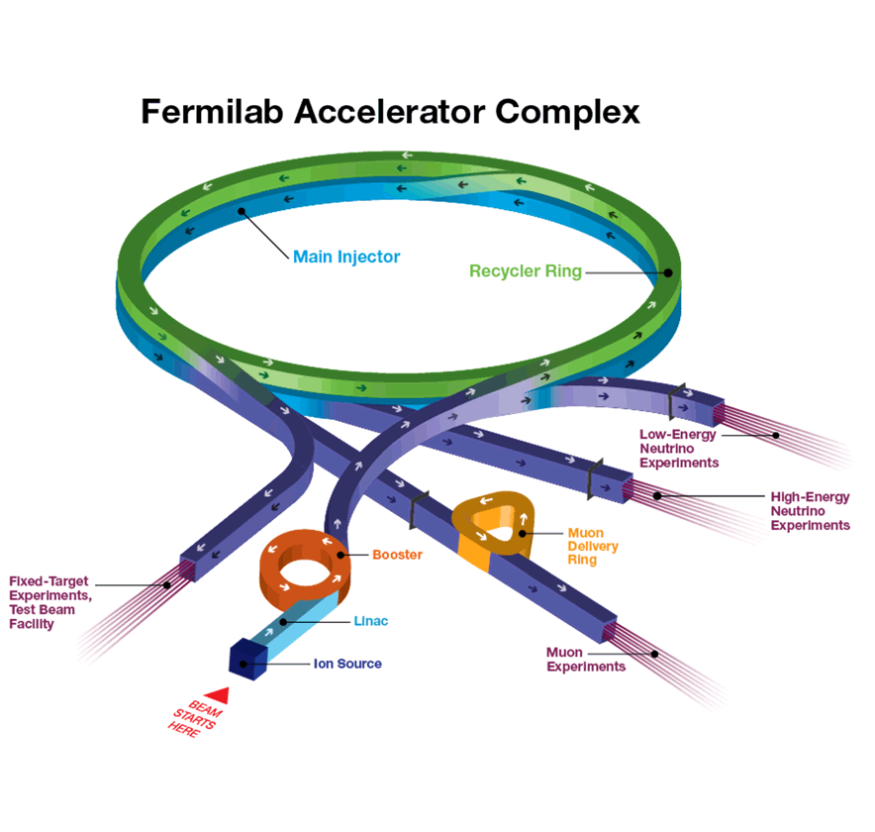
Complex Overview + Our Mission
– Rich history of accelerator complex Preaccelerator + Linac [400 MeV] PIP-II linear accelerator will drive the next-gen. infrastructure [800 MeV] Booster [400 MeV – 8 GeV] 15 Hz Ramp Rate 4.5e12 protons per pulse (ppp) Future: 20 Hz Ramp Rate + 6.7e12 ppp PAR explored as viable solution for “PIP-II+” Recycler Ring [8 GeV] Slip-stacking functionality 2.5 MHz rebunch for Muon Campus Combined function magnets are evil Main Injector [8 GeV – 120 GeV] Ramping to 120 GeV High Energy Neutrino Experiments!

Slide 3
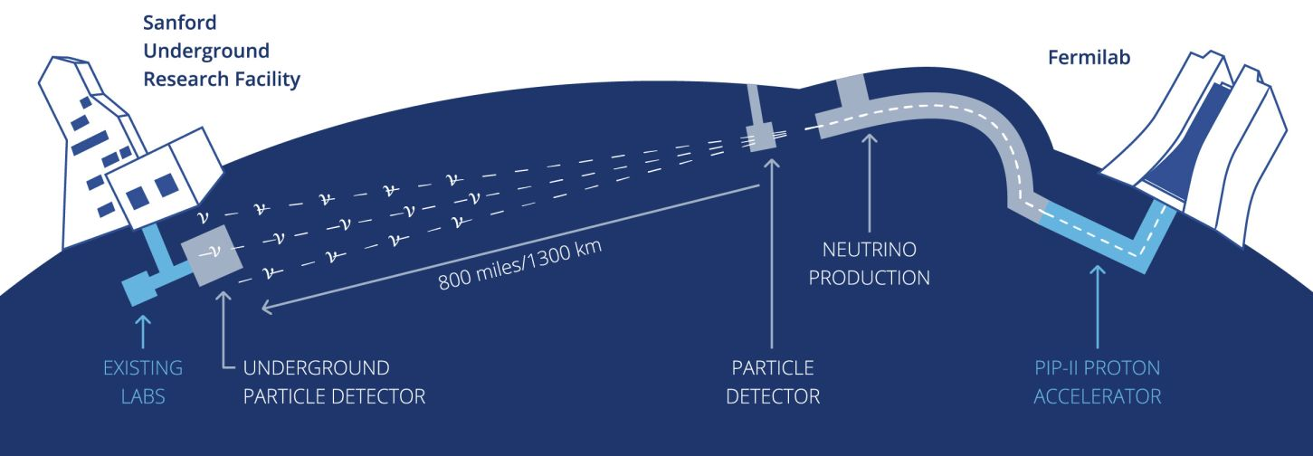
DUNE: The world’s most capable neutrino experiment, driven by LBNF and PIP-II
Delivering on LBNF/DUNE is Fermilab’s highest priority

Slide 4
DUNE: The world’s most capable neutrino experiment, driven by LBNF and PIP-II
Delivering on LBNF/DUNE is Fermilab’s highest priority

Slide 5
Delivering on LBNF/DUNE is Fermilab’s highest priority
Met by producing the most neutrinos possible
→ Increase the proton flux!
A.P. Schreckenberger | New Ideas for the Accelerator

Slide 6
Delivering on LBNF/DUNE is Fermilab’s highest priority
Met by producing the most neutrinos possible
→ Increase the proton flux!
$P=eE\frac{N}{T}$
Max energy (E) fixed at 120 GeV 😐
Increase beam pulse intensity (N)
Requires more 8 GeV beam
Intensity-related upgrade path
Decrease the MI ramp time
A.P. Schreckenberger | New Ideas for the Accelerator

Slide 7
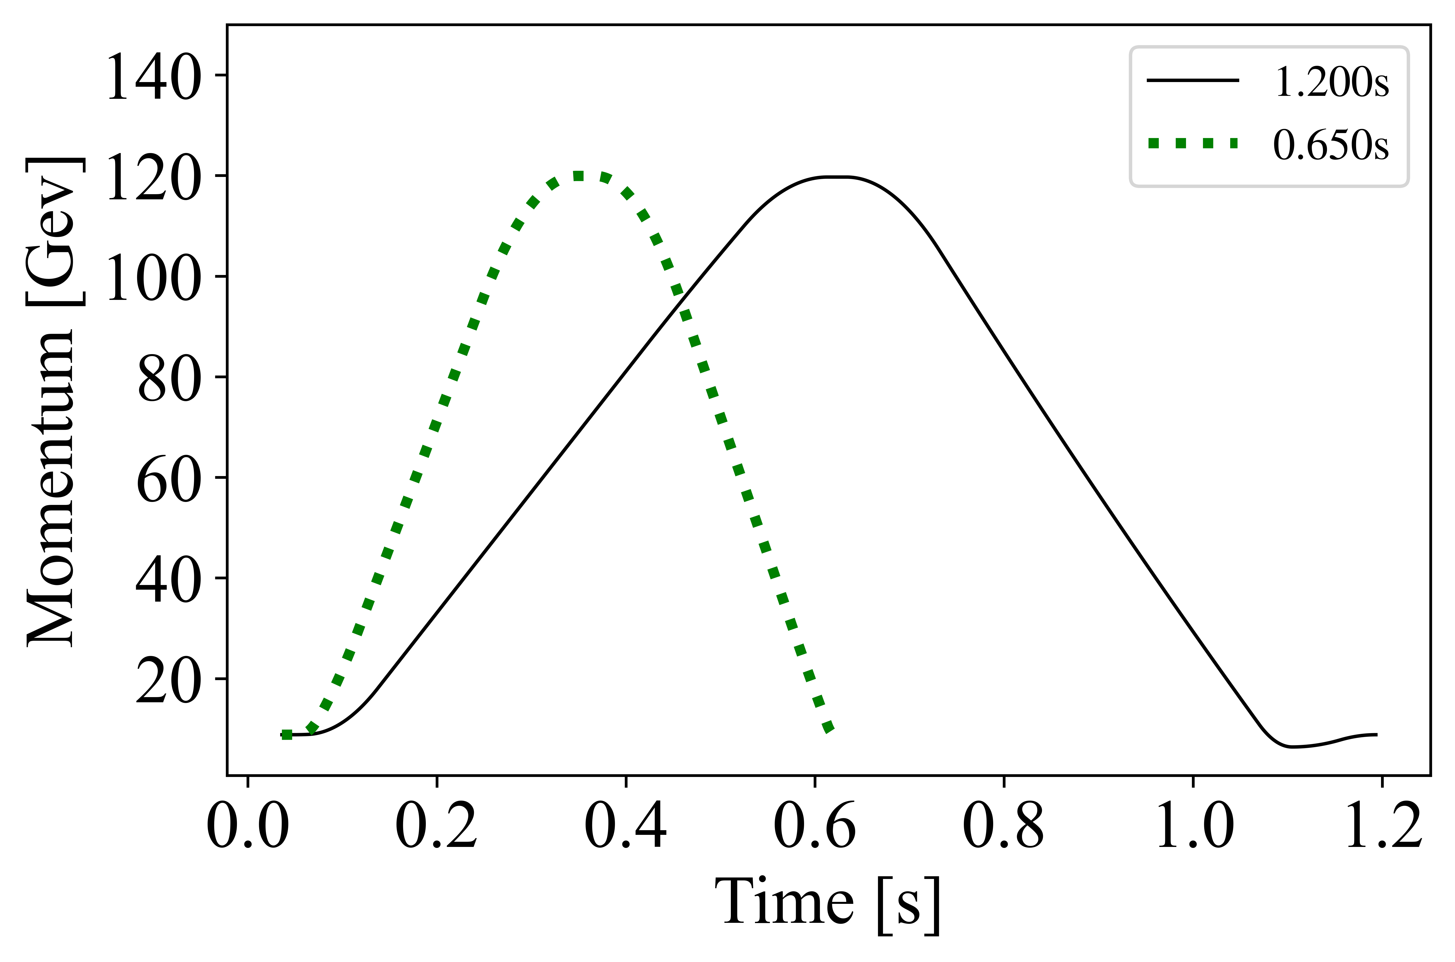
All a Matter of Time
 |  | PIP-II Targets + Options
Scenario | Apr. 23 | PIP-II | A | B
MI 120 GeV ramp time [s] | 1.333 | 1.2 | 0.9 | 0.7
Booster ramp rate [Hz] | 15 | 20
Number of batches | 12 | 12
MI power [MW] | 0.865 | 1.25 | 1.666 | 2.142
Cycles for 8 GeV | 6 | 12 | 6 | 2
Reducing Ramp Time has advantages Immediately viable to pursue tests and increase power Targets one accelerator machine
0.65s is the absolute minimum time for slip-stacking in Recycler Case leaves no beam for 8-GeV program Developing full capabilities comes with infrastructure needs Addressing challenges would facilitate a ~2.2-MW facility Help deliver groundbreaking science Aid project execution Fit vision for next 20 years of beam

Slide 8
Options would greatly exceed 240 GeV/s design rate Will epoxy degrade? Will our failure rate increase? Re-evaluating cooling needs Greater details on Magnet and Power concerns in D. Morris ACE talk
Getting to 0.9s ramp and beyond requires more voltage Replace all or double supplies Kautz Road Substation needs Can we add transformers?
Aim for 30kV feeder options?
Impact to service buildings
MAGNETS
POWER
ᛘᚢ ᚱ
ᛒᛁᛘ
ᛒᚬᚢ ᛦ
CONTROL
RF
BEAM
Regulators, controls, and instrumentation MECAR (Main Ring Excitation Controller and Regulator) replacement required Controls (water, field bus, RF, vacuum, etc.) over 30 years old New LLRF will bring additional needs Reliant on 1970s tech K. Hazelwood’s ACE talk has more depth
Current RF good to ~1.8 MW beam power Have 20 cavities, 17 more for bucket area J. Dey’s ACE presentation
Beam concerns → tighter loss controls Eddy currents, transition crossing, collimators, the abort lines, monitoring, shielding, etc…

Slide 9
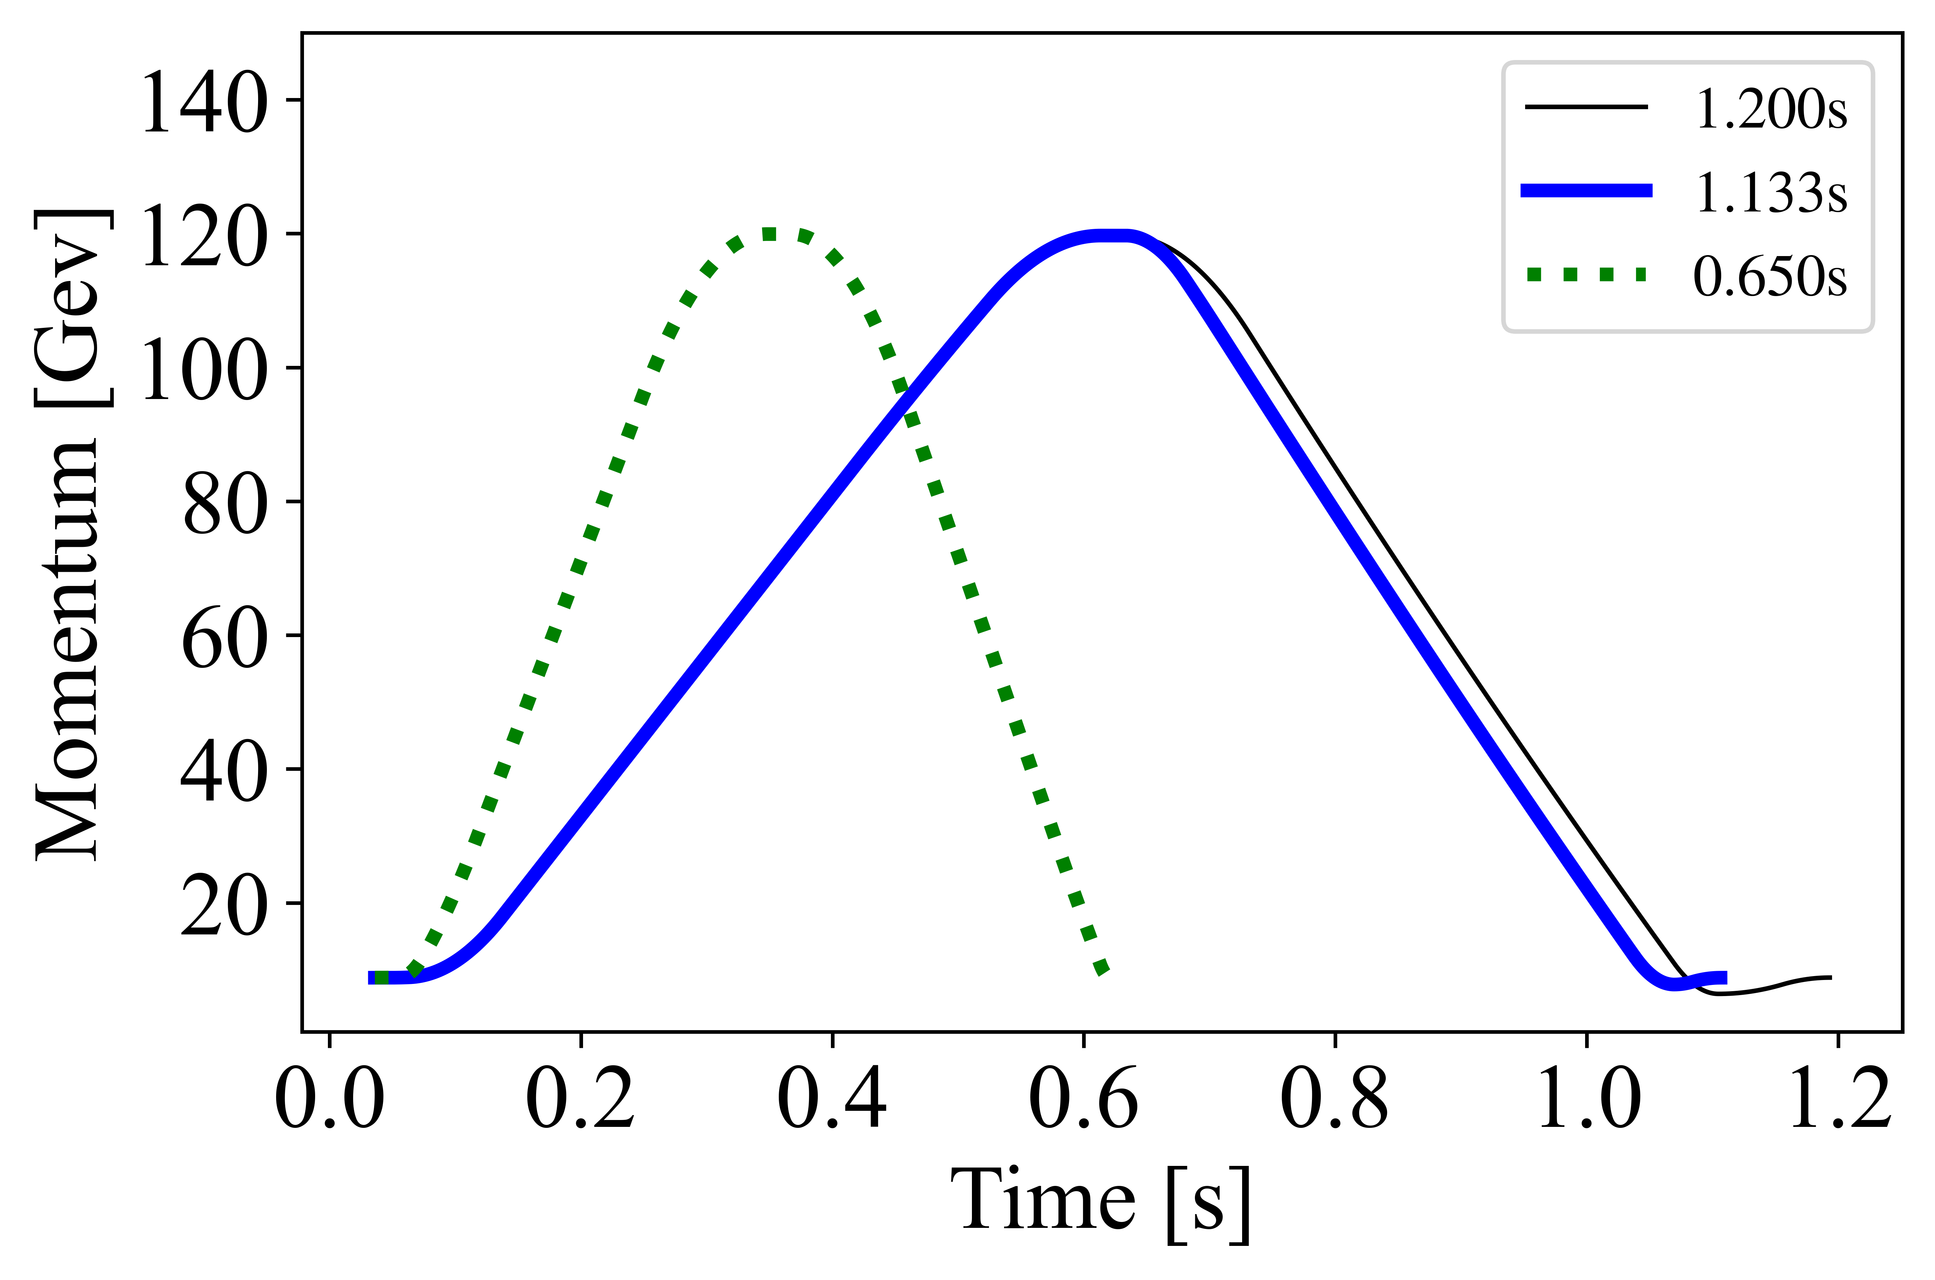
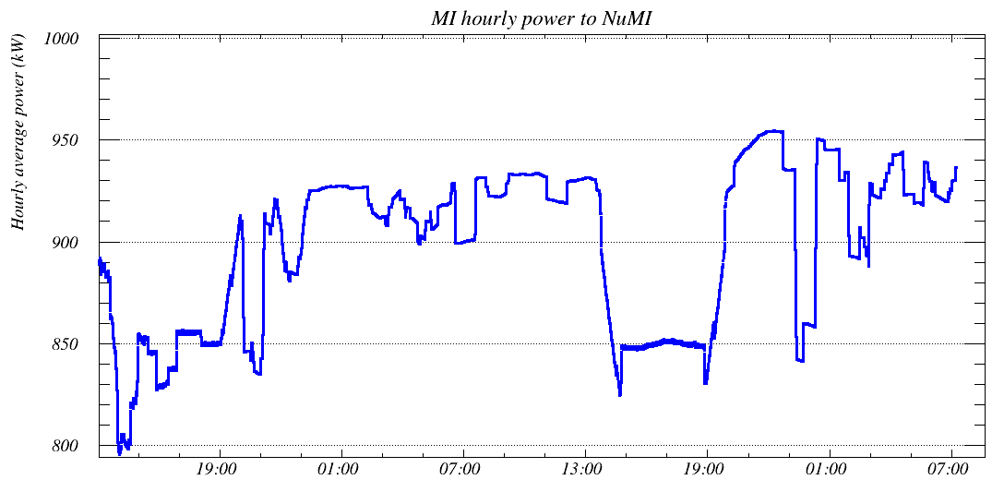
Time Is On Our Side… Yes, it is…
Demonstrated capability with 1.133s run New power record (~959 kW) in May
1.067s test planned, moved to next run Necessitated MECAR and controls work Uncovered thermal issue
The push to a MW beam!
Massive thanks to colleagues in the MI Department, EE Support, and Operators
Hourly average power (kW)

Slide 10
The Inconvenience of Intensity
The intensity approach has limitations Upgrade path targets multiple machines Charge injected into Booster Charge accelerated in Booster Charge accumulated in Recycler Charge accelerated in Main Injector
Significant roadblocks in process Limited aperture in machines Especially Recycler Space charge effects Instabilities! Combined function magnets are evil

Slide 11
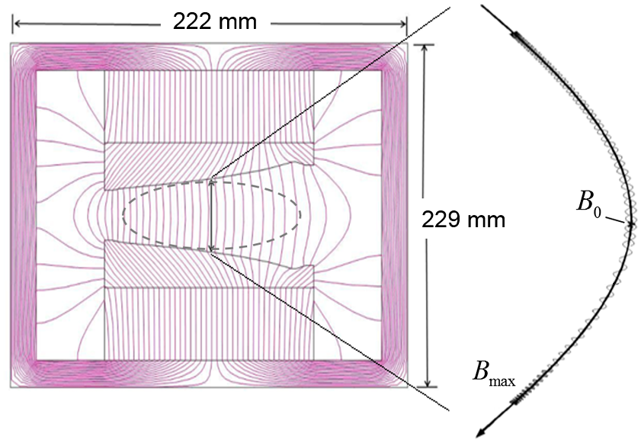
Instabilities in the Recycler — An Example
Combined Function Magnets B-Fields can trap electrons that serve as fuel for electron cloud accumulation Magnetic mirrors…
Secondary Emission Yield (SEY) Interactions between in-chamber electrons and beam pipe material Electron-cloud accumulation and runaway condition J. Eldred et al., Proc. HB2014, 2014 S. Antipov, University of Chicago Thesis, 2017 Y. Ji, IIT Chicago Thesis, 2019 A.P. Schreckenberger, NAPAC 2022 SEY strength set by pipe material…

Slide 12
Instabilities in the Recycler — SEY
Combined Function Magnets B-Fields can trap electrons that serve as fuel for electron cloud accumulation Magnetic mirrors…
Secondary Emission Yield (SEY) Interactions between in-chamber electrons and beam pipe material Electron-cloud accumulation and runaway condition J. Eldred et al., Proc. HB2014, 2014 S. Antipov, University of Chicago Thesis, 2017 Y. Ji, IIT Chicago Thesis, 2019 A.P. Schreckenberger, NAPAC 2022 SEY strength set by pipe material…
MAGNETIC MIRRORS →
ELECTRON ACCUMULATION MECHANISM

Slide 13
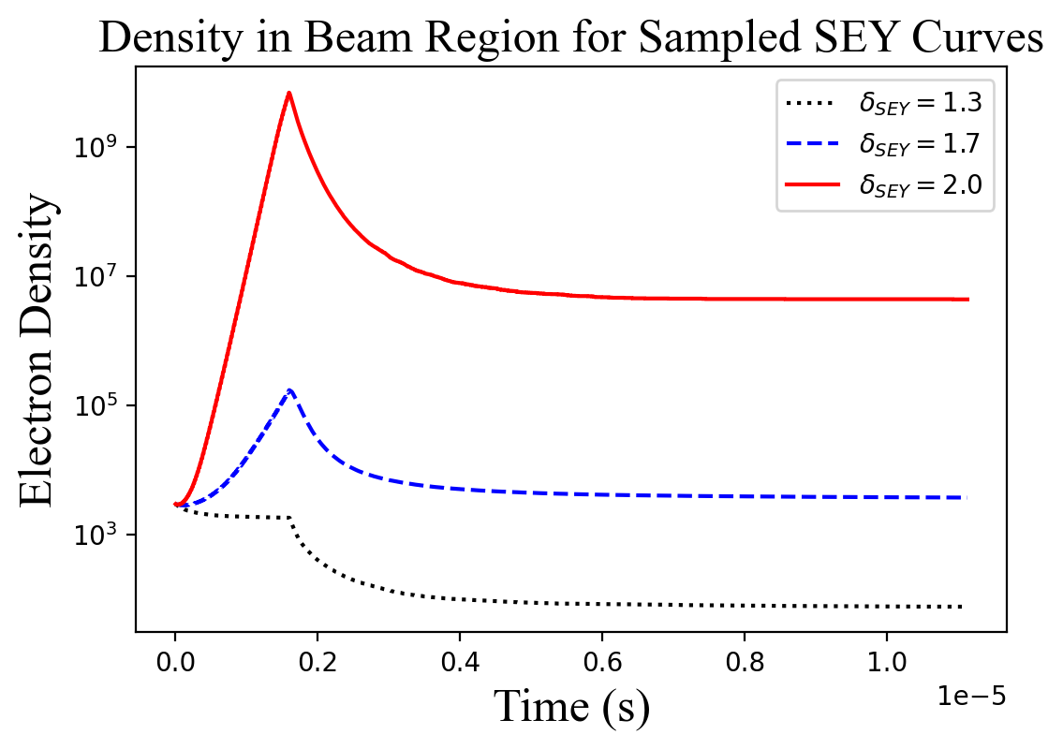
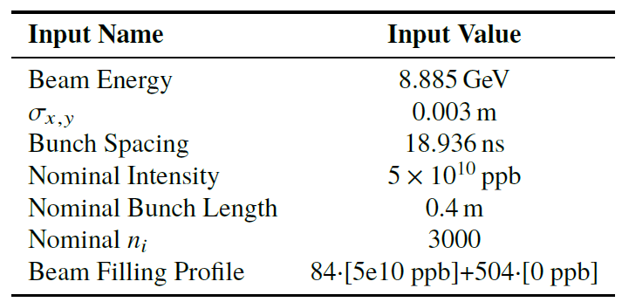
Building an SEY Analysis
Simulate Electron Cloud Density SEY Simulation + Machine + Variables Use PyECLOUD v8.6.0 to predict densities in the Recycler combined function magnets
Develop stability metric for Recycler
Simplest metric is a matter of math…
If $n_{i}>n_{f}$, mathematically impossible for SEY-driven instability.
If $n_{f}>n_{i}$, continued electron cloud accumulation is possible!
$R_{s}={n_{f}}/{n_{i}}$ , $R_{s}<1.0$ sets stability region

Slide 14
Building an SEY Analysis
Simulate Electron Cloud Density SEY Simulation + Machine + Variables Use PyECLOUD v8.6.0 to predict densities in the Recycler combined function magnets
Develop stability metric for Recycler
$$n_{f}$$
$$n_{i}$$
Simplest metric is a matter of math…
If $n_{i}>n_{f}$, mathematically impossible for SEY-driven instability.
If $n_{f}>n_{i}$, continued electron cloud accumulation is possible!
$R_{s}={n_{f}}/{n_{i}}$ , $R_{s}<1.0$ sets stability region

Slide 15
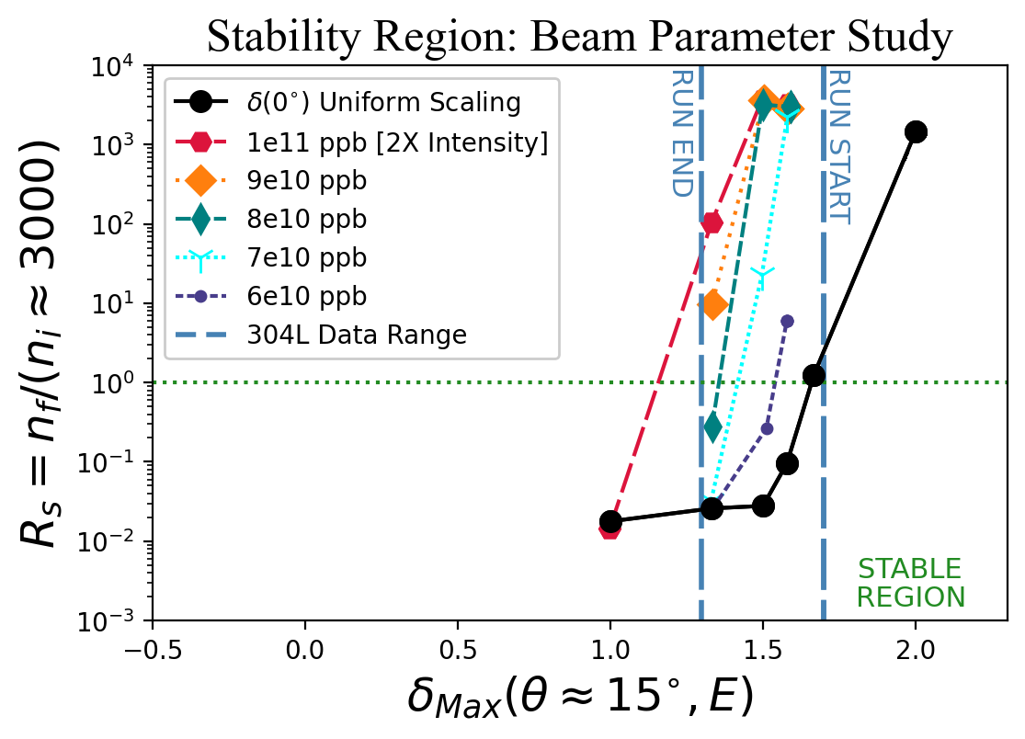
Recycler Fast-Transverse Instability Already Exists
We live on the razor’s edge! … at $5∙{10}^{10}$ ppb
PIP-II intensity-based upgrade Questionable region, would demand conditioning
Electron-cloud challenge is just one example… First analysis to correctly pin instability data to simulation! ☺ Most of complex has needs
Cycle time is a viable path
Stability Metric
Peak number of electrons produced by electron-pipe collisions

Slide 16
Recycler Fast-Transverse Instability Already Exists
We live on the razor’s edge! … at $5∙{10}^{10}$ ppb
PIP-II intensity-based upgrade Questionable region, would demand conditioning
Electron-cloud challenge is just one example… First analysis to correctly pin instability data to simulation! ☺ Most of complex has needs
Cycle time is a viable path
Stability Metric
Peak number of electrons produced by electron-pipe collisions

Slide 17
Recycler Fast-Transverse Instability Already Exists
We live on the razor’s edge! … at $5∙{10}^{10}$ ppb
PIP-II intensity-based upgrade Questionable region, would demand conditioning First e-cloud analysis to pin the instability, SEY data, and sims!
Electron-cloud challenge is just one example… Most of complex has needs
Cycle time is the viable path
Stability Metric
Peak number of electrons produced by electron-pipe collisions

Slide 18
Recycler Fast-Transverse Instability Already Exists
We live on the razor’s edge! … at $5∙{10}^{10}$ ppb
PIP-II intensity-based upgrade Questionable region, would demand conditioning First e-cloud analysis to pin the instability, SEY data, and sims!
Electron-cloud challenge is just one example… Most of complex has needs
Cycle time is the viable path
Stability Metric
Peak number of electrons produced by electron-pipe collisions

Slide 19
Recycler Fast-Transverse Instability Already Exists
We live on the razor’s edge! … at $5∙{10}^{10}$ ppb
PIP-II intensity-based upgrade Questionable region, would demand conditioning First e-cloud analysis to pin the instability, SEY data, and sims!
Electron-cloud challenge is just one example… Most of complex has needs
Ramp time is the viable path
Stability Metric
Peak number of electrons produced by electron-pipe collisions

Slide 20
Sights on the Horizon…
Scientific obligation to investigate intensity options…
$$\frac{N}{T}$$

Slide 21
Backups
The land that 17+3 forgot…

Slide 22
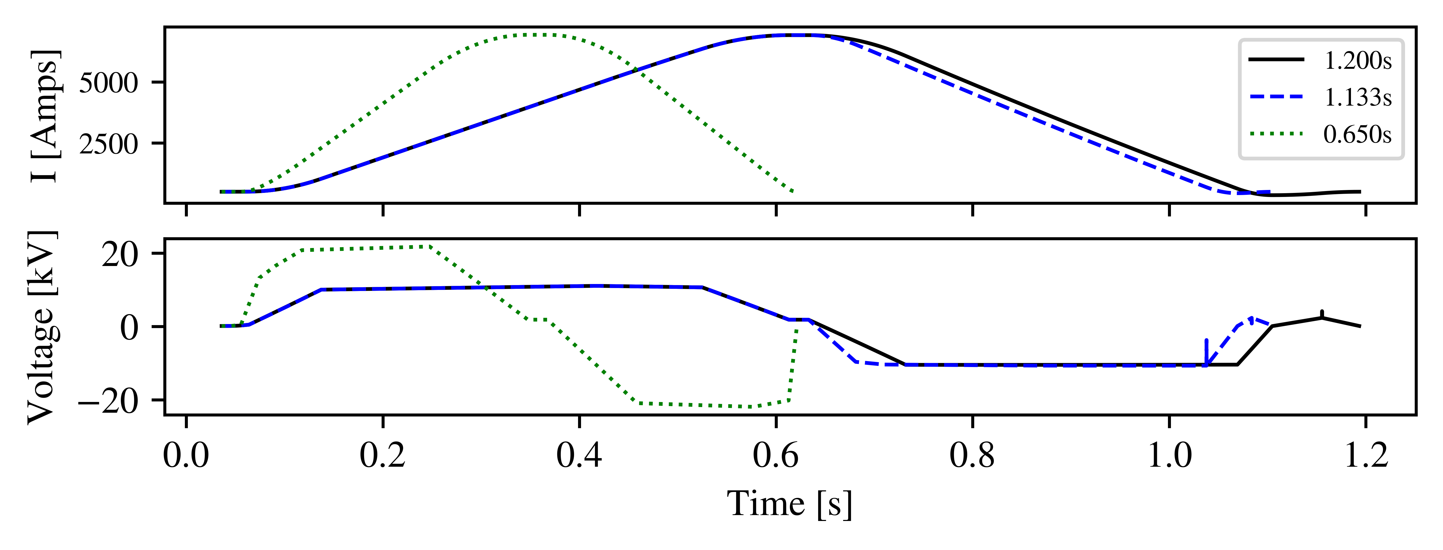
How to Beat the Clock…
240 → 500 GeV/s; can systems handle this?
Is the power infrastructure at MI facilities capable?

Slide 23
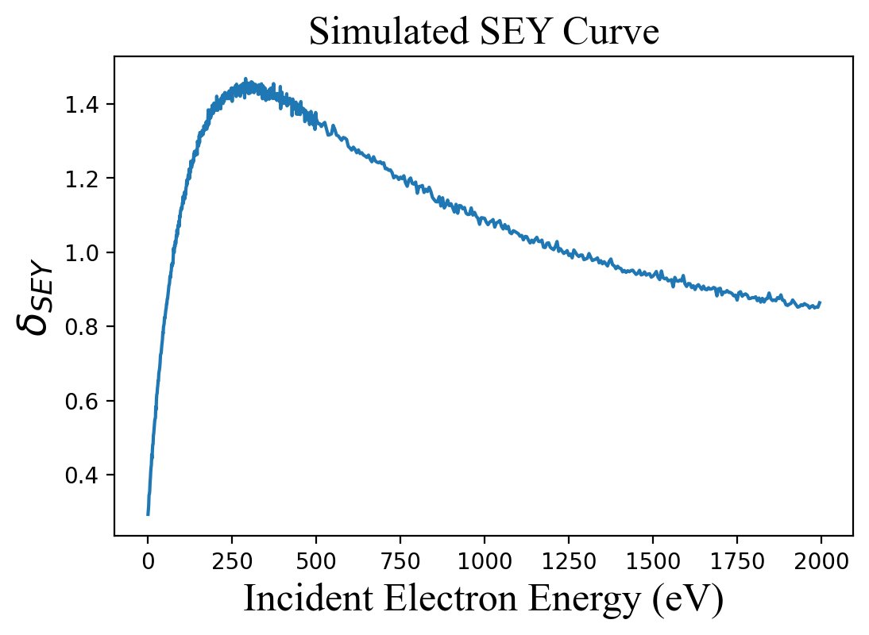
Building an SEY Analysis
Start with the primary assessor Map material response as $δ_{SEY}$ Average number of electrons produced by electron-surface interaction Peak value ($δ_{Max}$) serves as primary metric Use Furman-Pivi Model to simulate $δ\left(E,θ\right)$ Simulate Electron Cloud Density Machine + SEY Simulation + Variables Use PyECLOUD v8.6.0 to predict densities in the Recycler
 = 0

Slide 24
Building an SEY Analysis
Start with the primary assessor Map material response as $δ_{SEY}$ Average number of electrons produced by electron-surface interaction Peak value ($δ_{Max}$) serves as primary metric Use Furman-Pivi Model to simulate $δ\left(E,θ\right)$ Simulate Electron Cloud Density SEY Simulation + Machine + Variables Use PyECLOUD v8.6.0 to predict densities in the Recycler combined function magnets

Slide 25
Building an SEY Analysis
Simulate Electron Cloud Density SEY Simulation + Machine + Variables Use PyECLOUD v8.6.0 to predict densities in the Recycler combined function magnets
Develop stability metric for $δ\left(\text{E}\text{,}\text{15}\text{°}\right)$
$$n_{f}$$
$$n_{i}$$
Simplest metric is a matter of math…
If $n_{i}>n_{f}$, mathematically impossible for SEY-driven instability.
If $n_{f}>n_{i}$, continued electron cloud accumulation is possible!
$R_{s}={n_{f}}/{n_{i}}$ , $R_{s}<1.0$ sets stability region

Slide 26
Recycler Fast-Transverse Instability Already Exists
We live on the razor’s edge! … at $5∙{10}^{10}$ ppb
PIP-II intensity-based upgrade Questionable region, would demand conditioning
Electron-cloud challenge is just one example… First analysis to correctly pin instability data to simulation! ☺ Most of complex has needs
Cycle time is a viable path
Stability Metric
Peak number of electrons produced by electron-pipe collisions

Slide 27
Backup’s Backup
In case someone asks if there is a song… or is still confused

Slide 28
S E Y
There’s always a song
You are my Recycler… Got one desire…
Believe when I say…
That I want stability!

Slide 29
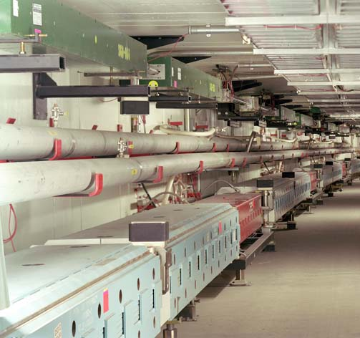
S E Y
But these
Have two functional parts!
And gradients play with your heart!
Then clouds reign…

Slide 30
S E Y
As magnetic mirrors mess with our beam!
SEY, ain’t nothing but a heartache! SEY, ain’t nothing but a big pain!
Tell me why—

