Slide 1




International Muon Collider Collaboration
D. Schulte
for the International Muon Collider Collaboration
ACE Science Workshop, June 2023

Slide 2
Motivation and Goal
Previous studies in US (MAP, now very strong interest again), experimental programme in UK (MICE) and studies of alternatives by INFN (LEMMA)
New strong interest in high-energy, high-luminosity lepton collider
Combines precision physics and discovery reach
Muon collider promises sustainable approach to the energy frontier
limited power consumption, cost and land use
Technology and design advances in past years
review did not find any showstoppers
Goal is
10+ TeV collider
potential initial energy stage (e.g. 3 TeV)
higher energies to be explored later
2

Slide 3
Accelerator R&D Roadmap
European/global evaluation:
no insurmountable obstacle found for the muon collider
but important need for R&D
Full scenario deliverables by next ESPPU/other processes
Project Evaluation Report
R&D Plan that describes a path towards the collider;
Allows to make informed decisions
Interim report by end of 2023
Do not yet fully have the resources of the reduced scenario
Working following priorities, available expertise and resources
Are approaching O(40-50 FTE for accelerator)
Would need a bit more than doubling the resources
Scenario | FTEy | M MCHF
Full scenario | 445.9 | 11.9
Reduced scenario | 193 | 2.45
http://arxiv.org/abs/2201.07895
3

Slide 4
Cost and Sustainability
CLIC is highest energy proposal with CDR
No obvious way to further improve linear colliders (decades of R&D)
Cost 18 GCHF, power approx. 500 MW
Rough rule of thumb:
cost proportional to energy
power proportional to luminosity
Muon Collider goals (10 TeV), challenging but reasonable:
Much more luminosity than CLIC at 3 TeV (L=20x10³⁴, CLIC: L=2x10³⁴/6x10³⁴)
Lower power consumption than CLIC at 3 TeV (P_{beam,MC}=0.5P_{beam,CLIC})
Lower cost
Staging is possible
Synergies exist (neutrino/higgs)
Unique opportunity for a high-energy, high-luminosity lepton collider
4

Slide 5
US Snowmass Implementation Task Force
ITP investigated the muon collider and concluded:
Muon Collider is a viable option for the HEP future
ITP provided parametric cost and power estimate for muon collider take it cum grano salis
ITP places MC in same risk tier as FCC-hh
Th. Roser, R. Brinkmann, S. Cousineau, D. Denisov, S. Gessner, S. Gourlay, Ph. Lebrun, M. Narain, K. Oide, T. Raubenheimer, J. Seeman, V. Shiltsev, J. Straight, M. Turner, L. Wang et al.
5

Slide 6
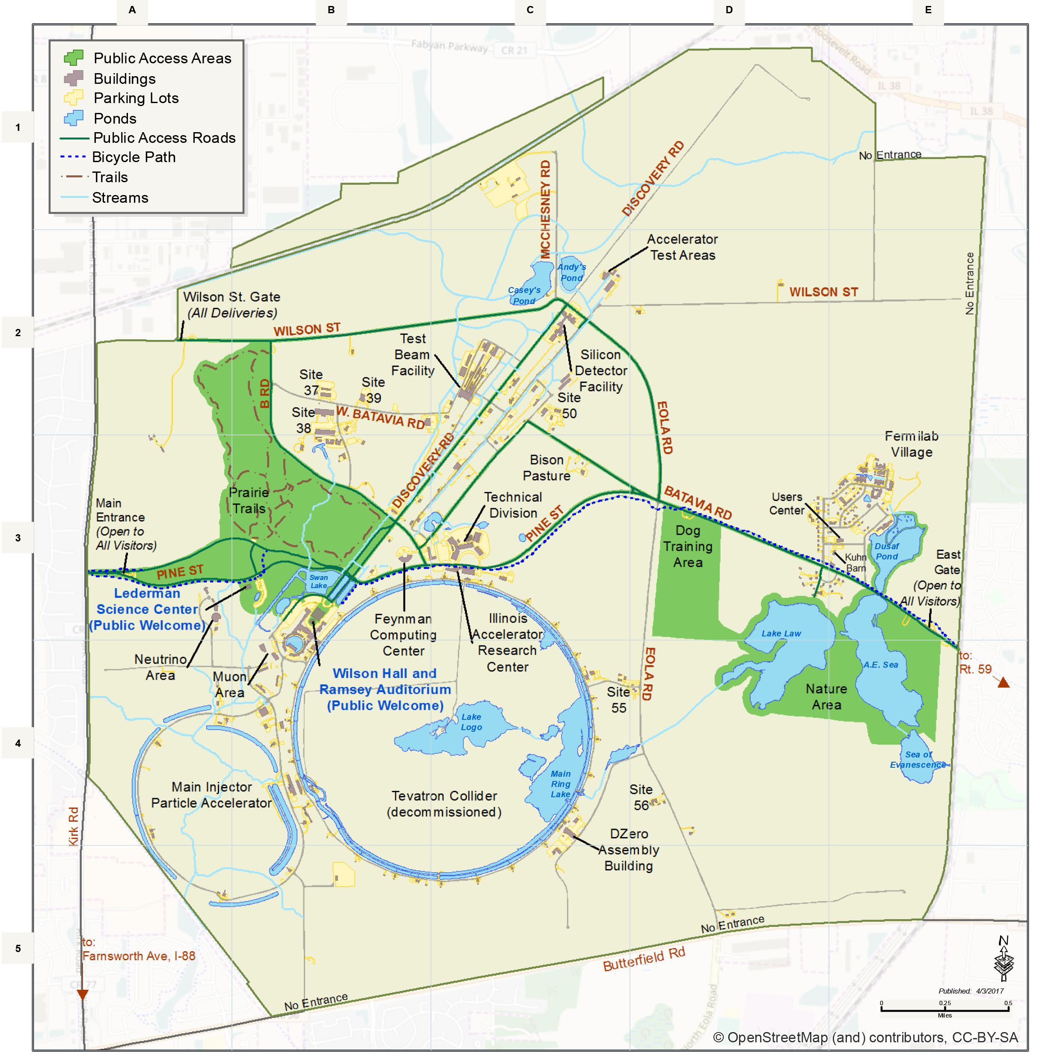
Muon Collider Community
Formed collaboration to implement and R&D Roadmap for CERN Council
EU Design Study approved
(EU+Switzerland+UK and partners)
50+ partner institutions
30+ already signed formal agreement
US Snowmass showed strong support
to contribute to R&D
as a collider in the US
Lia Merminga appointed team to prepare P5 ask
Contacts also with other regions
Plan to apply in 2024 for HORIZON-INFRA-2024-TECH Goal: prepare experimental programme, e.g. demonstrator, prototypes, …
TIARA wants magnet proposal

Slide 7
Organisation
Collaboration Board (ICB)
  Elected chair: Nadia Pastrone
Steering Board (ISB)
  Chair Steinar Stapnes
  CERN members: Mike Lamont, Gianluigi Arduini
  ICB members: Dave Newbold (STFC), Mats Lindroos (ESS), Pierre Vedrine (CEA), N. Pastrone (INFN)
  Study members: SL and deputies
  Will add US but do not want to preempt US decision on members
Advisory Committee
  To be defined
Coordination committee (CC)
  ICB endorsed
    Study Leader: Daniel Schulte
    Deputies: Andrea Wulzer, Donatella Lucchesi, Chris Rogers

Slide 8
Organisation
Collaboration Board (ICB)
  Elected chair: Nadia Pastrone
Steering Board (ISB)
  Chair Steinar Stapnes
  CERN members: Mike Lamont, Gianluigi Arduini
  ICB members: Dave Newbold (STFC), Mats Lindroos (ESS), Pierre Vedrine (CEA), N. Pastrone (INFN)
  Study members: SL and deputies
  Will add US but do not want to preempt US decision on members
Advisory Committee
  To be defined
Coordination committee (CC)
  ICB endorsed
    Study Leader: Daniel Schulte
    Deputies: Andrea Wulzer, Donatella Lucchesi, Chris Rogers
Will be same level as LDG/Council, e.g. DoE

Slide 9
MoC and Design Study Partners
IEIO | CERN
FR | CEA-IRFU
 | CNRS-LNCMI
DE | DESY
 | Technical University of Darmstadt
 | University of Rostock
 | KIT
IT | INFN
 | INFN, Univ., Polit. Torino
 | INFN, Univ. Milano
 | INFN, Univ. Padova
 | INFN, Univ. Pavia
 | INFN, Univ. Bologna
 | INFN Trieste
 | INFN, Univ. Bari
 | INFN, Univ. Roma 1
 | ENEA
Mal | Univ. of Malta
BE | Louvain
UK | RAL
 | UK Research and Innovation
 | University of Lancaster
 | University of Southampton
 | University of Strathclyde
 | University of Sussex
 | Imperial College London
 | Royal Holloway
 | University of Huddersfield
 | University of Oxford
 | University of Warwick
 | University of Durham
SE | ESS
 | University of Uppsala
PT | LIP
NL | University of Twente
FI | Tampere University
LAT | Riga Technical Univers.
US | Iowa State University
 | Wisconsin-Madison
 | Pittsburg University
 | Old Dominion
 | BNL
China | Sun Yat-sen University
 | IHEP
 | Peking University
EST | Tartu University
AU | HEPHY
 | TU Wien
ES | I3M
 | CIEMAT
 | ICMAB
CH | PSI
 | University of Geneva
 | EPFL
KO | KEU
 | Yonsei University
India | CHEP
IT | INFN Frascati
 | INFN, Univ. Ferrara
 | INFN, Univ. Roma 3
 | INFN Legnaro
 | INFN, Univ. Milano Bicocca
 | INFN Genova
 | INFN Laboratori del Sud
 | INFN Napoli
US | FNAL
 | LBL
 | JLAB
 | Chicago
 | Tenessee
9

Slide 10
Coordination Committee Members
Physics | Andrea Wulzer
Detector and MDI | Donatella Lucchesi
US (detector) | Sergo Jindariani
US (accelerator) | Mark Palmer
Asia (China) | Jingyu Tang
Asia (Japan) | tbd
Protons | Natalia Milas
Muon production and cooling | Chris Rogers
Muon acceleration | Antoine Chance
Collider | Christian Carli
Magnets | Luca Bottura
RF | Alexej Grudiev, Claude Marchand
Beam-matter int. target systems | Anton Lechner
Collective effects | Elias Metral
A strengthening on the physics and detector side is planned
Cooling cell design | Lucio Rossi
Demonstrator | Roberto Losito

Slide 11
Technically Limited Timeline (From Roadmap)
To be reviewed considering progress, funding and decisions
Muon collider important in the long term
Fastest track option
To see if muon collider could come directly after HL-LHC
Important resource ramp-up assumed
Compromises in performance, e.g. 3 TeV
Needs to be revised but do not have enough information at this point for final plan
Evaluation+decision
Evaluation+decision
11

Slide 12
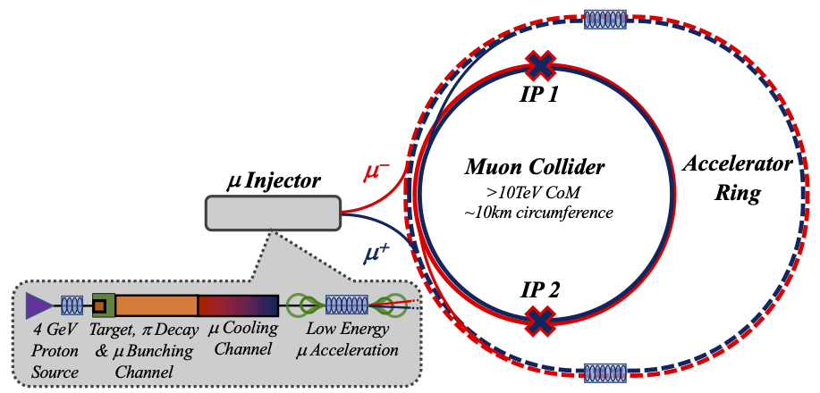
Work on Key Challenges
0) Physics case
1) Dense neutrino flux
mitigated by mover system and site selection
4) Drives the beam quality
MAP put much effort in design
optimise as much as possible
2) Beam-induced background
3) Cost and power consumption limit energy reach, e.g. 35 km accelerator for 10 TeV, 10 km collider ring
Also impacts beam quality
12

Slide 13
US Integration
Participation of US experts to CC and ICB
Preparing open data and code policy
  You can use data and codes from the collaboration, as far as we own them
Want to allow everyone to publish under the IMCC or to speak for the IMCC
  Provided our procedures are respected
Small task force to understand how a common work programme can be developed
  Progress will have to synchronise with US progress
Plan to review organization next year to integrate US
  But have to wait for US decisions
Will find common timelines/scenarios

Slide 14
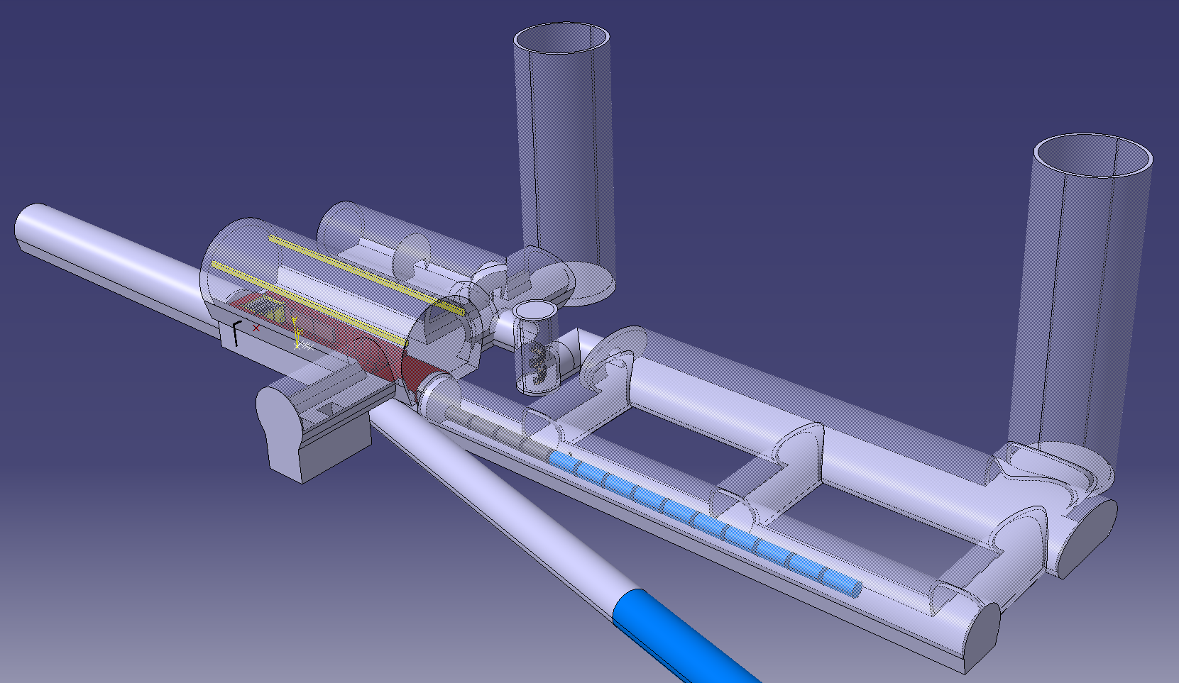
CDR Phase, R&D and Demonstrator Facility
Broad R&D programme required and can be distributed world-wide
Models and prototypes
  Magnets, Target, RF systems, Absorbers, …
CDR development
Integrated tests, also with beam
Integrated cooling demonstrator is a key facility
look for an existing proton beam with significant power
Different sites are being considered
CERN, FNAL, ESS are being discussed
J-PARC also interesting as option
Could be used to house physics facility
Are trying to explore what are good options
C. Rogers, R. Losito, et al.

Slide 15
CDR Phase, R&D and Demonstrator Facility
Broad R&D programme required and can be distributed world-wide
Models and prototypes
  Magnets, Target, RF systems, Absorbers, …
CDR development
Integrated tests, also with beam
Timeline will change according to resources and decisions
Integrated cooling demonstrator is a key facility
look for an existing proton beam with significant power
Different sites are being considered
CERN, FNAL, ESS are being discussed
J-PARC also interesting as option
Could be used to house physics facility
Are trying to explore what are good options
C. Rogers, R. Losito, et al.

Slide 16
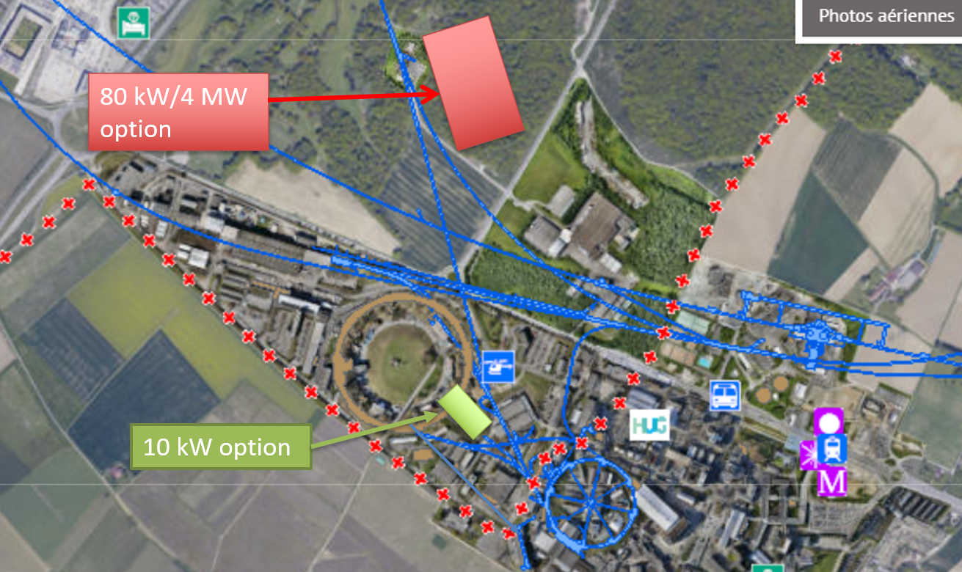
Example CERN Locations
Consider nTOF-like beam from PS for cooling experiment:
1 pulse of 10¹³ p at 20 GeV per 1.2 s
i.e. 27 kW, maybe O(100kW) possible
If SPL were, installed could use its beam, e.g. 5 GeV, 4 MW
What could be done at FNAL?
M. Calviani

Slide 17
Conclusion
Muon collider is unique opportunity for high-energy, high-luminosity lepton collider
  but less mature than other options
Collaboration exists
  Hope that US will soon play an important role
Addressing key challenges
  US made contributions, hope this can continue while waiting for decisions
Demonstrator is important project
  Requires proton complex but could be anywhere, FNAL important opportunity
http://muoncollider.web.cern.ch To join contact muon.collider.secretariat@cern.ch
17

Slide 18
Reserve

Slide 19
Key Challenges
Proton complex
- Compressing protons to few bunches
Target
- Target
- Solenoid
Cooling channel
- Channel design
- Solenoids
- RF in magnetic field
- Absorbers
- Integration
RCS
- Beam dynamics
- Ramping magnets
- Power converter
- RF system
Collider ring
- Optics
- Magnets
- Neutrino flux
- Detector background
19

Slide 20
Organisation
International Collaboration Board represents the partners
Same level as LDG/Council, e.g. DoE
International Advisory Committee
Steering Board oversees study and links to regional supervision (addition to MoC)
Coordination Committee
executes the study

Slide 21
Thanks
Muon Beam Panel: Daniel Schulte (CERN, chair), Mark Palmer (BNL, co-chair), Tabea Arndt (KIT), Antoine Chance (CEA/IRFU) Jean-Pierre Delahaye (retired), Angeles Faus-Golfe (IN2P3/IJClab), Simone Gilardoni (CERN), Philippe Lebrun (European Scientific Institute), Ken Long (Imperial College London), Elias Metral (CERN), Nadia Pastrone (INFN-Torino), Lionel Quettier (CEA/IRFU), Magnet Panel link, Tor Raubenheimer (SLAC), Chris Rogers (STFC-RAL), Mike Seidel (EPFL and PSI), Diktys Stratakis (FNAL), Akira Yamamoto (KEK and CERN) Contributors: Alexej Grudiev (CERN), Roberto Losito (CERN), Donatella Lucchesi (INFN)
Community conveners: Radio-Frequency (RF): Alexej Grudiev (CERN), Jean-Pierre Delahaye (CERN retiree), Derun Li (LBNL), Akira Yamamoto (KEK). Magnets: Lionel Quettier (CEA), Toru Ogitsu (KEK)‎, Soren Prestemon (LBNL), Sasha Zlobin (FNAL), Emanuela Barzi (FNAL). High-Energy Complex (HEC): Antoine Chance (CEA), J. Scott Berg (BNL), Alex Bogacz (JLAB), Christian Carli (CERN), Angeles Faus-Golfe (IJCLab), Eliana Gianfelice-Wendt (FNAL), Shinji Machida (RAL). Muon Production and Cooling (MPC): Chris Rogers (RAL), Marco Calviani (CERN), Chris Densham (RAL), Diktys Stratakis (FNAL), Akira Sato (Osaka University), Katsuya Yonehara (FNAL). Proton Complex (PC): Simone Gilardoni (CERN), Hannes Bartosik (CERN), Frank Gerigk (CERN), Natalia Milas (ESS). Beam Dynamics (BD): Elias Metral (CERN), Tor Raubenheimer (SLAC and Stanford University), Rob Ryne (LBNL). Radiation Protection (RP): Claudia Ahdida (CERN). Parameters, Power and Cost (PPC): Daniel Schulte (CERN), Mark Palmer (BNL), Jean-Pierre Delahaye (CERN retiree), Philippe Lebrun (CERN retiree and ESI), Mike Seidel (PSI), Vladimir Shiltsev (FNAL), Jingyu Tang (IHEP), Akira Yamamoto (KEK). Machine Detector Interface (MDI): Donatella Lucchesi (University of Padova), Christian Carli (CERN), Anton Lechner (CERN), Nicolai Mokhov (FNAL), Nadia Pastrone (INFN), Sergo R Jindariani (FNAL). Synergy: Kenneth Long (Imperial College), Roger Ruber (Uppsala University), Koichiro Shimomura (KEK). Test Facility (TF): Roberto Losito (CERN), Alan Bross (FNAL), Tord Ekelof (ESS,Uppsala University).
21
And the participants to the community meetings and the study

Slide 22
Roadmap
In aspirational scenario can make informed decisions:
Three main deliverables are foreseen:
a Project Evaluation Report for the next ESPPU will contain an assessment of whether the 10 TeV muon collider is a promising option and identify the required compromises to realise a 3 TeV option by 2045. In particular the questions below would be addressed.
  What is a realistic luminosity target?
  What are the background conditions in the detector?
  Can one consider implementing such a collider at CERN or other sites, and can it have one or two detectors?
  What are the key performance specifications of the components and what is the maturity of the technologies?
  What are the cost drivers and what is the cost scale of such a collider?
  What are the power drivers and what is the power consumption scale of the collider?
  What are the key risks of the project?
an R&D Plan that describes an R&D path towards the collider;
an Interim Report by the end of 2023 that documents progress and allows the wider community to update their view of the concept and to give feedback to the collaboration.
22

Slide 23
R&D Plan
The R&D plan will describe the R&D path toward the collider, in particular during the CDR phase, and will comprise the elements below.
An integrated concept of a muon cooling cell that will allow construction and testing of this key novel component.
A concept of the facility to provide the muon beam to test the cells.
An evaluation of whether this facility can be installed at CERN or another site.
A description of other R&D efforts required during the CDR phase including other demonstrators.
This R&D plan will allow the community to understand the technically limited timeline for the muoncollider development after the next ESPPU.

Slide 24
Minimal Scenario
Will allow partially informed decisions
No conceptual design of neutrino flux and alignment system
No alternative superconducting fast-ramping magnet system
Several collider systems would (almost) not be covered, in particular
  the linacs
  the target complex
  the proton complex
  engineering considerations of the muon cooling cells
  alternative designs for the final cooling system, acceleration, collider ring
No RF test stand would be constructed for the muon cooling accelerating cavities
No conceptual design of a muon cooling cell for the test programme
No conceptual design of a muon cooling demonstrator facility
No concept of RF power sources
No tests/models to develop solenoid technology.

Slide 25
Schedule
2023
Interim Report to gauge progress
Initial baseline defined
2025
Assessment Report
2025-2027
R&D plan will be refined
25

Slide 26
Key Technologies
Magnets
Superconducting solenoids for target and cooling profit from developments for society
  target solenoid comparable to ITER central solenoid fusion
  6D cooling solenoids similar and wind power generators, motors
  final cooling solenoids synergetic with high-field research, NMR
Collider ring magnets
  profit from developments for other colliders FCC-hh, stress-managed magnets
Fast-ramping normal-conducting magnet system
  HTS alternative, power converter
RF systems
superconducting RF, normal-conducting RF, efficient klystrons
Target, cooling absorbers, windows, shielding
Neutrino mitigation mover system, cooling cell integration, …
Detector

Slide 27
Key Technologies, cont.
RF systems
Normal-conducting cooling cavities in magnetic field
  profit from CLIC work
Superconducting accelerator RF
  profit from ILC, …
Efficient power sources
  profit from CLIC work
Beam-matter interaction
Proton target
Cooling absorbers
Shielding (accelerator and detector)
Mechanical system
Neutrino flux mitigation system
Muon cooling cell integration

Slide 28
Collaboration Vision
IMCC is an international collaboration and aims to
Enlarge the collaboration
  Physics interest in all regions, strong US contribution to the muon collider physics and detector, interest in Japan
  First US university have joined collaboration, try to see how to move forward, also with labs
Combine the R&D efforts for the design and its technologies
  Critical contributions in all relevant fields the US
Consider several sites for the collider
  CERN would be one, FNAL and others should also be considered
  A proposal with alternative sites is stronger for a single site
Consider several sites for the demonstrators
  E.g. Muon production and cooling demonstrator at CERN, FNAL, ESS, JPARC
  e.g. RCS at ESRF or elsewhere
  Target tests
  …

Slide 29
US Snowmass
Strong interest in the US community in muon collider
seen as an energy frontier machine
decoupled from LC
US community wants funding for R&D
Community interested in the US to host a muon collider
Implementation task force:
MC 10 cost range 12-18G$
MC 10 power O(300 MW)
Meenakshi Narain: Energy Frontier / Large Experiments, Snowmass Community Summer Study July 17-26, 2022
29

